Slide 1
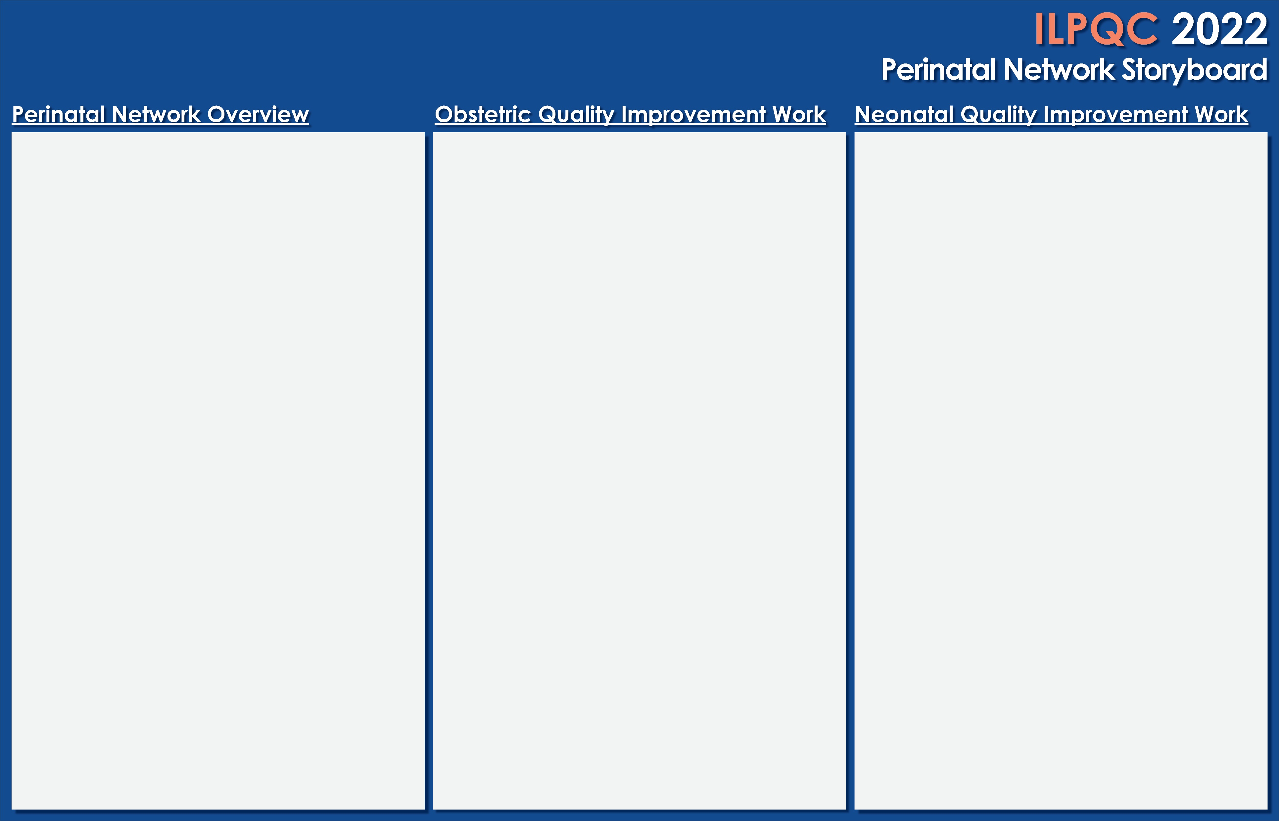
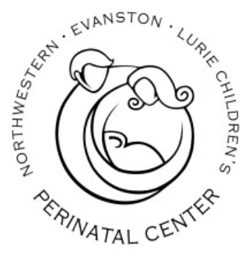
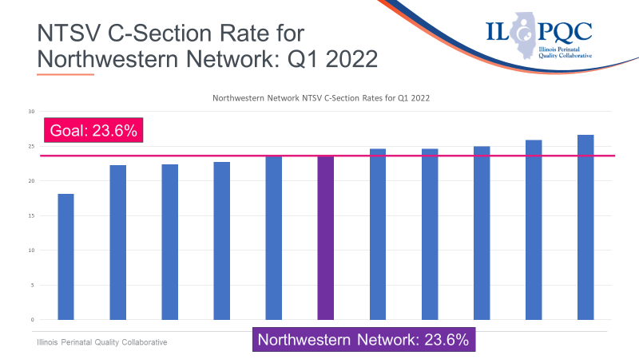
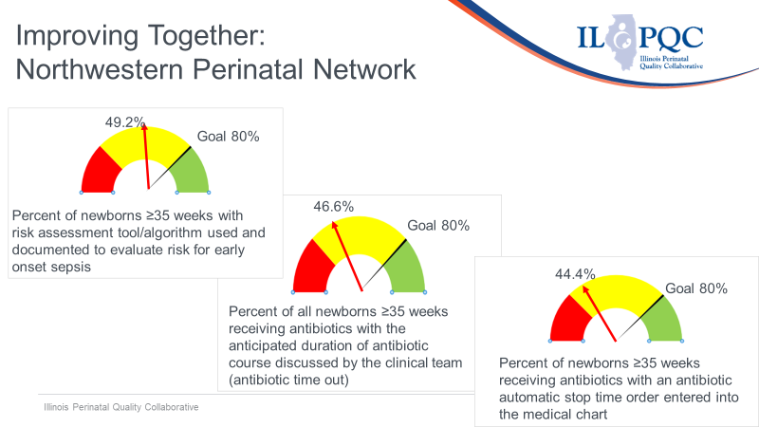
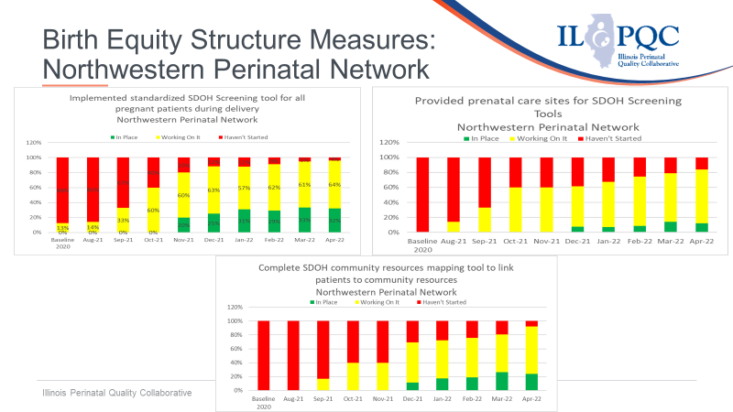
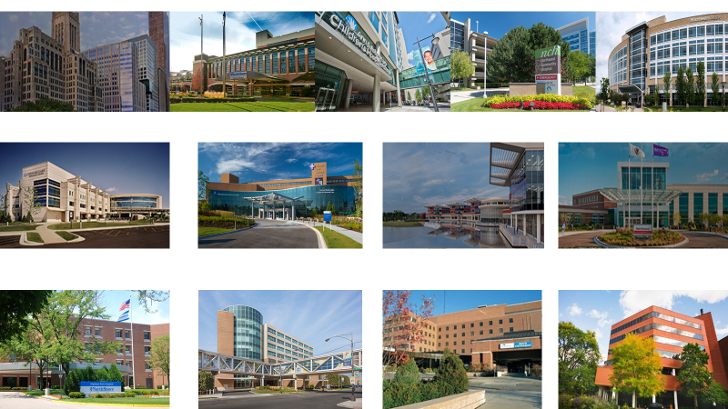
Northwestern Perinatal Network
The Northwestern Perinatal Network is comprised of 18 hospitals throughout metropolitan Chicago and northern, northwestern, and western suburban collar counties in Cook, DuPage, Kane, and Lake Counties covering a 50-mile radius of the Northwestern Administrative Perinatal Center.
Level III Hospitals
Northwestern Memorial Hospital
NorthShore Evanston Hospital
Lurie Children’s Hospital
Northwestern Central DuPage Hospital
Northwest Community Hospital of NorthShore
Level IIe Hospitals
Advocate Condell Hospital
Advocate Good Shepherd Hospital
Northwestern Lake Forest Hospital
Northwestern Delnor Hospital
Level II Hospitals
NorthShore Highland Park Hospital
Swedish Hospital of NorthShore
Vista Medical Center
West Suburban Medical Center
Promoting Vaginal Birth
Birth Equity
BASIC
Northwestern Administrative Perinatal Center
Administrator – Daniell Ashford, DNP, MBA
OB Educator – Myra Sabini BSN, RNC-OB
Neo Educator – Keri Benbrook, BSN, RNC-NIC
Notes:
Folders, coordinated discharge worksheet,

