Slide 1
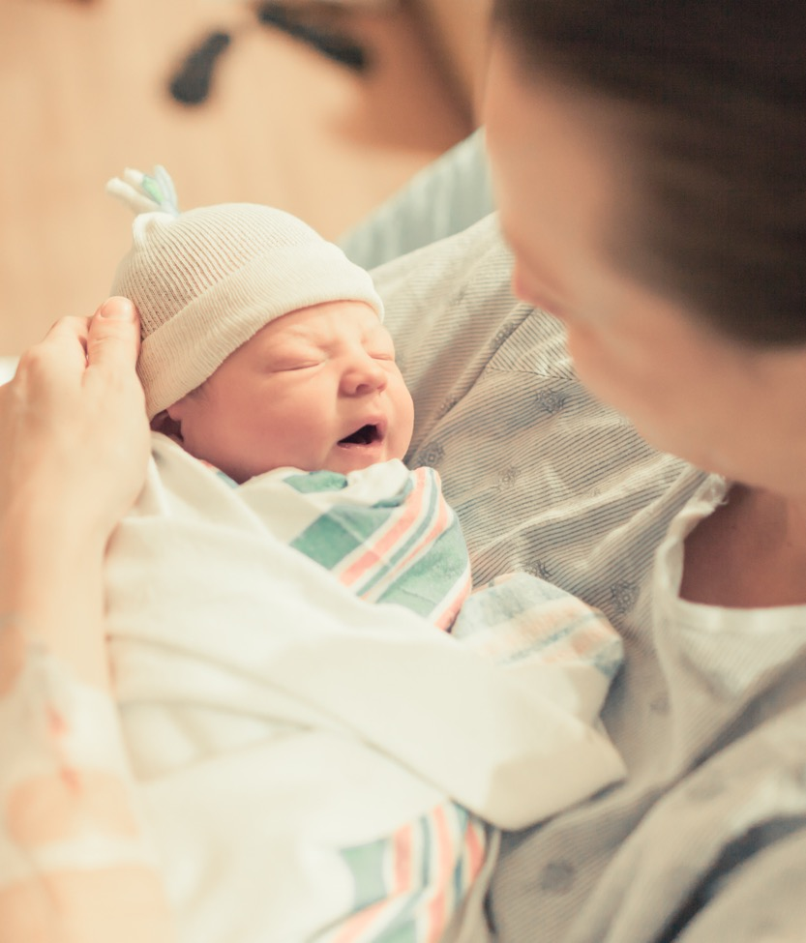
OB Face-to-Face 2022 Storyboards
(Perinatal Level 3)

Slide 2
Perinatal Level 3 OB Hospital Storyboards
Perinatal level | Name
3 | AdventHealth Hinsdale
3 | Advocate Christ Medical Center
3 | Advocate Good Samaritan Hospital
3 | Advocate Illinois Masonic Medical Center
3 | Advocate Lutheran General Hospital
3 | Ascension Saint Alexius
3 | Edward Hospital
3 | John H. Stroger Hospital
3 | Loyola University Medical Center
3 | Memorial Hospital Carbondale
3 | MercyHealth Javon Bea Hospital
3 | Northwestern Memorial
3 | NM Lake Forest Hospital
3 | NSUHS Evanston Hospital
3 | OSF Saint Francis Medical Center
3 | SSM Health St. Mary's - St. Louis
3 | UChicago Medicine

Slide 3
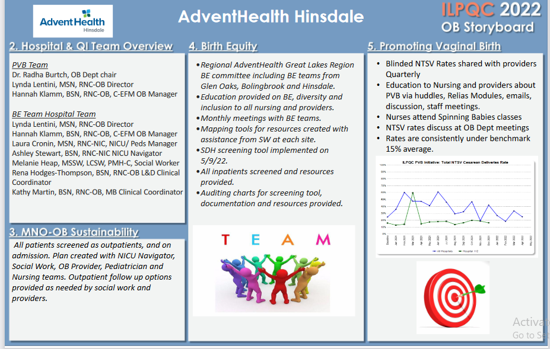
Northwestern Perinatal Network
Notes:
Folders, coordinated discharge worksheet,

Slide 4
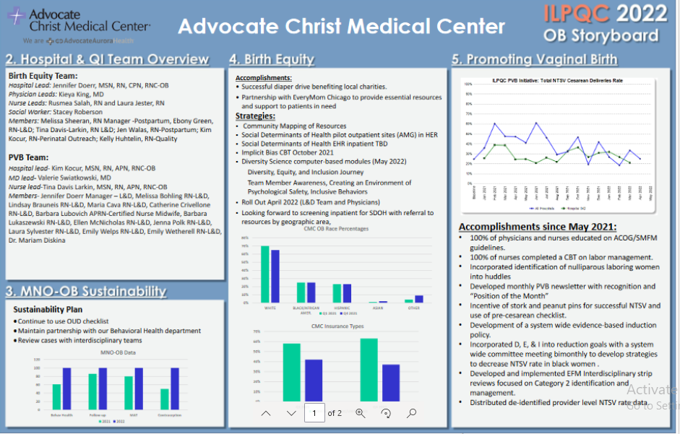
Northwestern Perinatal Network
Notes:
Folders, coordinated discharge worksheet,

Slide 5
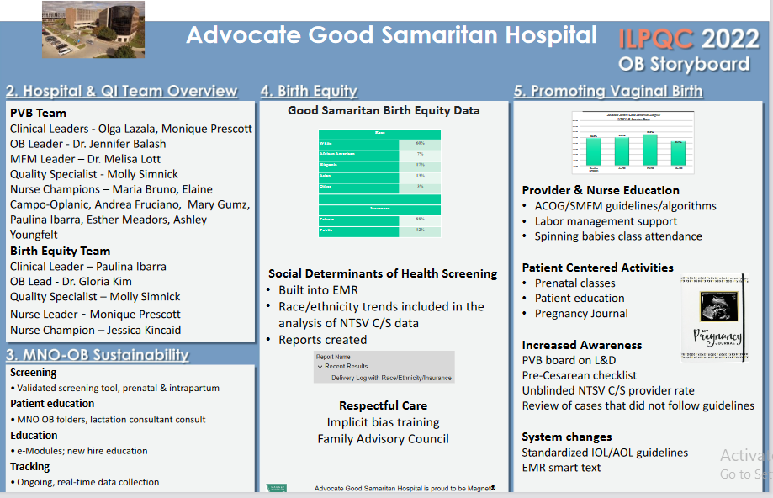
Northwestern Perinatal Network
Notes:
Folders, coordinated discharge worksheet,

Slide 6
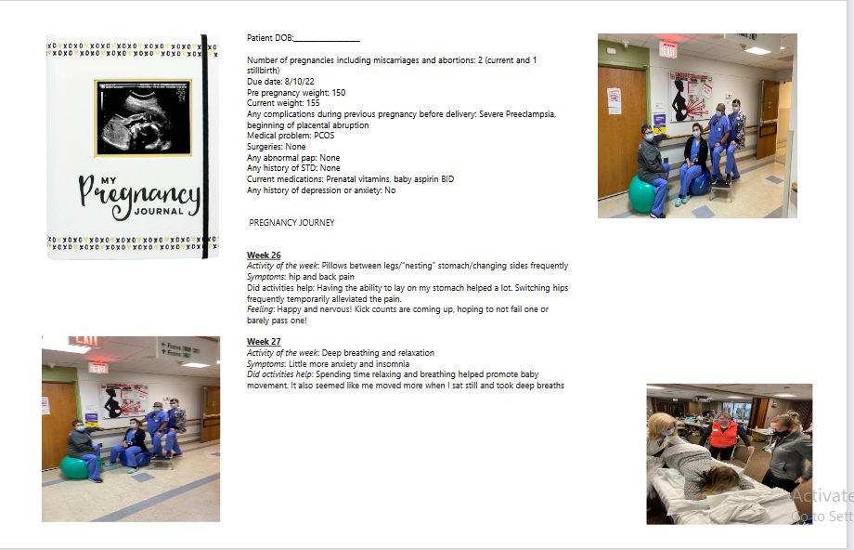
Northwestern Perinatal Network
Notes:
Folders, coordinated discharge worksheet,

Slide 7
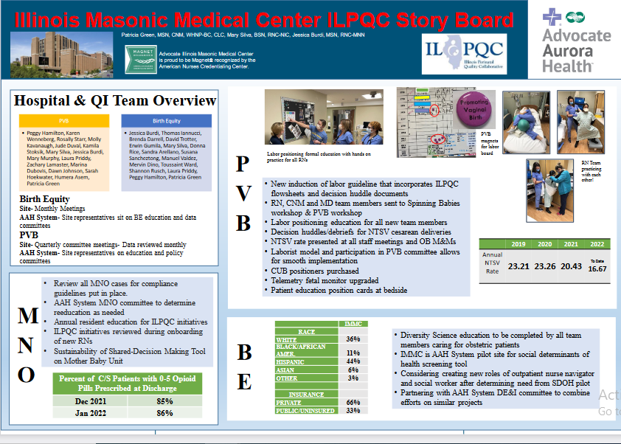
Northwestern Perinatal Network
Notes:
Folders, coordinated discharge worksheet,

Slide 8
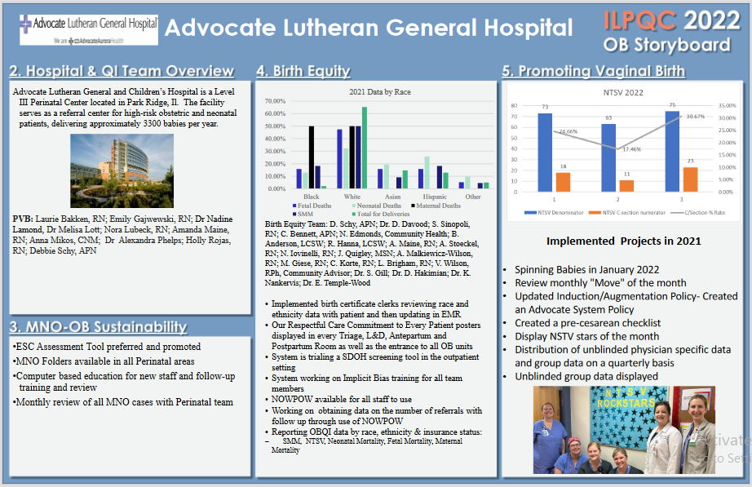
Northwestern Perinatal Network
Notes:
Folders, coordinated discharge worksheet,

Slide 9
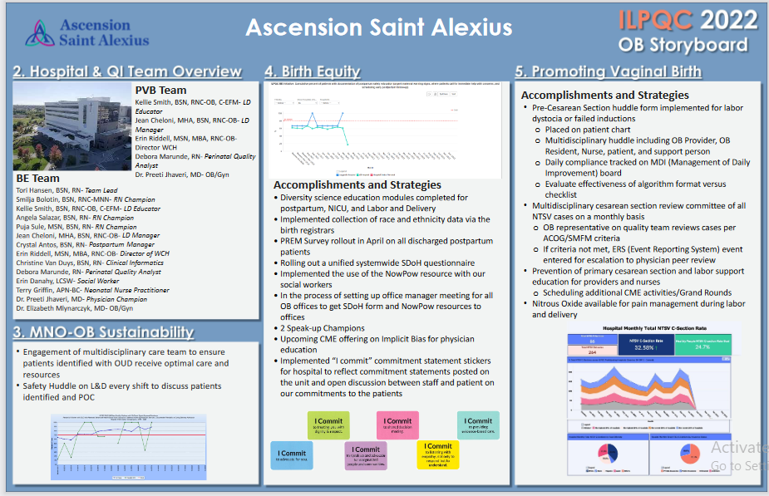
Northwestern Perinatal Network
Notes:
Folders, coordinated discharge worksheet,

Slide 10
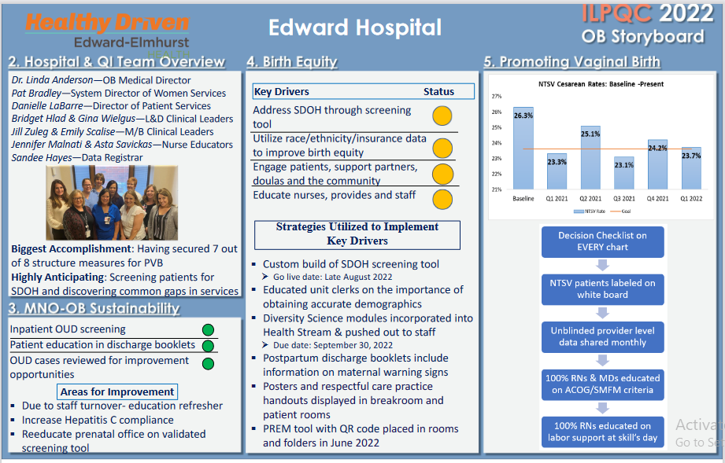
Northwestern Perinatal Network
Notes:
Folders, coordinated discharge worksheet,

Slide 11
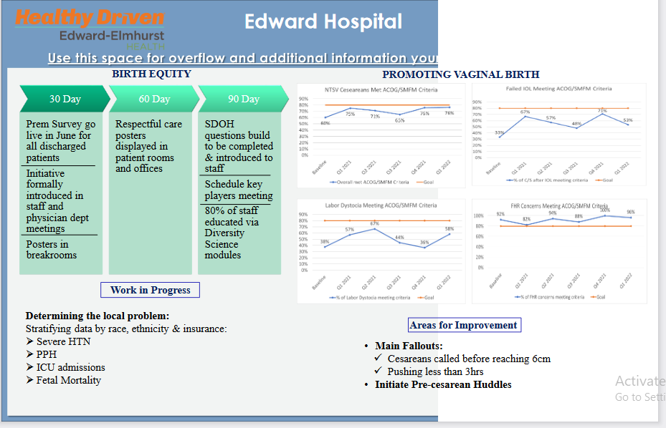
Northwestern Perinatal Network
Notes:
Folders, coordinated discharge worksheet,

Slide 12
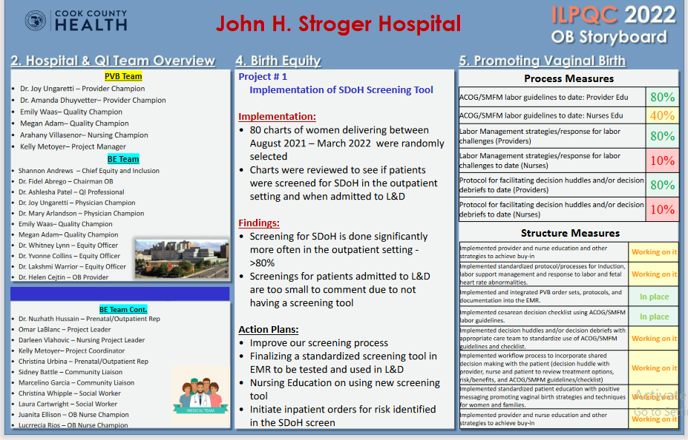
Northwestern Perinatal Network
Notes:
Folders, coordinated discharge worksheet,

Slide 13
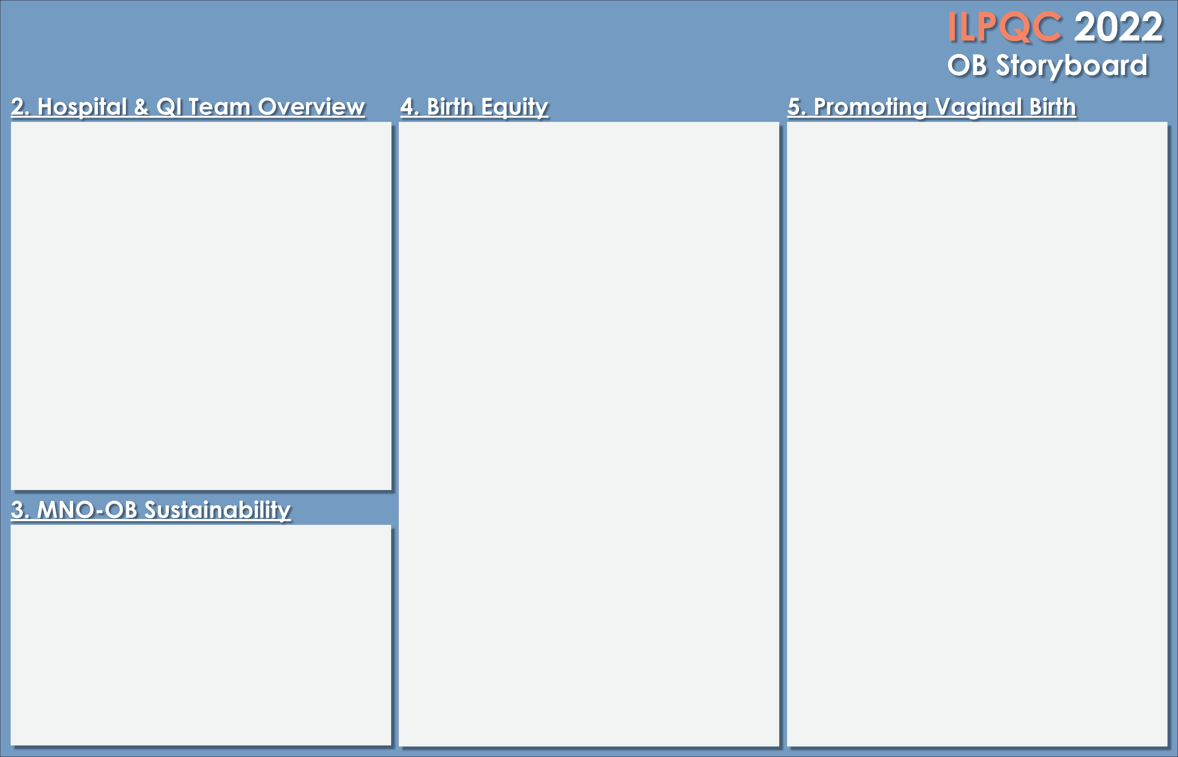

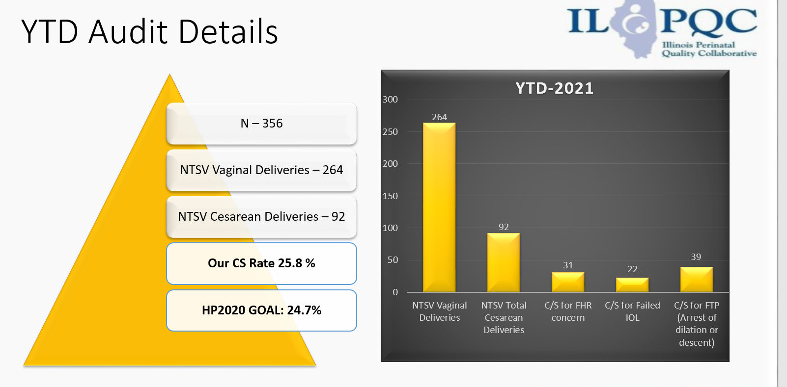

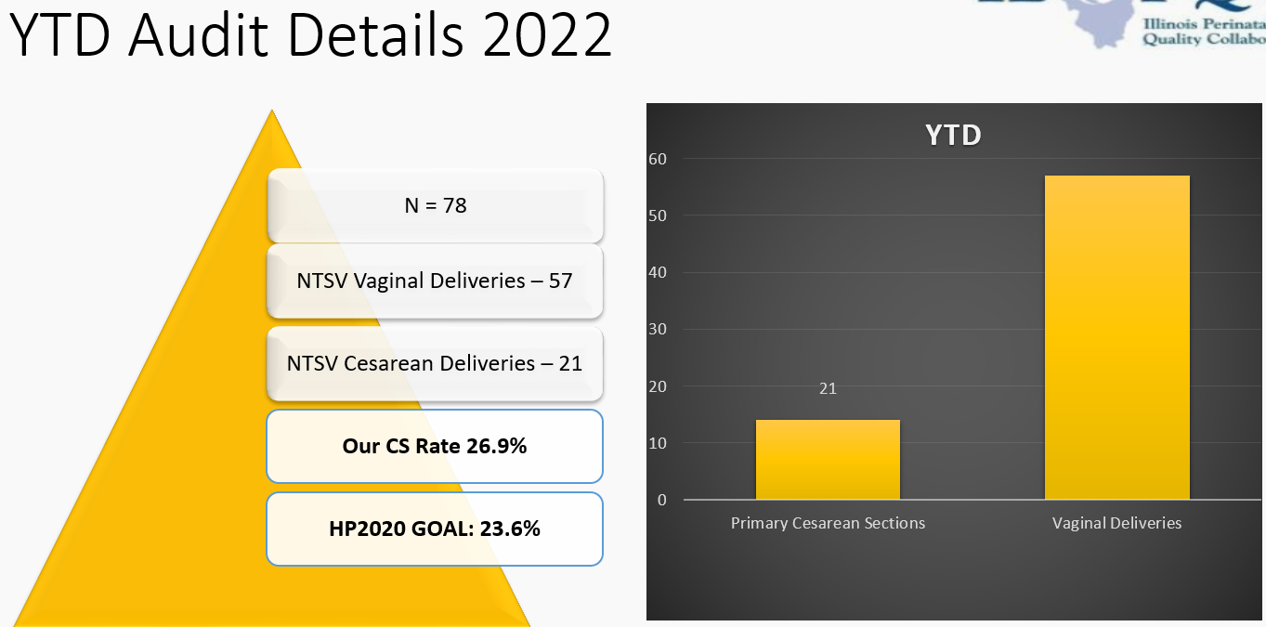
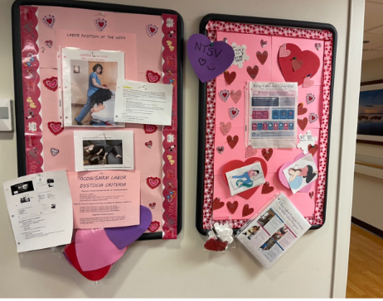
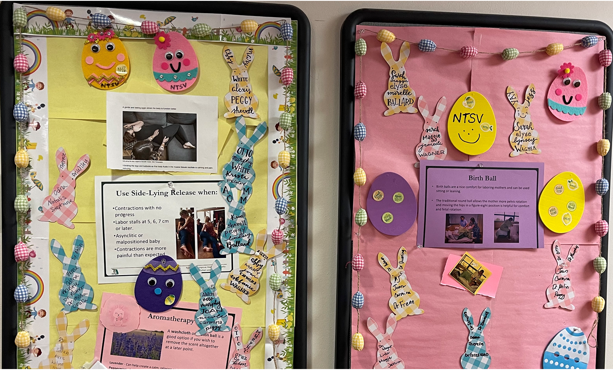
<Hospital Logo>
LOYOLA UNIVERSITY MEDICAL CENTER
BIRTH EQUITY TEAM
Dr. Ann Lal
Yara Anderson, Nurse Manager
Julie Dervishoski, Perinatal Educator, Nurse Champion
Laura De La Pena, Unit Quality
Jayme Anderko, RN Champion
Lynsey Riedl, RN Champion
Aurora Trnka, Prenatal Outpatient
Julie Marks, CNM
Daniela Munoz, Social Services
PVB Team
Dr. Recia Frenn
Yara Anderson, Nurse Manager
Julie Dervishoski, Nurse Champion
Joan Escalante, RN
Krystle Koszola, RN
Theresa Vanderhei, RN
Sandra Uribe, CNM
Aurora Trnka, Prenatal/Outpatient
Early identification/Counseling
Identify patients in morning huddle
Ongoing staff education in Skills Days
Early linkage to social services
Educate new staff in orientation
Assign new staff MNO Healthstream e-learning
Continue physician/resident ongoing education
IMPLEMENTATION STRATEGIES
SDoH Screening Tool on paper then entered
into Epic by RN (Revealed patients writing
more private information)
NowPow linkage to resources (All staff
trained)
PREM Survey tent in patient rooms, easy access
PREM Survey in patient discharge folder
All staff completed Diversity Healthstream training
Use of Smart Notes in Epic with link to NowPow
Postpartum Safety Education/Urgent Maternal Warning Signs handout given to all patients
Sharing Respectful Care Practices posters hung in patient care areas
FUTURE WORK
Continue audits
Engage communities
Share PREM results with staff
PVB EDUCATION BOARDS
PVB MEASURES/DATA
STRATEGIES
Position of the month
Champions auditing labor support documentation
NTSV rate on Huddle Board
Intermittent monitoring orders updated
All staff to attend Spinning Babies
ACOG/SMFM guidelines in place
Working on NTSV C/S rates for MD’s
SUSTAINABILITY PLAN

Slide 14
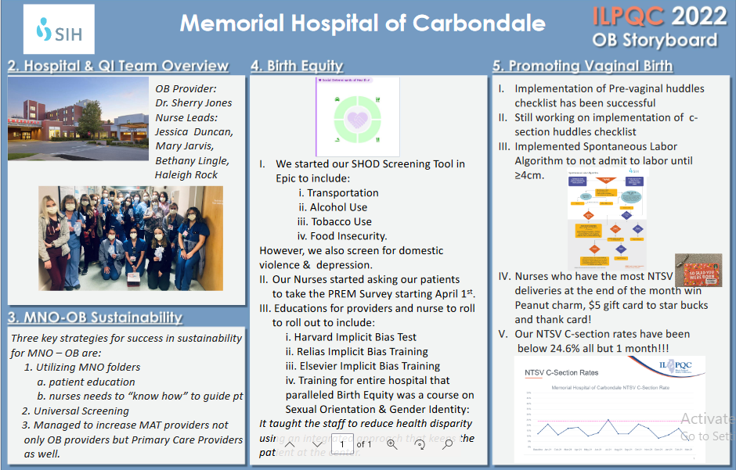
Northwestern Perinatal Network
Notes:
Folders, coordinated discharge worksheet,

Slide 15

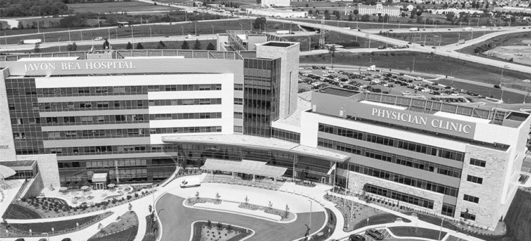

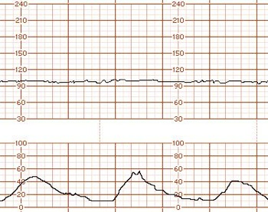






Javon Bea Hospital - Riverside
Level 1 Regional Perinatal Center
7 Perinatal/High Risk beds
10 Labor rooms
2 ORs and 3 PACU beds
20 Postpartum rooms
52 bed Level 3 NICU
906 deliveries in 2021

Slide 16

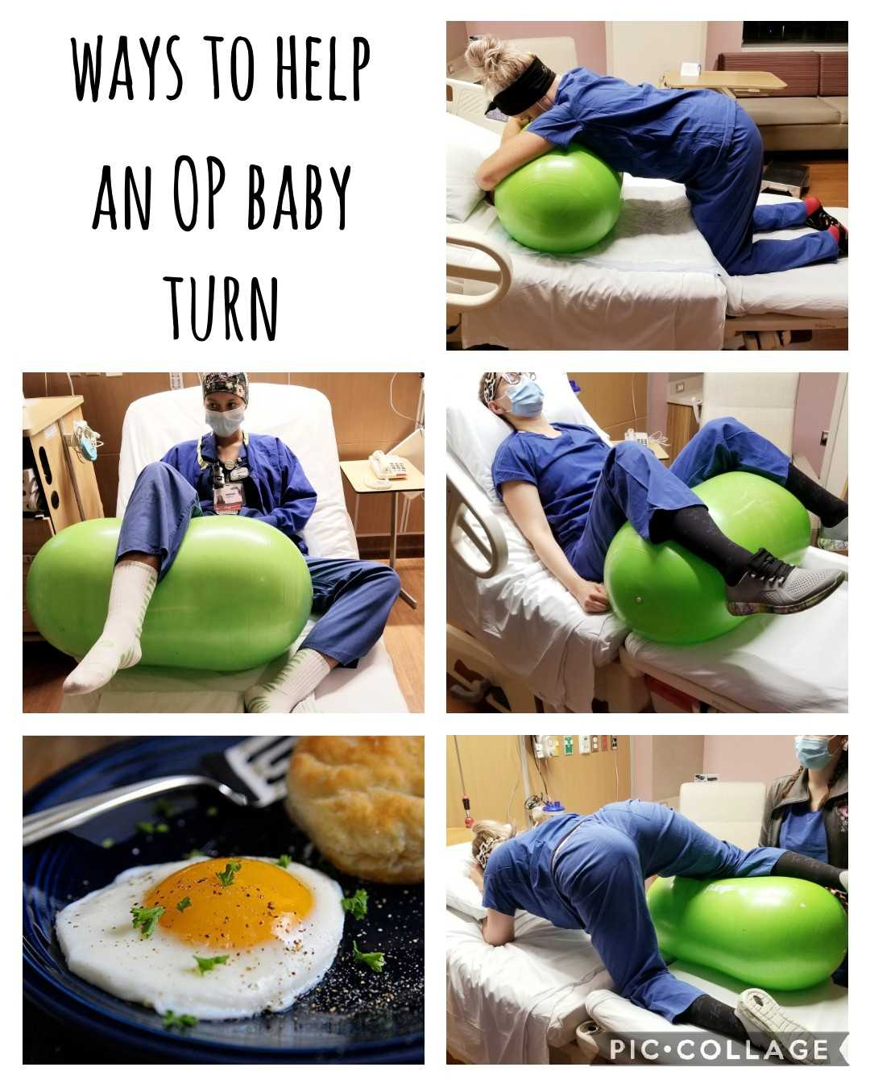
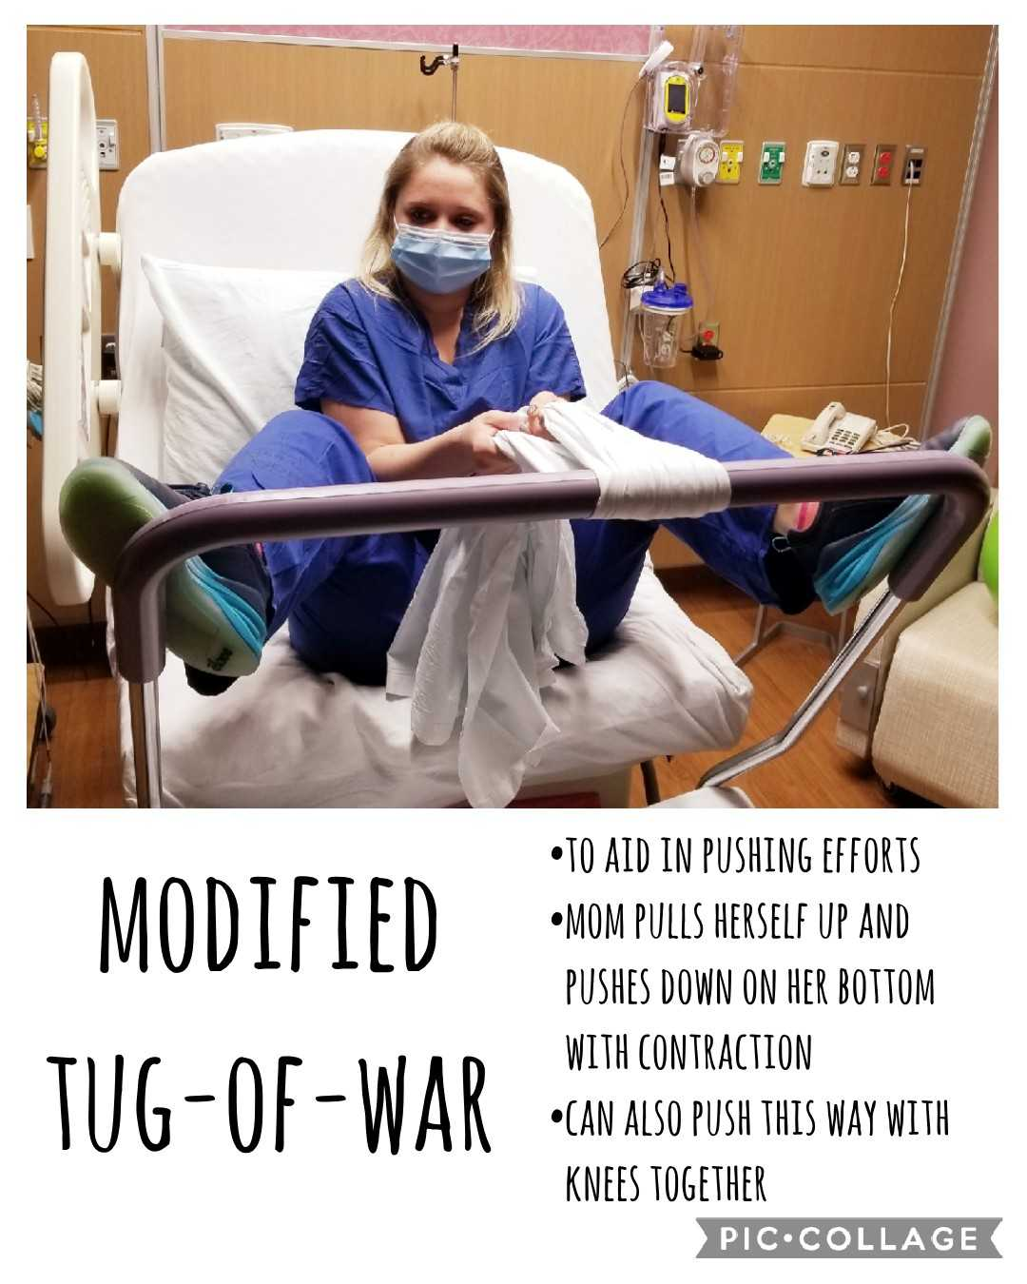
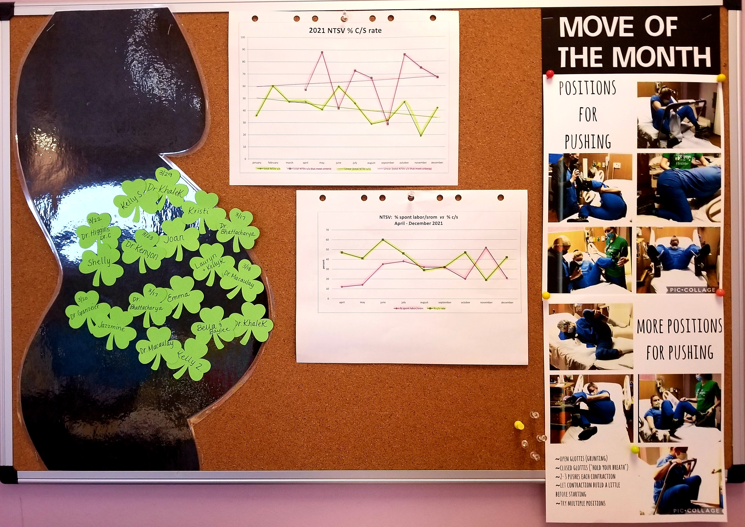
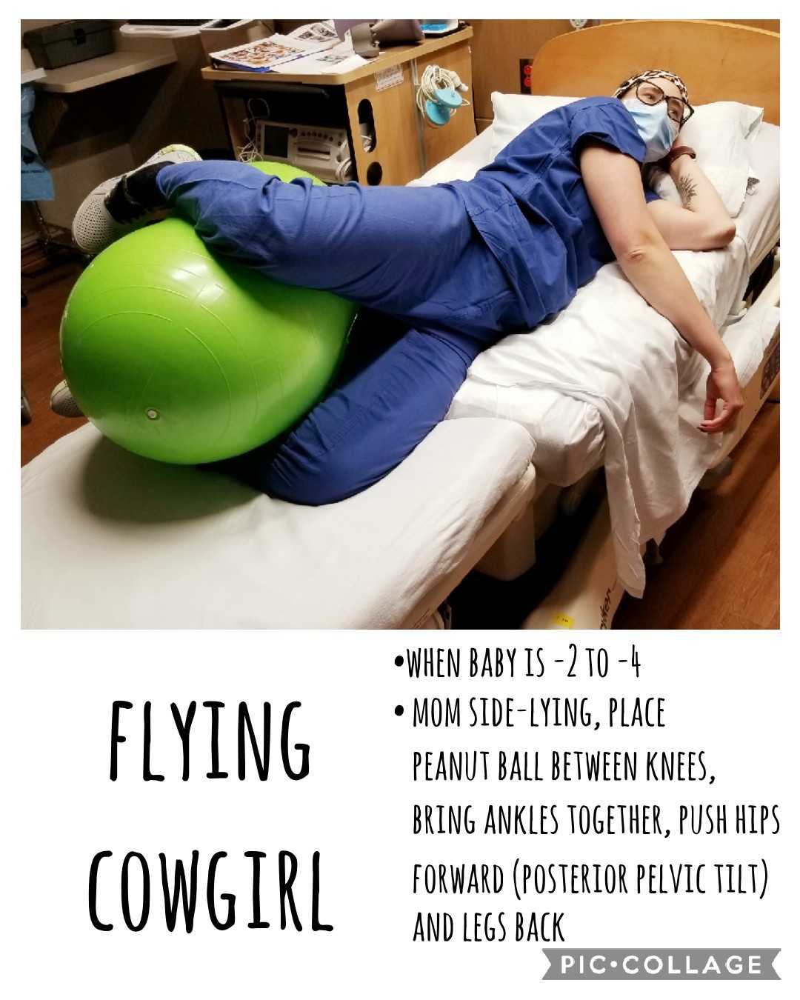

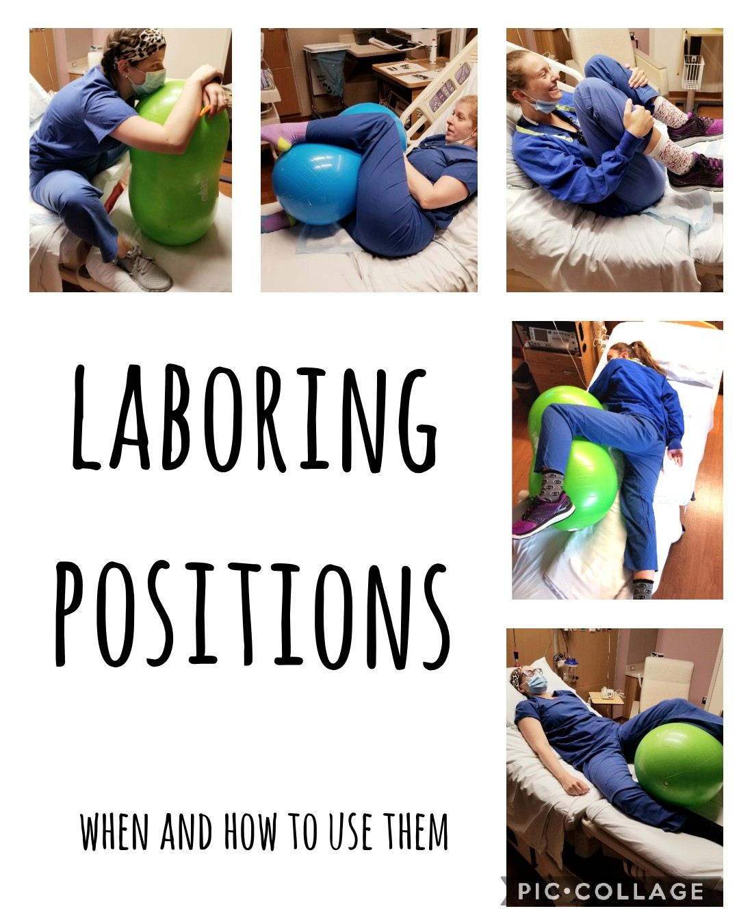
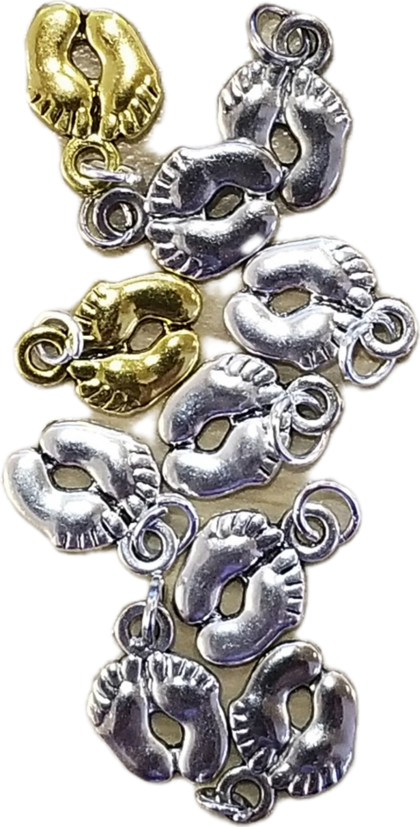
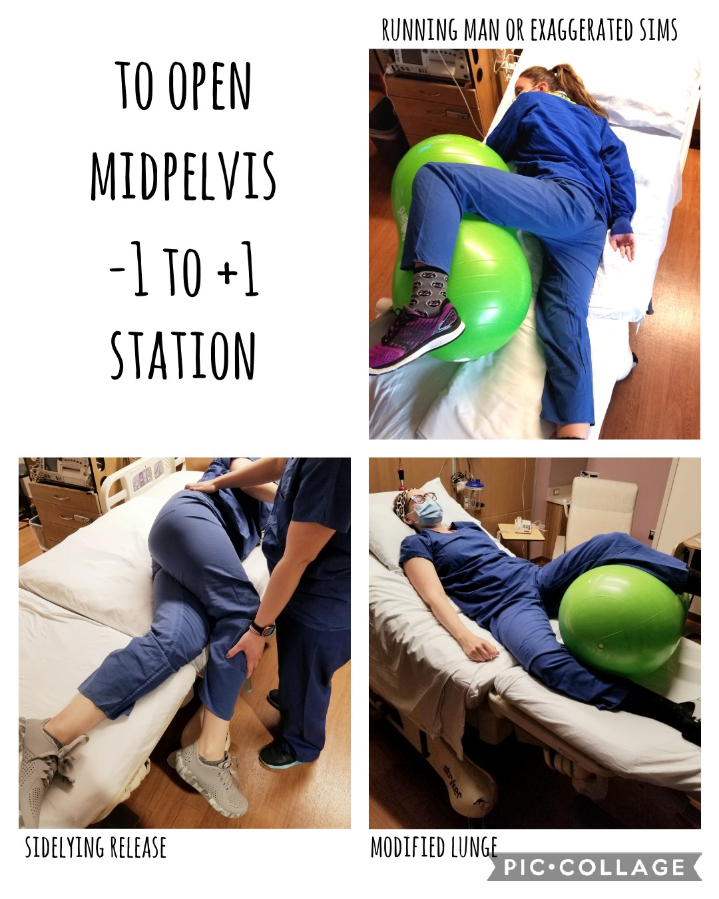
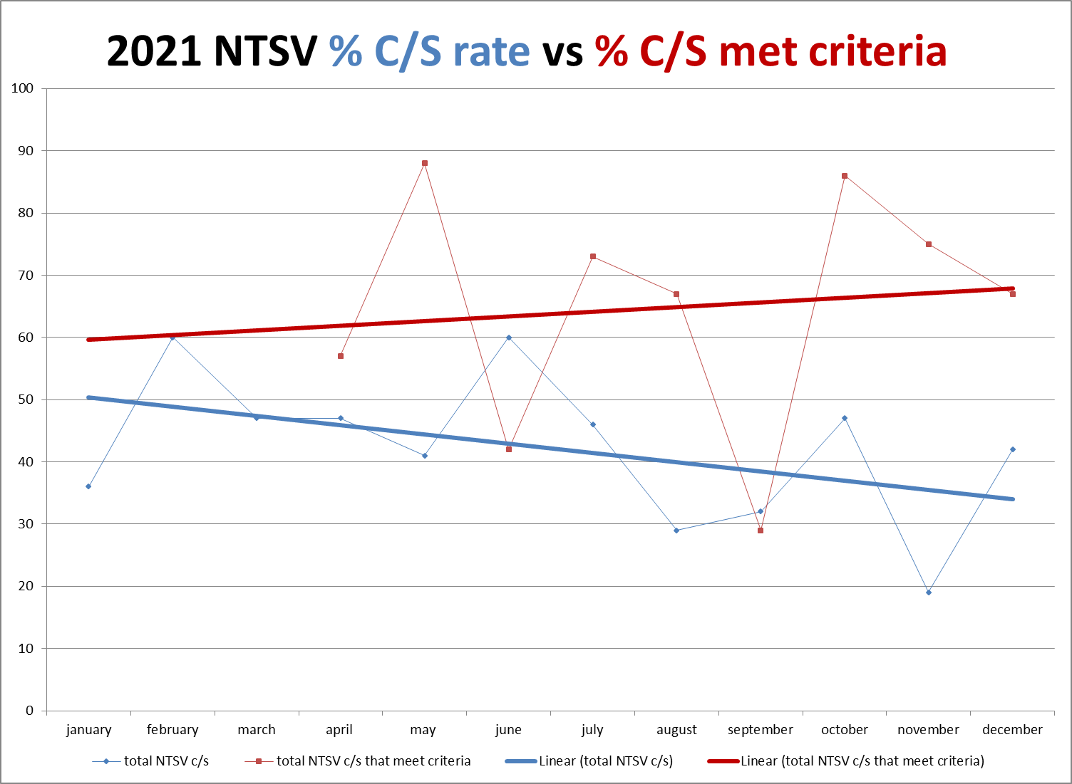
Javon Bea Hospital - Riverside
Teaching Move of the Month
Compiled Positions booklet, utilizing with patients
Earning Baby Feet charms
Giving Belly Board shout-outs
Educated 100% nurses, providers
Adopted c/s checklist, huddle
Unblinded provider data
Attending OB provider meetings
  Sharing statistics
  Giving updates
Sharing NTSV moms at daily huddle
Promoting longer early labor, longer pushing
Learning from our shortcomings
Celebrating our successes!

Slide 17
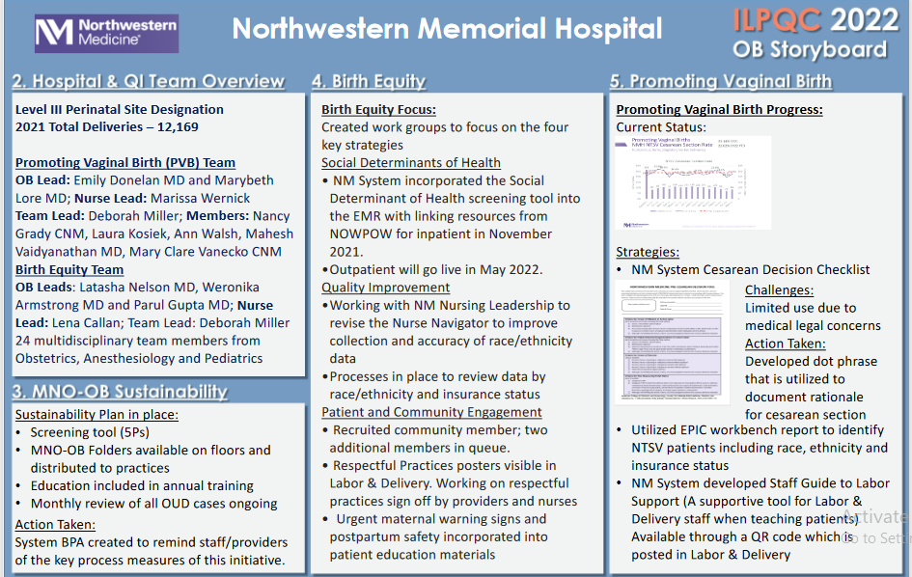
Northwestern Perinatal Network
Notes:
Folders, coordinated discharge worksheet,

Slide 18
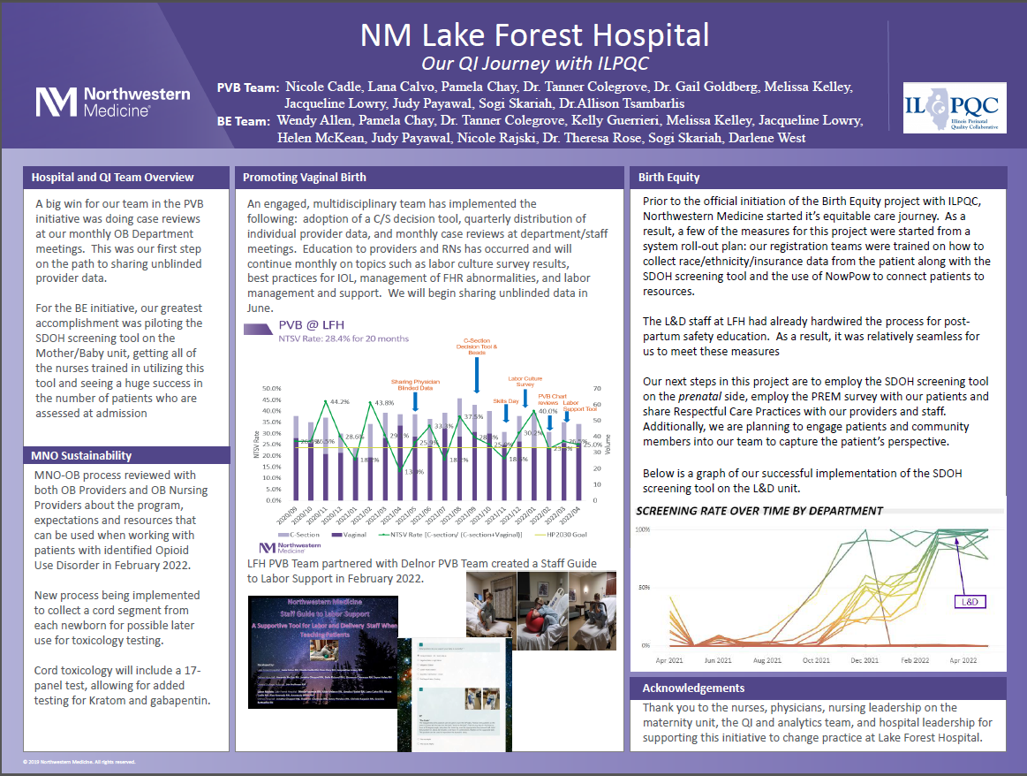

Slide 19
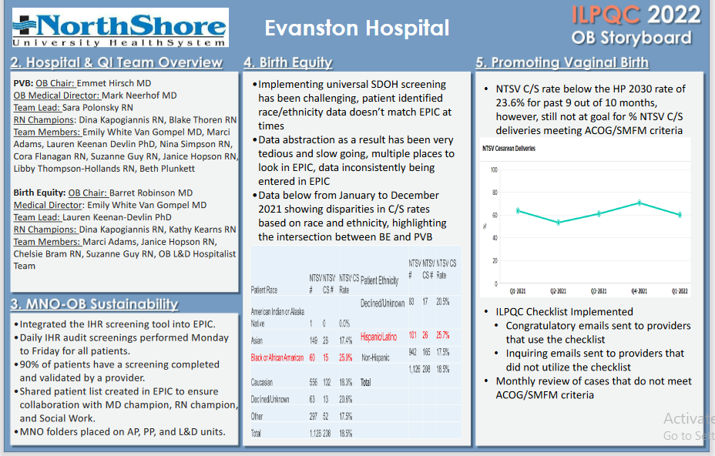
Northwestern Perinatal Network
Notes:
Folders, coordinated discharge worksheet,

Slide 20

Evanston Hospital
PVB Accomplishments:
Administered Labor Culture Survey
Monthly hospital team meetings
Resuscitative measures Labor flowsheet integrated in EPIC
Attended ILPQC Comfort Measures Workshop
Sent out blinded individual provider data and blinded group level to entire OB department in 2021 and 2022
Un-blinded personal C/S data sent to each individual provider with 2 years of data for comparison
Laminated labor positioning flip books that also detail pushing techniques placed in all L&D rooms
PVB Grand Rounds presented 4/27/22
Championing outpatient cervical ripening
Dot phrase create in EPIC for resuscitative measures
Monthly chart auditing
Investigating doula/centering pregnancy options
Created dot phrase with list of doula resources
Create link to doula resources on website
Exploring Alternative Birthing room options
Drafting proposal for doula program
Created and implemented prenatal education survey
Looking forward to:
Assigning ILPQC PVB Education module to all RN’s, CNM’s, and MD’s
Continuing to decrease our NTSV C/S rate
Recognizing importance of Birth Equity and Promoting Vaginal Birth Initiatives working together

Slide 21
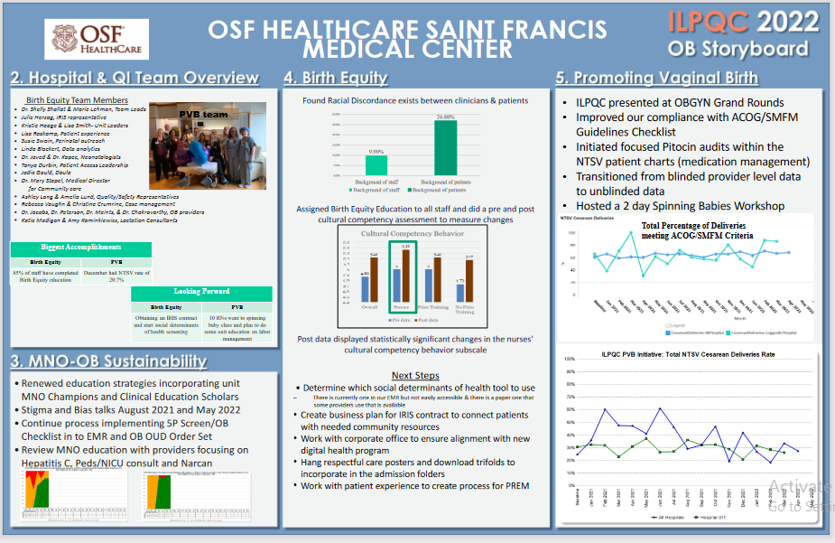
Northwestern Perinatal Network
Notes:
Folders, coordinated discharge worksheet,

Slide 22
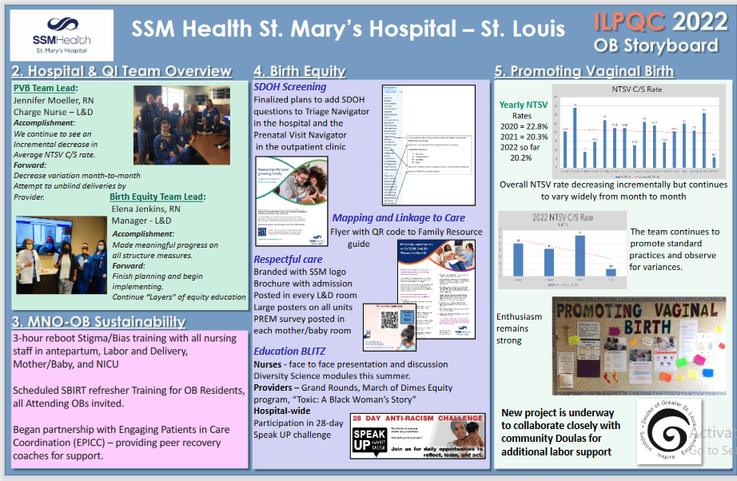
Northwestern Perinatal Network
Notes:
Folders, coordinated discharge worksheet,

Slide 23
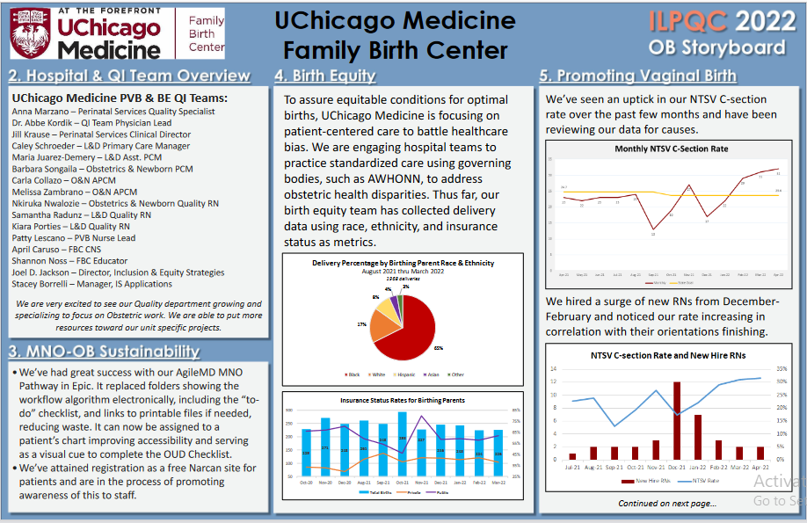
Northwestern Perinatal Network
Notes:
Folders, coordinated discharge worksheet,

Slide 24





Thank you
Questions?
Info@ilpqc.org
Sponsored by
I-PROMOTE IL

