Slide 1
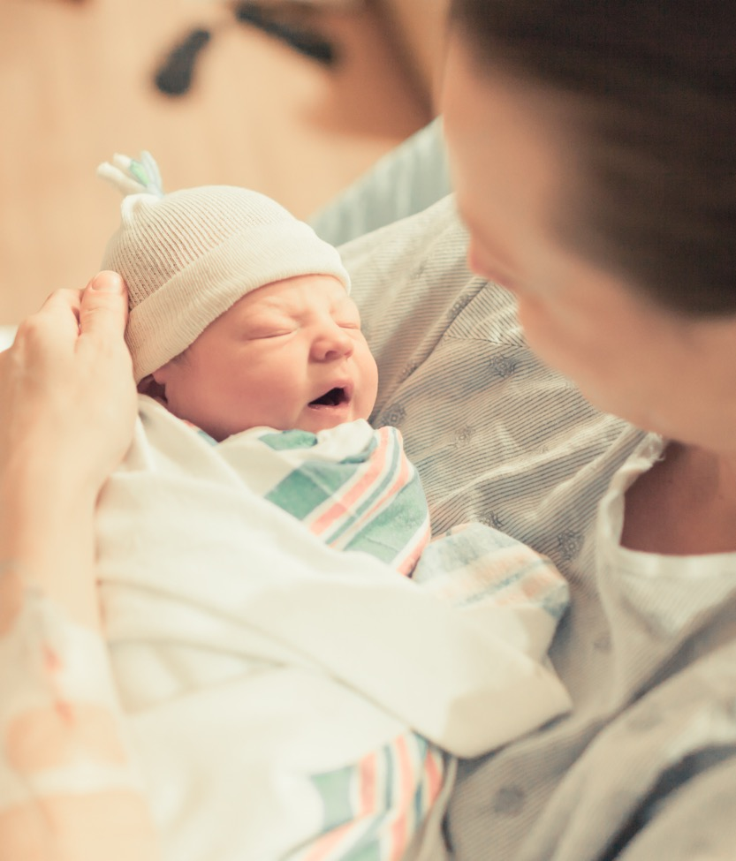
OB Face-to-Face 2022 Storyboards
(PerinatalLevels 1/2/2E)

Slide 2
Participating hospitals
Perinatal level | Hospital name
1 | Gibson Area Hospital
2 | Advocate Trinity Hospital
2 | Carle BroMenn Medical Center
2 | FHN Hospital
2 | Memorial Hospital Shiloh
2 | NM Palos Hospital
2 | Riverside Medical Center
2 | Silver Cross Hospital
2 | SSM Health Good Samaritan
2E | Advocate Condell Medical Center
2E | Ascension Resurrection
2E | Elmhurst Memorial Hospital
2E | Franciscan Alliance, Olympia Fields
2E | OSF Little Company of Mary Medical Center
2E | OSF Saint Anthony Medical Center

Slide 3
Level 1 Perinatal Hospitals

Slide 4
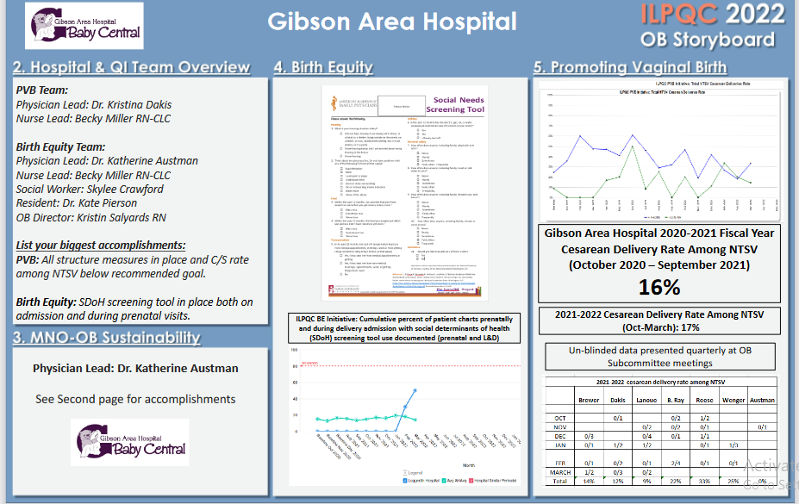
Northwestern Perinatal Network
Notes:
Folders, coordinated discharge worksheet,

Slide 5
Level 2 Perinatal Hospitals

Slide 6

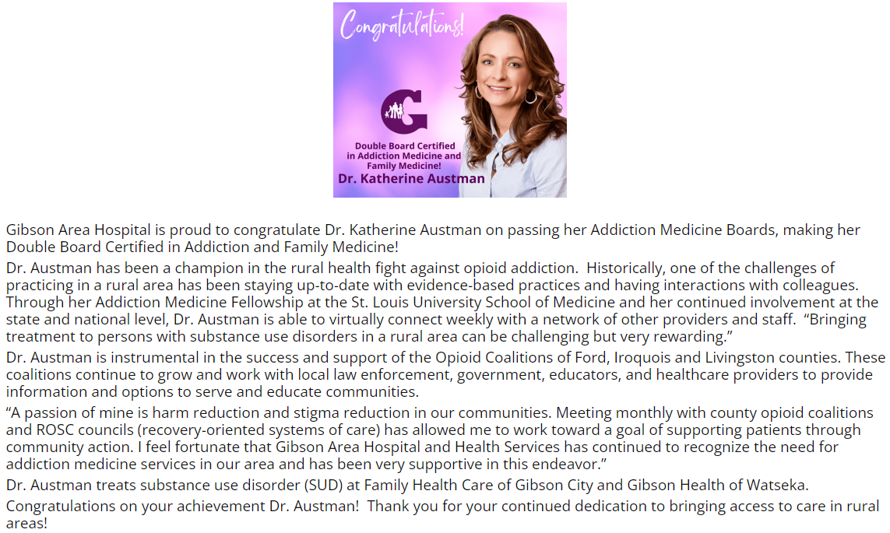
<Hospital Logo>
Gibson Area Hospital

Slide 7
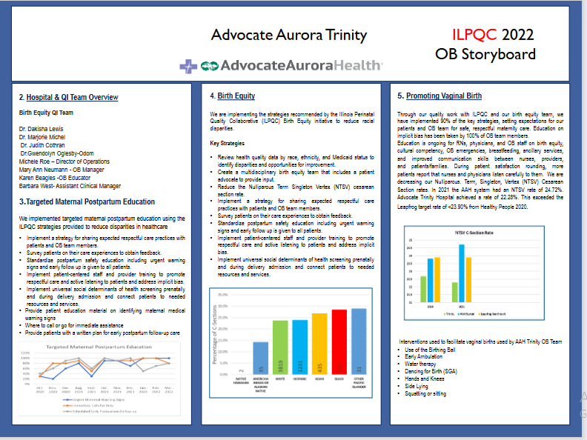
Northwestern Perinatal Network
Notes:
Folders, coordinated discharge worksheet,

Slide 8
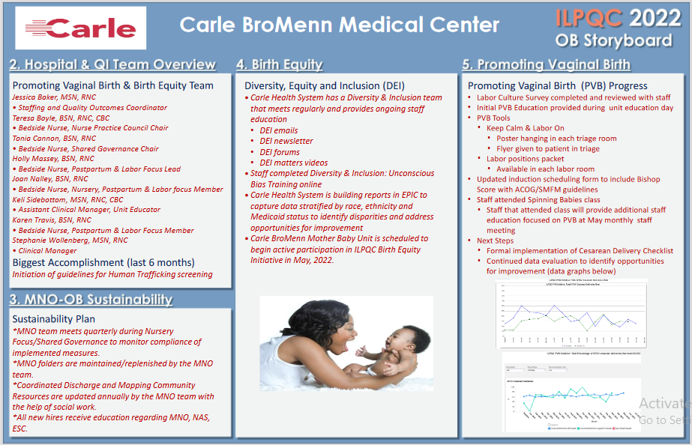
Northwestern Perinatal Network
Notes:
Folders, coordinated discharge worksheet,

Slide 9
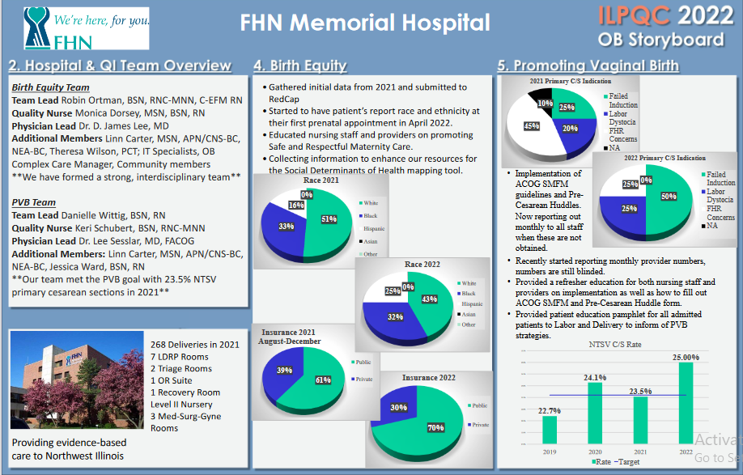
Northwestern Perinatal Network
Notes:
Folders, coordinated discharge worksheet,

Slide 10
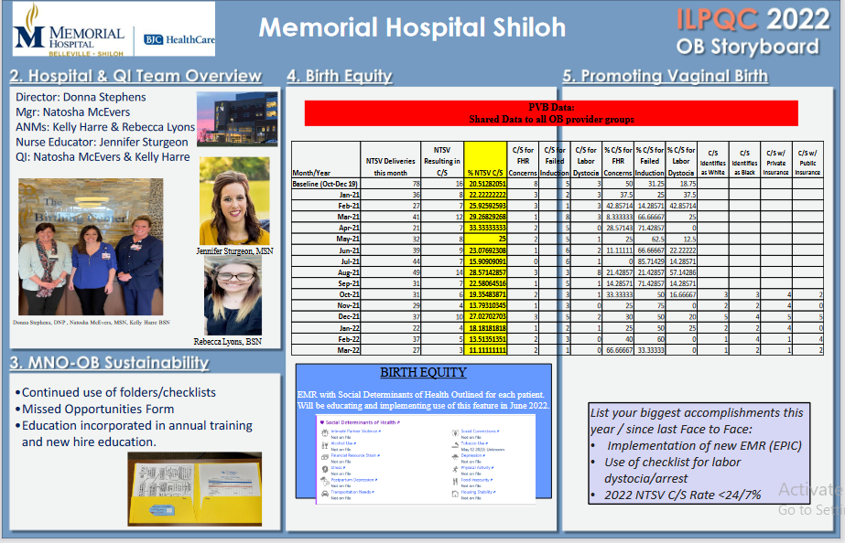
Northwestern Perinatal Network
Notes:
Folders, coordinated discharge worksheet,

Slide 11
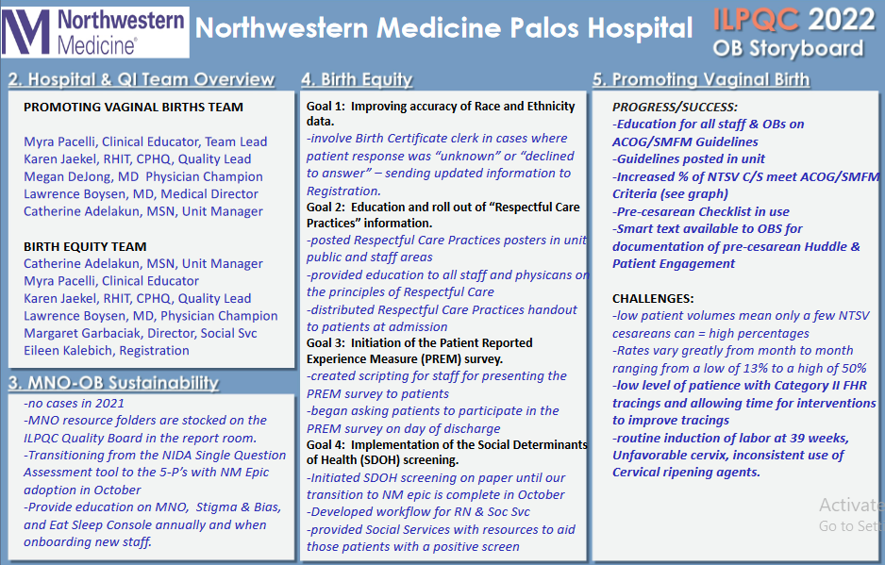
Northwestern Perinatal Network
Notes:
Folders, coordinated discharge worksheet,

Slide 12
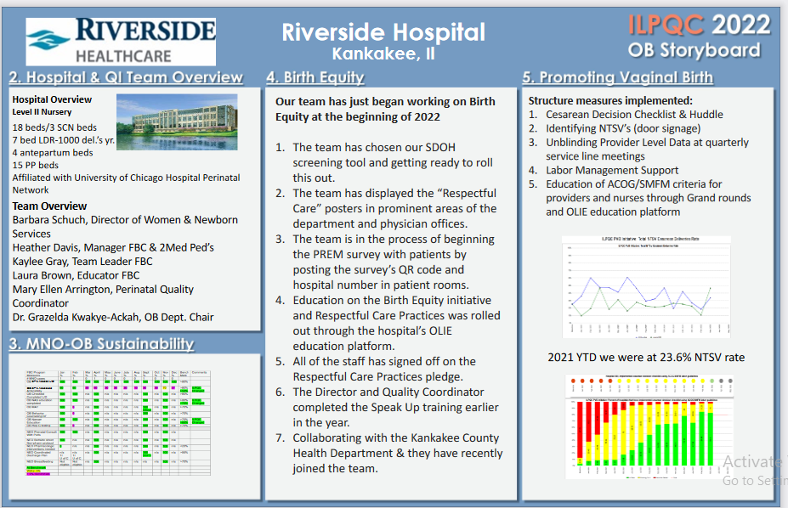
Northwestern Perinatal Network
Notes:
Folders, coordinated discharge worksheet,

Slide 13
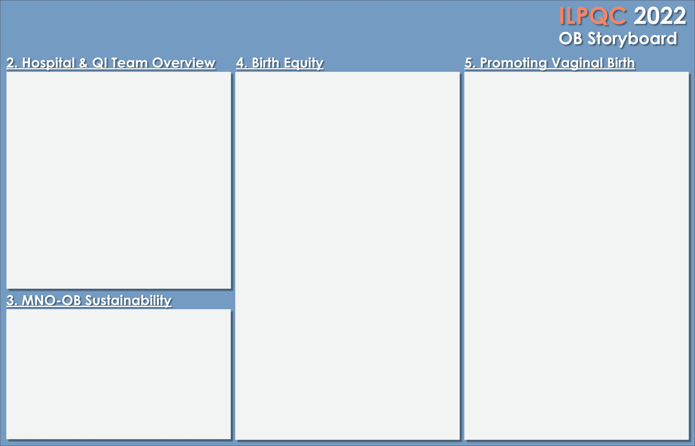

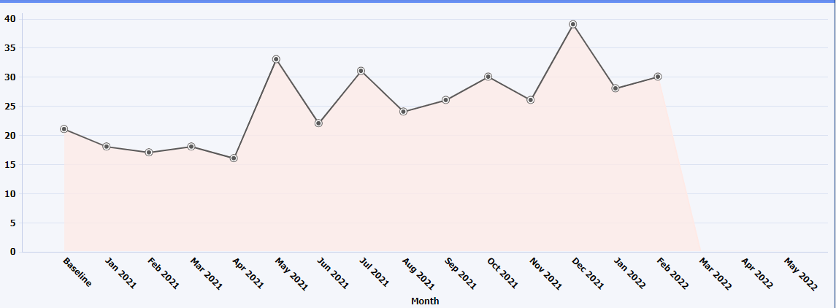
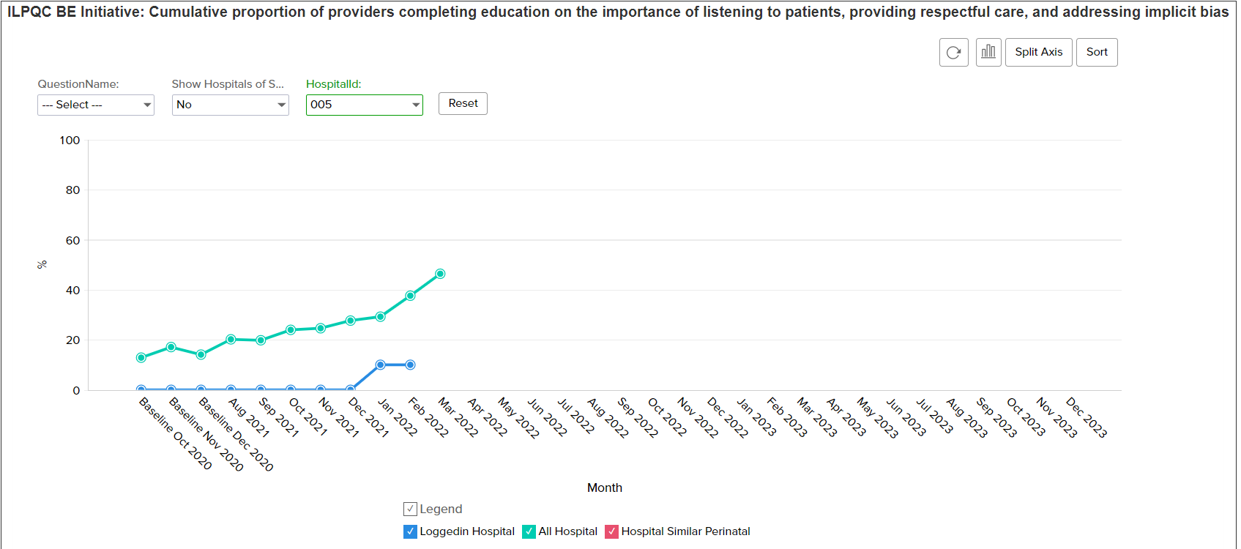
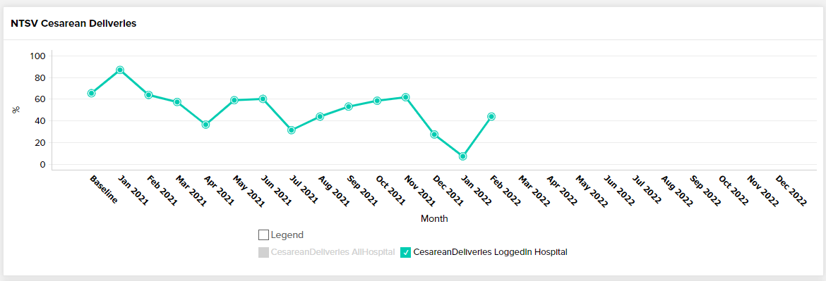
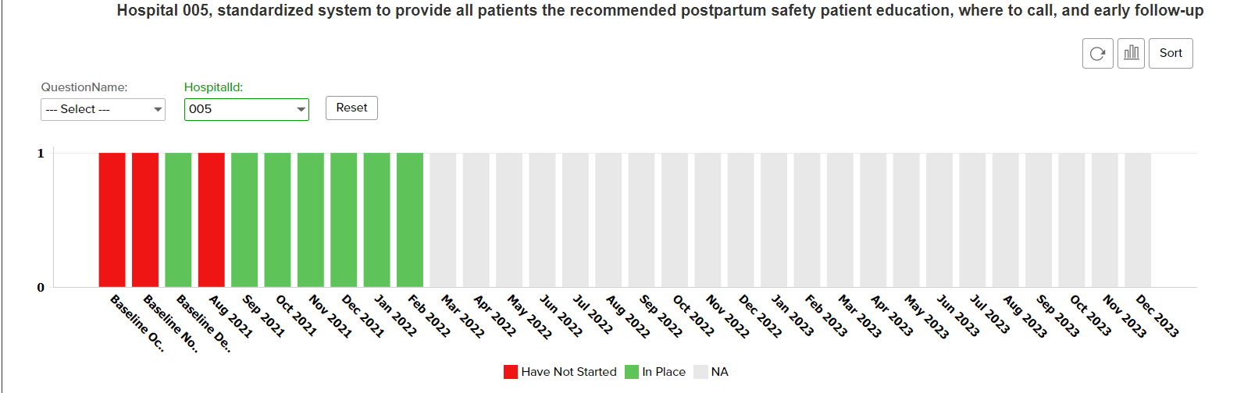
Silver Cross Hospital
PVB Team
Director of Woman & Infant Services: Kristina Salcedo
Manager of Woman & Infant Services: Lori Gaedt-Ramirez
OB Educator: Tina O’Sullivan
L&D Staff RN: Meg Murray
Provider Champions: Thomas Kazmierczak & Jeffrey Williams
Birth Equity Team
Director of Woman & Infant Services: Kristina Salcedo
Manager of Woman & Infant Services: Lori Gaedt-Ramirez
OB Educator: Tina O’Sullivan
Provider Champion: Veronica Arauz
Successes
Labor of Culture Survey sent out to staff
Pre-cesarean huddle tool implemented in December 2021
90% of nursing staff educated on ACOG/SMFM criteria labor management guidelines and labor support techniques
100% of providers educated on ACOG/SMFM criteria labor management guidelines and labor support techniques
Patient education tools implemented on vaginal birth strategies/techniques
Moving Forward
Will review and share data that includes provider-level data with the clinical team
Will offer Spinning Babies class to Labor and Delivery nurses and OB providers
Successes:
  -Hospital implemented a DEI (Diversity, Equity and Inclusion) committee in 2022
  -Staff received OB specific Diversity and Inclusion in healthcare education 5/1/22
  -Postpartum education includes urgent maternal warnings with updated information on reaching appropriate providers.
Challenges:
  -Implementing at this time was difficult. With staffing concerns during the pandemic and Level III perinatal designation education taking priority.
Hospital Monthly Total NTSV C-Section Rate
ILPQC PVB Initiative: Total Percentage of NTSV cesarean deliveries that meet ACOG/ SMFM criteria
Share sustainability data and the strategies you used to sustain your MNO-OB work.
Challenges:
OB providers utilized a validated screening tool for OUD
OB providers prescribing Narcan at discharge for any OUD patient or patient being discharged with opioids
OB providers ordering Hepatitis C screening on OUD patients
Providers, nursing staff, and /or Social Services completing the discharge checklist on mom and newborn
Sustainability:
Continue data collection
Coordinate care plans prenatally with MFM providers
New staff are given education during orientation

Slide 14
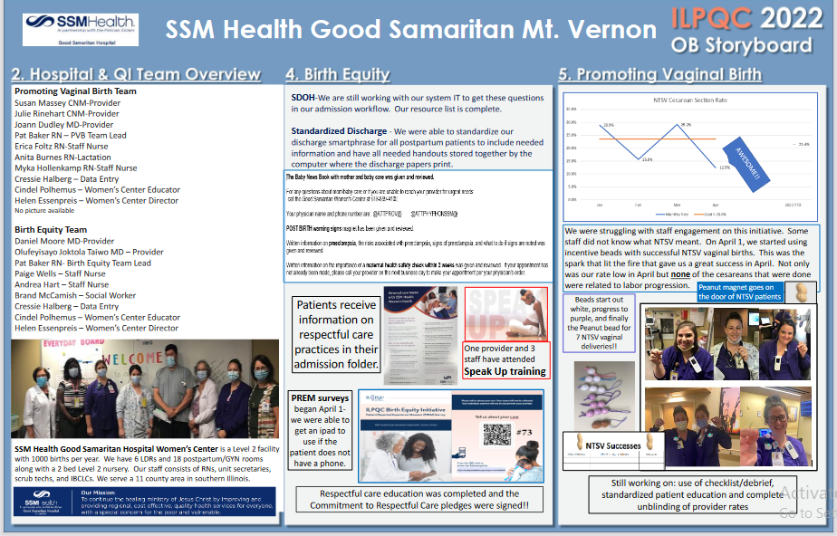
Northwestern Perinatal Network
Notes:
Folders, coordinated discharge worksheet,

Slide 15
Level 2E Perinatal Hospitals

Slide 16
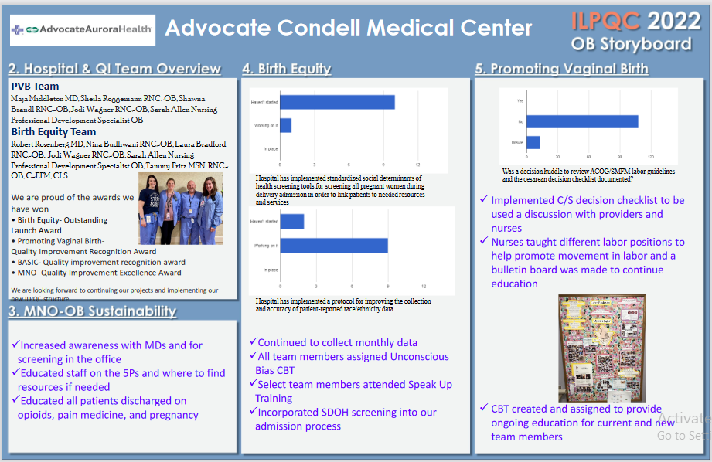
Northwestern Perinatal Network
Notes:
Folders, coordinated discharge worksheet,

Slide 17
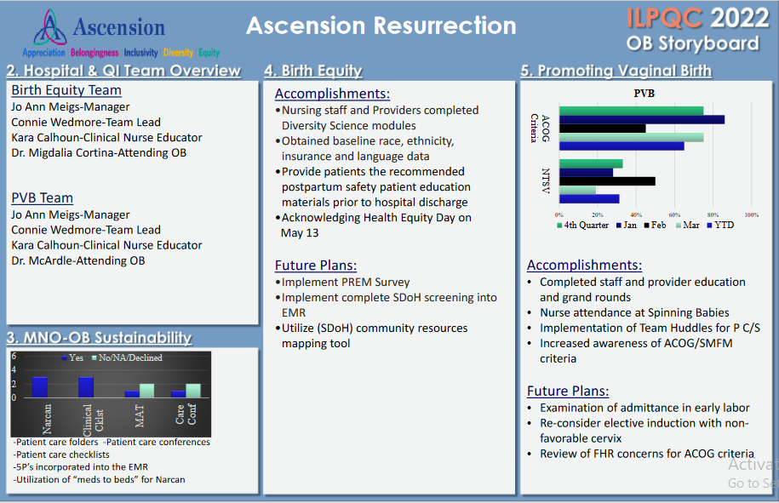
Northwestern Perinatal Network
Notes:
Folders, coordinated discharge worksheet,

Slide 18
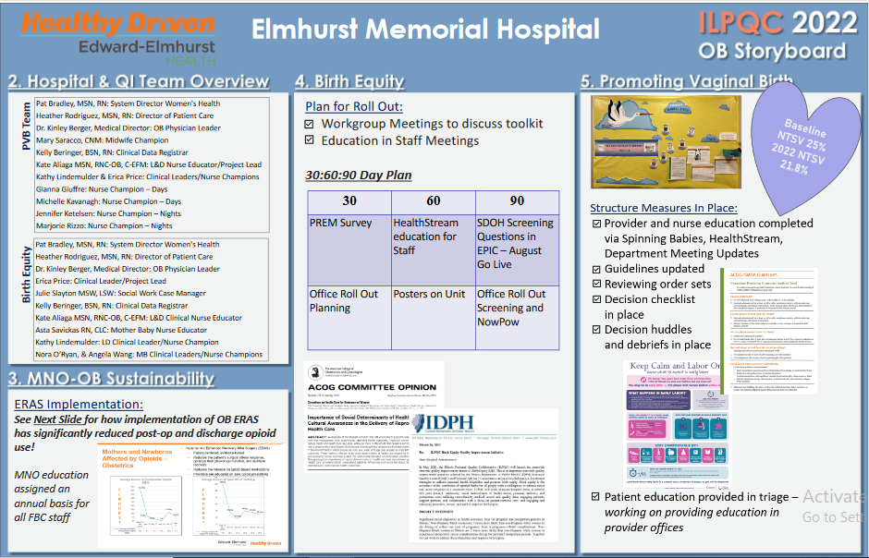
Northwestern Perinatal Network
Notes:
Folders, coordinated discharge worksheet,

Slide 19
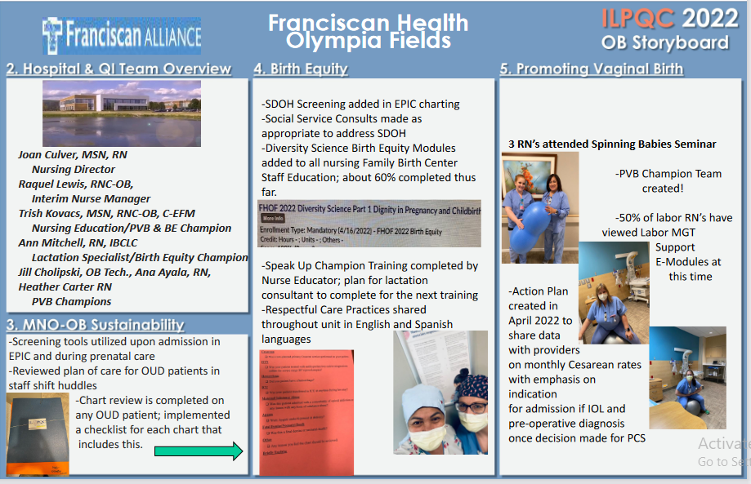
Northwestern Perinatal Network
Notes:
Folders, coordinated discharge worksheet,

Slide 20
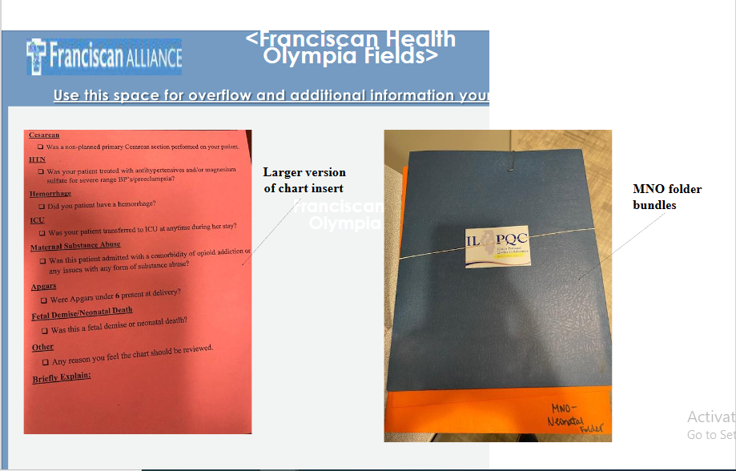
Northwestern Perinatal Network
Notes:
Folders, coordinated discharge worksheet,

Slide 21
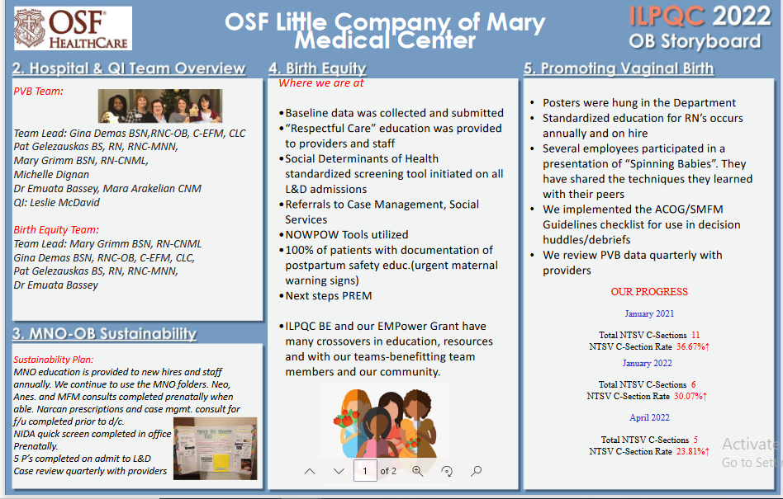
Northwestern Perinatal Network
Notes:
Folders, coordinated discharge worksheet,

Slide 22
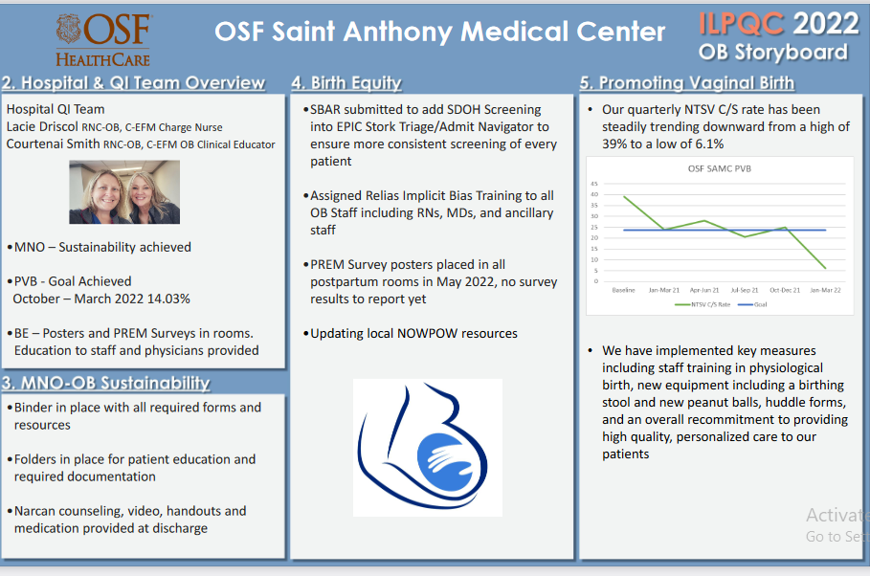
Northwestern Perinatal Network
Notes:
Folders, coordinated discharge worksheet,

Slide 23





Thank you
Questions?
Info@ilpqc.org
Sponsored by
I-PROMOTE IL

