Slide 1

Neonatal Face-to-Face 2022 Storyboards (Perinatal Level 3)

Slide 2
Perinatal Level 3

Slide 3
Participating hospitals
Perinatal level | Name
3 | AdventHealth Hinsdale
3 | Advocate Good Samaritan
3 | Advocate Lutheran General & Children's Hospital-Park Ridge
3 | Ascension Saint Alexius
3 | Ascension Saint Joseph Hospital Chicago
3 | Loyola University Medical Center
3 | NM System BASIC
3 | OSF Saint Francis Medical Center
3 | Rush University Medical Center

Slide 4
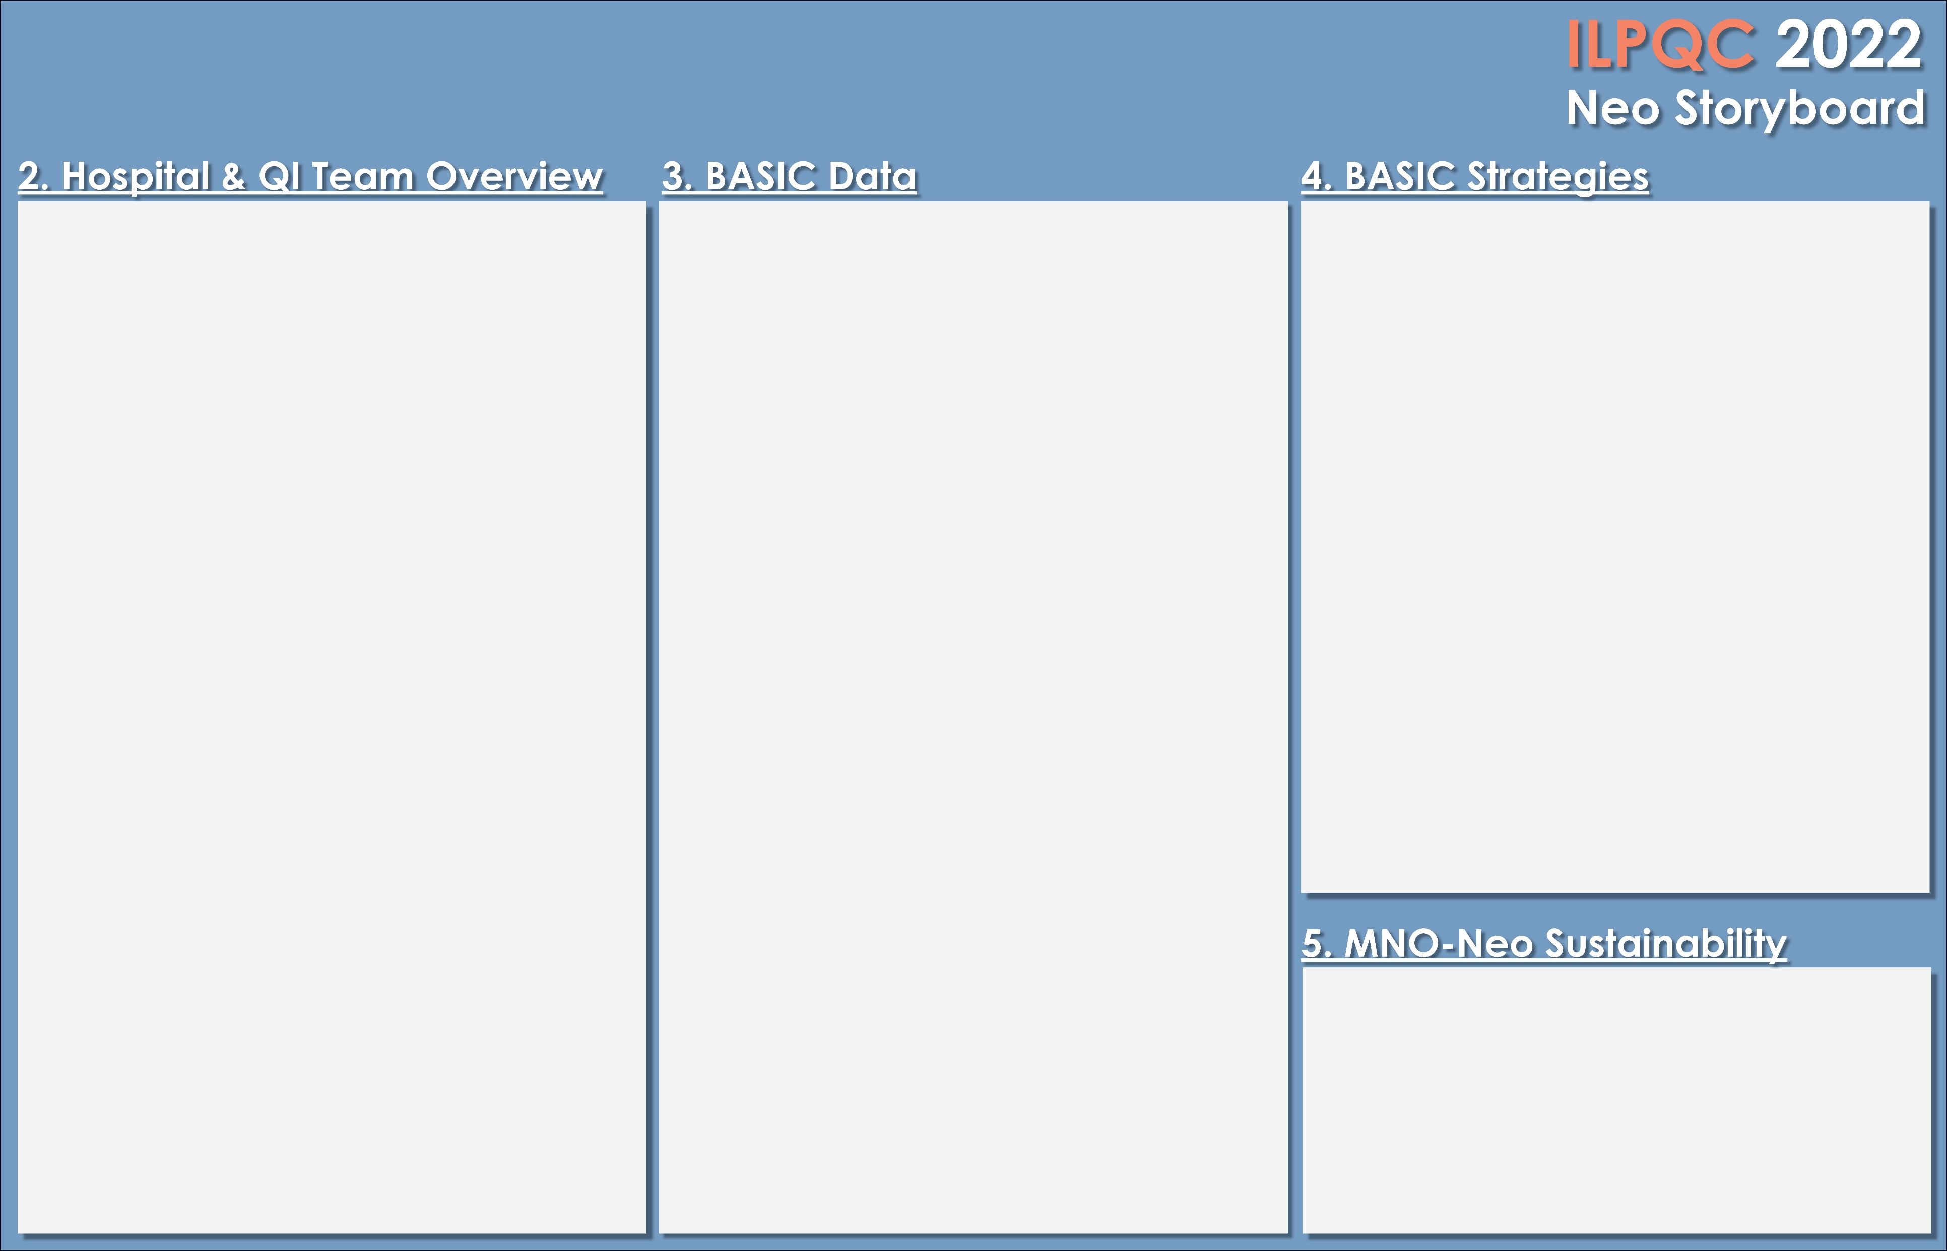


<Hospital Logo>
AdventHealth Hinsdale
Laura Cronin, MSN, RNC-NIC, NICU/Peds Manager
Lynda Lentini, MSN, RNC-OB Director
Stavros Ionides, MD, Director of Neonatology
With the launch of the BASIC initiative, Hinsdale Hospital’s NICU is in a sustainability phase, which is to have a goal of less than 4% overall antibiotic rate. At this stage we no longer have the need for a robust team, so the BASIC team consists of the NICU educator, manager, and neonatologists.
Each month the NICU leadership team meets for our level III quality meeting. This meeting consists of the Director for Women and Children’s, the NICU manager, the NICU educator, pharmacy, and neonatology. During this meeting we discuss the QI projects that we are performing currently and suggest areas that we would like to focus on in the future.
The NICU nurses recently relaunched their unit-based governance, which is empowering the bedside nurses to have a voice in what QI projects they would like to see implemented.
We do educate every family that has a baby being treated for EOS on antibiotic use and the treatment plan. This is documented in the neonatologist’s note.
Hinsdale Hospital NICU’s journey in antibiotic stewardship began back in late 2017. The antibiotic stewardship team was created and consisted of the NICU educator, an antimicrobial pharmacist, a neonatologist, and group of new graduate NICU nurses that needed an evidence-based practice project.
The first task for the team was to examine the NICU baseline data of positive cultures from 2015-2017. After reviewing the data, the team agreed to proceed with decreasing the rule-out sepsis period from 48 hours to 36 hours., resulting in one less dose of Ampicillin and one less dose of gentamicin for EOS at birth.
The team instructed the neonatologists to use the Kaiser Permanente Newborn Sepsis Calculator and identify maternal risk factors to determine the infant’s risk for EOS. With these implementations, the NICU went from performing septic workups on 96.2% of patients admitted to the NICU to 83% of patients.
Finally, with the QI initiative, the NICU saw 42.8% of all patients admitted to the NICU being treated with antibiotics for EOS, which was down from 56.8% of all patients.
All patients screened as outpatients, and on admission. Plan created with NICU Navigator, Social Work, OB Provider, Pediatrician and Nursing teams. Outpatient follow up options provided as needed by social work and providers.
Notes:
Folders, coordinated discharge worksheet,

Slide 5
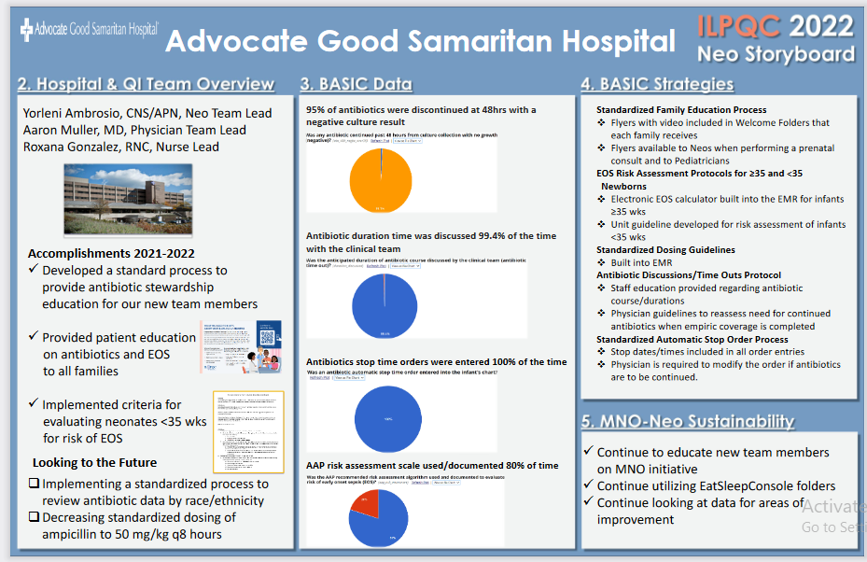
<Hospital Logo>
Notes:
Folders, coordinated discharge worksheet,

Slide 6
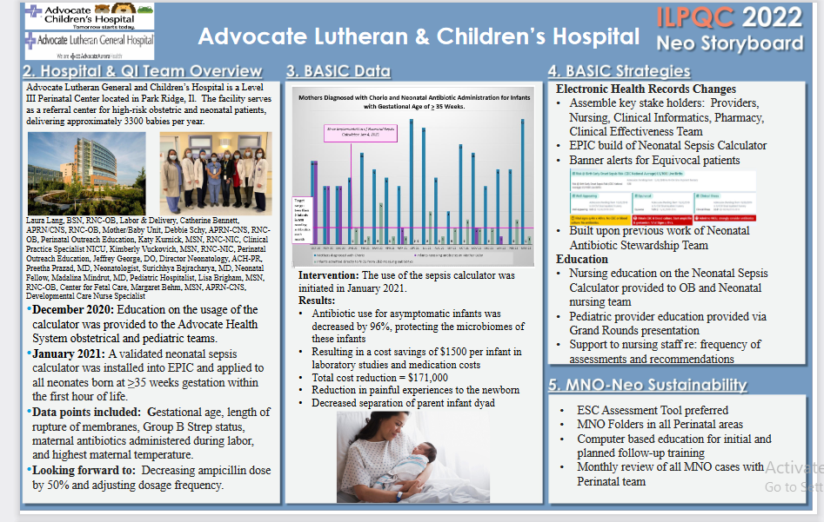
<Hospital Logo>
Notes:
Folders, coordinated discharge worksheet,

Slide 7
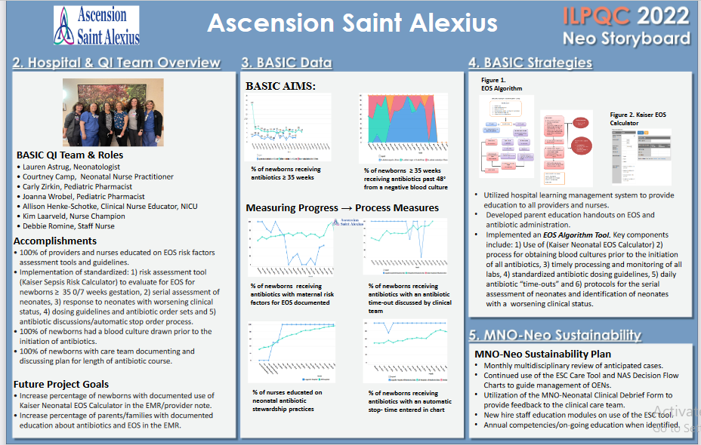
<Hospital Logo>
Notes:
Folders, coordinated discharge worksheet,

Slide 8
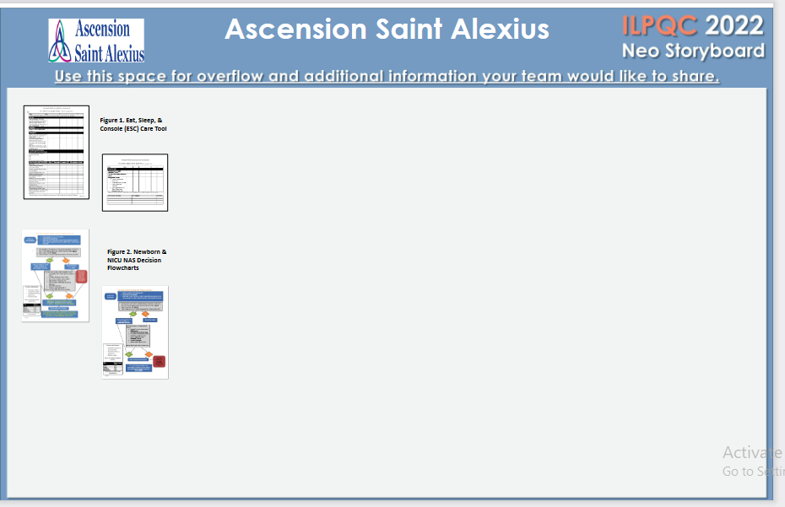
<Hospital Logo>
Notes:
Folders, coordinated discharge worksheet,

Slide 9
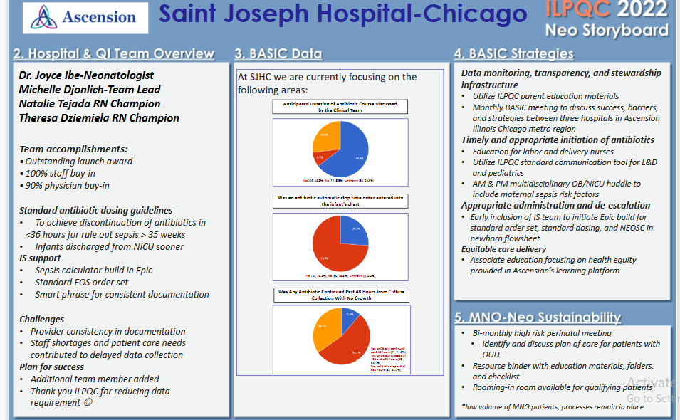
<Hospital Logo>
Notes:
Folders, coordinated discharge worksheet,

Slide 10
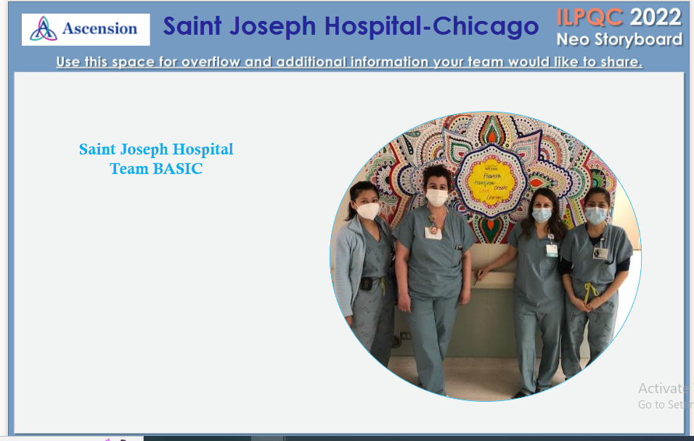
<Hospital Logo>
Notes:
Folders, coordinated discharge worksheet,

Slide 11
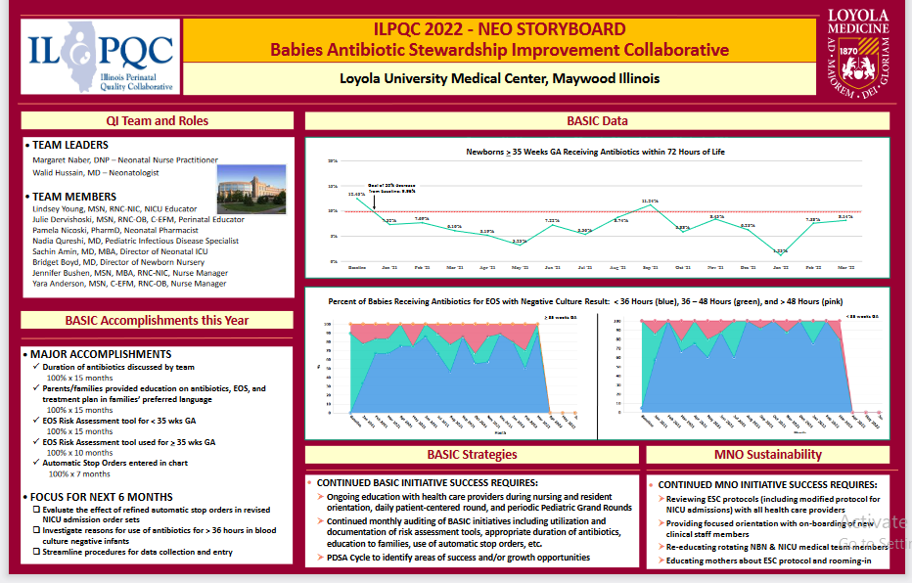
<Hospital Logo>
Notes:
Folders, coordinated discharge worksheet,

Slide 12
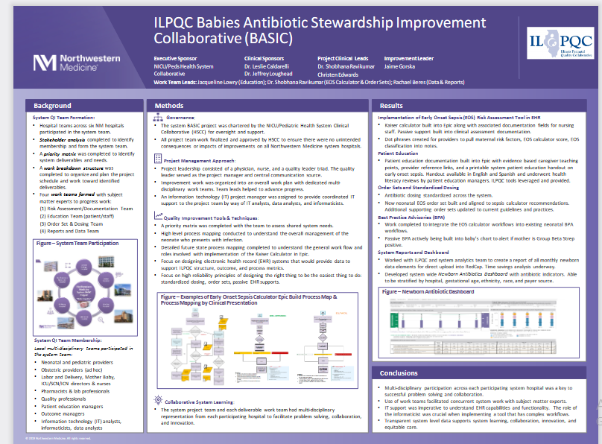
<Hospital Logo>
Notes:
Folders, coordinated discharge worksheet,

Slide 13
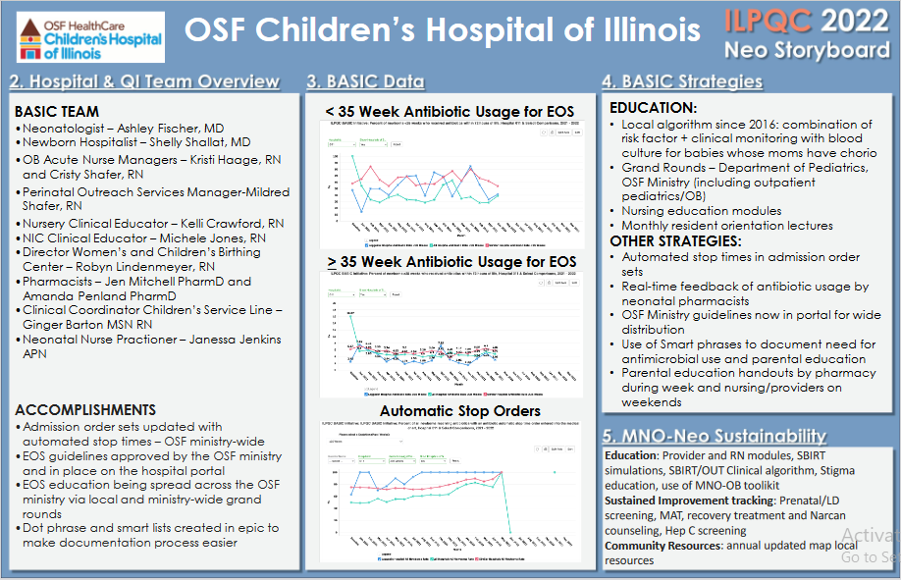
<Hospital Logo>
Notes:
Folders, coordinated discharge worksheet,

Slide 14
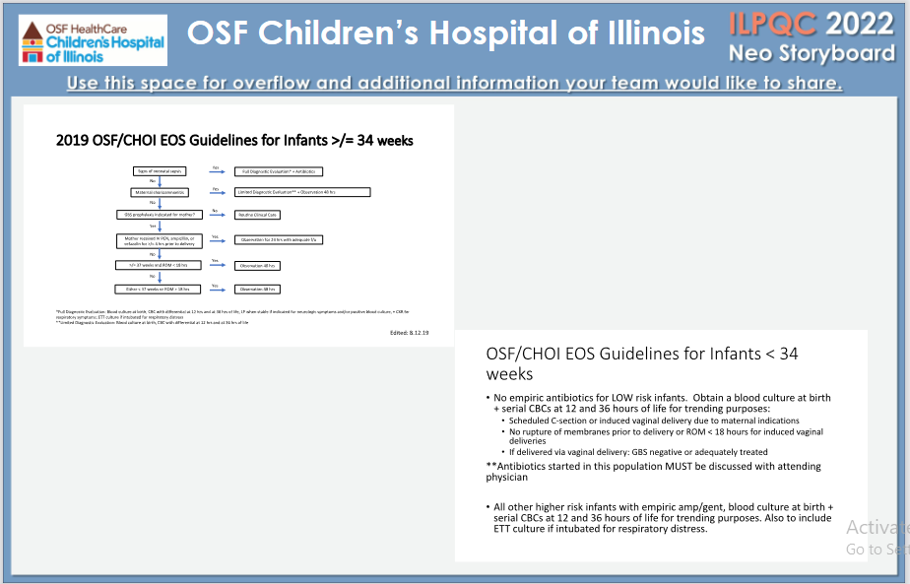
<Hospital Logo>
Notes:
Folders, coordinated discharge worksheet,

Slide 15
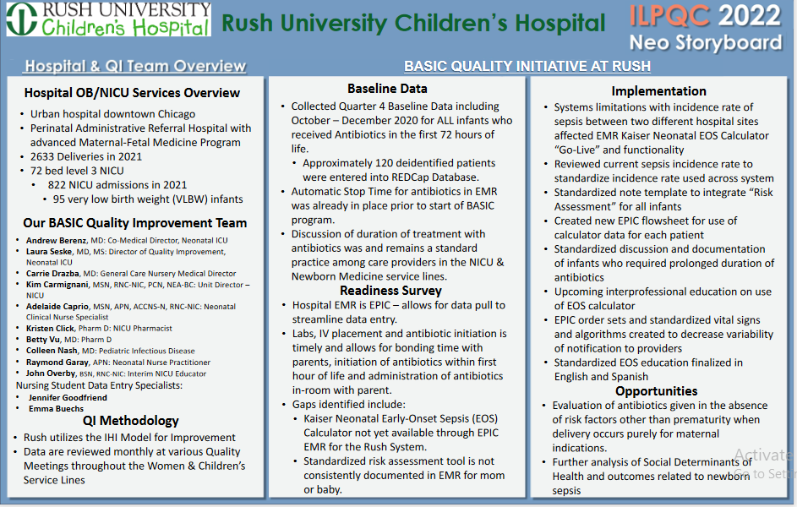
<Hospital Logo>
Notes:
Folders, coordinated discharge worksheet,

Slide 16





Thank you
Questions?
info@ilpqc.org
I-PROMOTE IL

