Slide 1
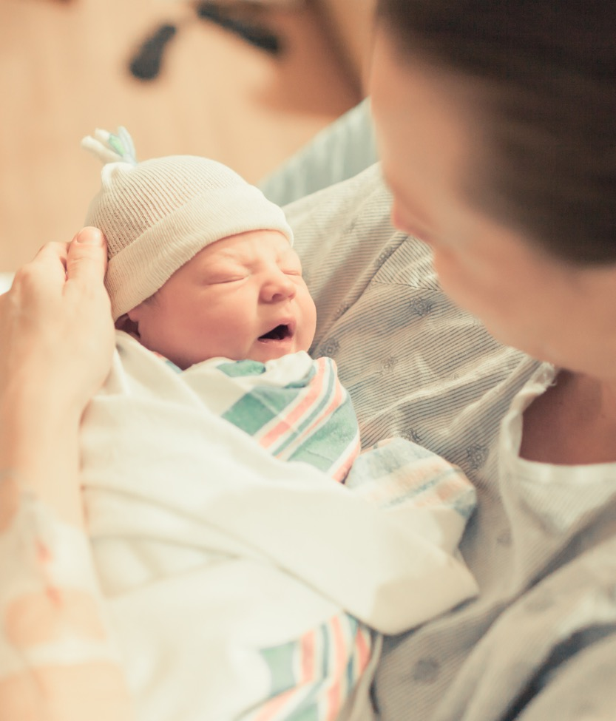
ILPQC: Wrap-up, Next Steps, & Raffle
Starts at 2:45 pm

Slide 2
What’s next for BASIC?
Monthly Team Webinars
1-1 QI Support Calls
Grand Rounds
Neo Provider Meetings
Keep the Momentum Going
Work to achieve all initiative aims
  When: 3rd Monday every month at 2:00pm
  Next call: June 20th
  Topic: Getting the reports you need from REDCap
  1-1 QI support calls for all teams not yet achieving initiative goals
  Email Ellie Suse and Alana Rivera at info@ilpqc.org to schedule
What: Personalized and FREE service to available to all participating teams
How: Email Ellie Suse to schedule today info@ilpqc.org
  Meet with your QI team and discuss what you learned from other hospital teams today
  Review which structure measures you are still working on and determine next steps
Complete a sustainability plan
Confirm standardized education
Utilize MNO folders for every OEN
Attend MNO-Neonatal sustainability calls
Notes:
Ellie, can you update this?

Slide 3
What Can I Do Tomorrow?
Take a minute to reflect on today's general sessions, panel, storyboards, and breakout sessions
Write down one thing that you are going to do to work towards BASIC improvement and MNO-Neonatal Sustainability next week

Slide 4




Opportunity to attend the
LAST PQI SPEAK-UP Training
The SPEAK UP Champion™ Implicit and Explicit Racial Bias education is a total of 8 hours over two days of live virtual interactive learning that outlines quality improvement strategies to support individuals and groups with dismantling racism, providing quality equitable care, and reducing health disparities.
Through the Birth Equity Initiative, ILPQC is sponsoring hospital team members (including neonatal teams!) to attend our 3rd ILPQC hosted SPEAK UP train the trainer session.
Illinois Perinatal Quality Collaborative

Slide 5

How to Register?
  WHEN: June 15th & 16th, 8:30 AM-12:30 PM CT (both days are required).
  View the Agenda Flyer via the link in the chat to learn more about the training
  Scan the QR code or the registration link in the chat to register today!
Notes:
Agenda: https://ilpqc.org/ILPQC%202020%2B/Birth%20Equity/SPEAK%20UP%20IL%20June%202022%20Flyer%20V1.pdf
Registration: https://www.perinatalqi.org/event/SPEAKUPILJUN2022CONFERENCE

Slide 6
Upcoming ILPQC Events
Event | Day/Time
Neonatal Advisory | June 6th at 1:00pm
PQI Speak-Up Training | June 15th & 16th at 8:30am
BASIC Teams Call | June 20th at 2:00pm
BASIC Teams Call | July 18th at 2:00pm

Slide 7
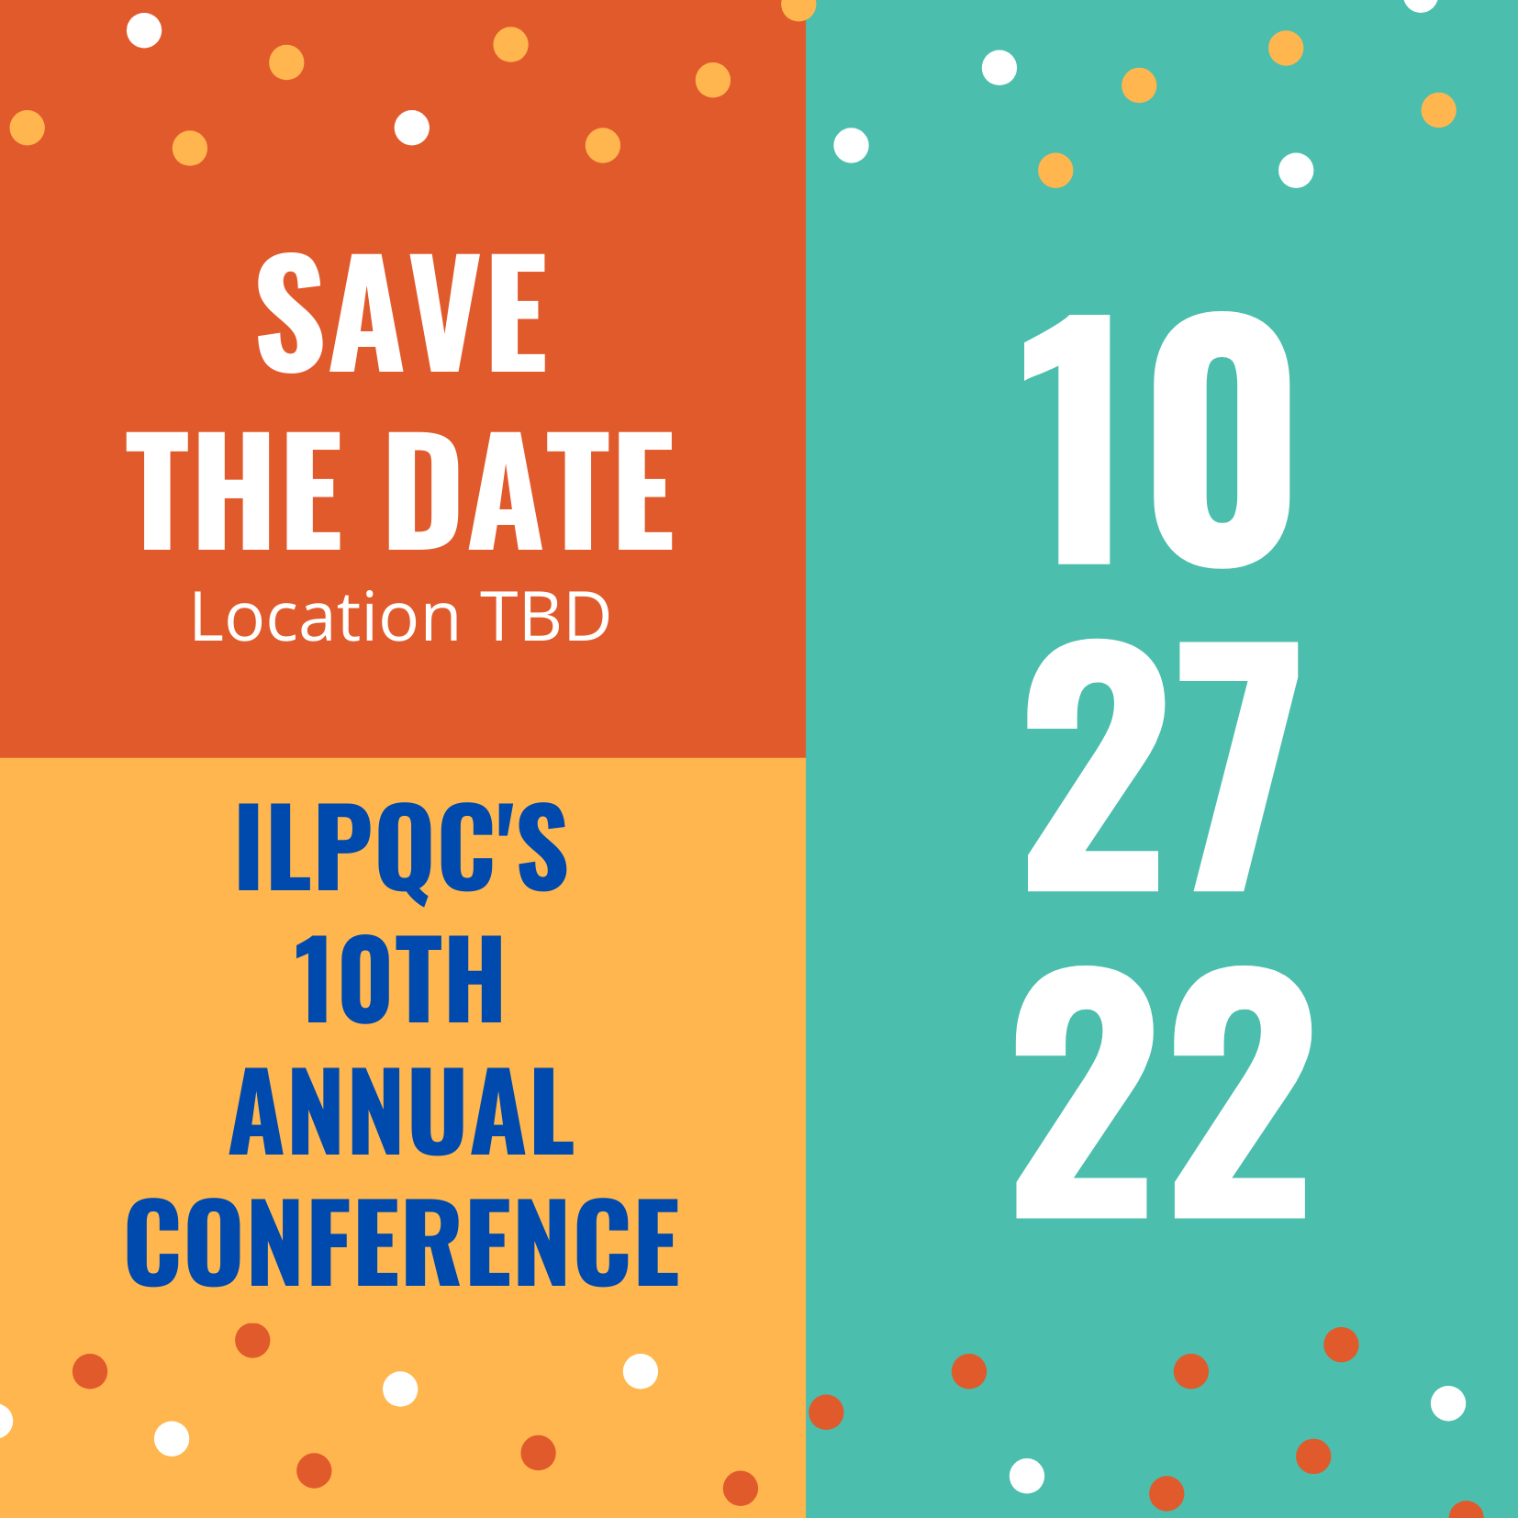
Save the Dates:
Calling all perinatal health care providers, nurses, allied health professionals, and public health/community partners!
ILPQC OB and Neonatal Face to Face Meetings:
  May 24 and 25, 2023 TBD

Slide 8

ILPQC Thanks You for a Great Day!

Slide 9
Thank You to our Speakers and Panelists!
Adelaide Caprio, MSN, APRN, ACCNS-N, RNC-NIC
Dr. Arvind Goyal
Dr. Guarava Agarwal, MD
LaToshia Rouse, CD(DONA)
Rachel Varghese, MSN, RN
Genevieve Field, BSN, RN
Dr. Laura Seske, MD, MS
Dr. Rajeev Kumar, MD

Slide 10
Thank You to our
Breakout Facilitators & Discussants!
Allison Henke Schotke
Andrea Cross
Ashley Fischer
De-Ann Pillers
Donna Lemmenes
Gustave Falciglia
Jacqueline Lowry
Joe Hageman
Kenny Kronforst
Lauren Astrug
LaToshia Rouse
Lisa Davis
Margaret Ozga
Matt Derrick
Michael Fitzgerald
Mickey Jones
Natosha McEvers
Patrick Lyons
Peggy Farrell
Pele Dina
Rajeev Kumar
Sameer Patel
Shawn O'Connor
Sue Horner
Tonia Branche

Slide 11
Thank You Planning Committee!!!
Andrea Cross MSHA RN
Cecilia Lopez MSN, RN
Christina Stupek MSN, RNC-OB, C-EFM, C-ONQS
Deborah Miller MPH, BSN, RN, CPHQ
Donna Lemmenes MSN, CPNP, RNC-NIC
Dr. Joseph Hageman, MD
Dr. Shawn O’Connor, MD
Dr. Sherry Jones, MD
Joanne Sorce MSN, RNC-OB, C-EFM
Laura Peters, MSN, RN, NE-BC, RNC, C-EFM
Mary Jarvis MSN, RN, CLC
Sogi Skariah RN
Thanks to Jodie Brooks, AJ Menconi, Kyle Molenkamp & 25/8 Production Staff for helping implement the meeting!

Slide 12

Most important thank you to all
ILPQC teams: We are ILPQC

Slide 13
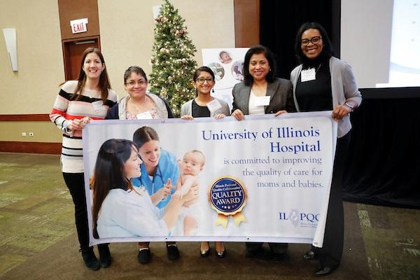
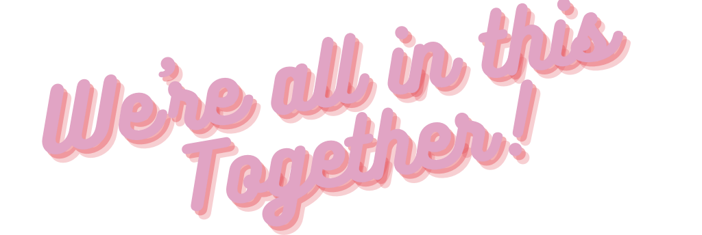
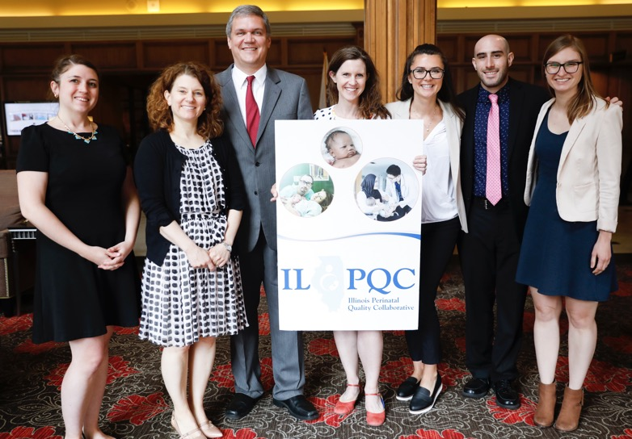
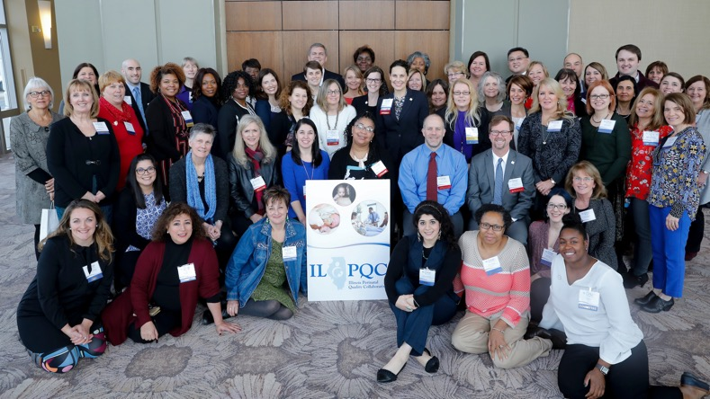

Slide 14


