Slide 1

BASIC Hospital ​Teams
Panel Shares
Real-World Approaches ​
2022 Virtual Neonatal​
Face to Face Meeting

Slide 2






ILPQC Team Panel Discussions
Actionable Strategies
Motivating Discussions
Share Experiences
Align Initiative Goals
Build Community
Move Forward Together
Notes:
-objective of Team Panel session
--share actionable strategies
--motivating discussions
--share experiences
--align initiative goals
--build your community
-move forward together
--community and teams, share and learn from each other, collaborations

Slide 3
BASIC Key Strategies
Right Antibiotics, Right Babies, Right Amount of Time
EOS Risk Assessment Tools/Guidelines
Antibiotic Time-out
Automated Stop Orders
Standardized PARENT/FAMILY education, focus on equitable care to families
Standardized HEATLHCARE TEAM education on BASIC best practices
Standardized Dosing Guidelines
Notes:
-objectives of session
-key strategies and resources (toolkit)
--community and teams, share and learn from each other, collaborations
-

Slide 4
BASIC Teams Panel
Rachel Varghese, MSN, RN & Genevieve Field, BSN, RN
  Northwestern Medicine Huntley Hospital
Dr. Laura Seske, MD, MS & Adelaide Caprio, MSN, APRN, ACCNS-N, RNC-NIC
  Rush University Medical Center
Dr. Rajeev Kumar, MD
  John H. Stroger, Jr. Hospital of Cook County

Slide 5
Rachel Varghese, MSN, RN &
Genevieve Field, BSN, RN
Northwestern Medicine Huntley Hospital

Slide 6





Northwestern Medicine Huntley Hospital
NM Huntley
Regional Destination for Women’s Health
20 Obstetrics Beds
8 Labor and Delivery Rooms
2 C-Section Rooms
6 Level II ICN-Intermediate Care Nursery

Slide 7
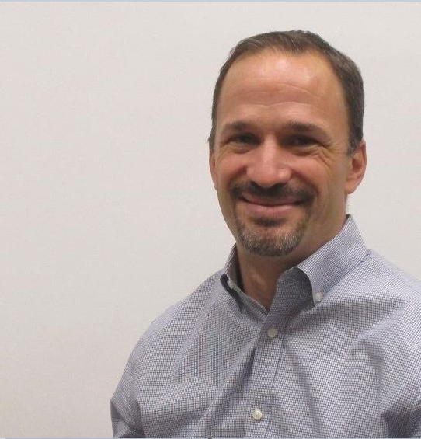
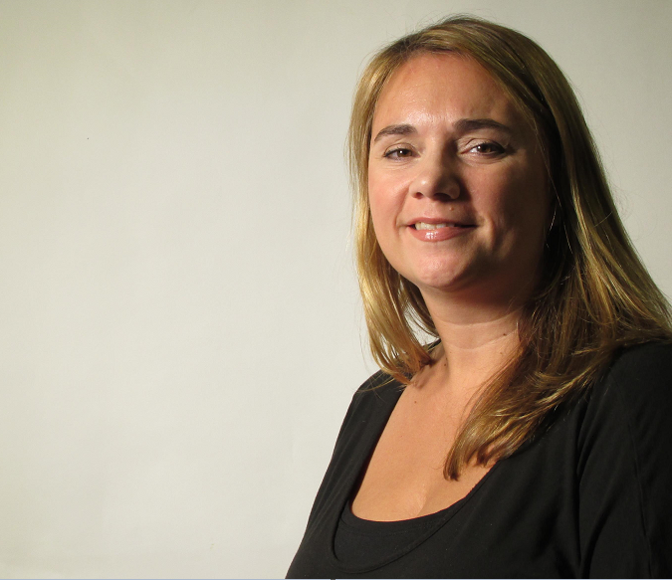
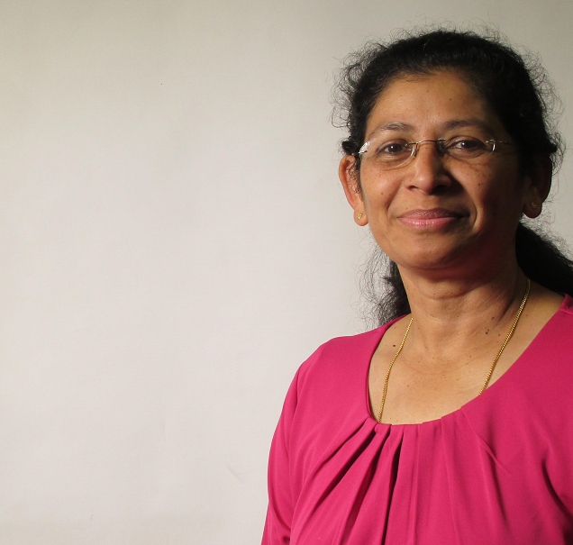

Our QI Team
Dr. Bill Reda
Neonatologist
Genevieve Field
Nursery Nurse
Rachel Varghese
Clinical Practice Nurse
Close collaboration with a multidisciplinary team including:
Quality
Pharmacy
Pediatrics
Informatics & Analytics

Slide 8
Project Milestones
February 2019
November 2020
October 2021
April/May 2022
First PDSA cycle improvement work began
ILPQC BASIC Initiative Launch
EOS Calculator and Documentation Go-Live in Epic
Order Set Optimization and Report Development.
Implemented education and use of Kaiser Permanente EOS online calculator
Northwestern System Project Kick-off. Developed NEOSC patient education
NEOSC Education flyer translated to Spanish and linked within Epic
March 2019
September 2021
January 2022

Slide 9
BASIC Data
ILPQC Goal: Decrease by 20% or an absolute rate of 4% for newborns ≥35 weeks receiving antibiotics
12 month Rolling Average=2.6%
[Lower is better]
Data includes months with qualifying cases. Other months removed from data set.

Slide 10

Key Strategies for Success
EOS
Reporting
Early Education
EMR Optimization
Antibiotic Time-Out

Slide 11
Dr. Laura Seske, MD, MS &
Adelaide Caprio, MSN, APRN, ACCNS-N, RNC-NIC
Rush University Medical Center

Slide 12
Rush University Children’s Hospital
This is a BASIC Presentation
Adelaide B. Caprio, MSN, APRN, ACCNS-N
Neonatal Clinical Nurse Specialist
Laura M. Seske, MD, MS
NICU Director of Quality Improvement & Patient Safety
5.26.2022
ILQPC Neonatal Face to Face Meeting

Slide 13

Overview
Urban hospital downtown Chicago, IL
Perinatal Administrative Referral Hospital with Maternal-Fetal Medicine Program
2633 Deliveries in 2021
72 bed level 3 NICU
    822 NICU admissions in 2021
    95 VLBW infants
Pediatric Surgery & ECMO Center
24/7 coverage in house with Attendings, Residents, APPs, and Fellows in NICU

Slide 14
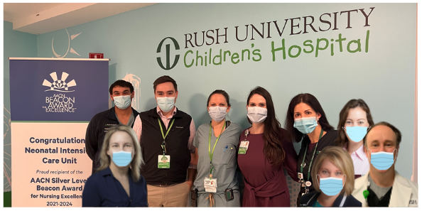
Our Team
Andrew Berenz, MD: Associate Medical Director, Neonatal ICU
Adelaide Caprio, MSN, APN, ACCNS-N, RNC-NIC: Neonatal Clinical Nurse Specialist
Kim Carmignani, MSN, RNC-NIC, PCN, NEA-BC: Unit Director – NICU
Kristen Click, Pharm D: NICU Pharmacist
Carrie Drazba, MD: Medical Director, General Care Nursery
Raymond Garay, APN: Neonatal Nurse Practitioner
Colleen Nash, MD: Pediatric Infectious Disease
John Overby, BSN, DNP, RNC-NIC: NICU Educator
Laura Seske, MD, MS: Director of Quality Improvement & Patient Safety, Neonatal ICU
Betty Vu, MD: Pharm D
Nursing Student Data Entry Specialists:
Jennifer Goodfriend
Emma Buechs

Slide 15
Our Story
Data Collection
Baseline Data & Ongoing Data collection entered by Nursing Students from Rush’s College of Nursing
Interventions
Automatic Stop Time was in place
Opportunities
Evaluation of antibiotics given in the absence of risk factors other than prematurity when delivery occurs purely for maternal indications.
Further analysis of Social Determinants of Health and outcomes related to newborn sepsis.
Culture Negative Sepsis Management
36 is the new 48
EPIC Reports:
Verified by CNS
Helpful in identifying patients retrospectively
Daily needs assessment was in place
ILPQC Grand Rounds – completed Dec 2021
Education for family – standardized! – but distribution and documentation pending.
Kaiser Calculator Pending (order sets, dot phrases, workflows with standardized vital signs and algorithms created to decrease variability of notification to providers) and staff education on workflows
Include demographics and insurance status

Slide 16
Strengths
Good buy-in. Providers are excited to have this!
Motivated to do it right and have all workflow and processes accurate
Key stakeholders remain actively involved
Nursing students are amazing
  Data entry
  Family education material development

Slide 17
Challenges
Only 24 hours in a day
AND multiple competing initiatives
Initial customization of flowsheet and utilization of different incidence rate than CDC
Analyzed additional data and will now utilize same incidence rate throughout Rush’s System – consistent with CDC’s recommendation
EPIC holds for upgrades & implementations
Multiple Dimensions:
Units & Divisions
Hospitals in System
Providers & Disciplines
Approval Processes

Slide 18
Challenges
  Data Reporting Structure
  All reports pulled and verified by Neonatal ICU CNS
    Students help enter these data
COVID:
Especially Omicron Variant
BASIC Parking lot due to:
  Personnel availability
    Service
    Calls
    PTO
    Conferences
    Clinic
    Maternity Leaves
    Etc.
  36 is the new 48
  Need to use EOS Calculator before a move toward
  “36 is the new 48”

Slide 19
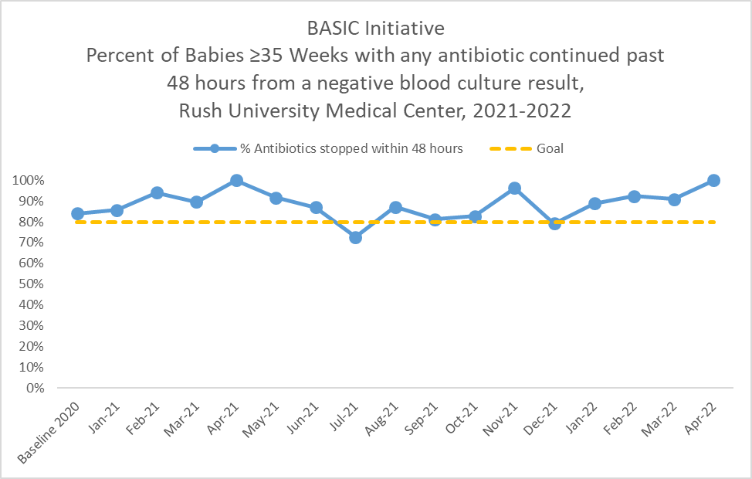
RUMC: Antibiotics Discontinued

Slide 20
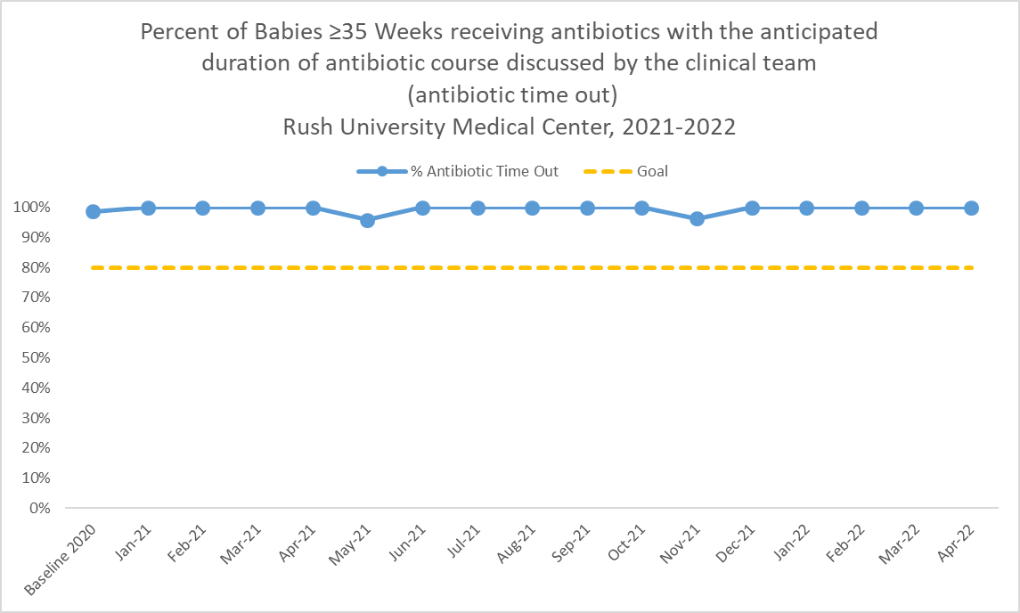
RUMC: Antibiotic Time Out

Slide 21
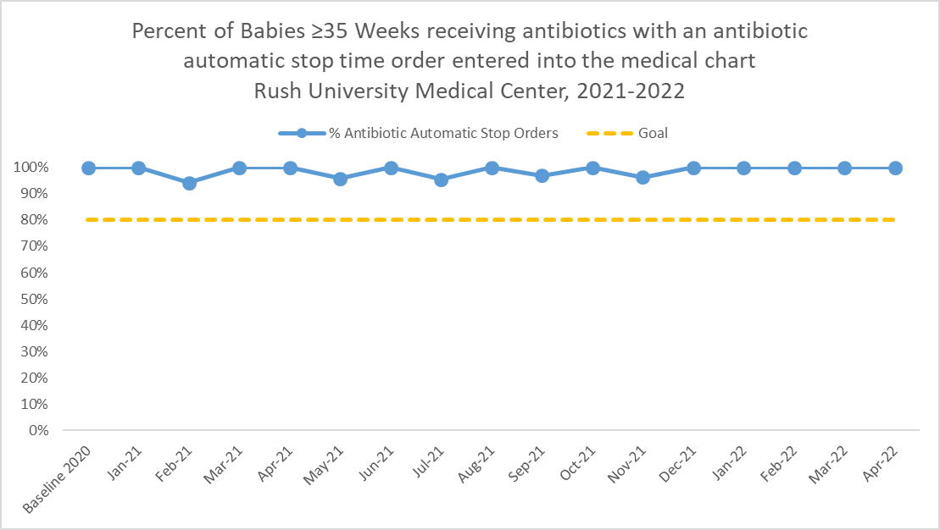
RUMC: Automatic Stop Order

Slide 22
What questions do you have?

Slide 23
Thank You!

Slide 24
Dr. Rajeev Kumar, MD
John H. Stroger, Jr. Hospital of Cook County

Slide 25

Lessons Often Come Dressed Up
As ROADBLOCKS!...
Rajeev Kumar, MD
John H. Stroger Jr., Hospital of Cook County
Chicago, IL

Slide 26
John H. Stroger Jr.,
Hospital of Cook County
Level-III NICU and Perinatal Center
Subspecialities including Pediatric Surgery
Maternal and Neonatal Transfers from Level-II Hospitals
No Private Pediatricians
In-house Nursery Coverage
Pediatric and Family Medicine Residency
Neonatal Fellowship
Cerner/PowerChart

Slide 27
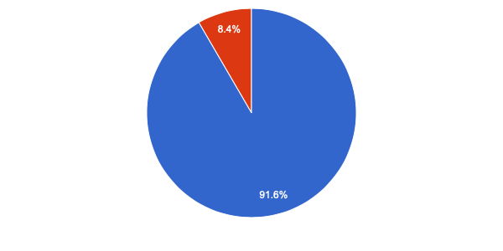
Inborn vs Outborn
Births

Slide 28
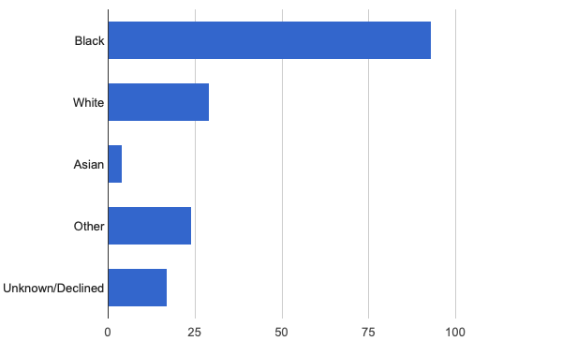
Race

Slide 29
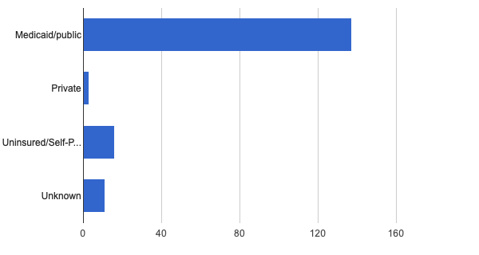
Insurance Status

Slide 30
Objectives
Neonates Born at ≥35 0/7 Weeks’ Gestation With Suspected or Proven Early-Onset Bacterial Sepsis
1. Percent of newborns ≥35 weeks who received antibiotics within 72 hours of life by 20%. Our baseline usage rate was 15.74% and the goal was to reduce it to 12.6%.
2. Reduce the number of babies receiving antibiotics beyond 36 hours with negative blood cultures by 20%.

Slide 31
Fish Bone Diagram
Limiting Antibiotic usage and duration in Newborns >=35 weeks
Policy - BASIC guidelines implementation
Procedure -EMR , Pharmacy Hard stop, Huddles
Monitoring and Feedback
Physicians
Nurses
Microbiology lab
People
Performance Compliance

Slide 32
AIMS
Primary Drivers
Change Ideas
Create multidisciplinary antibiotic stewardship QI team
Educate healthcare team on best practices
Educate and support partners and family
By June 2022
Implement QI infrastructure
Monitor & share transparent antibiotic data
A. Decrease by 20% (or absolute rate of 4%) the number of newborns, born at ≥35 weeks who receive antibiotics
B. Decrease by 20% the number of newborns with a negative blood culture who receive antibiotics for longer than 36 hours
Coordinate with IT to implement reporting system
Review transparent data and debrief with providers
Standardize risk assessment for early-onset sepsis (EOS)
Communicate with OBs to share maternal risk for EOS
Implement protocols for serial assessment with response to the worsening status
Initiate timely and appropriate antibiotics
Consistently obtain blood cultures
Partner with inpatient lab to process blood culture results
De-escalate therapy based on culture and sensitivity results
Implement pharmacy protocols to assure appropriate use
Standardize dosing guidelines and order sets
Implement a process to discuss antibiotic duration and course
Implement automatic stop order processes
Administer and de-escalate antibiotics
Provide training and education on social determinants, cultural sensitivity, and implicit and explicit bias
Develop QI efforts to ensure care to eliminate disparities
Identify social determinant needs of families and link them to resources
Implement a process to assist families after discharge
Deliver equitable care

Slide 33
PDSA 1
Team building.
Introduction to Division.
Sepsis calculator use and documentation.
Nursing staff educated.
Educate nursing staff to draw appropriate amount of blood for blood cultures.
Assign Personnel responsible for data collection.
Created our own blood culture tracking system. ​
Monthly report of antibiotic use. ​
Monthly admission reports from NICU and newborn nursery.​
Newborn forms filled at admission if baby was started on antibiotics.
30 day
  Identify QI team- Team leader, leadership involvement, Nursing leadership, Pharmacy, Infectious disease specialist, and OB leadership involvement.
  Education of Physician and Nursing staff.
60 day
  Blood Culture tracking and data collection.
  Standardize Blood draw.
90-day plan
  Antibiotic automatic stop orders.
  IT department involvement.
  Sepsis calculator documentation.

Slide 34
Workflow Changes
Use of sepsis calculator and documentation in NICU and newborn nursery.
Flagged babies with Equivocal symptoms for close observation.
All nursery babies received q 4 hour vital check.
Automatic stop orders.
Physician documentation why antibiotics were continued past 36 hours.

Slide 35
PDSA 2
Feedback provided to physicians in quarterly QI meetings.​
Standardized OB communication form.​
Improved blood culture and data tracking system. ​
Included Antibiotic stewardship in morning huddles. ​
Made sure it is being discussed
Ensured compliance of physician and nurses.
Reeducation of staff.
Create H & P template with Sepsis calculator.
Data reviewed and presented.
30 day
  Feedback and Reeducation.
  Assess blood culture tracking system and data collection.
60 day
  Improve blood culture tracking system.
  Improve OB communication.
90-day plan
  Include antibiotic stewardship in morning huddles.
  Work with IT department.
  Improve data collection.
  Improve Documentation.

Slide 36
PDSA 3
Started using parent education tool.
Made sure documentation was appropriate.
Feedback to physicians.
Ensured compliance.
Data presentations and feedback.
30 day
  Improve documentation.
  Improve parental education.
60 day
  Improving parent education using Education tools
  Reassess the Blood tracking and Data collection systems and compliance/feedback to workflow changes
90-day plan
  Improve parental education and involvement.

Slide 37
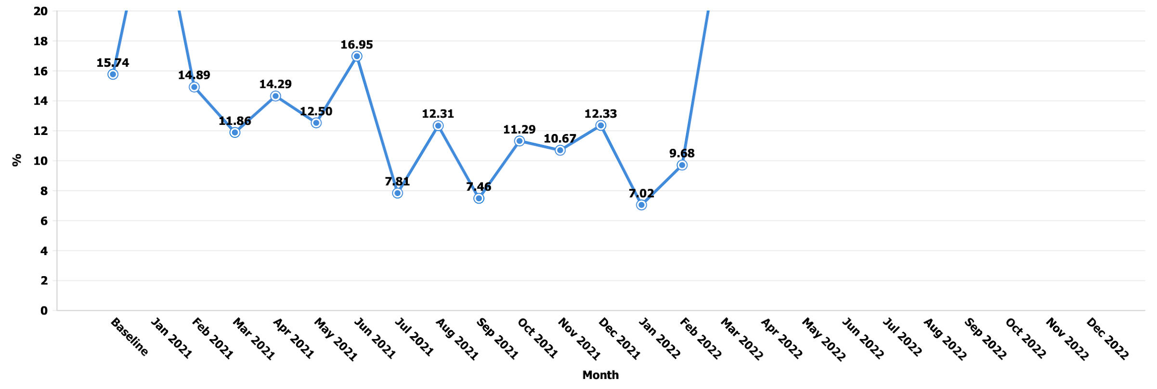
Percent of newborns >=35 weeks who received antibiotics within 72 Hours

Slide 38
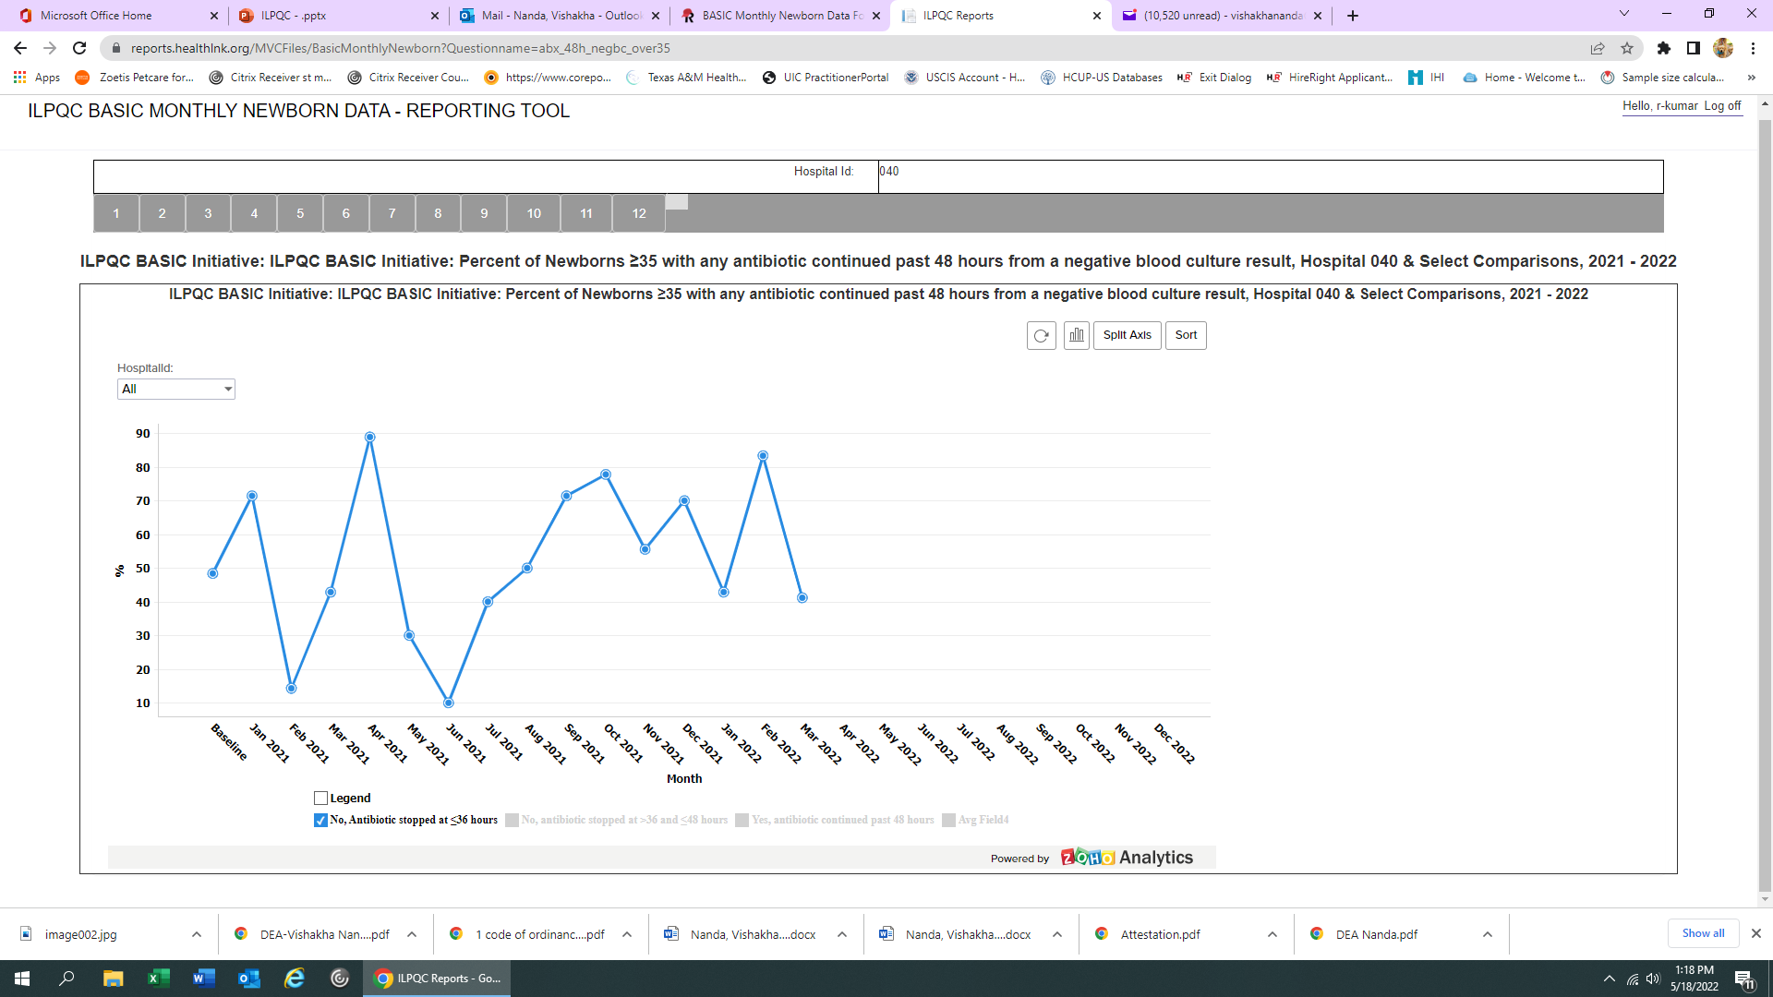
Percent of Newborns >=35 weeks who received antibiotics <=36 Hours

Slide 39
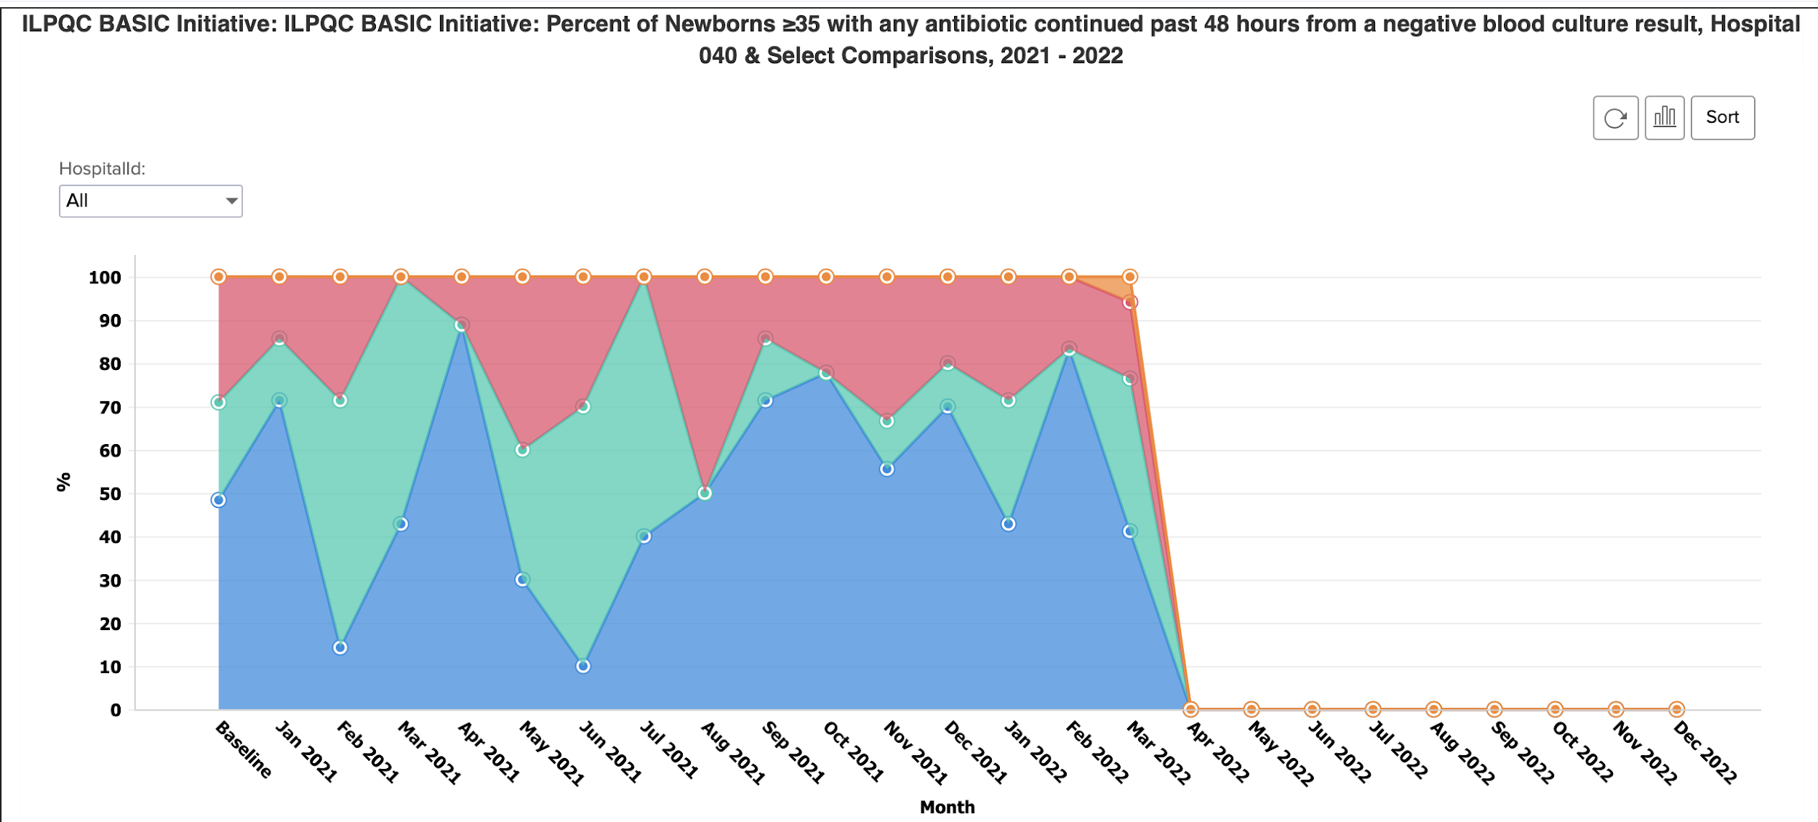
Duration of Antibiotics: Percent of Newborns >=35 weeks

Slide 40
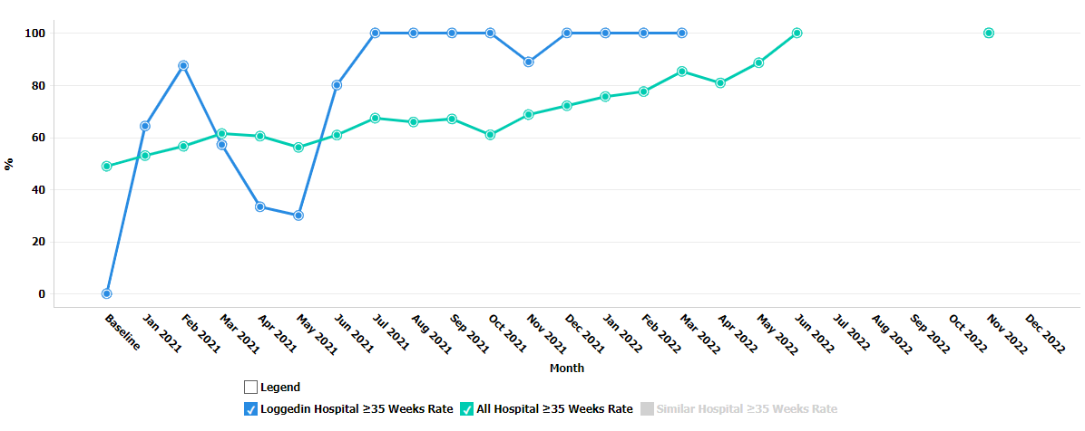
Percent of Newborns >=35 weeks with a Risk Assessment Tool used and documented

Slide 41
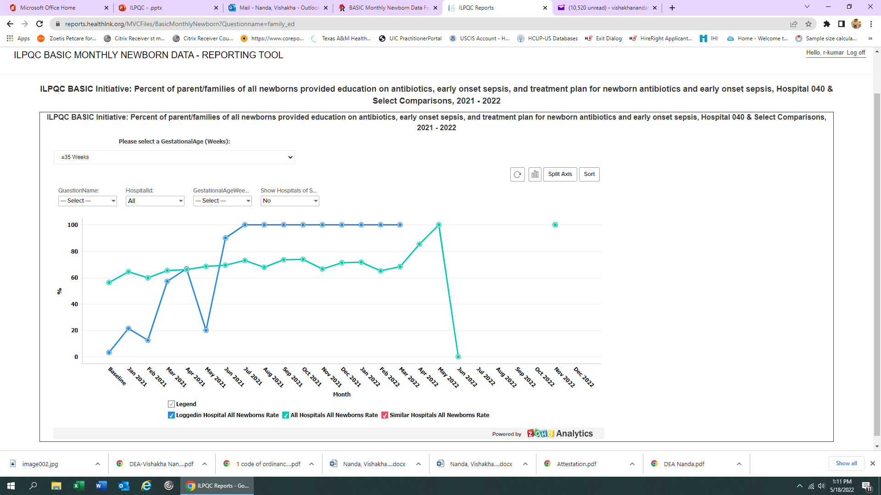
Percent of Parent/Families of All Newborns Provided Education on
Antibiotics, EOS and Treatment Plan

Slide 42
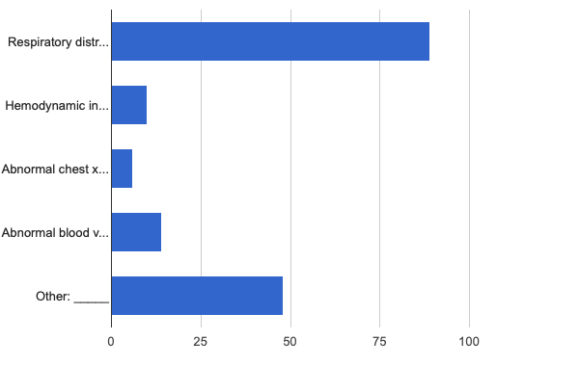
Reason for Continuing Antibiotics

Slide 43

Things That Worked:
Morning Huddles.
Automatic antibiotic stop orders.
Education and feedback.
Buy-in from the providers and staff.
Leadership support.
Team effort.

Slide 44
Challenges:
System issues.
Rapid turnover of support staff.
COVID surge.
Provider specific data collection and feedback.

Slide 45
Future Goals
Change antibiotic stop order to babies receiving antibiotics beyond 36 hours.
Bring the absolute antibiotic use to less than 5%.
Reduce antibiotic use in preterm babies.
Improve communication.
Equitable care.

Slide 46
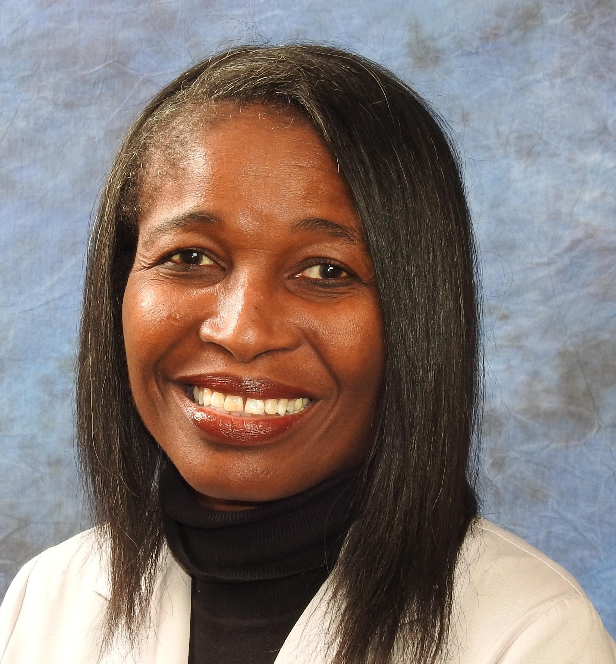
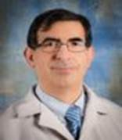
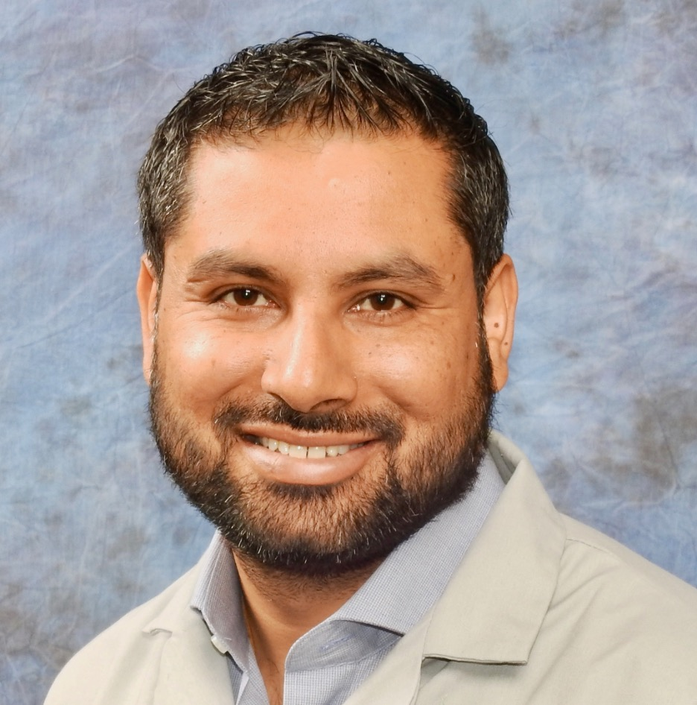
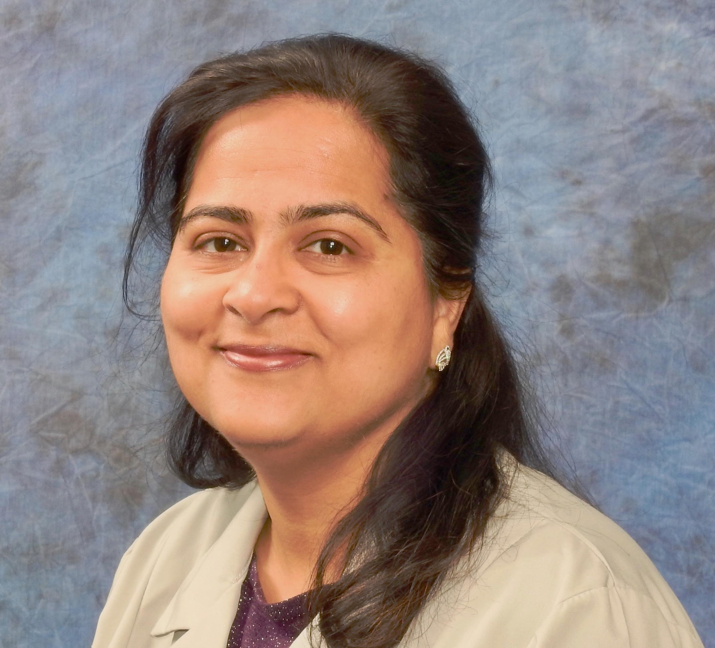
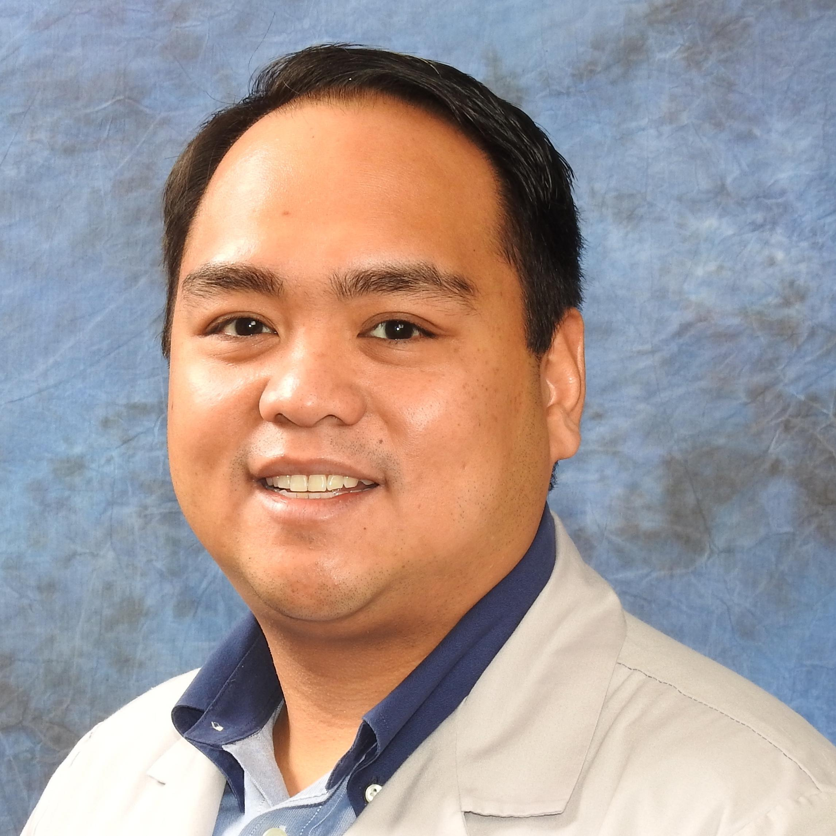
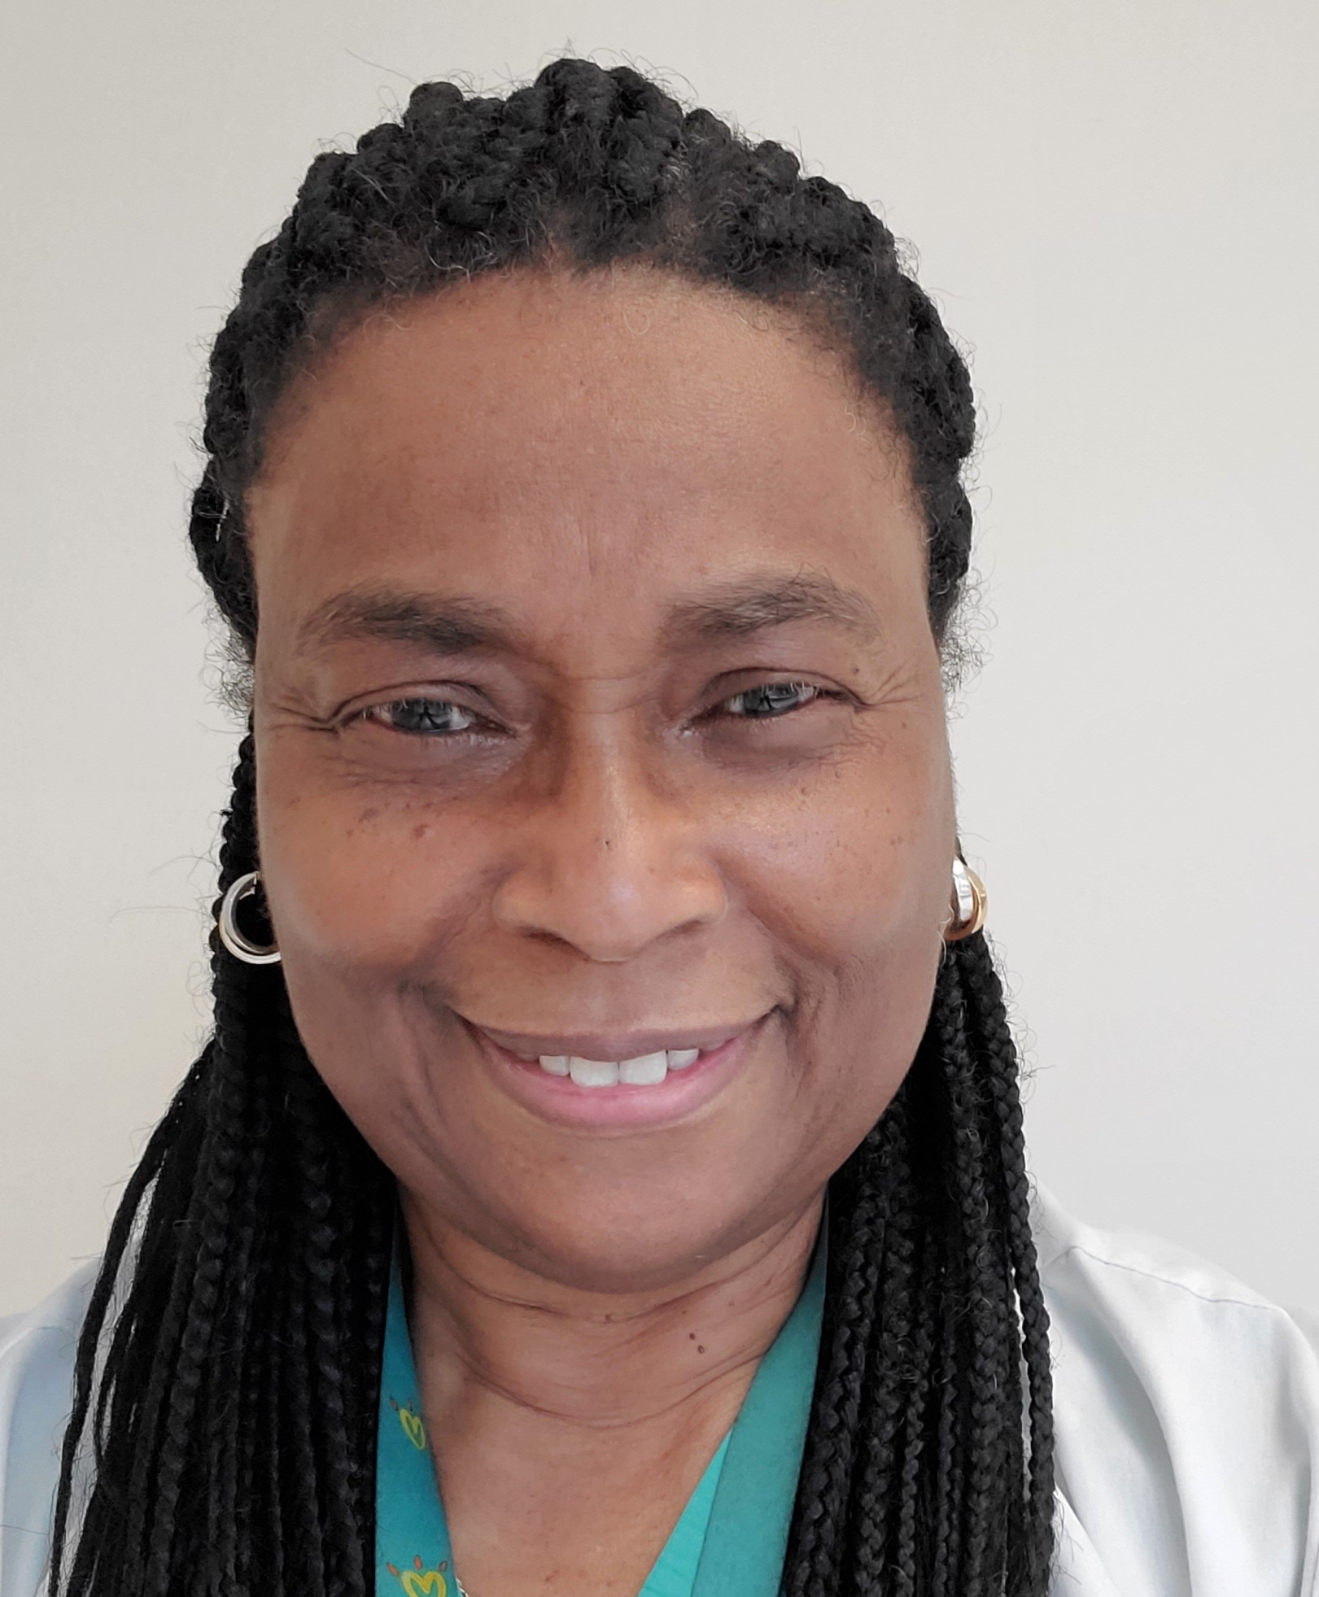
Leadership Team
Mope Akintorin
Manhal Khilfeh
Q.I. Team
Photo Not Available
Photo Not Available
Rajeev Kumar
Vishakha Nanda
Andrew Altiveros
Pam Botchway
Phyllis Jackson

Slide 47

Questions?
Notes:
3 questions (noted in internal agenda)

