Slide 1
The Right Antibiotics for Right Babies for the Right Amount of Time
Going for Gold in 2022
Notes:
Goal: divide up the vision
Why are we doing this, why is it important in general
Right antibiotics (what structure measures, what we achieved, what we need to focus on in 2022 )
Right Babies (what structure measures, what we achieved, what we need to focus on in 2022 )
Right Time (what structure measures, what we achieved, what we need to focus on in 2022 )
Fewer antibiotics equal more kisses ;)
JB

Slide 2
Let’s take it back to the BASICs
Unnecessary or prolonged antibiotic exposure
Increased risk of NEC
Mother-baby separation
Higher costs of care
Impaired development of intestinal microbiome
Unnecessary IV placements
Antibiotic resistance
Notes:
*What is our WHY?
Why are we doing this
Why is it important in general

Slide 3
BASIC Vision
ILPQC hospitals, regardless of perinatal level or experience with newborn antibiotics initiatives, will implement best practices to provide:

Slide 4
BASIC AIMs
Decrease by 20% (or absolute rate of 4%) the number of newborns, born at ≥35 weeks who receive antibiotics
Decrease by 20% the number of newborns with a negative blood culture, who receive antibiotics for longer than 36 hours
Initiative Success!

Slide 5
BASIC Clinical Culture Change
Old Culture
New Culture in Progress…
EOS Risk Assessment Guidelines
Unwarranted
Practice
Variation
Time-Outs & Automated Stop Orders
Standardized Parent/Family Education
Standardized Dosing
Guidelines
Notes:
*Our progress to change culture, focusing back on the basics of our why

Slide 6
Keep it BASIC with Structure Measures
Right Antibiotics
Standardize Dosing Guidelines
Right Babies
EOS Risk Assessment Protocols for ≥35 and <35 Newborns
Standardized Parent/Family Education
Right Amount of Time
Antibiotic Discussions/Time Outs Protocol
Standardized Automatic Stop Order Process
Notes:
*discuss how structure measures align with our vision
*discuss the concept of:
*Right antibiotics (what structure measures, what we achieved, what we need to focus on in 2022 )
*Right Babies (what structure measures, what we achieved, what we need to focus on in 2022 )
*Right Time (what structure measures, what we achieved, what we need to focus on in 2022 )

Slide 7
BASIC: Making Systems Change Happen
75% standardized healthcare team education
65% standardized family education
86% ≥35 EOS Risk Assessment
73% <35 EOS Risk Assessment
89% standardized dosing guidelines
80% standardized antibiotic debriefs/
"Time Outs"
76% standardized antibiotic automatic stop orders
Notes:
JJ: Can we have roughly the same order as in the slide “Keep it BASIC”
75% healthcare team education
95% providers educated
95% nurses educated
65% patient education
86% >35 risk assessment
73% <35 risk assessment
89% standardized dosing guidelines
80% Time outs
76% automatic stop orders
*data slide connecting dots to have antibiotic
Ex: % of teams who have time out structure measure are actually doing timeouts
Ex: % of teams who have actual stop at 36 hours vs those who don’t
Falling out of award of criteria:
-timeouts and stop times
THEME: Why we think structure measures are important
Greater than 35 weeks risk assessment protocol-is this our most important structure measure??

Slide 8
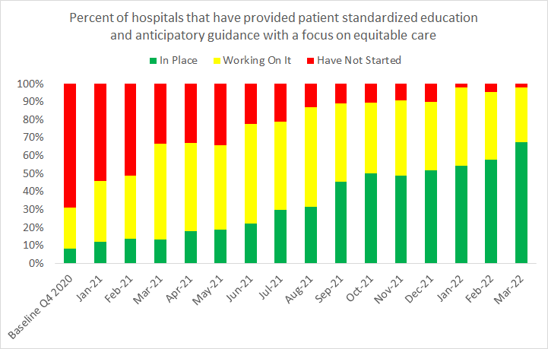
Get to GREEN to Succeed
EOS Risk Assessment Protocols for ≥35 and <35 Newborns
Standardized Dosing Guidelines
Antibiotic Time Out (Huddle) Protocol
Standardized Automatic Stop Order Process
Standardized Patient Education
Notes:
JJ: we need a slide that shows example structure measures getting to green from our data.
*discuss how these structure measures equals success in “crossing the finish line” with BASIC initiative
*facilitates clinical culture change that supports antibiotic stewardship
*standardized processes and protocols for the identification & response to support antibiotic stewardship
*implement strategies and processes to assist with equitable care delivery for all newborns

Slide 9
Right Antibiotics: Standardized Dosing Guidelines
Stay current with AAP antibiotic dosing recommendations
Educate healthcare team on AAP guidelines to establish best practices
Utilize ILPQC BASIC Toolkit for resources
Communicate updates to clinical teams
(email, daily huddles, boards, etc.)
Notes:
Why: reduces variation in care, expedites ordering process for a common clinical scenario, aligns clinical practice with BASIC AIMS, healthcare team educate together on best practices

Slide 10
Right Babies: Standardized EOS Risk Assessment Protocols
Standardize use of NEOSC as part of workflow
Educate on use of the NEOSC to ensure consistency
Determine best integration method for your hospital
Develop systematic process for documentation of EOS risk
Notes:
Why: Increase percentage of physicians and nurses educated about early-onset sepsis (EOS) risk factors, assessment tools, and guidelines & Increase percentage of newborns with documented use of EOS risk assessment tools at delivery

Slide 11
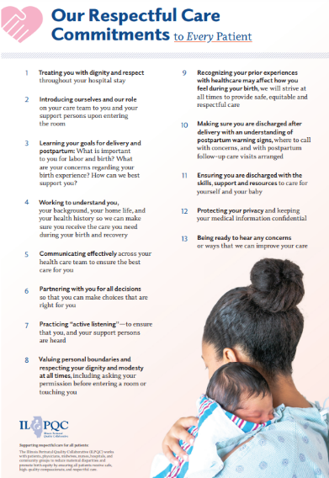
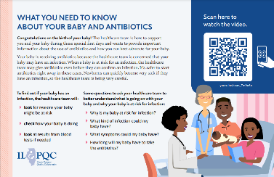
Right Babies: Standardized Parent/Family Education
Standardized workflow providing education to every parent/family every time
Equitable, Respectful care practices for neonatal patients and their families

Slide 12
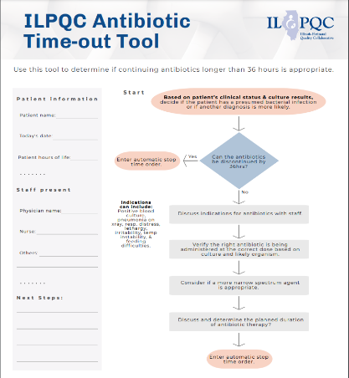
Right Amount of Time: Antibiotic Time Out Process
Process for every baby, every time
Brief team antibiotic length/plan discussion
Use ILPQC Time out tool or similar process
Standardized antibiotic timeout workflow
Notes:
Why: Increase percentage of newborns with care team discussing and documenting plan for length of antibiotic course for standardization
*Paint a workflow for teams to follow
Understand the "process" for teams to follow, not just about the timeout tool (one way to get to green, not the only way)

Slide 13
Right Amount of Time: Standardized Automatic Stop Order Process
PDSA Part 1:
Standardized Workflow/Process
Next Steps:
Ensuring every baby, every time
PDSA Part 2:
Implement Process in EMR
QI team, IT, & Pharmacy collaborate
Act: Adopt, adapt, abandon
Plan: Educate team on tools, guidelines
Study: Determine if pilot workflow effective
Act
Plan
Do:
Implement pilot workflow
Study
Do
Notes:
Why: Increase percentage of physicians and nurses educated about early-onset sepsis (EOS) risk factors, assessment tools, and guidelines & Increase percentage of newborns with documented use of EOS risk assessment tools at delivery
*

Slide 14
Aim for the BASICs to GET to GREEN
Basic Vision
Focus on Structure Measures
Clinical Culture Change
Better Outcomes!

Slide 15
Getting to Green with our Community
Review
Listen
Participate
Network
Review Informative Storyboards!
Steal Shamelessly, Share Seamlessly (Part 1)
Listen to BASIC Hospital Teams Panel share!
Steal Shamelessly, Share Seamlessly (Part 2)
Participate in Interactive Breakout Sessions!
Cameras & Mic on
Network, Network, Network!
Reach out to info@ilpqc.org if you want to connect with a hospital
Notes:
*a lot of information was just thrown their way
*simplify the “next steps” with focus & engagement in the next parts of the agenda/day
--storyboards
--BASIC hospital teams
--interactive breakout sessions (remember camera on, audio working)
--network/collaborate with other hospitals, gain new friends and strategies

Slide 16
This is BASICally the Best Part!
Join us in the
Neonatal Breakout Sessions
36 is the new 48
"We only see a few babies"
BASIC Clinical Culture Change
Strategies to get the most out of the ILPQC Data System
EOS Risk Assessment <35wks

