Slide 1
Partnering with Parents on your QI Journey
LaToshia Rouse, CD(DONA)

Slide 2
Partnering with Parents on Your QI Journey
IPFCC Faculty
NNPQC Co-Chair
ABP Board of Directors
NICHQ Board of Directors
Engagement Consultant
Birth and Postpartum Doula
Patient Educator
LaToshia Rouse, CD(DONA)

Slide 3
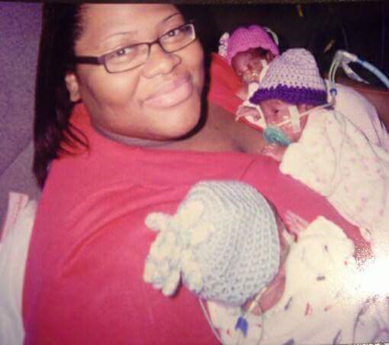
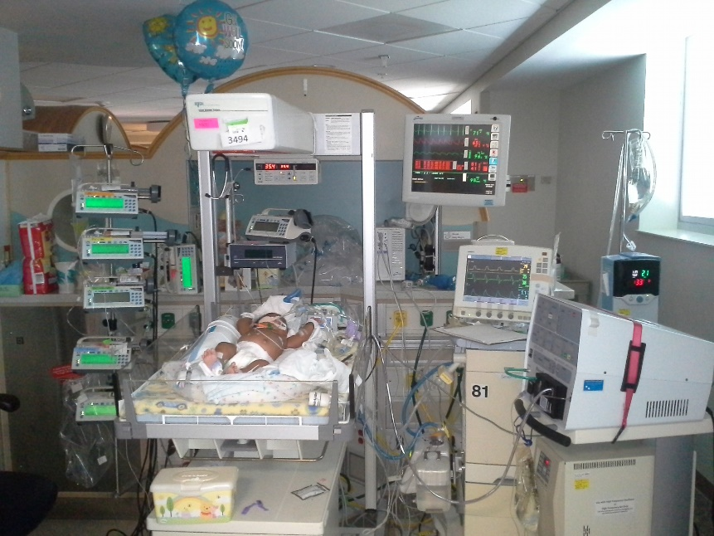
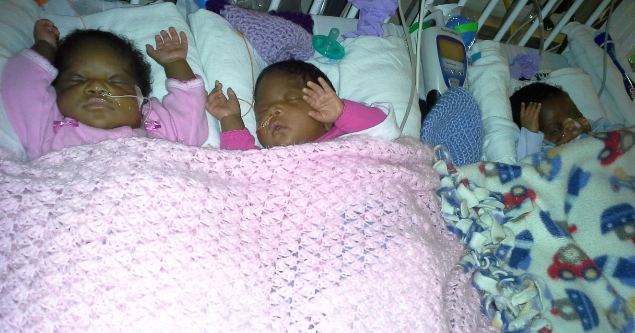
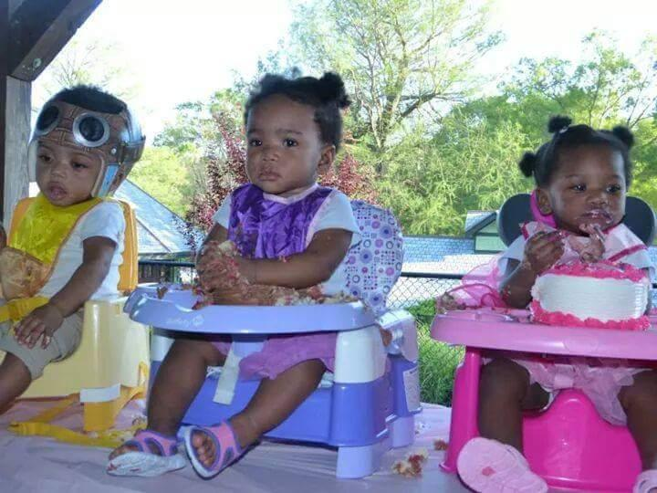

Slide 5
What does a parent and family partner offer to a quality improvement team?
Holders of new information
Feedback from a parent’s perspective on your policies, your method of distributing information, and your ways to engage families at the beside
Timely feedback on care experiences well before the customer service surveys are completed by families
A story to accompany the data that can be told from an educated patient perspective
Help with parent education from a parent perspective

Slide 6
Core Concepts of Patient- and Family-Centered Care
Dignity and Respect
Information Sharing
Patient Engagement
Participation
Collaboration
Adapted from: Johnson, B. H. & Abraham, M. R. (2012). Partnering with Patients, Residents, and Families: A Resource for
Leaders of Hospitals, Ambulatory Care Settings, and Long-Term Care Communities. Bethesda, MD: Institute for Patient- and Family-Centered Care
Notes:
Dignity and Respect- Health care practitioners listen to and honor patient and family perspectives and choices. Patient and family knowledge, values, beliefs and cultural backgrounds are incorporated into the planning and delivery of care.
Information Sharing- Health care practitioners communicate and share complete and unbiased information with patients and families in ways that are affirming and useful. Patients and families receive timely, complete and accurate information in order to effectively participate in care and decision-making.
Participation- Patients and families are encouraged and supported in participating in care and decision-making at the level they choose.
Collaboration- Patients, families, health care practitioners, and health care leaders collaborate in policy and program development, implementation and evaluation; in research; in facility design; and in professional education, as well as in the delivery of care.

Slide 7
This is a culture change.
Culture will eat strategy for breakfast, lunch and dinner.

Slide 8
Building a Space for Collaboration with the Communities you serve.
C Suite
Managers
Directors
Change
Medical
Staff
Other Hospital
Staff
Administrative
Staff
Patients

Slide 9
Methods to Engage Patients in QI
1. Interviews
2. Focus/ workgroups
3. Questionnaires/ Surveys
4. Townhall meetings/ Listening Session
5. Conferences/ Workshops
6. Co-Design on QI Teams
7. PFACs
Notes:
Poll to see if anyone has used these

Slide 10
Reflection/ Evaluation
Awareness
You don’t have to be perfect.
Problem Solving Wheel
Action
Information / Gathering
Visioning/ Planning
Analysis
©dRworks

Slide 11
1:1 Interviews
Focus Groups
Quality of Info
Pros
Cons
Targeted Information, detailed- Dynamic evolving Communication
Great Context
Relevant solutions
Time consuming if doing several
Could be a delayed response

Slide 12
Focus Groups
Focus Groups
Quality of Info
Pros
Cons
Broader range of information received on a specific topic – Bilateral Communication
Insights into patient family experience beyond what we might have assumed
Minimal effort for high return of information

Slide 13
Questionnaires/Surveys
Focus Groups
Quality of Info
Pros
Cons
Somewhat diluted from delayed & diffusion of experience – unilateral
Targeted information
Financial, Dissemination, Context may be difficult to determine

Slide 14
Townhall/Listening Sessions
Focus Groups
Quality of Info
Pros
Cons
Broader range of information received on a wide range of topics– bilateral
Insights into patient family experience beyond what we might have assumed
Minimal effort for high return of information
Information may be difficult to act upon

Slide 15
Conference/Workshops
Focus Groups
Quality of Info
Pros
Cons
Highly relevant – Patient Family Partners work on a specific topic
Dynamic Communication
Teams learn together
Builds bonds
Great for new partnerships
Moderate Effort if you organize these
Financial Resources

Slide 16
Co-Design
Focus Groups
Quality of Info
Pros
Cons
Highly relevant – Patient Family Partners continuously inform improvement efforts across the organization-
Dynamic
360 degree understanding of improvement needs of the organization
led to changes in the health care delivery systems
Moderate amount of staff time and financial resource

Slide 17
PFACs
Focus Groups
Quality of Info
Pros
Cons
Highly informative on a continuous basis, dependent on relationship of trust & relevance to the organization-
Reciprocal
A resource hard wired into the hospital so that your patients and families continuously inform improvement
Moderate amount of staff time and financial resource required.

Slide 18
Strategies for Integrating Patient Partners on Committees/Projects
Step 1
Onboarding
Provide information to provide to Partners. (Time commitment, date, what to expect in meeting, etc.)
Step 2
Match Interests
Make every effort to match the interests of the Partners to the topic of the committee or project.
Step 3
Preparation
Connect the Partner with team liaison to provide more information on the meeting topic. Plan a 30 minute meeting for 1:1 time with Partners and allow time for questions.
Step 4
Follow Up
Follow up soon after the first encounter with a new team. Provide additional resources and answer questions.
Did they have everything they needed to participate effectively?
Notes:
Make every effort to match interests
Provide additional Preparation
Identify low hanging fruit first
Send PFA teams of 2
If not possible, Point Person should be available to accompany to first meetings/encounters
Follow up soon after encounter
Additional resources needed
Increased understanding of concepts

Slide 19
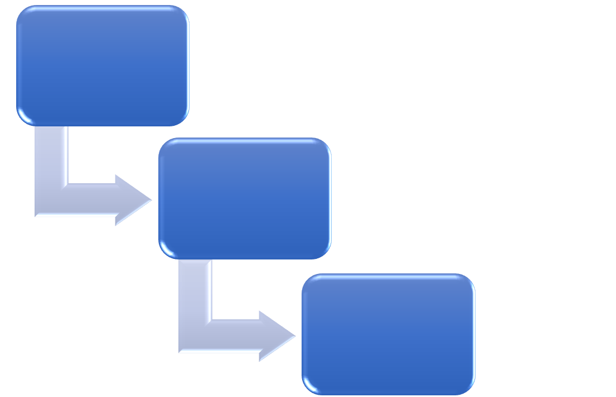
Sharing Best Practices and strategy
How to Select and Recruit PFPs
How to tell a story and use a story
Listening to Patients
Planning and Sustainability
Improving Outcomes with PFE
Wins, Barriers, and Opportunities
Creating a Culture of PFCC
Start of Series
How to Tell and Use a Story
Levels of Engagement
Levels of Engagement
ILPQC Toolkit via website
Notes:
Culture eats strategy for breakfast, lunch and dinner.

Slide 20
Family Centered Care is not something you do for a family, it’s something you do WITH a family.

Slide 21
THANK YOU FOR YOUR IMPACT ON CARE! Any questions? contact@latoshiarouse.com

