Slide 1
ILPQC Awards Ceremony:
10:55am-11:15am

Slide 2
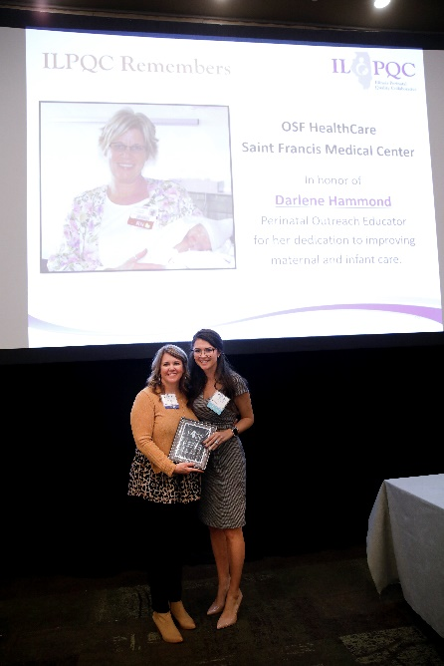
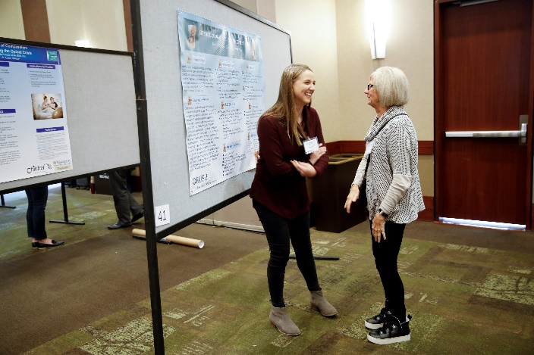
What is coming up next
10:55-11:15am: ILPQC Award Ceremony
QI Data Champions
MNO-Neo QI Excellence Awards
BASIC QI Recognition Awards
Storyboard Awards
11:15am-12:30pm: Team Storyboard Session – Opportunity to Share and Networking Lunch
Make sure to visit the Virtual Storyboard Session at the ILPQC Neonatal Face-to-Face webpage (www.ilpqc.org)
12:30pm: After Storyboards and lunch click on your main session link to return to the conference

Slide 3
QI Data Champions
Recognizing team's hard work in submitting monthly QI data to drive change at your hospital
All teams who submit complete baseline data through March 2022 are eligible to receive a $50 gift card per initiative for a QI team celebration
Teams are eligible for recognition through Friday, June 10th at Midnight!

Slide 4
QI Data Champions to Date: MNO-Neonatal
Advocate Children's Hospital - Park Ridge
Advocate Condell Medical Center
Advocate Good Samaritan Hospital
Ascension Saint Mary - Chicago
Ascension St Mary- Kankakee
Carle BroMenn Medical Center
Crawford Memorial Hospital
Edward Hospital
Elmhurst Memorial Hospital
HSHS St Mary's Hospital
Little Company of Mary Hospital
Memorial Hospital of Carbondale
Morris Hospital
NM Huntley Hospital
NM Kishwaukee Hospital
NM Lake Forest Hospital
Northwest Community Healthcare
Northwestern Memorial Hospital
Palos Health
Riverside Medical Center
Rush Copley
Silver Cross Hospital
SSM Health St Mary's - St Louis
West Suburban Medical Center

Slide 5
QI Data Champions to Date: BASIC
Advocate Aurora Sherman Hospital
Advocate Children's Hospital- Oak Lawn
Advocate Condell Medical Center
Advocate Good Samaritan Hospital
Advocate Illinois Masonic Medical Center
Alton Memorial Hospital
Ascension Alexian Brothers Medical Center
AdventHealth Hinsdale
Ascension Resurrection Medical Center
Ascension St. Mary’s Hospital- Chicago
Ascension St. Mary’s Hospital- Kankakee
Ascension St. Alexius Medical Center
Blessing Hospital
Edward Hospital
Elmhurst Memorial Hospital
FHN Memorial Hospital
HSHS St. John's Hospital
John Stroger Hospital of Cook County
Loyola University Medical Center
Memorial Hospital East
Memorial Hospital of Carbondale
Morris Hospital
NM Delnor Hospital
NM Huntley Hospital

Slide 6
QI Data Champions to Date: BASIC
NorthShore University HealthSystem Evanston
Northwestern Lake Forest Hospital
Northwestern Medicine Central DuPage Hospital
Northwestern Memorial Hospital
OSF Little Company Mary Medical Center
OSF St. Anthony Medical Center
OSF St. Francis Medical Center
Palos Hospital
Riverside Medical Center
Rush Copley Medical Center
Rush University Medical Center
SSM Health Good Samaritan Hospital
UI Health & Hospital System
West Suburban Medical Center

Slide 7
ILPQC QI Awards
Thanks to everyone for all of your hard work and congratulations to the award winners!
Please use the chat box to celebrate all the award winners
ILPQC will follow up with award winners to request contact & shipping information for certificates
If you have any questions, comments, or concerns about your award status, please email info@ilpqc.org

Slide 9
Notes:
Ann, start sharing screen

Slide 10
Team Storyboard Session – Opportunity to Share and Networking Lunch
11:15-12:30 pm

Slide 11
Virtual Storyboard Session
Can be found on the ILPQC Face-to-Face Webpage (link in your conference email or go to www.ilpqc.org and click Face-to-Face button).
Browse through all the Storyboards and make sure to check out and congratulate award winners!
Share what you learned on the Steal Shamelessly and Share Seamlessly Google form to win a $50 Visa Gift Card! Fill-out the quick link on the conference webpage to be put into a drawing to win a prize! Winners (3) will be announced at the 2:45pm Wrap-Up session. Must attend to win.
All links above available on Face-to-Face Webpage

Slide 12
Neonatal Storyboards
The virtual Storyboards enable teams to connect, collaborate and empower others to understand that QI successes are possible with small change, data, and teamwork.
Who: All Neonatal Face-to-Face participants
What: Review the Neonatal Storyboards to learn about the great work of ILPQC neonatal teams
Where:
Neo Face to Face link in your conference registration email
Face to Face button on ilpcq.org
When: 11:15 - 12:30 pm
Why: Collaboration and exchange of ideas – Share your excellent work across the state!
Example Hospital Storyboard

Slide 13
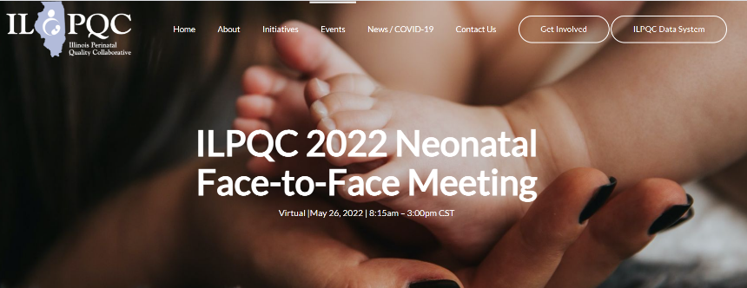
Scroll down to find storyboards

Slide 14
Accessing the Storyboards
Visit the ILPQC 2022 Neonatal Face-to-Face Event page and SCROLL DOWN!!!
Notes:
Screenshot of 2022 page to be updated

Slide 15
Congratulations ILPQC Storyboard Excellence Award Winners!!
Congratulations
Level II
Northwestern Medicine Huntley
Level II+
Ascension Resurrection
Level III
Advocate Lutheran General & Children's Hospital-Park Ridge
Notes:
to be filled in after PC votes

Slide 16
Thank you to all hospitals who shared Storyboards!

Slide 17
Next Steps – Come back at 12:30!
Go enjoy lunch!
Take time to browse the Neonatal Storyboards
Submit a Steal Shamelessly/Share Seamlessly form online by 2pm to be in the running for a Visa gift card
At 12:30pm after Lunch/Storyboard Review please come back to the same Zoom webinar link you used for the AM sessions

Slide 18
Afternoon Schedule
12:30 – 1:15 pm​ | BASIC Hospital Teams Panel Share Real-World Approaches BASIC teams to collaboratively share strategies
1:15 – 1:25 pm​ | Break​
1:25 – 2:00 pm​ | Breakout Session 1: Small Group Key Topic Discussions on Implementation Strategies 36 is the new 48: Moving to a 36-hour rule-out BASIC Clinical Culture Change: Leveraging Education, Debriefs, and Data “We only see a few babies”: Making your data work for you Strategies to get the most out of the ILPQC Data System Implementation strategies for Early Onset Sepsis Risk Assessment in newborns <35 weeks MNO-Neonatal Sustainability: Optimizing Coordinated Discharge Plans Taking the first steps to partner with parents on our QI journey
2:00 – 2:05 pm​ | Break​
2:05 – 2:40 pm​ ​ | Breakout Session 2: Small Group Key Topic Discussions on Implementation Strategies ​ (See above sessions)
3:15 – 3:30 pm​ | Wrap-up, evaluation, raffle and next steps for 2022 ​ ​ Leslie Caldarelli, MD; Justin Josephsen, MD

