Slide 1
Continuing our MNO-Neonatal Work amidst Increasing OUD Rates in Illinois

Slide 2
The Opioid Epidemic-US Impact
100,306 drug overdose deaths in past year
28.5% increase from year before
COVID
CDC NCHS Data

Slide 3
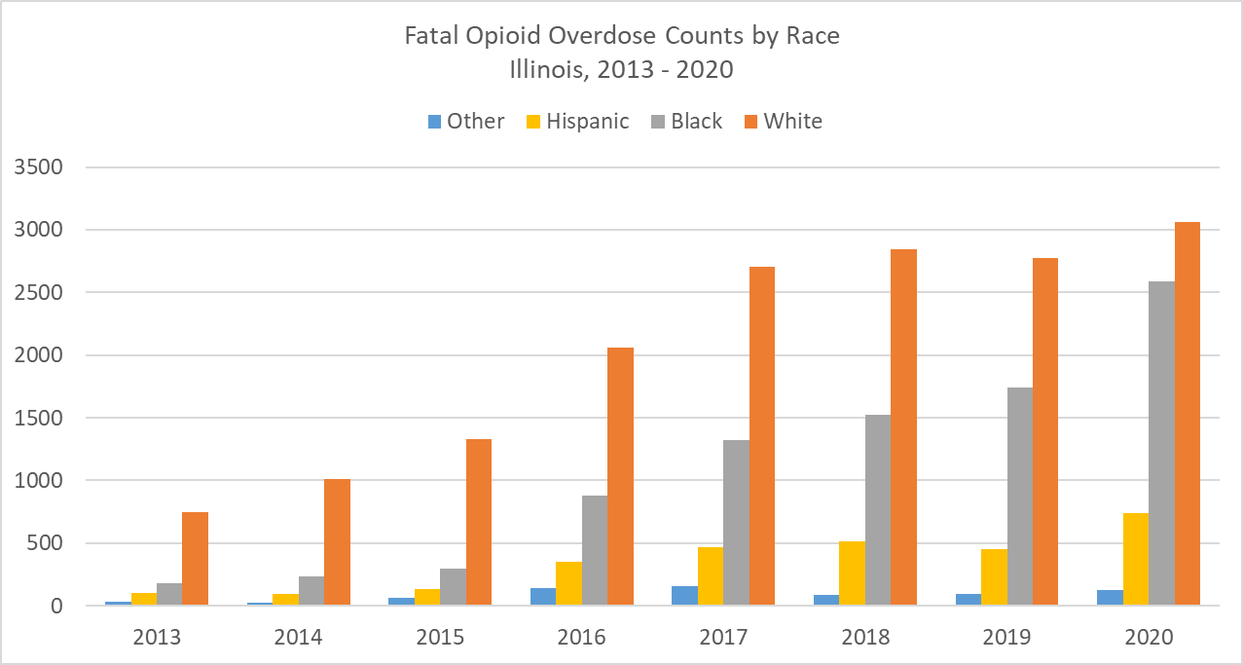
The Opioid Epidemic- Illinois Impact
33% overdose increase (2019 to 2020)
https://dph.illinois.gov/topics-services/opioids/idph-data-dashboard.html
Notes:
Dan: The numbers for 2020 don’t match the numbers on the graph. On the graph it looks like 5000-6000 deaths. That’s true for all of the following slides.

Slide 4
The Opioid Epidemic- Illinois Impact
33% overdose increase (2019 to 2020)
https://dph.illinois.gov/topics-services/opioids/idph-data-dashboard.html

Slide 5
The Opioid Epidemic- Illinois Impact
33% overdose increase (2019 to 2020)
https://dph.illinois.gov/topics-services/opioids/idph-data-dashboard.html

Slide 6
The Opioid Epidemic- Illinois Impact
33% overdose increase (2019 to 2020)
https://dph.illinois.gov/topics-services/opioids/idph-data-dashboard.html

Slide 7
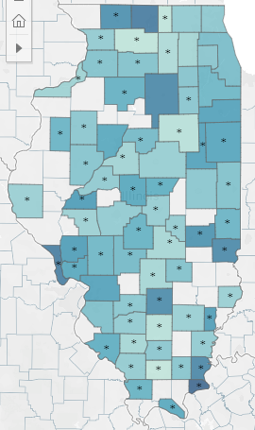
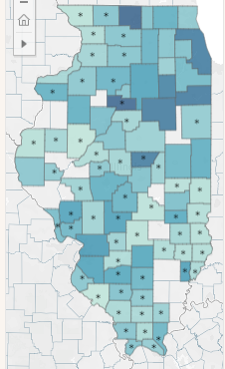
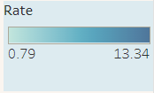
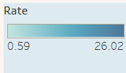
Expanding Geography
Fatal Overdose Rate 2013
Fatal Overdose Rate 2020
Per 10,000 population
Per 10,000 population
https://dph.illinois.gov/topics-services/opioids/idph-data-dashboard.html

Slide 8
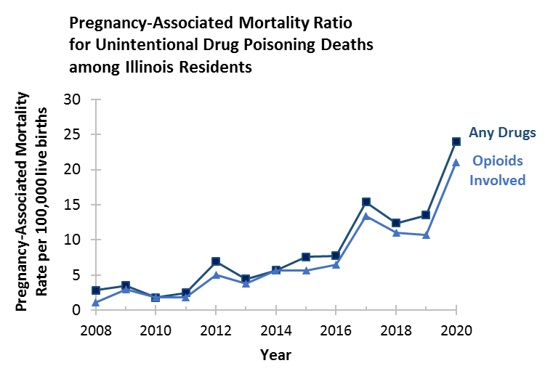
Maternal Deaths due to Opioids in Illinois
2019 – 2020:
Pregnancy-associated mortality ratio increased from 10.7 to 21.0 deaths per 100,000 live births
96% Increase!
IDPH Maternal Morbidity and Mortality report on 2016-2017 deaths, 2021; IDPH Death Certificates, 2021
Notes:
How to show increase in oud cases in 2020
Need an NAS slide or two here after this one.

Slide 9
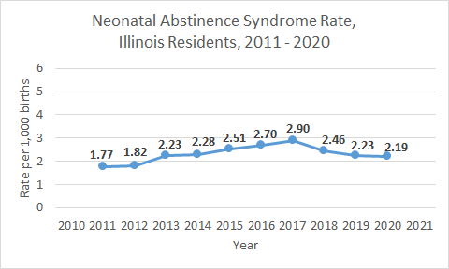
Neonatal Abstinence Syndrome Rates
2017 – 2020:
NAS rate decreased by 32% from 2.90 to 2.19 per 1,000 births

Slide 10
MNO-Neonatal Aims: Sustaining Improvement in 2022

Slide 11
Our Goal: Optimal OEN care every time
Prenatal Consult
Non-Pharmacologic Care
Pharmacologic Treatment
Eat, Sleep, Console
MNO Folders
Coordinated Discharge

Slide 12
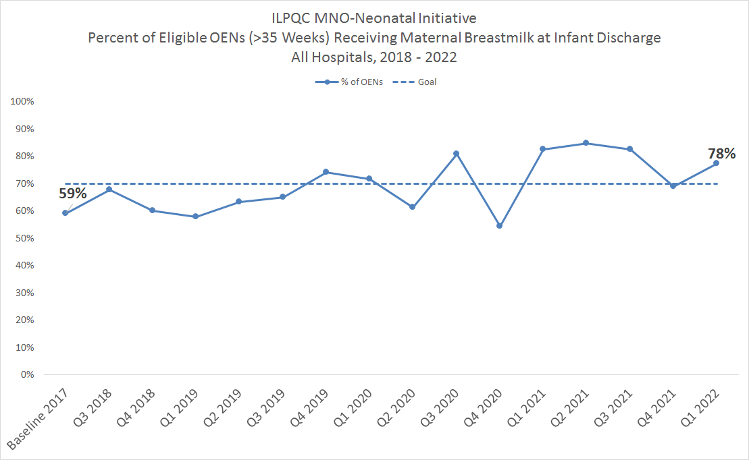
4 Years of MNO: More Breastmilk at Infant Discharge
> 70% of Opioid Exposed Newborns (OENs) are now receiving breastmilk at infant discharge!
Sustainability
Notes:
ADD IN THE SUSTAINABILITY BOX

Slide 13
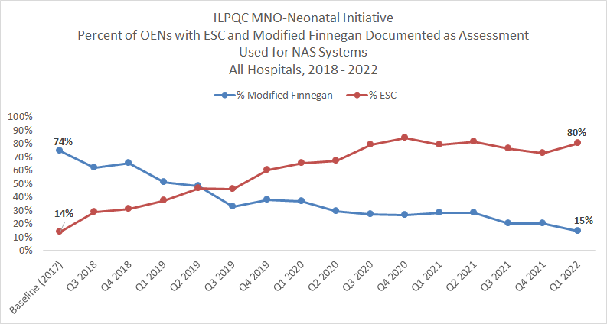
4 Years of MNO: Patient-Centered NAS Assessments
Sustainability

Slide 14
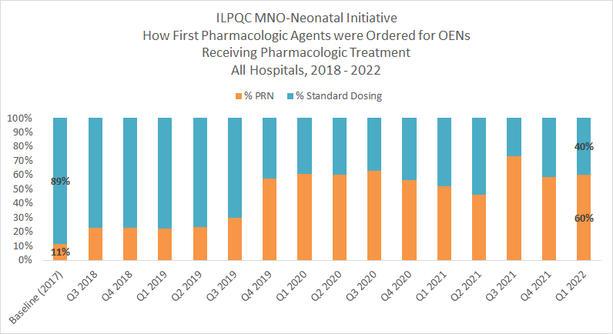
4 Years MNO: Less Pharmacologic Therapy
Sustainability
Notes:
Dan, can we remove the % on the stacked bar chart here as we can’t read them and add them manually with separate text boxes to make them larger/readable.
Dan: “Dosing frequency for pharmacologic treatment” instead of “how first. . “

Slide 15
4 Years of MNO: More Coordinated Discharges
At Baseline 2 of 10 OENs had a coordinated discharge plan
For Q1 2022, 7 of 10 OENs had a coordinated discharge plan
Over 1,200 OENs were discharged with a coordinated discharge plan!

Slide 16
4 Years of MNO: Fewer Days in the Hospital
11.4
11.0
9.4
10.0
8.4
Baseline
2018
2019
2020
2021
Sustainability

Slide 17
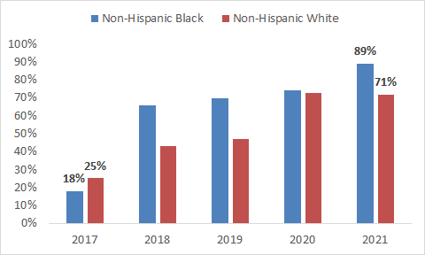
Optimal OEN Care- Inequities in Coordinated Discharge

Slide 18
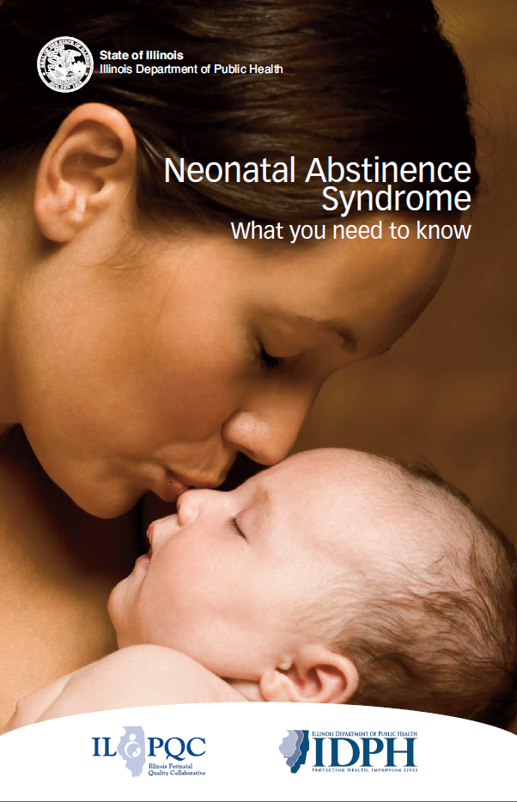
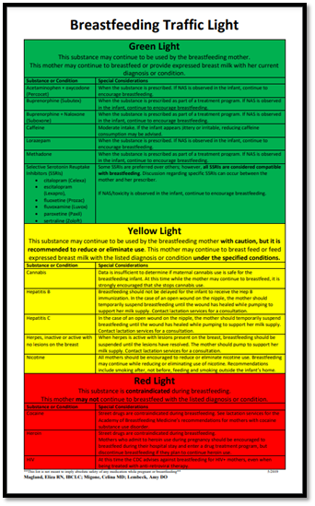
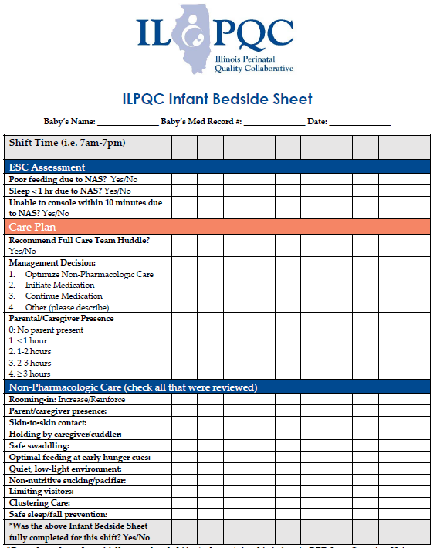
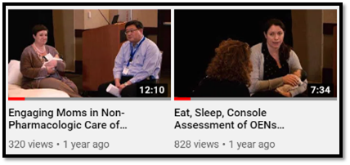
4 years of MNO-Neonatal Tested Strategies to Make Change Happen
MNO-Neonatal Folders
Prenatal Consultation Checklist
NAS Booklet: What you need to know
Breastfeeding Traffic Light Counseling Resource
Eat Sleep Console Materials
Collaborative Discharge Plan
ESC & Non-Pharmacologic Care Simulation Videos

Slide 19
What comes next? Sustain in 2022 and beyond
MNO
MONITOR YOUR DATA TO ACHIEVE OPTIMAL OUD CARE
REVIEW SUSTAINABILITY PLAN WITH YOU TEAM AND MAKE ANY UPDATES ON PROTOCOL CHANGES SINCE 2020
ATTEND MNO-NEO BREAKOUT SESSION TO DISCUSS ONGOING OEN WORK

Slide 20
MNO – A Partnership with the Family
NEO
Screening and Linkage to Care
Optimizing Care for Moms/Babies
Prevention
Notes:
Improving outcomes means identifying moms with opioid use or OUD earlier in pregnancy and linking them to treatment to reduce overdose deaths and improve pregnancy outcomes
Engaging moms in planning for non-pharmacologic care of the newborn can improve outcomes for babies with NAS.
Prevention of OUD requires patient / provider awareness and reduction in over prescription of opioids

