Slide 1
ILPQC Awards Ceremony

Slide 2
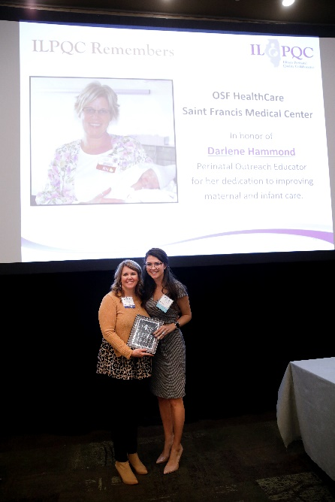
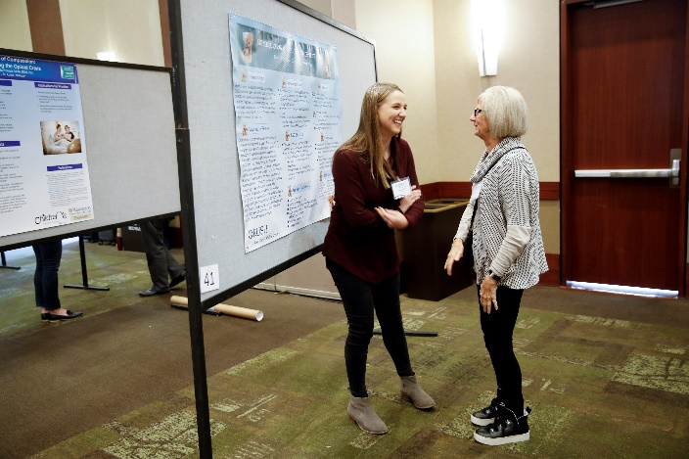
What is coming up next
11:30-11:50am: ILPQC Award Ceremony
Storyboard Award Winners
QI Data Champions
MNO-OB QI Excellence
PVB QI Awards
BE QI Awards
11:50-1:00pm: Team Storyboard Session – Opportunity to Share and Networking Lunch
Make sure to visit the Virtual Storyboard Session at the ILPQC Face-to-Face webpage (www.ilpqc.org)
1:00pm: After Storyboards and lunch join your breakout sessions

Slide 3
Congratulations ILPQC Storyboard Excellence Award Winners!!
Congratulations
Level II
Advocate Trinity Hospital
Level II+
Ascension Resurrection
Level III
Advocate Lutheran General & Children's Hospital-Park Ridge
Elmhurst Memorial Hospital
Notes:
to be filled in after PC votes

Slide 4
Thank you to all hospitals who shared Storyboards!
AdventHealth Hinsdale
Advocate Christ Medical Center
Advocate Condell Medical Center
Advocate Good Samaritan Hospital
Advocate Illinois Masonic Medical Center
Advocate Lutheran General Hospital
Advocate Trinity Hospital
Ascension Resurrection
Ascension Saint Alexius
Carle BroMenn Medical Center
Edward Hospital
Elmhurst Memorial Hospital
FHN Hospital ​
Franciscan Alliance, Olympia Fields ​
Gibson Area Hospital ​
Illinois Chapter AAP ​
Illinois Department of Human Services
Illinois Department of Human Services
John H. Stroger Hospital
Loyola University Medical Center
Loyola University Medical Center APC
Memorial Hospital Carbondale
Memorial Hospital Shiloh
MercyHealth Javon Bea Hospital
NM Palos Hospital ​​
Northwestern Memorial ​​
Northwestern Perinatal Network ​​
NSUHS Evanston Hospital ​​
OSF LCMMC ​​
OSF Saint Anthony Medical Center ​​
OSF Saint Francis Medical Center ​​
Riverside Medical Center ​​
Silver Cross Hospital ​​
SSM Health Good Samaritan ​​
SSM Health St. Mary's - St. Louis ​​
UChicago Medicine ​

Slide 5
QI Data Champions Recognition
Recognizing team's hard work in submitting monthly QI data to drive change at your hospital
All teams who submit complete data, baseline through March 2022, are eligible to receive a $50 gift card per initiative for a QI team celebration
Teams are eligible to be recognized with GC for team celebration through Friday, June 10th at Midnight!

Slide 6
QI Data Champions so far... PVB
Advocate Condell Medical Center
Abraham Lincoln Memorial Hospital
AdventHealth Glen Oaks Hospital
Advocate Aurora Good Shepherd Hospital
Advocate Christ Medical Center
Advocate Good Samaritan Hospital
Advocate Illinois Masonic Medical Center
Advocate Lutheran General Hospital
Alton Memorial Hospital
Ascension Mercy Medical Center
Ascension Resurrection Medical Center
Ascension Saints Mary and Elizabeth Medical Center
Barnes-Jewish Hospital
Carle Richland Memorial Hospital
Carle BroMenn Medical Center
CGH Medical Center
Edward Hospital
Elmhurst Hospital
FHN Memorial Hospital
Gibson Hospital
HSHS St. Francis Hospital - Litchfield
Katherine Shaw Bethea (KSB) Hospital
Loyola University Medical Center
MacNeal Hospital
Memorial Hospital of Carbondale
Morris Hospital and Health Care Centers
NM Huntley Hospital
NM Lake Forest Hospital
NM Delnor Hospital
NM Kishwaukee Hospital
NorthShore University Health System - Evanston Hospital
Northwest Community Hospital
Northwestern Memorial Hospital
OSF Little Company of Mary Hospital
OSF St. Anthony Medical Center- Rockford
OSF St. Francis Medical Center
OSF St. James - John W. Albrecht Medical Center
Palos Community Hospital
Riverside Medical Center Rush University Medical Center
Rush-Copley Medical Center
Silver Cross Hospital
SSM Health Good Samaritan
SSM St. Mary's Hospital - St. Louis
Stroger Hospital of Cook County
University of Chicago Medical Center
West Suburban Medical Center

Slide 7
QI Data Champions so far......BE

Slide 8
QI Data Champions so far... MNO-OB
Advocate BroMenn Medical Center
Advocate Lutheran General Hospital
Alton Memorial Hospital
Ascension Saint Mary's - Kankakee
Crawford Memorial Hospital
Decatur Memorial Hospital
Edward Hospital
Elmhurst Memorial Hospital
Little Company of Mary Hospital
Macneal Hospital
Memorial Hospital of Carbondale
NM Huntley Hospital
Morris Hospital
NM Kishwaukee Hospital
NM Lake Forest Hospital
Northwest Community Healthcare
Northwestern Memorial Hospital
OSF St Francis Medical Center
Palos Health
Riverside Medical Center
Rush Copley
West Suburban Medical Center

Slide 9
ILPQC QI Awards
Thanks to everyone for all of your hard work and congratulations to the award winners!
If your hospital is recognized, please use the chat box to celebrate your team members
ILPQC will follow up with award winners to request contact & shipping information for certificates
If you have any questions, comments, or concerns about your award status, please email info@ilpqc.org
Notes:
Ann, stop sharing screen.

Slide 10
ILPQC QI Award Show

Slide 11
Notes:
Ann, start sharing screen

Slide 12
Team Storyboard Session – Opportunity to Share and Networking Lunch
11:50-1:00 pm

Slide 13
Virtual Storyboard Session
Can be found on the ILPQC Face-to-Face Meeting Webpage (link in your conference email or go to www.ilpqc.org and click Face-to-Face button).
Browse through all the Storyboards and make sure to check out and congratulate award winners!
Share what you learned on the Steal Shamelessly and Share Seamlessly Google form by 2pm to win a $50 Visa Gift Card. Fill-out the quick link on the conference webpage to be put into a drawing to win a prize! Winners (3) will be announced at the 3:15pm Wrap-Up session. Must attend to win.
All links above available on Face-to-Face Meeting Webpage

Slide 14
OB Storyboards
The virtual Storyboards enable teams to connect, collaborate and empower others to understand that QI successes are possible with small change, data, and teamwork.
Who: All OB Face-to-Face Meeting participants
What: Review the OB Storyboards to learn about the great QI work of ILPQC OB teams over the past year
Where:
OB Face to Face link in your conference registration email
Face to Face button on ilpcq.org
When: Storyboard Lunch session from 11:50-1:00pm
Why: Collaboration and exchange of ideas – Share your excellent work across the state!
Example Hospital Storyboard

Slide 15
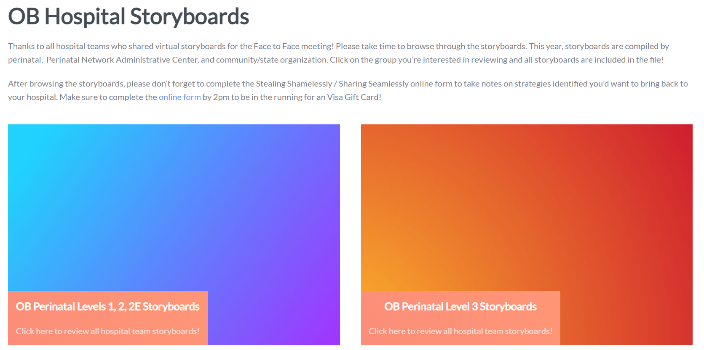
Accessing the Storyboards
Go to the ILPQC 2022 OB Face-to-Face Event page and SCROLL DOWN
Notes:
Scan me for the homepage

Slide 16
Afternoon Schedule
1:00 – 1:35 pm​ | Breakout Session 1: Small Group Key Topic Discussions on Implementation Strategies​ ​ PVB: Sharing Provider Data and Using Data to Drive QI ​ PVB: Checklist and Huddles Strategies ​ PVB: Patient Education & Shared Decision Making ​ BE: Social Determinants of Health Screening and Linkage to Resources ​ BE: Implementation of respectful Care Practices and the PREM survey ​ BE: Implementation of Implicit Bias Training and Equity Discussions ​ MNO-OB: Strategies to Address Maternal Overdose Deaths and Sustain Optimal OUD Care ​
1:35 – 1:45 pm​ | Break​
1:45 – 2:20 pm​ | Breakout Session 2: Small Group Key Topic Discussions on Implementation Strategies (*See above for sessions)
2:20 – 2:30 pm​ | Break​
2:30 – 3:15 pm​ ​ | Creating Change through Patient and Community Engagement ​ ​ LaToshia Rouse, CD(DONA); Kimberly D. Harper, MSN, RN, MHA; Tomeka James Isaac, MBA, MHRM, CAMS ​
3:15 – 3:30 pm​ | Wrap-up, evaluation, raffle and next steps for 2022 ​ ​ Ann Borders, MD, MSc, MPH​

Slide 17
Next Steps (11:50-1:00)
Go enjoy lunch!
Take time to browse the OB Storyboards
Submit a "Steal Shamelessly/Share Seamlessly" form online by 2pm to be in the running for an Amazon gift card
Before 1:00 pm (after Lunch/Storyboard Review), please go to the OB Face-to-Face webpage to find the links to your breakout sessions

Slide 18
Breakout Sessions
Attend the breakout sessions you selected during registration:
Each attendee can attend a total of 2 sessions
Session #1: 1:00pm – 1:35pm
Session #2: 1:45 pm -2:20 pm
PVB: Sharing Provider Data and Using Data to Drive QI
PVB: Checklist and Huddles Strategies
PVB: Patient Education & Shared Decision Making
BE: Social Determinants of Health Screening and Linkage to Resources
BE: Implementation of respectful Care Practices and the PREM survey
BE: Implementation of Implicit Bias Training and Equity Discussions
MNO-OB: Strategies to Address Maternal Overdose Deaths and Sustain Optimal OUD Care

Slide 19
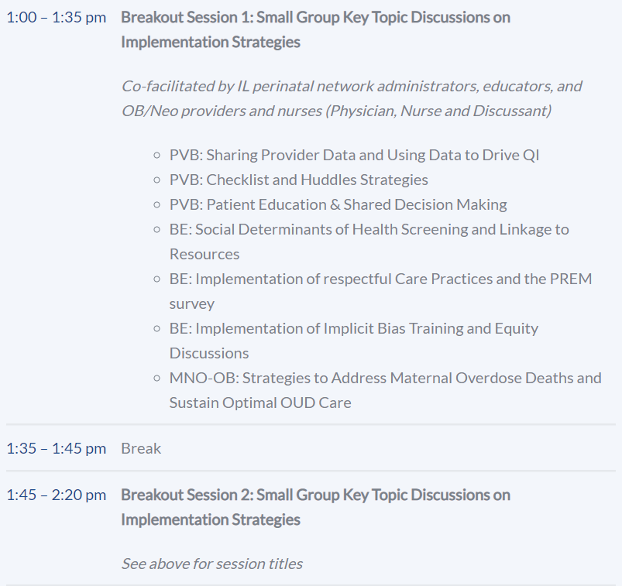
How to get to your Zoom Breakout Session
session links
Go to https://ilpqc.org/2022-ob-face-to-face/
Accessible via your attendee guide or the ilpqc.org homepage
Scroll Down to the Agenda
Find the session you chose to attend
Click the appropriate link based on the first letter of your last name
Simply click the link to join the session!

Slide 20
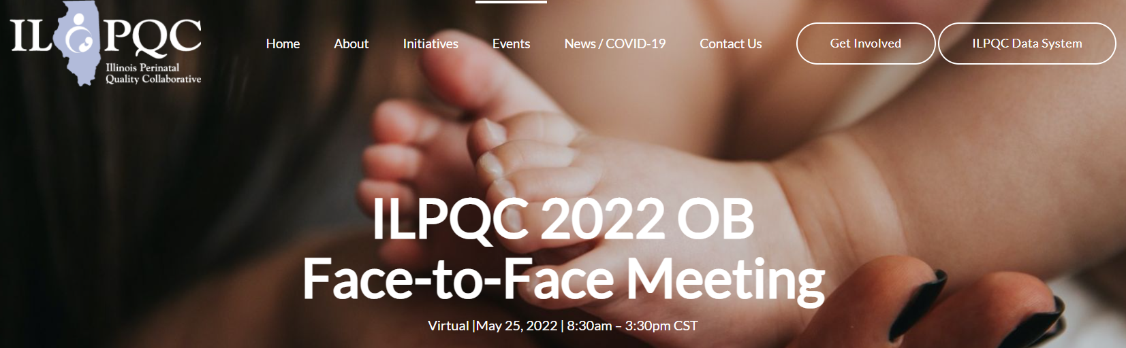
How to get back to the main Zoom Session for the final speaker

