Slide 1
BE & PVB Hospital ​
Teams Panel: ​
Sharing Real-World Approaches

Slide 2
Collaborative Learning
Gain innovate ideas
Create cultural change
Make system changes
Focus: PSDA cycles
Focus: 30/60/90 plans

Slide 3
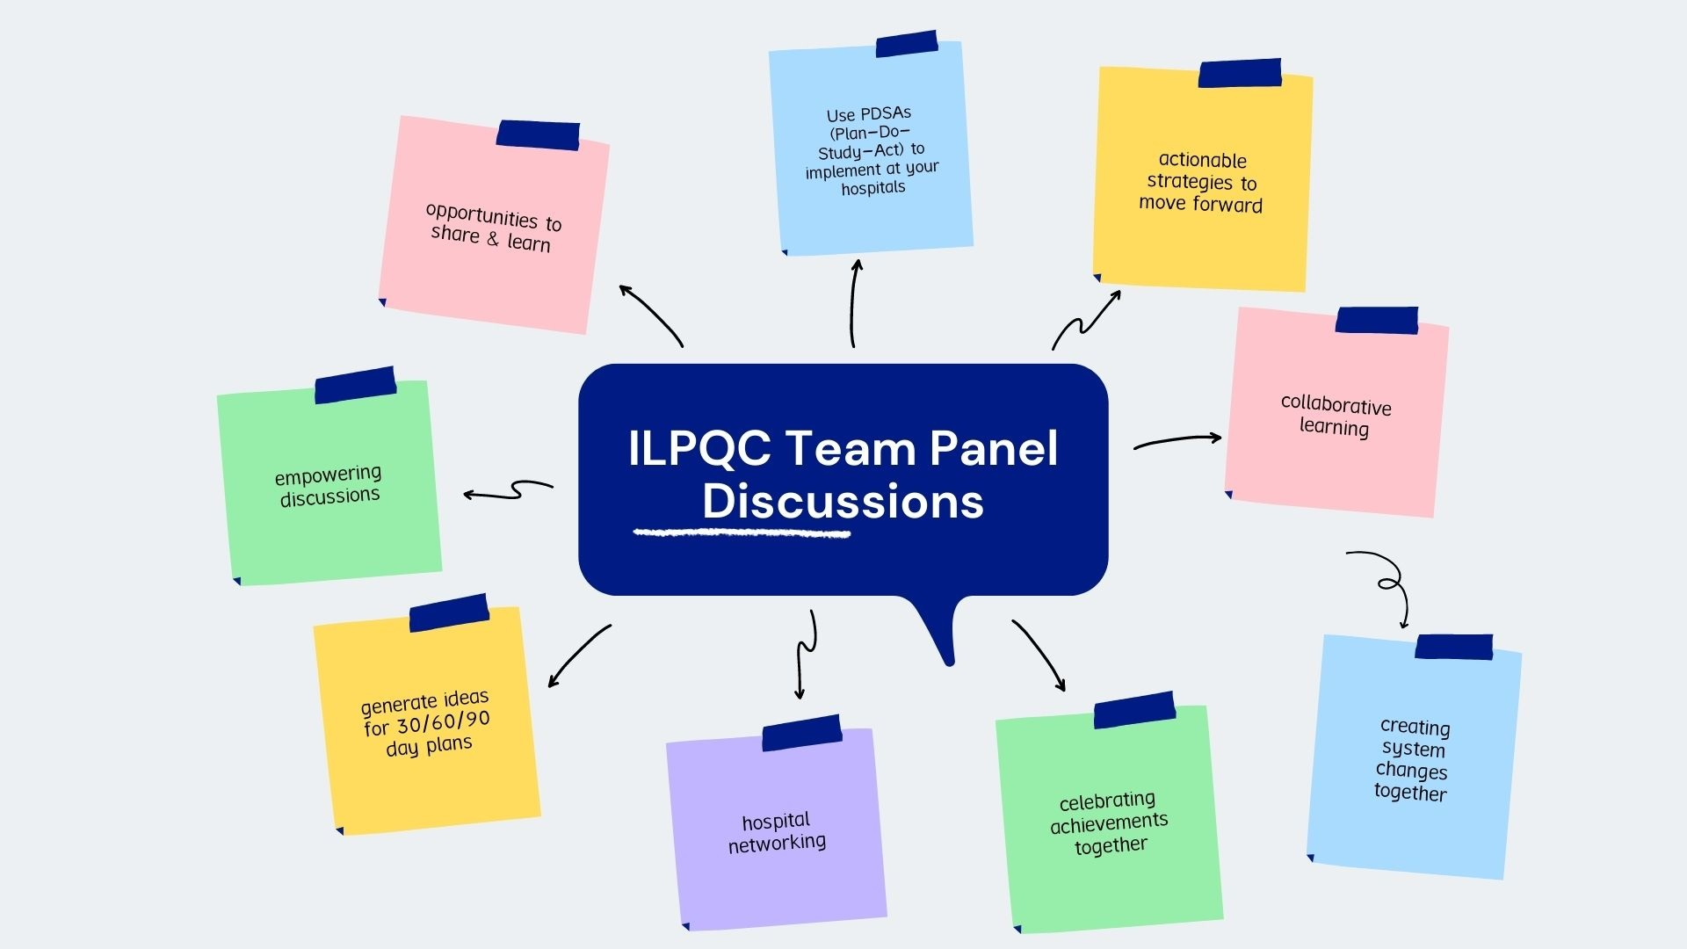

Slide 4
Birth Equity (BE)

Slide 5
Birth Equity Key Strategies

Slide 6
BE Teams Panel
Julie Dervishoski, MSN, RN, C-EFM
Loyola University Medical Center, Maywood, IL
Elena Jenkins, BSN, RN, BA
SSM Health St. Mary’s Hospital- St. Louis
Dr. Weronkia Armstrong, MD & Ann Walsh BS, BSN, RN, RNC-OB
Northwestern Medicine, Prentice Women‘s Hospital, Chicago, IL

Slide 7
Julie Dervishoski, MSN, RN, C-EFM
Loyola University Medical Center, Maywood, IL

Slide 8
Loyola University Medical Center
Birth Equity Initiative
Julie Dervishoski, MSN, C-EFM
Perinatal Educator
Loyola University Medical Center

Slide 9
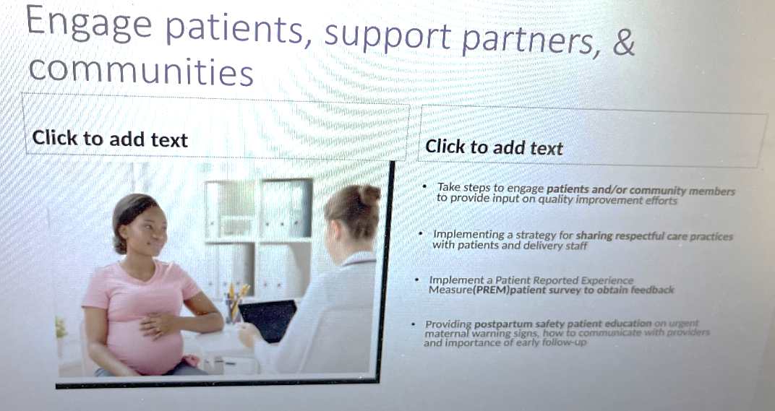

Slide 10
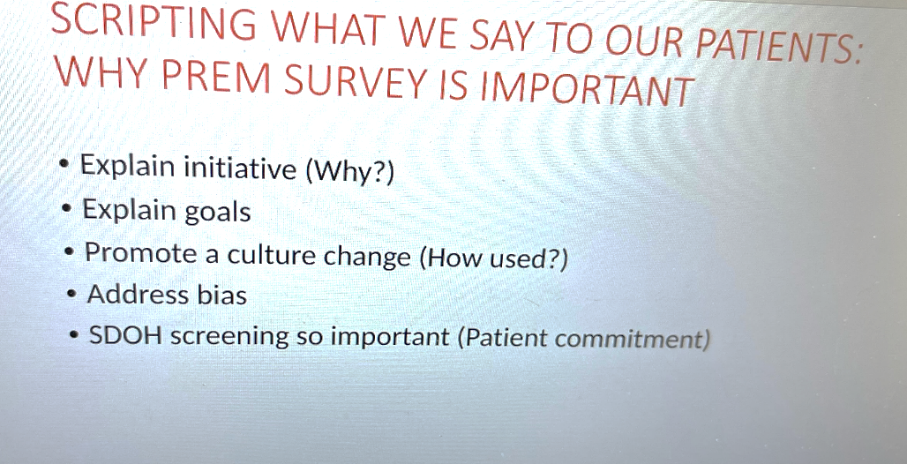

Slide 11
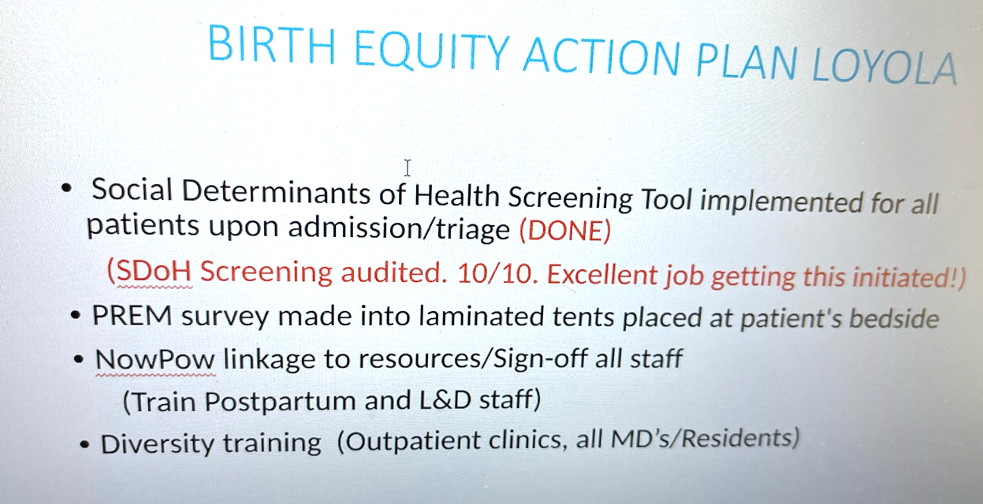

Slide 12
Elena Jenkins, BSN, RN, BA
SSM Health St. Mary’s Hospital-St. Louis

Slide 13
Approaches and Strategies for implementation of SDoH screening, Respectful Care Practices, and Implicit Bias Training
Elena Jenkins, BSN, RN, BA

Slide 14
St. Mary’s Hospital - Background
SDOH screening
Respectful Care Practices
Implicit Bias

Slide 15
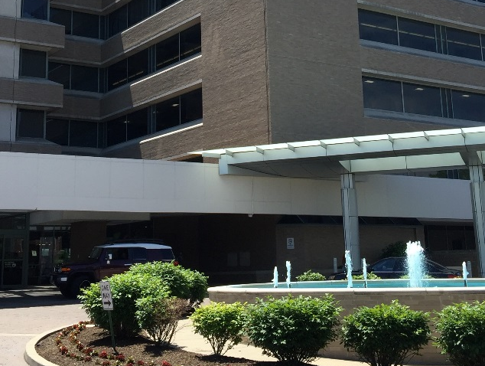
St Mary’s Hospital
2600 Deliveries/yr
Labor and Delivery Unit
13 LDR rooms, 6 Triage rooms, 2 ORs
Antepartum Unit
28 Antepartum rooms,10 Perinatal Special Care Unit rooms
Mother/Baby Unit
30 Postpartum rooms
Level III NICU
42 beds
Designated Administrative Perinatal Center for the Southern Illinois Perinatal Network.

Slide 16
St Mary’s Hospital
2600 Deliveries/yr
Labor and Delivery Unit
13 LDR rooms, 6 Triage rooms, 2 ORs
Antepartum Unit
28 Antepartum rooms,10 Perinatal Special Care Unit rooms
Mother/Baby Unit
30 Postpartum rooms
Level III NICU
42 beds
Designated Administrative Perinatal Center for the Southern Illinois Perinatal Network.

Slide 17
Social Determinants of Health (SDoH) Screening & Linkage to Resources
Challenges: No consistent screening, ability to document for SDOH, or easily accessible resources. No way to flag needs identified prenatally to alert the inpatient team.
Initial work:
Developed a SDoH survey tool on paper
  challenges re:
    transcription into record,
    visibility to other providers,
    staffing/time resource

Slide 18
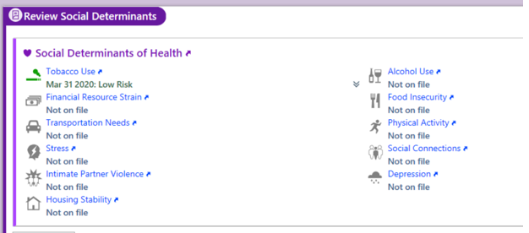

SDoH Screening & Linkage to Resources
In Progress Work:
EPIC work group assigned to screening project
  Created EPIC based SDOH screening for in-hospital and out-patient clinic with tailored questions;
  will be able to integrate as part of admission workflow and visible flag to inform providers of identified needs/when linkage to resources completed
Petitioned to have screening placed on admission navigator as required documentation

Slide 19

SDoH Screening & Linkage to Resources
Accomplishments within last year:
Identification of resources to allow for linkage to patients in Missouri local area
‘Easily accessible resources’ (project by grad student) completed, mapping resources in our area
Resources listed on website; flyers created with QR code to provide to patients

Slide 20
SDoH & Linkage to Resources
In progress and looking forward:
Partner with community organizations to improve:
    Consistency of referral to resources and warm hand-offs
    Decrease needs gaps
    Increase patients receiving follow-up care and home visits
Monitor for commonalities in needs for community
Doula Collaboration Program

Slide 21

Respectful Care Practices
Accomplishments within last year:
Respectful Care Practices Posters re-branded with permission from ILPQC
Large Posters posted in all Women’s Services inpatient units and in all SSM outpatient clinics in St Louis area
Smaller posters ordered to post in each inpatient room in Antepartum, Labor & Delivery, and Postpartum
Pamphlets added to admission materials

Slide 22
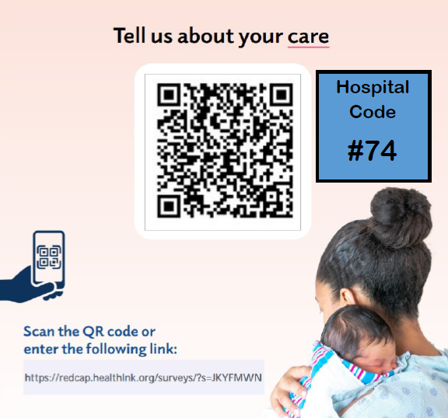
Respectful Care Practices
In Progress Work:
Commitment to RCP introduced to staff
Badge buddies created
PREM Survey Go Live
    education for staff in process on Postpartum unit
    QR code posted on Whiteboards in front of patients
    ordered small survey QR codes to be placed into patient folders
    PP RNs go over info about survey with patients on admission

Slide 23
Implicit Bias Training
Challenge: Hospital started discussions of DE&I issues, but no initiatives have reached the staff.
Accomplishments within last year:
Speak Up Training Grant – 16 employees across 4 units attended training, 2 additional employees attended for a total of 18
Feb 2022 – implemented 28 day speak up challenge on all 4 WS units (including NICU) – partnered with Mission in Action Team and posted house-wide

Slide 24

Implicit Bias Training
Reviewed educational offerings:
    Submitted and approved to have Diversity Science modules on LMS for RN/support staff – assigned summer 2022 schedule
    Created lecture based on Diversity Science modules, presented to 300 RN staff during skills days
    Grand Rounds for Physicians/Residents April 1, 2022

Slide 25
Implicit Bias Training
Looking forward to working on:
Using PREM Survey results to drive further needs based focus
“Toxic: A Black Woman’s Story” purchased with plans to view and discuss in multidisciplinary groups.
Continue with opportunities to “layer” opportunities for more exposure to equity.

Slide 26
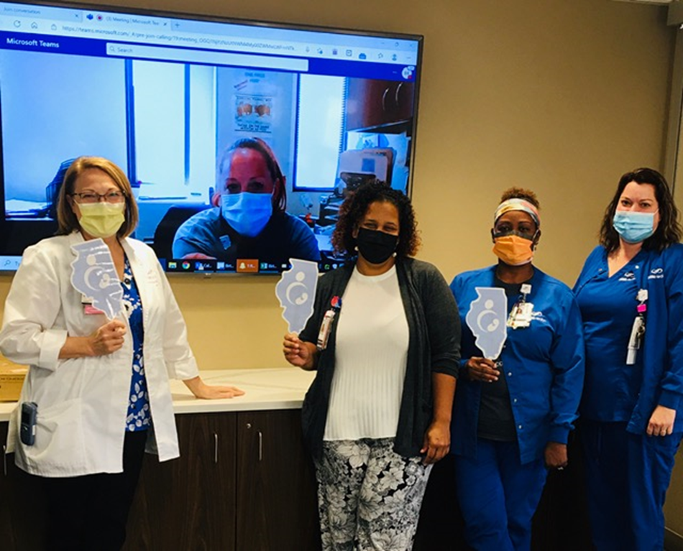

Thank you!

Slide 27
Dr. Weronkia Armstrong, MD &
Ann Walsh BS, BSN, RN, RNC-OB
Northwestern Medicine, Prentice Women‘s Hospital, Chicago, IL

Slide 28
Birth Equity Approaches
Northwestern Memorial Hospital
Ann Walsh BSN, RNC-Inpatient OB and Weronika Armstrong MD

Slide 29
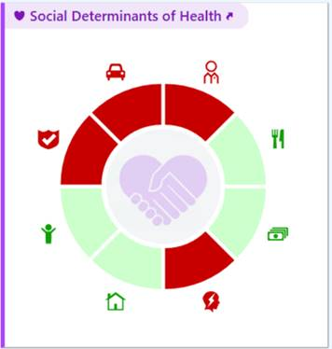
Social Determinants of Health Screening
Required document that is completed upon admission for all patients
Nurses and providers were educated through email and morning huddles regarding the new process
Triggers a Social Work consult for patients to be connected with services on Mother Baby Units before discharge
Outpatient SDOH Screening Pilot → universal adaptation

Slide 30
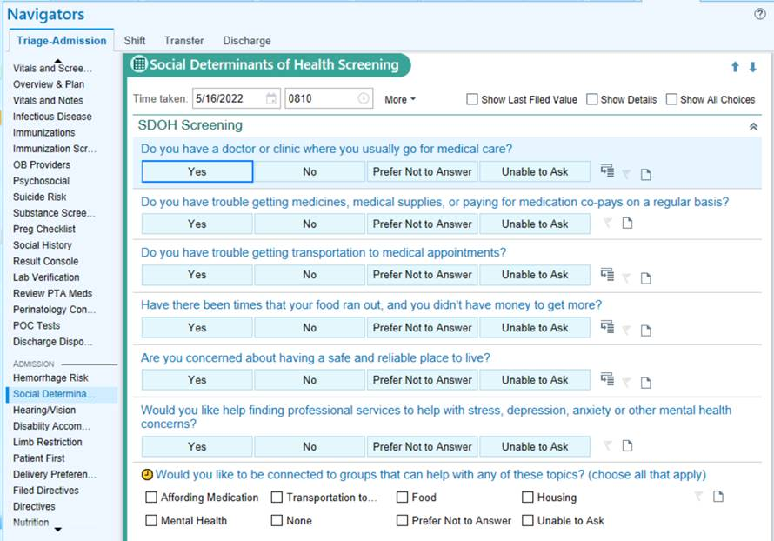
Social Determinants Of Health Screening
Questions as they appear in the Triage-Admission Navigator
Additional questions cascade depending on responses

Slide 31
Social Determinants of Health Screening
Barriers
  Nurses and providers did not know what happened after a patient was identified as needing assistance
    Closed the loop by educating regarding social work consult
  Created more work for Social Work
    Currently strategizing ways to mitigate this

Slide 32
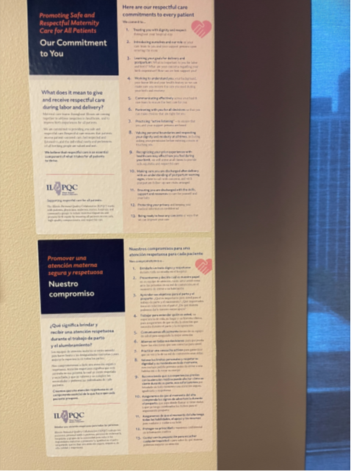
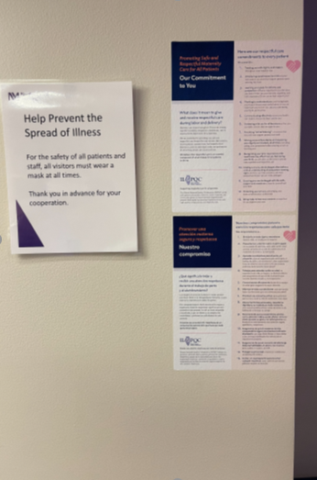
Respectful Care Practices
Education emailed to RNs with a required attestation form to ensure completion
Posters in OBE, Antepartum and in each in-patient room
Health Equity Rounds to look at cases through an equity lens (Department’s DEI Committee)
Notes:
*need to add picture of posters in room (emailed team x2)

Slide 33
Implicit Bias
Dignity in Childbirth Implicit Bias Training Modules (voluntary)
Posted materials throughout the unit and on a Facebook group
  S.T.O.P. mindfulness technique
Education emailed to RNs and providers with attestation form to ensure completion

Slide 34
Implicit Bias – Barriers and strategies for moving forward
Only 3% of RNs completed the voluntary training
  Increased signage on the unit in break rooms, hallways and bathrooms
  Small, frequent in-services lead by RNs who attended the SPEAK UP workshop
Implicit Bias training at Grand Rounds for providers
  Pending approval
Bias reporting mechanism- TBD

Slide 35
Promoting Vaginal Birth (PVB)

Slide 36
PVB Key Strategies to help teams achieve initiative aims
Identify NTSVs and recognition for clinical team
Education of ACOG/SMFM criteria for providers and nurses
Implement cesarean decision checklists and huddles
Promote Labor management support
Share Un-blinded provider data
Standardize Patient Education and Shared Decision Making

Slide 37
PVB Teams Panel
Danielle Felty, MSN, RN, NEA-BC, RNC-OB, C-EFM
Loyola Medicine MacNeal Hospital, Berwyn, IL
Amy Mehl, BSN, RN & Amelia Lund, BSN, RN
OSF St. Francis Medical Center, Peoria, IL

Slide 38
Danielle Felty, MSN, RN, NEA-BC, RNC-OB, C-EFM
Loyola Medicine MacNeal Hospital, Berwyn, IL

Slide 39

Promoting Vaginal Birth
5/25/2022

Slide 40

374 Licensed Bed Hospital
Berwyn, Illinois
SERVICES INCLUDE
Emergency Services
  Chest Pain Center
  EDAP
  Primary Stroke Center
  Level II Trauma Center
Adult Critical Care
Neurosurgery (24/7)
Cardiovascular Surgery
Telemetry & Medical Surgical Units
Obstetrics & Level II Nursery
MRI, CT, Lab Services (24/7)
Bariatrics
Cancer Care
Heart & Vascular Care
Rehabilitation Services
Behavioral Health
Hospice Unit
Ambulatory Care Centers

Slide 41
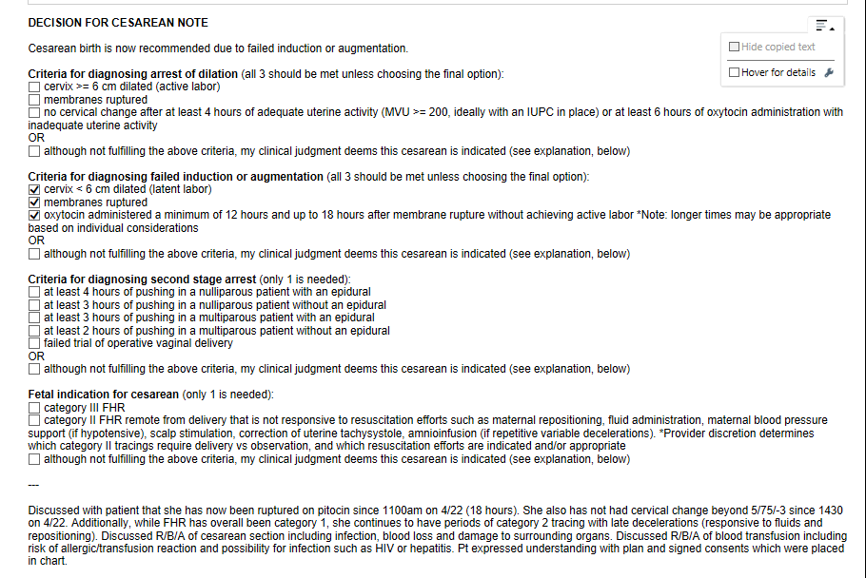

Checklist & Huddle Strategies
PDCA(Cycle 1):
  Plan: Standardize Criteria for Primary Cesarean.
  Do: Implement the ACOG decision checklist on paper
  Check: Primary responsibility for ensuring checklist was completed fell to nursing staff to ensure completion.
  ACT: Integrate ACOG checklist into EMR for Physician ownership.
PDCA (Cycle 2):
  Plan: Integrate the ACOG checklist in the EMR
  Do: Build checklist into EPIC. Provider education on the .dot phrase documentation
  Check: Routine auditing of EMR to validate compliance. Send any non-compliant to OB Chair for follow-up.
  ACT: Continue to monitor

Slide 42
Statistics
11 months of maintaining below the goal line!

Slide 43
ACOG Checklist &
Huddle Implementation
  What’s going well
    Provider education and support of the initiative
    Documentation of the ACOG checklist into EMR (EPIC)
    OB Chief Support” 1:1 Coaching any providers when checklist not completed
    100% Physician documentation within EPIC since January 2022
    Implementation of nursing and patient huddle, especially when strict criteria was not met.
  Opportunities
    Joint huddle with nursing, physician, and patients together. Currently process is for the physician meets separately with nursing and the patient.

Slide 44
Amy Mehl, BSN, RN & Amelia Lund, BSN, RN
OSF St. Francis Medical Center, Peoria, IL

Slide 45
Journey to Unblinding NTSV Data
Amy Mehl RN Supervisor of Labor and Delivery &
Amelia Lund RN Quality and Safety Coordinator

Slide 46

OSF St. Francis Medical Center
Total of 649 beds
We do about 2,000 deliveries annually
A level 1 Perinatal Center
Level 3 NICU
Majority of the physicians are in private practices

Slide 47
Reasons for Unblinding Data
Studies have proven that unblinding data positively impacts NTSC C-section rates
Hospitals across the nation are moving towards unblinding their data
Most providers are unaware of their C-section rates, therefore do not know if they have room for improvement
Data is knowledge and knowledge is power

Slide 48
Collecting the Data
It was decided that the NTSV C-Section rates should be pulled quarterly
Every quarter data is pulled for a rolling calendar year
  This is due to the volatility of the data if pulled for a smaller time frame
Pulled data by delivering physician and reported this out
Adjustments were made for practices that employee midwives
Data was also reported by provider group
Included the number of deliveries each provider did on graphs

Slide 49
Sample Graph
13
6
6
43
11
16
5
23
8
64
26
56
21
18
9
36
21
24
23
60
4
16
30
58
14
6
30
69
11
2
17
Red Number below letter is total vaginal and C/S deliveries adjusted with Midwives

Slide 50
Sample Graph
6
14
69
31
64
56
228
60
145
69
11
2
Red Number below letter is total vaginal and C/S deliveries for each group

Slide 51
Presented Blinded Data
Data was initially presented blinded at the OB Department Meeting
Prior to the meeting the data and the provider’s individual letters were emailed out to each provider
Data was presented with an explanation of how it was pulled and adjusted
Had a few providers reach out with questions regarding the data
  If requested raw data was given to the provider to review and confirm accuracy
Blinded data was shared for 3 quarters
Sit downs with individual providers were done to review data and opportunities

Slide 52
Transition to Unblinded Data
Director of Labor and Delivery mailed each provider notifying them that unblinded data would be shared and included current blinded NTSV rates
Unblinded data was presented at the OB Department meeting
Currently data is not distributed out to providers to review independently

Slide 53
Barriers and Solutions
Concerned that data would be shared publicly by their competitors
  Started with blinded data
  Unblinded data was not distributed
Concerns with data accuracy
  Explanation of how data was pulled was given every time data was presented
  Providers were encouraged to ask questions
  Raw data for each provider was provided if requested
Concern from provider groups that have midwives or multiple providers
  Adjusted rates for midwives
  Presented provider group rates

Slide 54
Next Steps
Considering distributing unblinded data to providers
Would like to establish RN NTSV C-section rates
Continuing other measures to reduce C-section rates
  Focused Pitocin audits
  Sent bedside RNs to a Spinning Babies Workshop
  Spinning Babies is set to present again in the winter
  Labor management tools created and available for nursing staff to reference

Slide 55

ILPQC Support to BE and PVB Teams
Birth Equity
Promoting Vaginal Birth
Schedule BE Grand Rounds today
Schedule BE Key Players Meetings
BE Community Engagement Meetings
Attend monthly BE webinar
  3rd Monday of the month at 12:00pm
Schedule PVB Grand Rounds today
ILPQC Labor Support E-Modules available
Arrange 1 on 1 QI Support Call with ILPQC
Attend monthly PVB webinars
  4th Monday of the month at 12:30pm
Email info@ilpqc.org for more information

Slide 56
"Alone we can do so little; together we can do so much."
– Helen Keller

Slide 57

Questions

