Slide 1
Achieving PVB Goals:
Strategies to Cross the Finish Line
Christa Sakowski, MSN, RN, C-ONQS, C-EFM, CLE
CMQCC

Slide 2
Promoting Vaginal Birth:
Strategies to Achieve your PVB Goals
Christa Sakowski, MSN, RN, C-ONQS, C-EFM, CLE
Clinical Lead, CMQCC
Co-lead for the Supporting Vaginal Birth Reducing Primary Cesarean Collaborative
Notes:
Promoting Vaginal Birth
A Journey that Never Ends…but hey…you’ve got this!

Slide 3
Objectives
Understand the utilization of the Cesarean Decision Checklist for optimal buy-in and results
Learn how to optimize data sharing among the entire team to increase and sustain motivation
Recognize the importance of unblinding provider-level data for impact
Identify ways to support and empower nurses on your units
Disclosures
Ms. Sakowski has no conflicts or disclosures to report
Notes:
READ SLIDE

Slide 4
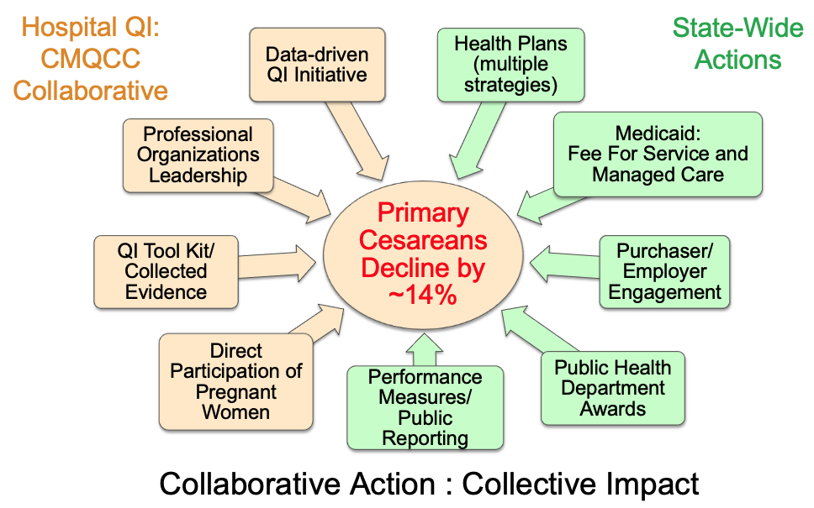
CMQCC Collaborative to Reduce Primary Cesarean Birth
First Birth Low-Risk Cesarean Rate
State-wide Initiative Activities
U.S. Target
U.S. Healthy People 2020 Target: 23.9%
Rosenstein MG, Chang S-C, Sakowski C, Markow C, Teleki S, Lang L, Logan J, Cape V, Main EK. Hospital Quality Improvement Interventions and Statewide Policy Initiatives and Rates of Nulliparous Term Singleton Vertex Cesarean Deliveries in California. JAMA 2021. Apr 27;325(16):1631-1639.
Notes:
Why am I here?
CA Collab Effort – 3 years – 3 Cohorts
Reduction – CA Rates compared to the US
Safety
Couldn’t do it alone – Partners/Support

Slide 5
The Essential Role of the SMART Goal
Specific statement of exactly what, who, how much, by when
  What: Measure that we will “improve, increase, or decrease”
  Who: Which population or patient group
  By how much: Number of, or percentage of, change from baseline to target
  By when: Specific target Date
SM
Notes:
SMART Goals keep us focused on the process measures needed to achieve the overall result.
A SMART goal is a specific statement of exactly what, who, how much, by when
What: Measure that we will “improve, increase, or decrease”
Who: Which population or patient group
By how much: Number of, or percentage of, change from baseline to target
By when: Specific target Date
Smart Goals keep the team from becoming overwhelmed.
They allow the team to engage in planning and ideas for implementation.
They provide several wins along the way.

Slide 6
Why Should We Change?
Variation in Care
Tremendous variation seen among hospitals for nearly all obstetric outcome measures
Large variation also noted in process and structural metrics
Large variation observed among providers in the same facility
Very small proportion of the variation is explained by patient characteristics
Notes:
Why change?
Variation in Care alerts us to opportunities
Tremendous variation is seen among hospitals for nearly all obstetric outcome measures
Large variation is also noted in process and structural metrics
Large variation observed among providers in the same facility
Very small proportion of the variation is explained by patient characteristics (Click for dot plot) – add bit about adjusted for NTSV

Slide 7
How to Be Persuasive
Aristotle’s: 3 Frames for Every Argument
  Logos - appeal to logic: “statistics show fewer
  deaths”, “greater teamwork”, “reduced complications”
  Ethos - appeal to ethics: “patients deserve the best care”, “safety must come first”, “we strive for patient-centered care”
  Pathos - appeal to empathy: patient stories are critical, “it could have happened to any of us”, “we will all be patients”
Notes:
Aristotle presented 3 frames for every argument.
Logos appeals to logic. Statements that describe this sound like: “statistics show fewer deaths”, “improved teamwork”, “reduces complications”
Ethos appeals to ethics: Statements that describe this sound like: “patients deserve the best care”, “safety must come first”, “we strive for patient-centered care”
Pathos appeals to empathy: patient stories are critical. Statements that describe this sound like: “it could have happened to any of us”, “we will all be patients”
The vast majority of us went into our profession to help people. No one goes to work planning to provide anything less then the best care.

Slide 8

Six Sources of Influence
http://www.youtube.com/watch?v=osUwukXSd0k
Notes:
I am sure that many of you have seen this already, but influence is critical to the success of any quality improvement project element and influence from multiple sources is not overkill, it’s necessary.
http://www.youtube.com/watch?v=osUwukXSd0k
I am just going to show a short clip (if it works). Start at 3:50 If it doesn’t work, I’ll summarize.

Slide 9




COMMON QI ACTIVITES:
Labor support techniques
Active phase guidelines - huddle
CS rate transparency (unit and provider)
Latent phase guidelines
Induction guidelines
Techniques to reduce OP
Patient engagement
Unit culture/teamwork/perinatal QI team
Longer 2nd Stage
(in approximate order of frequency of use)
Notes:
You will see common activities that California hospital teams engaged in on their journeys listed in the order of frequency of use (explain what that means).
The three most common are what I be asked to talk to you about today.

Slide 10
Maximizing the Cesarean Decision Checklist

Slide 11
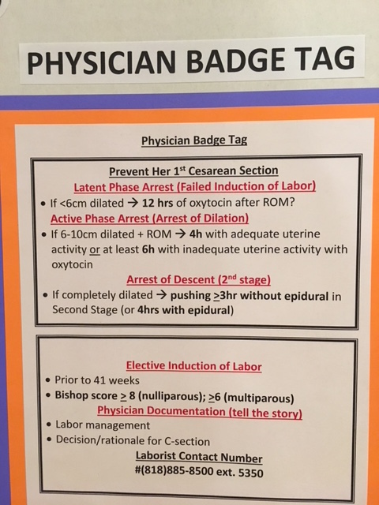
Education and Adoption of
ACOG/SMFM Guidelines
Notes:
Explain the role and importance of education – can’t apply what we don’t know – helps us speak the same language – helps us creates a shared mental model.
It’s not one and done
ACOG/SMFM consensus statement
AIM Bundle
Toolkit
Badge Cards
CS Decision Checklist

Slide 12
Cesarean Decision Checklist
Notes:
Ellie sent me some of your implementation metrics. Consider how this is being implemented at your hospital. It’s not really a simple yes or no question.
Only cases where there is a discrepancy?
When the patient is being rolled into the OR?
After the CS has taken place in recovery?
As an audit Tool?
As a communication tool with the team? With the physician? With both?
GOLD STANDARD - with the patient – Ariadne Team Birth

Slide 13
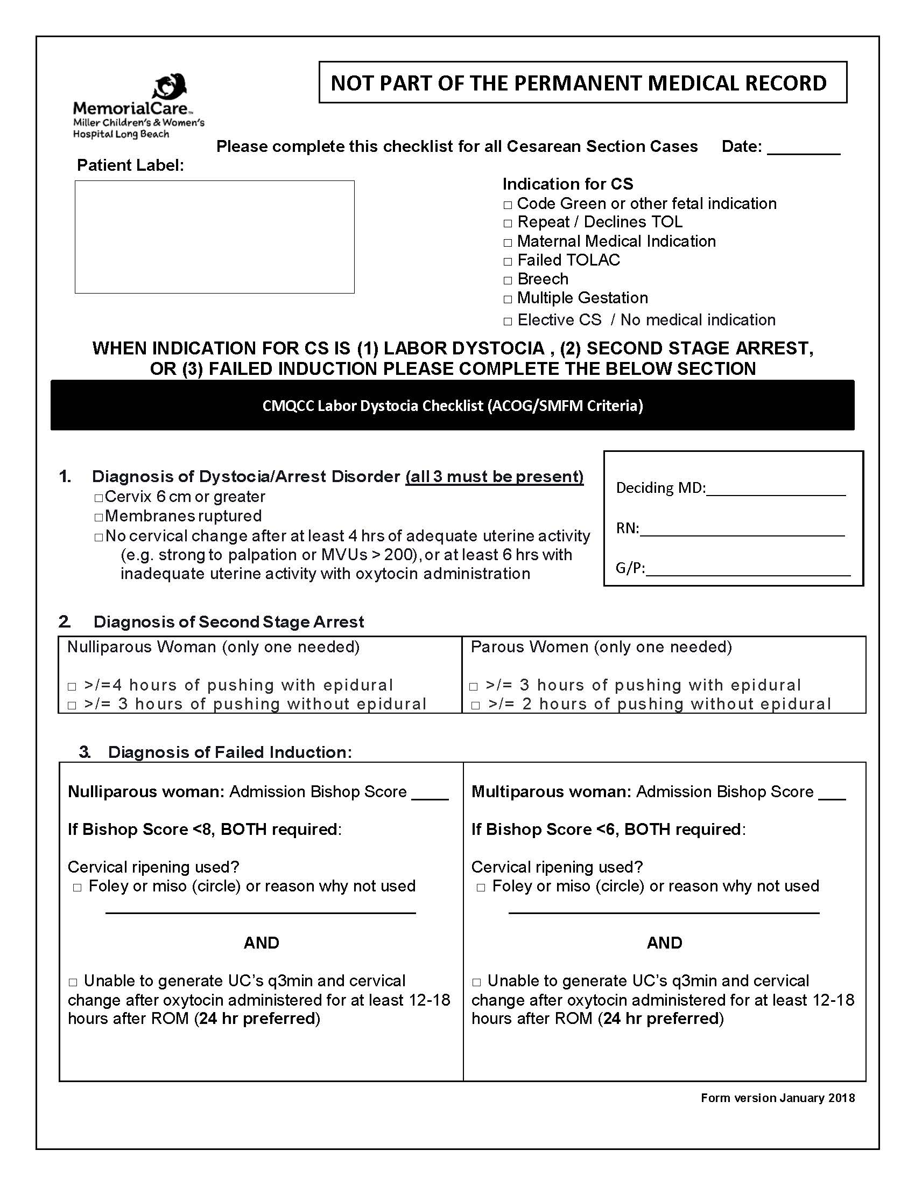
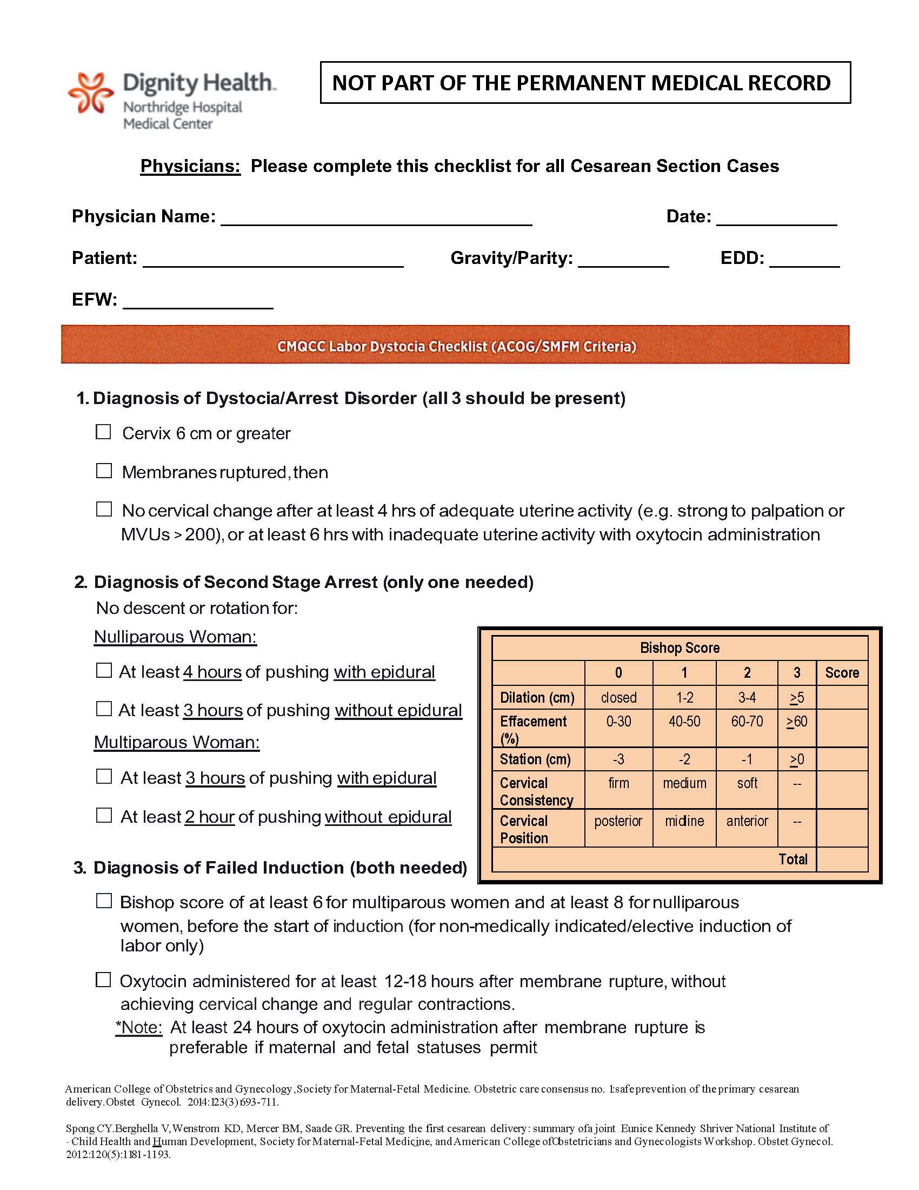
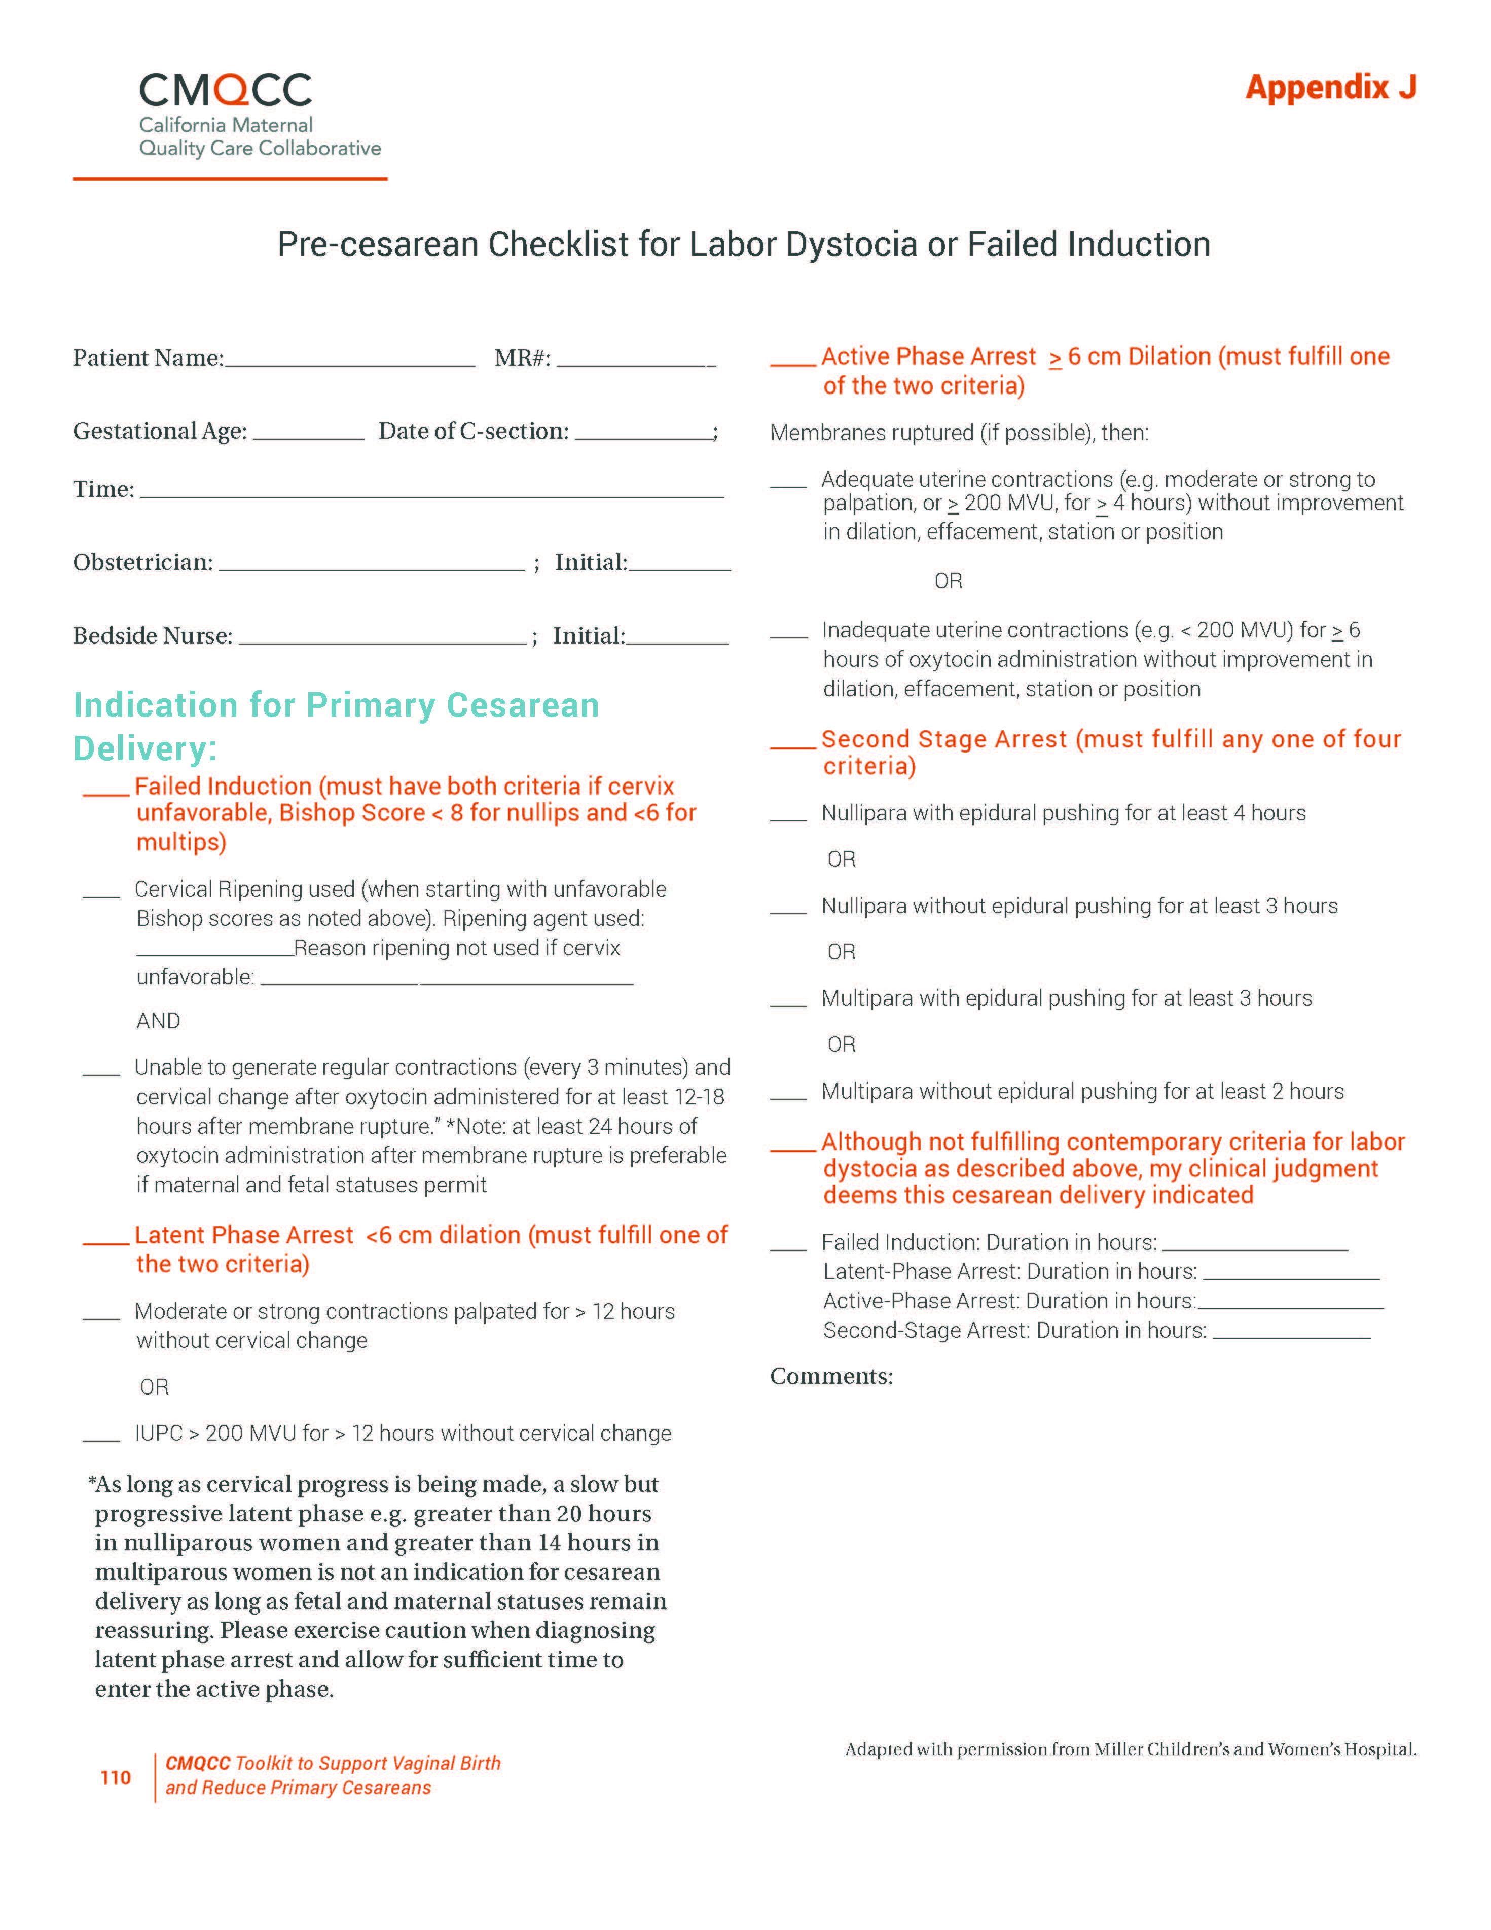
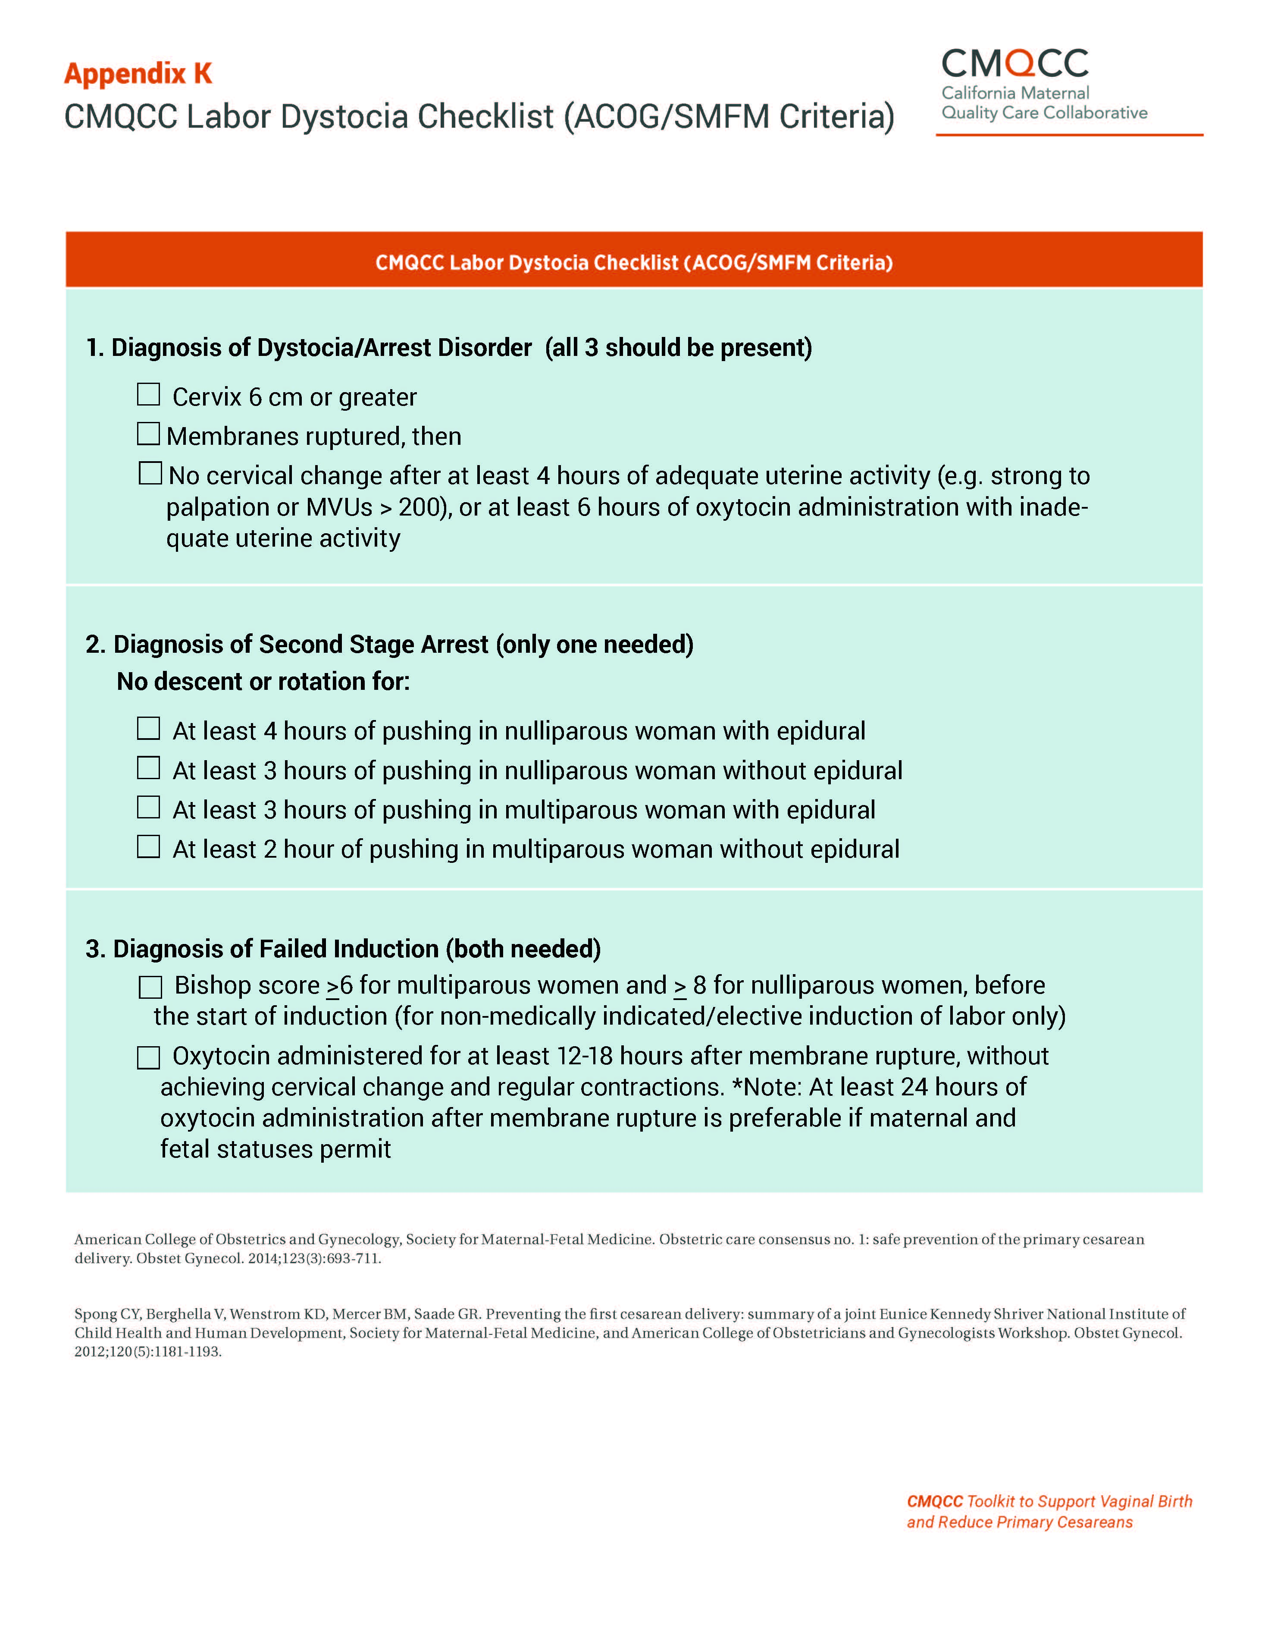
USE FOR EVERY
NONEMERGENT CESAREAN!!!
Notes:
There are many many versions of this tool available and I encourage you to utilize one that meshes with the flow of your unit.
Building a version of this tool into the EHR can be useful in some sites as a way to document that guidelines were or were not followed. There are even some sites that require this information within the physician delivery note.
If you are having difficulty FULLY implementing the tool, I suggest a “rebranding” as a communication tool. ”Checklist” doesn’t really get at the intent of the tool. We are looking to communicate where we’ve been, where we are now, and what the appropriate next step is…not to “pass or fail”.
Opportunity to “stop and think” that the surgery is appropriate – guidelines aren’t simple to memorize (badge cards)
Opportunity to discuss what we might add to the care with the time we have “left” in the guideline (Oxytocin, positioning, epidural)
Opportunity for the physician to share why they do not believe the patient can wait to meet the criteria of the guideline (nonreassuring FHTs unresolved with corrective measures, fever, etc.), which allows for proper documentation.
All of this provides back and forth understanding between team members and reinforcement of guideline education. CLICK
Utilizing this list for every nonemergent cesarean eliminates judgement and becomes a routine part of the decision to c-section at your facility. It reduces confrontation and conflict. It is not the intention that nurses with prevent every section that does not meet criteria from happening, however your team should decide how they will handle disagreements and standardize that response. This may vary depending on the resources at your facility and where you are in your journey. (Charge nurse, laborist, ob chief, manager, etc.).

Slide 14
Data Sharing to Move the Needle

Slide 15
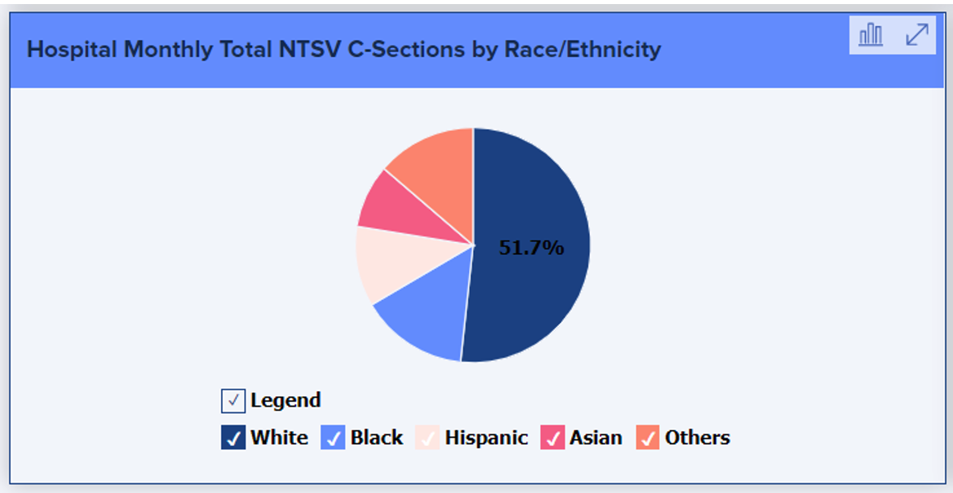
Equity and Targeting Racial Disparities as Top Priorities for QI
Foster individual, organizational and professional accountability
Ensure that the patient, family and the clinicians caring for them are well supported, especially in the face of biases such as structural or interpersonal racism
Hospital leaders should demonstrate an openness to feedback and reporting of concerning situations
Many institutions have well-developed approaches for addressing potential sources of conflict, including communication tools and team training and they should be utilized
Hospital leaders need to make equity and targeting racial disparities their top priorities for quality improvement, and ensure that staff are trained on implicit bias and interpersonal, institutional, and systemic racism.
Please visit the CMQCC
Birth Equity Resources Webpage
Notes:
TALKING POINTS
Equity and Targeting Racial Disparities are Top Priorities for Quality Improvement in the Management of HDP. To that end, it is encouraged to:
Foster individual, organizational and professional accountability
Ensure that the patient, family and the clinicians caring for them are well supported, especially in the face of biases such as structural or interpersonal racism
Hospital leaders should demonstrate an openness to feedback and reporting of concerning situations
Many institutions have well-developed approaches for addressing potential sources of conflict, including communication tools and team training and they should be utilized
Hospital leaders need to make equity and targeting racial disparities their top priorities for quality improvement, and ensure that staff are trained on implicit bias and interpersonal, institutional, and systemic racism.
CMQCC RESOURCES

Slide 16
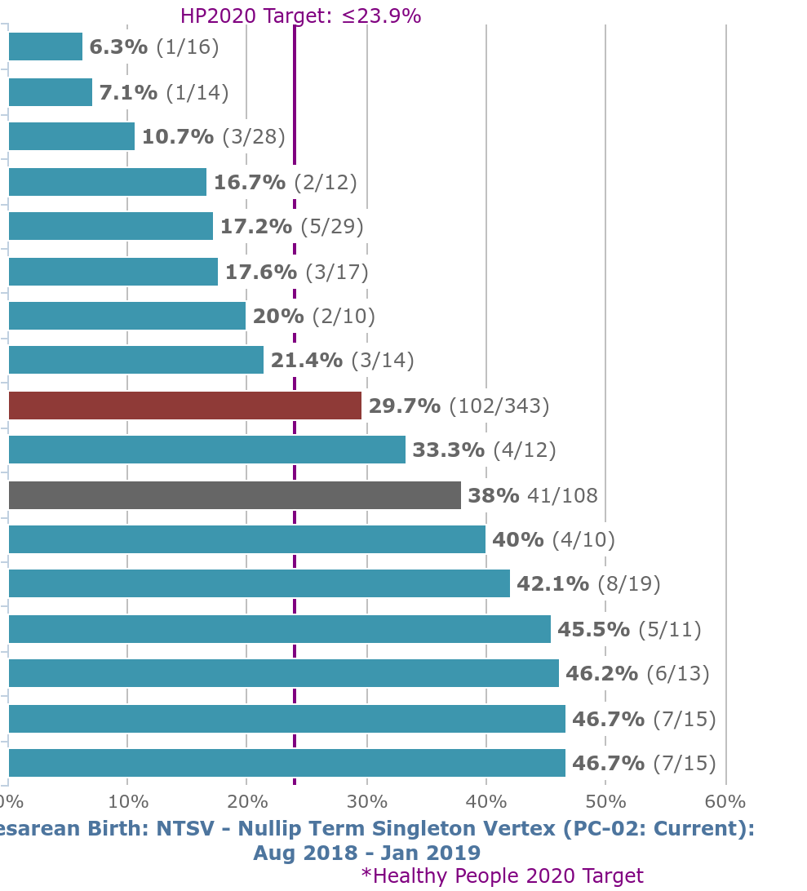
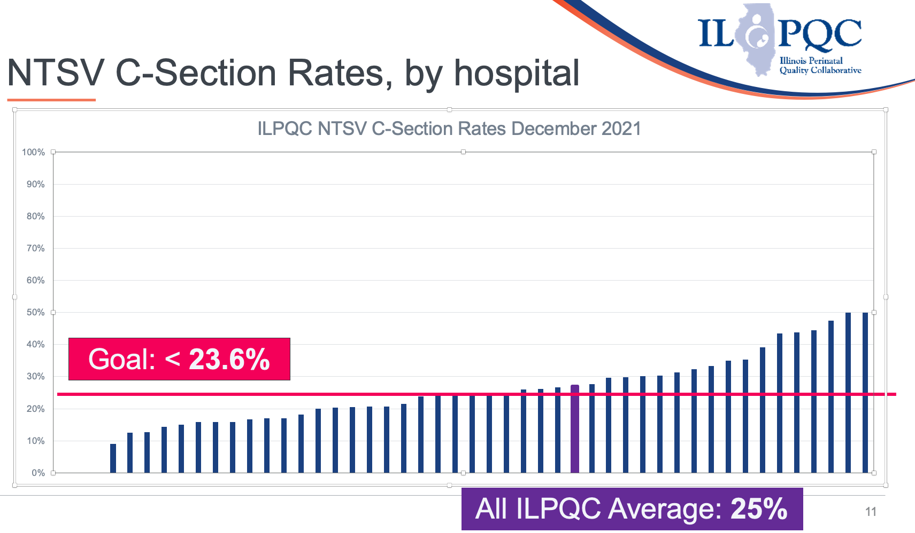
Share Data that Highlights Variation
Notes:
I encourage you to Share Data that Highlights Variation. Presenting data without comparison isn’t useless, but it lacks power.
Share this data as widely as you are able. Connect nursing to the data and the drivers of the data. Discuss Nursing QI huddles
Public sharing of aggregate quality date can be found on labor and delivery units in California and I am sure in Illinois as well.

Slide 17
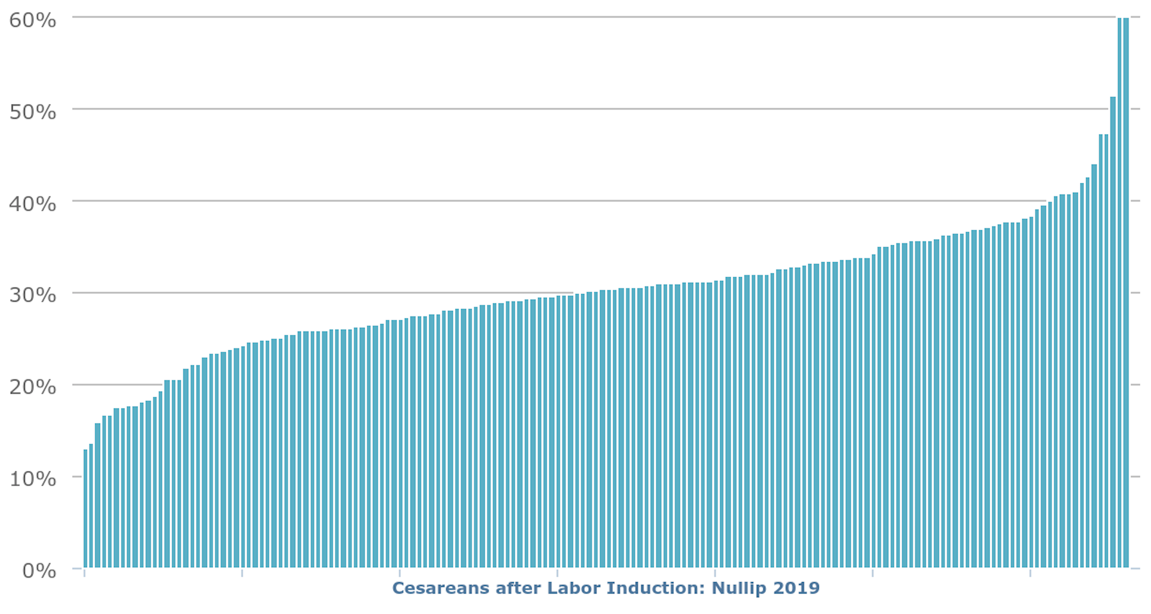
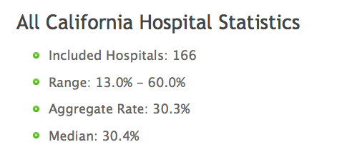
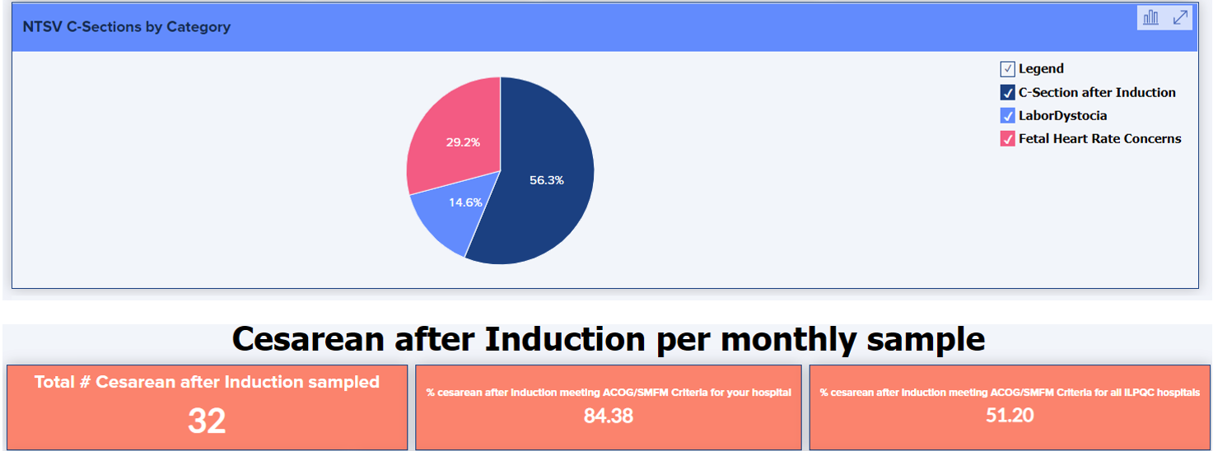
California Hospitals: CS after IOL (nullips), 2019
Notes:
This type of variation can be useful to show, especially of your hospital has taken on routine 39 week induction as a method of achieving reduced cesarean rates.

Slide 18
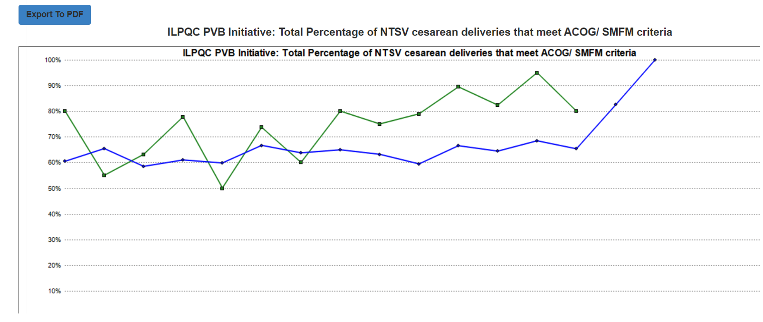
Notes:
Not all focus on variation is “bad”. This can be used to highlight wins as well.
Talk about the smoothing out of variation.

Slide 19
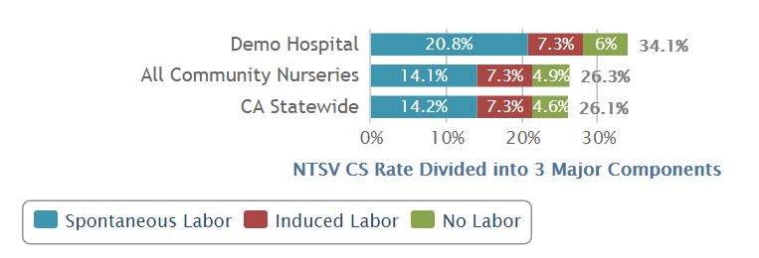

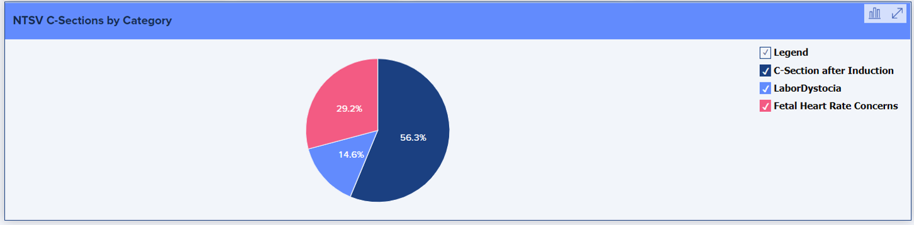
Measure Analysis: Identify “Drivers” of Rates
What Drives Our Nulliparous Term Singleton Vertex (NTSV) CS Rate?
Notes:
Discuss Measure Analysis and choosing structure and process measures that are most likely to provide the biggest impact.

Slide 20
Sharing Provider Level Data
Notes:
Similar to the Decision to CS checklist, consider how this is being implemented at your hospital. Unblinding provider-level data shows that everyone in the department is committed to improvement. Provider-level data that remains blinded provides little opportunity to share ideas and practices surrounding improvement that all clinicians could benefit from (what does she have that I don’t have – i.e. Foley bulb induction). Solely blinded data encourages silence from those that have an opportunity to provide even better care.
In some cases, systems improvement and support can provide improvement for outliers if they share their issues or frustrations (i.e. inconsistent use of labor positioning by nurses that work the same days as physician call days. Opportunity for reeducation of nursing).

Slide 21
Path to Sharing Unblinded Provider Rates - Month 1
Educate & Inform
  Confirm physician champion on board and that they will be notifying other physicians of the plan to reveal rates
    Key discussion points to include in communications
      Each physician has an individual responsibility to the success of the project
      This aspect of the project has proven to be one of the most important steps
      Process is not meant to be punitive
      Project’s goal is to target changes in practice and improve supportive systems
      Physicians should discuss with the champion if opposed to unblinding
      Reiterate factors that will be considered when interpreting physician data
  Reveal BLINDED baseline rates to each physician
Notes:
Before the process of unblinding NTSV cesarean rates begins, it is important for teams to have a baseline understanding of their underlying practices. This can be determined through an examination of the drivers for primary cesarean rates, followed by a chart review of a sample to assess how well the providers follow the national ACOG guidelines for Failure to Progress and other key primary cesarean indications. Ongoing monthly review for consistency with guidelines is also quite useful (recognizing that not every case will follow the guidelines perfectly). CMQCC’s Readiness Assessment and Structure Measures Checklist will assist with this baseline review. The success of the project hinges upon system improvements that support providers in reducing individual rates.
Educate & Inform
Confirm physician champion on board and that they will be notifying other physicians of the plan to reveal rates. They should notify physicians at a Quality or Department meeting, special cesarean reduction info session, or via email, of future intent to share unmasked individual NTSV cesarean rates (provide timeline!)
Key discussion points to include in communications
Each physician has an individual responsibility to the success of the project
This aspect of the project has proven to be one of the most important steps and will yield the most results
The process is not meant to be punitive, e.g. will not be used for “profiling” or credentialing. Rather, the data will foster improvement. Though when other steps have been less productive, some hospitals have used these data for the Joint Commission mandated: Ongoing Physician Performance Evaluation (OPPE).
The project’s goal is not only to target specific changes in practice, but also to improve the systems that support each physician in being successful
Physicians should discuss with the project leader if they are opposed to unblinding of physician rates
Reiterate factors that will be considered when interpreting physician data (upcoming slides)
- Reveal BLINDED baseline rates to each physician via letter, email, etc. I recommend a big chunk (looks different depending on del volume)

Slide 22
Common Considerations - Provider-Level Rates
Problem | Effect | Solution
Low Volume | Low volume often leads to an increase in variation of the results, possibly causing significant swings in the individual provider rates. | Point out these concerns with low volume leading to possibly wrong conclusions, consider making the sampling interval longer (e.g. 12 months instead of 3 to 6 months).
Notes:
REFER TO SLIDE

Slide 23
Common Considerations - Provider-Level Rates
Problem | Effect | Solution
Provider backing up other types of providers who cannot perform cesareans | Many care systems require OBGYNs to backup midwives, Family Practice, etc. which inflates the individual OB’s cesarean rates. | There are a couple of approaches to correct this issue: 1) Hospitals can calculate all the provider stats using the labor provider rather than the delivery provider. 2) Otherwise, consider “group rates” (combining the OB with the midwife practice, if that makes sense) for a collective evaluation.
Notes:
REFER TO SLIDE

Slide 24
Common Considerations - Provider-Level Rates
Problem | Effect | Solution
Provider is held responsible for decisions of others: long labors that are held over from the prior shift or where counselling in the office precludes the current provider from achieving vaginal delivery (elective cesarean; lowered expectations on the part of the patient as to length of labor etc.) | This can raise the rate of an individual OB where there are cases they feel could have potentially avoided cesarean. | This is part and parcel of group practice. Most of the time, this can be ameliorated by providers in the group discussing their practice differences and these data can jumpstart that process. Cases often balance out between shift changes over the long haul. Emphasize the use of “group rates” so that the individual provider doesn’t bear the full responsibility.
Notes:
REFER TO SLIDE

Slide 25
Common Considerations - Provider-Level Rates
Problem | Effect | Solution
Clerical entry errors in the birth certificate data or coding leading to wrong procedure or attributed provider. | Fortunately, these are uncommon and random, however with small denominators can be significant to individual providers. | Provide feedback loop for detected errors to correct the data (or reassign the provider).
Notes:
REFER TO SLIDE

Slide 26
Path to Sharing Unblinded Provider Rates –
Month 2
Share BLINDED rates of all physicians
Distribute personal rates to each physician to allow comparison to the BLINDED rates of entire cohort
Identify and work with the outliers
Identify and work with resistant physicians
Notes:
Share BLINDED rates of all physicians. This can be via a chart at a department meeting, via email, or posted in the provider lounge
Distribute personal rates (or a personal key) to each individual physician to allow comparison to the BLINDED rates of the entire cohort
Identify and work with the outliers
Chart review for outliers to determine: How consistent are they with ACOG dystocia guidelines? What can they work on? What tools could they benefit from?
Physician Champion to meet with and review this information with outlier physicians
Identify and work with resistant physicians
Physician Champion to communicate candidly and honestly to build trust: What is the resistant physician worried about? How can you as the champion and team make this process easier?
Are there resistant physicians who would benefit from a discussion with an outside MD mentor?

Slide 27
Path to Sharing Unblinded Provider Rates - Month 3
Share BLINDED rates of all physicians (2nd time)
Distribute personal rates to each individual physician with a comparison to the BLINDED rates of entire cohort (2nd time)
Expect lots of questions and concerns about validity of individual rates. Be sure to reiterate the factors that should be considered when interpreting physician data
Notes:
Share BLINDED rates of all physicians (2nd time) – yes again
Distribute personal rates to each individual physician with a comparison to the BLINDED rates of the entire cohort (2nd time)
Expect lots of questions and concerns about the validity of individual rates. Be sure to reiterate the factors that should be considered when interpreting physician data (reviewed in earlier slides)

Slide 28
Path to Sharing Unblinded Provider Rates - Month 4
Share in writing UNBLINDED rates of all physician GROUPS in a Department meeting.
There is often great variation within groups. UNBLINDED individual rates would be shared only within each group, with the expectation that next time individual rates will be unblinded between groups.
If “group rates” do not apply to your facility, you would now UNBLIND individual physician rates for those physicians open to individual unblinding
Notes:
Share in writing UNBLINDED rates of all physician GROUPS in a Department meeting. Make it lowkey initially.
There is often great variation within groups. At this point, UNBLINDED individual rates would be shared only within each group (if appropriate), with the expectation that next time individual rates will be unblinded between groups for all to see and compare.
If “group rates” do not apply to your facility where only individual practitioners practice, you would now UNBLIND individual physician rates for those physicians open to individual unblinding (for this to be successful, Physician Champion, Department Chairs, and Early Adopters must vocalize support for unblinding and could be examples of showing theirs first)

Slide 29
Path to Sharing Unblinded Provider Rates - Months 5 & 6
Share UNBLINDED rates of individual physicians. After a round or two, the individual rates can be shared more openly but not truly publicly. They should not be shared publicly as the data is not perfect. It is only respectful to provide plenty of notice, resources, and opportunities to improve.
Notes:
If not already done, share UNBLINDED rates of individual physicians. This is done after trust has been built with the data. After a round or two, the individual rates can be shared more openly but not truly publicly. Share via department meeting, posted in doctor’s lounge, and/or send via email, etc. They should not be shared publicly as the data is not perfect. Providers do not like to be outliers, which is useful for us to help drive change. The goal is never to shame our physicians but to generate conversation and share successful practices.
It is only respectful to provide plenty of notice and opportunity to improve with the full support of administration and nursing staff.

Slide 30
Troubleshooting / FAQs
What do we do if we are at the point of unblinding the data and we still have one or a few adamantly against it?
What about the Kaiser model (or other laborist models), where some physician rates don’t reflect true attribution?
How frequently should we share provider-level data?
Don't forget to pair the NTSV Rates and progress with the Balancing Measures!
https://www.cmqcc.org/content/guidance-understanding-and-unblinding-provider-level-ntsv-cesarean-rates
Notes:
What do we do if we are at the point of unblinding the data and we still have one or a few adamantly against it?
ANSWER: This is actually rare, but at some point it is necessary to proceed. Physician leaders should have firm conversations that unblinding is going to occur and that the rates will stay within the department.
2. What about the Kaiser model (or other laborist models), where some physician rates don’t reflect true attribution?
ANSWER: In models where providers work as a team, it is often better to have them consider improvement as a team and have open discussions about solutions at their department meetings. For example: Is everyone supporting breech version? Is someone consistently delaying the cesarean section to the next shift or admitting patients in the latent phase? Additionally, hospitals have the ability to track consistency with ACOG guidelines for the diagnosis of labor dystocia. For those who desire a proxy measure for provider improvement, provider-level data for “consistency with guidelines” could be used.
3. How frequently should we share provider-level data?
ANSWER: There is a balance to be had here. Monthly data analysis rarely provides providers with a sufficient sample size to be meaningful (and can “numb” the providers to the data) but annual data release removes the immediacy of the issue. A good medium is to provide quarterly provider-level data with annual or semi-annual un-blinded release. Department level data can be shared monthly unless the facility is quite small, as you would do in any QI project.
4. Don't forget to pair the NTSV Rates and progress with the Balancing Measures!
ANSWER: The pairing has been very helpful with advancing acceptance of the project. But be careful about sample sizes here as well! Small samples (a doctor or even a single month for the entire department) can be misleading. We recommend reporting these no more often than quarterly.

Slide 31
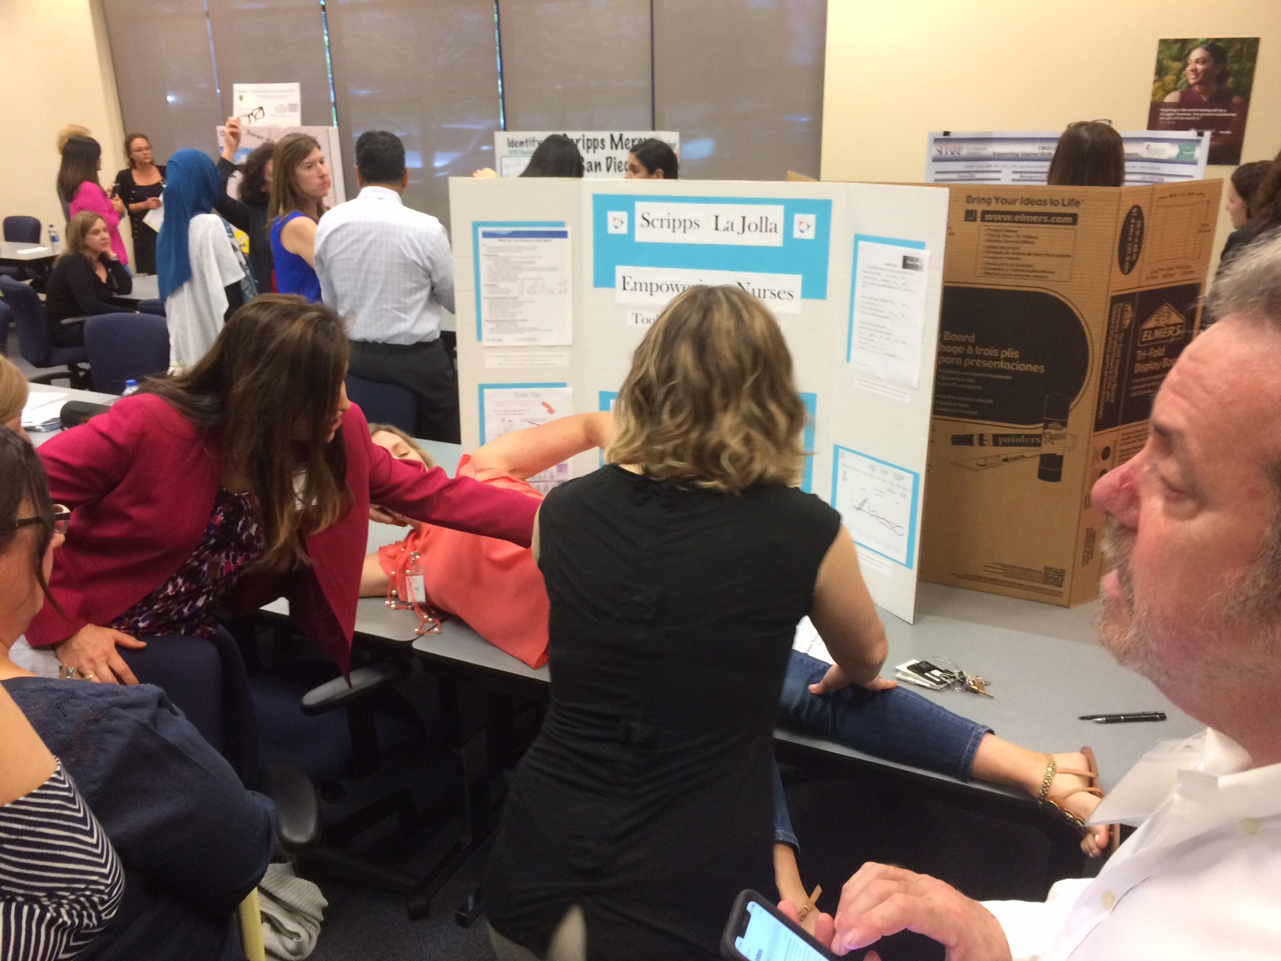
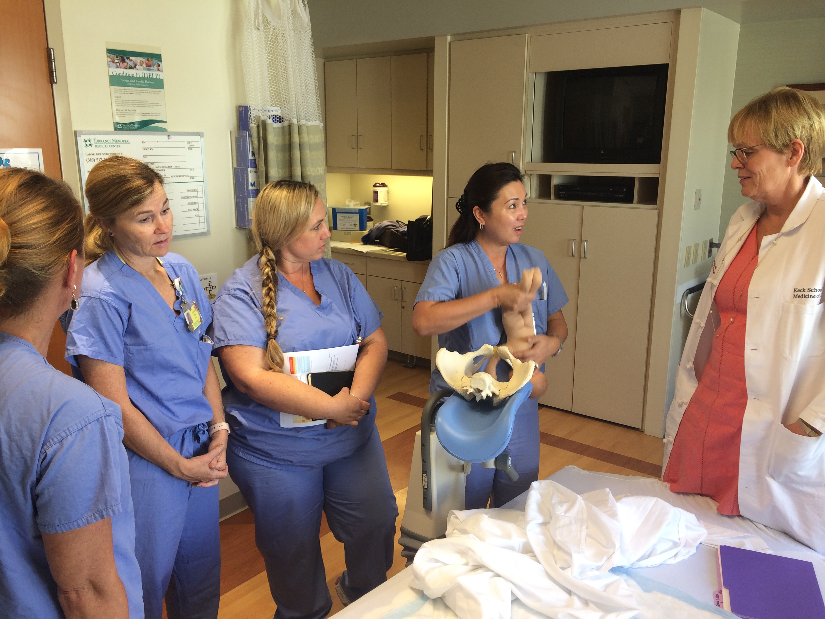
Labor Support
Notes:
Talk about education – how can nurses take control – after all….we do this every day
Skills Days
Superusers
Part of orientation
Spinning babies classes
Mini trainings
Connection and placing your hands on patients – useful when trained/retrained on Leopold’s, and assessing the position of the fetus internally and externally.
Labor support is more than just peanut balls and positioning though…

Slide 32

Think About Additional Education that Empowers
Birth Preferences
Rebozo
Communication
Intermittent Auscultation
Aromatherapy
Notes:
HUDLS – 25 lessons
I know you don’t have access – but how can your nursing staff home grow what the culture of labor support looks like in your facility. Many of these concepts are appropriately in the prevue of nursing and provide additional autonomous contributions to the project led by a unit practice council or informal leaders. Our nurses are creative and brilliant and they can come up with all kinds of ideas. Consider engaging a patient representative to contribute ideas to these projects.
CLICK
Talk through clicks – Communication LAST

Slide 33

Sustaining Success
Update structure measures
Keep up with chart audits
Reinforce with training and resources
Continue to share successes in a prominent place
Consider stretch goals
Notes:
Sustaining Success…The work is never done…and that is ok
Refer to slide

Slide 34
What if we Haven’t Achieved Success?
Regroup with your team
Elicit a broader range of support
Review your data
Narrow your focus
Set new goals
Re-educate
PDSA
Notes:
What if we haven’t achieved success? First of all….nonsense. Your team learned something (likely many things) that will give them the know-how they need to achieve the goal.
Regroup with your team
Elicit a broader range of support – connections you have made during the collaborative with like teams
Review your data
Narrow your focus
Set new goals
Re-educate
PDSA

Slide 35
Final Thoughts
Design SMART Goals with an impact statement in mind
No Data without Stories / No Stories without Data
Build everything into daily workflows
Be acutely aware of equity needs for different populations—LISTEN to and ENGAGE your patients
Recognize and build on the knowledge and creative implementation ideas from hospital teams
Make it FUN whenever you can
Notes:
Design Smart Goals with an impact statement in mind
No Data without Stories / No Stories without Data – success stories, accreta stories, cs readmissions
Build everything into daily workflows (harness the EHR!)
Be acutely aware of equity needs for different populations—LISTEN to and ENGAGE your patients
Recognize and build on the knowledge and creative implementation ideas from hospital teams
Make it FUN whenever you can. There is no such thing as too many awards!

Slide 36
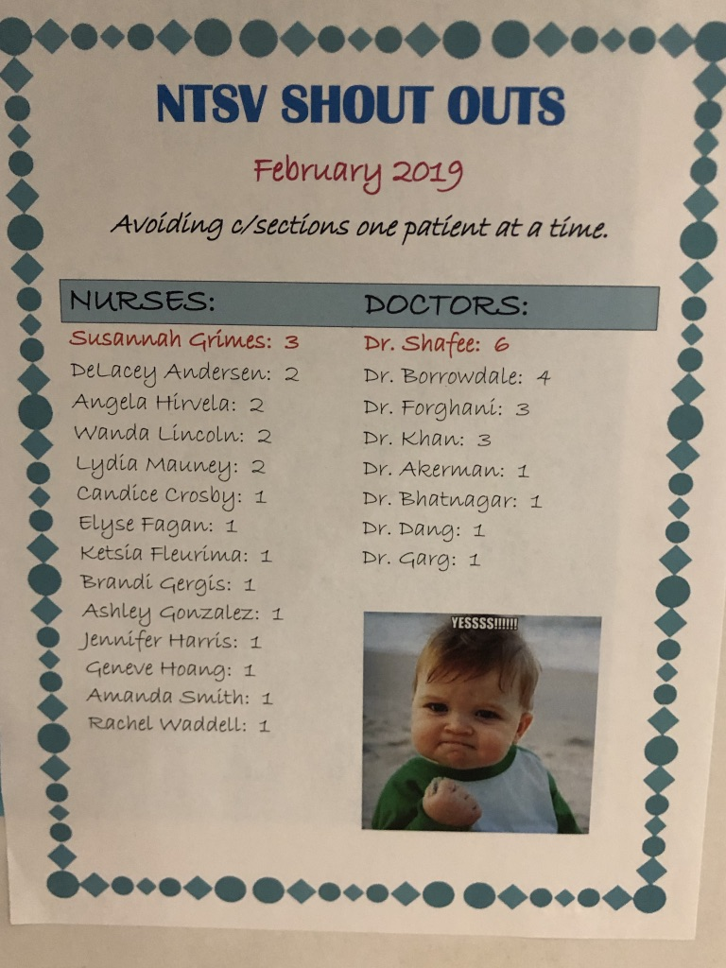
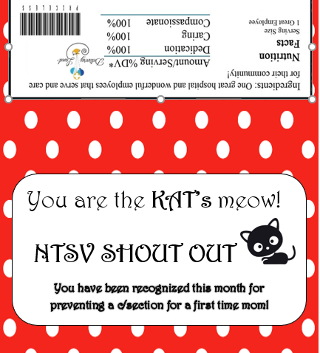
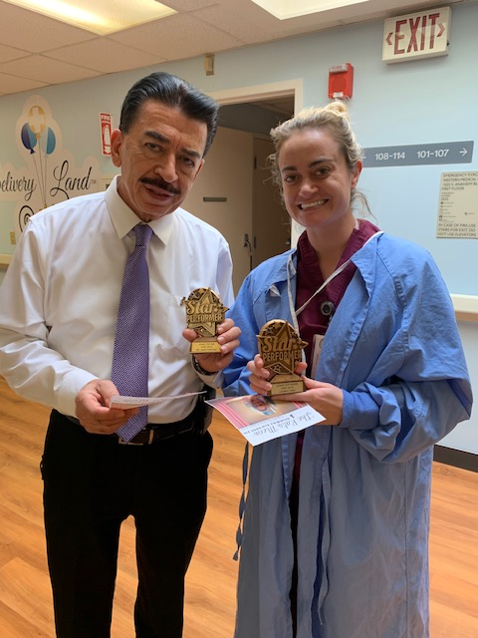
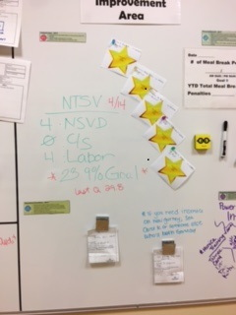
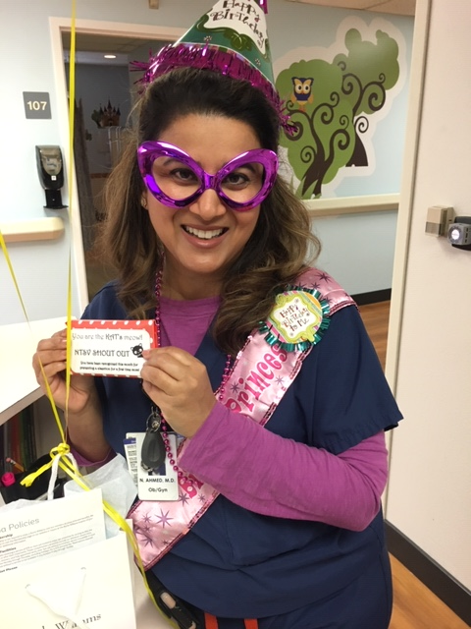
Celebrate!!!
Notes:
I hope that you all sent in your QI team photos for the contest. This work is incredibly hard and you deserve recognition. Promoting vaginal birth requires a change in culture and the slope of that hill is going vary widely from site to site and challenges like staff turnover can definitely impact the gains. Give yourself grace while keeping your eye on the prize. Don’t be afraid to change something that isn’t working. Like I said in the beginning, you’ve got this!

Slide 37

Questions

Slide 38
Notes:
Backdrop slide. Can also put this as the very first slide (before title slide) to be displayed on screen before you start talking.

