Slide 1
Recovering from the Pandemic:
The Role of Civility and Community
Dr. Gaurava Agarwal
Chief Wellness Executive, Northwestern Medicine

Slide 2
Recovering from the Pandemic:
The Role of Civility and Community
Dr. Gaurava Agarwal
Chief Wellness Executive, Northwestern Medicine
gagarwal@nm.org

Slide 3
Emotional
Highs
Honeymoon
Community Cohesion
Reconstruction
A New Beginning
Heroic
Pre-Disaster
Warning
Threat
Disillusionment
Setback
Impact
Working Through Grief
Coming to Terms
Inventory
Anniversary Reactions
Emotional
Lows
Trigger Events
Up to One Year After Anniversary
Substance Abuse and Mental Health Services Administration website: https://www.samhsa.gov/dtac/recovering-disasters accessed April 28, 2020.

Slide 4
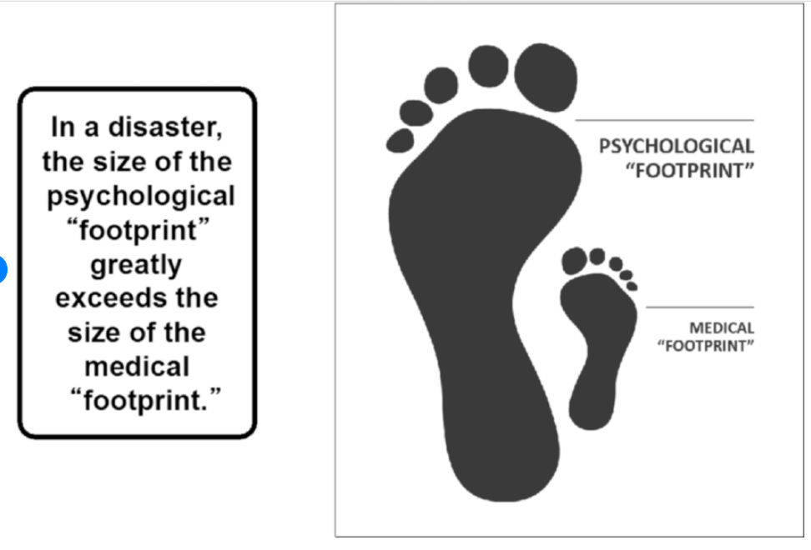


Slide 5
Health Worker Wellbeing During COVID-19 Pandemic
Public Policy
U.S. Government
Shelter in place Policy
Health System Leadership
Community
Scientific Knowledge
Support of Health workers
Community Morale
Community Behavior
Organization
Management
Media
Patient Care
Hospital Resources
Interpersonal
Routine
Family Functioning
Health of social circle
Team
Social Support
Individual
Hennein R, Lowe S (2020) A hybrid inductive-abductive analysis of health workers’ experiences and wellbeing during the COVID-19 pandemic in the United States. PLOS ONE 15(10): e0240646. https://doi.org/10.1371/journal.pone.0240646
https://journals.plos.org/plosone/article?id=10.1371/journal.pone.0240646
Personal Health
Self- Care

Slide 6
Organizational Climate and Culture
Organizational
Climate
Sociological
Belief about how one actually succeeds here
Long-lasting and slow change
Climate and Culture
Psychological
Perception of atmosphere
Managerial communications
Organizational
Culture

Slide 7
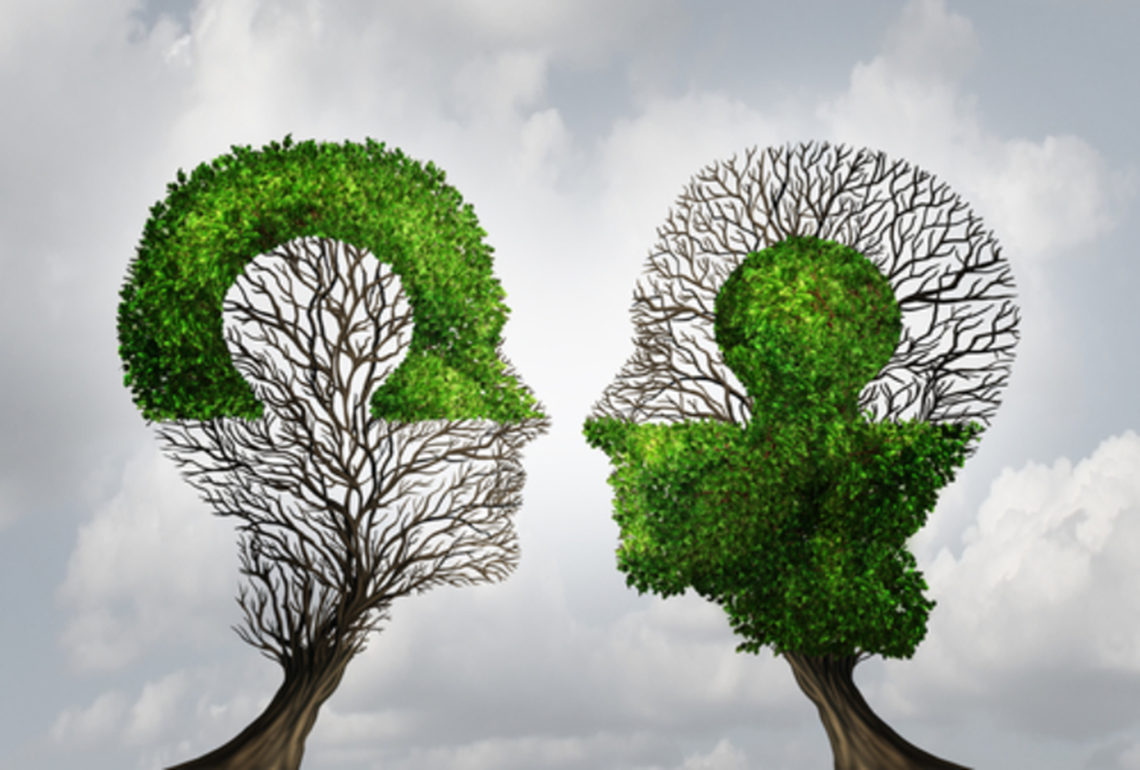

Slide 8
Trust
“Choosing to risk making something you value vulnerable to another person’s actions”
-Charles Feltman

Slide 9
4 Assessment Domains of Trust
Care (Foundational)
Sincerity
Reliability
Competence
Notes:
You have my interests in mind as well as your own, you have my well-being in mind.
Honesty and Integrity (Walk your Talk)---Intentional in our Behaviors and Actions
Keeping my Promises and Commitments (Do not overcommit, thinking about our yes and no and offers, make clear and complete requests)
Ability and Standards. I don’t trust someone to do something the way I want it done, but never had clear, shared standards on how I wanted it done.

Slide 10
Civility
“Civility is about more than just politeness, although politeness is a necessary first step. It is about disagreeing without disrespect, seeking common ground as a starting point for dialogue about differences, listening past one’s preconceptions, and teaching others to do the same. Civility is the hard work of staying present even with those with whom we have deep-rooted and fierce disagreements.”
Spath and Dahnke; Institute for Civility in Government

Slide 11
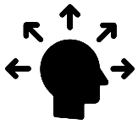


Fundamentals of Civility
Be Aware
Civility is a deliberate endeavor, requiring conscious awareness of oneself and others.
Communicate Effectively
Civil communication is more about how we say it as much as what we say.
Take Good Care of Yourself
It’s hard to be civil when personally stressed, distressed, or ill.

Slide 12
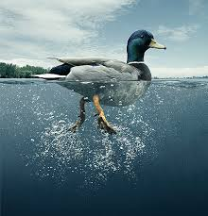
Be Aware

Slide 13
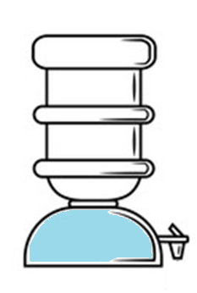
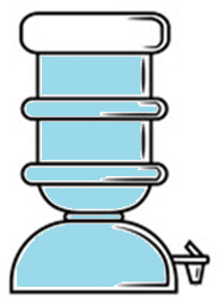

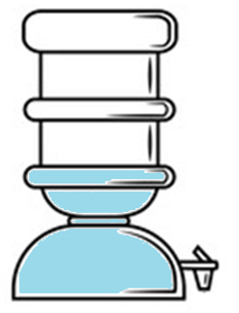
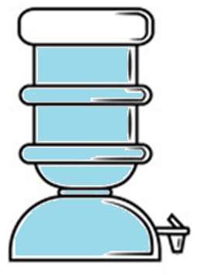
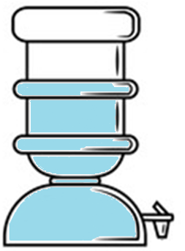
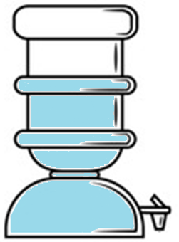
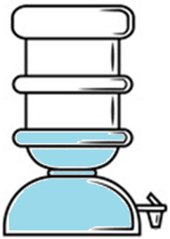

Delaying Deadlines
Social connection
Energy Tank
Processing Grief
Appreciation
Food, Rest, Water,
Sleep, Exercise
Coping
Reserve
Workload
Sleep Deprivation
Loneliness
Loss
Dunn, Iglewicz, Moutier. A conceptual model of medical student well-being: Promoting resilience and preventing burnout. Acad Psychiatry 2008
Trauma Triggers
21
Notes:
Here is a model that can help us to optimize flourishing and prevent crisis. This is something I came up with from personal and professional experience w patients and medical students. I want to share it with you because taking our own self-care deeper will not only help us to stay resilient but can inform the work we do in suicide prevention. What you live out these prevention practices, whether you have a MH condition or not- we all have MH to manage- this deeper experiential knowledge will get infused into your work and will inspire others. Remember contagion can work for good too.
This flourishing model is a reserve tank of substance we draw on for every day coping and for regulating emotional balance. The tank contains the reserve- but the fluid is constantly being drawn upon for use in life. There are inputs and outputs and some people have naturally leaky tanks, and others have naturally leak resistant. The drains on our coping reserve fluid are triggers or RF. (SHOW DRAINS) The inputs are things that fill it back up i.e. protective factors. (SHOW) The model boils down to a way to identify your own unique triggers (RF) and tank-fillers (PF). We know from research that RF and PF are critical to suicide prevention and we talk about RF a lot, so this is a way to put them into practice in a personalized way. Whether you carry suicide risk in your own life at various times, this model can be practiced to up our game, to optimize our MH.
I came up with this during a time when I needed to figure something out for myself for my own life. I was advising medical trainees and meeting with faculty in a dean/advisory role every day. I was also seeing patients in the VA and in a refugee trauma clinic. I was getting surprisingly fast promotions in my academic career, I’d lost colleagues and patients, so knew something about suicide and SP… and it was long after I’d come through an earlier major life changing crisis… but in my personal life I kept running into “mini-meltdowns” – feeling incredibly overwhelmed, upset, even trapped- and couldn’t figure out why. Strange for someone having so much success, or is it?
I got very serious about figuring it out in order to improve my own life- and for my family’s and pts’ sake- I wanted to prevent it from happening or at least lessen the severity of it.
I observed the patterns in my life and in the lives of my students and patients. I used a calendar and assigned points based on stress load to particular events, I thought about how certain relationships had become toxic and how certain people in my life would leave me feeling drained- unworthy or spiraling down. I used the calendar to look ahead and see what was coming the following month, and shored up my inputs (exercise, sleep, breathing exercises/prayer/meditation) just enough that I would get through the stress loaded periods better. I also made changes in relationships in my family and at work, setting healthy boundaries, etc. It was a process and wasn’t a solo journey- I had my S.O. to help brainstorm and support the changes I needed to make, I had therapy at various times, I was bolstered by krav maga and therapy to feel more worthy and more present. And spiritual practices were part of it as well. What I’m describing is multi-faceted where MH can improve as part of treatment, spiritual practice, interpersonal relationship growth, and mentorship/community.
There are many possible inputs to the flourishing tank, and many potential drains. Spend some time reflecting on what are the bigees for you. This requires objectivity and pattern recognition sometimes over long periods of time, and maybe some help from a trusted person or therapist.
Our work will be taken to the next level by this deeper way of understanding how prevention works, and living it out as much as we possibly can.
It also helps us flesh out what we mean when we say that “everyone has mental health” and when we say that prevention is possible. Our message: if you have a MH condition, treat and manage it as aggressively as possible. And for everyone, we all have MH to manage and optimize, crises to prevent.
[The next task is to determine if the inputs and drains are modifiable or not. Realize that we often assume things are out of our control, when there are actually little creative ways to modify it just enough to slow down the leak to a minimum. {For example, a chore you do at home and you assume that no one else will do it.}
There are some things that are not changeable. By mindfully acknowledging that fact, you might find that there is a new way to live and breathe through it rather than feeling frustrated, angry or resentful.]

Slide 14
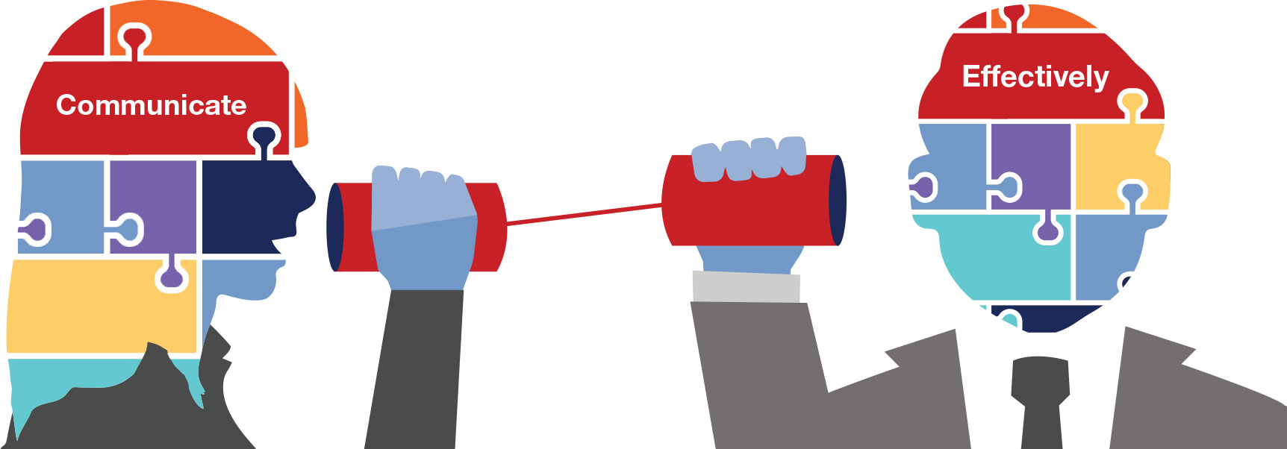
Communicate Effectively
“The single biggest problem in communication is the illusion
that it has taken place.”
George Bernard Shaw

Slide 15
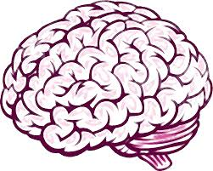

Listen Deeply.
Speak Unarguably.
When Leaders are Above the Line:
Open
Live in Curiosity.
Hold Story Loosely.
Curious
Committed to Learning
Where Am I?
We go below the line from…
When Leaders are Below the Line:
Loss of approval.
Closed
Loss of control.
Defensive
Loss of security.
Committed to Being Right
Behaviors that may surface:
Find fault and blame.
Gossip and drama.
Rationalize and justify.
Create
a story.
Reptilian Thinking
Emotions.

Slide 16
Take Care of Yourself
In our control
Within our influence
Out of our control

Slide 17
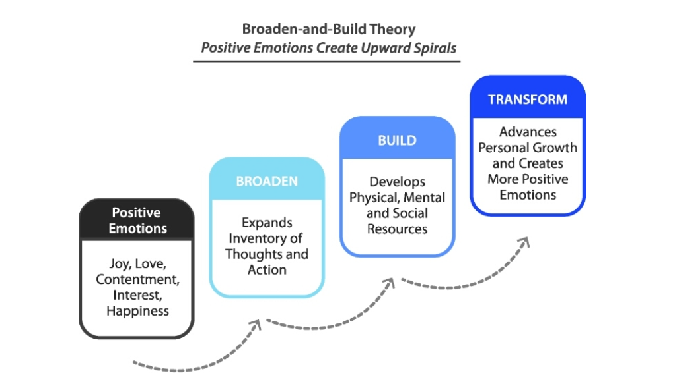

Slide 18
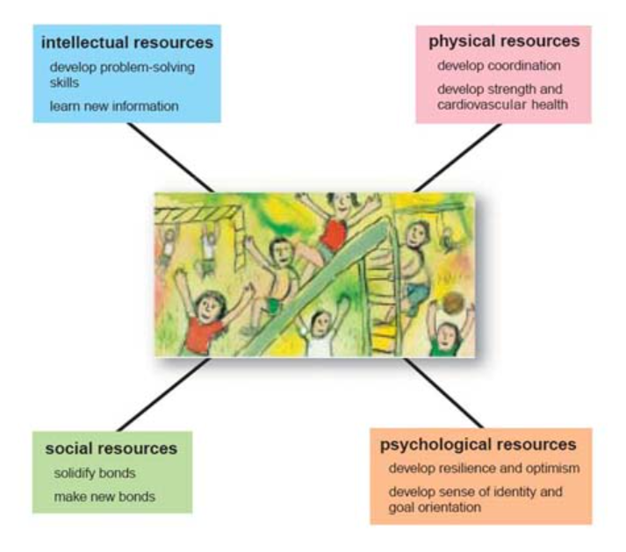

Slide 19

Community: Teams are Greater than the Sum of their Parts

Slide 20
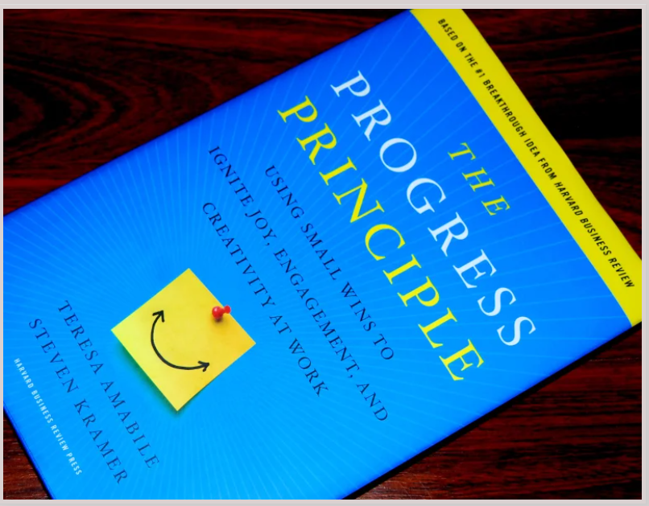

Slide 21
Inner Work Life System
Perceptions/thoughts
(Sense-making about workday events)
The organization
Managers, self, team
The work itself
Emotions/feelings
(Reactions to workday events)
Positive emotions
Negative emotions
Overall mood
Workday Events
Individual Performance
Motivation/drive
(desire to do the work)
What to do
How to do it
When to do it
Whether to do it
Amiable, T & Kramer, S. (2011). The Progress Principle

Slide 22
Positive Inner Work Life
Daily
Events
1
The Progress Principle
Events signifying progress
Small wins
Breakthroughs
Forward movement
Goal completion
2
The Catalyst Factor
Events supporting the work
Setting clear goals
Allowing autonomy
Providing resources
Providing sufficient time
Helping with the work
Learning from problems and successes
Allowing ideas to flow
3
The Nourishment Factor
Events supporting the person
Respect
Encouragement
Emotional Support
Affiliation
Positive Inner Work Life
Amiable, T & Kramer, S. (2011). The Progress Principle

Slide 23

Dr. Gaurava Agarwal
gagarwal@nm.org

