Slide 1

Celebrating Perseverance with our Strong ILPQC Community
2022 Virtual Neonatal
Face-to-Face Meeting

Slide 2
ILPQC Community
Joins over 95% of birthing hospitals and neonatal intensive care units in Illinois (and Missouri)
Collaborates with physicians, nurses, hospital teams, patients, public health and community stakeholders
Works together to implement evidence-based practices to improve maternal and infant health outcomes

Slide 3
ILPQC Initiatives
Neonatal
Obstetric
Neonatal Nutrition
18 teams
Golden Hour
26 teams
Mothers and Newborns affected by Opioids (MNO) – Neonatal
88 teams
Babies Antibiotic Stewardship (BASIC)
82 teams
Future Initiatives
Improving Postpartum Access to Care
Immediate Postpartum Long-Acting Reversible Contraception (LARC)
Birth Equity
86 teams
Early Elective Delivery
49 teams
Birth Cert Accuracy
107 teams
Maternal Hypertension
112 teams
Mothers and Newborns affected by Opioids (MNO) – Obstetric
101 teams
Promoting Vaginal Birth (PVB)
94 teams
2014
2015
2016
2017
2018
2019
2020
2021
2022
2023
Notes:
From 2014 to now our ILPQC community has impacted and improved the health outcomes of tens of thousands of mothers and birthing patients and their babies. Our newborn community has grown from 18 NICU teams to over 80 NICU/SCN/mother/baby unit teams.

Slide 4







BASIC -
What we have accomplished with virtual connections
December 2020:
BASIC Launch
April 2021:
Integration into the EMR
August 2021: Collecting Race and Ethnicity Data
Feb 2022:
BASIC Data Through an Equity Lens
January 2021: Introduction of NEOSC
July 2021:
Parent Education Materials and Antibiotic Timeouts
December 2021: Automatic Stop Times
Notes:
With our current BASIC initiative, we have come together to accomplish so much as our community turned to virtual connections.

Slide 5
The ILPQC Community:
The Groundwork for BASIC and Beyond
Team Lead Training Webinars
Partnering with parents
Examining Disparities and Inequities
Working together to achieve better outcomes for newborns
HIT/EMR partnership
Data Training Webinar
QI Education
Notes:
Together we have worked together to achieve better outcomes for newborns.

Slide 6
Building Team Capacity
ILPQC hosted a Data Training Webinar for BASIC teams to review the data collection, entry and report review in REDCap
Team Lead Training Webinars
QI Education
ILPQC hosted 2 QI Team Lead Training webinars in 2020 and 2021 to help them better understand their roles
QI Team members had the opportunity to attend virtual QI training at the Institute for Healthcare Improvement (IHI)
Data Training Webinar
Notes:
Together we have built team capacity

Slide 7
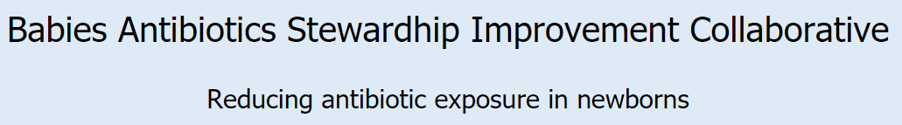
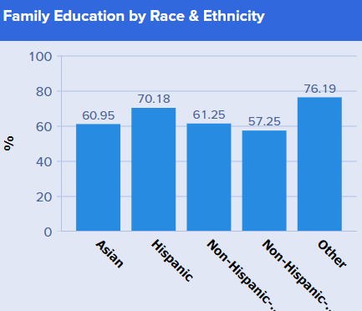
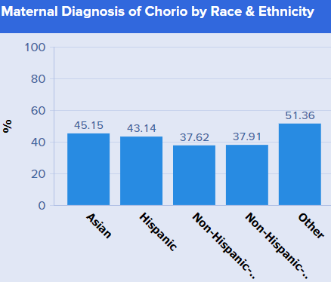
Examining Disparities and Inequities
ILPQC hosted 2 webinars focusing on neonatal equity:
Sharing BASIC Data by Race and Ethnicity in the Dashboard:
August 2021
BASIC Data through an Equity Lens
February 2022
Equitable Care in BASIC:
Equity Data, Dashboards, Strategies to Collect Race/Ethnicity Data
Notes:
Together we began to examine disparities and inequities

Slide 8
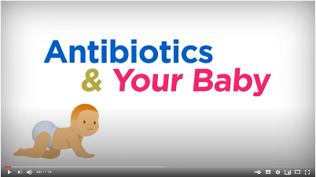
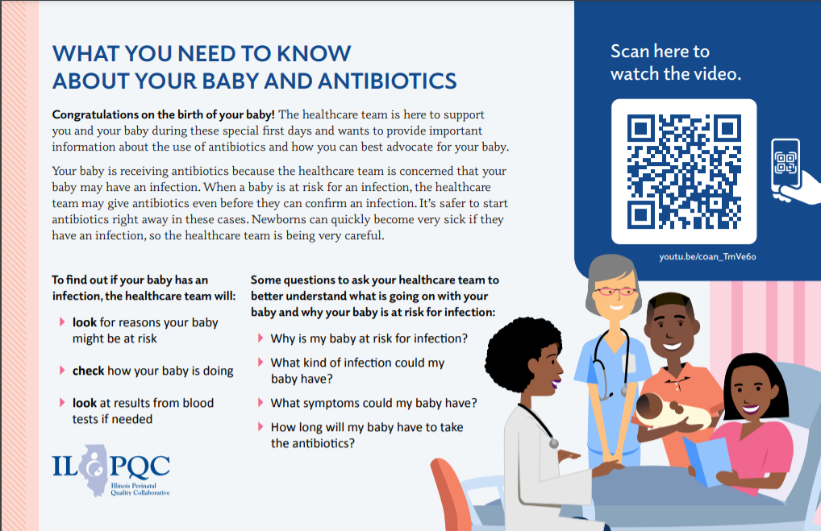
Partnering with Parents
Partnering with parents through education:
Antibiotics Education Flyer
Antibiotics & Your Baby Education Video
Notes:
Together we partnered with families

Slide 9




Developing HIT/EMR Partnership
Developed relationships with IT and EMR departments to better utilize the EMR for quality improvement:
            The EMR is a powerful tool that has become an integral part of providing patient care
            An understanding of the EMR capabilities allows you to fully leverage this tool to support current and future QI efforts
            Establishing a working relationship with IT will set you up for success in the future
Notes:
Together we built new relationships

Slide 10
Hospital Team Accomplishments
82
53
47
29
December 2020 Teams participating in BASIC Launch
May 2021: Outstanding Launch Award Winners
October 2021: QI Recognition Award Winners
May 2022: QI Excellence, Leader and Recognition Award Winners
Notes:
After years of distance, isolation, disconnection, exhaustion, and pain. Communities are essential. Our community has accomplished all of this during the COVID pandemic.
Already by May 2022, 29 teams have achieved substantial success in the initiative and we have 6 months to go!

Slide 11
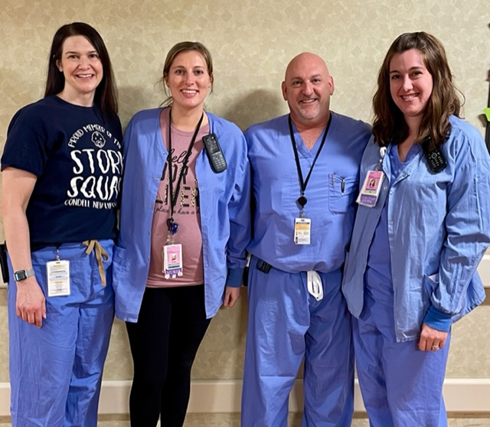
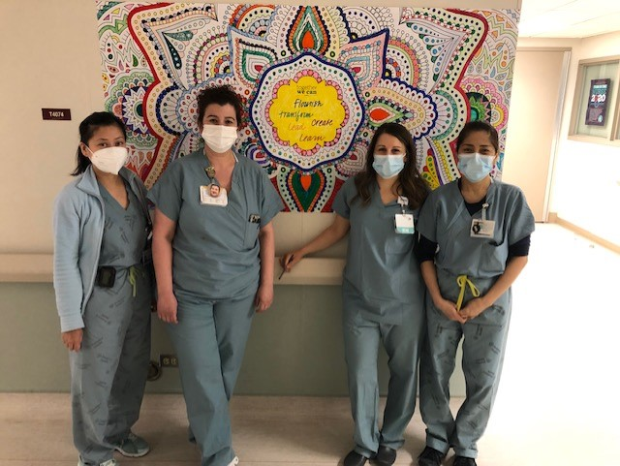
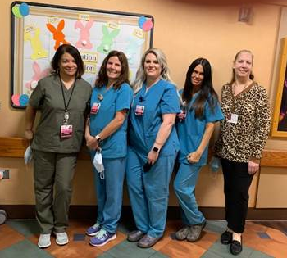
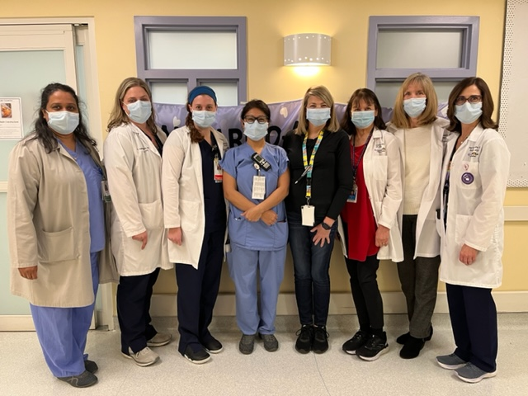
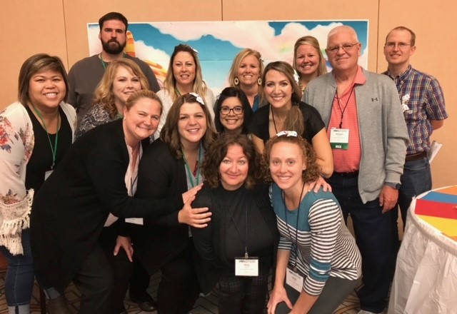
Notes:
ILPQC and the work we do is our community. We are a group of individuals, teams, and organizations that share common attitudes, interests, and goals. ILPQC connects us. Each of us is unique and we come together with a common goal. We work together to improve the health outcomes of babies in Illinois. Together; we connect, belong, share, learn, grow, offer, and support.

Slide 12
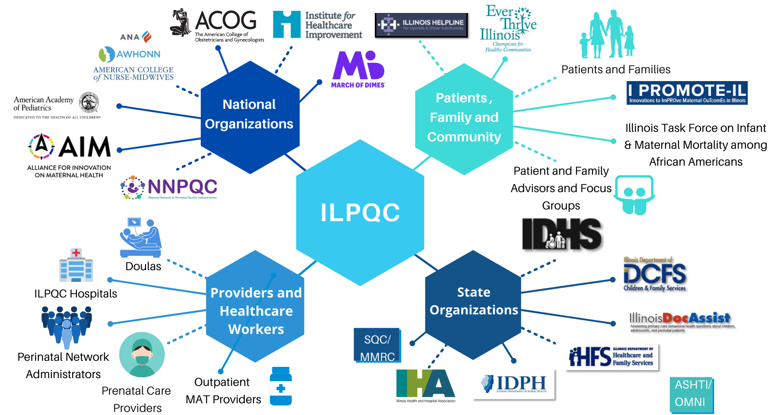
ILPQC Community
Notes:
We are a larger network of hospital teams, perinatal clinicians, patients, public health leaders, and policymakers committed to improving obstetric and neonatal care to reduce disparities and improve outcomes for all mothers, birthing patients and newborns in Illinois.

Slide 13
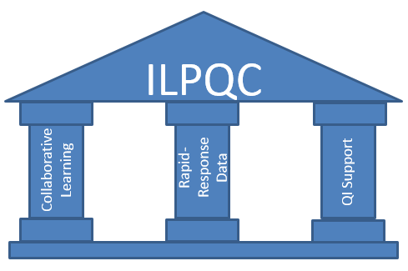
ILPQC Foundation
Our ILPQC Community
Notes:
We talk about ILPQC pillars as the supports, and they certainly are, but are foundation is our community
Our community connects us. It builds a foundation for current and future work. It is appreciated and celebrated.
Community provides a sense of togetherness.
Community provide connection.
Community provides a collective identity.
Community provides a sense of belonging.
Communities provide opportunities for sharing.
Communities provide opportunities for learning.
Communities provide opportunities for growth.
Communities are rich in resources.
Communities provide comfort in difficult times.
Communities provide support.

Slide 14
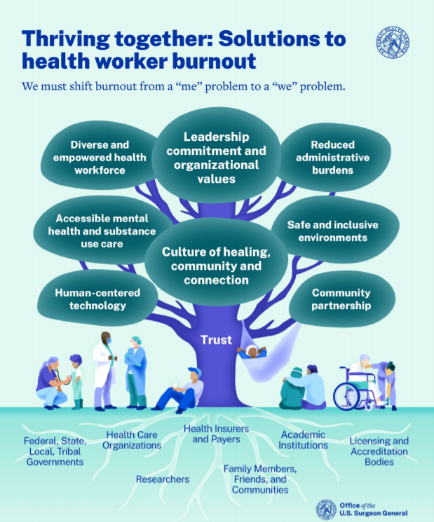
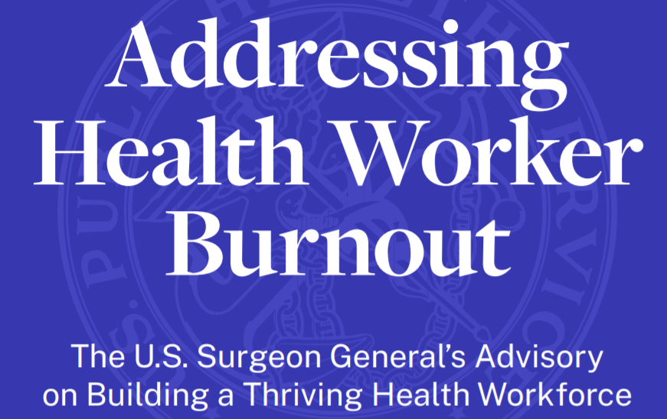
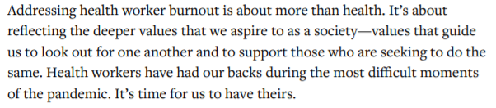
Notes:
Just this week the US surgeon General issued an advisory addressing health worker burnout. This advisory recognizes social connection and community as a core value of the health care system. It recognizes that strengthening social connection and community enhances job satisfaction, protects against loneliness and isolation, and improves the quality of patient care. Peer and team-based models, like ILPQC, are one way to strengthen collaboration, create important opportunities for social support and community for health workers, while also mitigating burnout and moral distress. Collaboration and a sense of belonging also contribute to the well-being of health workers and patients by building connections between health care, public health, and the community.

Slide 15
Hope endures
A few weeks before this Advisory was published, I met with a group of health workers at Jackson Memorial Hospital in my hometown of Miami, Florida. When I went around the room and asked everyone how they were coping with the pandemic and its impact on their work, one nurse told me he felt “helpless, but not hopeless.”
I was struck by his faith. After two unfathomably traumatic years, he was still showing up—sometimes tired, sometimes overwhelmed, sometimes scared or lonely, but always confident in the power of his compassion, his colleagues, and his community to make things just a little bit better every day.
Notes:
In his concluding thoughts, he shares a reflection.
He concludes his advisory by noting, “The hope of health workers has endured through far worse. Our efforts must as well.”

