Slide 1
Laboring with Hope: The Power of Community Voices to Address Birth Equity
Nakeitra Burse, DrPH, CHES

Slide 2
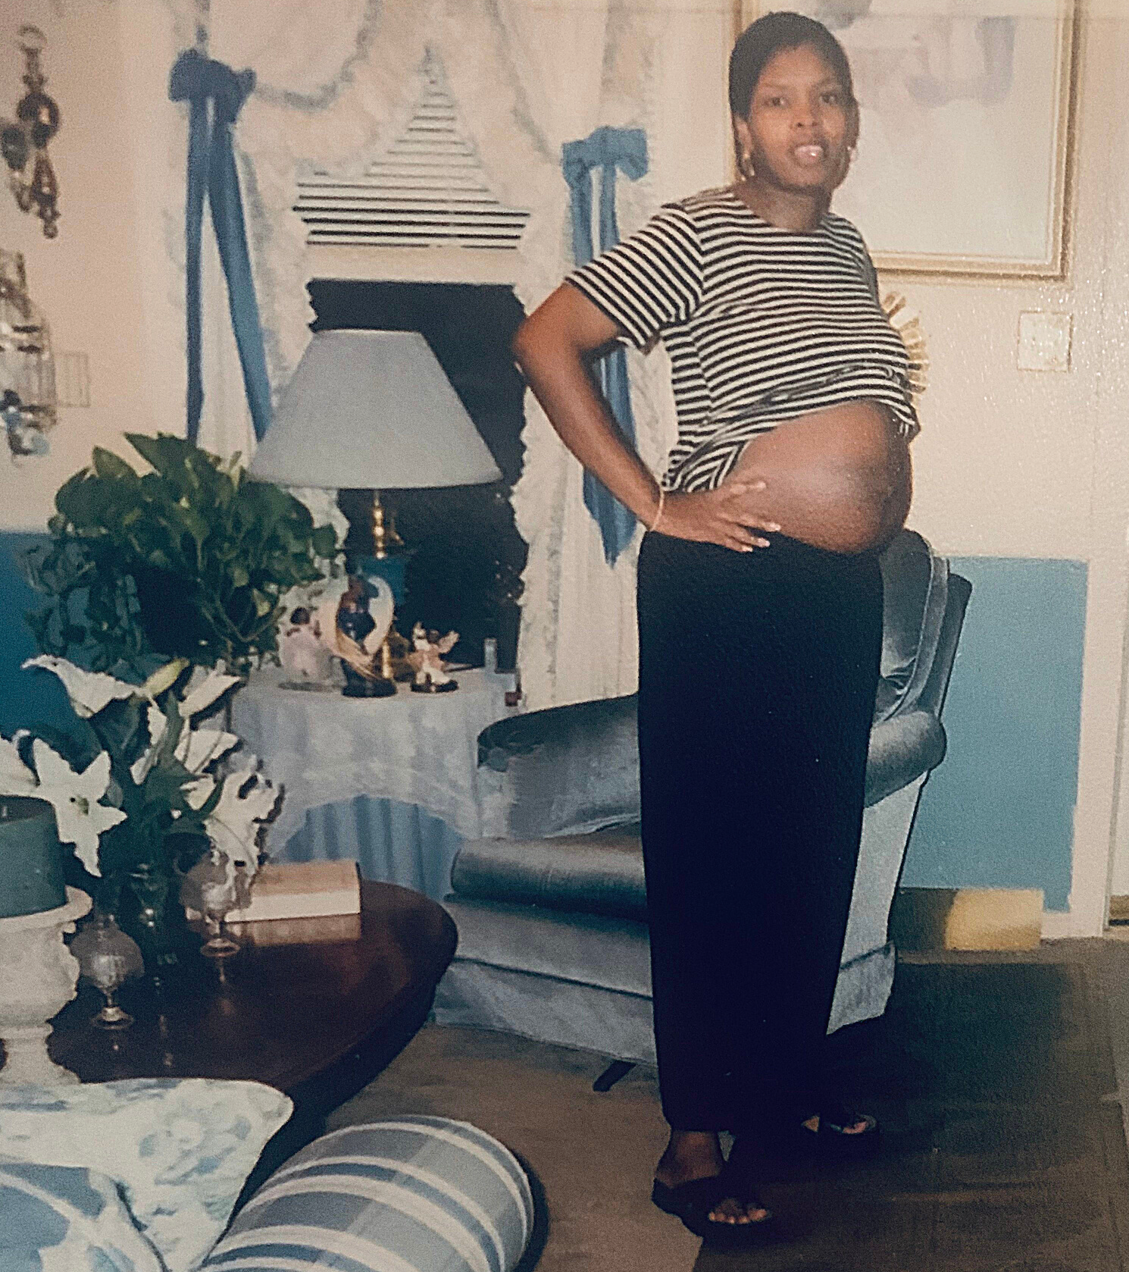
The Power of Labor
Addressing Black Maternal Health through Community-Based Strategies
Dr. Nakeitra L. Burse
Illinois Perinatal Quality Collaborative 2022 Conference May 25, 2022

Slide 3
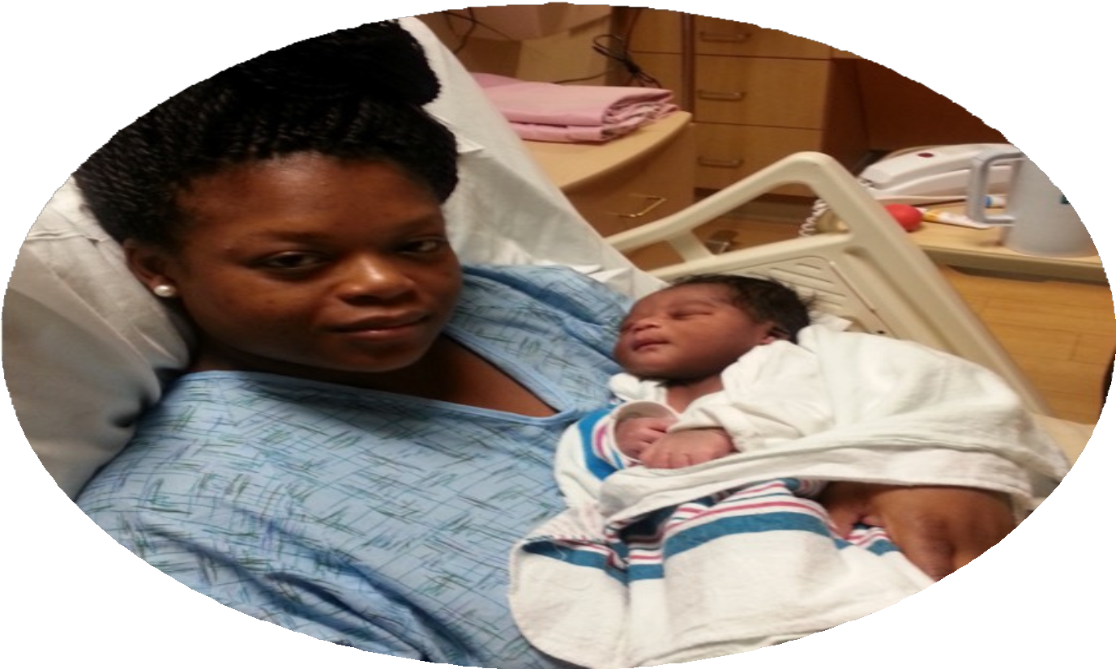
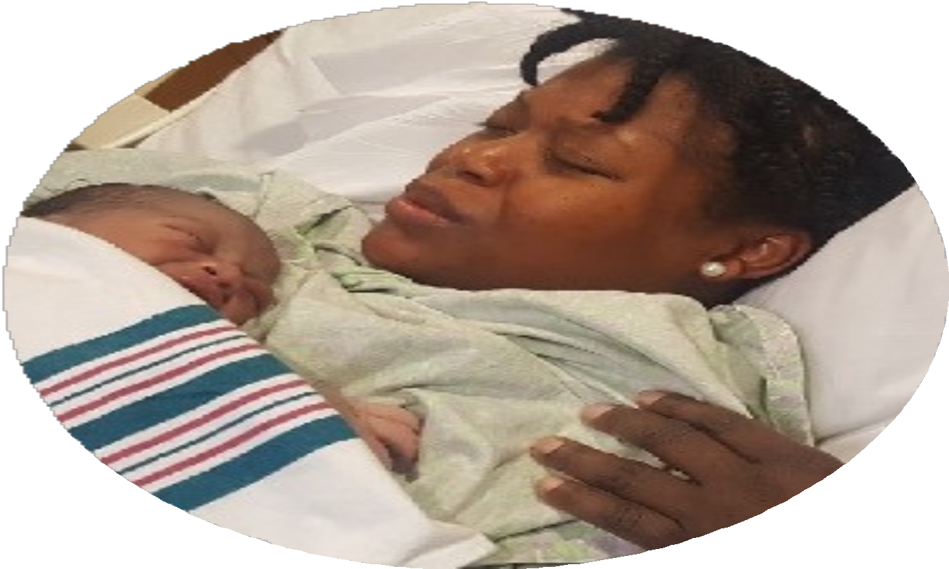
LABOR
PHYSICAL WORK
CHILDBIRTH

Slide 4
CHILDBIRTH & PARENTING FOR THE BLACK WOMAN
Comorbidities
Excitement
Childbirth & Parenting
Access to
care
Racism
Rewarding

Slide 5
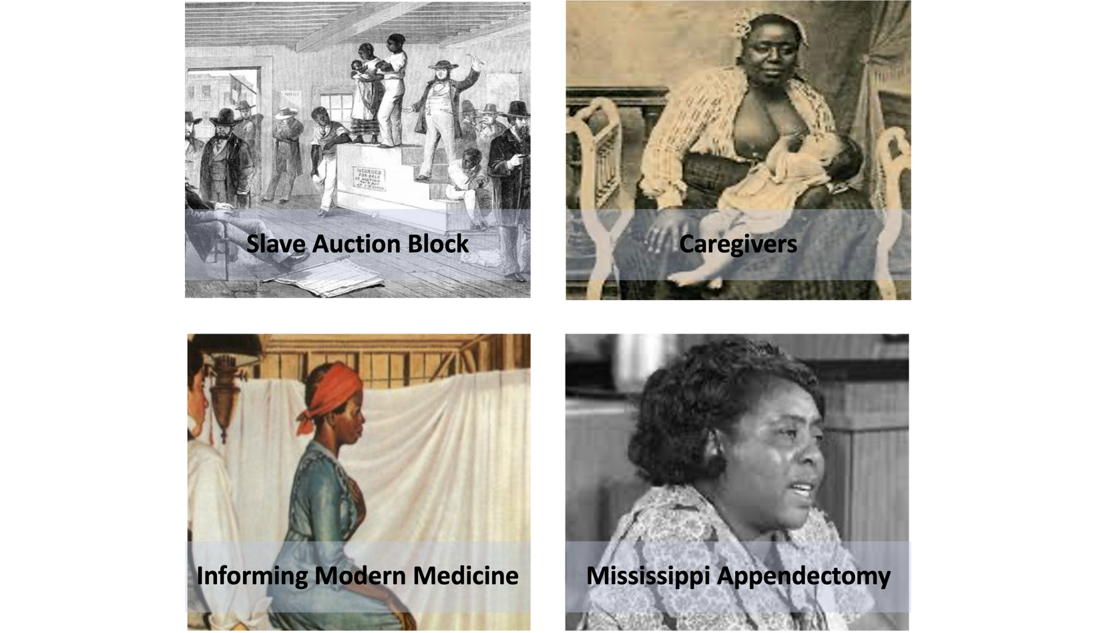
HOW DID WE GET HERE?

Slide 6
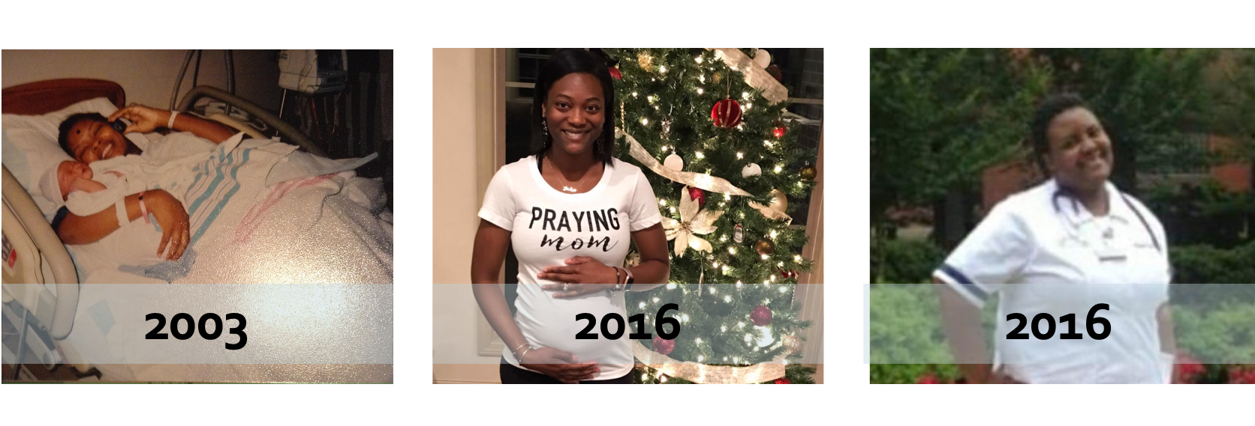
WHY ARE WE STILL HERE?

Slide 7
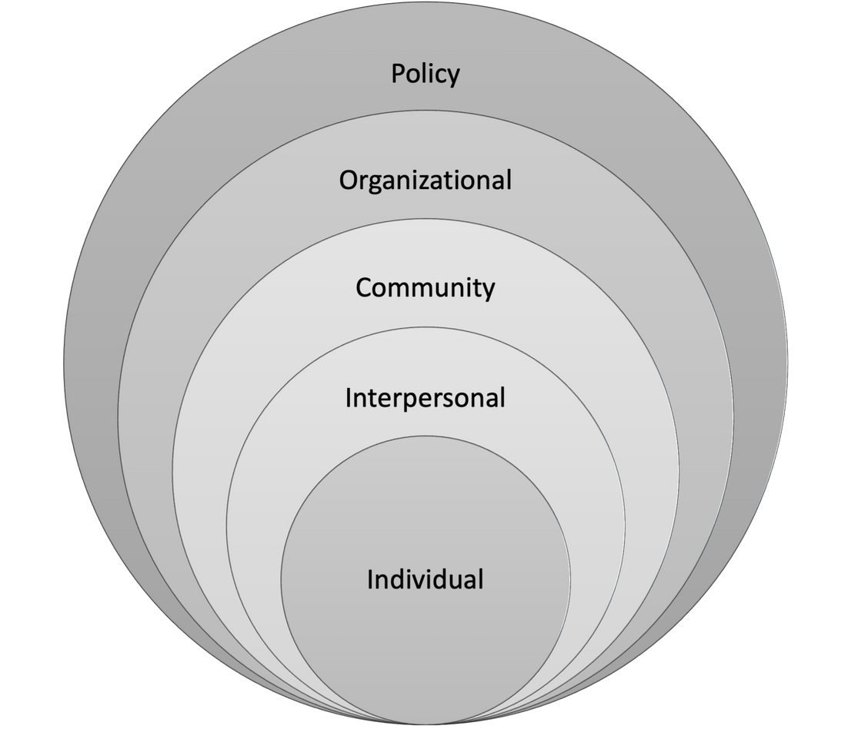
The Big Picture
An Ecological Appproach
Access to adequate health insurance
Access to quality healthcare Organizational policy Access to and recognition of
additional supportive care models and strategies
Abandoning white supremacist operations & adopting anti-racist practices
Community awareness and advocacy
Supportive social networks Family advocacy and education Self efficacy

Slide 8
YOU DON'T MAKE CHANGE BY SITTING ON THE SIDELINES WHIMPERING & COMPLAINING, YOU CREATE CHANGE BY IMPLEMENTING IDEAS.
SHIRLEY CHISHOLM
How do we create sustainable change?

Slide 9
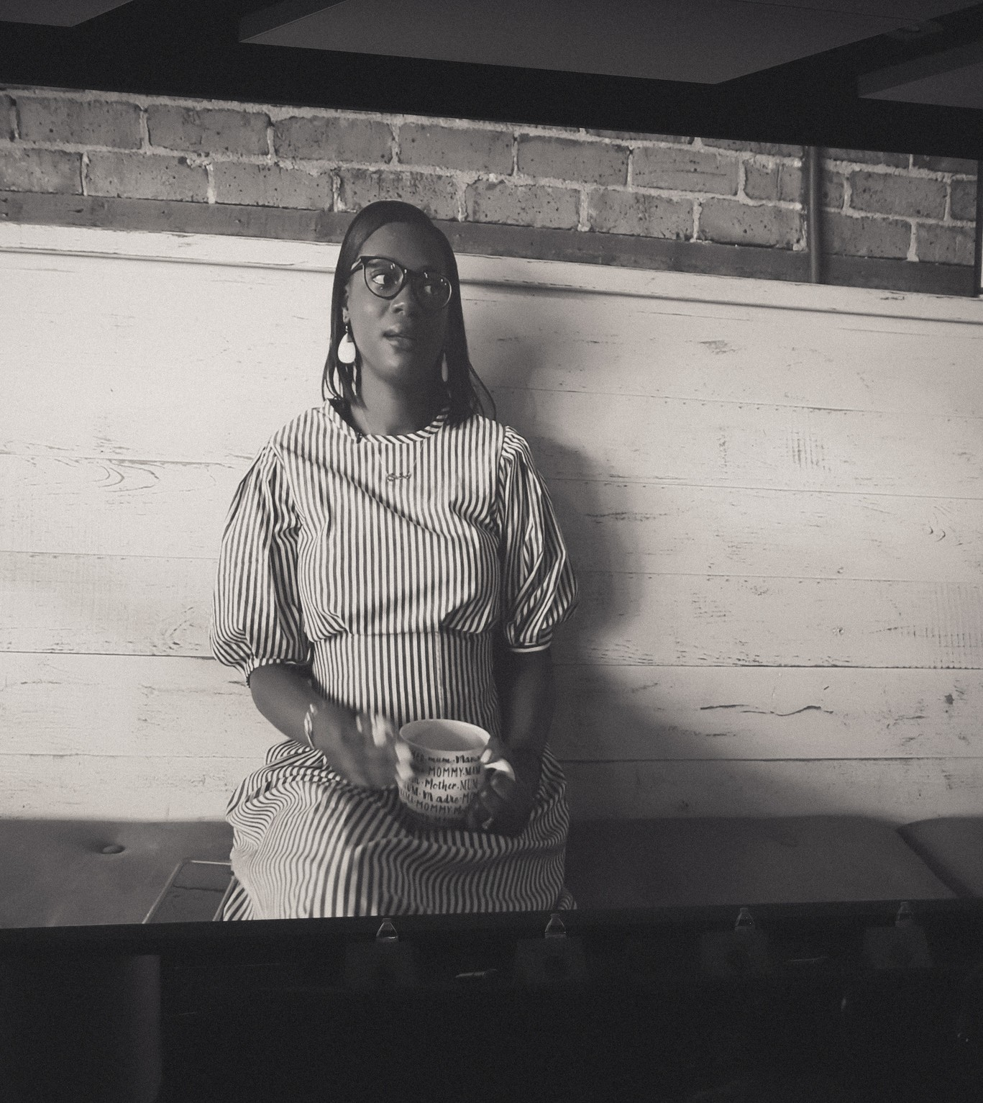
What are we doing?
Following the evidence
Collaboration, collaboration, collaboration
Amplifying and honoring Black voices and stories
Shifting power dynamics Listening...a lot

Slide 10
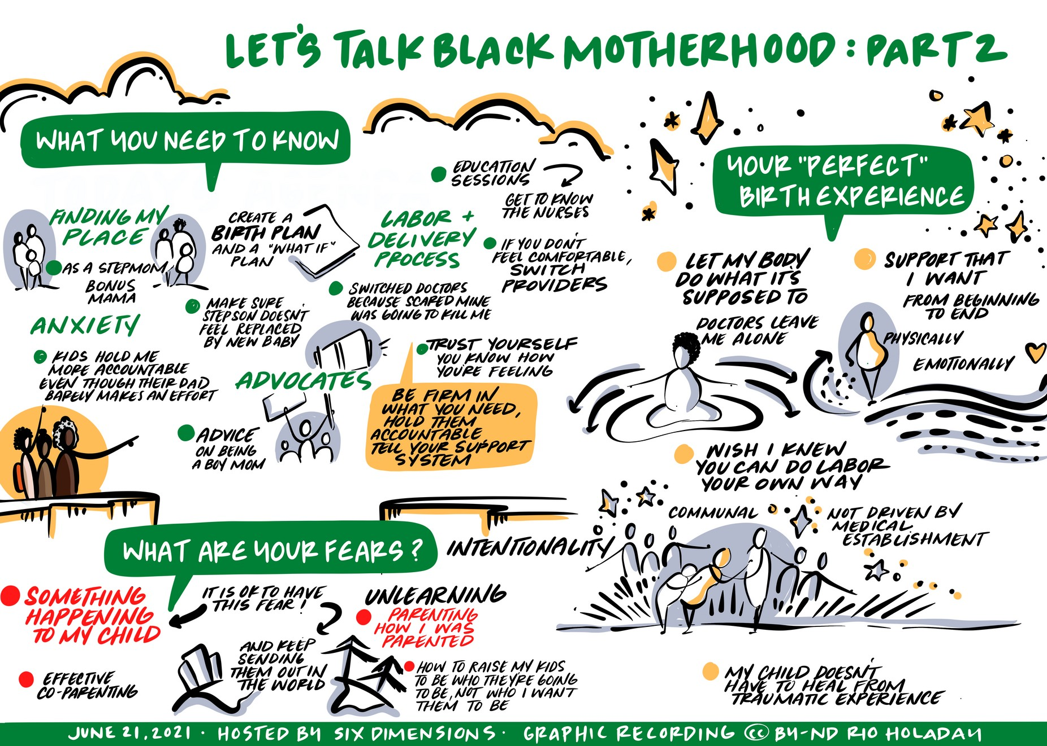
Listen to Black Mothers
Providers who listen
Support (physical & emotional) Community
Support in birth planning Relationship with healthcare provider Wishes honored
Less stigma
Options for the right provider Self efficacy
Parenting support Generational legacy

Slide 11
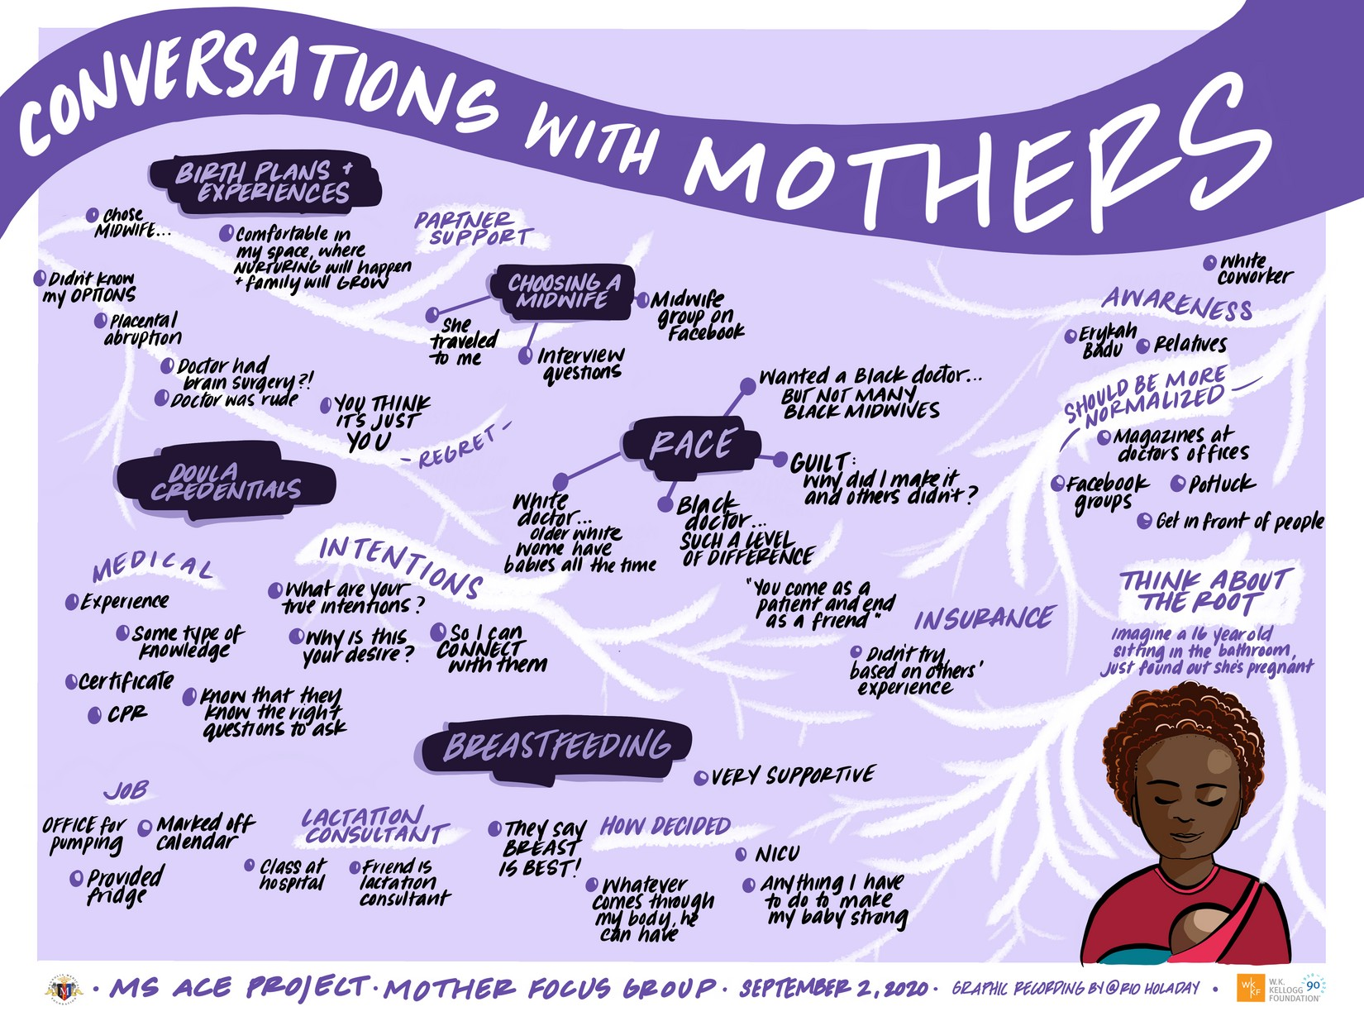
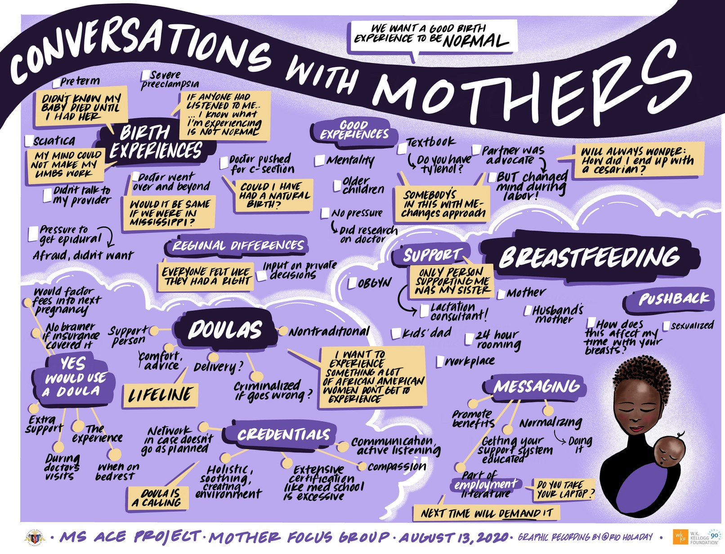
Listen to Black Mothers
Partner support
A good birth experience to be normal Representation in healthcare facilities
A supportive workplace (breastfeeding) A provider that looks like them

Slide 12
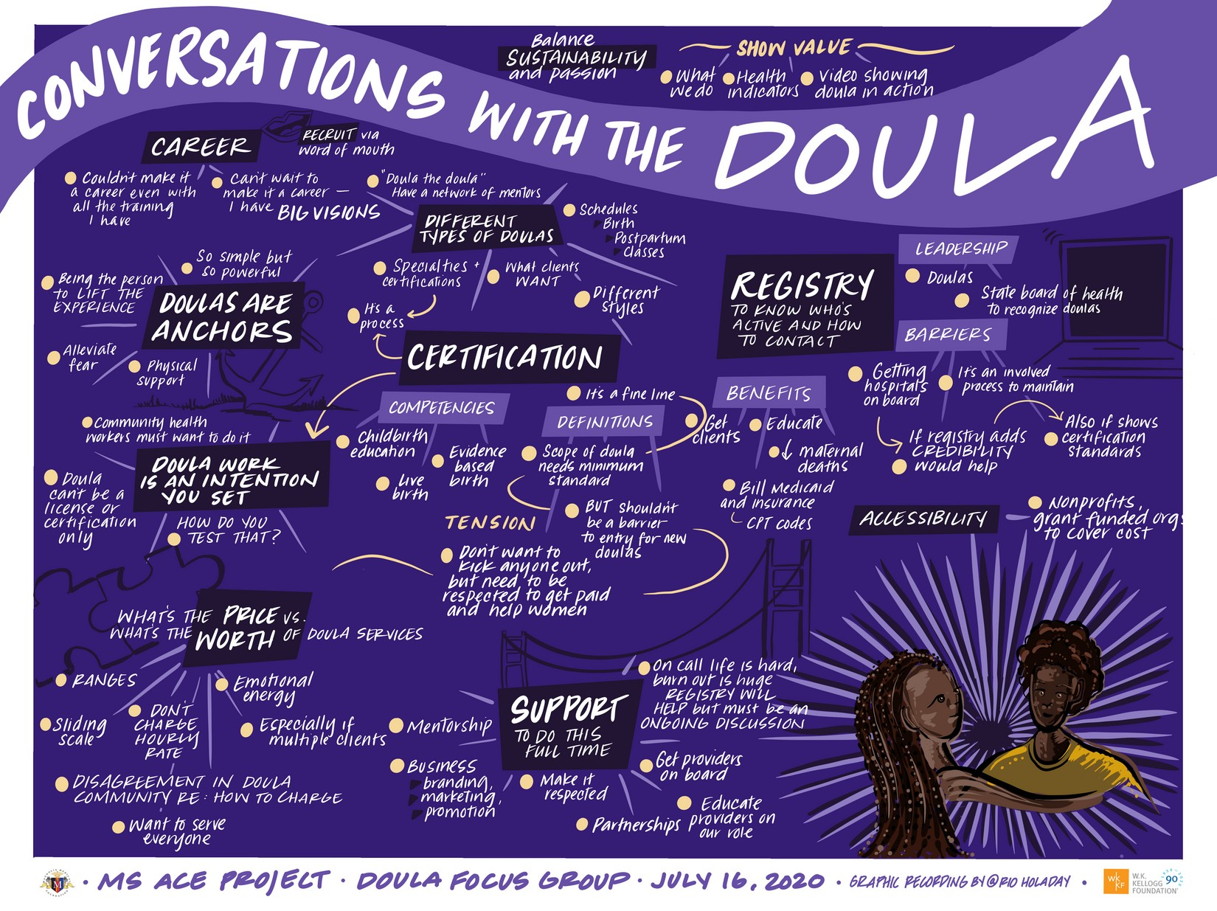
Follow the Evidence
Doula involvement is a cost-effective method to improve outcomes for mothers and infants.
Impact of doulas on healthy birth outcomes. 2013
Sustaining as a career and/or business
Emotionally and physically taxing
Certifications grounded in equity
Accessibility to those in most need
Coordination & integration into the healthcare community
Framing the narrative around the value of doula services

Slide 13
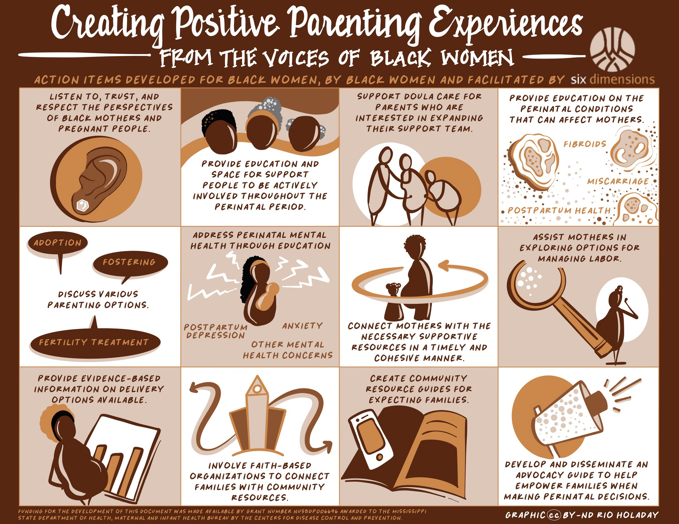

Slide 14
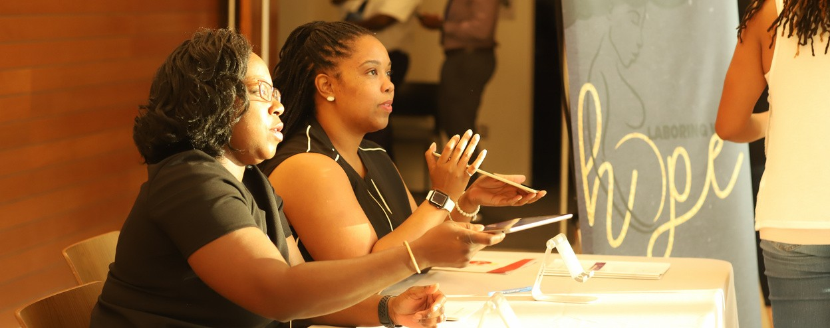
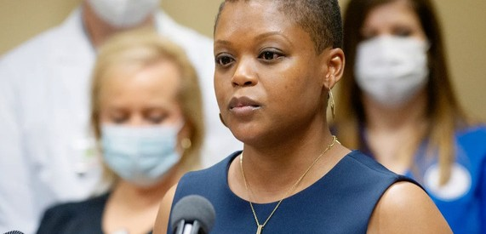
WHAT DOES THE WORK LOOK LIKE AT THE SYSTEMS LEVEL?
NARRATIVE CHANGE &
STORYTELLING
CURRICULA & TRAINING
ADVOCACY

Slide 15
WHAT DOES THE WORK LOOK LIKE AT THE COMMUNITY LEVEL?
SUPPORT FOR MOTHERS
EDUCATION & RESOURCES
ACCESS TO
BIRTHWORKERS

Slide 16
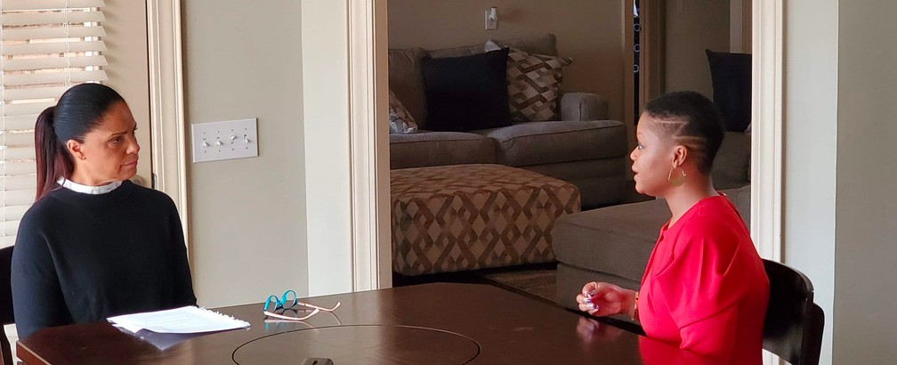
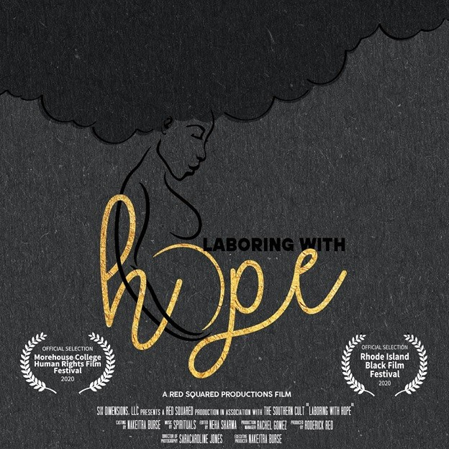
NARRATIVE CHANGE & STORYTELLING

Slide 17
Training & Curricula
Health & Racial Equity in Maternal Care Pilot Course
Building the capacity of birthworkers to sustain in business

Slide 18
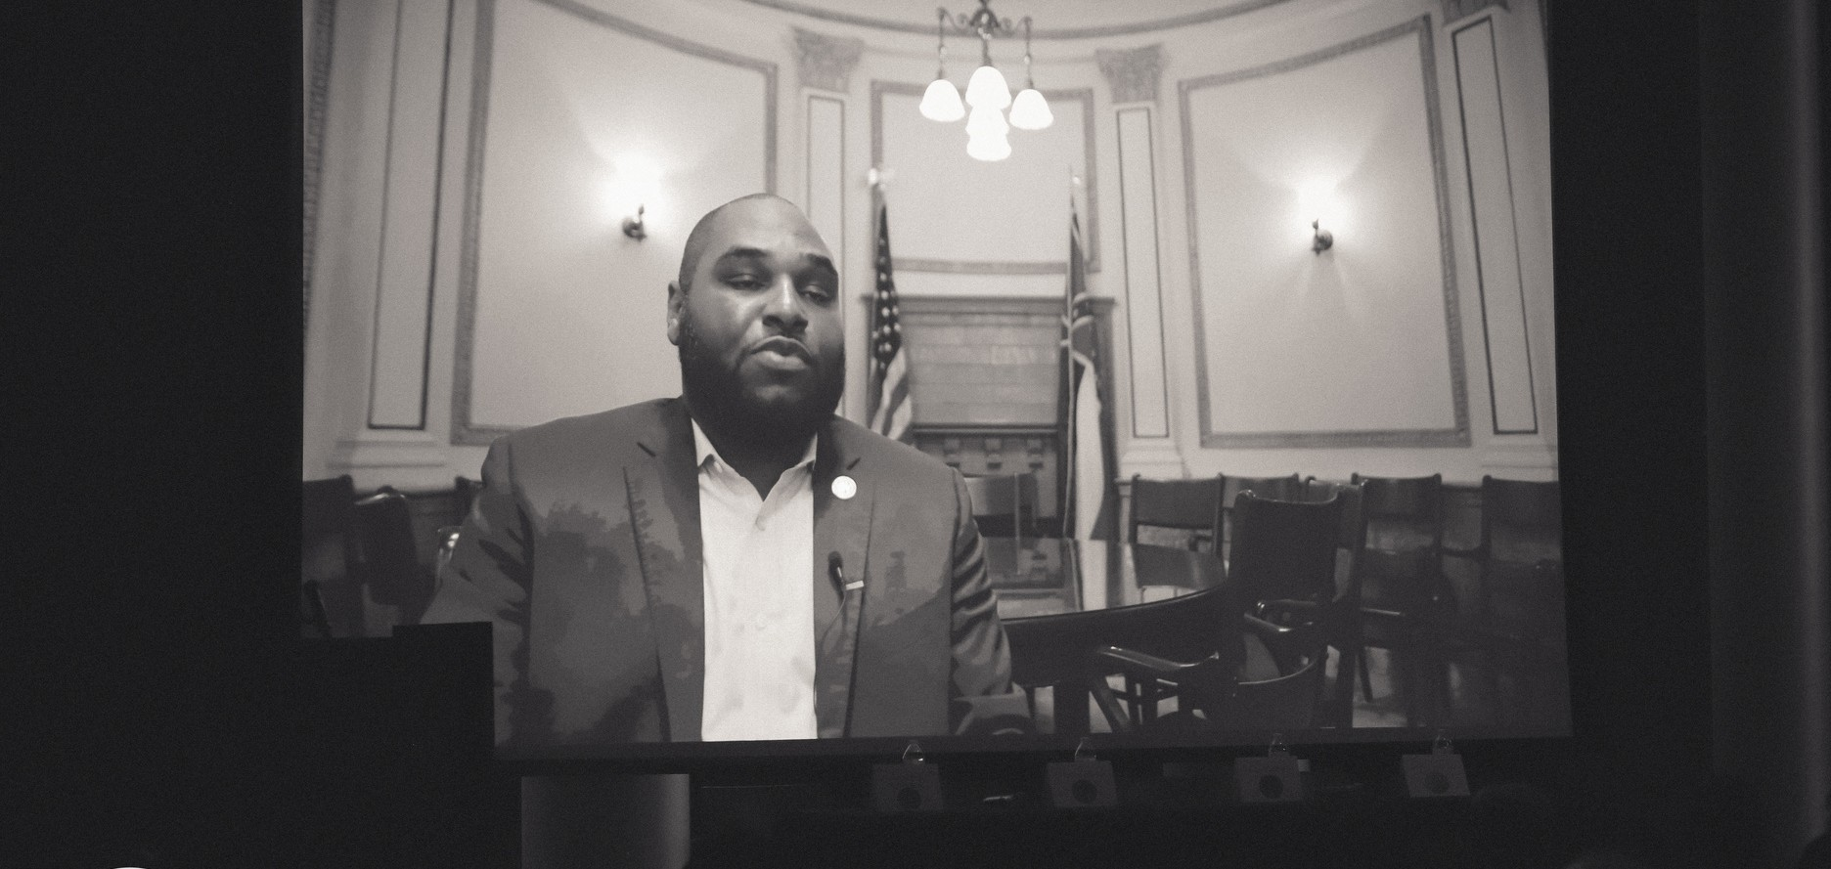
Breastfeeding Support
Supporting breastfeeding friendly businesses
Healthcare Access
Medicaid expansion - Care4MS Coalition Extending postpartum care

Slide 19
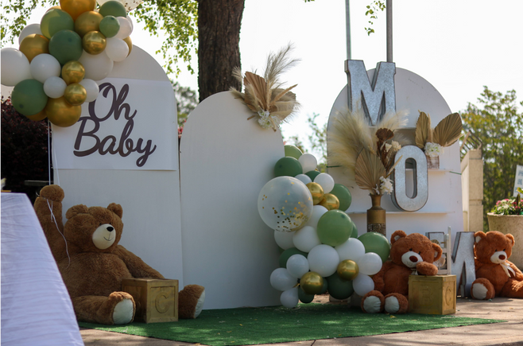
Support for Mothers
MENTAL HEALTH
Group therapy Individual Therapy
ACCESS TO A DOULA
EDUCATION & RESOURCES
Partnership for doula service
Monthly practical education Stipend, diapers, feminine products, car seat food boxes, wish list items, Mommy reset boxes.

Slide 20
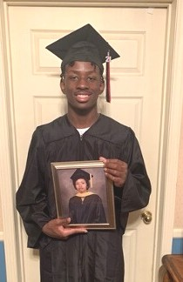
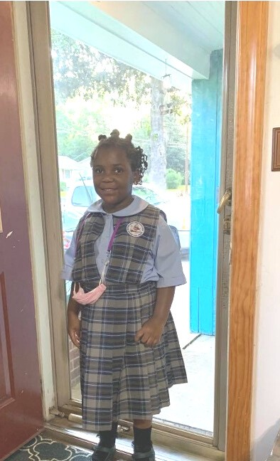
What has happened since the film?
New state flag COVID-19
Black mothers seeking other birthing options & supports Mental health a priority

Slide 21
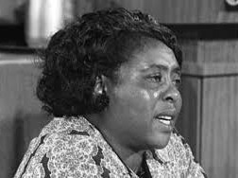
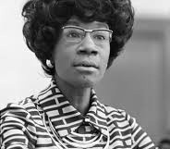
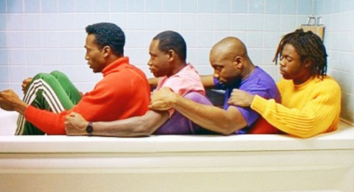
"Nobody's free until everybody's free"
- Fannie Lou Hamer
" You don't make progress by standing on the sidelines whimpering and complaining, you make progress by implementing ideas"
- Sen. Shirley Chisholm

Slide 22
Thank You!
Contact Us
Nakeitra L. Burse, DrPH, CHES nburse@sixdims.com www.sixdims.com www.laboringwithhope.com

