Slide 1

Coming Together to
Achieve Success:
Strategies for the Year Ahead
2022 Virtual OB Face to Face Meeting

Slide 2
2022 OB Face-to-Face Learning Objectives
Define strategies to engage obstetric providers, nurses, staff, patients, and community stakeholders to optimize care and improve outcomes for mothers and newborns through the implementation of quality improvement initiatives.
Identify key strategies for one or more of the following quality improvement initiatives: Promoting Vaginal Birth, Birth Equity, and Mothers and Newborns affected by Opioids-OB sustainability.
Notes:
Will need to re-evaluate when ONA provides approval*****

Slide 3
ILPQC 2022 OB Face-to-Face Agenda
8:30 – 9:00 am | Welcome & Overview: Coming together to Achieve Success: Strategies for the Year Ahead Congresswoman Robin L. Kelly (IL-02) Welcome Ann Borders, MD, MSc, MPH
9:00 – 9:50 am | Laboring with Hope: The Power of Community Voices to Address Birth Equity Nakeitra Burse, DrPH, CHES
9:50 – 10:00 am | Break
10:00 – 10:40 am | Achieving PVB Goals: Strategies to Cross the Finish Line Christa Sakowski, MSN, RN, C-ONQS, C-EFM, CLE, CMQCC
10:40 – 11:30 am | Birth Equity and Promoting Vaginal Birth Hospital Teams Panel: Sharing approaches that make a difference IL BE & PVB teams share strategies
11:30 – 11:50 am | QI Awards Ceremony
11:50 – 1:00pm | Team Storyboard Session- Opportunity to Share & Networking Lunch
1:00 – 1:35 pm | Breakout Session 1: Small Group Key Topic Discussions on Implementation Strategies PVB: Sharing Provider Data and Using Data to Drive QI PVB: Checklist and Huddles Strategies PVB: Patient Education & Shared Decision Making BE: Social Determinants of Health Screening and Linkage to Resources BE: Implementation of respectful Care Practices and the PREM survey BE: Implementation of Implicit Bias Training and Equity Discussions MNO-OB: Strategies to Address Maternal Overdose Deaths and Sustain Optimal OUD Care
1:35 – 1:45 pm | Break
1:45 – 2:20 pm | Breakout Session 2: Small Group Key Topic Discussions on Implementation Strategies (*See above for session titles)
2:20 – 2:30 pm | Break
2:30 – 3:15 pm | Creating Change through Patient and Community Engagement LaToshia Rouse, CD(DONA); Kimberly D. Harper, MSN, RN, MHA; Tomeka James Isaac, MBA, MHRM, CAMS
3:15 – 3:30 pm | Wrap-up, evaluation, raffle and next steps for 2022 Ann Borders, MD, MSc, MPH

Slide 4
Navigating the 2022 Virtual Meeting
2022 Virtual OB Face to Face Meeting

Slide 5


ILPQC OB Face to Face Webpage
The ILPQC OB Face-to-Face Website is your home-base for all the information you should need. Here you will find:
Main Zoom link
Breakout session Zoom links
Help Desk Zoom link
Attendee e-folder
RN contact hours info
Hospital Storyboards
For more information about the Face-to-Face Conference please visit: https://ilpqc.org/2022-ob-face-to-face/
or scan QR code to go directly to the webpage!
Notes:
They received the webpage link in their registration email or can go to the ILPQC website correct?

Slide 6


2022 Attendee Resource E-Folder
PVB​
Cesarean Decision Checklist
Fallout Reviews
Labor Support E-Modules
Provider Education Posters
Unblinding data process
​Birth Equity:​
ILPQC SDoH Screening Tools
SDoH Statewide Tip Sheets
Respectful Care Posters and PREM survey
MNO-OB
MNO-OB Sustainability Plan
Provider & Nurse eModules
Narcan Information (DOPP, Counseling)
QI Tools
PDSA worksheet
30/60/90d worksheet
Grand Rounds Requests
Key Player Meeting Requests
Great
e-resources for your team
Located on ILPQC Face-to-Face Webpage

Slide 7
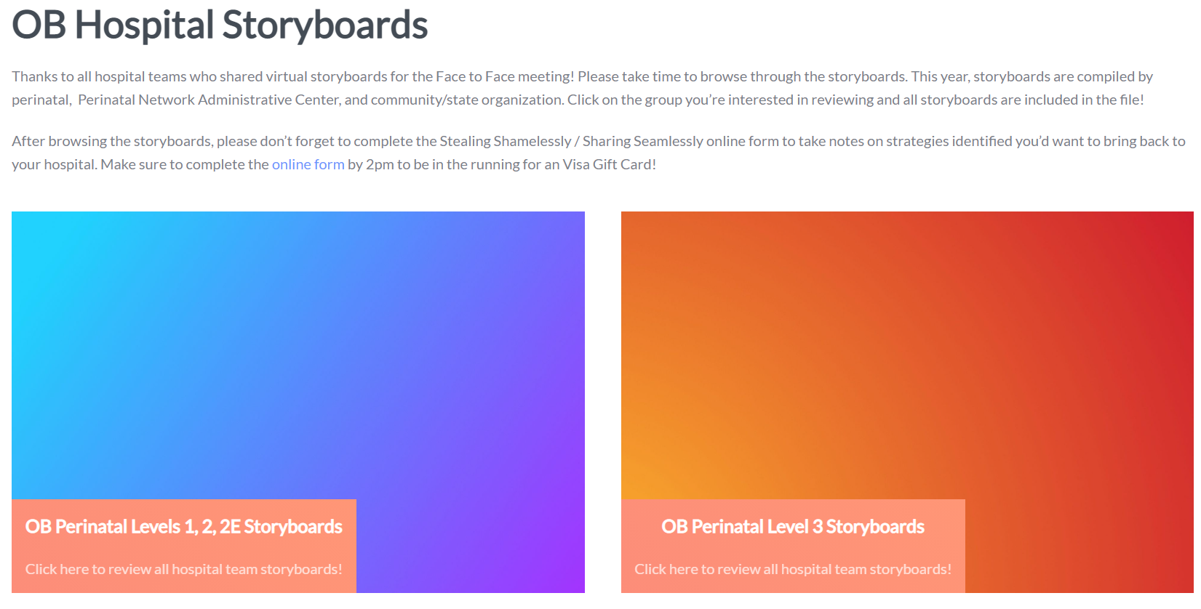
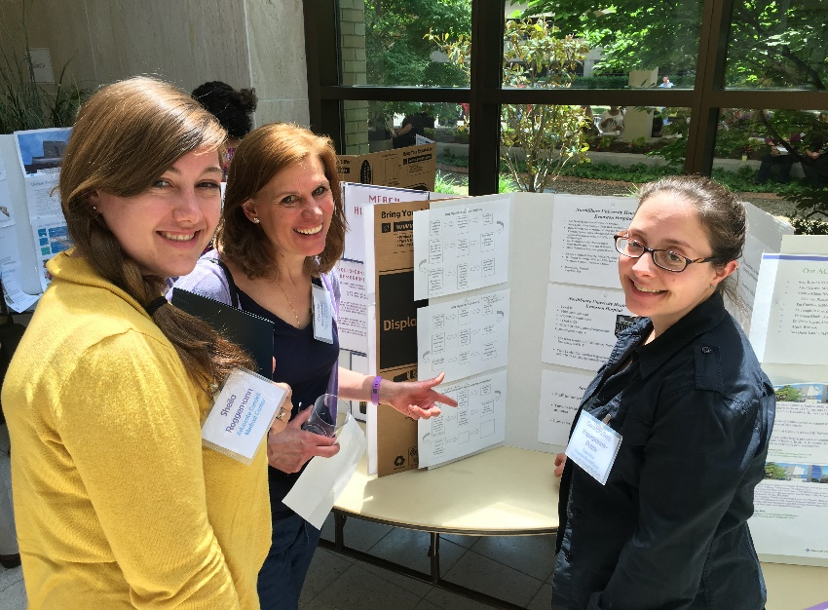
OB Storyboards: Learn and Share
Make sure you take the time to check out the virtual storyboards
Hospital teams share their QI progress from this year
Storyboards can be found on the Face to Face Home page (scroll down to see them)
Storyboard Lunch session
  11:50-1:00pm
Review the storyboards, submit the review form, be entered into the RAFFLE to win 1 of 3 $50 VISA gift cards at wrap up!

Slide 8





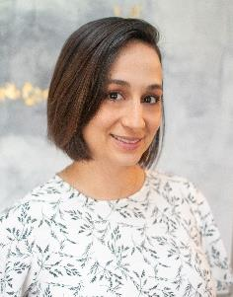




ILPQC Central Team
Ann Borders, MD, MSc, MPH: Executive Director, OB Lead
Patricia Lee King, PhD, MSW: State Project Director, Quality Lead
Daniel Weiss, MPH Director of Data & Operations
Leslie Caldarelli, MD : Neonatal Co-Lead
Justin Josephsen, MD: Neonatal Co-Lead
Alana Rivera, MSN, RNC-OB, C-EFM, CLC:
Nurse Quality Manager
Ieshia Johnson, MPH : Project Coordinator
Ellie Suse, MPH, MSN, RN: Project Coordinator
Su Lee, PhD: Postdoctoral Scholar
Kalyan Juvvadi: Data System Developer

Slide 9
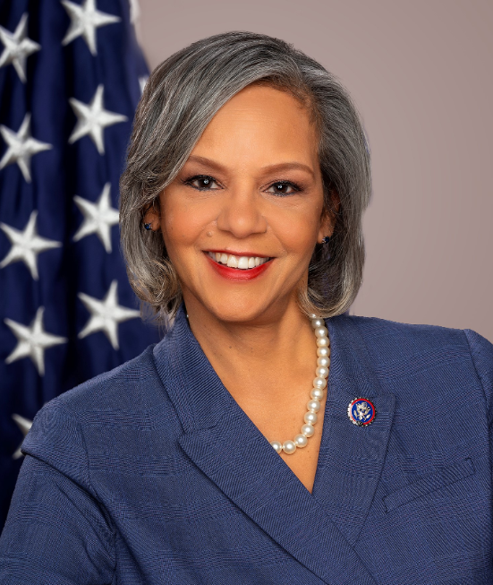
Welcome address
Congresswoman Robin L. Kelly
Serves Illinois’ 2nd Congressional District in the U.S. House of Representatives

Slide 10
Coming Together to
Achieve Success:
Strategies for the Year Ahead
2022 Virtual OB Face to Face Meeting

Slide 11
Overview
Coming Together to Achieve Success
PVB in 2022: Getting across the finish line to achieve PVB goals
BE: Helping hospital teams move this important work forward together
MNO-OB: Continuing our work amidst increasing maternal OUD rates in Illinois
Goals for Today

Slide 12
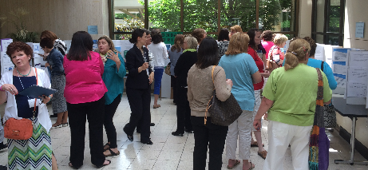
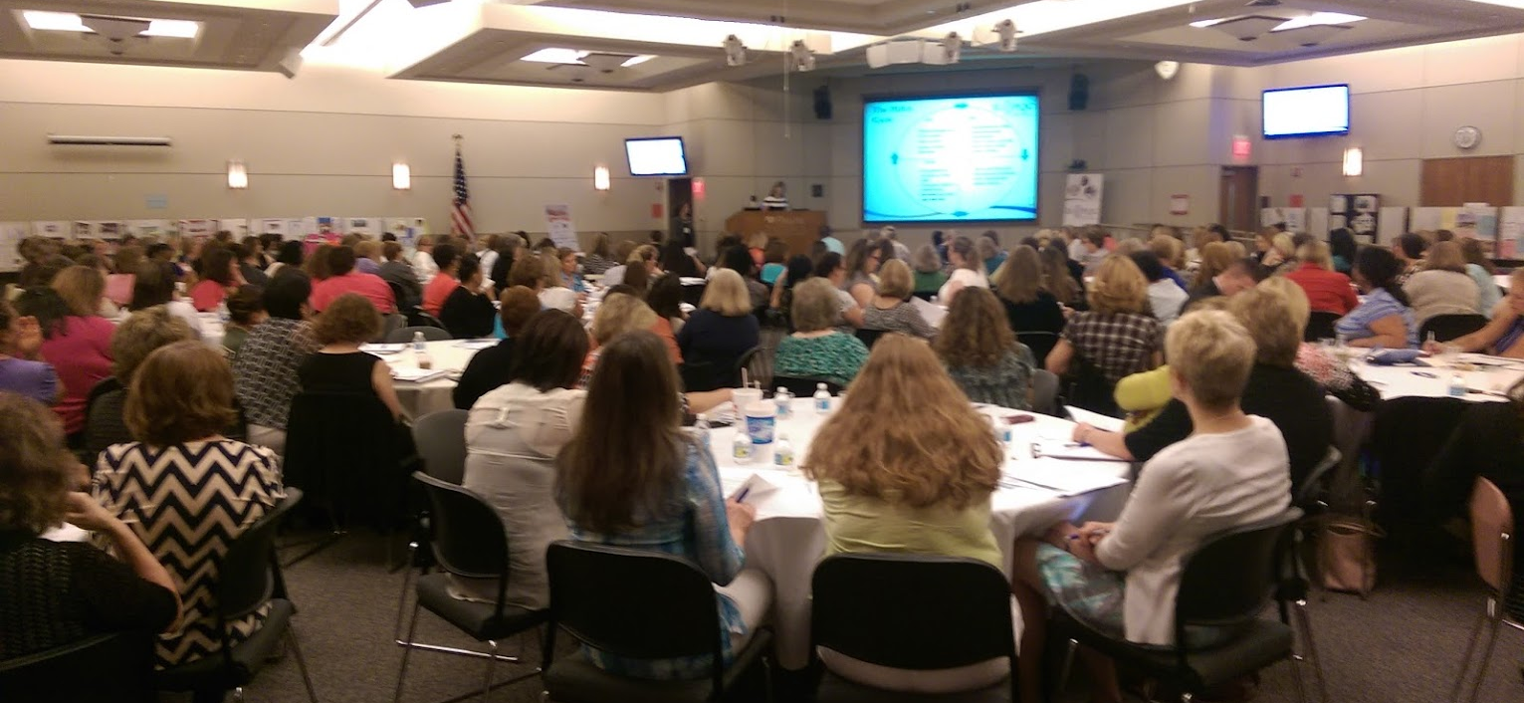
2022:
Moving forward together
Our 1st Face-to-Face was in 2015, held in Springfield, IL
Celebrating our 8th Face-to-Face meeting together today (3rd virtual)
Another year full of challenges, opportunities, & determination to move forward together
No matter in-person or virtual,
Face-to-Face meetings = same goal:
Providing opportunities for teams to come together to share and learn from one another

Slide 13
Celebrating our work together
We are a strong collaborative of providers, nurses, patients, stakeholders, and public health leaders making a difference for IL moms and newborns
Today we will focus on collaborating, sharing and coming together to achieve success
Focus on strategies for the year ahead:
  PVB in 2022: Getting across the finish line
  BE: Helping hospital teams move this important work forward together
  MNO-OB: Continuing our work amidst increasing maternal OUD rates in Illinois
>99% of IL births

Slide 14
Promoting Vaginal Birth
PVB in 2022: Getting across the finish line to achieve PVB Goals

Slide 15
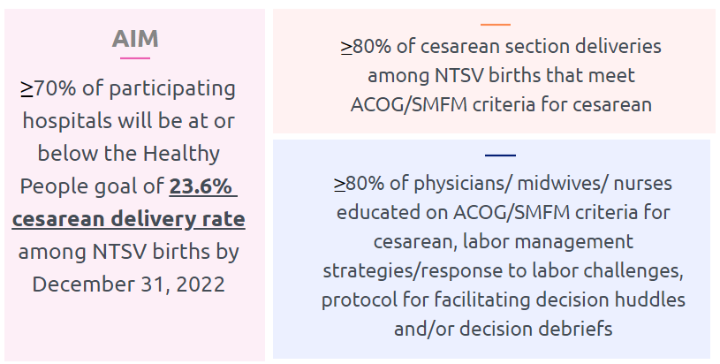
PVB Aims and Measures

Slide 16
PVB Structure Measures
Implement provider and nurse education and other strategies to achieve buy-in
Implement standardized protocol/processes for induction, labor support management and response to labor and FHR abnormalities
Integrate process to review and share data with clinical staff and share transparent unblinded provider-level data
Implement workflow process to incorporate shared decision making with the patient
Implement cesarean decision checklist using ACOG/SMFM labor guidelines
Implement decision huddles and/or decision debriefs with appropriate care team to standardize use of ACOG/SMFM guidelines and checklist
Notes:
Option 1: add lines Show at least 4 in place, 6 in place or working on it
Option 2: 6 SM graphs

Slide 17
PVB Teams Progress on Key Structure Measures

Slide 18
ILPQC teams NTSV C-Section Rate
23.0
Notes:
Option 1: add lines Show at least 4 in place, 6 in place or working on it
Option 2: 6 SM graphs

Slide 19
NTSV C-Section Rate by Race and
Ethnicity: 2018-2020 Average
NTSV C-Section Race and Ethnicity Data Collection:
Goal: Provide data reports to all teams with their NTSV CS rates stratified by race, ethnicity and insurance status
Bridging PVB and BE initiatives to stratify key measures to identify disparities and address them
"There is no quality without equity"

Slide 20



NTSV C/S data stratified by race/ethnicity/insurance status: next steps for PVB teams
Prospective Data (April 2022 – end of Initiative) collection ongoing
Retrospective Data (Baseline-March 2022)
  Due August 1st 2022
  Early Bird Due Date Incentive:
    Submit all Baseline-March 2022 Data by June 10th 2022 to receive a $50 Visa Gift Card to treat your PVB QI team to a Pizza Lunch or Coffee and Donuts to celebrate

Slide 21
PVB Structure Measures

Slide 22
PVB Structure Measures

Slide 23
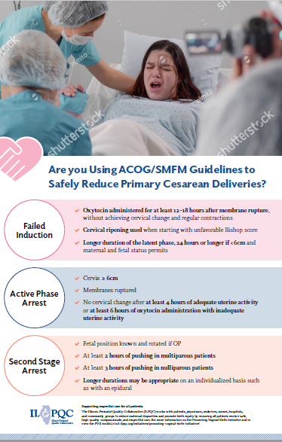
Process Measures:
Provider and Nurse Education
90%
82%
of nurses have received standardized education regarding: ACOG/SMFM labor guidelines
of providers have received standardized education regarding: ACOG/SMFM labor guidelines

Slide 24
NTSV C-Sections Meeting
ACOG/SMFM Guidelines (goal > 80%)

Slide 25
NTSV C-Sections Meeting
ACOG/SMFM Guidelines: Failed Induction
ACOG/SMFM Criteria for Failed Induction:
Oxytocin administered for at least 12-18 hours after membrane rupture, without achieving cervical change and regular contractions
Longer duration of the latent phase, 24 hours or longer if <6cm and maternal and fetal status permits

Slide 26
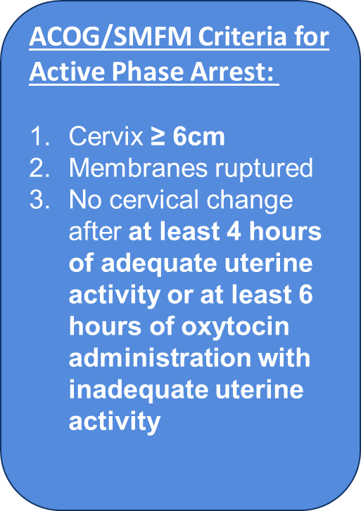
NTSV C-Sections Meeting
ACOG/SMFM Guidelines: Active Phase Arrest

Slide 27
NTSV C-Sections Meeting
ACOG/SMFM Guidelines: Second Stage Arrest
ACOG/SMFM Criteria for Second Stage Arrest:
At least 3 hours* of pushing in nulliparous patients
*Longer durations (e.g. 4 hours with epidural) may be appropriate on an individualized basis

Slide 28
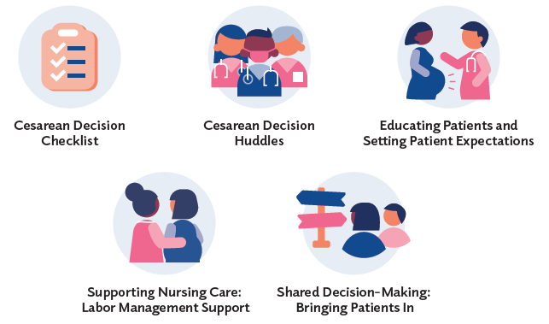


PVB Key Strategies for
Creating Clinical Culture Change
Sharing Unblinded Provider-level NTSV C-Section Rates
Review of NTSV C-Section Cases Not Meeting ACOG/SMFM Guidelines

Slide 29


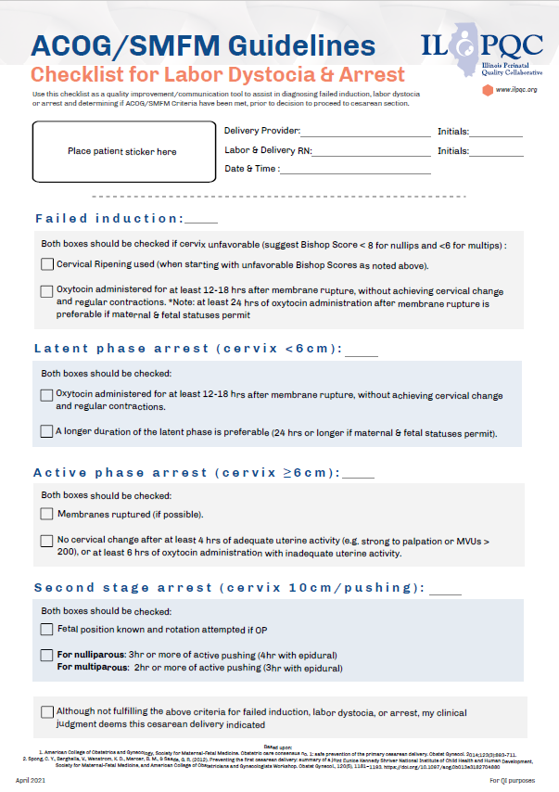


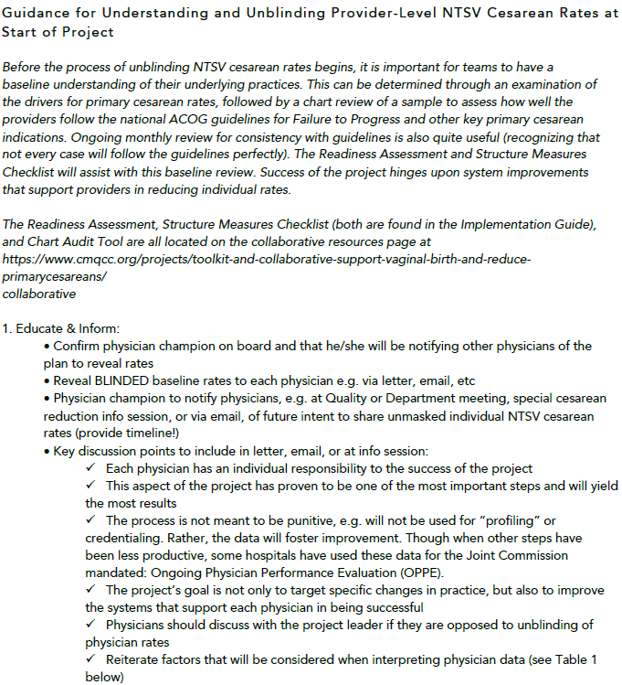
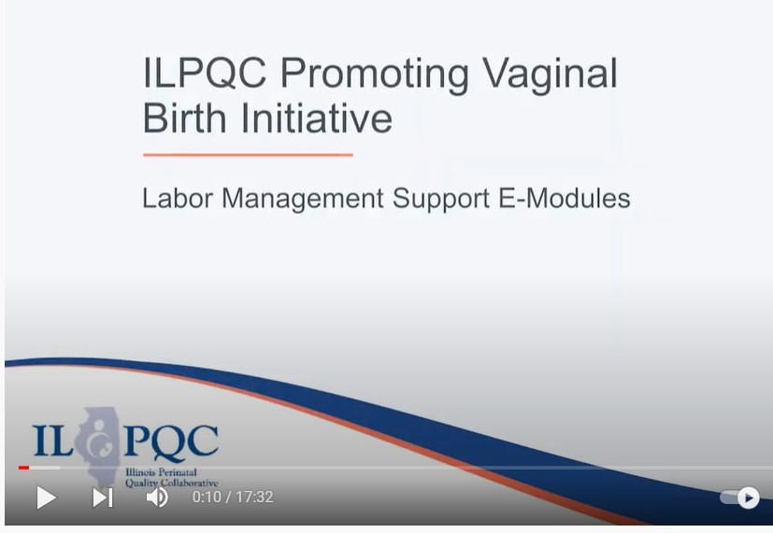
PVB Key Resources
Provider Education Posters
CMQCC Un-blinding Provider Data
Missed Opportunity Review
Cesarean Decision Checklist
Labor Management E-modules

Slide 30
ILPQC is here to help you get across the finish line!
Stay tuned for our PVB teams panel and PVB Breakout sessions to learn from hospital teams who have achieved these goals!
All teams with NTSV rate not yet at goal please email info@ilpqc.org to schedule a QI call for additional support
PVB Finish Line Goals:
QI Excellence Award
6 Key Structure Measures in Place
NTSV C-Section Rate ≤23.6%
80% of Providers and Nurses educated on ACOG/SMFM Guidelines
80% of all NTSV C-Sections Meeting ACOG/SMFM Guidelines

Slide 31
Birth Equity (BE) Initiative
Helping hospital teams move this important work forward together

Slide 32

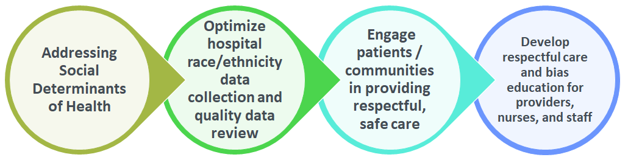
Birth Equity Initiative Aims & Drivers
AIMS
By December 2023:
≥ 75% of IL birthing hospitals will be participating in the Birth Equity Initiative
≥ 75% of hospitals participating will have all key strategies in place
KEY DRIVERS
Notes:
*New picture

Slide 33



Key strategies for laying your foundation to achieve equitable care
3. Take steps to engage patients and/or community members to provide input on quality improvement efforts
2. Optimize race/ethnicity data collection and review key maternal quality data by race, ethnicity and Medicaid status
1. Implementation of universal social determinants of health screening tool (prenatal/L&D) with system for linkage to appropriate resources and services
We are making progress team!

Slide 34
Key strategies for laying your foundation to achieve equitable care
6. Implement respectful care / implicit bias education for providers, nurses, and other staff with ongoing training and equity discussions
5. Standardize postpartum safety education and schedule early postpartum follow up prior to hospital discharge
4. Sharing respectful care practices on L&D and survey patients before discharge on their care experience (using the PREM) for feedback
Awesome work!

Slide 35


Engagement in year 1: Birth Equity Initiatives by the numbers
Hospital teams
86/100
Monthly webinars
8
Data calls
2
Avg # of teams submitting mo data
50
Regional community meetings
6
Notes:
Could add community engagement meetings here just for another number box?

Slide 36


Celebrating success: Speak-UP Anti-Racism Training and Regional Community Engagement Meetings
2 PQI SpeakUp Trainings, 147 team members from 64 teams have participated
Can register 2 staff / hospital for next session June 15-16
6 out of 10 Regional Community Engagement Meetings, 77% of hospital teams (4 more by June)
This is such a great discussion! Hearing from the community panelists is powerful and very much needed. I appreciate all of the input. – Provider, Stroger Network
Notes:
34/44

Slide 37

Celebrating success: Key Players Meetings
Great help with moving things forward! –Stroger Hospital
Very helpful and resourceful! – FHN Memorial Hospital
10 Key Players Meetings to provide QI support to Birth Equity Teams!
It was extraordinarily helpful! Looking forward to getting back together with our team to start putting things into action!! – Barnes Jewish Hospital
It was informative and helpful. Helped us eliminate barriers to moving forward! -- OSF HealthCare Saint Francis

Slide 38
Structure Measures:
Implementing Systems Changes

Slide 39
Structure Measures:
Implementing Systems Changes

Slide 40
Process Measures:
Implicit Bias Training
Notes:
Structure Measures- highlight/congratulate the success in place/working on measures: how to consolidate these
Implemented standardized social determinants of health screening tools for delivery admission
Implemented affiliated prenatal care sites standardized screening tools for universal social determinants of health screening
Completed ILPQC social determinants of health community resources mapping tool and shared with affiliated outpatient
Incorporating discussion of social determinants of health and discrimination as potential factors in hospital maternal morbidity reviews
Protocol for improving the collection and accuracy of patient-reported race/ethnicity data
Process to review maternal health quality data stratified by race/ethnicity and Medicaid status
Engaged patients and/or community members to provide input on quality improvement efforts
Sharing expected respectful care practices with delivery staff and patients
Implicit Bias Training (line graph)

Slide 41


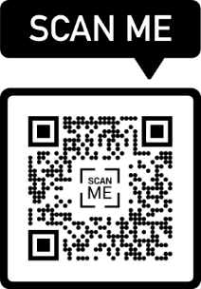
1. Addressing social determinants of health (SDoH)
1. Screen all patients for social determinants of health needs during prenatal care and at the delivery admission (sample screening tools)
2. Create process flow to link screen positive patients to needed resources and services (SDOH folder with tip sheets, mapping tool)
3. Incorporating social determinants of health and discrimination factors in hospital maternal morbidity reviews
SDoH folders for patients
Notes:
Let’s move this pic to respectful care

Slide 42

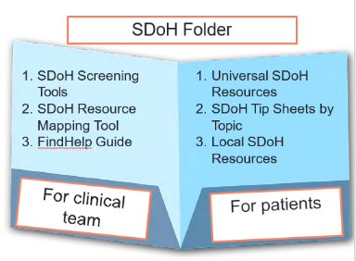
Ways to link patients who screen positive to resources
ILPQC has provided hospitals teams free access to NowPow, an online SDOH database.
Starting June 2022, two options for online database of resources:
  FindHelp.org via ilpqc.org free tool to search for social determinants of health resources
  Or continue to use your hospital NowPow access or connect with NowPow for options for hospital access
Findhelp.org has more than 300,000 verified programs that provide help across Illinois and Missouri (and all 50 states)

Slide 43
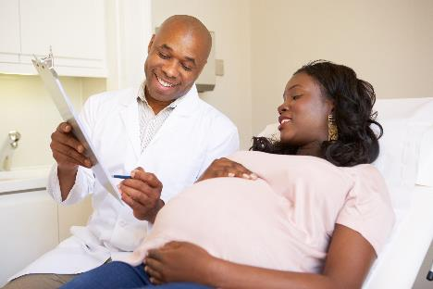
2. Utilize race/ethnicity medical record and quality data
How to Ask the Questions Regarding Race/Ethnicity
1. Implement processes and protocols for improving the collection and accuracy of patient-reported race/ethnicity data
2. Review maternal health quality data stratified by race, ethnicity, and Medicaid status to identify disparities and address opportunities for improvement

Slide 44


Helpful resources to start working on optimizing race/ethnicity data collection
Sample language to request patient race and ethnicity data
Resources to develop a process to stratify and review hospital maternal health quality data by race, ethnicity, and Medicaid status
Hospital Guide to Stratifying Data by Patient Demographics:
Assemble workgroup
Validate patient data
Identify priority metrics
Determine if stratification is possible
Stratify the data

Slide 45

3. Engage patients, support partners and communities with patient-centered respectful care
Take steps to engage patients and/or community members to provide input on quality improvement efforts
Implement a strategy for sharing respectful care practices with patients and delivery staff
Implement the Patient Reported Experience Measure (PREM) patient survey to obtain feedback
Provide postpartum safety patient education on urgent maternal warning signs, how to communicate with providers and scheduling early follow up

Slide 46




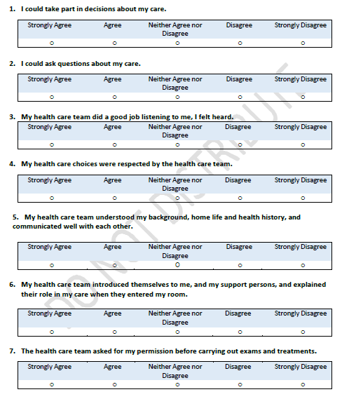
Labor & Delivery
PREM
Respectful Care Practices

Slide 47


Helpful resources to start working on implementing patient-centered respectful care
Respectful Care Practices poster and handout:
  Developed with IL patients
  All providers and nurses should read and sign off on the Respectful Care Commitments
  Post Respectful Care Practices in labor and delivery rooms, triage and check in
Patient Reported Experience Measure (PREM) – approved by HCAHPS for use with OB patients
  Provider/staff script and instructions
  Process to distribute the PREM survey QR Code to all birthing patients before discharge
PREM

Slide 48
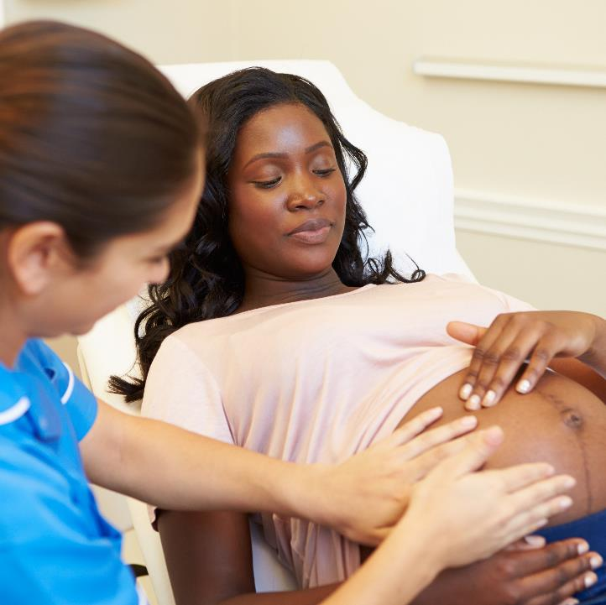
4. Engage and educate providers, nurses and staff
Educating providers, nurses and staff on the importance of listening to patients, providing respectful care and addressing implicit bias
Implementing strategies for addressing diversity in health care team hiring
Illinois Law: Section 1130.500 Implicit Bias Awareness Training
"Unconscious attitudes affect our behaviors such as body language, tone of voice, receptivity, or decision-making and affects treatment decisions and outcomes."
(Hall et al. 2015)

Slide 49










Implicit Bias Education for all providers, nurses, & other staff
Send two team members providers, nurses, or other staff to be trained on implicit and explicit racial bias, June 15th-16th
Resources for providers / patients to promote listening to patients and hearing her concerns
Share video and discussion guide with providers / nurses / staff to reflect, promote awareness and discussion in:
Grand Rounds / OB Meeting
Nurses skills day or training
Implement implicit bias education e-modules and reflect or share discussion

Slide 50

Thinking ahead… What is next for BE teams?
Find the right path for your team on your Birth Equity journey
Ok to focus on 1 strategy at a time
Plan a 30/60/90 plan that works for you
Remainder of 2022 we will focus on:
  SDOH screening/linkages
  Implicit Bias education
  Respectful care strategies
  PREM implementation
  Community Engagement meetings to facilitate patient/community feedback

Slide 51
Mothers and Newborns affected by Opioids- OB
Continuing our MNO-OB Work amidst Increasing Maternal OUD Rates in Illinois

Slide 52
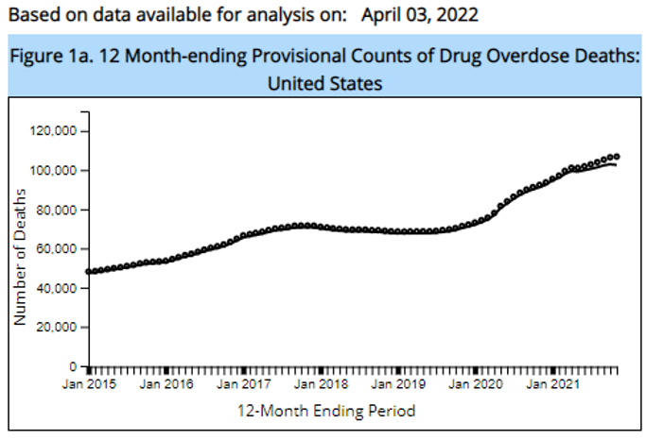


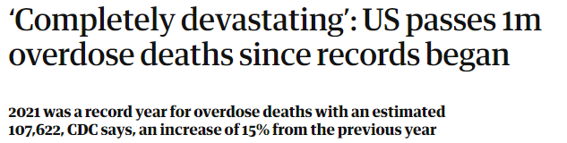
The Opioid Epidemic- U.S. Impact
100,306 drug overdose deaths in the past year
Increase of 28.5% from the 78,056 deaths the year prior
COVID-19 Pandemic
CDC NCHS Data

Slide 53
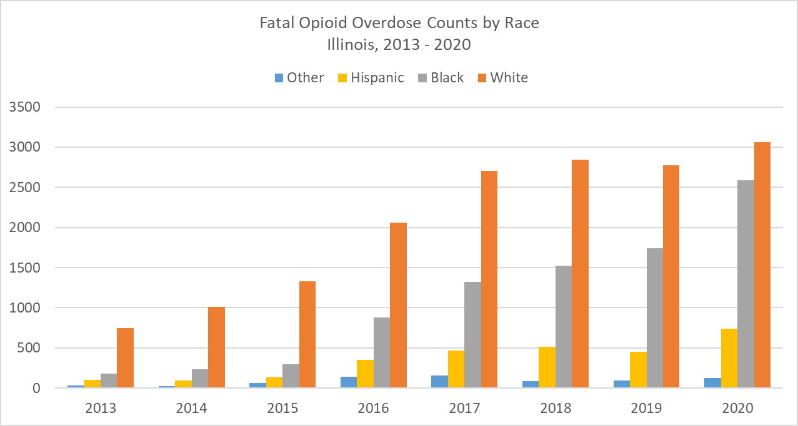
The Opioid Epidemic- Illinois Impact
Opioid overdoses in Illinois increased 33% from 2019 to 2020
In 2020, there were 2,944 opioid overdose fatalities
Opioid overdose deaths increased disproportionately among racial and ethnic minority groups
https://dph.illinois.gov/topics-services/opioids/idph-data-dashboard.html

Slide 54
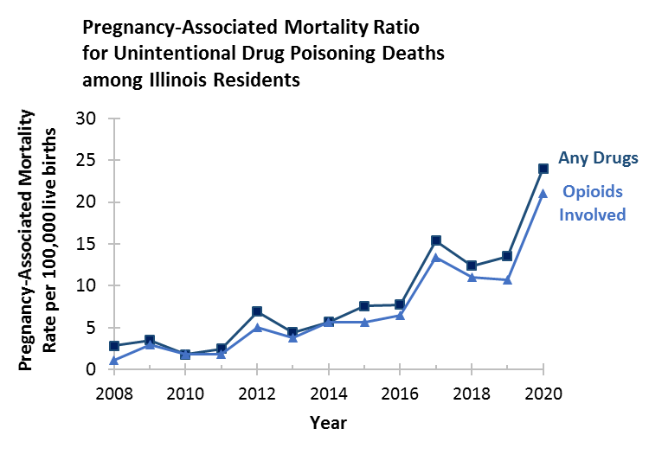
Maternal deaths due to opioids in IL
In Illinois between 2019 – 2020:
The rate of pregnancy associated mortality ratio for unintentional drug poisonings involving opioids increased from 10.7 to 21.0 per 100,000 live births
Mental health conditions, including substance use disorder, were the leading cause of pregnancy-related deaths​
IDPH Maternal Morbidity and Mortality report on 2016-2017 deaths, 2021; IDPH Death Certificates, 2021
Notes:
How to show increase in oud cases in 2020

Slide 55






Remember Our Goal:
Optimal OUD care every time
Screen every pregnant patient with OUD with a validated screening tool
Assess readiness for Medication Assisted Treatment (MAT)
Start MAT and link to recovery treatment services (RTS)
Provide patient education on OUD, NAS, and reduce stigma, promote respectful care across clinical team
Provide Naloxone (Narcan) counseling and medication
Warm hand-offs for community-based MAT, RTS, OB follow up

Slide 56
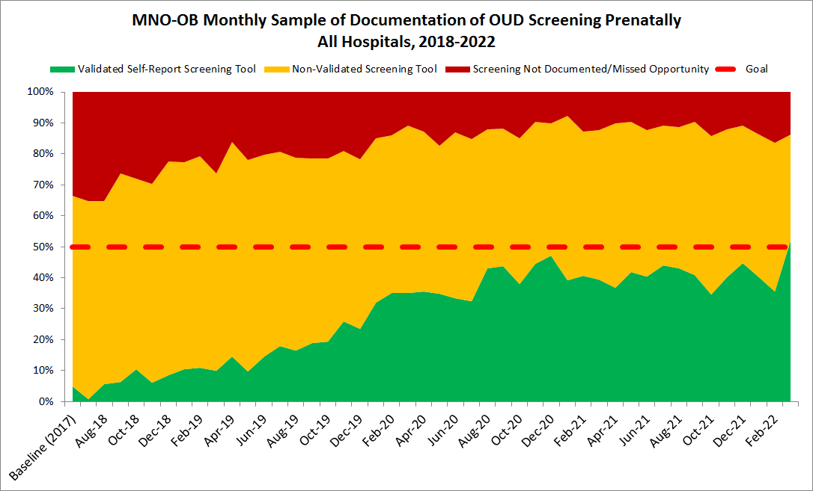
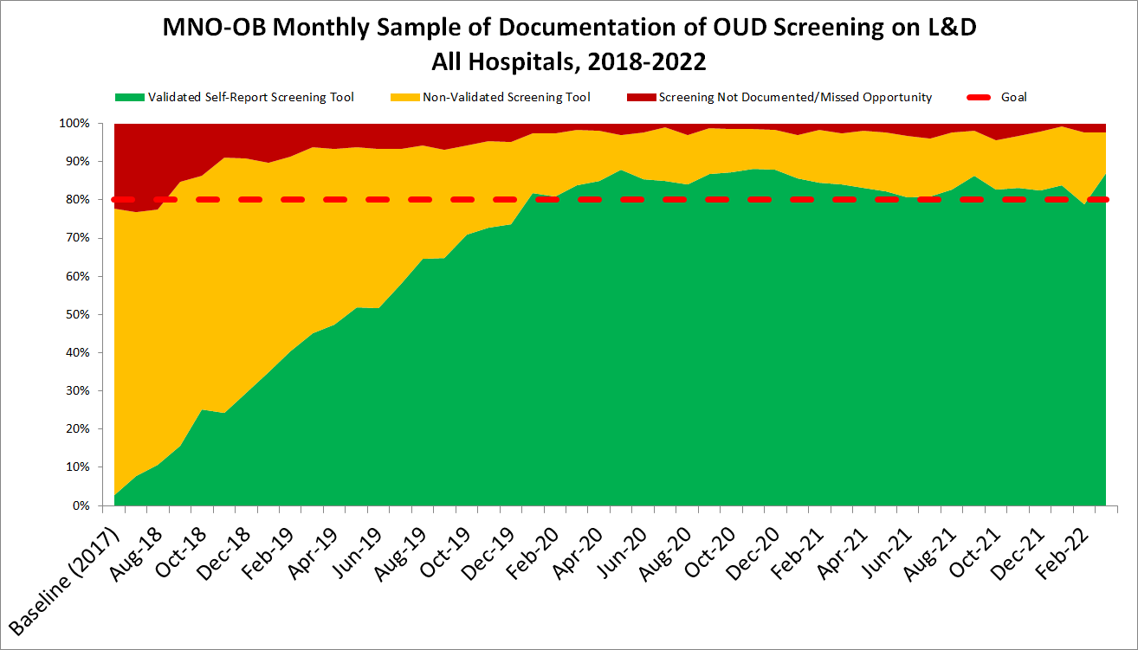
4 Years of MNO: Screening
Prenatal Screening
L&D Screening
52%
87%
2%
2%
Sustainability data
Sustainability data
28,440 charts sampled since 2018

Slide 57
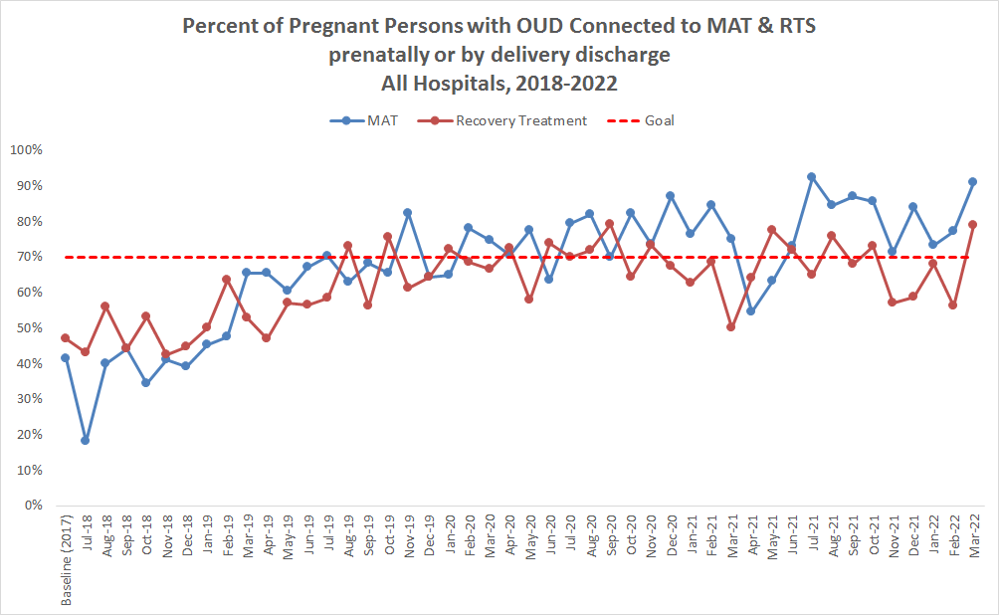
4 Years of MNO:
MAT and Recovery Treatment Services
Teams have cared for over 2,556 birthing persons with OUD across the initiative
Teams have connected over 1,500 birthing persons to MAT and Recovery Treatment services across the initiative
Sustainability data

Slide 58

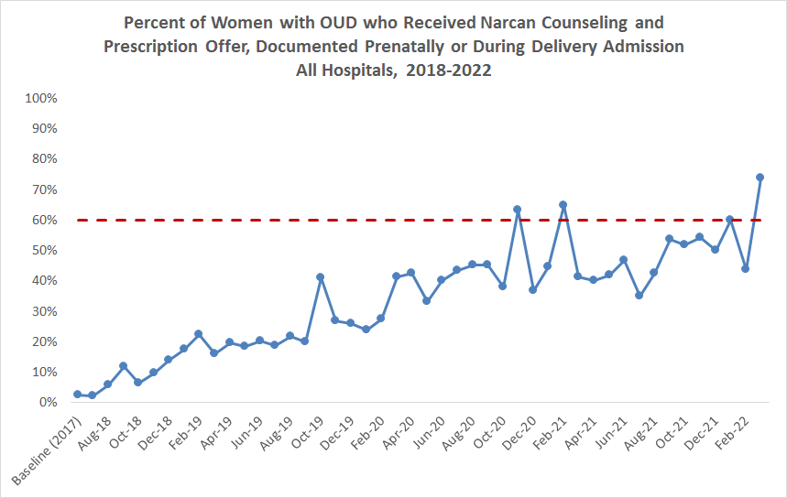
4 Years of MNO: Narcan
Teams provided Narcan counseling to over 683 pregnant persons with OUD since the start of the initiative
74%
2%
Sustainability data
Notes:
Stop at 2020?

Slide 59
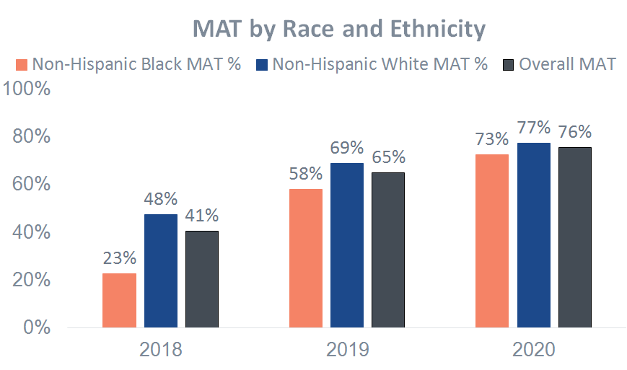
Optimal OUD Care- Reducing Inequities
Start of Initiative
Non-Hispanic Black persons with OUD were connected to MAT at lower rates compared to non-Hispanic White persons.
End of Initiative
The disparity in connecting patients to MAT closed, with the greatest achievement seen among non-Hispanic Black persons

Slide 60
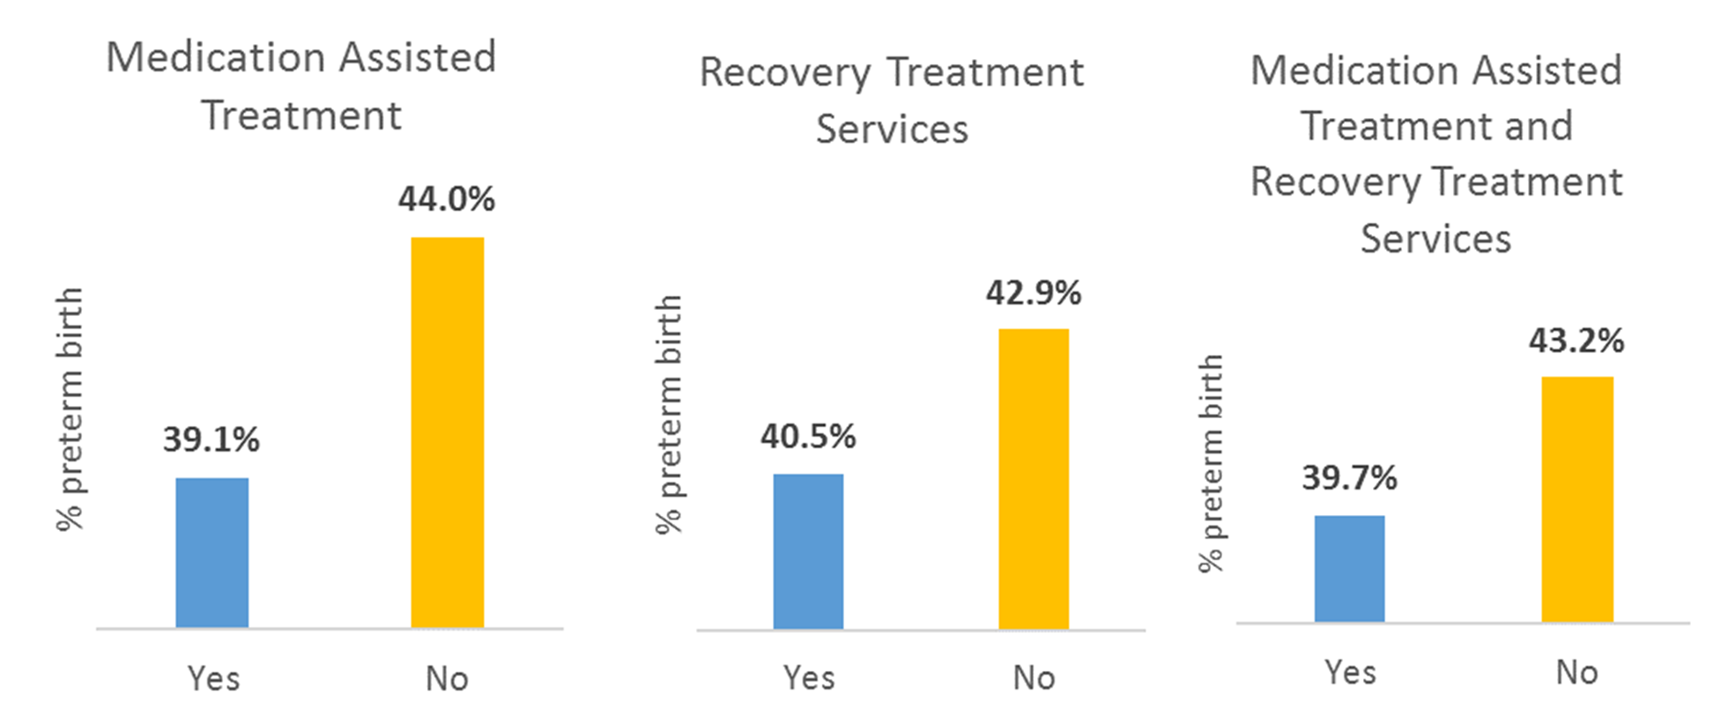
Optimal OUD Care – Reducing Preterm Birth
*
*
Reductions in Preterm Birth for patients with optimal OUD care remained significant in a subgroup analysis including only patients who received prenatal care, *p <0.05

Slide 61
What comes next?
Sustain in 2022 and beyond
Continue compliance monitoring and review of OUD cases to achieve optimal OUD care
Work with your team to review your sustainability plan and make any updates on protocol changes since 2020
Attend MNO-OB breakout session to discuss strategies to provide optimal OUD care in sustainability

Slide 62
Goals for Today
Celebrate
Celebrate together
Connect
Connect with other teams
Learn
Learn from our speakers, panelists, each other
Share
Share your successes, challenges, & ideas
Take
Take new strategies learned to approach your challenges
Gain
Gain fresh motivation to continue this important work

Slide 63
Questions?
Please put all questions in the Q&A section
or email us at info@ilpqc.org

Slide 64


