Slide 1

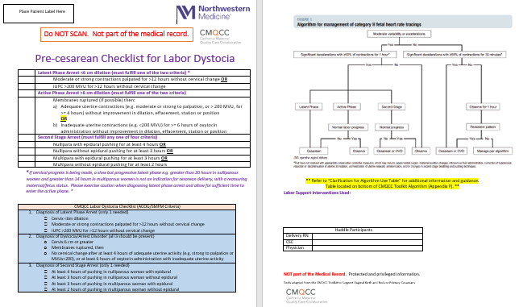
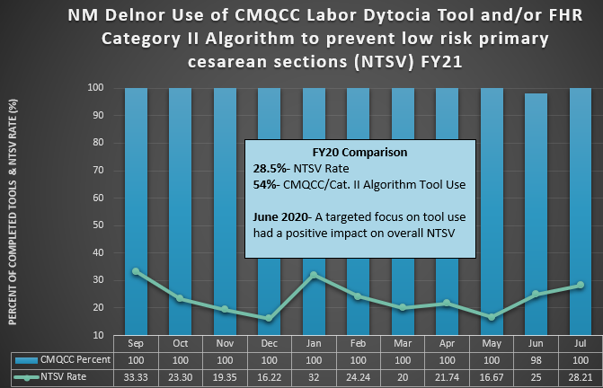
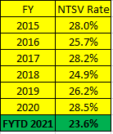
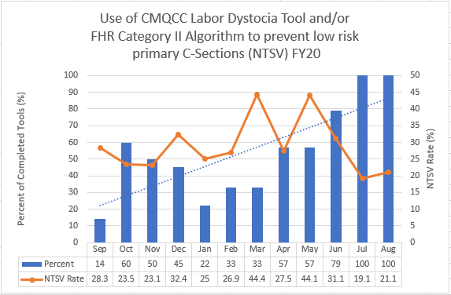
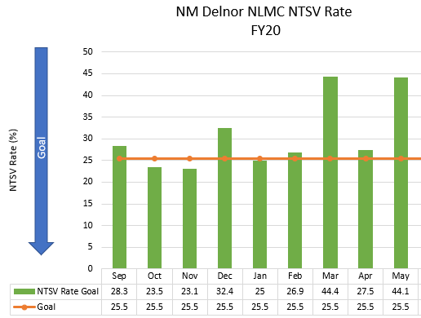
It’s a Matter of Timeliness- Hardwiring the Plan of Care to Reduce the Nulliparous Term Singleton Vertex (NTSV) Cesarean Section Rate Through Collaboration
Executive Sponsor
Gina Reid Tinio, PhD, MS, MPH, NPD-BC
Sponsor
Kim Czaruk, MSN, RN
Process Owner
Dawn Stanley, MSN, RNC
Improvement Leader
Emily Bingley, MSN, RN, CNML
Team Members: Jayne Haley, MS, RNC-OB, C-EFM; Dr. Edward Newman; Suzanne Heinkel, BSN, RNC; Maria Moreno, BSN, RNC; Christie Ragusin, BSN, RNC; Beth Richard, MSN, RNC; Susan Schultz, BSN, RNC; NLMC L&D Registered Nurses; Obstetricians.
Cesarean section rates are a national, state, health system and local hospital focus. Cesarean sections contribute to a higher maternal mortality and maternal morbidity than vaginal deliveries.
Nulliparous Term Singleton Vertex (NTSV) cesarean section rates are publicly reported through The Joint Commission Perinatal Care Measure Set PC-02.
Healthy People 2020 established an adjusted goal of 24.7% which is supported by The Joint Commission and Illinois Perinatal Quality Collaborative (ILPQC).
The Northwestern Medicine Delnor NewLife Maternity Center (NLMC) FY20 NTSV rate was higher than the established goal.
31% average for 9 months (September-May).
Previously in 2017, an interdisciplinary team was created to review the literature and identify opportunities in current practice using DMAIC. Two interventions were established:
Standard education and terminology using NICHD definitions of fetal heart rate characteristics and patterns provided to all Obstetricians and L&D nurses.
Introduced and encouraged use of CMQCC Pre-cesarean Checklist for Labor Dystocia and Algorithm for Management of Category II Fetal Heart Rate Tracings as MD/RN communication and collaboration tools.
Utilizing teamwork and the Relationship Based Care Model, a small interdisciplinary group evaluated the FY20 monthly NTSV rates and CMQCC paper tool return rates May 2020.
Two opportunities identified:
Combine CMQCC Labor Dystocia Checklist and Category II Algorithm into one huddle document (previously two separate resources) and place revised paper huddle document in the chart of each patient admitted for labor.
Refresh the best practice collaboration/huddle expectations with 100% of the L&D nurses and Obstetricians.
After education, huddle tool document and huddle process expectations were refreshed with nurses and physicians, huddle tool completion increased to 79% in June 2020.
July 2020 to July 2021, CMQCC tool completion 100% for all patients admitted for labor.
During the period September 2019 (FY20) through July 2021 (FY21), there has been a 4.9% decrease in the NTSV rate, which equates to 20 mothers that were delivered vaginally versus cesarean section.
Figure #2: CMQCC Pre-cesarean Checklist & Category II Algorithm
Figure #4: FY21 NTSV & CMQCC Tool Completion Rates & Overall NTSV Rates
Figure #3: FY20 NTSV & CMQCC Tool Completion Rates
Figure #1: FY20 NTSV Rate (September-May)
The purpose of the refresh initiative was to impact the NTSV rate through enhanced collaboration, communication and collegiality between nurses and physicians with standardized evidence-based tool and terminology utilization.
The success is attributed to supportive, respectful and collaborative working relationships between Delnor NLMC nurses and physicians.
Providing, displaying and discussing updated data (including unblinded physician data) monthly contributes to sustained success.
ACOG. 2009. Intrapartum Fetal Heart Rate Monitoring: Nomenclature, Interpretations, and General Management Principles. ACOG Practice Bulletin, 106, 1-11.
ACOG. 2010. Management of Intrapartum Fetal Heart Rate Tracings. ACOG Practice Bulletin, 116, 1232-1240.
AWHONN. 2018. Fetal Heart Monitoring [Position statement]. Jognn.org; doi:10.1016/j.jogn.2018.09.007
Clark, S.L., et al. 2013. Intrapartum Management of Category II Fetal Heart Rate Tracings: Towards Standardization of Care. American Journal of Obstetrics and Gynecology, 89-97.
Lagrew, D.C., et al. 2018. National Partnership for Maternal Safety : Consensus Bundle on Safe Reduction of Primary Cesarean Births- Supporting Intended Vaginal Births. JOGNN, 47, 214-226.

