Slide 1
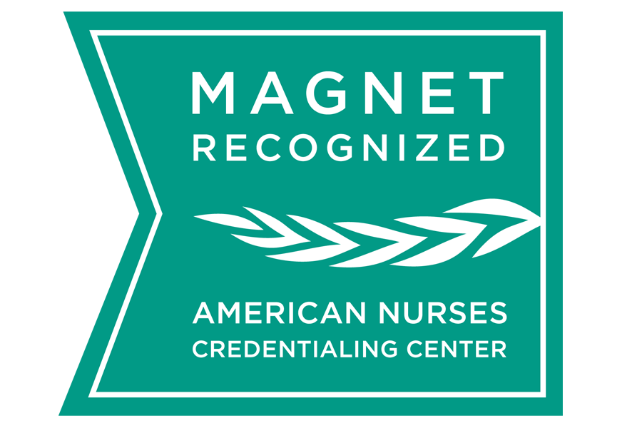
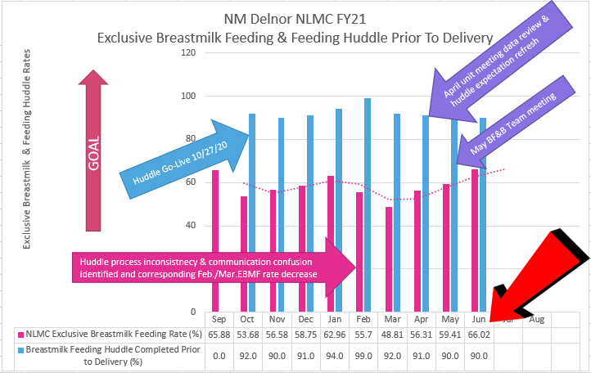
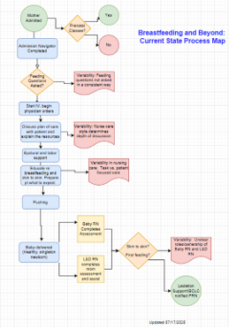
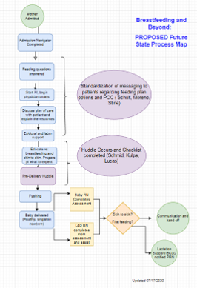
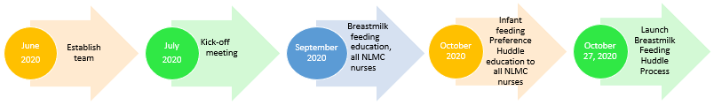
Breastmilk Feeding and Beyond:
Infant Feeding Preference Huddle Prior to Delivery
Executive Sponsor
Gina Reid Tinio, PhD, MS, MPH, NPD-BC
Sponsor
Kim Czaruk, MSN, RN
Process Owner
Dawn Stanley, MSN, RNC
Improvement Leader
Emily Bingley, MSN, RN, CNML
Team Members: Deanna Schult, BSN, RN, IBCLC; Maria Moreno, BSN, RNC; Suzanne Heinkel, BSN, RNC; April Weydert, BSN, RNC; Abbey Stine, BSN, RN, CPMHN; Christina Lucas, BSN, CMSRN; Emily Schmid, BSN, RN; Kati Kulpa, BSN, RN; Katie Bergman, BSN, RN.
Over the list five fiscal years, the NM Delnor Hospital Exclusive Breastmilk Feeding (EBMF) Rate has decreased by 6%.
The World Health Organization recommends implementing steps to protect, promote and support breastmilk feeding in the hospital setting, which includes patient education.
At NM Delnor Hospital NewLife Maternity Center (NLMC) breastmilk feeding education had primarily occurred after delivery during the recovery period or in post-partum.
A method to provide early breastmilk feeding patient education by the L&D RN prior to delivery after admission was not found in the literature.
An inter-professional team was assembled to evaluate patient education and resources for women who are considering breastmilk feeding their newborn.
The team was comprised of day and night shift clinical nurses, charge nurses, lactation consultant, pediatrician, obstetrician, outcomes manager, professional development specialist and nursing leadership.
Goal: Utilizing the tenants of Relationship Based Care, the Labor Nurse and patient will “huddle” about the infant feeding preference plan prior to delivery.
Scope: All mothers admitted to NM Delnor for delivery.
Outcome Metric: Increase the monthly NLMC Exclusive Breastmilk Feeding Rate by 6% (66%) by end of FY21.
Process Metrics:
80% of mothers will participate in huddle with the Labor Nurse prior to delivery, validated with documentation on developed tool.
100% NLMC nurses will receive breastmilk feeding education regarding pathophysiology and breastfeeding norms (annual education).
100% NLMC nurses will receive education focusing on standardized messaging and consistent education to admitted mothers for the infant feeding intent huddle process.
The inter-disciplinary project team assembled and achieved the following:
Bi-weekly meetings.
Completed a strengths, weaknesses, opportunities & threats (SWOT) analysis.
Created current and ideal state process maps.
Evaluation of patient education and resources for women who are considering breastmilk feeding their newborn.
Established components of infant feeding huddle prior to delivery
  Review “10 Tips for Successful Breastmilk Feeding” handout
  Introduce “Breastmilk Feeding Journal”
  Encourage viewing “First Droplets” video
Determined timeline for breastmilk feeding staff education, new process education for all NLMC nurses and infant feeding huddle process launch.
Outcome Metric: After 3 months of completed huddle data (November 2020 to January 2021), the Exclusive Breastmilk Feeding Rate increased 6.38%. In April, focused efforts/actions were put into place after a process drift and infant feeding huddle expectation confusion was identified. Achieved average monthly rate 58.41% FYTD.
Process Metrics:
92% patient participation in infant feeding preference huddle.
100% NLMC nurses received breastmilk feeding education (pathophysiology & breastfeeding norms).
100% NLMC nurses received standardized messaging and infant feeding huddle process education.
Figure #4: Outcomes
Figure #1: Process Map- Current State
Figure #2: Process Map- Future State
The vision and success of this project is a result of passion, innovative thinking and collaboration by the inter-professional project team.
Dedication of the entire NLMC nursing staff to support women’s infant feeding choice by providing education and breastmilk feeding support through the Infant Feeding Preference Huddle Prior to Delivery has been an essential element to the project success, as well.
An opportunity to refresh huddle process and communication expectations was identified and associated with the February & March breastmilk feeding rate decrease.
Figure #3: Timeline of Interventions
Bradford, V.A. et al. 2017. Creating Environments to Support Breastfeeding: The Challenges and Facilitators of Policy Development in Hospitals, Clinics, Early Care and Education and Worksites. Maternal Health, 21, 2188-2198.
Eckenrode, J. 2018. The Three B’s: Bonding, Breastfeeding and Baby Friendly. International Journal of Childbirth Education, 33(2), 40-43.
Matthew-Maich, N.; Ploeg, J.; Dobbins, M.; Jack, S. 2013. Supporting the Uptake of Nursing Guidelines: What You Really Need to Know to Move Nursing Guidelines into Practice, 10(2), 104-115.
The Joint Commission. 2020, July 29. Specifications Manual for Joint Commission National Quality Measures (v2021A). https://manual.jointcommission.org/releases/TJC2021A/MIF0167.html
Winter, G. 2018. Breastfeeding: Ethics and Evidence, 26(11), 749.

