Slide 1
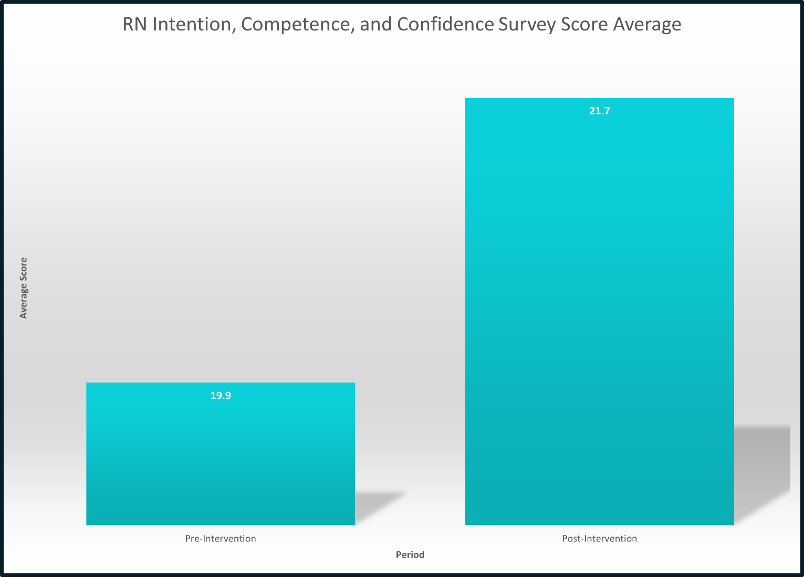
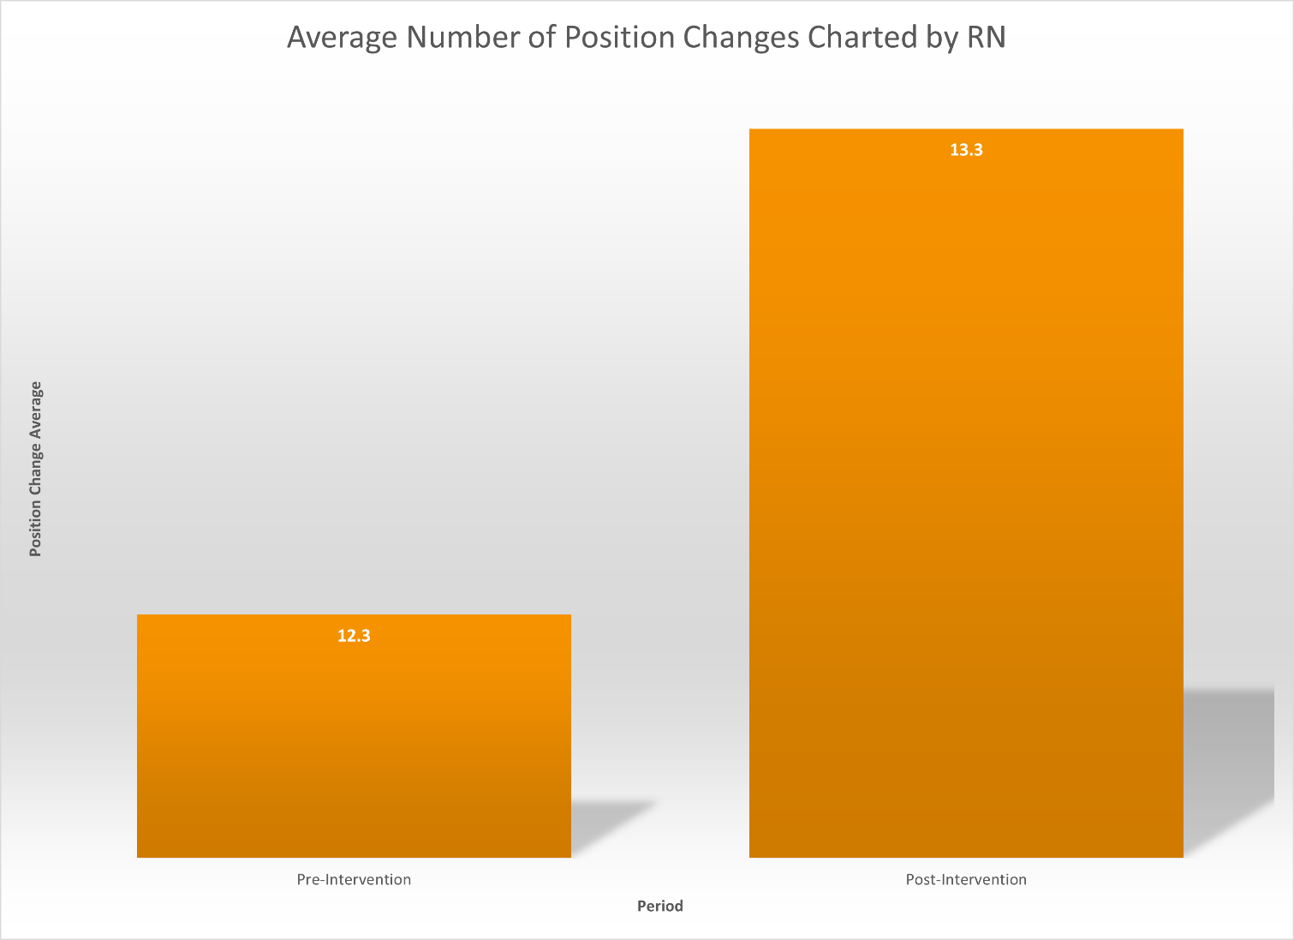
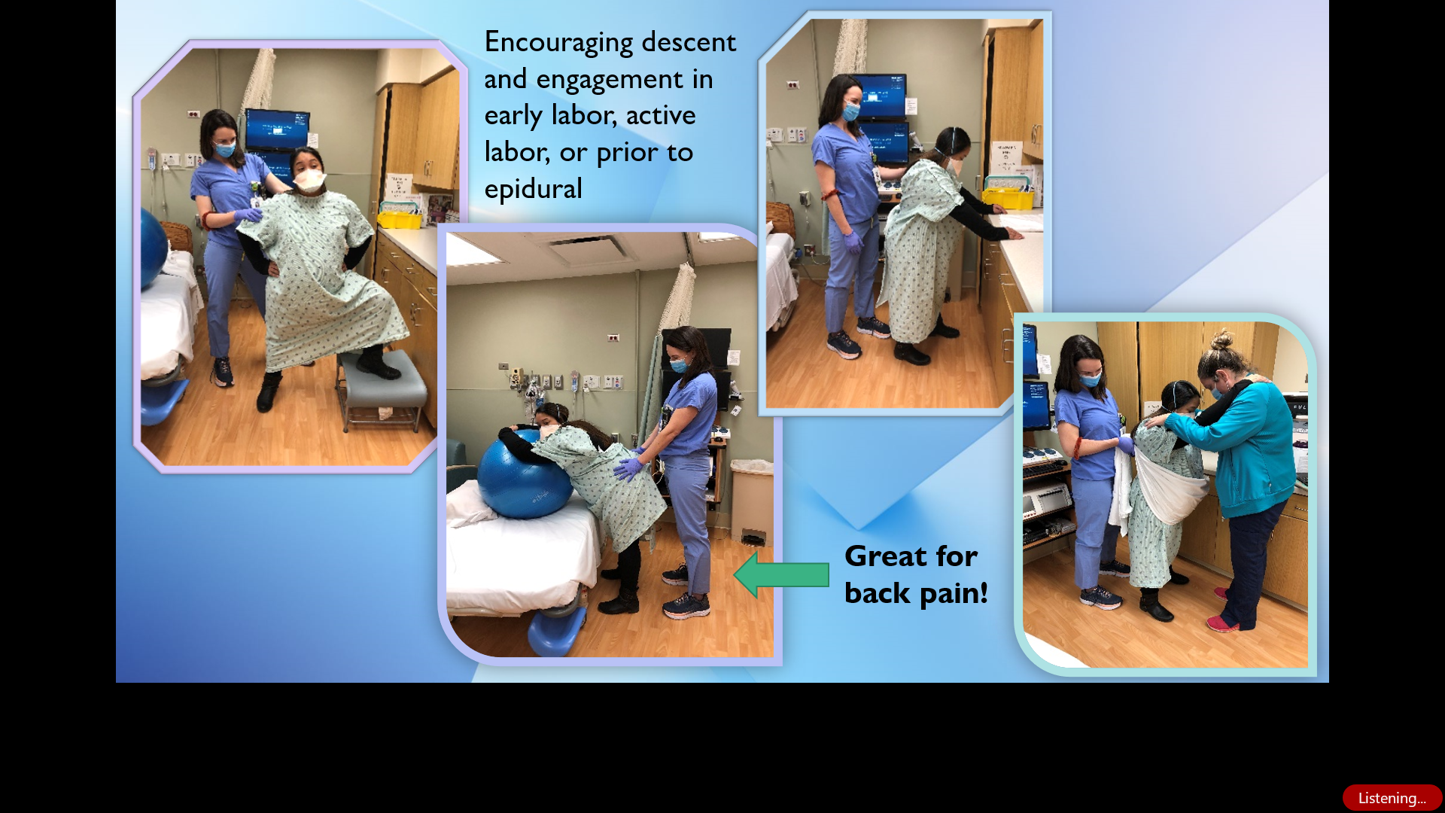
Positioning the Parturient for a Positive Labor & Birth
Mary M. Murphy, MSN, RNC, CLC
Problem
Methods
Cesarean sections carry increased risk of maternal morbidity and mortality, NICU admissions, and healthcare costs.
The most cited indication for primary cesarean is the “failure to progress.”
Factors that increase the risk of failed labor progress: lack of mobility, patient’s care provider, and the nurse assigned to a patient.
Healthy People 2020 measure: Nulliparous Term Singleton Vertex (NTSV) cesarean rate target 23.9%. Implementation site September 2018 to February 2019 NTSV rate 24.23%.
Quality improvement project.
Evidence-based and expert literature about labor positioning utilized to create a computer-based education training (CBT) module and hands on training.
Theoretical framework: Innovation Implementation framework.
Implementation site: 6-bed urban, level III perinatal center.
43 nurse participants
Measures: 1) chart review of number of position changes charted by nurses pre-and-post intervention, 2) nursing survey on confidence, competence, and intention pre-and-post intervention, 3) NTSV rates pre-and-post intervention.
PURPOSE
Conclusions
The purpose of this project was to increase nurse intention, competence, and confidence with labor positioning, and therefore increase patient position changes.
The desired outcome for the project was to decrease the cesarean rate at the hospital implementation site.
Well received by nursing staff, OB providers, and management.
Will become part of hospital system’s education as part of their Promoting Vaginal Birth initiative.
Unclear if cesarean rates affected by this project.
Background
Implications
Research has shown that upright positioning, frequent position changes, and the use of positioning tools such as a peanut ball can reduce the time spent in the first stage of labor, along with the risk of having a cesarean section.
This project is anticipated to increase nursing confidence, competence, and intention with labor positioning, and therefore increased number of patient position changes.
This project, along with other interventions in the Promoting Vaginal Birth toolkit, could assist in decreasing the clinical site’s cesarean rate.
Results
Initial number of nurses educated 26, remainder completed by June 1st.
The average charted position changes three months prior to intervention 12.3 and increased to 13.3 for three months post-intervention.
RN labor positioning survey pre-intervention score average 19.9 and increased post-intervention to 21.7.
NTSV cesarean rate average three months prior to implementation 17.8%, and 17.5% two months following implementation.
Acknowledgements
Carrie Klima, PhD, CNM, FACNM, FAAN
Patricia Green, MSN, CNM, WHNP-BC, CLC
My wonderful labor Positioning Models
Leadership and nursing staff at clinical site

