Slide 1
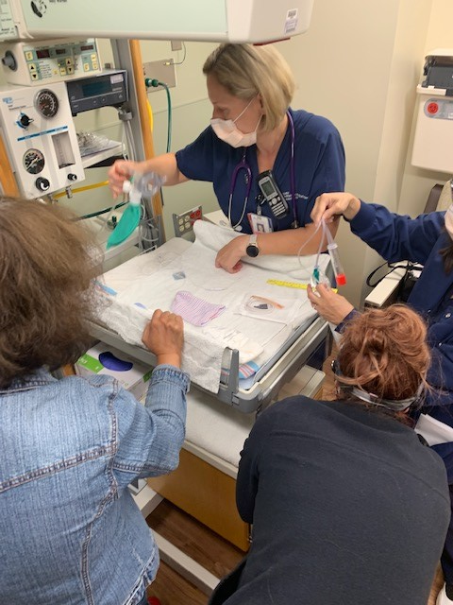
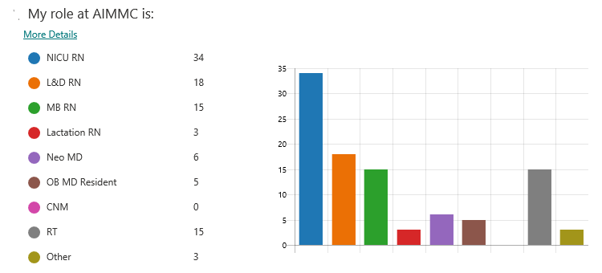
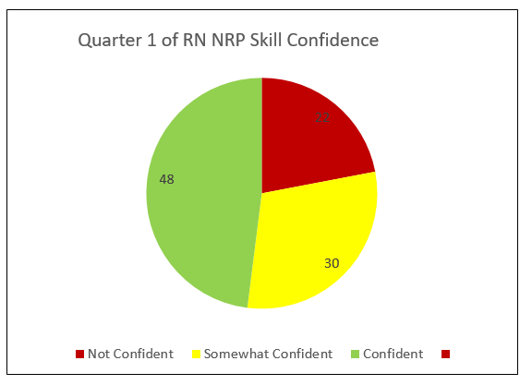
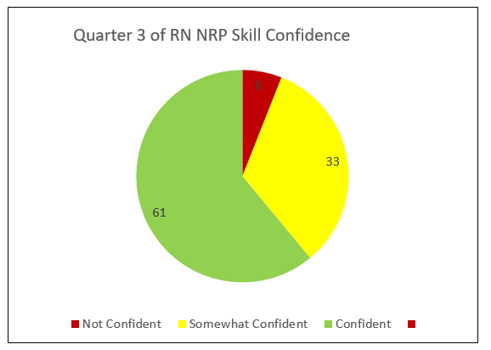
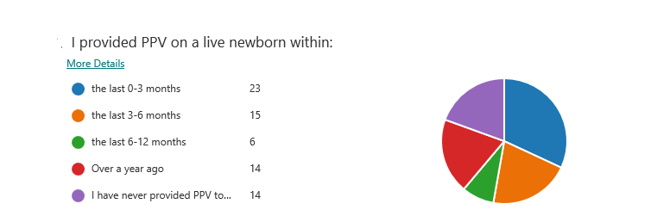
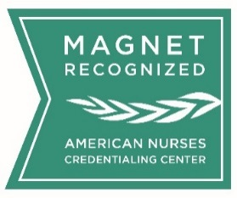
Growing Provider Confidence in Neonate Resuscitation Skills
Patricia Green, MSN, CNM, WHNP, CLC
Advocate Illinois Masonic Medical Center
Introduction
Methods
Conclusions
Educational studies suggest cardiopulmonary resuscitation knowledge and skills decay within 3 months after training (AHA 2020). Booster training has been shown to improve performance in simulation studies and reduce neonatal mortality in low resource settings (AHA 2020).
Resuscitation Quality Improvement (RQI) is the new standard for acquiring American Heart Association (AHA) certification which includes Basic Life Support (BLS), Advanced Cardiac Life Support (ACLS) & Pediatric Advanced Life Support (PALS).
RQI provides simulation-based learning, implemented through low–dose, high frequency quarterly assignments that measure and verify competence.
Although RQI went live at the hospital in July 2020, NRP was not included in the RQI platform. The NRP instructor team recognized the benefit of regular psychomotor skills practice for NRP providers and developed a “home grown” version of RQI.
Sample and Setting
The plan was to include all team members who have current NRP credentials which includes: nurses, respiratory therapists, neonatologists, certified nurse midwives and OB/FM residents. During implementation, RT and nursing were the disciplines that completed quarterly skill development return demonstrations.
Intervention
Utilizing the “Take Ten” model developed by C, Lira-Crame, MSN, RNC-NIC, NPDC, team members were provided 2-minute videos of skills to review prior to hands on practice. NRP practice newborn mannequins and resuscitation supplies are stored on each unit for team members to practice NRP skills.
Each quarter NRP skills were selected scaffolding in complexity to repeat the previous skill each quarter. Return demonstration with real time feedback allowed for learners to practice and grow with NRP content experts in approximately 5-10 minutes per quarter.
The instructors set aside times to “sign off’ team members each quarter to ensure all disciplines and shifts could practice. The deadlines were aligned with ACLS and BLS RQI assignments which assisted with easy adoption of practice.
Team members completed a Likert scall rating their confidence after each practice interaction.
In three short quarters, the data shows that nurses are becoming more confident in NRP skills from structured practice. One RN survey response, “always room for more learning,” further justifies the extra time and effort by the NRP instructors to continue supporting the staff in development of their NRP skills.
Team members value the immediate feedback on crucial skills in NRP. Although targeted skills are focused on each quarter, learners are able to build muscle due to the repetitive skill building sequence.
Due to the anonymity of the survey, the NRP instructor team is unable to determine which team members self-report low confidence in their NRP resuscitation skills. The team is discussing adding in person debrief questions to the Take-10 to identify providers who require more practice to grow skill and confidence.
Although the NRP 8th edition is moving to the RQI platform, Advocate Aurora Health will not have neonate RQI mannequins implemented by 2022. The home grown RQI will continue through 2022 with hopes to utilize the RQI platform in 2023.
Figure 3. Equipment Utilized during Take Ten return demonstration skill practice
Results
Prior to beginning the Take-10 Skills Practice, a survey was sent to all NRP providers for baseline data. 86 nursing team members completed the survey, and of those, 48% reported “confident or very confident” in their NRP skills. Of note, 22% of nurses reported “not confident at all” before the quarterly psychomotor practice began. Team members have participated in 3 Take Tens focusing on: Positive pressure ventilation (PPV), PPV with coordinated chest compressions (CCC), and PPV, CCC, and alternate airway preparation. Third quarter post surveys were completed by 57 nursing team members. 61% of nurses report “confident or very confident” and only 6% (3 RNs) report “not confident” thus showing regular practice increases confidence in skills.
Figure 2. Team member break down who completed survey prior to targeted experiential learning
Implications for Practice
Targeted experiential learning beneficial in other skills that apply to all units. The AIMMC nursing professional development team is utilizing the Take T.E.N. format for other high risk low volume skills giving team members opportunities to practice skills with immediate feedback provided by a content expert.
Figure 1. Take Ten flyer hung in the units
Purpose
AIMMC’s current practice was to maintain NRP Provider credentials as recommended by job description following the 7th edition format. The AAP’s Neonatal Resuscitation Program (NRP) Q2 year training requirements are not meeting the needs of our providers. Practicing skills infrequently leads to apprehension and/or fear due to lack of confidence in emergent situations requiring newborn resuscitation skills.
Provider confidence in neonatal resuscitation skills is difficult to maintain due to the low volume of neonates requiring resuscitation. This performance improvement project focused on increasing confidence and ensuring skills are performed correctly in NRP providers.
Acknowledgements
Thank you to the NRP content experts who validated NRP provider skills and coached skills as needed: Jacquelyn Chiera, BSN, RNC, Sherr Ann Bianzon, BSN, RNC, Rachel Haacker, BSN, RNC, Cynthia Lira-Crame, MSN, RNC, NPDC, Jacob Thomas, RT, Maksym, Melnyk, RT
(Site) is proud to be Magnet® recognized by the American Nurses Credentialing Center
Figure 4. Percentage comparison of RNs who rated confidence in NRP skills using Likert scale. Self reported NRP experience on the unit

