Slide 1
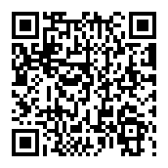
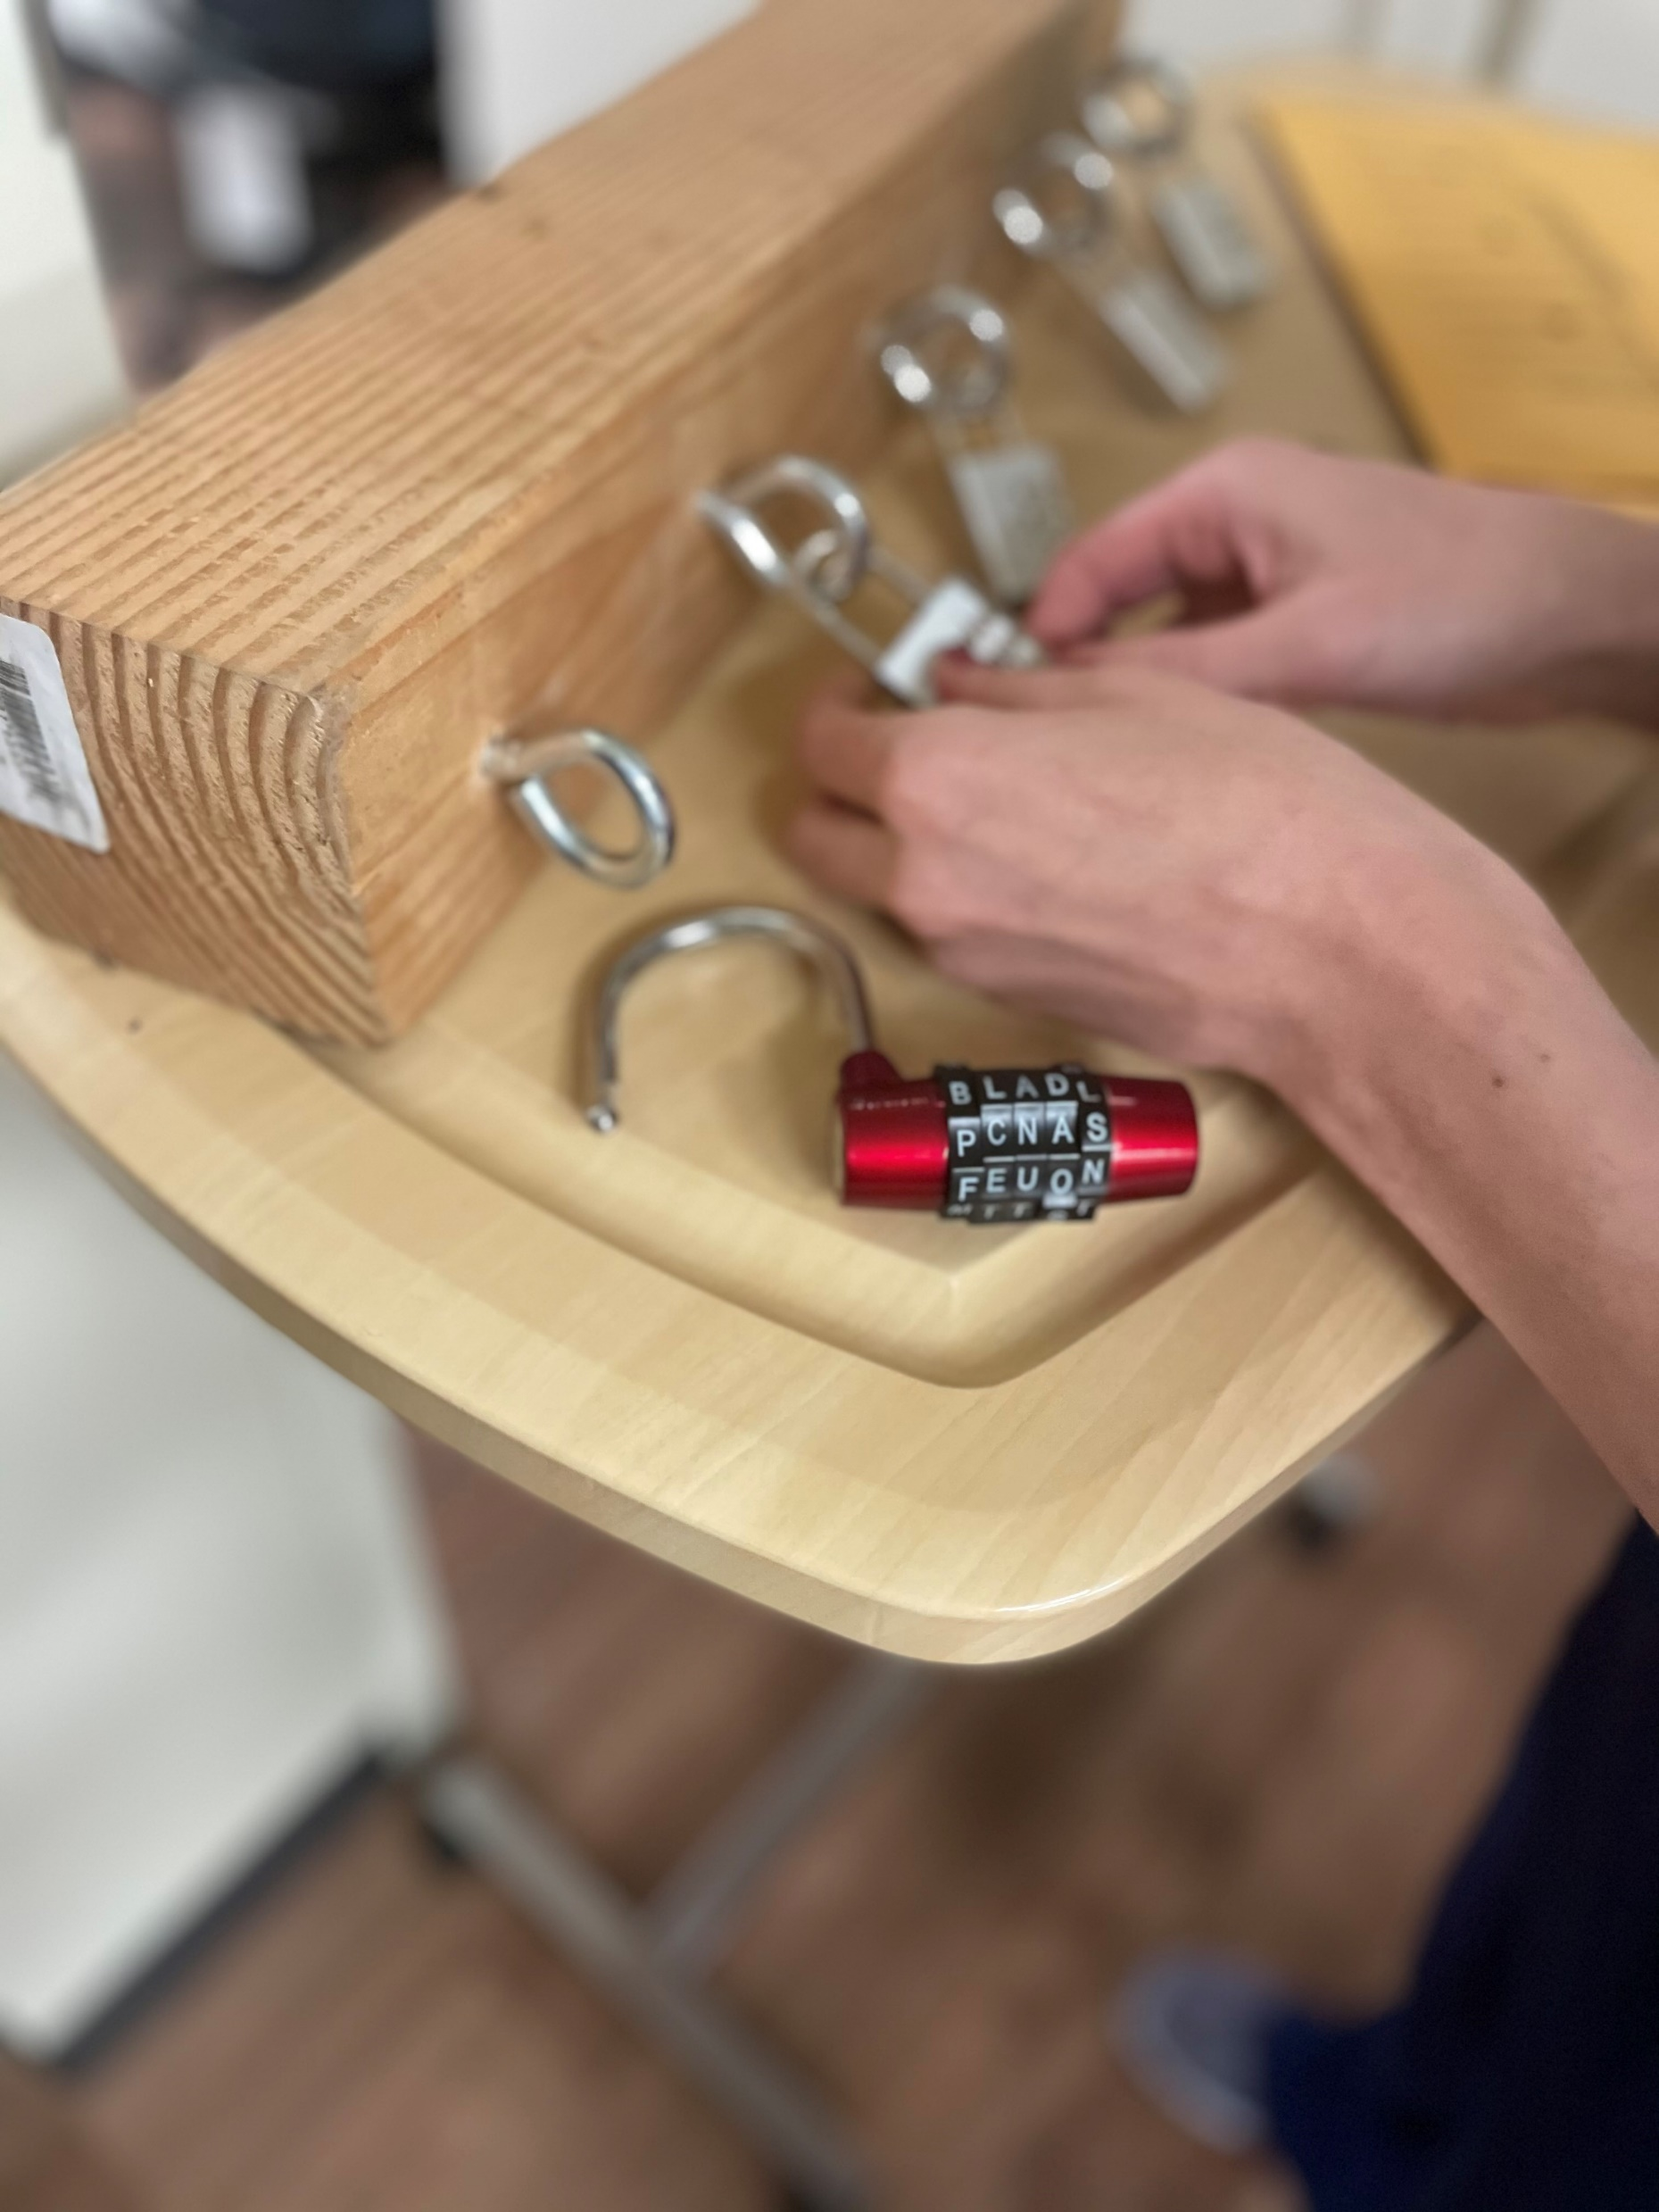
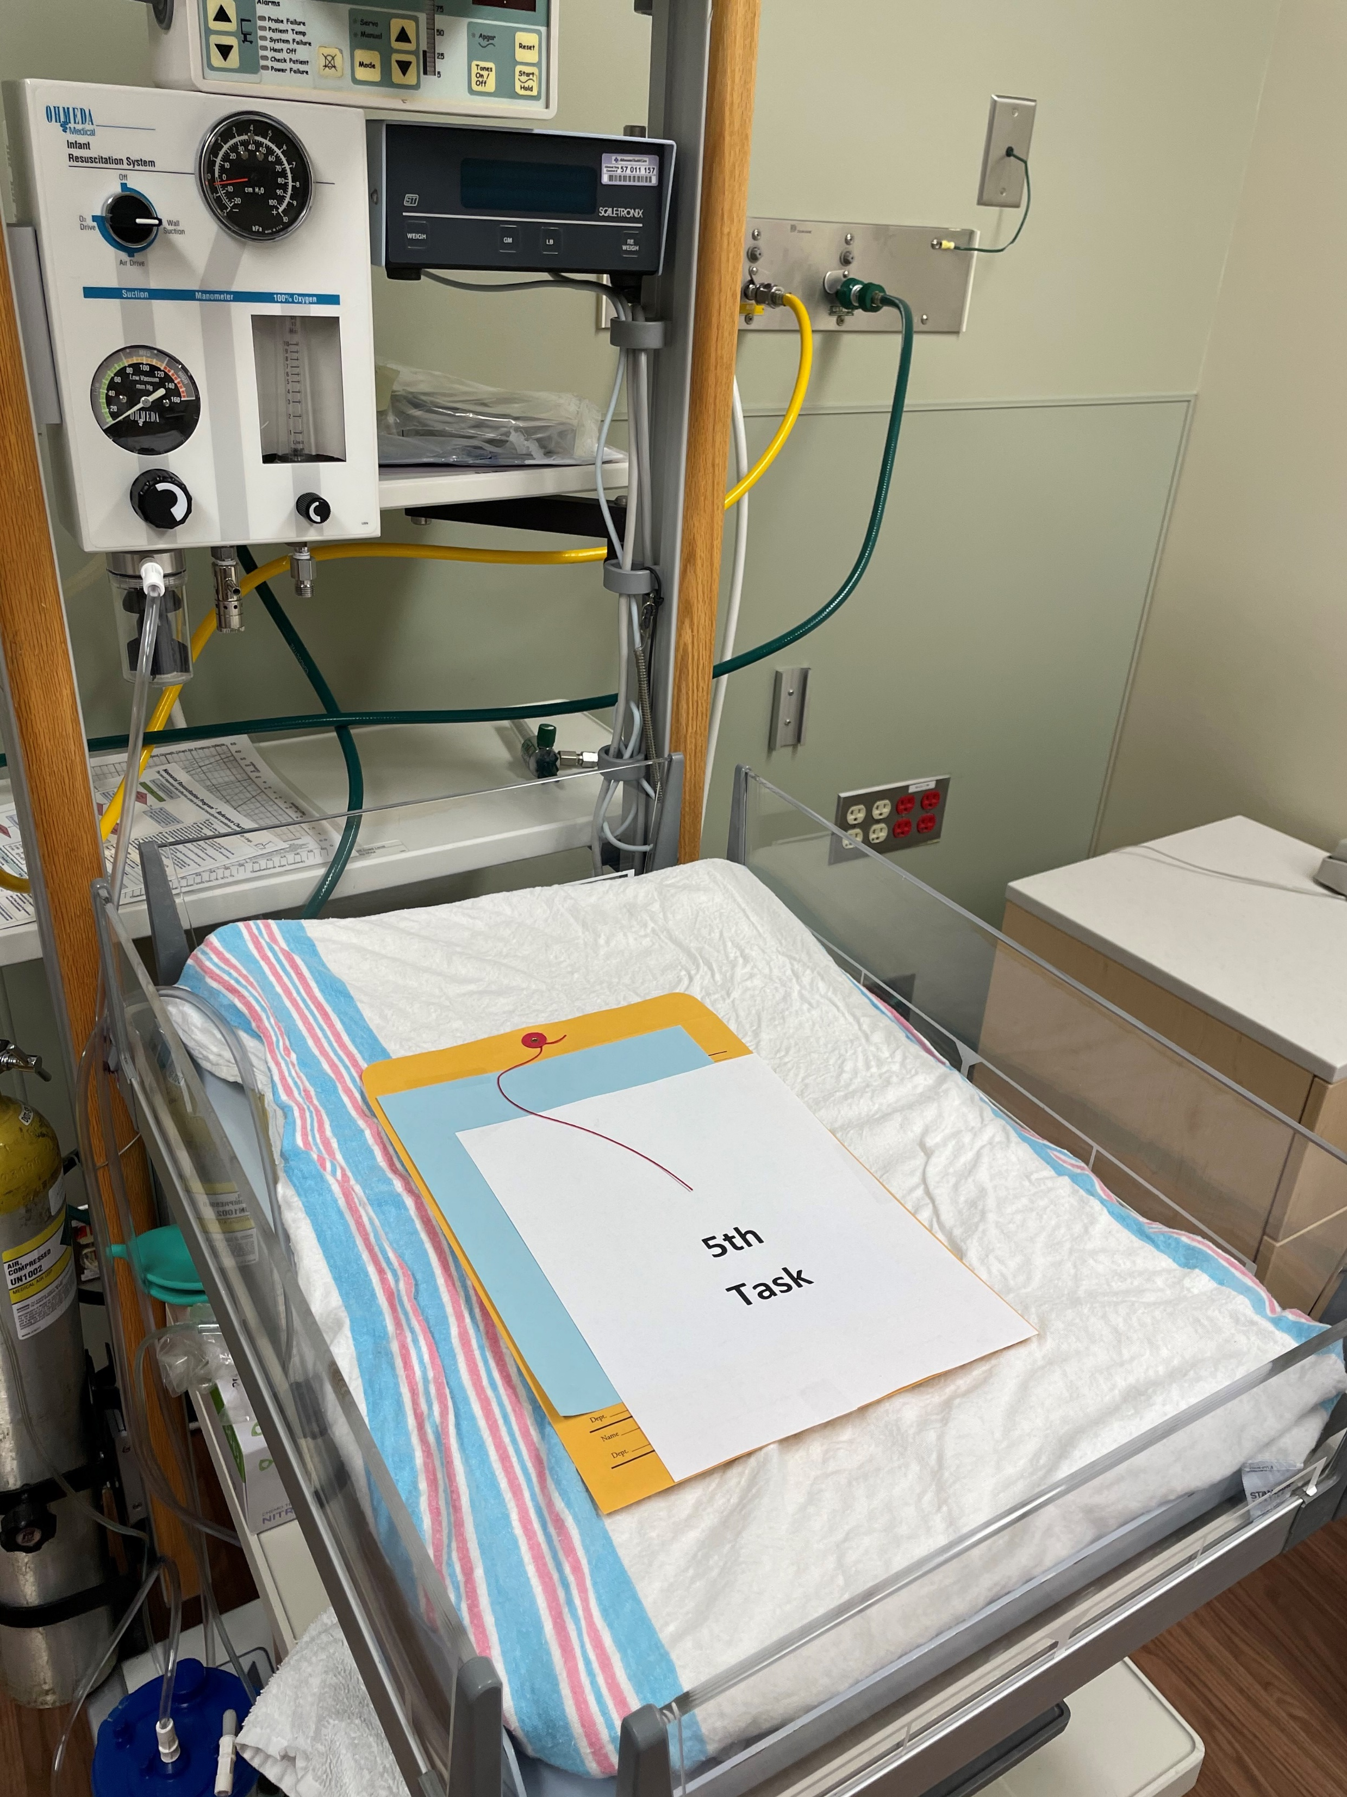
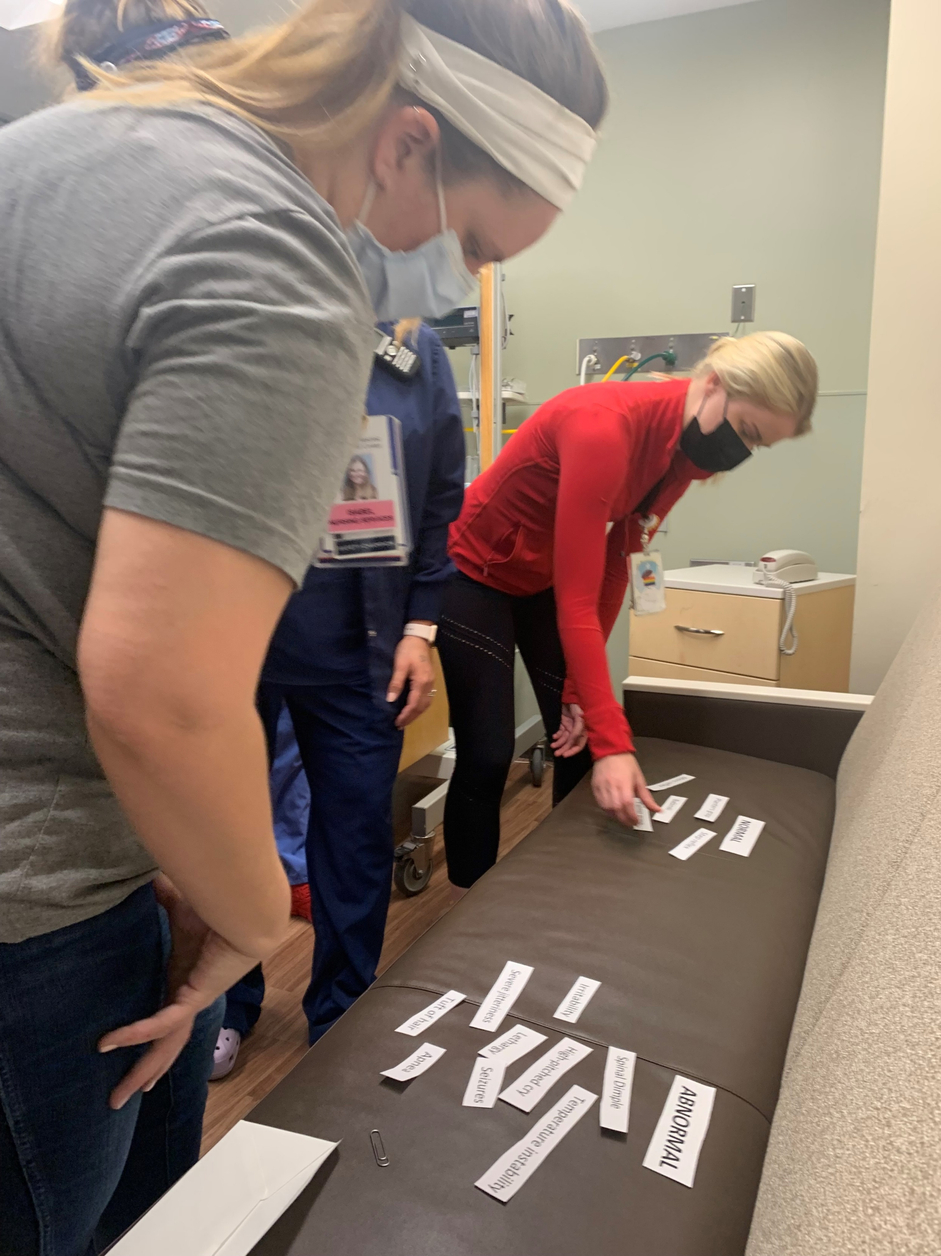
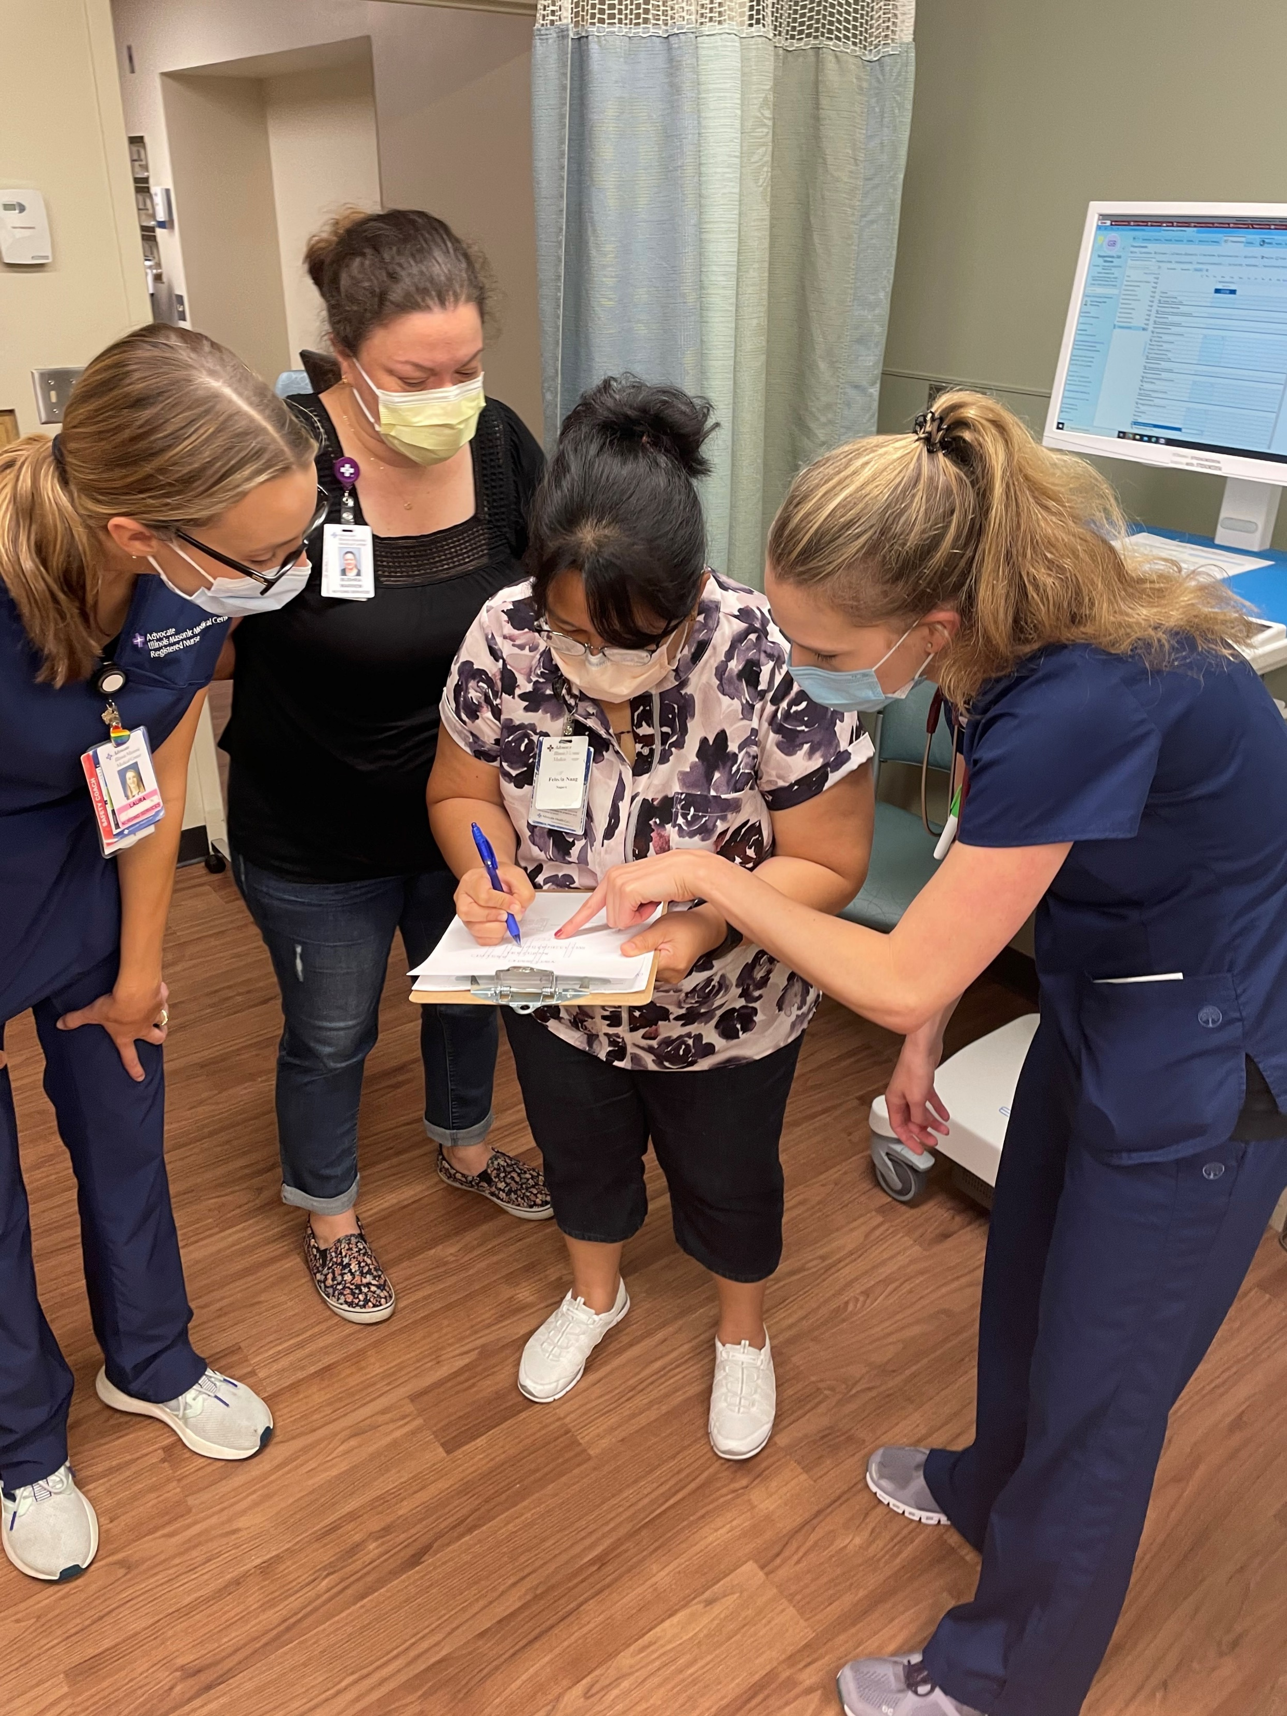
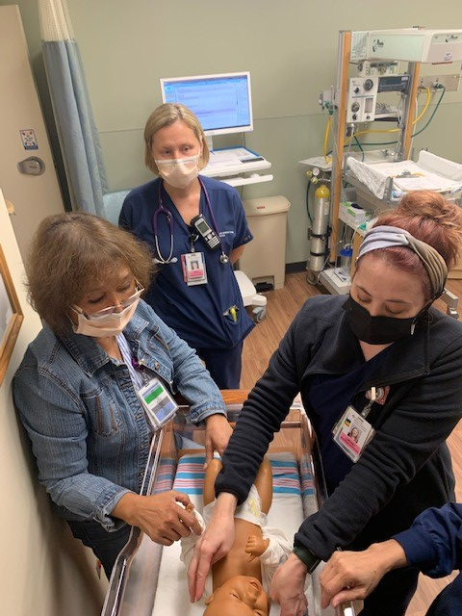
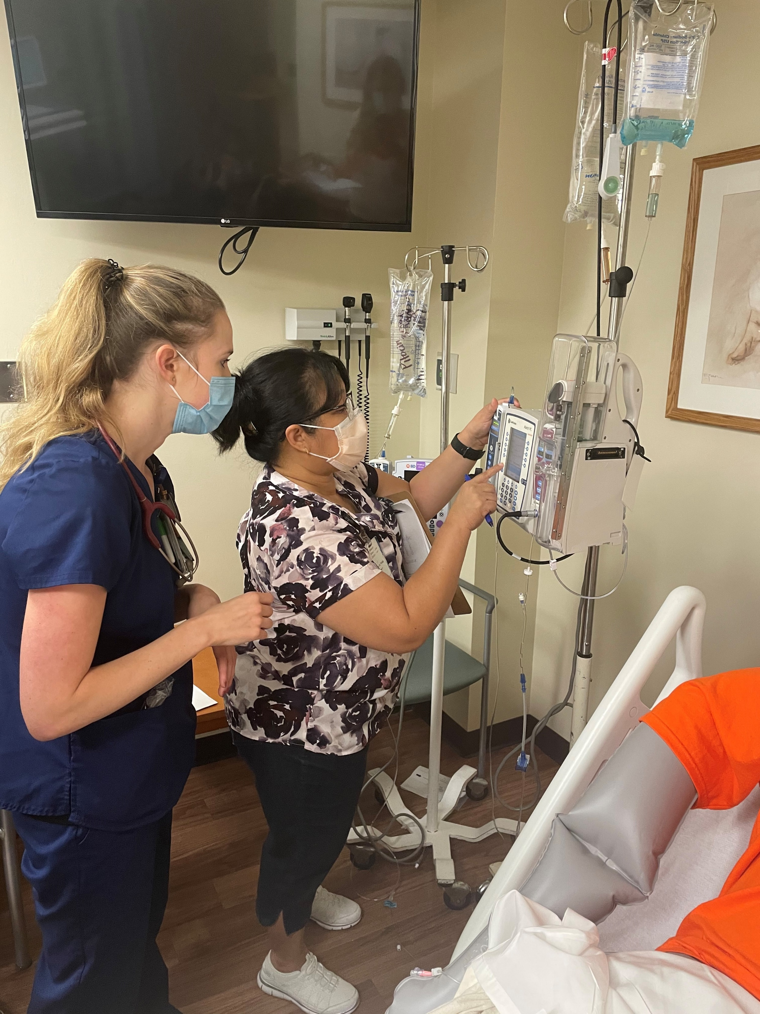
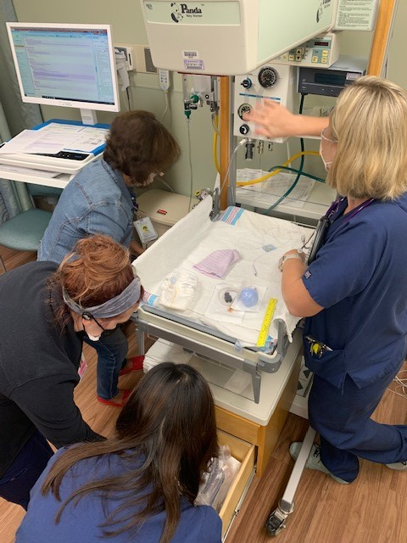
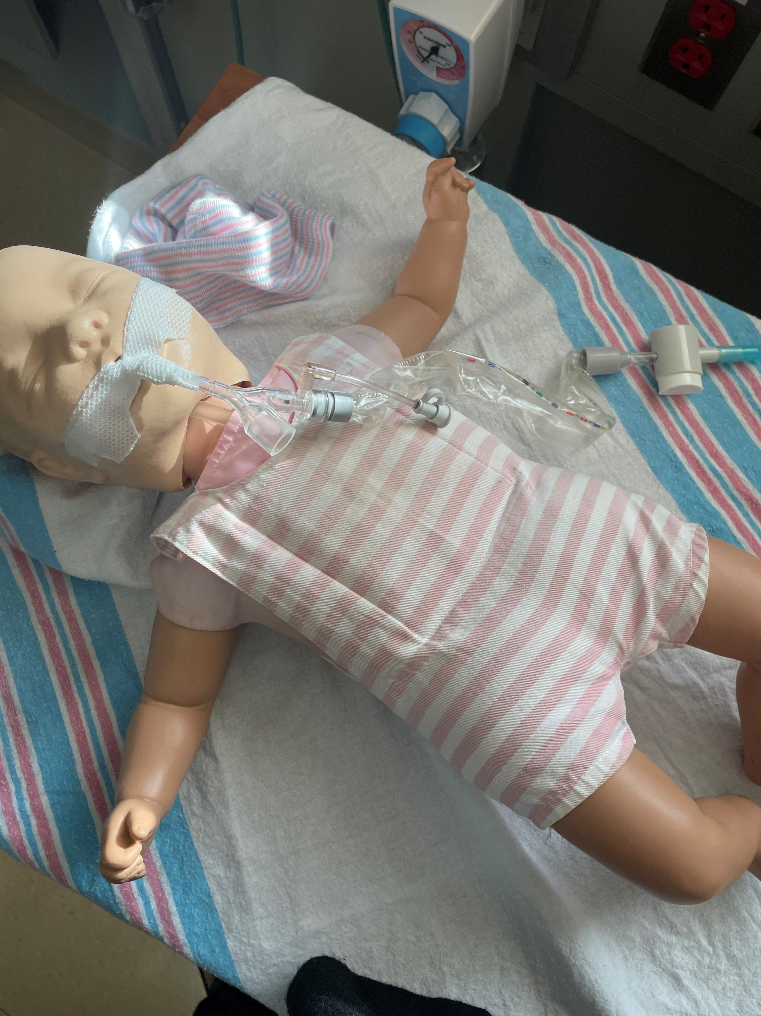
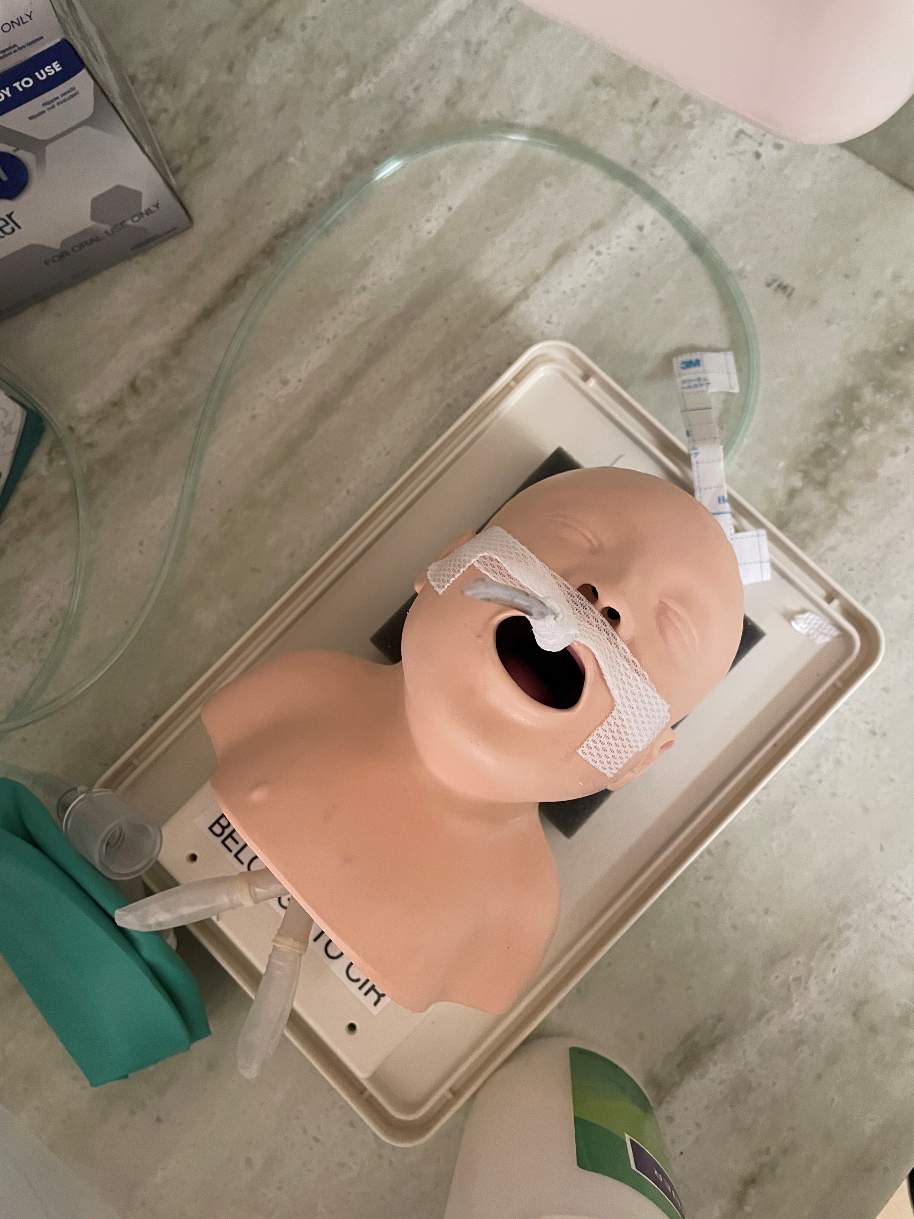

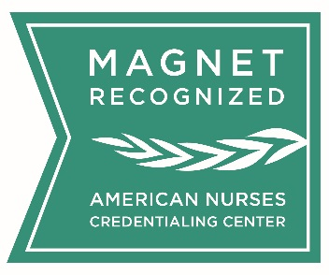
“Escaping” from Traditional Competency Verification: The “Wright” Way to Validate Competency
Tricia Green, MSN, CNM, WHNP-BC, CLC
patricia.green@aah.org
Advocate Illinois Masonic Medical Center
Background
Donna Wright Model (DWM) of competency verification key concepts include ownership, empowerment and accountability for the frontline staff
DWM has 11 different methods of verification dependent on the skill selected
Team members choosing their competency AND verification method increases team member satisfaction and aligns with the professional practice model.
Objective
AIMMC’s Nursing Professional Development department wanted to explore non-traditional methods of verification as outlined by DWM
Escape Room and Return Demonstration Photos
Pictures are great—but do not tell the entire story. Scan for more details!
.
Andriod users:
1. Go to Play Store
2. Download QR code scanner application
3. Follow prompts
Use the camera on your iphone and hover over the QR code to capture the link
Advocate Illinois Masonic Medical Center is proud to be Magnet® recognized by the American Nurses Credentialing Center.

