Slide 1

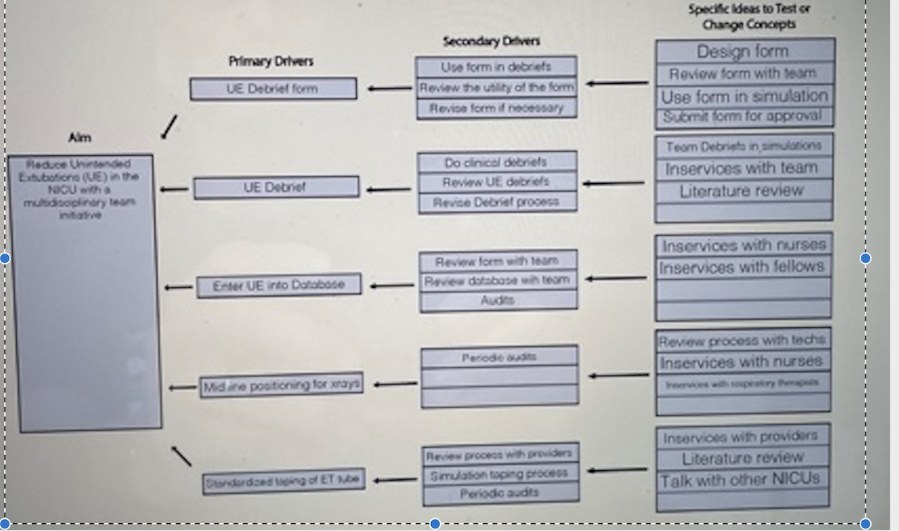
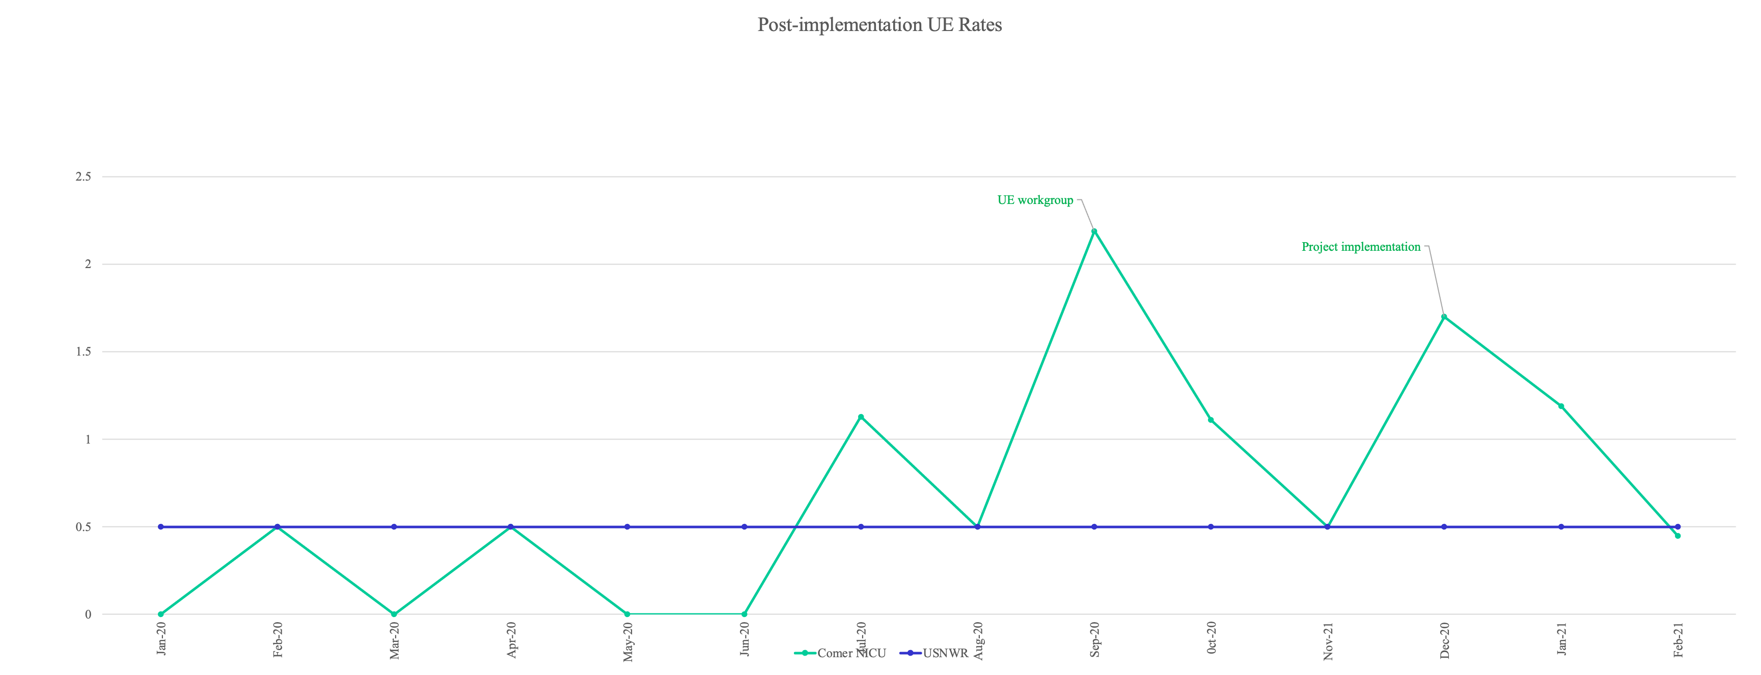
Decreasing Unintended Extubation Rate in a Level IIIb NICU
Emily Campbell, BSN RN, Brandi Parker MSN MBA, Christina Billy, BSN RN, Jaideep Singh, MD, Kelly Nelson Kelly, MD, Joan Liput, MBA, Allison Bartlett, MD, Joseph R. Hageman, MD
University of Chicago Medical Center
Problem
“Lessons Learned”
Unintended extubation (UE) rate is a reflection of best practice of airway management in the neonatal intensive care unit (NICU)
It is defined as UE/invasive ventilator days and is used in NICUs in the United States as a reflection of best practice
Key Lessons Learned
UE definition
  Continue to question eligibility
  Discussing vs. reporting
Midline positioning
  Chart audits revealed ~50% compliance with a gradual decline over the project period
  Both positive and negative feedback from staff
Post-UE debriefing
  70% of all UEs were followed by a post-UE debrief
  Several duplicate forms indicating both yes and no…
UE Event Form
  Improved awareness of data reporting
  No evidence to suggest missed UEs
  Rise in duplicate entries
Goal
To reduce and maintain the UE rate to < 0.5 UE/100 ventilator days.
“Results to Date”
Choose 1: “Innovation”, “Strategy”, or “Intervention Design”
Part 1: Unintended Extubation Data Collection Tool
Define unintended extubation
  Not part of the plan of care
  No provider order
Identify priority data for ease of use and timely collection
  Date and time of unintended extubation
  Medical record number
  Activity during unintended extubation
  Manual ventilation required?
  Reintubation required?
  Resuscitation required?
Acknowledgements
Educate staff on use of tool
  How are we going to create a culture change around unintended extubations
Limit discoverability
  Worked with med-legal
  Survey is anonymous
  User is taken out of the EMR and into RedCap
We would like to thank the NICU nurses, nurse practitioners, residents, fellows, and the nursing and attending leadership

