Slide 1

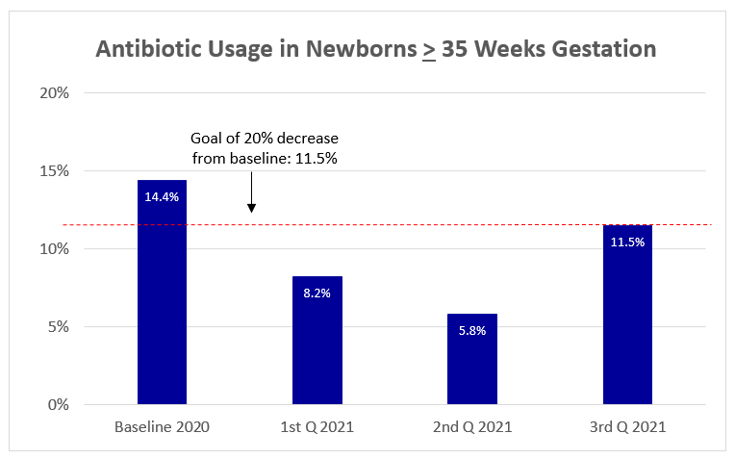
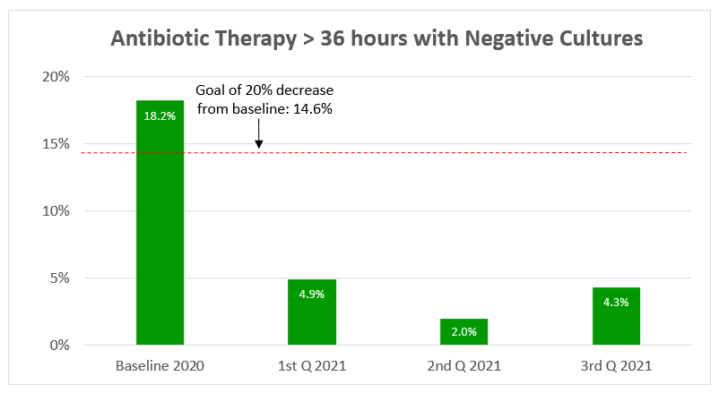
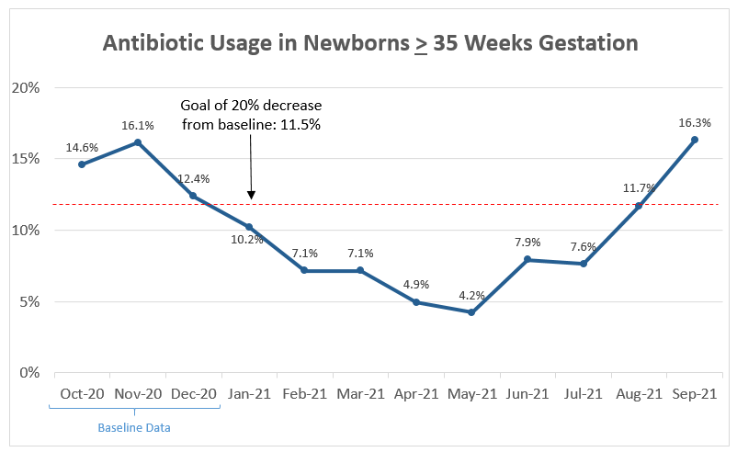
Down to the BASICs:
Babies Antibiotic Stewardship Improvement Collaborative
Margaret Naber, DNP, Pamela Nicoski, PharmD, Nadia Qureshi, MD, Andrew Bonwit, MD, Lauren Astrug, MD, Walid Hussain, MD
Lindsey Young, MSN, Julie Dervishoski, MSN, Bridget Boyd, MD, Sachin Amin, MD, MBA
Loyola University Medical Center, Maywood Illinois
Problem
Results
Overuse and prolonged antibiotic courses have been associated with increased short and long term morbidity amongst newborns
The Babies Antibiotic Stewardship Improvement Collaborative (BASIC) initiative advocates antibiotic administration to the right babies for the the right amount of time
Aim # 1: decrease the usage of antibiotics by 20% in newborns born at > 35 weeks gestation
Aim # 2: decrease the usage of antibiotics for longer than 36 hours in newborns with a negative blood culture
Antibiotic usage:
Baseline data from 2020 showed 14.4% of newborns > 35 weeks gestation received antibiotics within the first 72 hours of life
After implementation, antibiotic use decreased by 40% over the next three quarters in 2021 (quarter 1: 8.2%; quarter 2: 5.8%; quarter 3: 11.5%)
During quarter 3, 2021, there was an uptick in antibiotic usage
Length of antibiotic therapy:
Baseline data from 2020 showed 18.2% of all newborns were treated with antibiotics beyond 36 hours, despite a negative blood culture
After implementation, antibiotic therapy decreased by 79% over the next three quarters in 2021 (quarter 1: 4.9%; quarter 2: 2.0%, quarter 3: 4.3%)
There were no complications or harm to any nursery or NICU infants
Project Implementation
Clinical practice changes
1.) Revision of our institutional early-onset sepsis (EOS) algorithm utilized for newborns in the nursery and in the Neonatal Intensive Care Unit (NICU) incorporated the American Academy of Pediatrics recommendations:
Use of the Kaiser Permanente EOS Calculator on all babies born > 35 weeks gestation
Use of a risk assessment on babies born < 35 weeks gestation
2.) Limitation of EOS antibiotic course from 48 to 36 hours for newborns with a negative blood culture
Extensive education of nursery and NICU health care providers occurred before implementation of the clinical practice changes
Data collection
Baseline data: October – December 2020
Post-implementation data:
Collected monthly, starting January 2021
Ongoing collection
Conclusions
Acknowledgements
Implementation of a modified EOS algorithm and reduction in length of empiric therapy significantly decreased unnecessary use of antibiotics in our nursery and NICU
Continued success with this BASIC initiative requires ongoing education of all health care providers regarding antibiotic stewardship
Sincere gratitude to all Loyola nursery and NICU health care providers (from nursing, medicine, and pharmacy) for contributions which supported implementation of these quality improvement clinical practice changes

