Slide 1
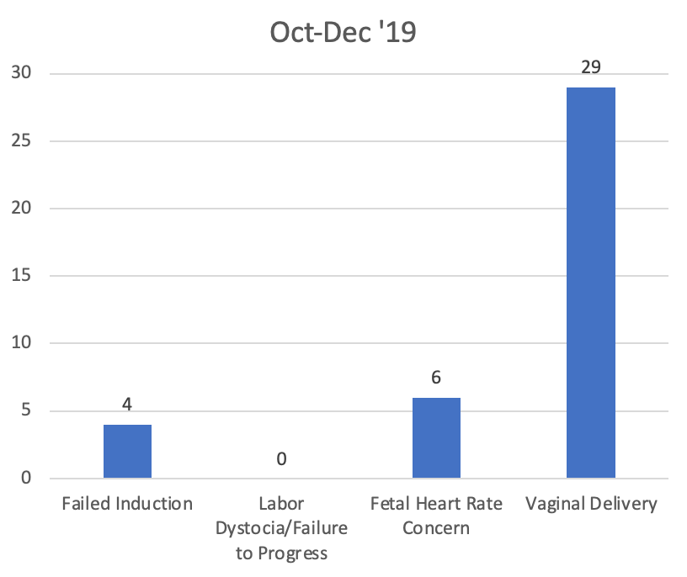
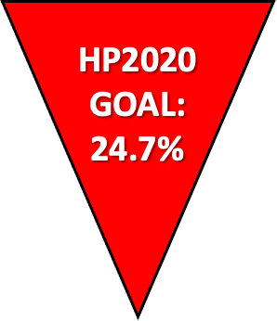
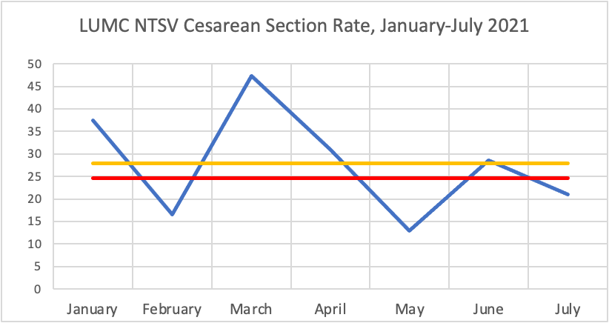

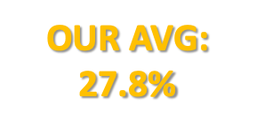
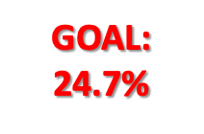
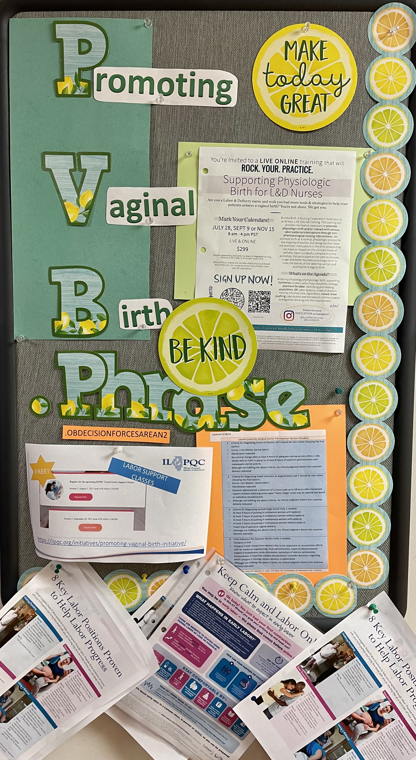
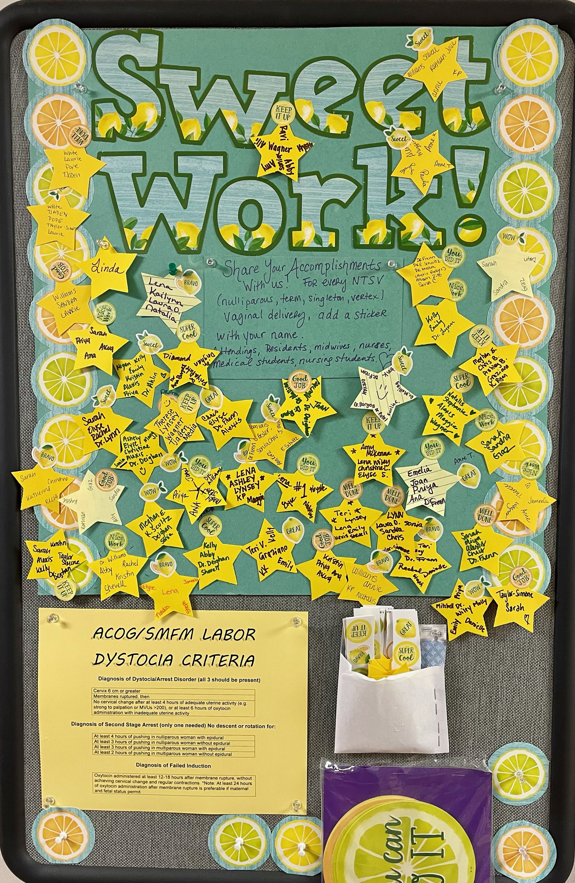
The Cost-Effectiveness of Promoting Vaginal Birth: A Quality Improvement Project
Elise Heisler, MS4, Recia Frenn, MD
Stritch School of Medicine, Department of Obstetrics & Gynecology, Loyola University Chicago, Maywood, IL
Introduction
Figures and Tables
Conclusion
The rate of cesarean delivery in the United States continues to rise without a related improvement in neonatal or maternal outcomes. In fact, cesarean deliveries have risen 60%, from 20.7 to 32.8% of total live births.
Cesarean sections cost up to $10,000 more than vaginal deliveries and are associated with higher morbidity and mortality, ultimately leading to further increased costs.
Nulliparous Term Singleton Vertex (NTSV) who undergo cesarean section have a significantly higher risk of undergoing subsequent cesarean section in future deliveries, compounding costs exponentially.
There are numerous accessible and affordable methods to help promote vaginal delivery and decrease the rate of cesarean sections in the NTSV population.
Objectives:
To describe the potential strategies available to safely encourage vaginal delivery over cesarean section in NTSV women.
To compare the cost of proposed PVB strategies versus cost of cesarean delivery.
To implement PVB initiatives and subsequently decrease the overall cesarean rate at LUMC.
Figure 1. Rate of Baseline NTSV Cesarean Deliveries at LUMC
Figure 2. LUMC NTSV Cesarean Rate, After Initial PVB Initiatives
There are multiple non-invasive and cost-effective methods to promote vaginal delivery in NTSV women to be considered at LUMC.
Future Goals
1. PVB Grand Rounds
2. Publishing provider-level data
3. Continued education for doctors and nurses
Barriers
High L&D nurse turnover, likely related to COVID-19, makes 1:1 nursing challenging and increases the costs of PVB classes and education.
Pictures 1-5. LUMC PVB Initiatives, including “Spinning Babies” Class, L&D Poster with “Competitions”, and more
References
Table 1. PVB Proposals and Associated Costs at LUMC
1. DeJoy SA, Bohl MG, Mahoney K, Blake C. Estimating the Financial Impact of Reducing Primary Cesareans. J Midwifery Womens Health. 2020 Jan;65(1):56-63. doi: 10.1111/jmwh.13010. Epub 2019 Jul 28. PMID: 31353803.
2. Main, E. K., Chang, S.-C., Cape, V., Sakowski, C., Smith, H., & Vasher, J. (2019). Safety Assessment of a Large-Scale Improvement Collaborative to Reduce Nulliparous Cesarean Delivery Rates. Obstetrics and Gynecology, 133(4), 613–623. https://doi.org/10.1097/AOG.0000000000003109
3. Morbidity and Mortality. Healthy People 2020 Website. https://www.healthypeople.gov/2020/topics-objectives/objective/mich-71. Accessed April 28, 2021.
4. Osterman MJK, Martin JA. Trends in low-risk cesarean delivery in the United States, 1990–2013. National vital statistics reports; vol 63 no 6. Hyattsville, MD: National Center for Health Statistics. 2014.
5. Rosenstein, M. G., Chang, S.-C., Sakowski, C., Markow, C., Teleki, S., Lang, L., Logan, J., Cape, V., & Main, E. K. (2021). Hospital Quality Improvement Interventions, Statewide Policy Initiatives, and Rates of Cesarean Delivery for Nulliparous, Term, Singleton, Vertex Births in California. JAMA, 325(16), 1631–1639. https://doi.org/10.1001/jama.2021.3816
6. Safe prevention of the primary cesarean delivery. Obstetric Care Consensus No. 1. American College of Obstetricians and Gynecologists. Obstet Gynecol 2014;123:693-711
7. Smith H, Peterson N, Lagrew D, Main E. 2016. Toolkit to Support Vaginal Birth and Reduce Primary Cesareans: A Quality Improvement Toolkit. Stanford, CA: California Maternal Quality Care Collaborative
8. ZipRecruiter/GlassDoor
9. Fedex
Proposal | Cost (per year)
Cultivate buy-in
Create a PVB QI Team | $0
"Competitions" re: frequency of vaginal delivery | $200
Physician and Patient Education
Physician grand rounds re: PVB | $500-1,000
Poster with published guidelines for L&D Room | $50
PVB handouts at prenatal visits | $1,000
Spinning babies class for nurses | $150/student
Labor Support
Hire extra L&D nurse to achieve 1:1 nursing | $82,197
Portable monitors/Telemetry | $0, already have
Hire Doula | $35,385
Hydrotherapy | $0
Healthy snacks | $500
Birthing balls | $0, already have
New birthing bed | $13,151/bed
Intermittent monitoring | $0
Prenatal Support
Prenatal exercise classes | $2,162
Prenatal nutrition classes | $6,200
Methods
The population of interest included NTSV women who underwent cesarean section at LUMC in 2019 and 2021.
Collected patient information and indication for cesarean delivery; either failed induction, labor dystocia/failure to progress, or fetal heart rate concern.
Researched viable proposals to help promote vaginal delivery using suggestions from the Illinois Perinatal Quality Collaborative (ILPQC), the California Maternal Quality Care Collaborative (CMQCC), and original ideas.
Estimated potential costs of each proposed strategy at LUMC and compared to cost of cesarean section.

