Slide 1

QI Excellence Awards, Virtual Storyboard Session, and Transition to Breakouts
May 20, 2020
9am – 3:15pm
Notes:
MNO-OB, MNO-Neo, IPLARC, IPAC
Gold → Bronze

Slide 2
Awards and Recognitions
11:30 – 11:40am
Quality Improvement Awards for MNO-OB, MNO-Neo, IPLARC, and IPAC
Storyboard Session Information
Breakout Session Information

Slide 3
Congrats MNO-OB QI Award of Excellence Winners!
QI Champion
Advocate Good Samaritan Hospital
Advocate Sherman Hospital
Barnes Jewish Hospital
Mount Sinai Hospital
NM Central DuPage Hospital
NM Northwestern Memorial Hospital*^
NorthShore University HealthSystem Evanston Hospital
Palos Health – Palos Hospital*^
Riverside Medical Center
Silver Cross Hospital
SSM Health St Mary's Hospital – St. Louis*
UI Health – University of Illinois Hospital
*Received QI Award November 2019
^Received Higher Level of QI Award Since November 2019
Notes:
Acknowledge ALL Winners *asterics for previously winners. + for upgrading their award

Slide 4
Congrats MNO-OB QI Award of Excellence Winners!
QI Leader: Systems & Culture Change
Abraham Lincoln Memorial Hospital
Advocate BroMenn Hospital*
Advocate Christ Medical Center
Advocate Condell Medical Center
Advocate Illinois Masonic Medical Center
AMITA Health St. Alexius Medical Center
AMITA Health Adventist Medical Center Bolingbrook*
CGH Medical Center
Edward Hospital
HSHS St. Joseph’s Hospital- Breese
Illinois Valley Community Hospital*
Little Company of Mary Hospital
Loyola University Medical Center*
Memorial Hospital Belleville
Memorial Hospital East
Memorial Hospital of Carbondale*
Memorial Medical Center
Morris Hospital
NM Huntley Hospital
NM Kishwaukee Hospital
NM Lake Forest Hospital
NM McHenry Hospital*
OSF St. Elizabeth Medical Center
OSF St. Francis Medical Center*
Rush Copley
Saint Anthony Hospital*
*Received QI Award November 2019
^Received Higher Level of QI Award Since November 2019
Notes:
Acknowledge ALL Winners *asterics for previously winners. + for upgrading their award

Slide 5
Congrats MNO-OB QI Award of Excellence Winners!
QI Leader: Systems Change
Elmhurst Memorial Hospital
Northwest Community Healthcare
Notes:
Acknowledge ALL Winners *asterics for previously winners. + for upgrading their award

Slide 6
Congrats IPLARC Wave 2 QI
Award of Excellence Winners!
QI Champion
Barnes Jewish Hospital^
QI Leader
Abraham Lincoln Memorial Hospital ^
Gibson Area Hospital^
QI Recognition
Rush Copley Medical Center^
^Received Higher Level of QI Award Since November 2019
Notes:
Acknowledge ALL Winners *asterics for previously winners. + for upgrading their award

Slide 7
Congrats IPAC
QI Award of Excellence Winners!
QI Champion
AMITA Health St. Alexius Medical Center^
AMITA Health Alexian Brothers Hospital^
AMITA Health St. Joseph Hospital^
Loyola University Medical Center^
Illinois Valley Community Hospital^
Morris Hospital^
St. Margaret’s Hospital^
University of Illinois Hospital and Health Sciences System^
Memorial Hospital of Carbondale^
QI Leader
SSM St. Mary's Centralia Hospital^
^Received Higher Level of QI Award Since November 2019
Notes:
Acknowledge ALL Winners *asterics for previously winners. + for upgrading their award

Slide 8
Award Instructions
ILPQC will follow up with new award winners who have not previously received a plaque to request contact & shipping information to send QI Award of Excellence plaques
If you have any questions, comments, or concerns about your award status, please email info@ilpqc.org

Slide 9
MNO Materials Order
Starting today through 5/29/2020 at 5pm CST, ILPQC will open an order form for hospital teams to order and ship FREE bundles of MNO OB & Neonatal Folders and provider education posters!
Link to order folders is here: https://ilpqc.org/ilpqc-2020-virtual-ob-face-to-face/ and the OB Face to Face webpage
Ordering 1 MNO Folder Bundle will include:
  1 x MNO-OB Folder,
  1 x MNO-Neonatal Folder, and
  1 x complete set of OB & Neonatal Provider Education Posters
Attendees can order up to 5 bundles.

Slide 10
Virtual team storyboard session & lunch break

Slide 11
Virtual Storyboards Session
11:40pm – 12:30pm
Storyboards and Steal Shamelessly Document can be found on the ILPQC 2020 Virtual OB Face to Face Website: https://ilpqc.org/ilpqc-2020-virtual-ob-face-to-face/ (Password: OBF2F2020)
Browse through all of the storyboards, listed alphabetically & with a unique OB identifier (i.e. OB 1, OB 5…)
Email us at info@ilpqc.org with something you’ll take back to your team from the storyboards in your Steal Shamelessly Document or an email titled “Storyboards” to be enrolled in a raffle to win $50 Amazon gift cards to be awarded at the end of the meeting!
Vote for your top storyboard and submit your vote into the link on https://ilpqc.org/ilpqc-2020-virtual-ob-face-to-face/- hospitals with most votes will receive awards!
All links above also available on OB Face to Face Webpage
Notes:
https://redcap.healthlnk.org/surveys/?s=CM9LTJ9D77

Slide 12
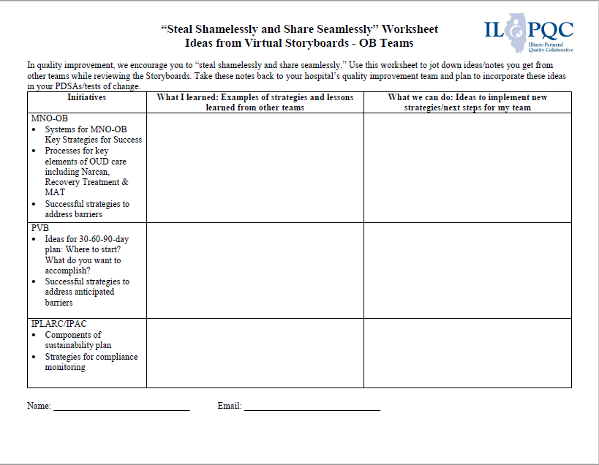
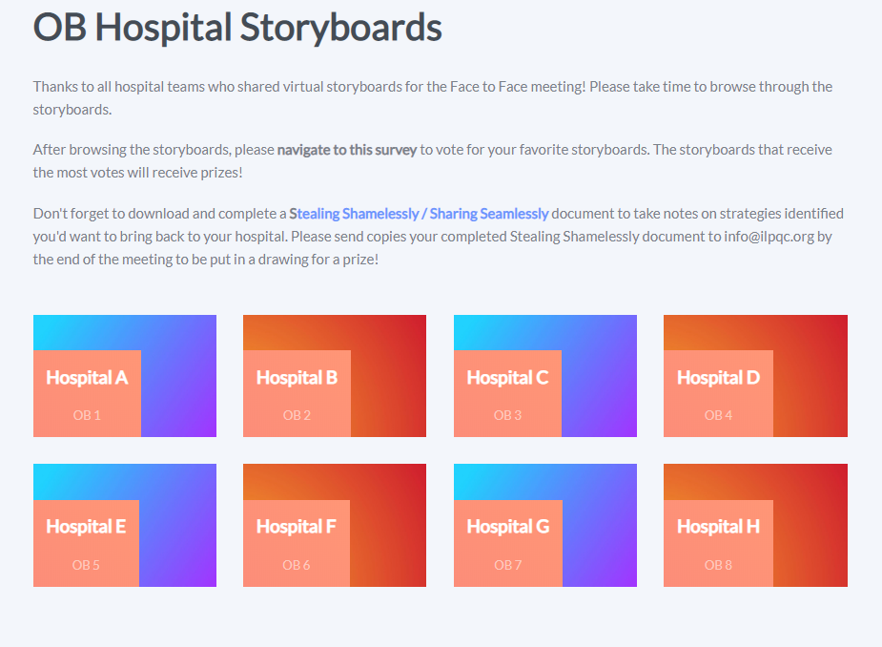
Virtual Storyboards Session
11:40pm – 12:30pm
All links available on OB Face to Face Webpage
Notes:
https://redcap.healthlnk.org/surveys/?s=CM9LTJ9D77

Slide 13
OB Breakout Session Logistics

Slide 14
Breakout Session
Initial Steps
At 12:15 go to the ILPQC Face to Face webpage (https://ilpqc.org/ilpqc-2020-virtual-ob-face-to-face/ (Password: OBF2F2020) and click the zoom link for the breakout session #1 that you selected during registration.
The link will take you to a zoom meeting with an ILPQC Central Host (Dan Weiss, Autumn Perrault, or Patti Lee King) where we will actively move participants into their selected breakout session.
Participants will need to “raise their hands” to opt into their breakout session.
The Breakout Session #1 discussion will start at 12:30pm

Slide 15
OB Breakout Sessions
Click Breakout Sessions Link at 12:15 to join the zoom meeting to be assigned to your breakout session
MNO-OB: Finishing Strong / Key Strategies for Success 1 & 2
MNO-OB: Preparing for Sustainability 1 &2
MNO-OB: Optimize Narcan Counseling & Access
Immediate Postpartum LARC (IPLARC): Sustainability & Billing
Improving Postpartum Access to Care (IPAC): Sustainability & Billing
PVB: Data Collection Strategies 1 & 2
PVB: Unpacking the Toolkit / Getting Started 1 & 2
Obstetrics Chair / Obstetrics Leadership Breakout
State & Community Partner Breakout
Breakout sessions run from
#1: 12:30-1:15
#2: 1:30-2:15

Slide 16



THANKS TO OUR
FUNDERS
Email info@ilpqc.org or visit us at www.ilpqc.org
Notes:
Updated 10/22/19

