Slide 1



THANKS TO OUR
FUNDERS
Email info@ilpqc.org or visit us at www.ilpqc.org
Notes:
Updated 10/22/19

Slide 2
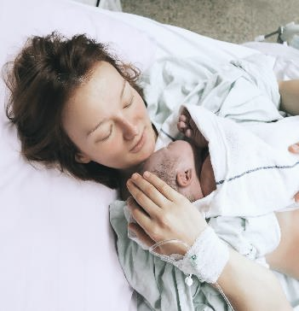
Unpacking the PVB Initiative: Aims, Measures, Data Form & Toolkit
ILPQC OB Face-to-Face Meeting
May 20th, 2020

Slide 3
Overview
PVB Aims
PVB Measures
PVB Data Form
PVB Toolkit

Slide 4
Promoting Vaginal Birth Clinical Leads
Rob Abrams, MD, Co-Director, IL South Central Perinatal Center
Roma Allen, DNP, MSN ed., RNC-OB, Perinatal Network Administrator, Loyola University Medical Center
Rita Brennan, DNP, RNC-NIC, APRN, CNS, CPHQ, Outcomes Manager, Women’s & Children’s Services, Northwestern Medicine Central DuPage Hospital
Lakieta Edwards, DNP, CNM, WHNP-BC, Advocate South Suburban Hospital
Abbe Kordik, MD, Executive Medical Director, Family Birth Center, The University of Chicago
Tina Stupek, MSN, RNC-OB, C-EFM, Northwest Illinois Perinatal Center
Notes:
Provider and nursing clinical leads providing their expertise to the ILPQC QI Initiave

Slide 5
Wave 1 Teams- THANK YOU!
Wave 1 Teams
Advocate BroMenn | Loyola University Medical Center | St. Anthony Hospital
Advocate Christ Hospital | Memorial East Hospital | St. Bernard Hospital
AMITA Alexian Brothers Medical Center | Memorial Hospital of Carbondale | SSM Health St. Mary’s, St. Louis
AMITA Sts. Mary & Elizabeth | Mt. Sinai | Stroger Hospital
Elmhurst Hospital | Northwest Community Hospital | Swedish American
HSHS St. John’s | Northwestern Memorial Hospital | University of Chicago Medicine
HSHS St Mary’s, Decatur | OSF St. Francis | UnityPoint Trinity
Javon Bea Hospital | Rush University Medical Center | West Suburban Medical Center
Notes:
Need to update tomorrow with Brad

Slide 6
PVB Aims and Measures

Slide 7
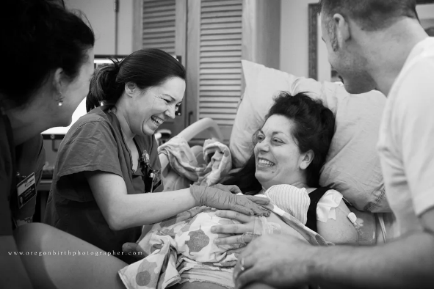
Promoting Vaginal Birth (PVB)
What will we focus on?
Optimizing Labor Management and support
Protocols and Guidelines for Induction and Labor Decision Making
Provider, Nurse, Patient Education to support clinical culture change

Slide 8
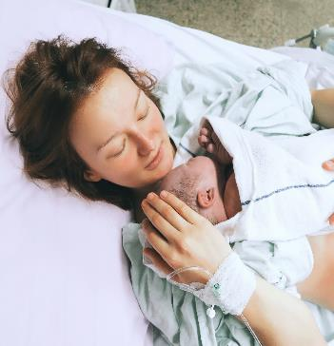
ILPQC Promoting Vaginal Birth
Aim: 70% of participating hospitals will be at or below the Healthy People goal of 24.7% cesarean delivery rate among NTSV births by December 31, 2021.
To optimize the health of women by facilitating clinical culture change to optimize vaginal delivery, develop and implement standard protocols and guidelines for induction and C-section decision making, and educate providers, nurses, and patients on optimal labor management
Key Goals:
Increase % of c/s deliveries among NTSV births that meet ACOG/SMFM criteria for cesarean
Increase % of physicians/midwives/nurses educated on ACOG/SMFM criteria for cesarean, labor management strategies/response to labor challenges, protocol for facilitating decision huddles and/or decision debriefs
Notes:
Hi Ann, do we want to push this May 31, 2022 given the staggered start and COVID?

Slide 9
PVB Smart Aim: To support vaginal birth and reduce primary cesareans to reach the Healthy People goal for low risk cesarean section target rate of 24.7% by December 2021
Key QI Strategies
1. Facilitate clinical culture change that promotes and supports vaginal birth
2. Develop standardized processes for induction and labor support
3. Develop standardized protocols for identification and response to labor challenges / abnormalities
Notes:
See smart aim date again – May 2022?

Slide 10
1) Facilitate clinical culture change that promotes, and supports vaginal birth
Create a QI team of providers, staff & administrators to lead the effort & cultivate buy-in
Educate physicians/midwives and nurses on ACOG/SMFM labor management guidelines and labor support techniques
Develop patient education with positive messaging to women and families about promoting vaginal birth strategies/techniques through prenatal classes and patient education
Utilize care team huddles/debriefs to identify and review delivery decisions for consistency with ACOG/SMFM protocols/checklist
Integrate order sets, protocols, and documentation for the safe reduction of primary cesareans into EMR
Share provider-level measures with providers with the goal of working to transparency/open data

Slide 11
2) Develop standardized processes for induction and labor support
Implement policies, protocols and support tools for women who present in latent (early) labor to safely encourage early labor at home
Implement policies and protocols for encouraging movement in labor and intermittent monitoring for low-risk women
Implement policies and protocols for induction of labor
Implement policies and protocols for pain management and labor support

Slide 12
3) Develop standardized protocols for identification and response to labor challenges/abnormalities
Implement standard criteria for diagnosis and treatment of labor dystocia, arrest disorders and failed induction
Develop checklist for ensuring ACOG/SMFM criteria for c/s is met
Implement training/procedures for identification and appropriate interventions for malpositions (e.g. OP/OT)
Implement standardized assessment, and response to fetal heart rate concerns
Implementation of a workflow process for shared decision making (decision huddle with provider, nurse and patient to review progress, patient input, treatment options, risk/benefits, and ACOG/SMFM guidelines)

Slide 13

Promoting Vaginal Birth
Key Driver Diagram
Strategies
To support vaginal birth and reduce primary cesareans to reach the Healthy People goal for low risk cesarean section target rate of 24.7% by December 2021
1. Facilitate clinical culture change that promotes, and supports vaginal birth
1. Create a QI team of providers, staff & administrators to lead the effort & cultivate buy-in
2. Educate physicians/midwives and nurses on ACOG/SMFM labor management guidelines and labor support techniques
3. Develop standardized protocols for identification and response to labor challenges / abnormalities
2. Develop standardized processes for induction and labor support
7. Implement policies, protocols and support tools for women who present in latent (early) labor to safely encourage early labor at home
9. Implement standard criteria for diagnosis and treatment of labor dystocia, arrest disorders and failed induction
10. Develop checklist for ensuring ACOG/SMFM criteria for c/s is met
8a. Implement policies and protocols for encouraging movement in labor and intermittent monitoring for low-risk women
3. Develop patient education with positive messaging to women and families about intended vaginal birth strategies/techniques that prevent cesareans through prenatal classes and patient education
4. Utilize care team huddles/debriefs to identify and review delivery decisions for consistency with process flows/protocols/checklist
13. Implementation of a workflow process for shared decision making (decision huddle with provider, nurse and patient to review treatment options, risk/benefits, and ACOG/SMFM guidelines)
11b. Implement standardized assessment, and response to fetal heart rate concerns
8c. Implement policies and protocols for pain management and labor support
8b. Implement policies and protocols for induction of labor
5. Integrate order sets, protocols, and documentation for the safe reduction of primary cesareans into EMR
6. Share provider-level measures with department with the goal of working to transparency/open data
11a. Implement training/procedures for identification and appropriate interventions for malpositions (e.g. OP/OT)
12. Develop checklist for ensuring ACOG/SMFM criteria for c/s is met
Drivers
AIM
Notes:
Updated 4.6.20 strategies based on map to measures and toolkit discussion. Will all show on screen in present mode.

Slide 14
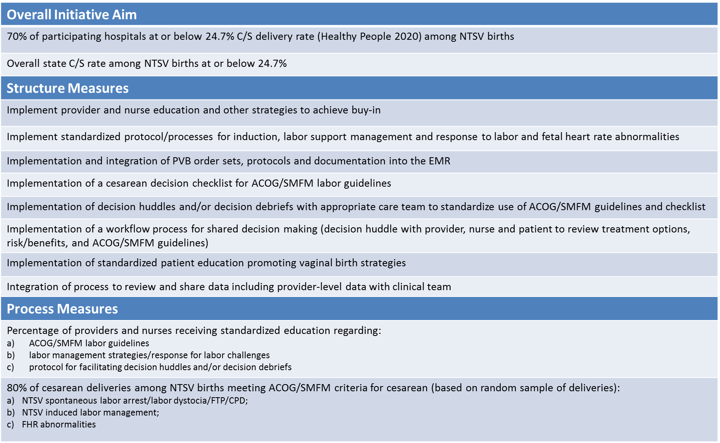
PVB AIMs & Measures
Notes:
Updated 4.6

Slide 15
Structure Measures help you track your implementation of systems changes
Implement provider and nurse education and other strategies to achieve buy-in
Implement standardized protocol processes for induction, labor support management and response to labor and fetal heart rate abnormalities
Implement a cesarean decision checklist for ACOG/SMFM labor guidelines
Implement a decision huddle and/or decision debriefs with appropriate care team to standardize the use of ACOG/SMFM labor guidelines
Implement a workflow process for shared decision making (decision huddle with provider, nurse and patient to review progress, patient input, risk/benefit and ACOG/SMFM labor guidelines)
Implement standardized patient education promoting vaginal birth strategies
Integrate process to review and share data including provider-level data with clinical team

Slide 16
Process Measures
Help you track your implementation of clinical practices towards culture change
% of providers and nurses receiving standardized education on ACOG/SMFM labor guidelines, labor management strategies/response for labor challenges, protocols for facilitating decision huddles and/or debriefs
% of c/s deliveries among NTSV births meeting ACOG/SMFM criteria for cesarean (based on a random sample deliveries)
  NTSV spontaneous labor arrest/labor dystocia/FTP/CPD
  NTSV induced labor management
  FHR abnormalities
Notes:
Add additional process measure from table.

Slide 17
Outcome Measures
Help you track your progress towards changing the health status of patients
% of participating hospitals at or below the Healthy People Target Rate of 24.7 C/S delivery rate among NTSV births
  Goal: 70% or greater
Overall state C/S delivery rate among NTSV births
  Goal: 24.7% or lower
Notes:
Add additional process measure from table.

Slide 18
PVB Timeline
May | July | Sept
May 4: PVB Launch Call May 20: OB Virtual Face-to-Face Meeting | Jul 27: PVB Webinar, Data Collection Q&A | Sept 15: Baseline data due Sept 28: Monthly webinars and data collection begins

Slide 19
PVB Data Forms and Collection

Slide 20
PVB Data Collection:
Monthly Random Sample of NTSV and Vaginal Births
20 Nulliparous Term Singleton Vertex (NTSV) C-sections per month based on a random stratified sample. Data includes at least:
  5 failed inductions
  5 labor dystocia/failure to progress
  5 FHR concerns/indications
10 NTSV Vaginal births per month

Slide 21
Short Monthly Data Form to drive QI change at your hospital
* Only complete color section corresponding to delivery route/indication *

Slide 22
Data Form – ILPQC – C-Section Deliveries part 1/3
Notes:
Data form screenshot updated Mar 25

Slide 23
Data Form – ILPQC – C-Section Deliveries part 2/3
Notes:
Data form screenshot updated Mar 25

Slide 24
Data Form – ILPQC –
C-Section Deliveries section 3/3
Notes:
Data form screenshot updated Mar 25

Slide 25
Data Form – ILPQC – Vaginal deliveries part 1/1
Notes:
Data form screenshot updated Mar 25

Slide 26
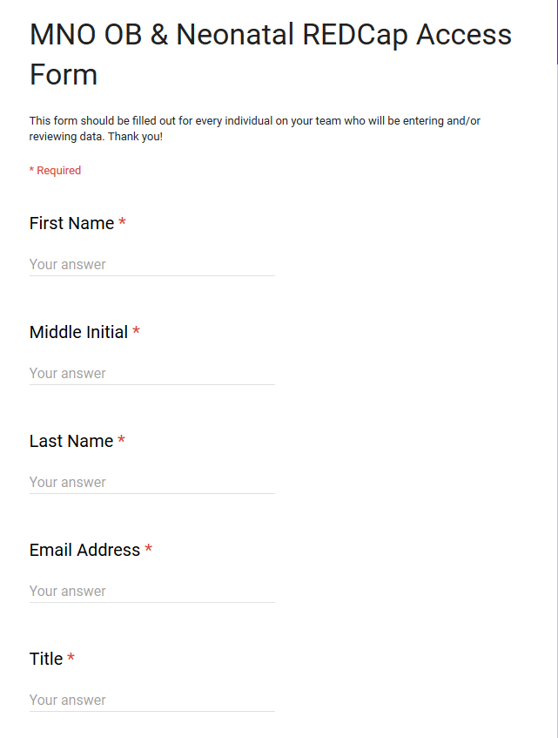
Access to REDCap for PVB Data Collection
Complete the REDCap Access Form for ALL members of your team to enable REDCap data access/review

Slide 27
PVB Teams
Steps for Data Collection
Submit team roster if not yet submitted
Gain access to REDCap to submit data
  Submit REDCap access form if you haven’t yet
July 27th Webinar-Data Collection Q&A
Baseline data collection (January – March 2020) submitted into REDCap by September 15th
PVB monthly webinars start September 28th
September 2020 monthly data due by October 15th
Please reach out to info@ilpqc.org with any questions or special circumstances
Notes:
DO we want to ask them to have baseline data in before the statewide initiative?
Also would you like to add the link to the rosters in? https://redcap.healthlnk.org/surveys/?s=NF8MPDY9LF

Slide 28
PVB Toolkit
Created with national resources/guidance and resources from CMQCC & FPQC

Slide 29
Current Tools/Responses Available to Staff for Labor Support
PVB Readiness Survey Results:
52 Teams Reporting
Notes:
N=52

Slide 30
Methods Currently used to Make Decisions around Cesarean Deliveries After a Failed Induction
PVB Readiness Survey Results:
52 Teams Reporting
Notes:
N=52

Slide 31
Methods Currently used to Make Decisions around Cesarean Deliveries for Labor Complications in the Second Stage
PVB Readiness Survey Results:
52 Teams Reporting
Notes:
N=52

Slide 32
Methods Currently used to Make Decisions around Cesarean Deliveries for Fetal Heart Rate Concerns
PVB Readiness Survey Results:
52 Teams Reporting
Notes:
N=52

Slide 33

Promoting Vaginal Birth Toolkit Outline
Introduction
Initiative Resources *10 Steps to Getting Started with PVB*
Promoting Vaginal Birth Slide Set
National Guidance: AIM Bundle
National Guidance: ACOG Committee Opinions/Practice Advisories and AWOHNN Statements
Creating Clinical Culture Change
  Building a Strong QI Team
  Provider/Nurse Education
  Patient Education
  Clinical Care team Debrief/Huddles and SHARED decision making
Labor Management
  Algorithms for stages of labor
  Labor management support and response to labor challenges
Standardization of Policy, Protocols, & Algorithms
  Inductions
  Labor Challenges/Dystocia
  Fetal Intolerance

Slide 34
10 Steps to Getting Started with
PVB

Slide 35
National Guidance

Slide 36
CMQCC Pre-c/s Checklist for Labor Dystocia or Failed Induction helps ensure ACOG/SMFM Criteria
for c/s is met

Slide 37
Provider & Nurse Education

Slide 38
Patient Education Resources
Notes:
Add in the patient education here

Slide 39
THANKS TO OUR
FUNDERS
Email info@ilpqc.org or visit us at www.ilpqc.org
Notes:
Do we need to remove Pritzker from the PVB or do we keep them on?

