Slide 1



THANKS TO OUR
FUNDERS
Email info@ilpqc.org or visit us at www.ilpqc.org
Notes:
Updated 10/22/19

Slide 2

OB Teams Panel: Sharing Strategies for Success for Obstetric QI Initiatives
ILPQC OB Face-to-Face Meeting
May 20th, 2020

Slide 3
OB Teams Panel
Ann Borders, MD, MSc, MPH- Moderator
Barbara Parilla, MD, FACOG, FASAM- Attending, Rush Medical Group
Meg Puente, MSN, RNC-OB, C-EFM, Clinical Nurse Educator, Rush Medical Group
Beth Plunkett, MD, MPH – Attending, NorthShore University Health Systems
Lori Stevenson, MSN, RNC-OB, CNML, CPPS, ASQ-SSBB, Senior Performance Improvement Consultant, Women and Infants Barnes-Jewish Hospital
Patricia Baker, RN, BSN, CLC – OB Manager, SSM Health St. Mary’s Hospital Centralia

Slide 4
OB Teams Panel: MNO
Rush Copley Medical Center
Barbara Parilla, MD, FACOG, FASAM- Attending
Meg Puente, MSN, RNC-OB, C-EFM-Clinical Nurse Educator

Slide 5

Strategies for Success
MNO Initiative
Rush Copley Medical Center
Barbara V. Parilla, MD, FACOG, FASAM
Meg Puente, MSN, RNC-OB, C-EFM
Notes:
5

Slide 6

Key Strategies for MNO Success
It takes a Village!!
NAS assessment tool- ESC in place
  None of our opiate exposed neonates (OEN) were admitted to the NICU for medication management of withdrawal
MNO Education Campaign
  Grand Rounds, Department meetings, Lunch & Learn, Posters/Flyers Packets brought to all OB offices
Neonatology consults in MFM office, L&D
MNO folders: MFM clinic, L&D, M/B, NICU

Slide 7
Key strategies for mno success
EMR- EPIC
  We started with implementation of the 5 Ps as our first step to begin the identification of patients for this initiative.
  Clinical Care Checklist contributed to continuity of care for the patient Initiated in MFM office (buprenorphine provider).
  Care plan in EPIC for all caregivers to see.
Coordinated discharge plan- warm hand off
  Buprenorphine Rx to bridge
  Narcan Rx: at diagnosis OUD, MAT initiation, delivery

Slide 8
sustainability
Structure Outcome Measures for both Neo and OB are part of our Women’s Health Quality Dashboard-track our progress monthly
  Reviewed and discussed monthly at FBC Quality Team
Education Bundle is being developed specific to the MNO Mom and baby in EPIC to ensure education is consistent and efficient
  Key information disseminated to staff through partnership and staff meetings
All 3 MFM physicians now buprenorphine waivered, along with an OB/GYN physician, and Family practice at VNA

Slide 9
HUDDLE
When MNO patient presents to L&D
  Manager L&D notified at admission.
  Staff to be included in Huddle based on availability: Director of Women’s Health, Managers of Labor/Delivery, Mother-Baby and NICU, Nurse Educators, Clinical Coordinators, Patient’s RN, Social Services, Neonatology, Pediatrician, Obstetrician.
Huddle discussion includes: brief review of maternal history, clinical care checklist, newborn discharge checklist.
Purpose of huddle is to anticipate patient needs ahead of time to avoid missed opportunities later.

Slide 10
OB Teams Panel: MNO
NorthShore University HealthSystem
Beth Plunkett, MD, MPH – Attending

Slide 11
MNO Initiative at NorthShore
Hurdle #1
  Outpatient Screening with Validated Tool
Hurdle #2
  Consistent completion of our OUD Checklist

Slide 12
Hurdle #1: Outpatient Screening at NorthShore
First round of interventions
  Distributed materials x 2
  Face to face meetings with providers/staff
  Grand Rounds x 2
Frustration
Second round of interventions
  2-week audit of 100% deliveries (n=118)
  Evaluated by office practice

Slide 13
Audit of 100% deliveries over 2 weeks
n=9
n=13
n=16
n=17
n=9
n=9
n=7
n=26
n=3
n=5
n=4

Slide 14
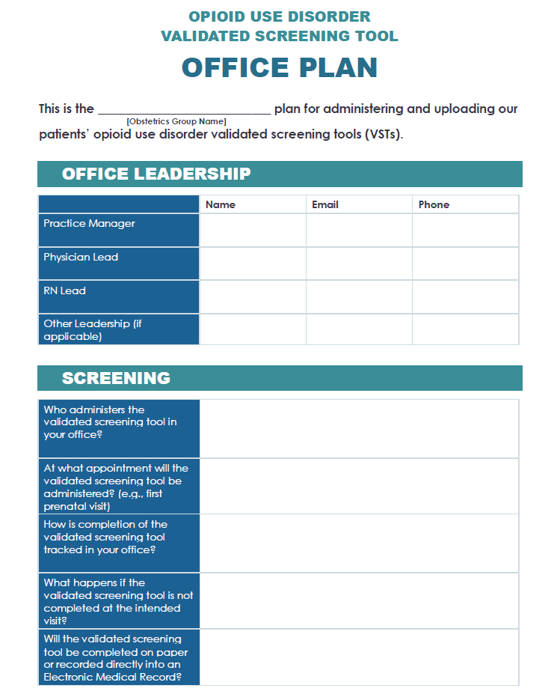

Slide 16
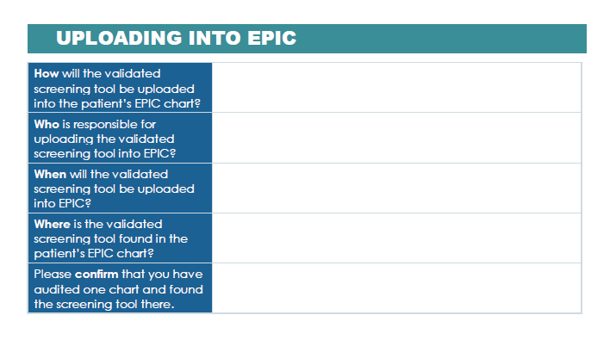

Slide 17
Hurdle #2: Completion of OUD Checklist at NorthShore
First round of interventions
  Paper validated screening tool with workflow embedded within it
  Handy “.oudchecklist” embedded into EPIC
  Not used/not used effectively
Frustration
Second round of interventions
  Created a shared list of patients with OUD
  Neonatologist, social workers, myself
  Ongoing review →real time message providers/team to optimize care of our patients

Slide 18
Thank you!
Questions?

Slide 19
OB Teams Panel: IPLARC
Barnes-Jewish Hospital
Lori Stevenson, MSN, RNC-OB, CNML, CPPS, ASQ-SSBB, Senior Performance Improvement Consultant, Women and Infants

Slide 20



Implementation and Sustainment of IPLARC
Lori Stevenson, MSN, RNC-OB, CNML, CPPS, ASQ-SSBB, Senior Performance Improvement Consultant, Women and Infants
May 20, 2020

Slide 21
How our IPLARC journey started
In May, 2016, our pharmacy received notification that Missouri Medicaid announced that hospitals can receive separate payment when IPLARC is placed during the post partum.
This information led to the formation of a multidisciplinary team focused on creating a process for stocking and billing for IPLARC devices
In October, 2016, the devices were available for patient use in the Pyxis machines in Labor and Delivery.
IUDs were not stocked in the Mother/Baby units due to the risk of IUD expulsion if inserted more than a few hours after delivery.

Slide 22
Stocking
  We keep IPLARCs in the Pyxis machine so that they are easily accessible for immediate postpartum placement
    5 Nexplanons in the Pyxis on labor and delivery
    5 Nexplanons in the Pyxis on mother baby
    We keep ~10 IUDs on the floor at all times with more in the pharmacy
  Barnes Jewish Hospital has multiple pharmacies on campus. The majority of IUDs are stocked in the satellite pharmacy, in Parkview Tower, which supplies Women and Infants. A limited number of IUDs are maintained in the main pharmacy on campus in the event one is needed in the Operating Rooms on the South Campus.

Slide 23
Patient Contraceptive Counseling
Patients are given contraceptive counseling at admission by the provider
Patients are provided with a wide variety of options and encouraged to select the method most beneficial for their individual situation (which may also be no birth control)
If a patient elects for IPLARC, the laborist attempts to obtain pre-approval from the patient’s insurance carrier prior to delivery
Patients are not refused IPLARC if pre-approval is not given or not obtained prior to delivery

Slide 24
Lessons Learned
Streamlining the ordering/billing process is ideal. It creates no additional work for providers and allows for tracking.
Ordering/billing through the EMR also helps maintain par levels in Pyxis as the number used is auto transmitted to pharmacy for restocking.
Providers need to be engaged in the process from the beginning.
If IPLARC is offered, many patients want it!
Validate who will own the process of retrieving the IPLARC device at time of delivery. Our nursing staff retrieves when obtaining other meds for delivery.
Identify who will train providers to insert IPLARC and who will track this information.
Have an action plan for periodically reviewing IPLARC utilization and insertion.

Slide 25
OB Teams Panel: IPAC
SSM Health St. Mary’s Hospital Centralia
Patricia Baker, RN, BSN, CLC – OB Manager

Slide 26
SSM Health
St. Mary’s Hospital Centralia
We are a rural 125 bed hospital with around 300 deliveries a year. We have one OB physician group that provides OB and GYN coverage which consists of different physicians who come for 24-72 hours at a time. This same group has a private office on the hospital property.
The team consists of:
Pat Baker- OB manager and team lead
Shalisa Henson - CNM employed at the physician group
Kelsey Herrin/Brittany Pollmann- Data collection and entry

Slide 27
Getting started
For providers:
  Buy-in using OB Provider Folders
    ACOG CO #736
    Maternal Health Safety Check Elements and suggested patient survey for waiting room-this can focus visit with provider to patient needs
    Patient education materials (AWHONN, ILPQC 2wk Maternal Health Safety Ed)
  Personal reach out to outpatient offices/OB providers
    Rotating group given the folders
    Talked with office staff
For the nurses:
  Education for staff
  Utilized process already in place that is familiar and been successful
    Switched from the traditional 6 week to 2 week visit “Maternal Health Safety Check”
      The word “safety” added weight and importance
Notes:
For providers, we started our project by creating folders. It included the ACOG recommendation along with the copies of the patient information on the importance of the maternal health safety check and the AWHONN POST-BIRTH information. Shalisa was able to speak to physicians in the office and I spoke to them and gave the folders as the rotated call in the department. We spoke to the leader of the group early who was onboard with doing 2 week follow-up. Shalisa spoke with office staff letting them know that the hospital would be calling for 2 week appointments for vaginal deliveries (we already did 1 week appointments for cesarean section). We met no resistance to this.
For the nurses, we shared the same information. Since making follow-up appointments was already part of our discharge process, we just needed to change the request to 2 weeks instead of 6.
The change from calling the visit a “follow-up appointment” to a “maternal health safety check” was one of the difficult pieces. It was easy to explain and agree that the word safety adds weight to the importance of the visit but the FU appointment terminology is hard to remove.

Slide 28
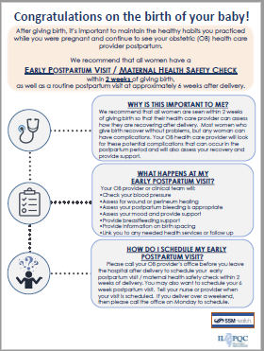

Process changes for implementation
Patient Folders:
Patient education materials printed in color & strategically placed near printer
Given with the AVS (After Visit Summary) for easy discharge process
Staff familiar with the process since already doing the process for Preeclampsia Foundation Tear Sheet
Call Center:
The physician group has a call center that is open from 6AM-10PM weekdays and 9AM-4PM on the weekend. This makes it much easier to actually get the appointment before discharge no matter what time of day the discharge is.
Nurses will make one call to make appointments for multiple patients
  Nurses were empowered that when the call center questioned the timing of the visit, they were firm insisting on the 2 week timing
Data Collection/Compliance Monitoring:
Switched to someone who is already auditing for MNO and will audit for IPAC
Barriers/Strategies:
Healthy Birth Spacing- problem solved with ILPQC
Notes:
We provided a folder on the computer with the documents for discharge. Staff are able to print these in color which seems to engage the patient better than black and white. There is a stack of each next to the computer that prints the AVS (after visit summary) for discharge. It is easy to grab the AVS and the extra papers at the same time. We also give the tear sheet from the Preeclampsia Foundation.
The physician group has a call center that is open from 0600-2200 weekdays and 9-4 on the weekend. This makes it much easier to actually get the appointment before discharge. The nurses have gotten really good at making one call and getting the appointments for multiple patients. At times, the call center questioned the timing of the visit but the nurses were firm insisting on the 2 week timing.
Brittany began our data collection but it switched to Kelsey who was already getting into the 10 charts for MNO. She was able to audit for this initiative at the same time.
We were not able to use the March of Dimes birth spacing form. Our pastoral care team felt it was not appropriate for our Catholic facility. We continued in the project even though we were not able to provide birth spacing information. Autumn Perrault ultimately helped us find some verbiage that was acceptable.

Slide 29
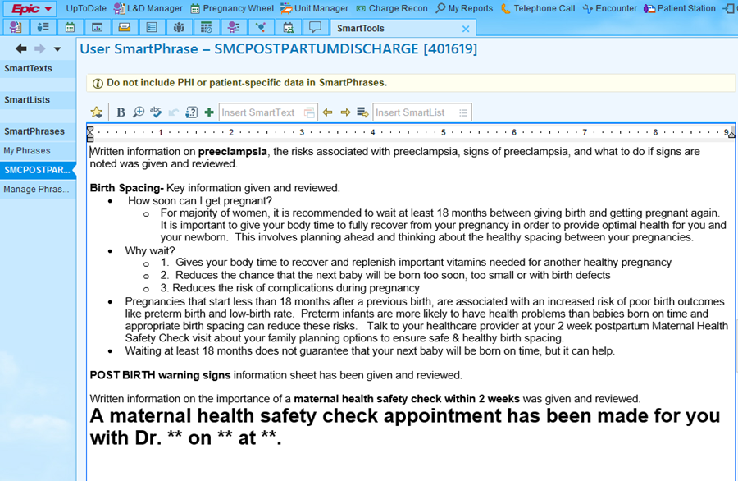
Process Changes for Implementation
We added birth spacing recommendations to an EPIC smartphrase that is inserted on the discharge instructions for every postpartum discharge.
We are able to bold this for emphasis and leave a place for the doctor, date and time of the appointment.

Slide 30
Questions for panel
How did you engage your OB providers in your work to facilitate buy in and move from system change to clinical culture change?
  For MNO teams, can you share with us how you successfully ensured patients who screened positive for OUD received optimal care prenatally and/or during delivery admission before discharge?
How did you make sure you are engaging your nurses in obtaining buy in and moving from systems change to clinical culture change? How can we continue to build on this work?
How do you engage providers and nurses in the outpatient setting?
  For IPLARC: how have you been able to improve comprehensive contraception counseling both outpatient and during the delivery admission
What strategies do you think will be most important for sustainability of this hard work to improve care?

Slide 31
THANKS TO OUR
FUNDERS
Email info@ilpqc.org or visit us at www.ilpqc.org
Notes:
Updated 10/22/19

