Slide 1



THANKS TO OUR
FUNDERS
Email info@ilpqc.org or visit us at www.ilpqc.org
Notes:
Updated 10/22/19

Slide 2

Welcome!
ILPQC Obstetric
Virtual Face to Face Meeting
May 20, 2020
9am – 3:15pm

Slide 3
Conference Objectives
Participants will be able to:
Identify strategies to systematically engage obstetric providers in the implementation of MNO-OB Key Strategies for Success;
Recognize opportunities and identify strategies to effectively plan and implement a perinatal quality improvement project that promotes vaginal births.
Notes:
ONA Update

Slide 4
ONA Approval Statement
This activity will provide 5.00 contact hours.
This continuing nursing education activity was approved by the Ohio Nurses Association, an accredited approver by the American Nurses Credentialing Center’s Commission on Accreditation (OBN-001-91).
Approval valid through (5/20/2022)
ONA Activity # 2020-0000000280
Notes:
ONA Update

Slide 5
Criteria for Successful
Completion
Prior to the learning activities there are no required items to complete.
To obtain full contact hours for CNEs, you need to register for the event, complete the entire conference ( 5.00 contact hours) and an evaluation. No partial credit will be awarded.
Day-of online evaluation will open for participants to complete at 3:00pm on https://ilpqc.org/ilpqc-2020-virtual-ob-face-to-face/
Certificates for contact hours will be accessible after online evaluation is completed.
Notes:
ONA Update

Slide 6
Disclosures
The planners and faculty have declared no conflicts of interest.

Slide 7
Agenda
9-9:30am: Welcome & Overview; Working Together in 2020: Celebrating MNO-OB, IPLARC, and IPAC; and Launching Promoting Vaginal Birth, Ann Borders, MD, MSc, MPH
9:30-10:15am: OB Teams Panel: Sharing Strategies for Success for Obstetric QI Initiatives
  Barbara Parilla, MD, FACOG, FASAM- Attending, Rush Medical Group; Meg Puente, MSN, RNC-OB, C-EFM- Clinical Nurse Educator, Rush Medical Group
  Beth Plunkett, MD, MPH- Attending, NorthShore University HealthSystem
  Lori Stevenson, MSN, RNC-OB, CNML, CPPS, ASQ-SSBB- Senior Performance Improvement Consultant, Women & Infants, Barnes Jewish Hospital
  Patricia Baker, RN, BSN, CLC- Ob Manager, SSM Health St. Mary’s Hospital- Centralia
10:15-10:25am: Break
10:25-11:10am: Promoting Vaginal Birth: Lessons Learned from FPQC, Jessica Brumley, CNM, PhD
11:10-11:30am: Unpacking the PVB Toolkit, Ann Borders

Slide 8
Agenda (continued)
11:30-11:40am: Team QI Excellence Awards
11:40am-12:30pm: Virtual Team Storyboard Session & Lunch Break (12:15pm join zoom meeting for breakout session assignments)
12:30-1:15pm: Breakout Session 1: Small Group Key Discussion Topics on Implementation Barriers and Strategies for Success
1:15-1:30: Join zoom meeting for breakout session assignments
1:30-2:15pm: Breakout Session 2: Small Group Key Discussion Topics on Implementation Barriers and Strategies for Success
2:15-2:30: Break, Transition to Plenary
2:30-3:00pm: A Mom’s Recovery Story, Helena Girouard
3:00-3:15pm: Wrap Up & Next Steps for 2020

Slide 9
Navigating The virtual meeting

Slide 10


Participant eFolder Overview
https://ilpqc.org/ilpqc-2020-virtual-ob-face-to-face/
Password: OBF2F2020
OB Agenda
OB Steal Shamelessly
MNO Resources
IPLARC Resources
IPAC Resources
PVB Resources

Slide 11
Virtual Storyboards Session
11:40pm – 12:30pm
Storyboards and Steal Shamelessly Document can be found on the ILPQC 2020 Virtual OB Face to Face Website: https://ilpqc.org/ilpqc-2020-virtual-ob-face-to-face/ (Password: OBF2F2020)
Browse through all of the storyboards, listed alphabetically & with a unique OB identifier (i.e. OB 1, OB 5…)
Email us at info@ilpqc.org with something you’ll take back to your team from the storyboards in your Steal Shamelessly Document or an email titled “Storyboards” to be enrolled in a raffle to win $50 Amazon gift cards!
Vote for your top storyboard and submit your vote into the link on https://ilpqc.org/ilpqc-2020-virtual-ob-face-to-face/- hospitals with most votes will receive awards!
All links above also available on OB Face to Face Webpage
Notes:
https://redcap.healthlnk.org/surveys/?s=CM9LTJ9D77

Slide 12
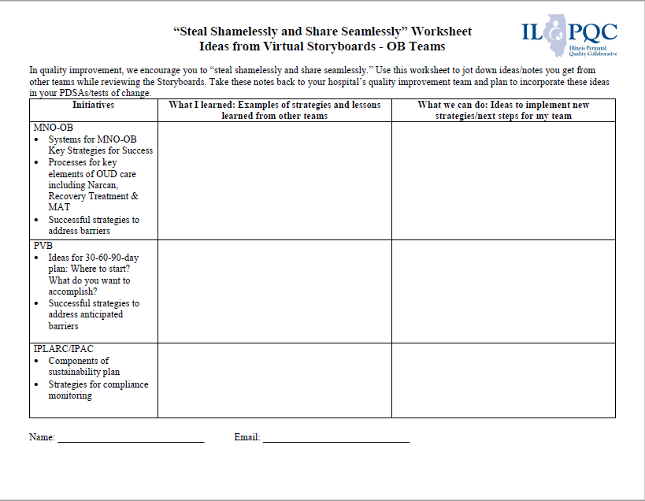
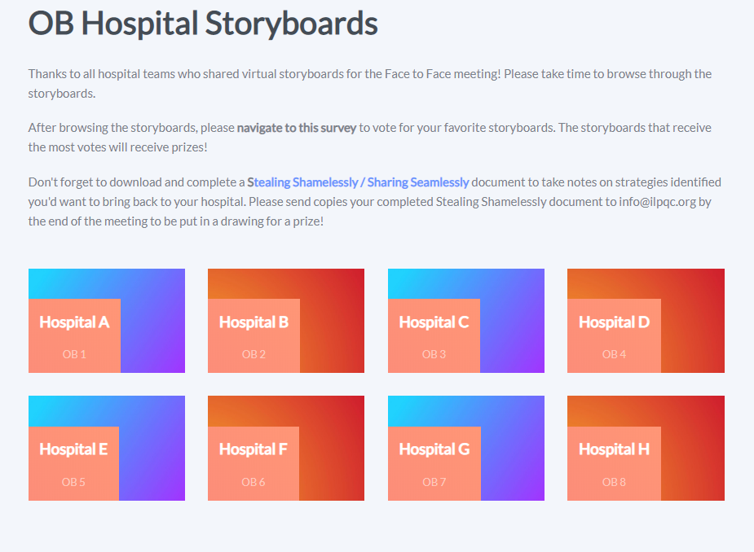
Virtual Storyboards Session
11:40pm – 12:30pm
All links above also available on OB Face to Face Webpage
Notes:
https://redcap.healthlnk.org/surveys/?s=CM9LTJ9D77

Slide 13
Breakout Session
Initial Steps
At 12:15 go to the ILPQC Face to Face webpage (https://ilpqc.org/ilpqc-2020-virtual-ob-face-to-face/ (Password: OBF2F2020) and click the zoom link for the breakout session #1 that you selected during registration.
The link will take you to a zoom meeting with an ILPQC Central Host (Dan Weiss, Autumn Perrault, or Patti Lee King) where we will actively move participants into their selected breakout session.
Participants will need to “raise their hands” to opt into their breakout session.
The Breakout Session #1 discussion will start at 12:30pm

Slide 14
OB Breakout Sessions
Click Breakout Sessions Link at 12:15 to join the zoom meeting to be assigned to your breakout session
MNO-OB: Finishing Strong / Key Strategies for Success 1 & 2
MNO-OB: Preparing for Sustainability 1 &2
MNO-OB: Optimize Narcan Counseling & Access
Immediate Postpartum LARC (IPLARC): Sustainability & Billing
Improving Postpartum Access to Care (IPAC): Sustainability & Billing
PVB: Data Collection Strategies 1 & 2
PVB: Unpacking the Toolkit / Getting Started 1 & 2
Obstetrics Chair / Obstetrics Leadership Breakout
State & Community Partner Breakout
Breakout sessions run from
#1: 12:30-1:15
#2: 1:30-2:15

Slide 15
MNO Materials Order
Starting today through 5/29/2020 at 5pm CST, ILPQC will open an order form for hospital teams to order and ship FREE bundles of MNO OB & Neonatal Folders and provider education posters!
Link to order folders is here: https://ilpqc.org/ilpqc-2020-virtual-ob-face-to-face/
Ordering 1 MNO Folder Bundle will include:
  1 x MNO-OB Folder,
  1 x MNO-Neonatal Folder, and
  1 x complete set of OB & Neonatal Provider Education Posters
Attendees can order up to 5 bundles.

Slide 16
Welcome & Overview:
Working Together in 2020: Celebrating MNO-OB, IPLARC, and IPAC and Launching Promoting Vaginal Birth
May 20, 2020
9am – 3pm

Slide 17
Overview
ILPQC Overview and Model for Improvement
Supporting each other during COVID-19
Initiative Successes and What’s Next:
  MNO-OB
  IPLARC
  IPAC
Launching Promoting Vaginal Birth
Partnerships with State & Community Stakeholders

Slide 18

ILPQC Overview and Model for Improvement
Thank you!

Slide 19
Illinois Perinatal Quality Collaborative (ILPQC)
Collaborative of physicians, nurses, hospital teams, patients, public health and other stakeholders implementing data-driven, evidence-based practices to improve maternal and neonatal outcomes in Illinois
Support participating hospitals’ implementation of evidenced-based practices using quality improvement science, collaborative learning and rapid response data
>99% of IL births
119 Illinois hospitals participating in 1 or more initiative
Notes:
The Illinois Perinatal Quality Collaborative is a multi-disciplinary, multi-stakeholder perinatal quality collaborative started in 2013 with over 100 Illinois hospitals representing greater than 95% of Illinois births.
ILPQC supports participating hospitals’ implementation of evidenced-based practices using quality improvement science, collaborative learning and rapid response data

Slide 20
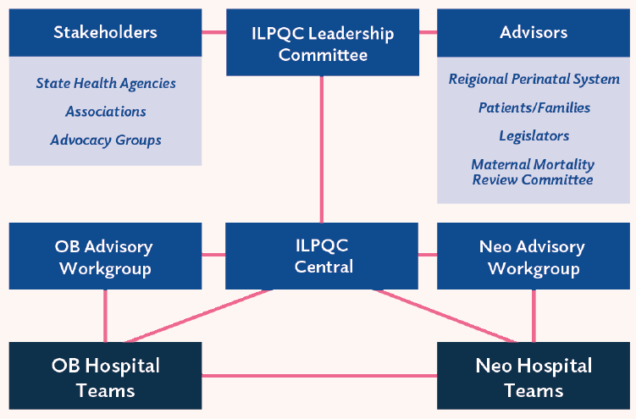
ILPQC Infrastructure
Notes:
Will update with Burness final image when ready

Slide 21




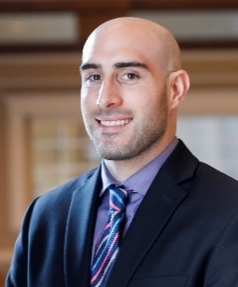

ILPQC Central Team
Ann Borders
ILPQC Executive Director, OB Lead
Leslie Caldarelli & Justin Josephsen
Neonatal Leads
Patricia Lee King
State Project Director, Quality Lead
Daniel Weiss
Project Manager
Autumn Perrault
Nurse Quality Manager
info@ilpqc.org OR www.ilpqc.org
Notes:
Confirmed 10/22/19

Slide 22
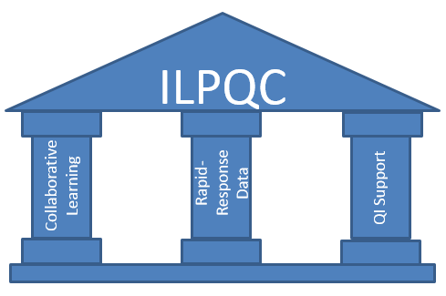
ILPQC: Using QI to Build Hospital Capacity to Drive Systems & Culture Change
Leadership, Advisors, Stakeholders, Patients/Families
Notes:
ILPQC facilitated the following QI strategies:
We supported the creation of multidisciplinary hospital-based QI teams,
Provided opportunities for collaborative learning across hospitals through in person events, and monthly web-based meetings
created a rapid response data system that allowed teams to track and compare their data
And maintained regular communication via newsletters and updated website
Importantly, we provided QI support to hospital teams through a toolkit, regional network meetings and QI coaching calls.

Slide 23
Supporting each other during covid-19

Slide 24
COVID-19
THANK YOU to the nurses, doctors, health care workers, public health teams and others across our state confronting the COVID-19 pandemic.
In partnership with IDPH, ILPQC has held 7 weekly COVID-19 OB / Neonatal Strategies Discussion webinars averaging 350 participants (up to 619).
OB & Neonatal providers from across the state present cases, share strategies, and respond to participant questions, with written answers to all questions posted weekly. Thank you to all who have shared and attended!
ILPQC COVID-19 Webpage https://ilpqc.org/covid-19-information/ has resources for hospital teams and patients, prior recorded webinars and Q/A’s from those webinars.
ILPQC Hospital QI Teams continue to attend monthly collaborative webinars with nearly normal attendance, eager to share strategies for success and learn from each other!

Slide 25

Masks for MOMs wants to get reusable cloth face masks to the moms and moms-to-be who need them in the Chicago-land area.
The aim is to ensure that pregnant moms from vulnerable communities have access to face masks at their prenatal visits and when they arrive at hospitals for delivery.
Find out more & sign-up to volunteer at https://bit.ly/masksforMOMs
Notes:
I Promote IL is an acronym for Innovations to Improve Maternal Outcomes in Illinois. The I-promote team, Illinois Department of Public Health Office of Women’s Services, Administrative Perinatal Centers and ILPQC are partners on the following three goals:
Establish a State-Focused Maternal Health Task Force
I PROMOTE-IL & IDPH’s OWHFS/Title V will form a task force and develop a strategic plan to improve maternal health outcomes in IL.
Collaborate with IDPH in implementation of Maternal Health Summit.
Improve State-Level Maternal Health Data/Surveillance
I PROMOTE-IL & IDPH’s OWHFS/Title V will enhance state-level maternal health data surveillance efforts.
Analysis based on two MM committees and process to review SMM. Data findings will be disseminated to stakeholders and the public.
Promote & Execute Innovation in Maternal Health Service Delivery
In partnership with OWHFS/Title V, IL Administrative Perinatal Centers and the Perinatal Health Quality Collaborative:
Ensure that hospital providers receive trainings and are current on best practices related to maternal care including hypertension and hemorrhage
And Work with Emergency Departments throughout IL to ensure that all are trained to ask women about current and recent pregnancies
IL Perinatal Health Quality Collaborative will develop an initiative to improve birth equity and reduce prenatal and postpartum racial/ethnic disparities.
Other projects of the grant include:
Ensure that MIECHV and other IL perinatal home visitors are an active part of the Maternal Mortality Solution in IL.
Enhance the work of Illinois DocAssist to expand psychiatric consultation telehealth services in central and southern IL.
Develop and implement an innovative approach to postpartum care (Two Generation) and develop a Two Generation Postpartum Care Research and Training Center.

Slide 26
Increasing access to home blood pressure cuff kits
ILPQC partnership with Everthrive to advocate for BP Cuff Kit coverage for pregnant / postpartum patients with Medicaid in Illinois
  HFS has asked MCO’s to cover home BP cuffs for pregnant & postpartum patients
  Public announcement for providers is coming soon

Slide 27
Finishing strong and preparing for sustainability
MNO-OB, IPLARC, and IPAC

Slide 28

Mothers and Newborns affected by Opioids- OB
Aim: ≥70% women with OUD receiving MAT; ≥70% connected to Recovery Treatment prenatally or by delivery discharge
Benchmarks:
≥80% all pregnant women screened with a universal validated screener during prenatal period among all deliveries
≥80% all pregnant women screened with a universal validated screener during L&D admission among all deliveries
≥70% women with OUD with an OUD clinical care checklist completed prenatally or during delivery admission
≥70% women with OUD receiving: Narcan, Hep C, contraception, behavioral health/ social work consult prenatally or during delivery admission
≥70% women with OUD receiving pediatric / neonatal consult on NAS and role in newborn care prenatally or during delivery admission
≥80% women with OUD receiving OUD/NAS education prenatally or during delivery admission

Slide 29
ASAM Treatment of OUD
Buprenorphine Waiver Courses
8 courses offered between September 2018 and May 2020
145 women’s health providers (MFM, OB/GYN, NP, CNM, PA)have been trained
48% of Illinois hospitals participating in MNO-OB and 100% of perinatal networks have had OB provider(s) trained through these courses
Next Training – June 24 (FULLY ONLINE): https://elearning.asam.org/p/ILPQCJune24

Slide 30
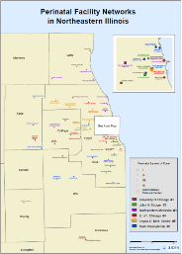
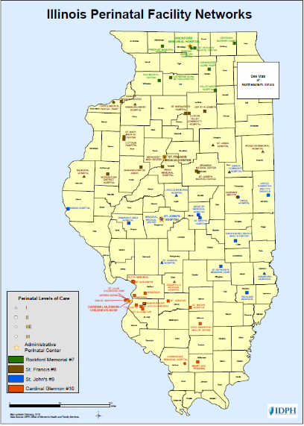
Key Strategies for Success
Across Perinatal Networks
ILPQC partnered with perinatal network administrators to co-facilitate MNO-OB Regional Strategies for Success sessions for almost all 10 Perinatal Networks!
Opportunity for hospitals to share strategies for success, review and compare network data and develop network-specific goals

Slide 31

As of May 2020 MNO-OB teams have reported data on over 2,097 pregnant/postpartum women with Opioid Use Disorder, averaging 75 women per month
Reported OUD screening data (L&D and prenatal) for 17,410 pregnant women

Slide 32
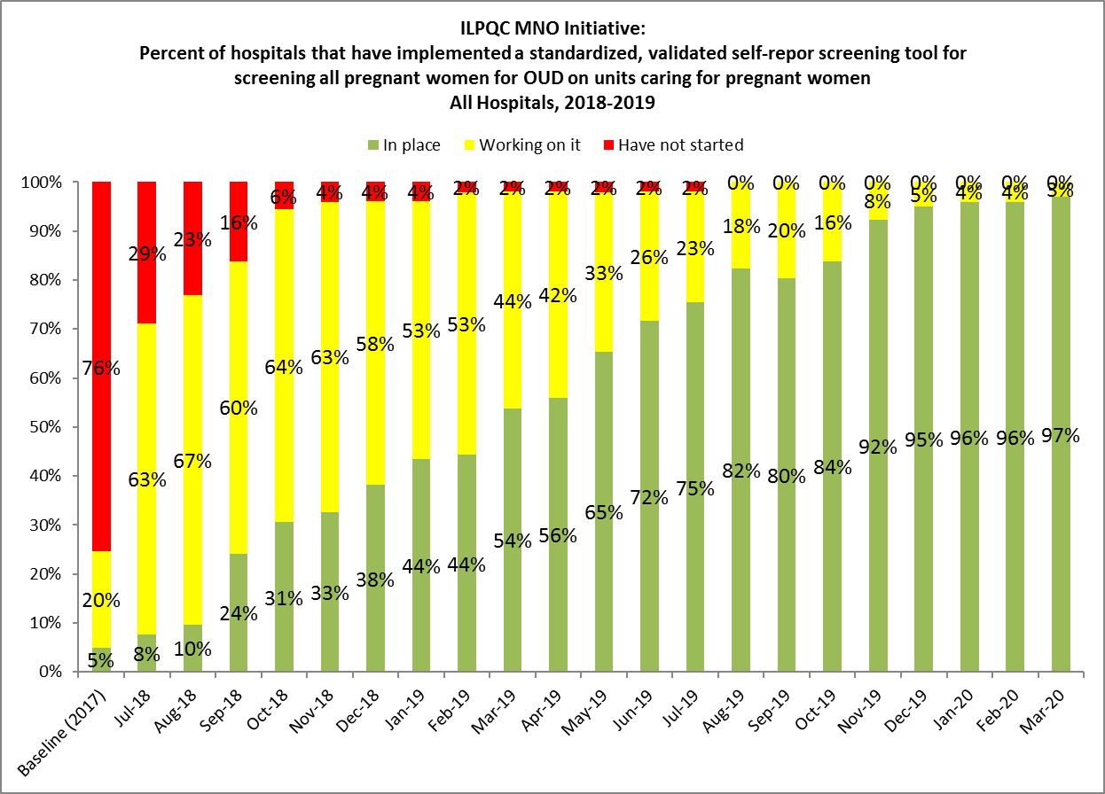
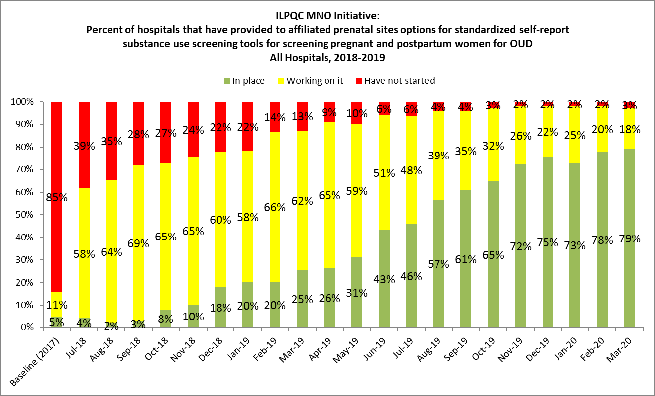
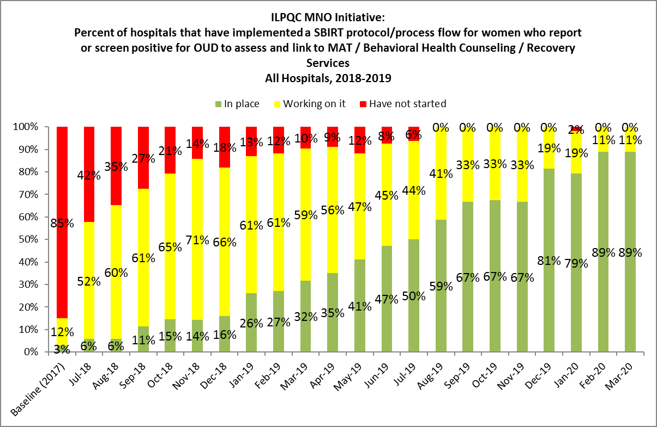
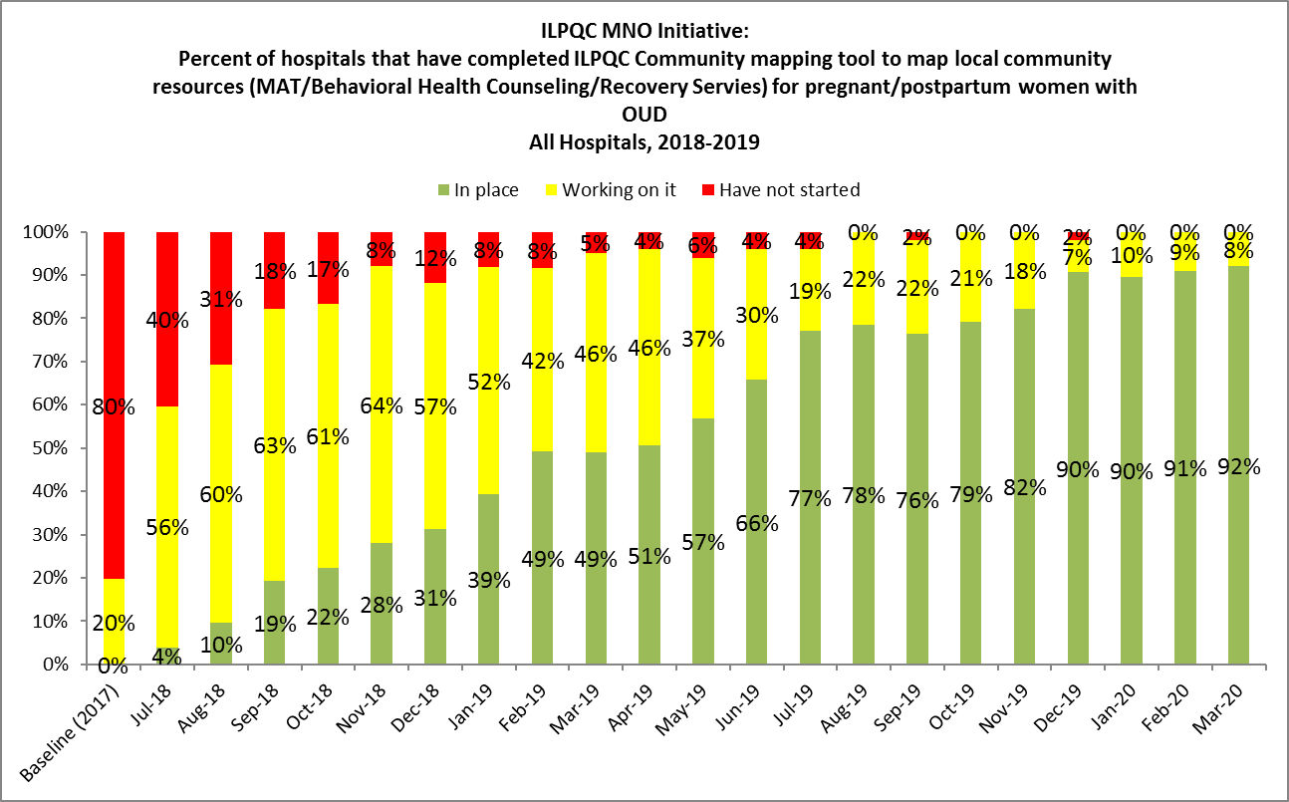
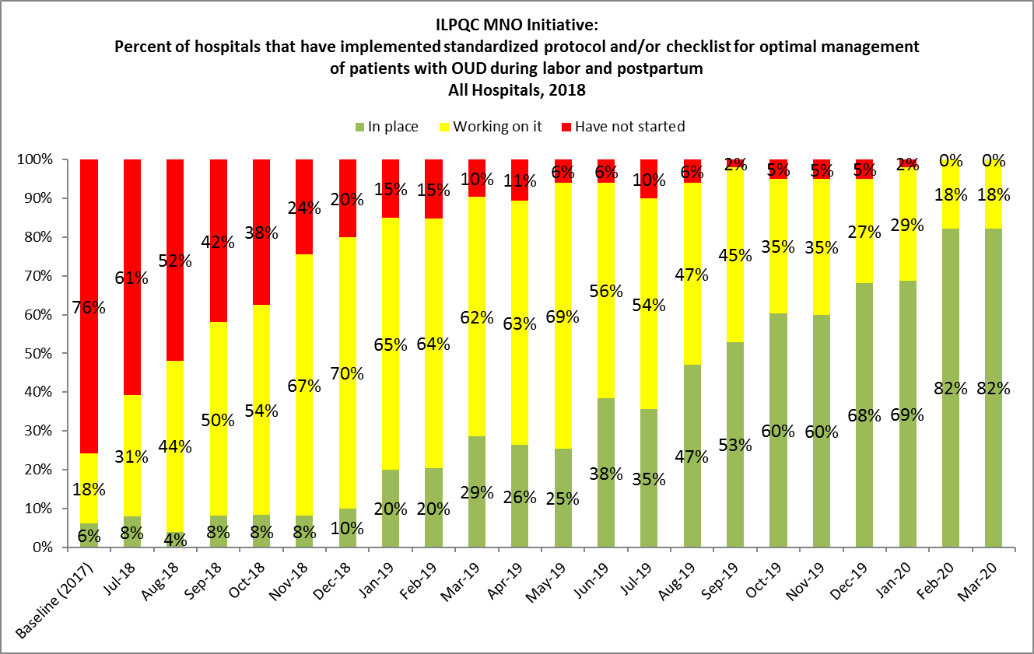
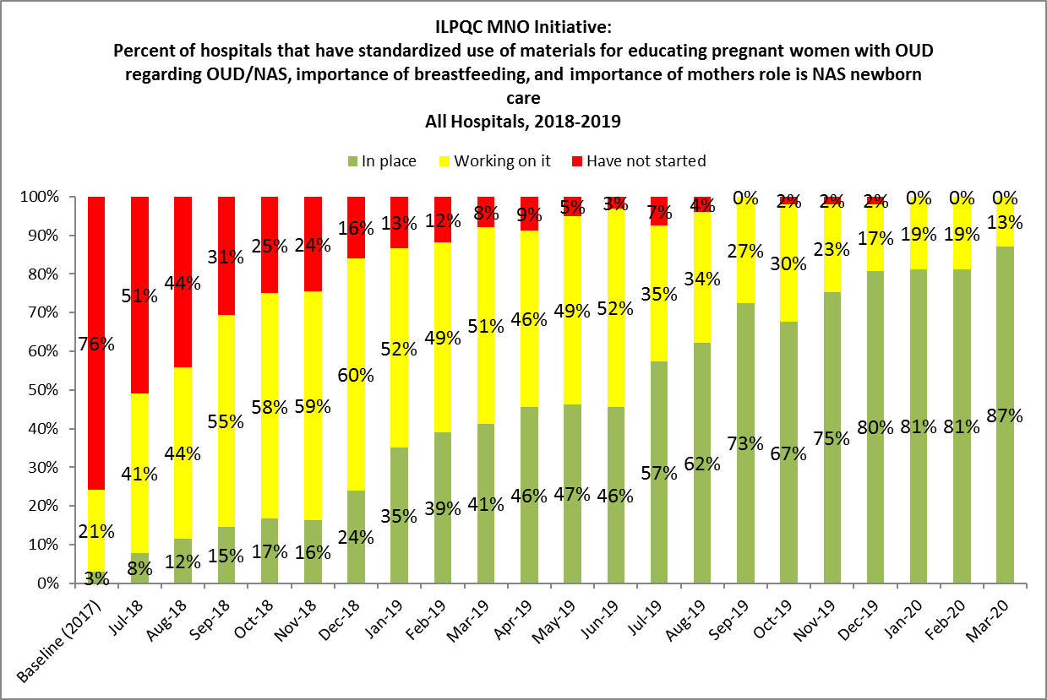
Foundations for Success:
MNO Structure Measures in Place
97% of teams have validated screening tool in place on L&D
82% of teams have validated screening tool in place prenatally
86% of teams have SBIRT protocol/ algorithm in place on L&D
94% of teams have mapped community resources for women with OUD
84% of teams implemented OUD Clinical Care Checklist on L&D
88% of teams have implemented standardized patient education on L&D

Slide 33


Achieving MNO-OB AIMs
Screening Patients on L&D
During Quarter 4, 2018 (Baseline)…
As of Quarter 1, 2020…
Less than 1 out of 10 pregnant women were screened with a validated SUD/ OUD screening tool on L&D (2%)
Around 8 out of 10 pregnant women were screened with a validated SUD/OUD screening tool on L&D (83%)
Notes:
Quarter, Region, Level, birth volume,

Slide 34

Achieving MNO-OB AIMs
Medication Assisted Treatment
During Quarter 4, 2018 (Baseline)…
As of Quarter 1, 2020…
Only 4 out of 10 women with OUD were connected to MAT prenatally or by delivery discharge (41%)
Around 8 out of 10 women with OUD were connected to MAT prenatally or by delivery discharge (75%)
Notes:
Quarter, Region, Level, birth volume,

Slide 35


Achieving MNO-OB AIMs
Linking to Recovery Treatment Services
During Quarter 4, 2018 (Baseline)…
As of Quarter 1, 2020…
Around 5 out of 10 women with OUD were connected to Recovery Treatment Services prenatally or by delivery discharge (47%)
Around 7 out of 10 women with OUD were connected to Recovery Treatment Services prenatally or by delivery discharge (68%)
Notes:
Quarter, Region, Level, birth volume,

Slide 36

What’s Next for MNO:
Crossing the Finish Line
Ensure all Structure Measures are ‘green’
Work to achieve all Initiative Aims
4 Key Strategies for Success
MNO folders L&D / prenatal
Patient / clinical team education
Confirm outpatient sites validated screening
Case reviews for every OUD patient, huddles or debriefs
Optimal care: link to MAT and Recovery Services, Narcan

Slide 37


Improving Together
Received Maternal Education
During Quarter 4, 2018 (Baseline)…
As of Quarter 1, 2020…
Around 2 out of 10 women with OUD received education on OUD, NAS, and importance of engaging in non-pharmacologic care of OENs (16%)
Around 6 out of 10 women with OUD received education on OUD, NAS, and importance of engaging in non-pharmacologic care of OENs (60%)
Notes:
Quarter, Region, Level, birth volume,

Slide 38

Improving Together:
Screening Patients Prenatal
During Quarter 4, 2018 (Baseline)…
As of Quarter 1, 2020…
Less than 1 out of 10 pregnant women were screened with a validated SUD/ OUD screening tool prenatally (3%)
Around 3 out of 10 pregnant women were screened with a validated SUD/OUD screening tool prenatally (36%)
Notes:
Quarter, Region, Level, birth volume,

Slide 39
Improving Together:
Narcan Counseling
During Quarter 4, 2018 (Baseline)…
As of Quarter 1, 2020…
Under 1 out of 10 women with OUD received Narcan counseling prenatally or by delivery discharge (2%)
Around 3 out of 10 women with OUD received Narcan counseling prenatally or by delivery discharge (29%)
Notes:
Quarter, Region, Level, birth volume,

Slide 40
Sustain the Gains:
Transition to Sustainability
Sustainability Plan- a plan to make sure your hospital can maintain MNO success and provide optimal care for every patient with OUD over time
Ongoing MNO team meetings
Determine compliance monitoring
Ongoing case reviews & clinical feedback
New hire/continuing education
  *new eModules*, order folders, Grand Rounds slide set etc.
Updates for mapping tool of MAT/Recovery Resources
Continued 1:1 ILPQC Support for Hospital Teams

Slide 41

ILPQC Immediate Postpartum
LARC Initiative
Aim: Within 9 months of initiative start, ≥75% of participating hospitals will be providing immediate postpartum LARCs
To empower women with information and improved access to effective contraception before discharge home after delivery to reduce short interval and unintended pregnancies linked with adverse MCH outcomes
Key Goals:
Increase % of women with prenatal comprehensive contraceptive counseling and documentation
Increase % of providers/ nurses trained to provide IPLARC
Increase % of hospitals who have completed key steps needed to provide IPLARC
Achieve GO LIVE goal to provide IPLARC for 16 participating Wave 1 hospitals by March 2019

Slide 42
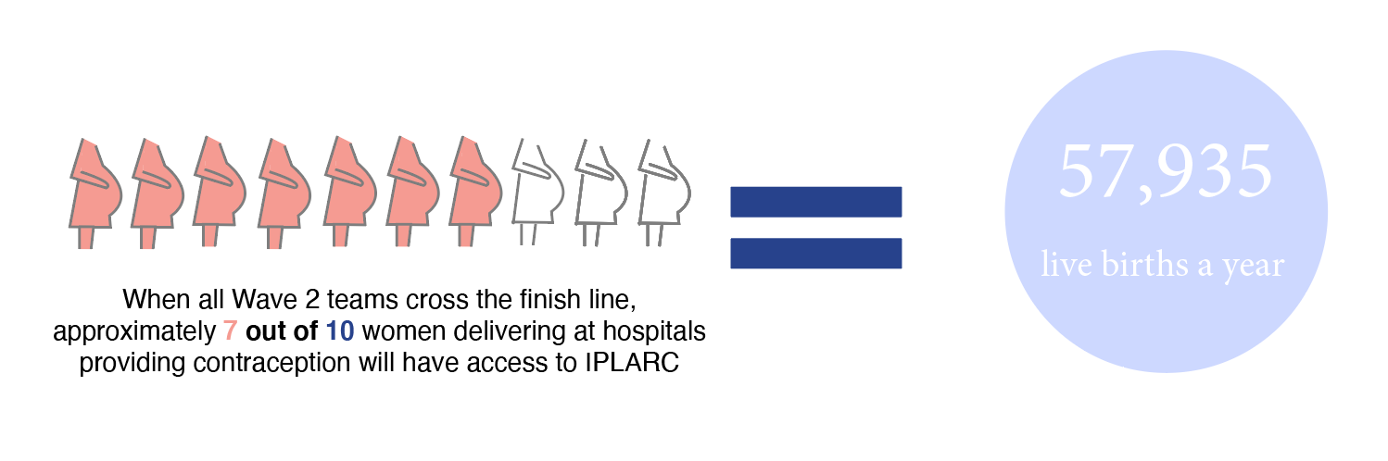
IPLARC - Improved Options for Contraception Statewide Impact
Wave 2 team expanded the geographical reach of the IPLARC initiative

Slide 43
IPLARC Key components

Slide 44
IPLARC during COVID
ACOG Covid-19 State Advocacy Brief: Access to Contraception (May 2020) https://www.acog.org/-/media/project/acog/acogorg/files/advocacy/letters/acog-covid-stateadvocacybrief-contraception.pdf
  ACOG is concerned that the Covid pandemic has increased barriers to contraception, need to focus on improved access
Providing IPLARC as an option for contraception is now more important than ever, given increased barriers to postpartum care
Every hospital that provides contraception should focus efforts now to provide access to IPLARC as part of your long term COVID response

Slide 45

ILPQC Improving Postpartum
Access to Care (IPAC) Initiative
Aim: Within 11 months of initiative start, ≥80% of participating hospitals will implement universal early postpartum visits (within 2 weeks) and be able to facilitate scheduling prior to hospital discharge
To optimize the health of women by increasing access to early postpartum care within the first two weeks postpartum to facilitate follow-up as an ongoing process, rather than a single 6-week encounter and provide an opportunity for a maternal health safety check and link women to appropriate services.
Key Goals:
Increase % of women with an early postpartum visit scheduled with an OB provider within the first two weeks after delivery
Increase % of women receiving focused postpartum education prior to discharge after delivery
Increase % of providers / staff receiving education on optimizing early postpartum care
Achieve GO LIVE goal to provide IPAC for ≥80% participating hospitals by May 2020

Slide 46

IPAC GO-LIVE!
100%
of participating IPAC teams have implemented a universal early 2-week postpartum visit and are able to facilitate scheduling and IPAC education prior to hospital discharge

Slide 47
IPAC Key components
Protocols to schedule 2 wk pp visit before discharge
Providers and Nurses with IPAC Education
IPAC Patient Education before Discharge
AWHONN
Warning Signs
ILPQC Benefits of
2wk pp visit
Healthily
Birth Spacing

Slide 48


IPAC teams during
COVID-19
Patients need close postpartum follow now more than ever given concern for:
  Increased mental health issues/ domestic violence / strain from unemployment other social determinants such as food insecurity
  Underlying medical conditions may not receive needed follow up
  Patients may avoid seeking care when needed could worsen maternal mortality crisis
IPAC teams have successful processes in place to facilitate 2 week follow up for all pp patients including telehealth appointments

Slide 49
IPAC- Sustainability
What’s next?
QI Team meetings
Compliance monitoring
Inpatient ongoing education
Inpatient new hire education
Outpatient education
Sustainability phase

Slide 50
Promoting vaginal birth (Pvb) launch

Slide 51
Illinois NTSV
C-Section Rate Data
Notes:
Added 10/22/19

Slide 52
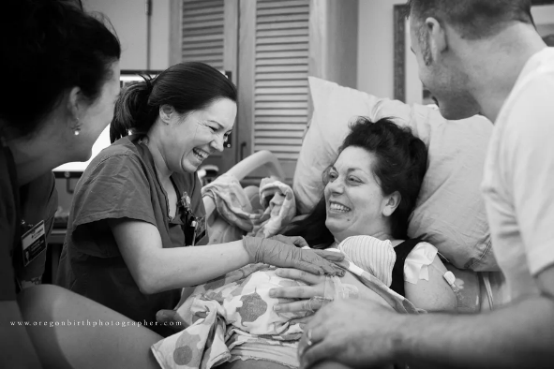
Promoting Vaginal Birth (PVB)
What will we focus on?
Optimizing Labor Management and support
Protocols and Guidelines for Induction and Labor Decision Making
Provider, Nurse, Patient Education to support clinical culture change
Quality Improvement Focus:
How can we prevent the development of Labor Indications for Cesarean?

Slide 53
PVB Smart Aim: To support vaginal birth and reduce primary cesareans to reach the Healthy People goal for low risk cesarean section target rate of 24.7% by December 2021
Key QI Strategies
1. Facilitate clinical culture change that promotes and supports vaginal birth
2. Develop standardized processes for induction and labor support
3. Develop standardized protocols for identification and response to labor challenges / abnormalities
Notes:
See smart aim date again – May 2022?

Slide 54
PVB Team Participation
Thank you to the Wave 1 teams
for their contributions
14 Hospital teams participated in Wave 1 of PVB teams
150+ people joined ILPQC on May 4th for the PVB Launch Webinar
Following is data from Readiness survey with 98% hospital teams signed up so far reporting
Its not too late to participate!- Sign up today for PVB the next Statewide QI Initiative!
Notes:
53 hospitals currently signed up. 52 completed the readiness form.

Slide 55
Processes or Protocols for Identification and Response to Fetal Heart Rate Abnormalities in Labor
Notes:
Yes: 69%
No: 21%
Unsure: 10%
N=51

Slide 56
Process to Review and Share Provider-Level Data for NTSV Rates with Clinical Providers
Notes:
Yes: 53%
No: 31%
Unsure: 16%
N=51

Slide 57
Use ACOG/SMFM Labor Guidelines to Aid in Decision Making Regarding Defining Labor Challenges
Notes:
Yes: 31%
No: 46%
Unsure: 23%
N=52

Slide 58
Process to Systematically Review/Discuss Decisions for Cesarean Deliveries
Notes:
Yes: 25%
No: 63%
Unsure: 12%
N=52

Slide 59
Process for Shared Decision Making prior to Cesarean Delivery
Notes:
Yes: 17%
No: 77%
Unsure: 6%
N=52

Slide 60
Processes or Protocols in Place for the Identification and Response to Labor Challenges
Notes:
Yes: 10%
No: 82%
Unsure: 8%
N=52

Slide 61
PVB Timeline
May | July | Sept
May 4: PVB Launch Call May 20: OB Virtual Face-to-Face Meeting | Jul 27: PVB Webinar, Data Collection Q&A | Sept 15: Baseline data due Sept 28: Monthly webinars and data collection begins

Slide 62
Partnerships to improve Maternal Outcomes

Slide 63

GOALS
1) Establish a State-Focused Maternal Health Task Force
I PROMOTE IL & IDPH’s OWHFS/Title V will establish and convene a Maternal Health Task Force.
The Maternal Health Task Force will develop a Strategic Plan in Year 1 to improve maternal health outcomes in IL.
2) Improve State-Level Maternal Health Data/Surveillance
I PROMOTE IL & IDPH’s OWHFS/Title V will enhance state-level maternal health data surveillance efforts.
Continue analysis based on Maternal Mortality Review Committees (MMRC and MMRC-V) and review severe maternal morbidity cases. Data findings will be disseminated to stakeholders and the public.
3) Promote & Execute Innovation in Maternal Health Service Delivery
I PROMOTE IL, the Administrative Perinatal Centers and Illinois Perinatal Quality Collaborative, ensures that hospital providers and staff are up to date on maternal hypertension and hemorrhage trainings for obstetrics and emergency room departments
Illinois Perinatal Quality Collaborative will develop an initiative trainings to improve birth equity and reduce prenatal and postpartum racial/ethnic disparities.
I PROMOTE IL
(Innovations to ImPROve Maternal OuTcomEs in Illinois)
HRSA-State Maternal Health Innovation Program
University of Illinois at Chicago
Program Staff
Dr. Rachel Caskey, Co-PI (rcaskey@uic.edu)
Dr. Stacie Geller, Co-PI (sgeller@uic.edu)
Dr. Arden Handler, Co-PI (handler@uic.edu)
Dr. Elizabeth Glassgow, Program Director (aglassgo@uic.edu)
Caitlin Garland, MPH, Program Coordinator (cgarla2@uic.edu)
Abby Holicky, MPH, Epidemiologist, (holicky2@uic.edu)
Ashley Horne, MSPH Epidemiologist (ahorne@uic.edu)
Shirley Scott, MS, APN, Research Nurse (sscott9@uic.edu)
Key Implementation Partners
HRSA/MCHB
IDPH Office of Women’s Health and Family Services/Title V
Illinois Perinatal Quality Collaborative
Illinois Administrative Perinatal Centers
Illinois DocAssist
Governor’s Office of Early Childhood Development (MIECHV)
For more information please contact Shirley Scott at sscott9@uic.edu
Notes:
I Promote IL is an acronym for Innovations to Improve Maternal Outcomes in Illinois. The I-promote team, Illinois Department of Public Health Office of Women’s Services, Administrative Perinatal Centers and ILPQC are partners on the following three goals:
Establish a State-Focused Maternal Health Task Force
I PROMOTE-IL & IDPH’s OWHFS/Title V will form a task force and develop a strategic plan to improve maternal health outcomes in IL.
Collaborate with IDPH in implementation of Maternal Health Summit.
Improve State-Level Maternal Health Data/Surveillance
I PROMOTE-IL & IDPH’s OWHFS/Title V will enhance state-level maternal health data surveillance efforts.
Analysis based on two MM committees and process to review SMM. Data findings will be disseminated to stakeholders and the public.
Promote & Execute Innovation in Maternal Health Service Delivery
In partnership with OWHFS/Title V, IL Administrative Perinatal Centers and the Perinatal Health Quality Collaborative:
Ensure that hospital providers receive trainings and are current on best practices related to maternal care including hypertension and hemorrhage
And Work with Emergency Departments throughout IL to ensure that all are trained to ask women about current and recent pregnancies
IL Perinatal Health Quality Collaborative will develop an initiative to improve birth equity and reduce prenatal and postpartum racial/ethnic disparities.
Other projects of the grant include:
Ensure that MIECHV and other IL perinatal home visitors are an active part of the Maternal Mortality Solution in IL.
Enhance the work of Illinois DocAssist to expand psychiatric consultation telehealth services in central and southern IL.
Develop and implement an innovative approach to postpartum care (Two Generation) and develop a Two Generation Postpartum Care Research and Training Center.

Slide 64
















We are all in this together.
Thank you to ILPQC partners and collaborators:
Perinatal Advisory Committee
State Perinatal Quality Council
Maternal Mortality Review Committee
Regionalized Perinatal System

Slide 65
THANKS TO OUR
FUNDERS
Email info@ilpqc.org or visit us at www.ilpqc.org
Notes:
Updated 10/22/19

