Slide 1
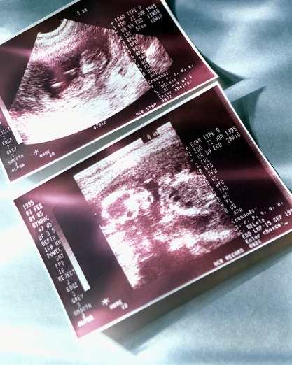
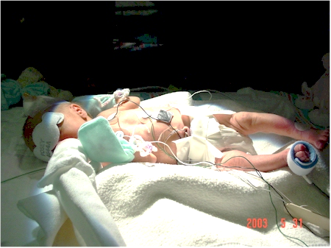
Listening to Mothers
Helena Girouard, Pritzker Fellow

Slide 2
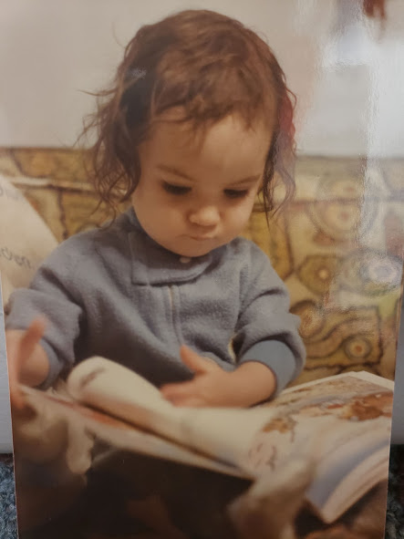
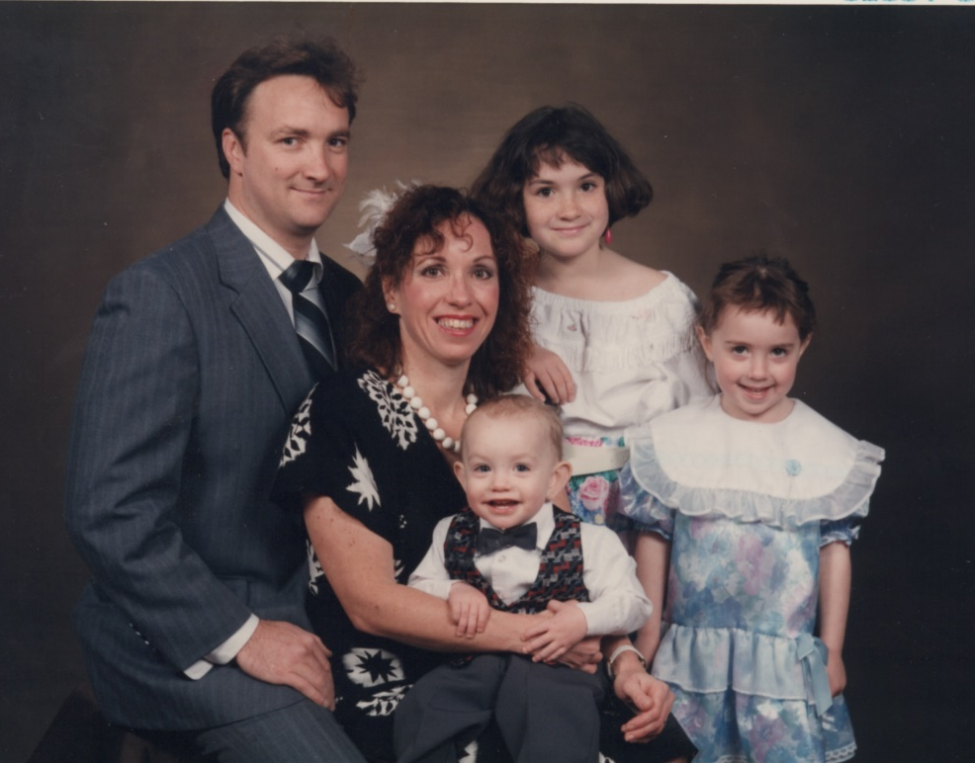
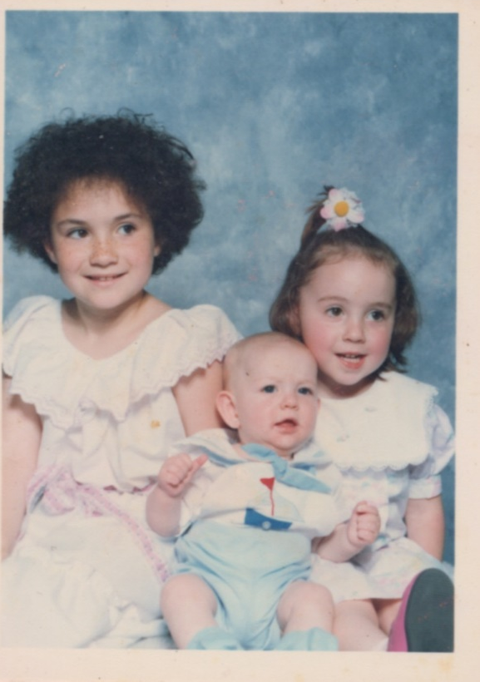
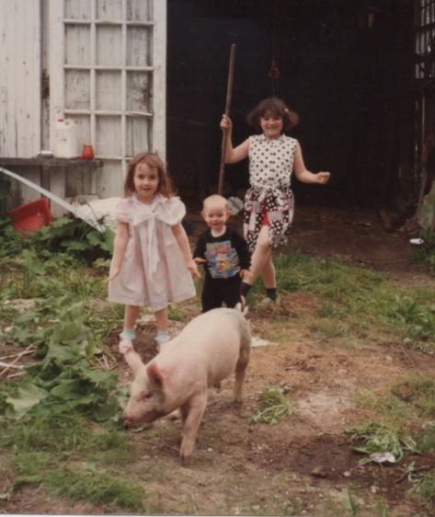

Slide 3
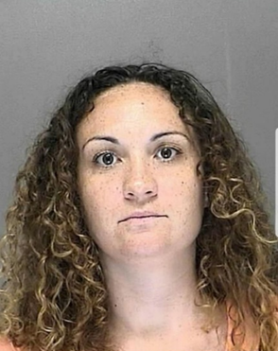
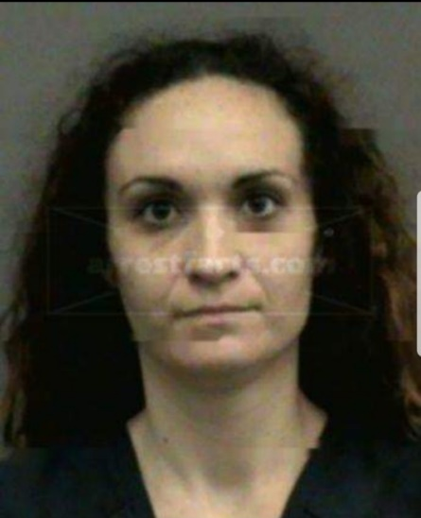

Slide 4


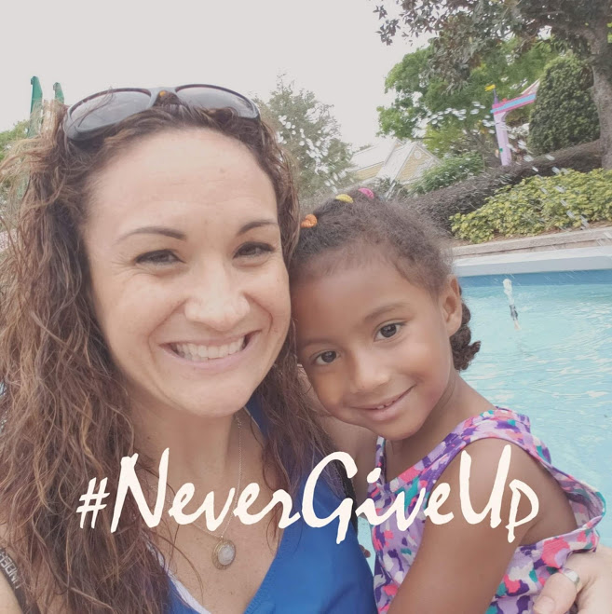
You’ve got potential
Girouard girls never give up!

Slide 5
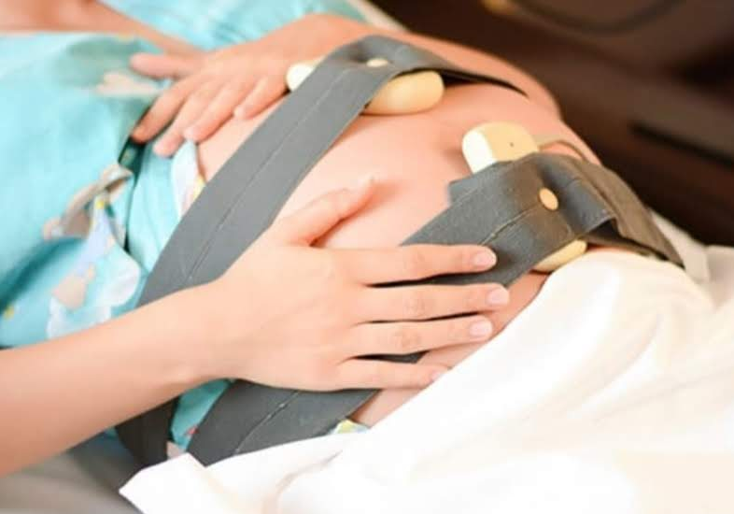
32 weeks pregnant
I got my smile back

Slide 6
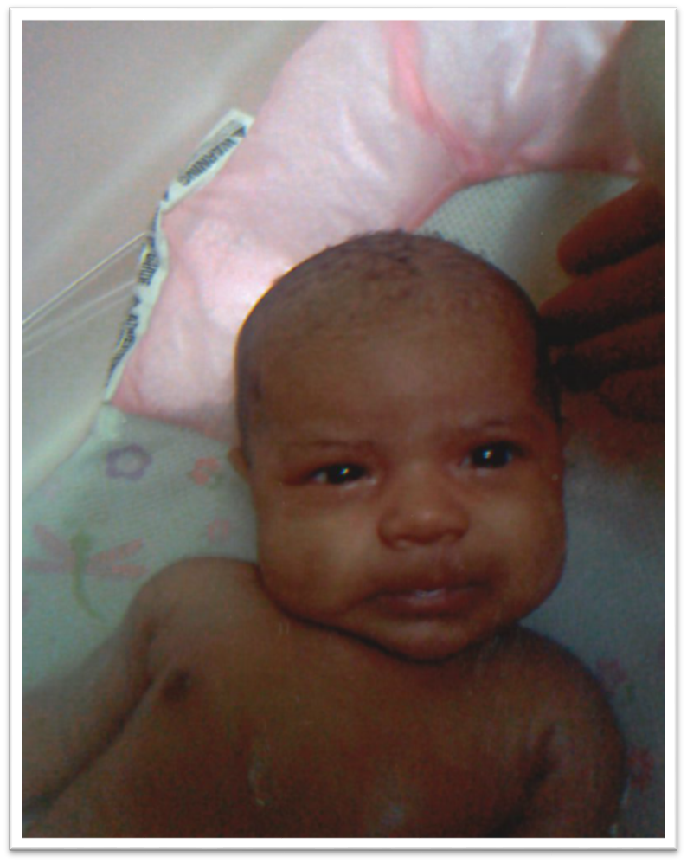
Emergency c-section
No narcotics!
BACK TO TREATMENT

Slide 7
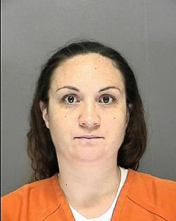
Last mugshot
71 days
3 counties
Pumped 3 times a day

Slide 8

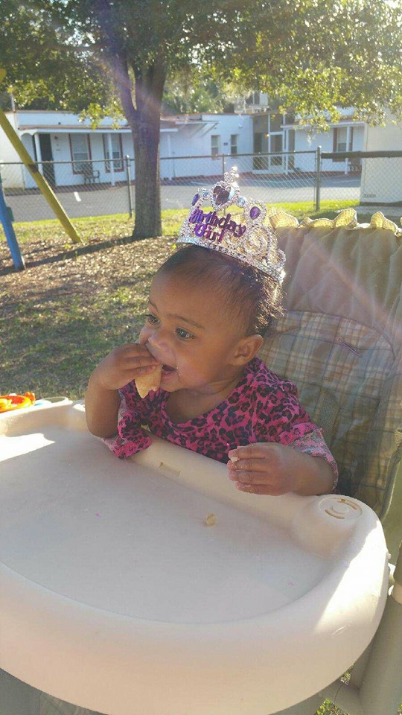
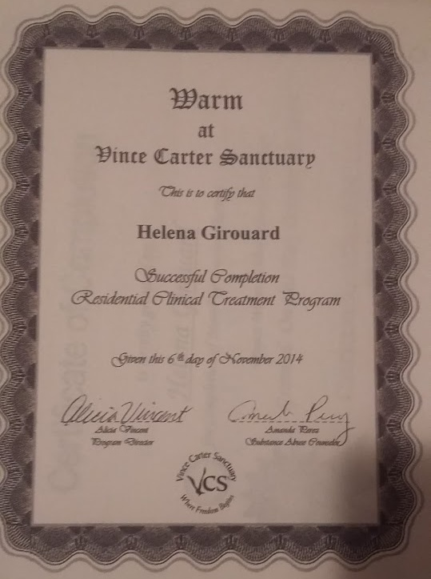
WARM
Family renew
2 jobs
Daytona state college
Harvoni
Apartment
Internship

Slide 9

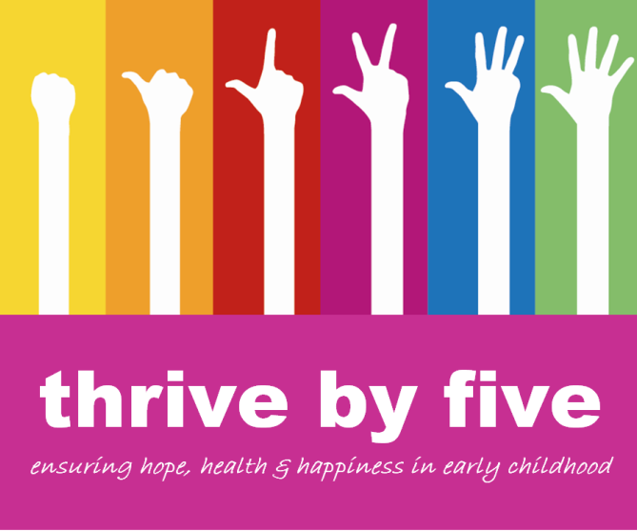

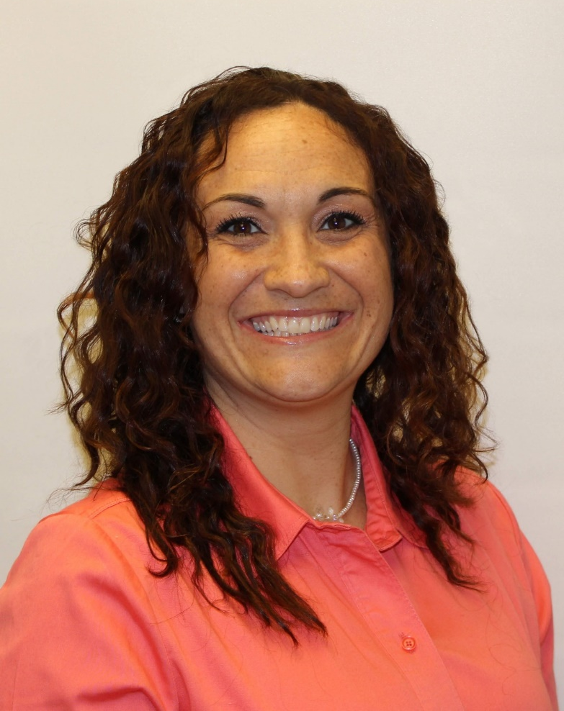
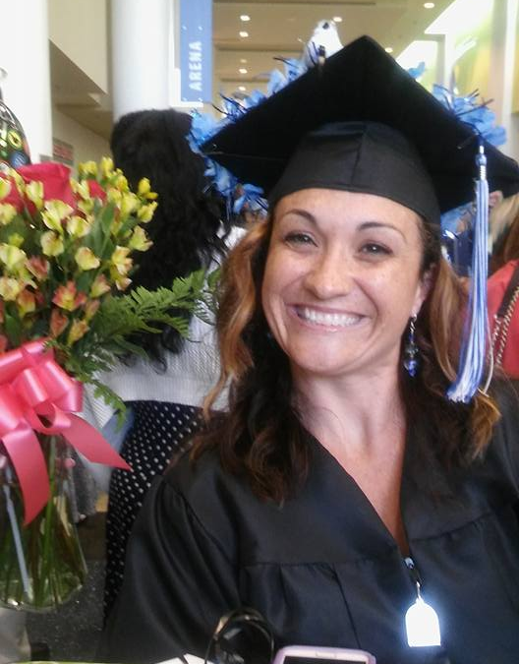



Slide 10
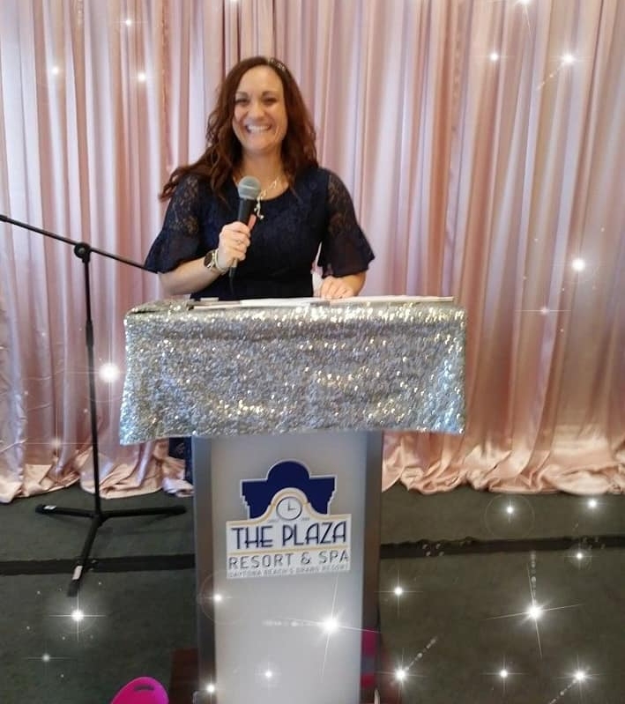
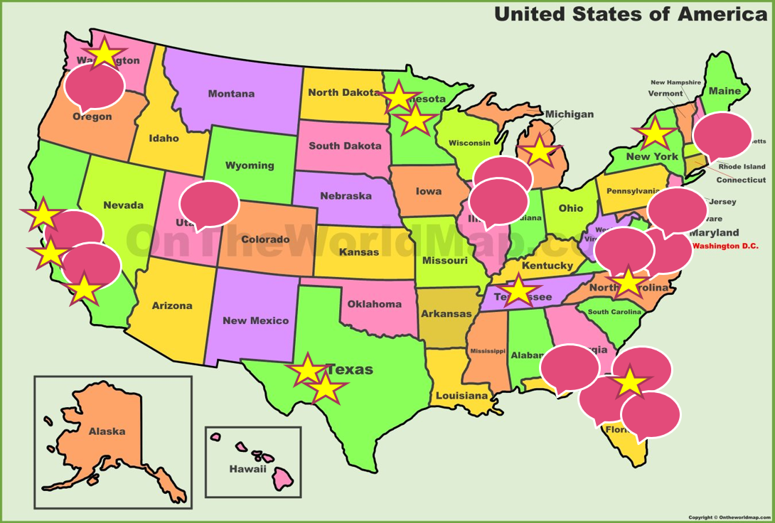
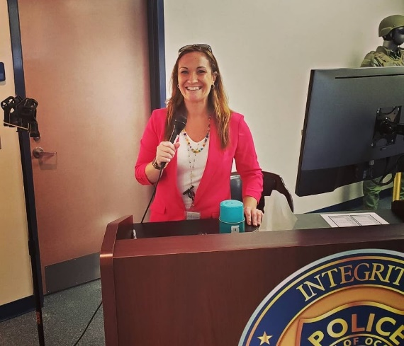
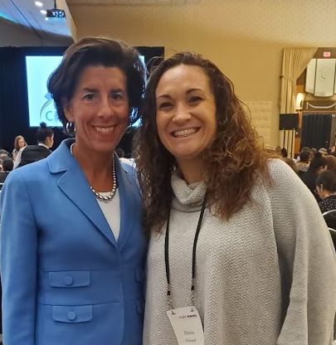
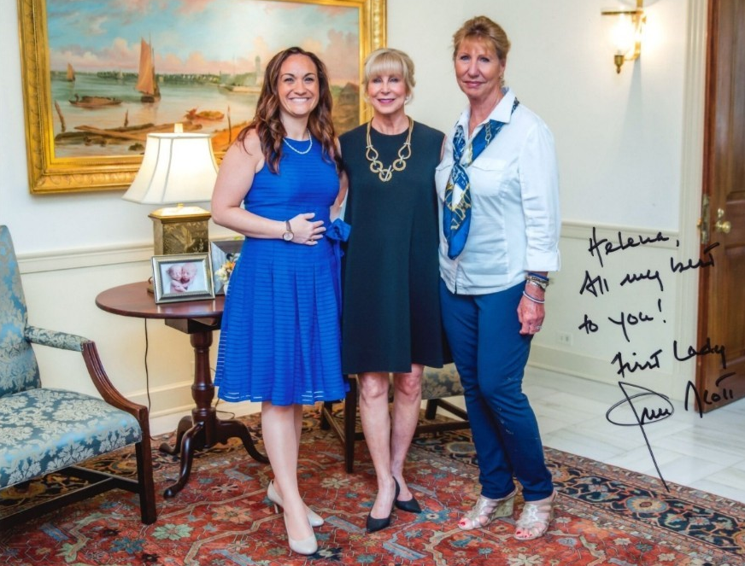
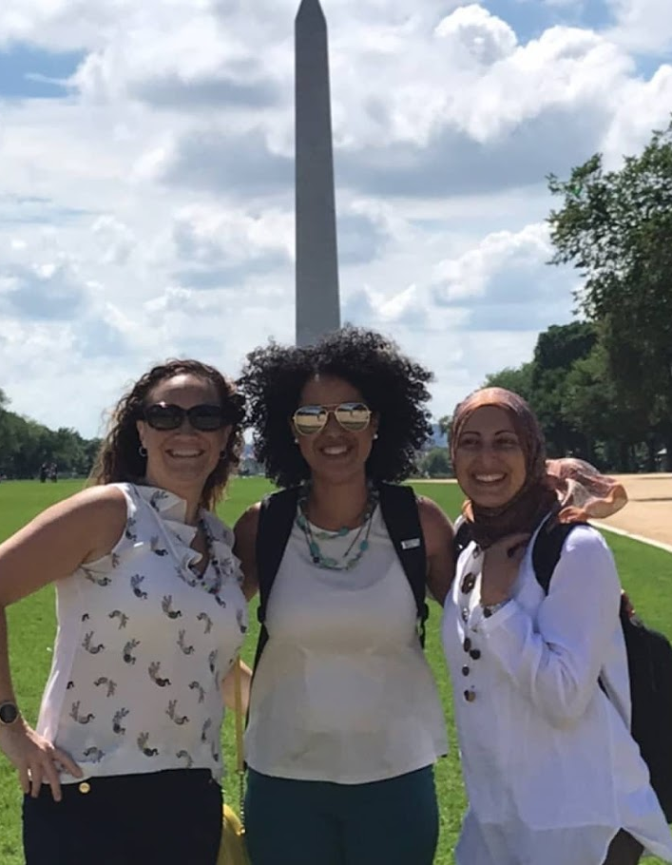
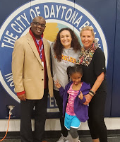
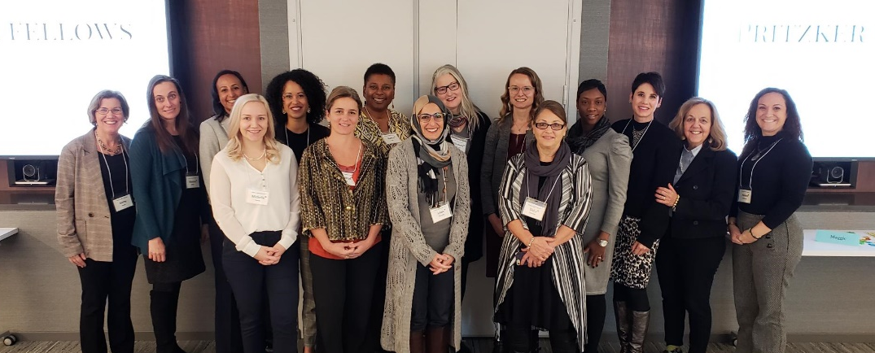
Speeches
Fellows

Slide 11

“ You are not alone.”
“I’m so proud of you.”
“I’m going to give you a chance.”
“I can tell you’re going to be a great mommy.”
“Look at the way she looks at you, she loves you.”
“You’re such a great role model for your daughter.”
“Izzy is doing great in school; I can tell you talk to her at home.”
“We are here for you.”
“You’re doing such a good job.”
“Is there something more I can do to help you?”
“Tell me more about your concerns.”
“I love you so much.”
Words Matter
“That’s what you get when you mix drugs & alcohol.”
“You’re just a junkie.”
“You’re not sick enough.”
“We’re trying to clean this place up.”
“You look like $@#* on paper.”
“You haven’t demonstrated ‘sufficient’ rehabilitation.”
“Look at what you did.”

Slide 12
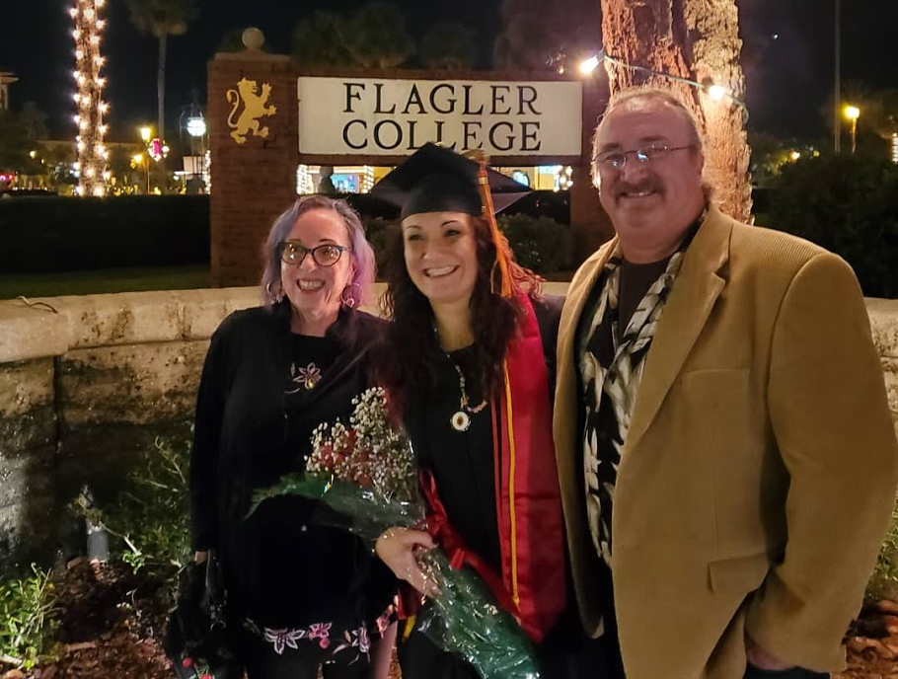
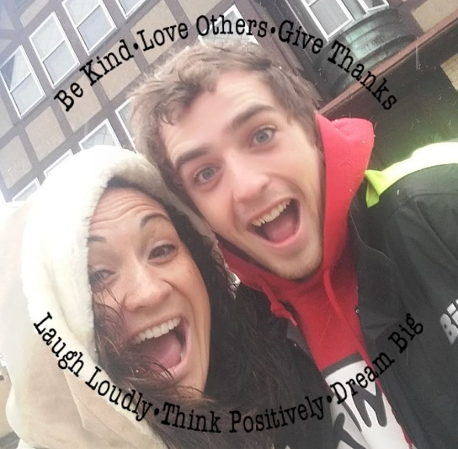
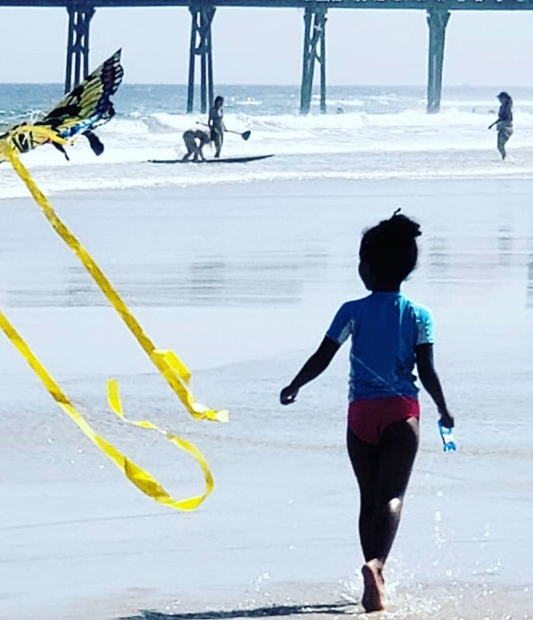
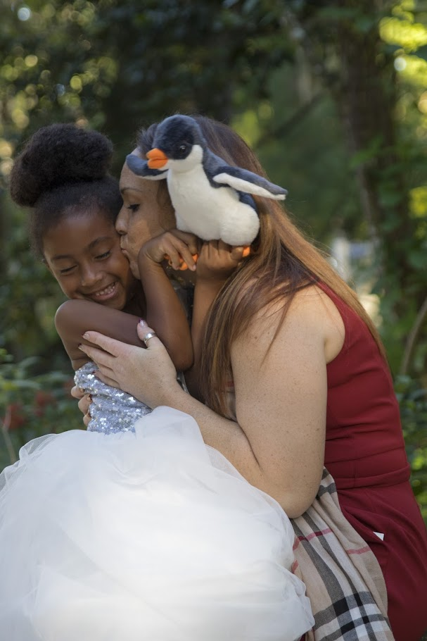
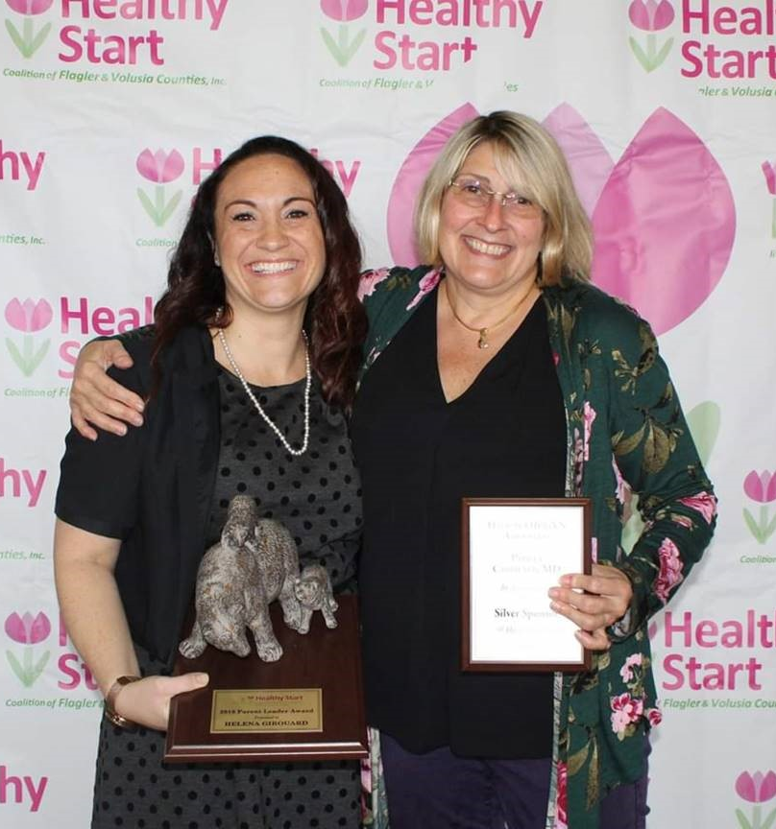
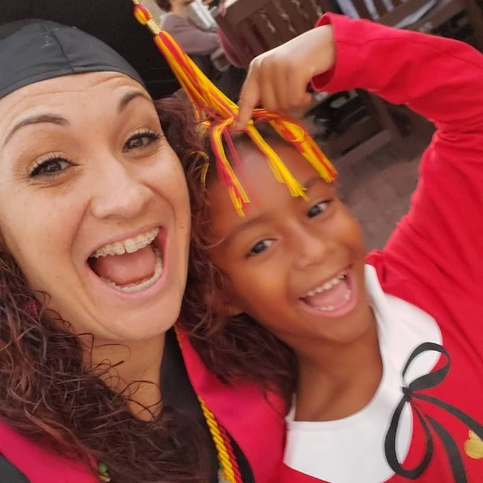
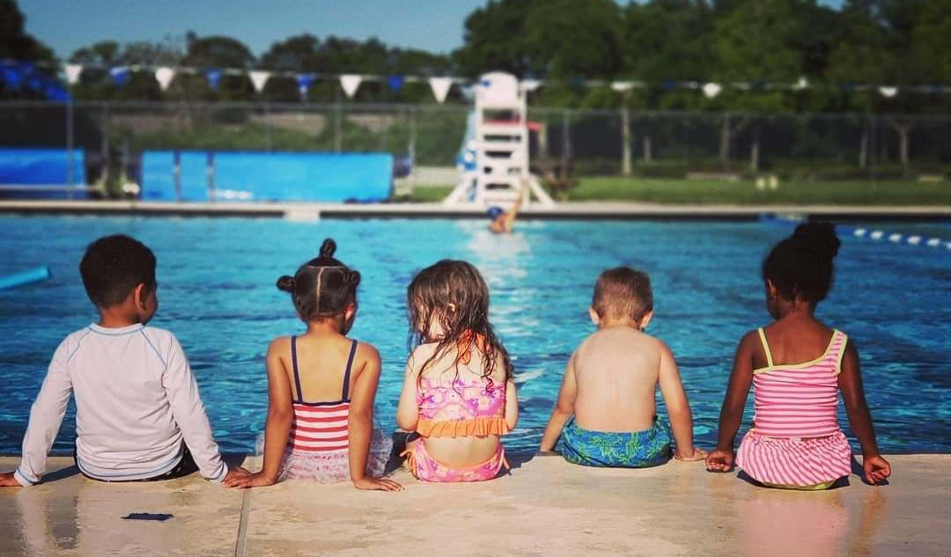
“I think you’ve got potential.”

Slide 13
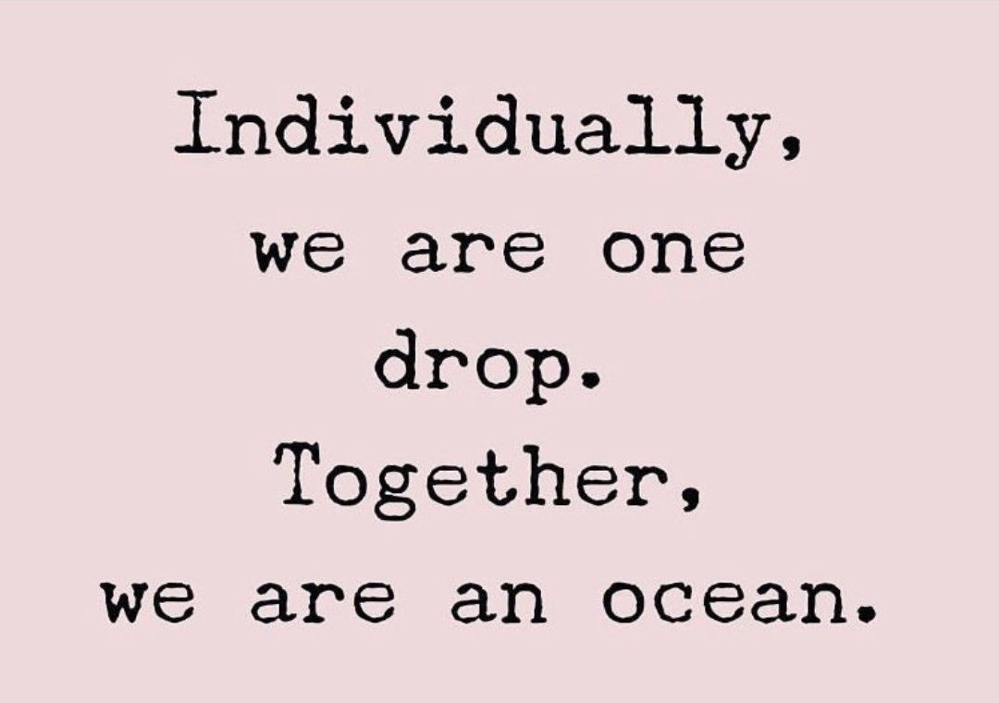
Questions?
How can I help you?
Thank you so much for all you do!

