Slide 1

Keeping the Torch Lit: Practical Strategies Using Data for Lasting Change
Sangeeta Schroeder, MD FAAP
Associate Medical Director - Center for Excellence Ann & Robert H Lurie Children’s Hospital of Chicago

Slide 2
Objectives
Data utilization to drive change
Case example: Bronchiolitis
Case example: CLABSI reduction
MNO Initiative

Slide 3
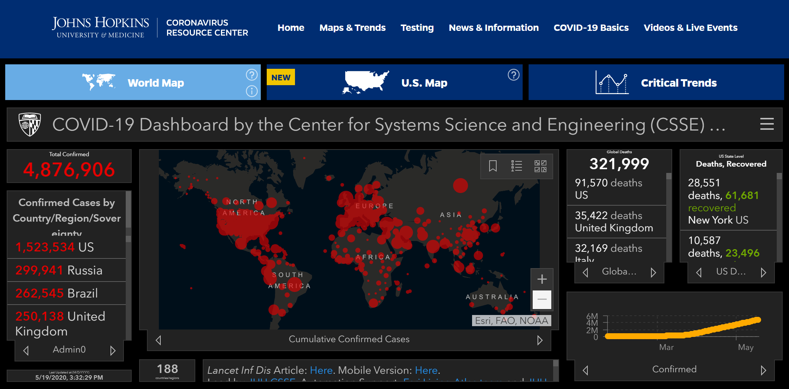
CASES ARE WIDESPREAD: LARGE IMPACT
DATA CAN BE STRATIFIED: DRILL DOWN
BIG PICTURE METRIC
DATA OVER TIME
https://coronavirus.jhu.edu/

Slide 4
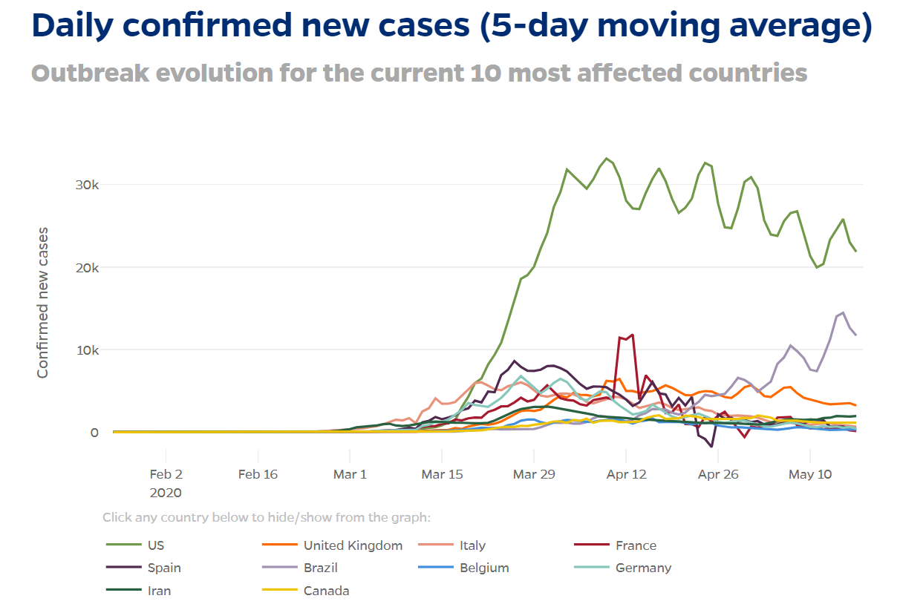
CASES ARE WIDESPREAD: LARGE IMPACT
DATA CAN BE STRATIFIED: DRILL DOWN
DATA OVER TIME
BIG PICTURE METRIC
https://coronavirus.jhu.edu/

Slide 5
Stay at home orders put in place in the US
Anticipated effect
https://coronavirus.jhu.edu/

Slide 6
Key Points
Cases are widespread: large impact
  Data should be applicable
Data can be stratified: drill down
  How does it affect me!
Data over time
  Did your changes result in improvement?
Big picture metric
  Will anyone else carry the torch?
  Why does this matter?

Slide 7
Case Example: Bronchiolitis

Slide 8
Bronchiolitis – National Evidence
Define
Leading cause of admission for infants
Up to 18% of all hospitalizations in the US
$1.73 billion in hospital charges
  an increase of 30% after adjusting for inflation between 2000 and 2009
Pediatric Health Information System (PHIS) database, contains administrative and billing data from 43 freestanding children’s hospitals
  6th most costly condition (after respiratory distress of the newborn, pneumonia, chemotherapy, acute respiratory failure and asthma)
  2nd most prevalent conditions (after asthma)
Hasegawa et al. Pediatrics 2013;132:28-36
Keren et al. Archives of pediatrics & adolescent medicine 2012;166:1155-64

Slide 9
Define
Bronchiolitis – National Evidence
2006, the American Academy of Pediatrics published a clinical practice guideline on the diagnosis and management of Bronchiolitis
  recommend not using
    bronchodilators (albuterol, levalbuterol or epinephrine)
    antibiotics (parenteral or oral)
    corticosteroids (inhaled, oral or parenteral)
    chest physical therapy
    chest radiographs
2014, the AAP published an update to the guideline
  emphasized not using bronchodilators and restated above recommendations
American Academy of Pediatrics Subcommittee on Diagnosis and management of bronchiolitis. Pediatrics 2014;134:e1474–e1502
American Academy of Pediatrics Subcommittee on Diagnosis and management of bronchiolitis. Pediatrics 2006;118:1774-93

Slide 10
Bronchiolitis – Baseline Data
Medications
Define
Measure

Slide 11
Define
Measure
Bronchiolitis – Baseline Data
Testing

Slide 12
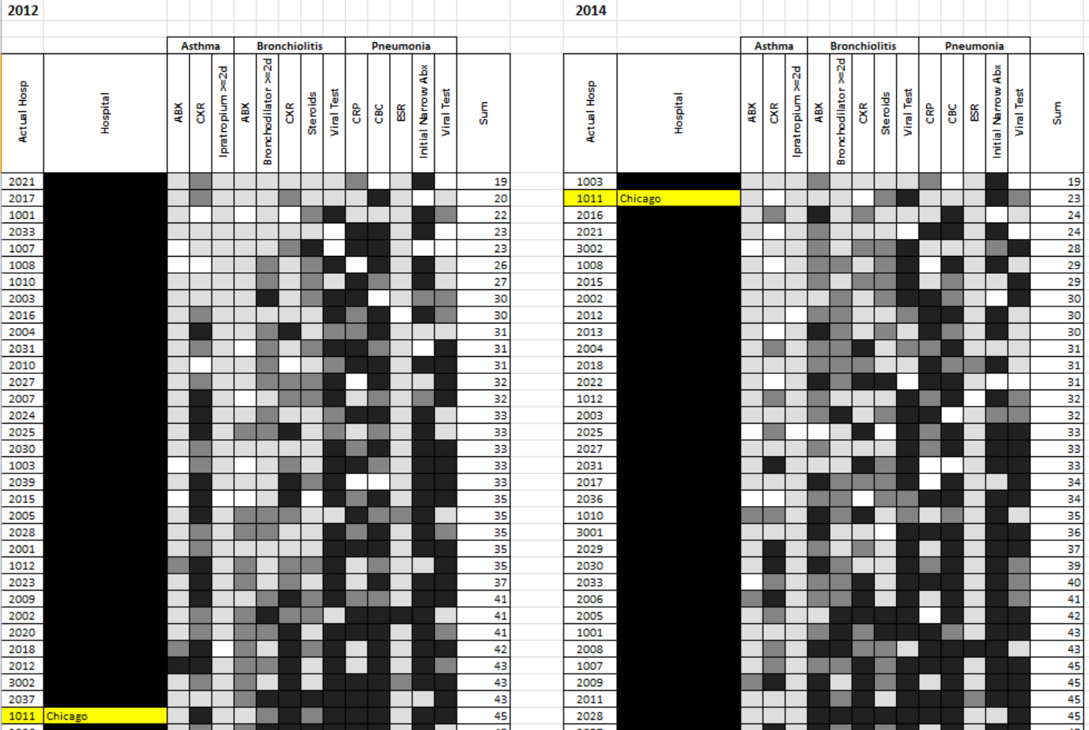
Benchmarking
Define
Measure
2012
Establishing Benchmarks for the Hospitalized Care of Children with Asthma, Bronchiolitis, and Pneumonia. Parikh et al, Pediatrics 2014;134;555

Slide 13
Multi-Modal Assessment for Rapid Cycle Guideline Development
Define
Measure
Analyze
Data
Focused Literature Review
Provider Variation
Nursing Surveys

Slide 14
Decreasing Variation in the
Pursuit of Excellence: Deployment of Working Groups
Define
Measure
Analyze
Improve
ED Order Set
Inpatient & Observation Unit Care Pathway
Provider Note Standardization
Patient & Family Education
IP/OU Order Set
Emergency Department Care Pathway
Nursing & Respiratory Therapy Documentation Fields

Slide 15
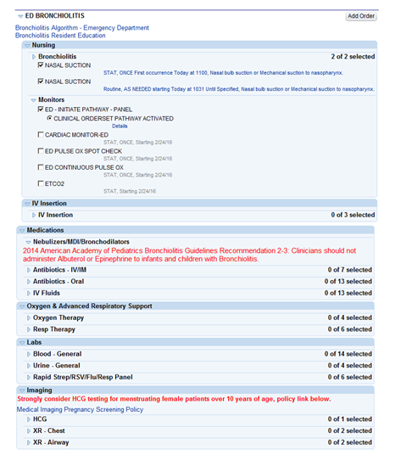
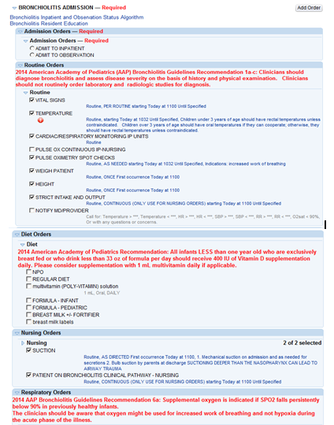
Order Sets - ED and Inpatient
Define
Measure
Analyze
Improve
Notes:
Links to Algo
Red writing

Slide 16
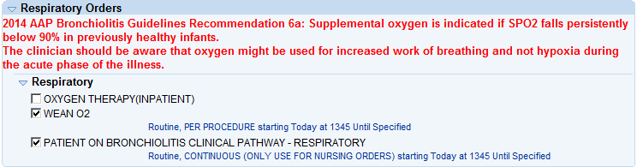
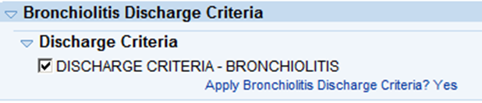
Order Sets - ED and Inpatient
Define
Measure
Analyze
Improve
Evidence placed in red writing
First line care is pre-checked; making it easy to do the right thing!
Discharge criteria established
Notes:
Links to Algo
Red writing

Slide 17
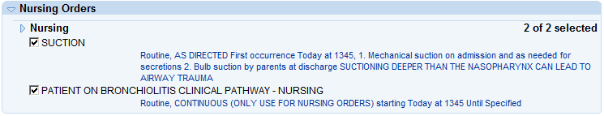
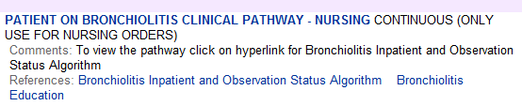
Order Sets - ED and Inpatient
Define
Measure
Analyze
Improve
Notes:
Links to Algo
Red writing

Slide 18
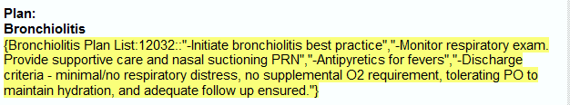
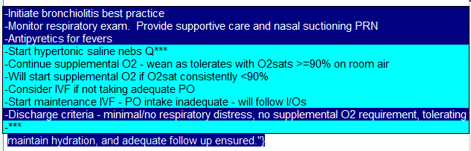
Note Standardization
Define
Measure
Analyze
Improve

Slide 19
Documentation Field Enhancements:
ED and Inpatient
Define
Measure
Analyze
Improve
Suctioning depth
Response to suctioning
Standard view across all disciplines

Slide 20
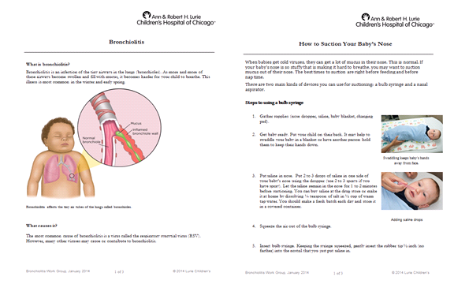
Patient and Family Education
Define
Measure
Analyze
Improve

Slide 21

Education and Dissemination
Define
Measure
Analyze
Improve

Slide 22
Inpatient Order Set Used
Define
Measure
Analyze
Improve
Control
Data should be applicable
Data can be stratified/Drill down
Data over time - Did the change result in an improvement?
BIG PICTURE METRIC – Why does this matter/Will anyone else carry the torch?
Subgroup Size
Min 4
Max 118

Slide 23
House Wide >1 bronchodilator
Define
Measure
Analyze
Improve
Control
Data should be applicable
Data can be stratified/Drill down
Data over time - Did the change result in an improvement?
BIG PICTURE METRIC – Why does this matter/Will anyone else carry the torch?
Subgroup Size
Min 4
Max 118

Slide 24
Benchmarking
Define
Measure
Analyze
Improve
Control
2012
2014
Establishing Benchmarks for the Hospitalized Care of Children with Asthma, Bronchiolitis, and Pneumonia. Parikh et al, Pediatrics 2014;134;555

Slide 25
Sustaining Improvement
Define
Measure
Analyze
Improve
Control
Monthly Data Review by Lead Team
Unit/Division data presentations in relevant areas during Bronchiolitis season (2 seasons)
Quarterly data presentations at hospital quality committee
Data allows for numerous medical student, resident and fellow initiatives

Slide 26
Case Example: CLABSI Reduction

Slide 27
CLABSI Occurs
Huddle within 72 hours to identify issues
Evaluation of Maintenance Bundle Data from RFI and EPIC to help in evaluation
RCA of CLABSI to determine preventability with multidisciplinary taskforce
Final Determination of Preventability with cause on Review Site
Unit takes final determination and spreads in unit huddles to foster improvements
CLABSI Liaison enters investigation into CLABSI Review Site

Slide 28
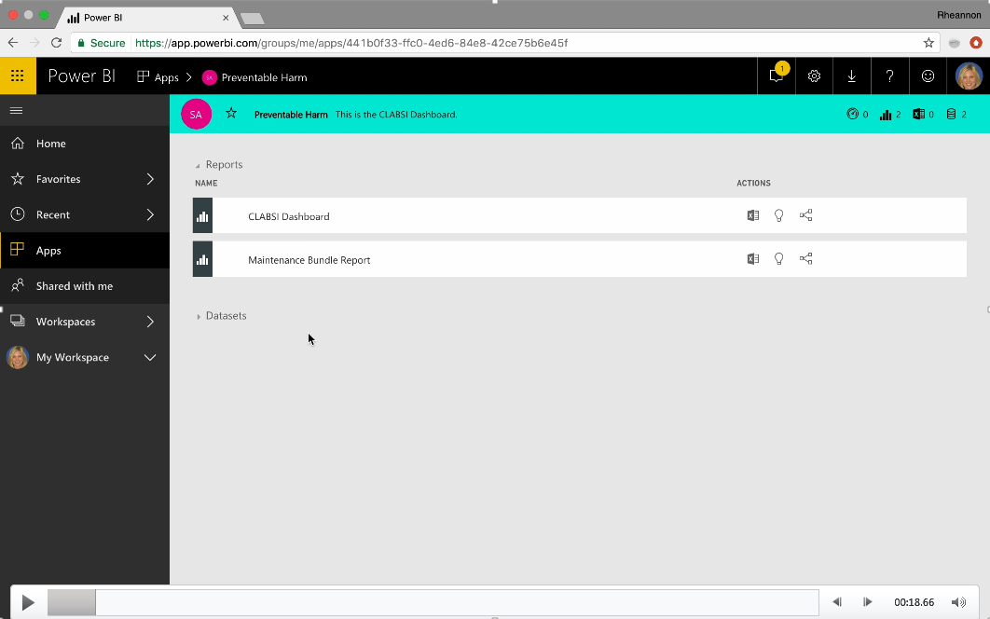

Slide 29
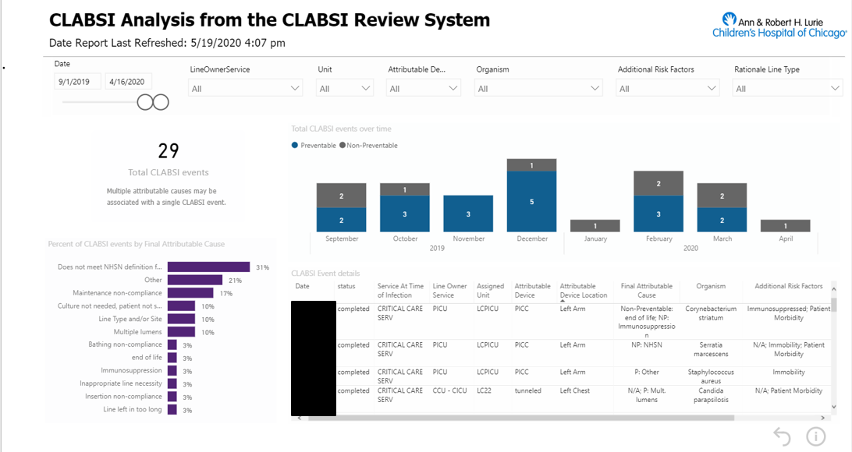
Data should be applicable
Data can be stratified/Drill down
Data over time - Did the change result in an improvement
BIG PICTURE METRIC – Why does this matter/Will anyone else carry the torch?

Slide 30
Maintenance Bundle
CLABSI Toolkit
Rounds for Influence
Preventable Harm Dashboard
Data should be applicable
Data can be stratified/Drill down
Data over time - Did the change result in an improvement
BIG PICTURE METRIC – Why does this matter/Will anyone else carry the torch?

Slide 31
MNO Initiative

Slide 32
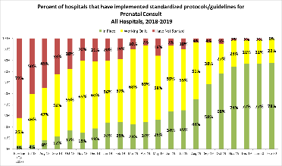
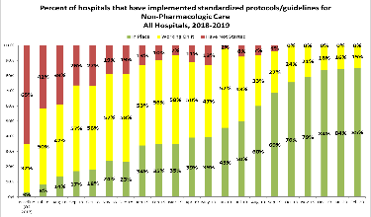
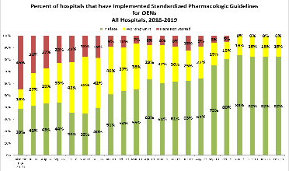
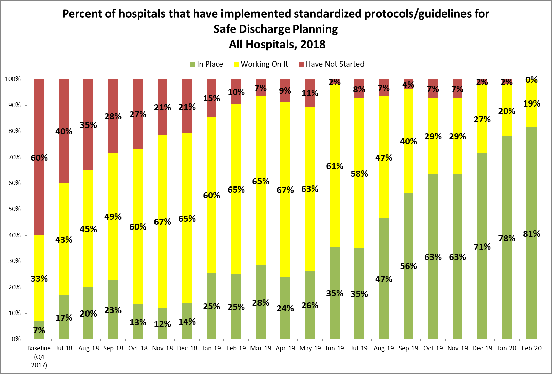
Making Systems Change Happen
80% of teams have a prenatal consult protocol in place
85% of teams have a non-pharm protocol in place
85% of teams have a pharm protocol in place
85% of teams have a discharge protocol in place

Slide 33
Received Maternal Breastmilk from Eligible Mothers at Infant Discharge
AIM = ≥ 70%

Slide 34
Received Pharmacologic Treatment
AIM = ≤ 20%

Slide 35
Discharged with a Coordinated Plan
AIM = ≥ 95%

Slide 36
Next Steps
Show your data! Make it applicable
Show your data! Drill it down as much as you are able
Show your data! Annotate with your improvements over time
Show your data! Drive home the big picture
Show your data! Let it be owned by others

Slide 37
Questions?

