Slide 1

QI Excellence Awards, Virtual Storyboard Session, and Transition to Breakouts
May 21, 2020
9am – 3:15pm
Notes:
MNO-OB, MNO-Neo, IPLARC, IPAC
Gold → Bronze

Slide 2
Awards and Recognitions
11:10 – 11:25am
Quality Improvement Awards for MNO-NEO
Storyboard Session Information
Breakout Session Information

Slide 3
To be awarded at the May 2020 ILPQC OB Face to Face
QI Excellence Awards
ILPQC Mothers and Newborns affected by Opioids- Neo
QI Champion | QI Leader: Culture & Systems Change | QI Leader: Systems Change
*All Data Submitted | All Data Submitted | All Data Submitted
+ | + | +
4 Structure Measures In Place | 4 Structure Measures In Place | 4 Structure Measures In Place
+ | +
3 Process Measure goals met** | 1-2 Process Measure goals met | (also route for teams with no patients)
**Determined by Cumulative data for Quarter 1 (January - March) of 2020
*All Data Submitted for Baseline (Oct – Dec 2017) and July 2018 through March 2020
*MNO-Neonatal Monthly Patient Data & Monthly Neonatal Structure Measures
    DATA DUE MONDAY, May 4th by MIDNIGHT

Slide 4
Congrats MNO-Neo QI Award of Excellence Award Winners!
QI Champion
OSF St Francis Medical Center
Palos Health
Saint Joseph Hospital Chicago*^
*Received QI Award November 2019
^Received Higher Level of QI Award Since November 2019
Notes:
Acknowledge ALL Winners *asterics for previously winners. + for upgrading their award

Slide 5
Congrats MNO-Neo QI Award of Excellence Award Winners!
QI Leader: Systems & Culture Change
Advocate Good Samaritan Hospital
Advocate Sherman Hospital
AMITA St. Alexius Medical Center
Carle Foundation Hospital
NM Central DuPage Hospital*^
NM Kishwaukee Hospital
NM McHenry Hospital
NM Northwestern Memorial Hospital
Little Company of Mary Hospital
Loyola University Medical Center*^
Memorial Hospital of Carbondale*^
Mount Sinai Hospital
OSF St Elizabeth Medical Center
Rush Copley*^
Silver Cross Hospital
SSM Health Cardinal Glennon Children's Hospital
SSM Health St Mary's - St Louis
*Received QI Award November 2019
^Received Higher Level of QI Award Since November 2019
Notes:
Acknowledge ALL Winners *asterics for previously winners. + for upgrading their award

Slide 6
Congrats MNO-Neo QI Award of Excellence Award Winners!
QI Leader: Systems Change
Advocate BroMenn Medical Center
Advocate Children’s Hospital- Oak Lawn
Advocate Children’s Hospital- Park Ridge
Advocate Condell Medical Center
Advocate Illinois Masonic Medical Center
NMHuntley Hospital
CGH Medical Center
Edward Hospital
QI Leader: Systems Change
Elmhurst Memorial Hospital*
Illinois Valley Community Hospital
Memorial Hospital East
Morris Hospital
NorthShore University Health System Evanston Hospital
Northwest Community Healthcare
Riverside Medical Center
Saint Anthony Hospital
*Received QI Award November 2019
^Received Higher Level of QI Award Since November 2019
Notes:
Acknowledge ALL Winners *asterics for previously winners. + for upgrading their award

Slide 7
Award Instructions
ILPQC will follow up with new award winners who have not previously received a plaque to request contact & shipping information to send QI Award of Excellence Plaques
If you have any questions, comments, or concerns about your award status, please email us at info@ilpqc.org

Slide 8
MNO Materials Order
Starting today through 5/29/2020 at 5pm CST, ILPQC will open an order form for hospital teams to order and ship FREE bundles of MNO OB & Neonatal Folders and provider education posters!
Link to order folders is here: https://ilpqc.org/ilpqc-2020-virtual-ob-face-to-face/
Ordering 1 MNO Folder Bundle will include:
  1 x MNO-OB Folder,
  1 x MNO-Neonatal Folder, and
  1 x complete set of OB & Neonatal Provider Education Posters
Attendees can order up to 5 bundles.

Slide 9
Virtual team storyboard session & lunch break

Slide 10
Virtual Storyboards Session
Browse through all of the storyboards at the bottom of the ILPQC 2020 Virtual Neo Face to Face Website and complete a Steal Shamelessly Document for ideas to bring back to your hospital
Email a takeaway from the storyboards you’ll take back to your team in your Steal Shamelessly Document or an email titled “Storyboard” to info@ilpqc.org by 2:30pm to be enrolled in a raffle to win a $50 Amazon gift card
Vote for your 5 top storyboards and submit your vote into the link on https://ilpqc.org/ilpqc-2020-virtual-neo-face-to-face/. You may not vote for your own hospital. Hospitals with most votes will win a prize!
All links available on Neo Face to Face Webpage
Notes:
11:25-12:15pm
: https://ilpqc.org/ilpqc-2020-virtual-neo-face-to-face/ Password: NEOF2F2020)
, listed alphabetically & with a unique Neo identifier (i.e. Neo 1, Neo 5…)

Slide 11
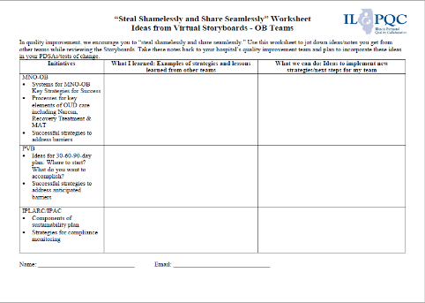
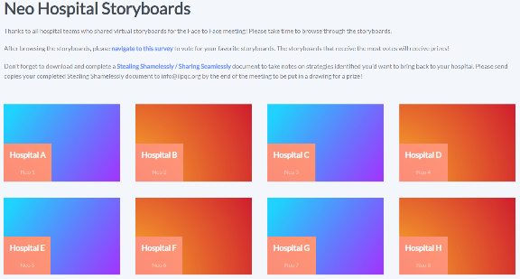
Virtual Storyboards Session
11:25pm – 12:15pm
All links above also available on Neo Face to Face Webpage
Notes:
https://redcap.healthlnk.org/surveys/?s=CM9LTJ9D77

Slide 12
Neo Breakout Session Logistics

Slide 13
Breakout Session
Ground Rules
Breakout sessions designed to be interactive!
This is a small group discussion, not a presentation.
Turn your video on so we can see each other.
If you do not have a microphone on your computer, please call into the Zoom meeting.

Slide 14
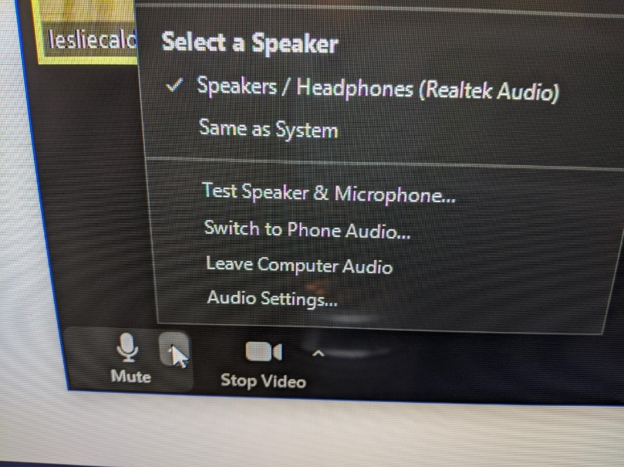
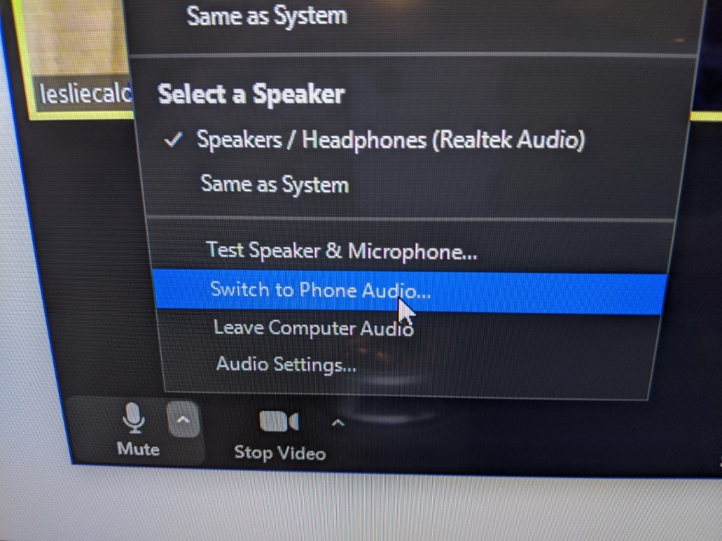
If no microphone, switch to phone

Slide 15
Breakout Session
Initial Steps
At 1:00 go to the ILPQC Face to Face webpage (https://ilpqc.org/ilpqc-2020-virtual-neo-face-to-face/ (Password: NEOF2F2020) and click the zoom link for the breakout session #1 that you selected during registration.
The link will take you to a zoom meeting with an ILPQC Central Host (Dan Weiss, Autumn Perrault, or Patti Lee King) where we will actively move participants into their selected breakout session.
Participants will need to “raise their hands” to opt into their breakout session.
The Breakout Session #1 discussion will start at 1:20pm

Slide 16
Neonatal Breakout Sessions
Click Breakout Sessions Link at 1:00 to join the zoom meeting to be assigned to your breakout session
MNO-Neonatal: Finishing Strong
MNO-Neonatal: Preparing for Sustainability
MNO-Neo: Engaging Pediatricians
QI: Using QI Data to Drive Change
QI: Building a Strong Interdisciplinary QI Team
BASIC: Preparing your QI Team for BASIC
State & Community Partner Breakout
Breakout sessions run from
#1: 1:20-2:05
#2: 2:25-3:10

Slide 17



THANKS TO OUR
FUNDERS
Email info@ilpqc.org or visit us at www.ilpqc.org
Notes:
Updated 10/22/19

