Slide 1



THANKS TO OUR
FUNDERS
Email info@ilpqc.org or visit us at www.ilpqc.org
Notes:
Updated 10/22/19

Slide 2

MNO-Neo Hospital Team Panel: Sharing Strategies for Success
ILPQC Neo Face-to-Face Meeting
May 21, 2020

Slide 3
Neonatal Teams Panel
Leslie Caldarelli, MD and Justin Josephsen, MD- Moderators
NM Central DuPage Hospital
  Rita Brennan, DNP, RNC-NIC, APN/CNS
  Lisa Maloney, MSN, RNC-NIC
  Mary Puchalski, NNP
AMITA Alexian Brothers Women & Children’s Hospital
  Maliha Shareef MD, MS, MBA, FAAP
  Korina Sanchez, RN, MSN
Carle Foundation Hospital
  Lisa Davis, APRN, MSN, NNP-BC
  Brent Reifsteck, MD
  Jenny Brandenburg, RN, MSN

Slide 4
MNO Newborn Initiative
ILPQC May 21, 2020
Central DuPage Hospital
392 bed hospital
~2800births per year
Level 3 OB and Neonatal services

Slide 5
Keys to Success
Setting the Foundation
Formal Hospital QI Project
Charter
Sponsors
Project, newborn & OB leads
Multidisciplinary involvement
Monthly team meetings
Quarterly joint & stakeholder meetings
Developed NM System Team
Newborn team:
  Clinical Practice Partner Neonatologist Nurse Practitioner
  Pediatrician Staff RNS Lactation
  Pharmacy Social Work Case Manager
  Quality Directors Outcomes Manager
Notes:
Charter- Our VP or W&C was the executive sponsor, medical director and NICU director were sponsors
Monthly meetings shared data (internal and comparison to ILPQC)
System Team took on global stigma & bias education and making EMR changes for all hospitals in our system

Slide 6
MNO Newborn Initiative
Objectives
Decrease the proportion of OENs receiving pharmacologic treatment
  No infants required pharmacologic treatment > 6 months
    NAS education with a strong focus on non-pharm interventions & ESC
    Bedside handout with non-pharm interventions
      Instructions, infant stability signals & infant stress signals
    Newborns to room with their mother post maternal discharge
    Implemented ESC in Mother Baby Unit (MB)
    Used ILPQC checklist and added Modified Finnegan Score line
    Educated physicians
    Standardized consults & note templates
    Neonatology team support for pediatricians
      Neonatologist/nurse practitioner participate in huddles
      Reexamine bundle compliance & reinforced interventions

Slide 7
MNO Newborn Initiative
Objectives
Increase proportion of eligible OENs receiving material breastmilk
  For mothers who chose breastfeeding (& eligible) – 100%.
    Historically high breastfeeding initiation rate for all infants
    Included breastmilk discussion in neonatal consult
    Developed process for prenatal lactation consultation
    Lactation support while inpatient
    Rooming in and CBC support
Increase OENs discharged with a coordinated plan
  Cumulative 83.3%. All discharges since Dec. 2019 met criteria.
    Coordinated with social work
    Collaborated with hospital child safety team
    Standardized social work notes template align with ILPQC recommendations
    Discussed at biweekly multidisciplinary rounds

Slide 8
MNO Newborn Initiative
Overall Contributions to Success
Early Identification
  MFM High Risk Rounds
    ILPQC booklet to be given & 3rd trimester neonatology consult in EMR
Strong team meetings- Right people at the right time
Meeting content aligned with ILPQC monthly calls
Data Sharing: Internal dashboard & External comparisons
Global education
System team to incorporate education materials & changes to the EMR
Hardwiring consultations
Standardizing consultation and discharge notes
MNO folders and resources at bedside for staff and families
Phased ESC implementation
CQI- cases reviewed at monthly meetings & learnings disseminated
Discussions at pediatric department and pediatric M&M presentation

Slide 9

ILPQC: Mothers and Newborns Affected by Opioids (MNO)-Neonatal Quality Improvement Project
Maliha Shareef, MD, MS, MBA, FAAP
Medical Director, NICU
AMITA Alexian Brothers Women and
Children’s Hospital Hoffman Estates, IL
Notes:
Maternity Services Include:
Comprehensive care for women experiencing complicated or high-risk pregnancies
Family-centered level III Neonatal Intensive Care Unit and Special Care Nursery
Access to maternal fetal medicine specialists
All-private rooms with family sleep accommodations
Expert lactation consultants
On- site treatment for mood and anxiety disorders, both during and after pregnancy

Slide 10


Patient Case Study
Background:
  36 3/7 week infant at birth admitted to unit on DOL 41 (2/26/20) post transport from local area hospital for continuation of care.
  Initially admitted to NICU due to prematurity, TTN and NAS.
  Mother requested transfer due to concerns that infant was becoming dependent on morphine and her inability to breastfeed (not allowed) at referring institution.
Maternal history:
  32 y/o Gravida: 2 Para: 1001
  Maternal-fetal opiate exposures: Subutex maintenance therapy. Hx of heroin abuse.
  Other maternal-fetal exposures: Adderall, Klonopin, Xanax, nicotine patch, Lunesta & Effexor. Reported discontinuing during pregnancy to breastfeed.
Infant history:
  Urine drug screen: + benzodiazepine
  Meconium toxicology screen: + for benzodiazepine & buprenorphine
  Evidence of NAS syndrome on assessment- Morphine therapy initiated at referring hospital. Dose at time of admission- 0.18 mg (0.05 mg/kg) Q4H & PRN dosing.
Plan:
Continue current dose of morphine and wean as able.
Utilize ESC tool for assessment & care plan.
Partner with mother to provide non-pharm care as primary treatment.
Encourage rooming-in.
Coordinate discharge care.
Notes:
Background:
In addition-
Referring hospital had a large-open bay unit.
Mother reported the environment was very loud and not conducive to good rest for baby or family (self-care). Mom felt “judged” by staff.
Baby frequently awakened by noise in NICU.
Baby had been on a scheduled Q3H PO/NG feeding schedule at referring hospital vs an ad lib schedule-not optimal feeding plan to allow for feeding at early hunger cues.

Slide 11
Care Summary
ESC Assessment Tool:
  Total number of nursing shifts used-24 (used every day for infant)
  Total number of “yes” answers-16 (for periods of poor eating, sleeping and consoling needs)
Non-Pham Care Interventions:
  Mother, father & grandmother engaged in non-pharm bundle.
  Private, single patient rooms allowed for rooming-in & quiet environment
  Clustering of care
  Ad lib demand feeding schedule
  Use of comforting devices (swing)
Pharm Interventions:
  Weaned morphine dose per ESC documentation and care huddles
  Discontinued after 6 days
Discharge:
  Discharged to home to mother after 12 days
  Mother in treatment program
  Safe discharge plan & communication with pediatrician
  NICU follow-up clinic appointment made for 1 month post discharge
  Early Intervention referral made
Notes:
ESC Tool:
March 2nd 2020-Go-Live
Implementation of Eat, Sleep Console Assessment Tool and Newborn and NICU Decision Flowcharts to guide plan of care for each patient.
Non-Pharm Interventions:
Partner with mothers as the best option to provide non-pharm care as the first line of treatment.
Encourage rooming-in, use of newborn care diary and active participation in care huddles to engage and empower mothers.
Pharm Interventions:
Hospital process-PRN morphine dosing vs scheduled. Administered on mother/baby unit as well per protocol.
Standardized dosing
Discharge:
Utilize MNO Discharge Checklist
Provider:
Determines clinical readiness for discharge including 5-7 days of inpatient monitoring.
Transfer of care and coordination with primary care provider.
Nurse:
Family preparedness- provides family education including IDPH “NAS: A Guide for Families.”
Coordinates necessary follow-up appointments.
Social Work:
Coordination and clearance with Illinois Department of Children and Family Services as applicable.
Provides referrals to additional community resources as needed.

Slide 12
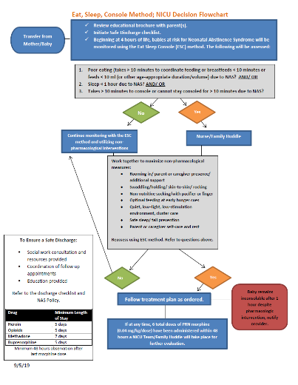
Eat, Sleep, Console, NICU Decision Flowchart

Slide 13
Compliance Monitoring & Education
Monthly review of all NAS cases
  Utilization of the MNO-Neonatal Clinical Debrief Form
  Review missed opportunities
  Provide feedback
On-going education to the clinical care team
  Annual nursing education on NAS and use of the ESC tool
  New hires receive education as part of the orientation process

Slide 14


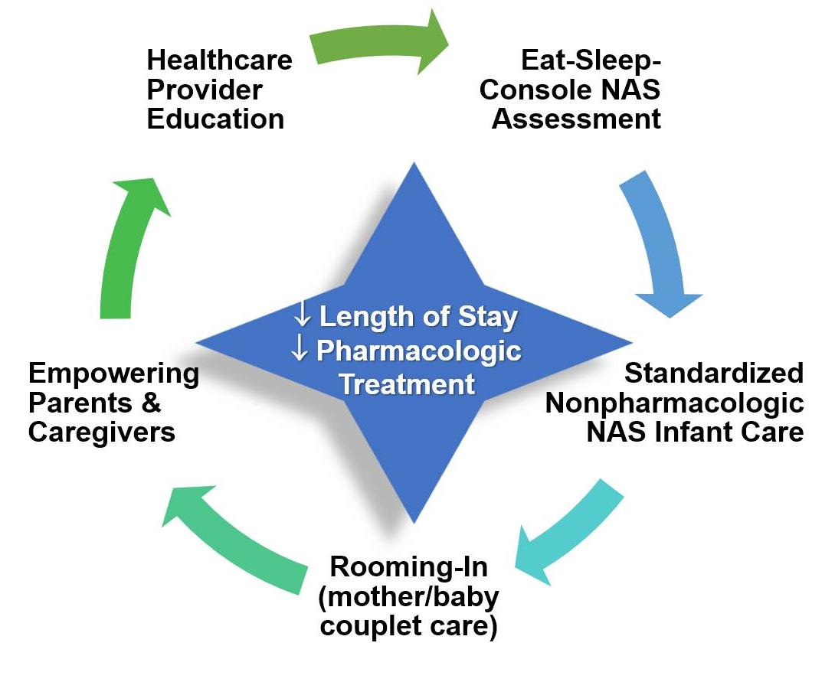
NEO Mothers and Newborns affected by Opioids (MNO)
Lisa Davis, APRN, MSN, NNP-BC
Jamie Summers, APRN, NNP-BC
Brent Reifsteck, MD Pediatrics
Nicole Spangler, APRN, PNP
Jenny Brandenburg, MSN
Carle Foundation Hospital, Urbana, IL

Slide 15

Results of MNO-ESC Project
Clinically well newborns stay with moms on postpartum floor
ESC (Eat, Sleep, Console) scoring done by postpartum staff and babies are managed by Peds Hospitalist and APP Team
Most babies stay with moms for observational period, for 4-7 days.
First line of treatment is non-pharm bundle (rooming-in, STS, breastfeeding)
Transferred to Peds floor if ESC huddle indicates pharmacologic treatment is needed.
If pharmacologic treatment required, PRN doses of morphine, up to 2 doses, are given.
1 baby sent to Peds for pharm tx; received 1 PRN dose of morphine only.
Only admitted to NICU with clinical illness.
No methadone initiation on any OEN (Opioid Exposed Newborn) since start of project (summer 2019).
Length of stay from 20.1 to 8.3 days.
Length of pharmacologic treatment from 14.7 to 1.3 days.

Slide 16
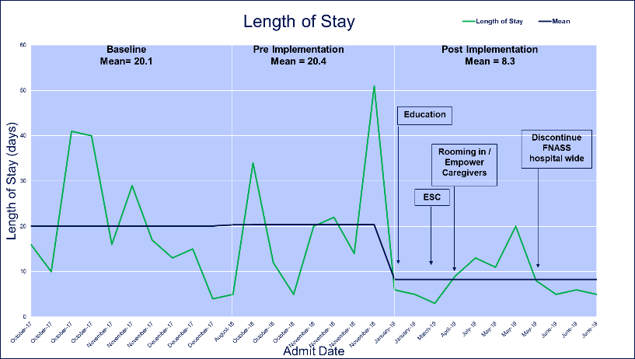
Length of Stay: Baseline 20.1 days → 8.3 days

Slide 17
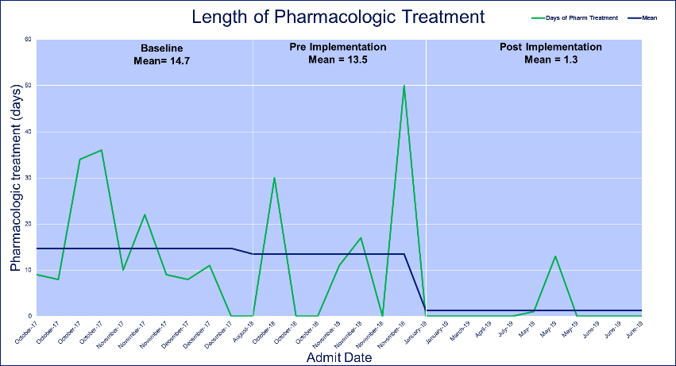
Length of Pharmacologic Treatment: Baseline 14.7 → 1.3 days

Slide 18
Coordinated Discharge
Coordinated, safe discharge:
4-7 days of inpatient monitoring for infants who do not require pharmacotherapy
  48 hours of inpatient monitoring after pharmacotherapy for infants who require pharmacotherapy
  The infant should feed well and gain weight over two consecutive days
  Consultation with social work completed
  Scheduled a developmental follow-up appointment (EI) and/or physical and occupational therapy appointments as applicable
Family understanding components of MNO Collaborative Discharge Plan
  Importance and benefits of breastfeeding, unless contraindicate
  Developmental follow-up, physical and occupational therapy
  Safe sleep practice and non-accidental trauma
Completion of MNO Collaborative Discharge Plan in partnership with care team, family, and community pediatrician.
  Coordination and clearance with Illinois Department of Children and Family Services (DCFS) completed, as applicable

Slide 19
Questions for panel
What were your most effective strategies to increase OENs receiving maternal breastmilk at infant discharge
What advice do you have for other teams working to reduce OENs receiving pharmacologic treatment?
What were the most challenging barriers to coordinated discharge of OENs your team faced and how did you overcome them?
How will you ensure sustainable lasting change in care for OEN at your hospital ?
Notes:
Please add other ideas for questions that bring it all together. I added questions to help us get some guidance from these teams on help with our statewide measures, especially discharge and non-pharmacological treatment. They often share a lot of ideas at once in the panel presentations so highlighting ideas other teams can take home in response to the measures is valuable – Patti
Question 1, 3; CDH and Carle speak to breastfeeding
Question 2: all three speak to this in some capacity

Slide 20
THANKS TO OUR
FUNDERS
Email info@ilpqc.org or visit us at www.ilpqc.org
Notes:
Updated 10/22/19

