Slide 1



THANKS TO OUR
FUNDERS
Email info@ilpqc.org or visit us at www.ilpqc.org
Notes:
Updated 10/22/19

Slide 2

Welcome!
ILPQC Neonatal
Virtual Face to Face Meeting
May 21, 2020
9am – 3:30pm

Slide 3
Conference Objectives
Participants will self-report understanding:
Systematic engagement of neonatal providers in the implementation of MNO-Neonatal Key Strategies for Success
Identification of opportunities and strategies to effectively plan and implement a perinatal quality improvement project that addresses neonatal antibiotic stewardship
Notes:
ONA Update

Slide 4
ONA Approval Statement
This activity will provide 5.00 contact hours
This continuing nursing education activity was approved by the Ohio Nurses Association, an accredited approver by the American Nurses Credentialing Center’s Commission on Accreditation (OBN-001-91)
Approval valid through (5/21/2022)
ONA Activity # 2020-0000000280
Notes:
ONA Update

Slide 5
Criteria for Successful Completion
Prior to the learning activities there are no required items to complete.
To obtain full contact hours for CNEs, you need to register for the event, complete the entire conference ( 5.00 contact hours) and an evaluation.
No partial credit will be awarded.
Day-of online evaluation will open for participants to complete at 3:00pm on https://ilpqc.org/ilpqc-2020-virtual-neo-face-to-face/
Certificates for contact hours will be accessible after online evaluation is completed.
Notes:
ONA Update

Slide 6
Disclosures
The planners and faculty have declared no conflicts of interest.

Slide 7
Morning Agenda
9:00 - 9:30am Welcome!
9:30 - 10:15am Sharing Strategies for Success: MNO-Neonatal Hospital Team Panel
10:15 - 10:25am Break
10:25 - 11:10am Neonatal Antibiotic Stewardship: the North Carolina Story, Martin McCaffrey, MD, CAPTN USN (Ret), Director, PQCNC
11:10 - 11:25am MNO-Neonatal QI Awards of Excellence
11:25 - 12:15am Team Storyboard Session- An Opportunity to Share and Lunch
https://ilpqc.org/ilpqc-2020-virtual-neo-face-to-face/
Password: NEOF2F2020

Slide 8
Afternoon Agenda
12:15 - 1:00pm Keeping the Torch Lit: Practical Strategies Using Data for Lasting Change, Sangeeta Schroeder, MD, Ann & Robert H. Lurie Children’s Hospital of Chicago
1:00 - 1:20pm Transition to Breakouts
1:20 - 2:05pm Breakout Session #1
2:05 - 2:25pm Transition to Second Breakout
2:25 - 3:10pm Breakout Session #2
3:10 - 3:15pm Transition to Plenary (Wrap-up)
3:15 - 3:30pm Summary, Evaluation, and Wrap up
Notes:
Need to update this

Slide 9


Participant eFolder Overview
https://ilpqc.org/ilpqc-2020-virtual-neo-face-to-face/
Password: NEOF2F2020
Neonatal Face to Face Agenda
Neonatal Storyboard Steal Shamelessly worksheet
MNO Resources
  Patient Education Resources
  Clinical Team Resources
Notes:
Patient Education Materials & Tools (Give to and review with moms)
Neonatal Abstinence Syndrome (NAS): What You Need to Know/Be with your baby: You are the treatment! Half‐ Page Card
Neonatal Abstinence Syndrome (NAS): What you need to know booklet
ILPQC Newborn Care Diary
Clinical Team Resources (Give to OB & Nurse to complete)
ILPQC MNO Prenatal Consultation Guidelines
Identify Newborns at Risk for NAS Decision Tree
ILPQC Infant Bedside Sheet
Breastfeeding Traffic Light Resource
MNO Discharge Checklist
Collaborative Discharge Plan

Slide 10
Virtual Storyboards Session
Browse through all of the storyboards at the bottom of the ILPQC 2020 Virtual Neo Face to Face Website and complete a Steal Shamelessly Document for ideas to bring back to your hospital
Email a takeaway from the storyboards you’ll take back to your team in your Steal Shamelessly Document or an email titled “Storyboard” to info@ilpqc.org by 2:30pm to be enrolled in a raffle to win a $50 Amazon gift card
Vote for your 5 top storyboards and submit your vote into the link on https://ilpqc.org/ilpqc-2020-virtual-neo-face-to-face/. You may not vote for your own hospital. Hospitals with most votes will win a prize!
All links available on Neo Face to Face Webpage
Notes:
11:25-12:15pm
: https://ilpqc.org/ilpqc-2020-virtual-neo-face-to-face/ Password: NEOF2F2020)
, listed alphabetically & with a unique Neo identifier (i.e. Neo 1, Neo 5…)

Slide 11
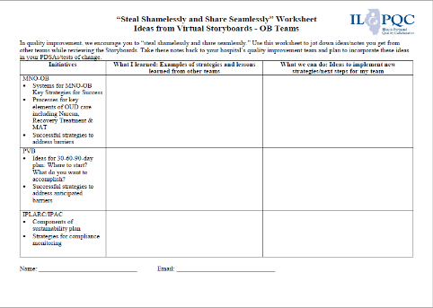
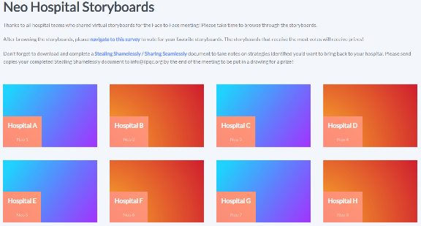
Virtual Storyboards Session
Links available on Neo Face to Face Webpage
Notes:
https://redcap.healthlnk.org/surveys/?s=CM9LTJ9D77

Slide 12
Neonatal Breakout Sessions
At 1:00 go to the ILPQC Face to Face webpage (https://ilpqc.org/ilpqc-2020-virtual-neo-face-to-face/ (Password: NEOF2F2020) and click the zoom link for the breakout session #1 that you selected during registration.
The link will take you to a zoom meeting with an ILPQC Central Host (Dan Weiss, Autumn Perrault, or Patti Lee King)
A host will actively move participants into their selected breakout session.
Participants will need to “raise their hands” to opt into their breakout session.
The Breakout Session #1 discussion will start at 1:20pm
Notes:
How do you go from session 1 to 2?

Slide 13
Neonatal Breakout Sessions
Click Breakout Sessions Link at 1:00 to join the zoom meeting to be assigned to your breakout session
MNO-Neonatal: Finishing Strong
MNO-Neonatal: Preparing for Sustainability
MNO-Neo: Engaging Pediatricians
QI: Using QI Data to Drive Change
QI: Building a Strong Interdisciplinary QI Team
BASIC: Preparing your QI Team for BASIC
State & Community Partner Breakout
Breakout sessions run from
#1: 1:20-2:05
#2: 2:25-3:10
Notes:
Need to update these times.

Slide 14
MNO Folder Order
Starting today through May 29th at 5pm CST, ILPQC will open an order form for hospital teams to order and ship FREE bundles of MNO OB & Neonatal Folders and provider education posters!
Link to order folders is here and on Neonatal Face to Face webpage: https://ilpqc.org/ilpqc-2020-virtual-neo-face-to-face/
An MNO Folder Bundle will include:
  1 x MNO-OB Folder,
  1 x MNO-Neonatal Folder, and
  1 x complete set of OB & Neonatal Provider Education Posters
Attendees can order up to 5 bundles

Slide 15
Welcome
Rear Admiral Wanda Barfield, MD, MPH
  Neonatologist
  CDC Director, Division of Reproductive Health

Slide 16
MNO-Neonatal Initiative
BASIC 2020
A Celebration of Statewide QI Initiatives

Slide 17
Overview
ILPQC Overview and Model for Improvement
Supporting each other during COVID-19
MNO-Neonatal Initiative: What’s Next?
Babies Antibiotic Stewardship Improvement Collaborative (BASIC) Initiative
Notes:
This needs help

Slide 18
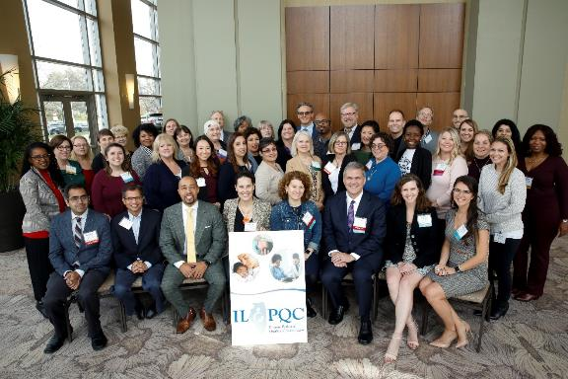
Thank you!

Slide 19
Illinois Perinatal Quality Collaborative (ILPQC)
Collaborative of physicians, nurses, hospital teams, patients, public health and other stakeholders implementing data-driven, evidence-based practices to improve maternal and neonatal outcomes in Illinois
ILPQC supports participating hospitals’ implementation of evidenced-based practices using quality improvement science, collaborative learning and rapid response data
>99% of IL births
119 Illinois hospitals participating in 1 or more initiative
Notes:
The Illinois Perinatal Quality Collaborative is a multi-disciplinary, multi-stakeholder perinatal quality collaborative started in 2013 with over 100 Illinois hospitals representing greater than 95% of Illinois births.
ILPQC supports participating hospitals’ implementation of evidenced-based practices using quality improvement science, collaborative learning and rapid response data

Slide 20
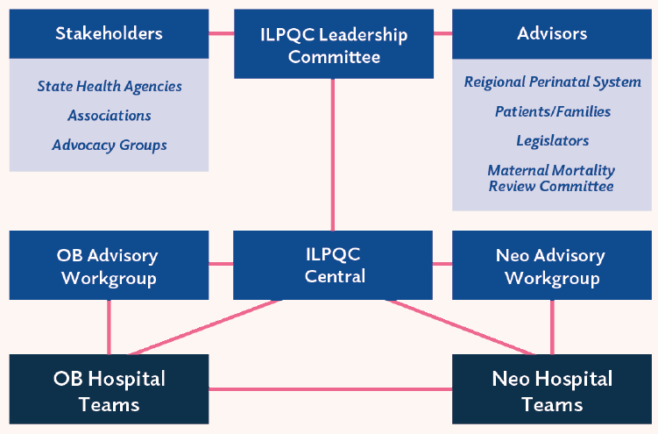
ILPQC Infrastructure
Notes:
Will update with final image when ready

Slide 21
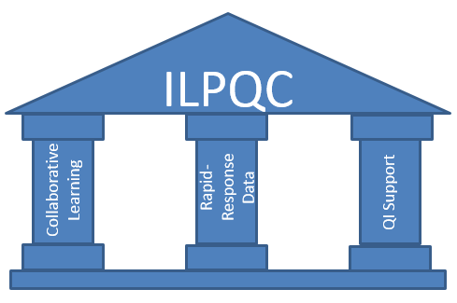
Using QI to Build Hospital Capacity to Drive Systems & Culture Change
Leadership, Advisors, Stakeholders, Patients/Families
Notes:
ILPQC facilitated the following QI strategies:
We supported the creation of multidisciplinary hospital-based QI teams,
Provided opportunities for collaborative learning across hospitals through in person events, and monthly web-based meetings
created a rapid response data system that allowed teams to track and compare their data
And maintained regular communication via newsletters and updated website
Importantly, we provided QI support to hospital teams through a toolkit, regional network meetings and QI coaching calls.

Slide 22
Supporting each other during covid-19

Slide 23
COVID-19
THANK YOU to the nurses, doctors, health care workers, public health teams and others across our state.
In partnership with IDPH, ILPQC held 7 weekly COVID-19 strategies webinars averaging 350 participants.
Neonatal & OB providers from across the state present cases, share protocols, and respond to participant questions.
ILPQC COVID-19 Webpage (www.ilpqc.org)
  Resources for hospital teams and patients with recorded webinars.
Notes:
Is that first sentence OK?

Slide 24

The aim is to ensure that pregnant moms from vulnerable communities have access to face masks at their prenatal visits, when they arrive at hospitals for delivery, and after discharge home.

Slide 25
MNO-Neonatal Initiative:
What’s next?
Notes:
Rename and match with intro slide

Slide 26
MNO-Neonatal Aims and Measures
Measures:
Percent of opioid-exposed newborns (OENs) receiving a toxicology test
Percent of OENs requiring pharmacologic therapy for NAS
Number of days of pharmacologic treatment for NAS
Percent of mothers and newborns rooming together during infant hospitalization
Percent of OENs receiving maternal breast milk at neonatal discharge
Percent of OENs discharged with plan of safe care in place
Average length of stay for OENs

Slide 27
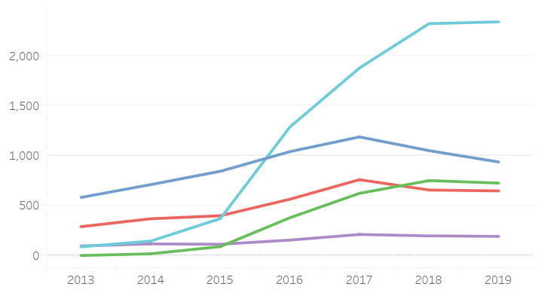
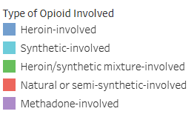
Illinois Mortality by Type of Opioid
Mortality
Year
https://idph.illinois.gov/OpioidDataDashboard/

Slide 28
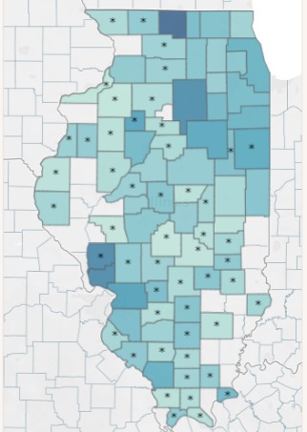
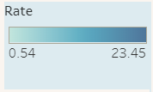
Illinois Fatal Overdose Rate, 2018
https://idph.illinois.gov/OpioidDataDashboard/

Slide 29
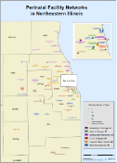
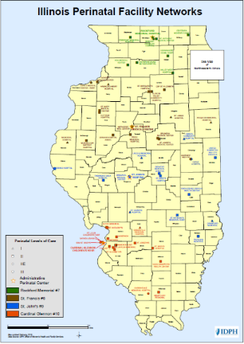
Key Strategies for Success
Across Perinatal Networks!
ILPQC partnered with perinatal network administrators to co-facilitate MNO-Neonatal Regional Strategies for Success sessions for almost all 10 Perinatal Networks!
Hospitals worked together to develop network-specific goals.

Slide 31
a look back: face-2-face Survey, May 2018

Slide 32
NAS Assessment Tools, 2018
Notes:
The next 5 slides demonstrate the observed variation in care.
This slide demonstrates assessment tool use:
91%of teams use Modified Finnegan scoring to assess OENs or newborns with NAS and 3% ESC.

Slide 33
Rooming-In After Maternal Discharge
2018
Notes:
This slide demonstrate rooming in practices after maternal discharge:
This findings illustrate a substantial barrier to non-pharmacologic care.

Slide 34
Engaging Mother & Family in Care of Opioid-Exposed Newborns
Notes:
This slide demonstrates hospital practices in engaging and partnering with mother and families:
We asked about the existence of standardized protocols and education for engaging mothers and families in the care of OENs and newborns with NAS.
62 percent of hospitals citied no protocols and education for prenatal consults, 40% had none for discharge planning, and 60% cited none for the care of newborns with NAS.

Slide 35
Breastfeeding Contraindications
Notes:
This last slide demonstrates attitudes regarding breastfeeding of OENs or newborns with NAS.

Slide 36
MNO Barriers
Facilitating buy-in
Providing stigma and bias education
Accessing resources to facilitate rooming-in
Changing culture with a limited patient population
Notes:
We asked, What are the “Biggest barriers your hospital team currently faces in implementing the MNO-Neo Initiative?”

Slide 37

MNO 2018-2020 Topics
Notes:
How to get mothers more engaged in the care of the newborn with NAS
How to implement Eat-Sleep-Console
Wanting to know successes/failures from other teams through sharing resources
How rooming in is being handled by other organizations
Additional stigma & bias training resources
How DCFS involvement works in these cases
Have education created for staff (grand rounds)
Q&A sessions while implementing

Slide 38

MNO Team Calls
Notes:
Learning from guest speakers and other hospitals who have already implemented M NO in their state
Camaraderie, openness, sharing
Sharing of information
Team talks
Sharing the data

Slide 39
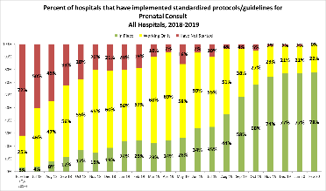
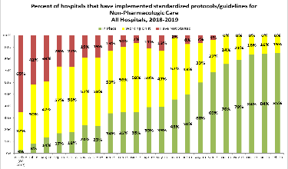
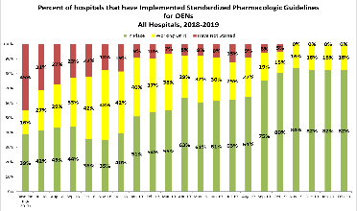
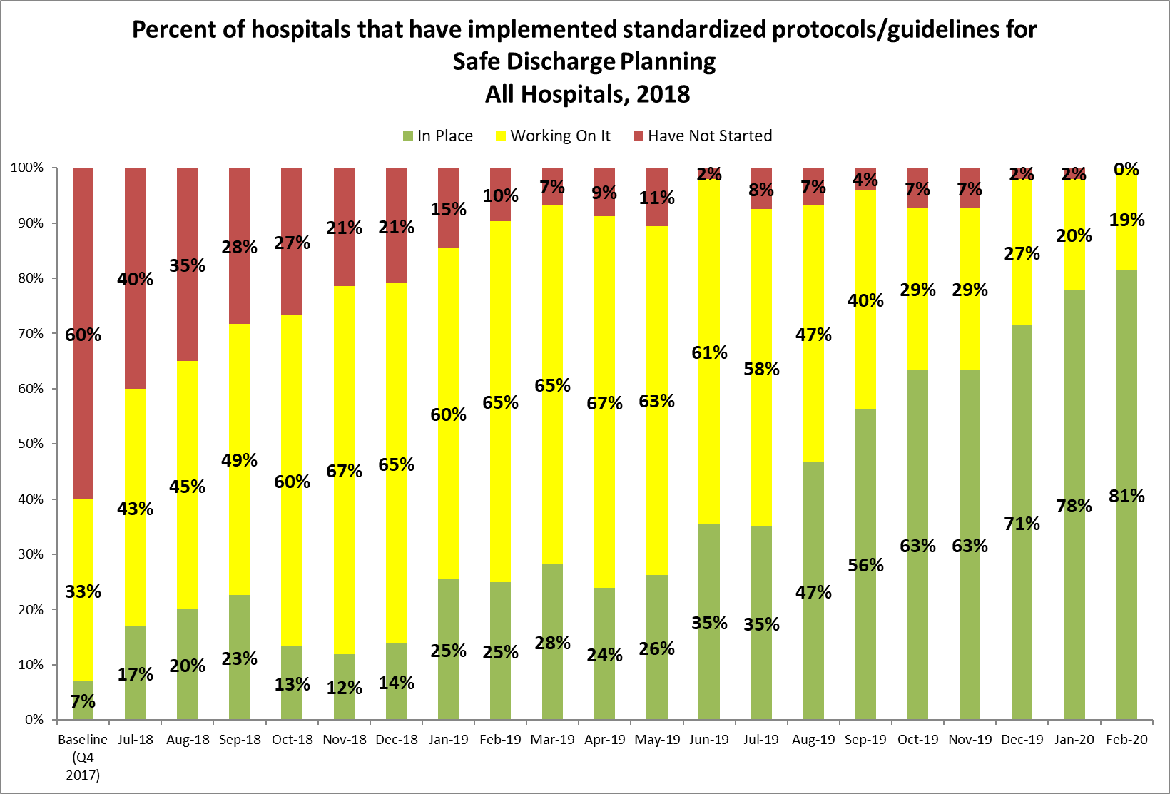
Strong Foundations for Success:
MNO Structure Measures in Place!
86% of teams have a prenatal consult protocol in place
86% of teams have a non-pharm protocol in place
90% of teams have a pharm protocol in place
89% of teams have a discharge protocol in place

Slide 40

What’s Next:
Crossing the Finish Line
Ensure all Structure Measures are ‘In Place’ to sustain the gains, especially during COVID-19!
Implement Four Key MNO-Neonatal Strategies
Work to achieve initiative AIMs
Implement standardized education for providers & nurses
Share materials/tools with community pediatricians

Slide 41


Achieving MNO-OB AIMs!
Medication Assisted Treatment
During Quarter 4, 2018 (Baseline)…
As of Quarter 1, 2020…
Only 4 out of 10 women with OUD were connected to MAT prenatally or by delivery discharge (41%)
Around 8 out of 10 women with OUD were connected to MAT prenatally or by delivery discharge (75%)
Notes:
Quarter, Region, Level, birth volume,

Slide 42


Improving Together:
Rooming-In after Maternal Discharge
During Quarter 4, 2018 (Baseline)…
As of Quarter 1, 2020…
Around 3 out of 10 women with OUD roomed in with their newborn after maternal discharge (35%)
Around 5 out of 10 women with OUD roomed in with their newborn after maternal discharge (56%)
Notes:
Quarter, Region, Level, birth volume,

Slide 43
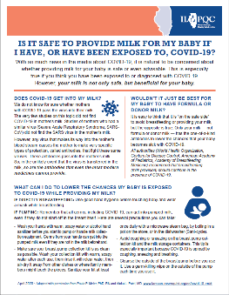
Achieving MNO-Neo AIMs Together:
Receiving Maternal Breast Milk at Infant Discharge
See https://ilpqc.org/covid-19-information/ for resource to support BF during COVID-19
AIM = ≥ 70%

Slide 44
Achieving MNO-Neo AIMs Together: Received Pharmacologic Treatment
AIM = ≤ 20%

Slide 45


Days of Pharmacologic
Treatment Decreased
Quarter 4, 2018 (Baseline)
Quarter 1, 2020
Average length of pharmacologic treatment for OENs with NAS symptoms overall was 16.9 days
Average length of pharmacologic treatment for OENs with NAS symptoms overall was 9.5 days
Notes:
Quarter, Region, Level, birth volume,

Slide 46


Days of Pharmacologic Treatment:
Finnegan vs. Eat Sleep Console (ESC)
Quarter 1, 2020
Modified Finnegan
Quarter 1, 2020
Eat Sleep Console
Average length of pharmacologic treatment for OENs with NAS symptoms overall was 17.3 days
Average length of pharmacologic treatment for OENs with NAS symptoms overall was 4.6 days
Notes:
Quarter, Region, Level, birth volume,

Slide 47

Days of Pharmacologic Treatment:
Scheduled Opioid dosing vs. PRN Dosing
Quarter 1, 2020
Scheduled Dosing
Quarter 1, 2020
PRN Dosing
Average length of pharmacologic treatment for OENs with NAS symptoms overall was 16.5 days
Average length of pharmacologic treatment for OENs with NAS symptoms overall was 4.6 days
Notes:
Quarter, Region, Level, birth volume,

Slide 48

Achieving MNO-Neo AIMs Together: Discharged with a Coordinated Plan
See https://ilpqc.org/covid-19-information/ for resources to support discharge during COVID-19
AIM = ≥ 95%
Notes:
PDSA: May – July 2020
Defined a Coordinated Discharge - 44% of respondents to the 2019 ILPQC Face-to-Face Meeting poll identified “disagreement and/or lack of understanding about what are the key components of a coordinated discharge” as the biggest barrier to a coordinated discharge
Improved the Toolkit - Reviewed current materials in the toolkit and found opportunities to clarify definitions, identify community resources, and create tools help care teams partner with mothers and families to develop a coordinated discharge plan
Combined Efforts and Knowledge - Facilitated conversations with other state perinatal quality collaboratives and Illinois partners including the Illinois Departments of Public Health and Human Services to discuss strategies for hospital teams to achieve coordinated discharge
Created a Coordinated Discharge Mapping Document for hospital teams to map their local Early Intervention offices, local pediatricians, and additional community resources and a Coordinated Discharge Plan Worksheet to complete with every mother/baby dyad by infant discharge, facilitating warm handoffs
Disseminated Information - Created a collaborative learning webinar with all MNO-Neonatal teams in August 2019 to roll out the QI tools and strategies

Slide 49


Median Length of Stay for OENs with NAS Symptoms
During Quarter 4, 2018 (Baseline)…
As of Quarter 1, 2020…

Slide 50

As of May 2020 MNO-Neonatal teams have reported data on over 1,595
opioid-exposed newborns,
averaging 54 newborns per month

Slide 51
Collaborative Efforts to
Achieve Aims
We know what we need to do:
Achieve our goals for increasing coordinated discharge and decreasing pharmacologic treatment
Stabilize and sustain our improvement on maternal breastmilk

Slide 52
Collaborative Efforts to
Achieve Aims
How will we get there, together?
TODAY: Steal shamelessly form panel and storyboards
TOMORROW: Share seamlessly with your hospital QI team
ILPQC collaborative learning calls July and August with teams sharing how they achieved goals
ILPQC QI support 1:1 calls to develop 30-60-90 day plans driven by you hospital’s needs

Slide 53
Sustain the Gains:
Transition to Sustainability
Sustainability Plan- a roadmap for the QI team to outline a plan for ‘Sustaining the Gains,’ and documenting strategies to implement:
Team meetings
Compliance monitoring
Ongoing case reviews & clinical feedback
New Hire/Continuing Education
  ESC & Non-Pharmacologic treatment simulations, order folders
Updating mapping Coordinated Discharge Community Resources
Continued 1:1 ILPQC support for hospital teams
Quarterly ILPQC MNO-Neonatal sustainability calls (June, August 2020)

Slide 54
MNO-Neonatal 2020 Timeline
Summer 2020:
Work to implement key strategies, cross the finish line, and start to develop a sustainability plan
Fall & Winter 2020
Work to implement sustainability plan, ILPQC 1:1 QI Support for hospitals
2021:
Twice a year Sustainability check in Calls with Teams, implement sustainability plans
Notes:
Added 10/22/19

Slide 55

Updates on Babies
Antibiotic Stewardship Improvement Collaborative:
BASIC Initiative

Slide 56
BASIC Vision
ILPQC Hospitals, regardless of perinatal levels, will implement standardized system-wide guidelines, policies, and protocols
to provide appropriate antibiotics
to appropriate babies
for the appropriate length of time
Notes:
Added 10/22/19

Slide 57
Accomplishments since
November 2020
What we have
What we’ve done
Proven effective strategies from other PQCs
Draft aims and key driver diagram
Review of work by North Carolina, Tennessee, VON
4 BASIC clinical leadership meetings
Kick-off Planning Committee meeting in March 2020
Coming soon
Measures, data form, WAVE 1!

Slide 58
BASIC DRAFT SMART AIMs
DRAFT AIM: Decrease the number of babies >35 weeks exposed to antibiotics by 20% (absolute rate of 3%)
DRAFT AIM: Decrease the number of babies (all gestational ages) with any antibiotic continued past 36 hours from the initial dose despite a negative blood culture by 20% (absolute rate of 0.5%)
Notes:
Added 10/22/19

Slide 59
Notes:
Added 10/22/19

Slide 60
Developing an Initiative
Leadership, Advisors, Stakeholders, Patients/Families
Notes:
ILPQC facilitated the following QI strategies:
We supported the creation of multidisciplinary hospital-based QI teams,
Provided opportunities for collaborative learning across hospitals through in person events, and monthly web-based meetings
created a rapid response data system that allowed teams to track and compare their data
And maintained regular communication via newsletters and updated website
Importantly, we provided QI support to hospital teams through a toolkit, regional network meetings and QI coaching calls.

Slide 61
BASIC 2020 Timeline
June-July 2020:
Workgroup finalize AIMs, Measures, Data Form
Aug-Oct 2020:
Wave 1 tests data collection process
October 29, 2020
Statewide Launch
November 2020: Monthly webinars begin
Email Dweiss@northshore.org if interested in participating in Wave 1!
Notes:
Added 10/22/19

Slide 62
Thanks to our
CLINICAL LEADS
Kenny Kronforst, MD, MPH, MS, Lurie Children’s Hospital
Patrick Lyons, MD, Lurie Children’s Hospital
Sameer Patel, MD, MPH, Lurie Children’s Hospital
Sudhir Sriram, MD, University of Chicago

Slide 63
Thanks to our
WORKGROUP
Leslie Caldarelli
Justin Josephsen
Sameer Patel
Sudhir Sriram
Patrick Lyons
Matt Derrick
Preetha Prazad
Pooja Shah
Richard Kampanatkosol
Rajeev Kumar
Jeffrey George
Catherine Bennett
Tina Taub
Bretty Galley
Emily Obringer
Michael Tekippe
Christine Emmons
Cindy Mitchell
Pele Dina
Christina Pykett
Lisa Maloney
Corryn Greenwood
Tina Horsky
Alexandra "Alex" Lahart
Rohitkumar B Vasa
Kat Bulthuis
Marin Arnolds
Elizabeth Dobler
Christen Edwards
Rebecca Hunt
Amanda Schaefer
Shakir Mohamed
Brian McGinn
Phyllis Burgess
Mopelola Akintorin
Ashley Fischer
Email Dweiss@northshore.org if interested in participating in the BASIC Workgroup! Looking for community hospital input!

Slide 64















We are all in this together.
Thank you to ILPQC partners and collaborators:
Perinatal Advisory Committee
State Perinatal Quality Council
Maternal Mortality Review Committee
Regionalized Perinatal System

Slide 65
THANKS TO OUR
FUNDERS
Email info@ilpqc.org or visit us at www.ilpqc.org
Notes:
Updated 10/22/19

