Slide 1
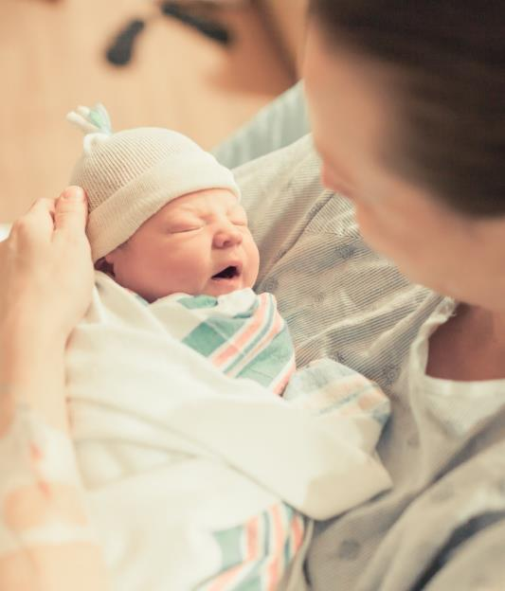
MNO-OB Sustainability Call
September 13th, 2021
12:30pm – 1:30pm

Slide 2
Call Overview
Introductions
Annual Conference
MNO-OB Finishing Strong and Preparing for Sustainability
Guest Speaker: Connections—Home Visiting, ILPQC Perinatal Care Providers, and PPW with Substance Use Disorder; Glendean Burton MPH, BSN, RN, CLC, CRADC (Inactive)
MNO-OB Learning Other Teams Plans for Sustainability

Slide 3
ILPQC 9th Annual Conference

Slide 4
Annual Conference Updates
ILPQC 2021 9th Annual Conference will be held virtually
OB Speakers confirmed
  PVB- Neel Shah, MD, MPP
  BE- Marilyn Kacica, MD, MPH
  Patient Stories- Wanda Irving
  State PQC Panel- New York, Oklahoma, Massachusetts
Registration opens this week. Be sure to check you MNO-OB Newsletter for more information.

Slide 5

Available here
We want to hear from you!
Share your teams thoughts & insights on the upcoming 2021 AC Team Survey

Slide 6
2021 Call for Abstract/Poster
Submission
All hospital teams are asked to submit an abstract on complete or in progress QI work
Abstracts submitted by Oct. 1st, will be reviewed for awards:
  Top abstract(s) in OB, Neonatal, Patient/Family Engagement, First time Level I/II Hospital receive Abstract of Excellence Awards
  Two OB & two Neonatal abstracts receive special recognition, one each for (1) Best Use of Data, (2) Best Project Implementation
Awarded abstracts will be announced at the conference and have a prize designation displayed on their poster
Late breaking abstracts (not eligible for awards) are due Oct 15th
Submission link available now
Check out your MNO-OBN newsletter for link
6

Slide 7
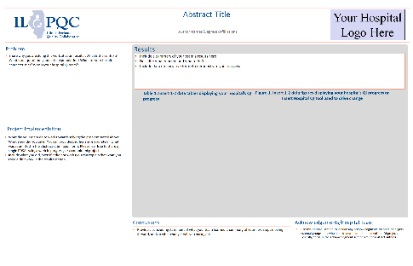

ILPQC is here to help!
ILPQC will be offering a variety of support services to assist with abstract/poster submissions
  Poster Template
  Mentorship Services
  FAQ Tool- to be released in initiative newsletters
  “After hours office hours” (Information + Q&A Sessions after team webinars)
Access the link to the poster template to when you submit your abstract

Slide 8

Annual Conference Awards
Due October 15, 2021
PVB & BASIC QI Awards:
  All data (baseline- Sept 2021) + progress on structure measures
BE Outstanding Launch Award:
  All data (baseline- Sept 2021) + readiness survey
MNO-OB QI Excellence Awards (plaque):
  Sustainability plan submitted + All data submitted through September 2021 + achievement of MAT, RTS, Narcan, and Prenatal Screening AIMs
MNO-Neo QI Excellence Awards (plaque):
  Sustainability plan submitted + All data submitted through September 2021 + achievement of Breastfeeding, Pharm treatment, and discharge AIMs

Slide 9
Mothers and Newborns affected by Opioids (MNO-OB)
Strategies to sustain optimal OUD care in 2021

Slide 10
New: Resource for Hospitals & Clinics to Access Narcan & Training
The Illinois Department of Human Services, Division of Substance Use Prevention and Recovery (IDHS/SUPR) manages the Drug Overdose Prevention Program (DOPP) to expand overdose education and naloxone distribution
Hospitals & Clinics can enroll in DOPP to access and distribute naloxone: https://www.dhs.state.il.us/page.aspx?item=58142
Share this link with hospitals in your network to begin the process to access Narcan: https://www.surveymonkey.com/r/HospitalsAccessNarcan

Slide 11
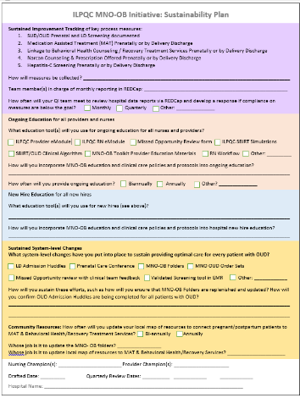
ILPQC MNO-OB & Neo Sustainability Plans
Goal is 100% of hospitals submit MNO Sustainability Plan to PNA’s & ILPQC
Only 45 (49%) of MNO-OB Teams have submitted a sustainability plan so far
  ILPQC held a MNO: Completing Your Sustainability Plan workshop on May 5th, you can review the recording here: https://northwestern.zoom.us/rec/share/OVP6GucS-8gzT0hmGoDQFeX_hGwC4ZvXNN3sAJxTWRP_cf13_iJSaWpw0mwN6BZs.jTBuqOTh-kC9y0ok
Illinois Perinatal Quality Collaborative

Slide 12
Sustainability Plan Submission Status by Network
Important for ALL hospitals to to submit a sustainability plan, very brief outline of how hospital will sustain optimal care for moms with OUD, regardless of where teams are in the initiative
All hospitals Please Submit!
U Chicago Network: 8/12 (67%)
Stroger Network: 1/3 (33%)
Northwestern Network: 11/12 (92%)
UIC Network: 3/6 (33%)
Loyola Network: 5/5 (100%)
Rush Network: 4/10 (40%)
Rockford Network: 4/9 (44%)
St. Francis Network: 4/11 (36%)
St. John’s Network: 2/13 (15%)
Cardinal Glennon Network: 6/10 (60%)
MNO-OB Sustainability Plan
MNO-Neonatal Sustainability Plan
Illinois Perinatal Quality Collaborative
Notes:
https://ilpqc.org/ILPQC%202020%2B/MNO-OB/MNO-OB%20Sustainability%20Plan_FINAL.docx
https://ilpqc.org/ILPQC%202020%2B/MNO-Neonatal/MNO-Neonatal%20Sustainability%20Plan_FINAL.docx

Slide 13
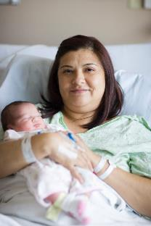
MNO-OB Initiative Aims: 101 hospital teams launched in 2018 to provide optimal perinatal OUD care
≥70%
BH/Recovery
Treatment
Services
≥80%
Universal Validated
OUD Screening
≥70%
Medication Assisted Treatment
Prenatal &
Labor & Delivery
≥70%
OUD Clinical Care
Checklist
≥80%
Patient Education
OUD/NAS
Narcan provided
Counseling/Materials
Hepatitis C screen
Neo/Peds Consult

Slide 14


MNO-OB Excellence Award Criteria for Optimal OUD Care
All Data Submitted
+
6 Structure Measures In Place (Prenatal Screening, L&D Screening, SBIRT, Mapping Resources, OUD Protocol, Patient Education)
+
All Process Measure goals met >70% MAT & Recovery Treatment Services; >60% Narcan Counseling; >50% Prenatal Screening
Submit Data by October 15th to qualify for an award!

Slide 15
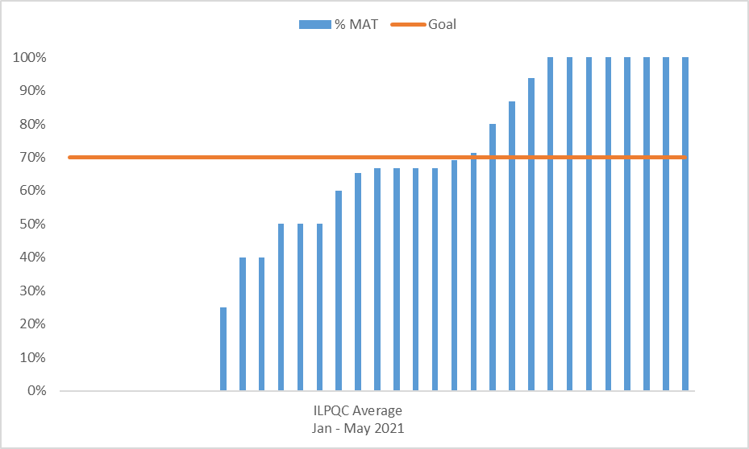
MAT by Delivery (Jan – May 2021)

Slide 16
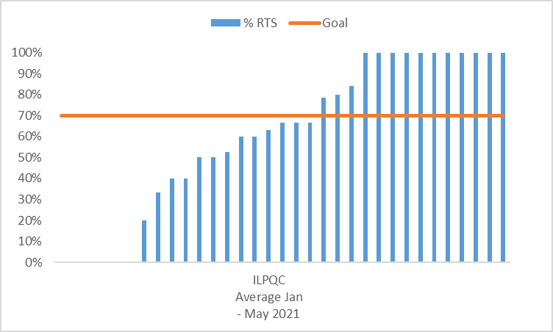
RTS by Delivery (Jan – May 2021)

Slide 17
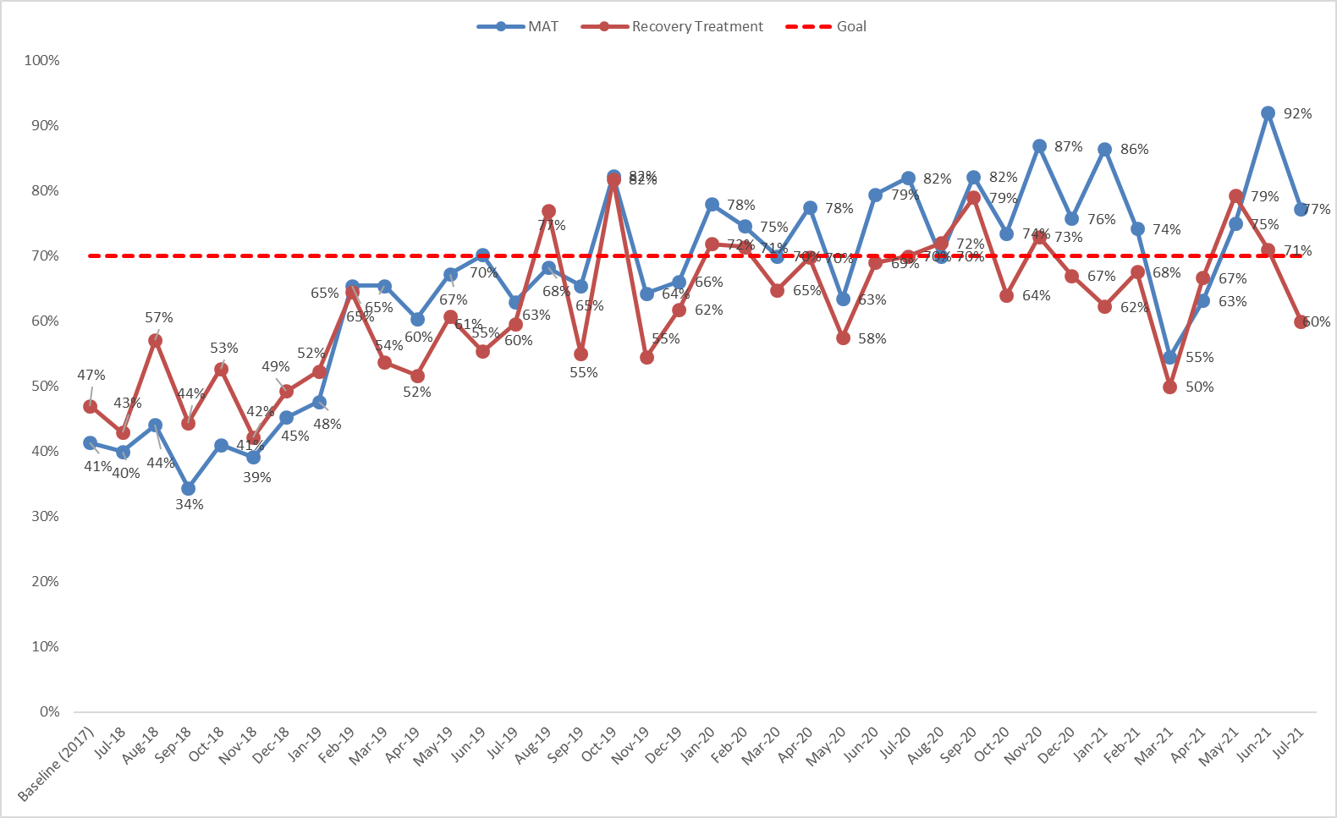
MAT & RTS by Delivery Discharge

Slide 18
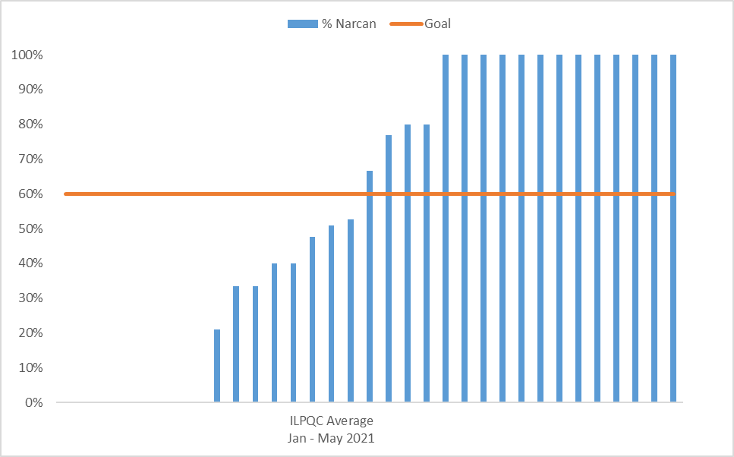
Narcan Counseling (Jan – May 2021)

Slide 19
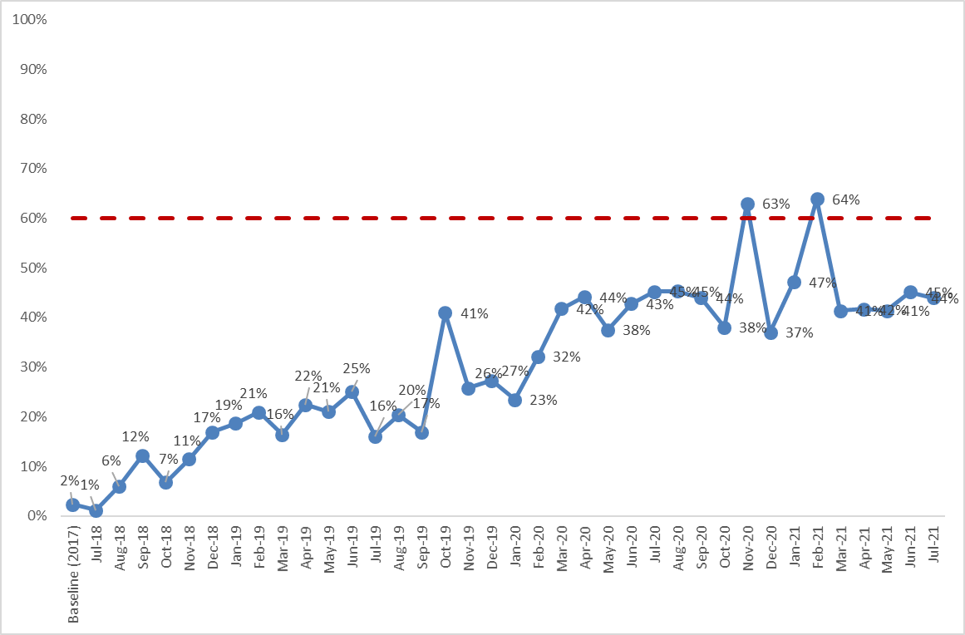
Narcan Counseling

Slide 20
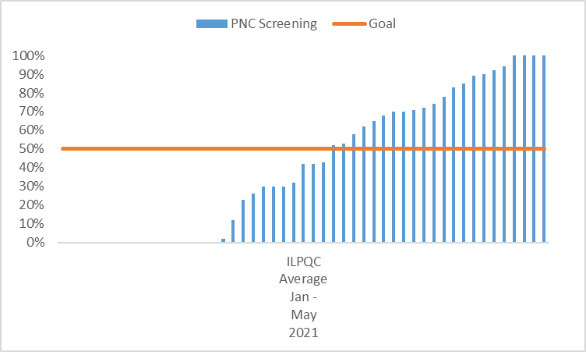
Prenatal Screening (Jan – May 2021)

Slide 21
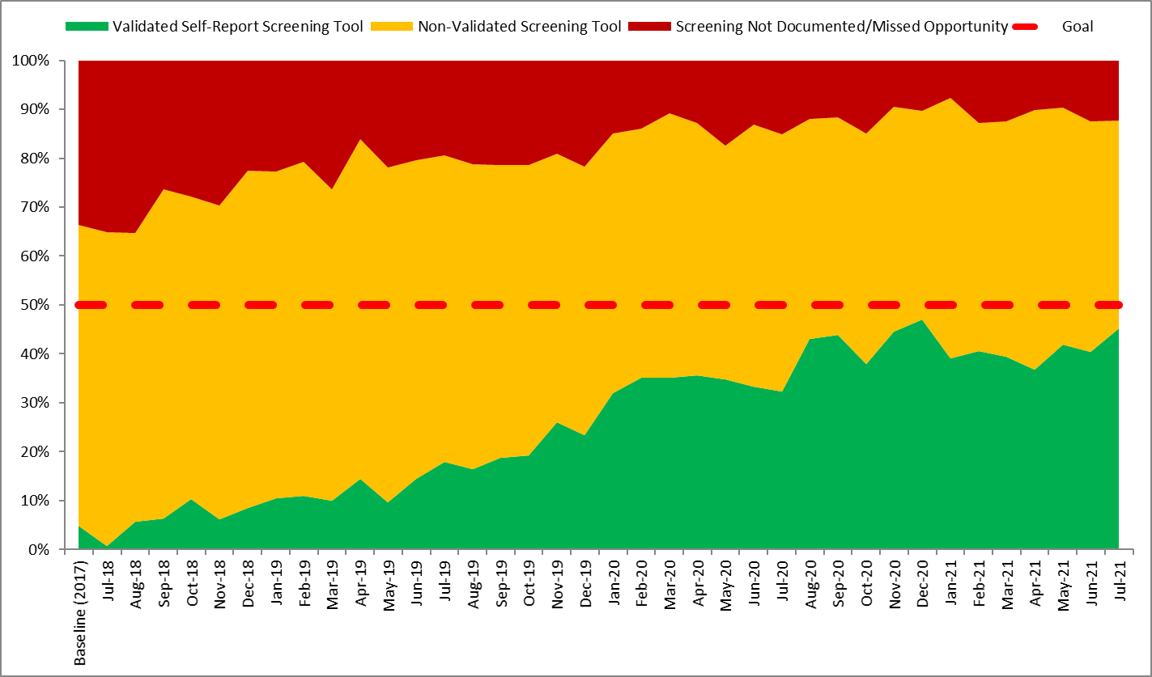
Prenatal Screening

Slide 22
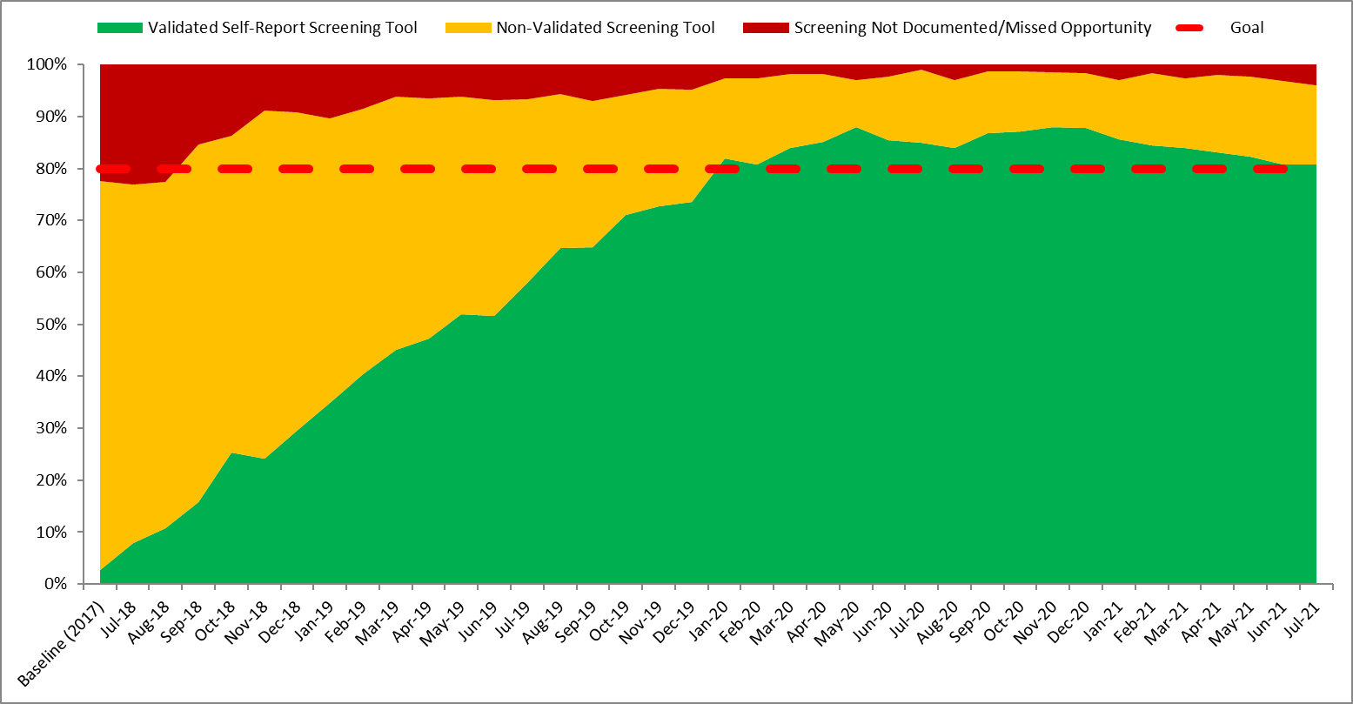
L&D Screening

Slide 23
Guest Speaker

Slide 24

Connections—Home Visiting, ILPQC Perinatal Care Providers, and PPW with Substance Use Disorder
Glendean Burton MPH, BSN, RN, CLC, CRADC (Inactive)

Slide 25
About Early Childhood in Illinois
Early Childhood Vision (Illinois Early Learning Council)
  We envision Illinois as a place where every young child – regardless of race, ethnicity, income, language, geography, ability, immigration status, or other circumstance – receives the strongest possible start to life so they grow up safe, healthy, happy, ready to succeed, and eager to learn..
Key Partners
  IDHS, DCFS, IDPH, ISBE, Head Start State Collaboration Office

Slide 26
About the Maternal, Infant, Early Childhood Home Visiting (MIECHV) Program
Funding
  HRSA
  $8.26M for Illinois in FFY20, overseen by IDHS
Goals
  strengthen and improve Title V programs and activities
  improve coordination of services for at-risk communities
  identify and provide comprehensive services to improve outcomes for eligible families who reside in at-risk communities.
Notes:
By way of brief background, starting in 2011, Illinois applied for and received funds from MIECHV (spell out), through HRSA and the Administration for Children and Families. The goals of MIECHV are to strengthen and improve Title V programs, improve coordination of services for at-risk communities, and provide comprehensive services to improve family outcomes, and we do this through evidence-based home visiting programs, which we’ll be talking about shortly.

Slide 27
Presentation Objectives
Increase understanding of home visiting (HV) services and their effectiveness
Review MCH outcomes that are shared by health care providers and Maternal, Infant, and Early Childhood Home Visiting (MIECHV) programs
Provide materials and procedures that ILPQC perinatal healthcare providers can share with staff, to refer PPW with SUD to local home visiting programs
Explore how home visiting can partner with ILPQC perinatal healthcare providers in the care of PPW with SUD and their babies

Slide 28
Presentation Outline
What is home visiting?
Social determinants of health
Priority populations
Health benchmarks
Evidence of effectiveness
HV models and training
Collaboration and referrals
Questions and discussion

Slide 29
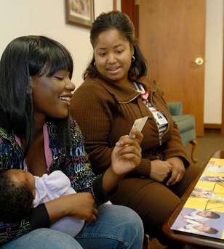

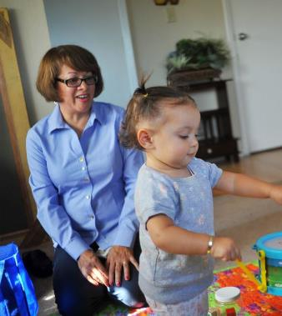
What is home visiting?
Notes:
Let’s get started: What comes to mind when you hear the term “home visiting?” (audience participation)
Home Visiting is NOT
Child welfare
Home safety inspections
Family Case Management

Slide 30
Home Visiting and SDOH
Addresses needs of families with young children related to the parent-child bond as well as access to care, safe housing, transportation, education, employment, food security, childcare, and intimate partner violence
Works to connect families to community resources, increase social support, and decrease personal isolation
Notes:
Evidence-based home visiting is a relationship-based program that aims to address the social determinants of health. Our programs help families with access to a wide range of resources and services to address early childhood development as well as comprehensive needs. Home visiting works to connect families to community resources and build their social supports.

Slide 31
Priority populations for home visiting
Families with teen parents
Families experiencing homelessness
Families in poverty or deep poverty (at or below 100% or 50% FPL)
Families with child welfare involvement
  Families of children with disabilities
  Families in which parents/caregivers are migrant or seasonal workers
Families in which parents/caregivers have low educational attainment
Families that face barriers based on culture, language, and religion
Families in which the parent has a disability
Families with refugee or asylee status
Families who face barriers due to immigration status
Notes:
These are some of the priority populations or target populations for home visiting: teen parents, families with young children experiencing homelessness, families in deep poverty, families with child welfare involvement, and so on. These are the families that we’d like to see receiving home visiting services, so that young children with risk factors can have a stronger start in life.

Slide 32
What is home visiting?
WHAT Family support and coaching
WHO By a trained professional
WHERE Through planned, regular visits to the home
WHEN Prenatally, through a child’s early years
Notes:
Home visiting provides family support and coaching through planned, regular visits with a trained professional based on a family’s needs. The home visits start prenatally and continues through a child’s early years. Most home visiting programs start with weekly visits, and some will move to a biweekly or monthly schedule at a designated point in time or based on the family’s needs.
Home visiting is a voluntary program, and home visitors work with parents on practical parenting skills as well as family bonding before birth and as children grow up. This is not a one-time service, but an ongoing relationship between families and trained home visitors.

Slide 33
What is home visiting?
High-quality, intensive services that do the following:
Promote positive parenting and child development, with education, screenings, monitoring and referrals
Support preventive pediatric health and prenatal care practices, including administration of routine periodic health screenings, linkage to community resources, and follow-up
Provide breastfeeding support and model desired infant care
Assists parents to set goals, continue education, find employment and overcome language barriers
On-going assessment of individual and family needs, with support, education, and linkage with services to address those needs
Notes:
Home visiting provides high quality, intensive services that address positive parenting and child development, supports preventive prenatal and pediatric health care, breastfeeding support, and works with parents to set and reach goals for their own advancement.

Slide 34
MIECHV Benchmark Domains
Improvement in maternal and newborn health
Reduction in child injuries, abuse, and neglect
Improved school readiness and achievement
Reduction in domestic violence
Improved family economic self-sufficiency
Improved coordination and referrals for other community resources and supports
Notes:
Here are the unified benchmark domains for MIECHV. As you can see, maternal and newborn health is at the top of this list. The other domains are child safety, school readiness, domestic violence, economic self-sufficiency, and coordination and referrals.

Slide 35
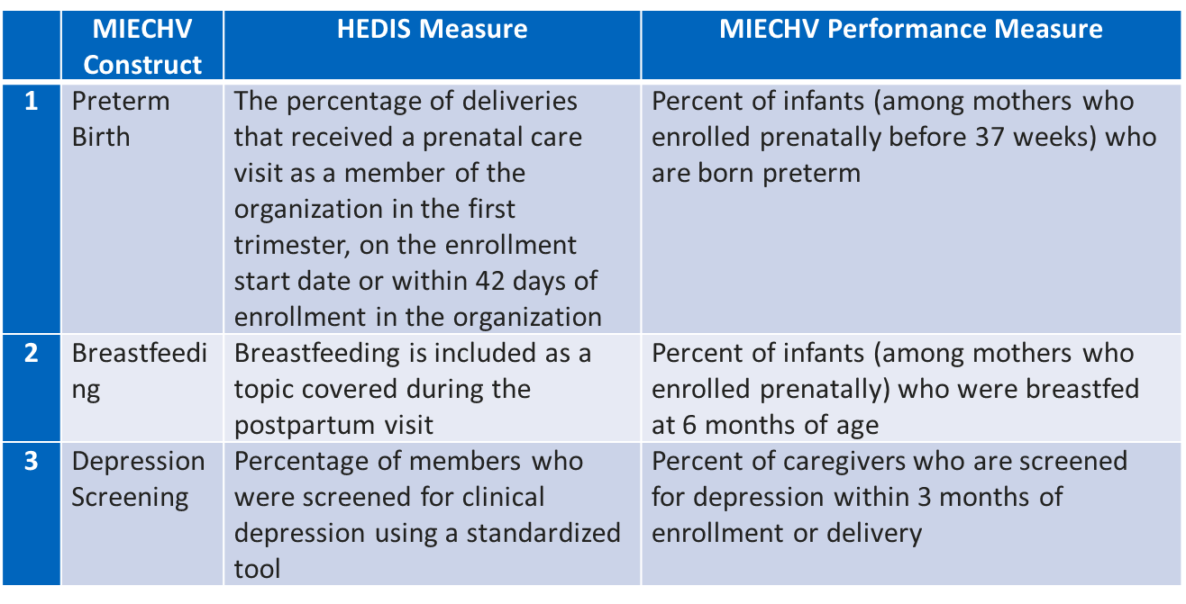
Sample of HEDIS and MIECHV Measures
Improvement in maternal and newborn health

Slide 36
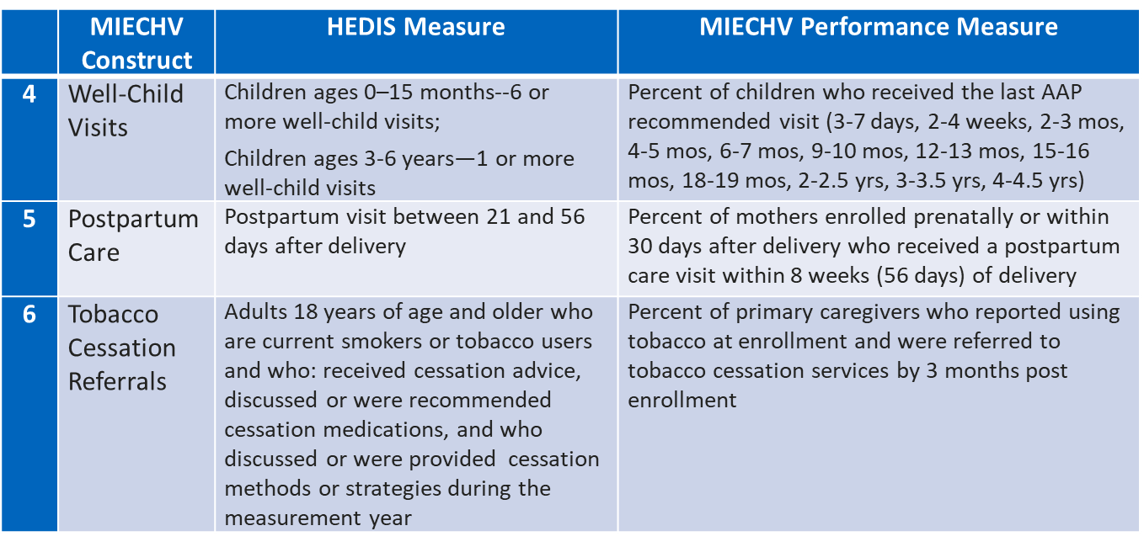
Sample of HEDIS and MIECHV Measures
Improvement in maternal and newborn health

Slide 37
Illinois MIECHV Data Highlights (FFY20)
13% preterm births
28% of babies were fed breastmilk at 6 months of age
86% of new enrollees were screened for depression within 3 months of enrollment
59% received their most recent well-child visit on schedule
66% of birthing parents received postpartum care within 8 weeks of delivery
59% of parents reporting tobacco use received a referral for tobacco cessation
69% of parents report using safe sleep practices
Notes:
Here are some of the performance measures and how we did in federal FY 2020. Please note that the data have been impacted by the pandemic.
We should note that not all home visiting programs have MIECHV funding and so not all of them are measuring these benchmarks.

Slide 38
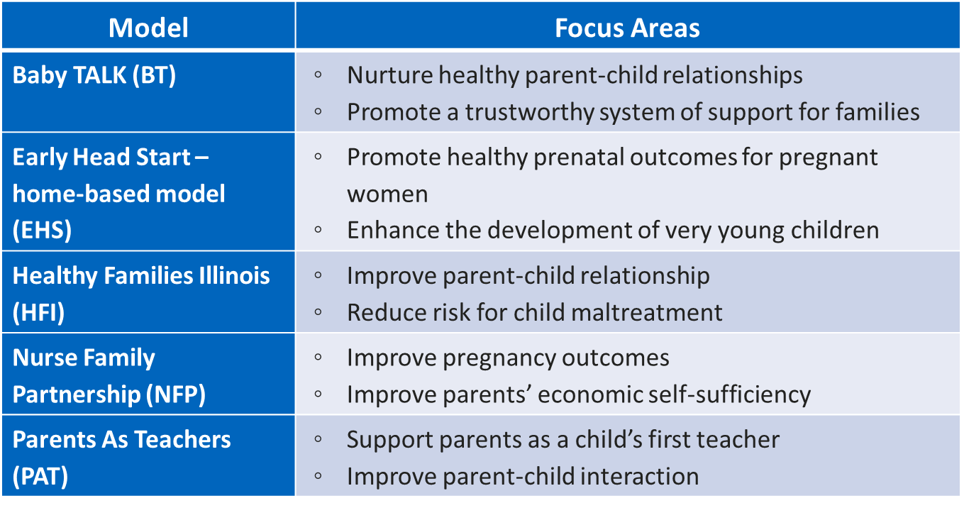
Major Home Visiting Models in Illinois
Notes:
There are 18 home visiting models which meet HRSA’s criteria for being evidence-based. Here are the five major models used in Illinois. These models use different curricula, and all focus on building parent-child attachment, developmental screening and supports, and connecting families with resources.
The frequency of home visits also varies slightly by model. In almost all cases, they start with weekly visits. Some models transition to biweekly or monthly visits after a defined period of time or based on the circumstances of the family.
Each model can enroll families prenatally, and they each have defined eligibility criteria.
You can visit the HOMVEE website for more information about each model and their evidence of effectiveness.

Slide 39
Home Visitor Training and Supports
Estimated 80-100 hours of training
  Core training
    HV model training (curriculum and approach)
    Infant and child development and developmental screening
  Advanced training may include
    Intimate partner violence (Futures Without Violence)
    Maternal depression (Mothers and Babies)
    Substance use (4P’s Plus)
Supervision
  Reflective supervision
  Infant/ EC Mental Health Consultation
Notes:
Home visitors come into the field with a variety of educational backgrounds. All home visitors must successfully complete core training that is specific to their home visiting model, and they also receive training on infant and child development. We are working to expand the reach of our advanced trainings on topics such as intimate partner violence, maternal depression, and substance use.
Reflective supervision is a form of ongoing professional development for home visitors that is distinct from administrative supervision and clinical supervision, because it involves intentional exploration of the parallel process, that is, attention to all of the relationships involved, including the relationships between home visitor and supervisor, between home visitor and parent, and between parent and infant/toddler. Reflective supervision supports professional and personal development of home visitors by attending to the emotional content of their work and how their reactions to the content affect their work.
In addition to reflective supervision, a growing number of home visiting programs also utilize Infant and Early Childhood Mental Health Consultation, which works with the supervisor and home visitor to build capacity and skills around mental health.
So home visitors receive a significant amount of training and supervision before starting their work in the field.
(In Illinois MIECHV, for example, less than 10% of home visitors had just a high school diploma, 16% had an associate’s degree, 58% had a bachelor’s degree, and 16% had an advanced degree.)

Slide 40
MIECHV Coordinated Intake Communities
Chicago Southside Cluster (Englewood, West Englewood, Greater Grand Crossing)
Cicero
East St. Louis
Elgin
Rockford
DeKalb County
Kankakee County
Lake County
Macon County
McLean-Piatt-DeWitt-Woodford Counties
Peoria-Tazewell Counties
Stephenson County
Vermilion County
Notes:
MIECHV funds currently support coordinated intake in 13 communities, which are listed here.

Slide 41

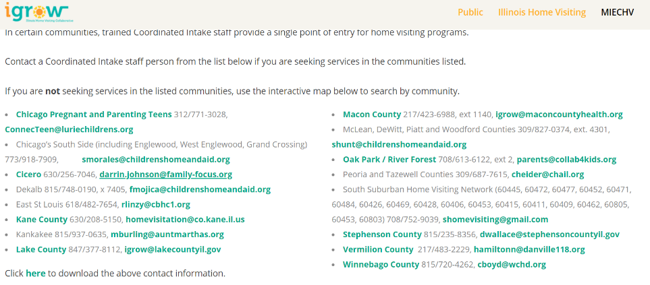
MIECHV Coordinated Intake Communities
http://www.igrowillinois.org/find-a-program/
Notes:
On the igrowillinois website, you can find the contact person for each coordinated intake community. To make a referral to these communities, simply contact coordinated intake staff and they will speak with the family to collect some basic information and to make a referral that best fits their situation.

Slide 42
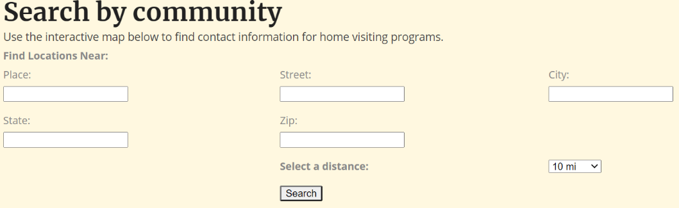
Referrals to Home Visiting in Communities without Coordinated Intake
http://www.igrowillinois.org/find-a-program/
Notes:
Most communities do not have a coordinated intake system. For these communities, you can search for the nearest home visiting program on the iGrowIllinois website and it will pull up their contact information. Here you see a screenshot of the search page on the igrowIllinois website.

Slide 43
Next Steps: Strengthening Connections
  Share igrow (MIECHV) information and our contact information with your staff and families
  Explore how we can better partner with ILPQC perinatal healthcare providers
  Identify tools/skills/knowledge Home Visitors need, in order to work more effectively with families experiencing substance use disorders.
  Establish a system of referral and care that supports the woman and her newborn, reduces risk for both, effectively promotes health and well-being, and is bi-directional in approach

Slide 44
Thank you!
Glendean Burton, RN, BSN, CLC, MPH
  MIECHV MCH Nurse Consultant
  Glendean.Burton@hotmail.com
  Joanna Su, MSW
  Manager of Strategic Planning, MIECHV
  Joanna.Su@Illinois.gov

Slide 45
MNO-OB Learning:
Team Talks Sharing Plans for Sustainability

Slide 46
MNO-OB Learning:
Team Talks Sustainability Strategies
University of Chicago Medical Center
Memorial Hospital- Carbondale

Slide 47
MNO Sustainability Plan at Uchicago Medicine
Presented by:
Dr. Andrew Fisher
Anna Marzano, RN

Slide 48
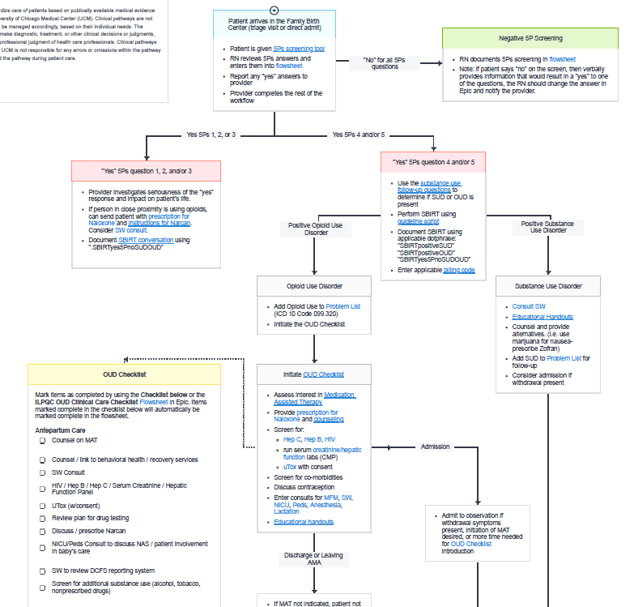
Sustainability Plans
Standardized new hire education as part of orientation process
Resources available for staff and patients in electronic form on unit SharePoint site
Recurrent “Grand Rounds” and educational opportunities for RNs and residents
September – OUD Awareness Month educational series
AgileMD Epic Pathway with OUD Checklist and links to resource documents
Monthly data reviews via Epic report and chart audit
  Sent to committee for oversight
  Missed Opportunities reviewed during monthly Whitesheet/M&M conferences

Slide 49
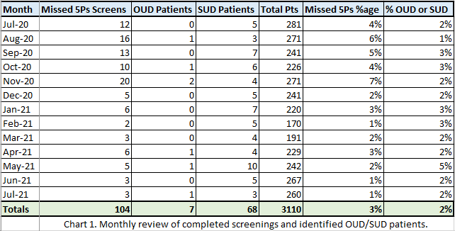
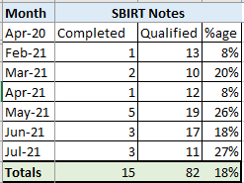
Data Review – OUD/SUD Cases, 5Ps Screening, SBIRT Notes

Slide 50
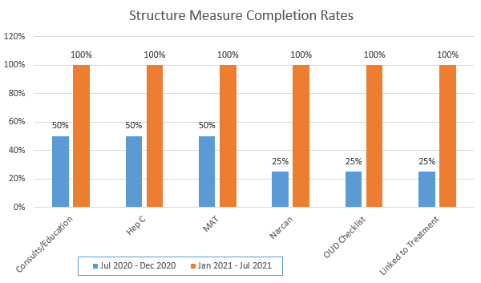
Data Review – Structure Measures
FY 2020 vs. FY 2021

Slide 51
Next Steps
Review auditing process for outpatient screening
Improve access to free Narcan for clinic and hospital sites
Collect patient feedback on prenatal care and delivery experience via interview
Link AgileMD Epic Pathway directly to qualifying patient chart as visual cue to complete tasks throughout pregnancy episode and delivery admission

Slide 52

MNO-ob sustainabilty
Memorial Hospital of Carbondale
Jessica Duncan RN
Stephanie Little RN,BSN
Sherry Jones MD

Slide 53

Sustained tracking of key process measures
SUD/OUD prenatal and L&D screening documentation
Linkage to MAT prenatally or by delivery discharge
Linkage to behavioral health/recovery treatment services prenatally or by delivery discharge
Narcan counseling and prescription offered prenatally or by delivery discharge
Hepatitis C screening prenatally or by delivery discharge
  OUD cases identified through EPIC reports
  Chart review and data entry into RedCap
  QI team (nurse and physician champions, case management, IT, lactation, patient navigator, and discharge coordinator) meets monthly to review missed opportunities.

Slide 54
Mno-ob sustainablitiy
Keys to Success
What’s Next?
MNO-OB folders delivered to Prenatal Clinics
System-wide implementation of 5Ps screening tool (with education provided to ED staff)
5Ps and OUD checklist integrated into Epic
Community resources updated annually
Ongoing and New-Hire education
Collaboration with system Pain Management/OUD Review Committee
Implementation of MNO-OB folders on unit
LD admission huddles

Slide 55
Questions

Slide 56


What Comes Next? Sustain in 2021
Continue compliance monitoring to achieve optimal OUD care
Sustainability Plan
Compliance Monitoring
Work with your team to complete and
implement your sustainability plan-
Or submit your plan if you haven’t yet.
New Hire Education
Attend MNO Sustainability webinars in
2021 to learn and share strategies with other IL hospitals
Continuing Education
ILPQC will provide QI support to teams not yet achieving AIMs
Systems Changes
Illinois Perinatal Quality Collaborative
29

Slide 57
MNO-OB Sustainability Webinars
Date | Topic
December 13th, 2021 12:30-1:30pm | MNO-OB Initiative Sustainability Call

Slide 58


Opportunity for every hospital team
Nominate OB / Neo QI champions for a FREE Certificate in Quality Improvement Science
ILPQC is offering hospital teams access to IHI Open School, a free opportunity to asynchronously complete over 13 continuing education hours!
Access stated June 2021 but people can complete the certificate over two years.
Please complete the IHI Open School inquiry form to designate a specific number of members across OB & Neonatal QI initiatives at your hospital.
Pump up your Quality Improvement skills!
Fill out this link with your team TODAY!
https://redcap.healthlnk.org/surveys/?s=RN9D4H9AMD

Slide 59












Thanks to our Funders
In kind support:

