Slide 1

MNO-OB Active Initiative
Crossing the Finish Line
September 28, 2020
12:30 – 1:30pm

Slide 2
REGISTER TODAY!
Notes:
Ieshia updated 9/11/2020

Slide 3
8:00-8:10 | Welcome
8:10-9:00 | ILPQC Stronger Together: Celebrating Success with MNO-OB, MNO-Neo, IPLARC and IPAC; Launching PVB, BASIC, and Birth Equity– Ann Borders with Leslie Caldarelli and Justin Josephsen
9:00-9:45 | Supporting Vaginal Birth: Lessons Learned from CMQCC- Dr. David LaGrew
9:45-9:50 | Break
9:50-10:35 | Antibiotic Stewardship for the Newborn Population: Ample Opportunities for Improvement- Dr. Dmitry Dukhovny
10:35-11:30 | Leveraging QI Success in Other States: Leaders from State Perinatal Quality Collaboratives Discuss Key Initiatives- Dr. Susan Hwang (Colorado), Charlene Collier (Mississippi) & Brenda Barker (Tennessee)
11:30-11:45 | ILPQC Award Ceremony
11:45-12:45 | Lunch and Poster Session
12:45-1:30 | Integrating Equity into Quality Improvement: Lessons Learned form LAPQC- Dr. Veronica Gillispie-Bell
1:30-2:15 | Listening to Patients: The Importance of Integrating Patient Perspectives for Optimal Quality Improvement- Kristen Terlizzi, and LaToshia Rouse
2:15-2:30 | Break
2:30 – 4:00 | Hot Topics in Obstetric QI: Crossing the Finish Line and Successful Sustainability for MNO-OB; Promoting Vaginal Birth Deep Dive; and Looking ahead to Birth Equity in 2021- Ann Borders with expert panel Neonatal QI: Finding the Balance: Moving the MNO Initiative to Sustainability while Successfully Launching BASIC in QI Partnership with Patients and Families – Leslie Caldarelli and Justin Josephsen with expert panel Improving Outcomes Through Patient Engagement – LaToshia Rouse with Kristen Terlizzi
4:00 – 4:15 | Wrap-up & Evaluation

Slide 4

5 Steps to Get Ready for the
ILPQC 8th Annual Conference
Register online
Submit abstract
Complete Survey
Submit Data
Hospital Slide
Click here and Register today!
Held Virtually Thursday, October 29th, 2020
Conference will be from 8am-4:15pm
1.
Submit poster session abstract here by October 9th to be considered for an award-Late-breaking abstracts due Oct 23rd
Please email your poster to info@ilpqc.org by Oct. 23rd to be displayed
2.
Coordinate with your colleagues working across initiatives to have one person from your hospital submit the survey- sent in the newsletter
Complete by Oct. 16th
3.
Please submit all outstanding data thru Sept. 2020 by Oct. 16th
4.
Please upload your team photo/slide collage via the AC survey or email to info@ilpqc.org by Oct. 16th
5.

Slide 5
Annual OB Teams Survey
OB Teams Survey sent
  Please coordinate with your colleagues working across ILPQC initiatives at your hospital to have one person submit the survey for your hospital
Survey link: https://redcap.healthlnk.org/surveys/?s=CNDEKNNXTF, and will be sent in newsletter
Option to upload your team photo/slide collage in the survey
Due to ILPQC on October 16th

Slide 6
Call for Abstracts for AC Poster Session
All hospital teams are asked to submit an abstract on complete or in progress quality improvement work
Abstracts submitted by Oct. 9th , will be reviewed for awards:
  Top abstract(s) in OB, Neonatal, Patient/Family Engagement, First time Level I/II Hospital receive Abstract of Excellence Awards
  Two OB & two Neonatal abstracts receive special recognition, one each for (1) Best Use of Data, (2) Best Project Implementation
Awarded abstracts will be announced at the conference and have a prize designation displayed on their poster
Late breaking abstracts (not eligible for awards) are due Oct 23rd
Submit: https://redcap.healthlnk.org/surveys/?s=RRXFCDL44H
A poster template will be provided and support is available from ILPQC.

Slide 7


Poster Session and Abstracts
Questions?
ILPQC offers a variety of support services to assist with abstract/poster submission
  Abstract and Poster Template
  Mentorship Services
  FAQ Tool
  Information + Q&A Sessions after team webinars
Expert abstract reviewers & past awardees will be available immediate following team calls starting 9/21
Please share your thoughts!

Slide 8


You are ILPQC!
ILPQC wants to celebrate all of you during our virtual conference!
Coordinate with your colleagues to create a slide celebrating your ILPQC team can include:
  Team/Hospital Picture
  Picture of QI bulletin board
  Location/Region
  Birth Volume/NICU Beds
  Perinatal Level and Network
  Current & Future Initiatives
  Contact information for your team for collaboration
All submissions will be entered to win a pizza lunch delivered to your hospital courtesy of ILPQC
Submit via upload with your ILPQC Teams survey or email to info@ilpqc.org

Slide 9
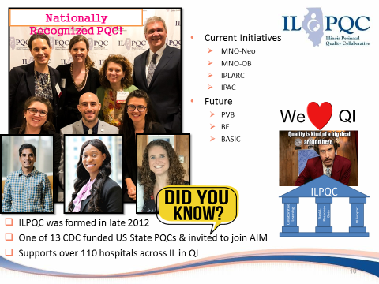


Sample submission
WIN
Pizza lunch delivered to your hospital
Submit your team slide through your AC survey or email to info@ilpqc.org

Slide 10
Hemorrhage and HTN continuing Education

Slide 11
Maternal Hypertension &
OB Hemorrhage continuing education requirement
To reduce maternal morbidity and mortality and build on current quality improvement efforts, I PROMOTE-IL and ILPQC support hospital efforts to provide ongoing education for managing obstetric hemorrhage and maternal hypertension, as specified in Public Act 101 0390.
There are several ways for birthing facilities to fulfill this annual training requirement, including e-modules, simulations, or drills from AIM, ACOG and other leading national groups available on the ilpqc.org website.
Notes:
Updated 9/25/20

Slide 12
Resources and Reporting at ilpqc.org
Please complete this form annually for your hospital to report training occurring in the calendar year by December 31st and annually thereafter. Hospitals should report the number of hospital staff and providers with admitting privileges who have met the obstetric hemorrhage and maternal hypertension training requirements.
This information will help hospitals track their training progress, identify areas for quality improvement initiatives, and will be used by I PROMOTE-IL and ILPQC to understand hospitals’ ability to complete the training requirement and identify opportunities to provide further support to hospitals towards our shared goal of improved maternal health across the state.
Notes:
Updated 9/25/20

Slide 13
MNO-OB: Data Review & Final Push

Slide 14

As of August 2020, 91 MNO-OB teams have reported data on over 2,323 pregnant/postpartum women with Opioid Use Disorder, averaging 61 women per month
Reported OUD screening data (L&D and prenatal) for 19,280 pregnant women

Slide 15
To be awarded at the 2020 ILPQC annual conference
MNO-OB Excellence Award
for Successful Completion of Key MNO AIMs
*All Data Submitted
+
6 Structure Measures In Place (Screening Prenatal, Screening L&D, SBIRT/OUD Protocol, Mapping, Checklist, Patient Education)
+
All Process Measure goals met** >70% MAT, >70% Recovery Treatment Services >60% Narcan, >70% Hep C >70% Patient Education, >50% Prenatal Screening
**Determined by Cumulative data for Quarter 3 (July - September) of 2020
*All Data Submitted for Baseline (Oct – Dec 2017) and July 2018 through September 2020
*MNO-OB Monthly Patient Data, Monthly OB Structure Measures, Monthly Sample of Documentation of Screening
    DATA DUE Friday, October 16th by MIDNIGHT

Slide 16
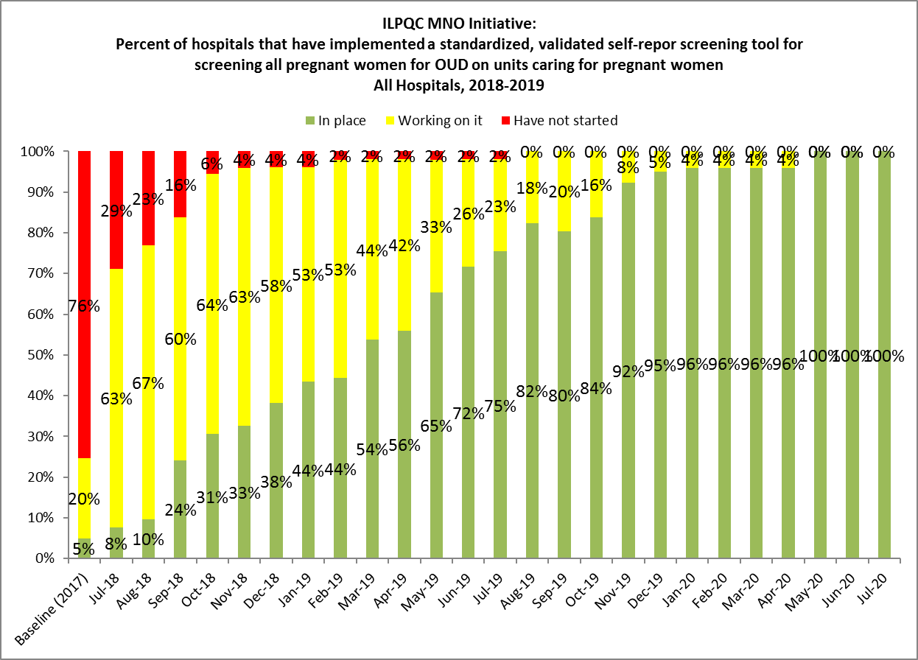
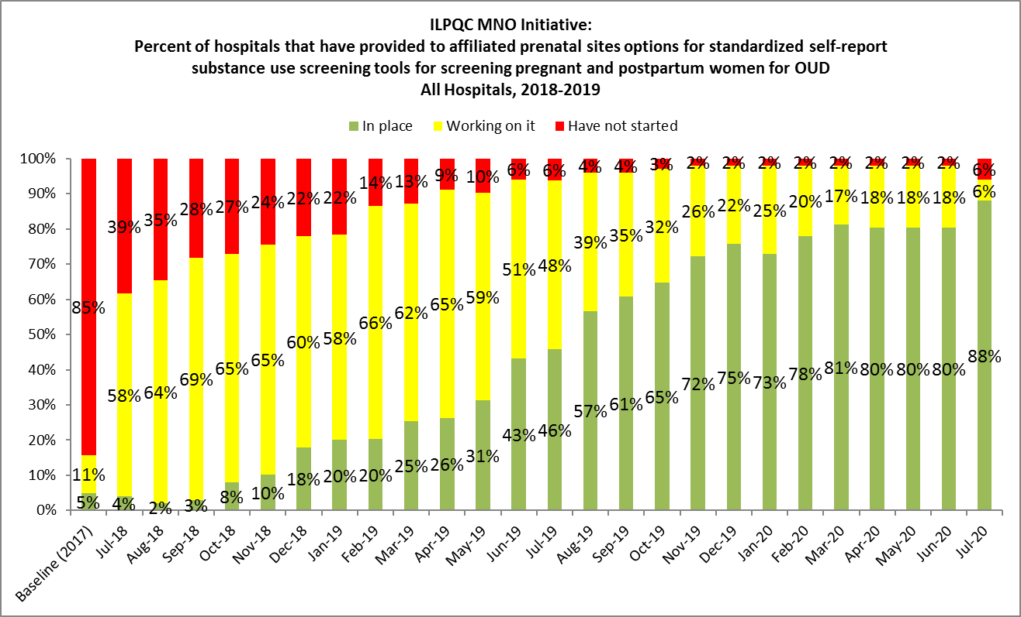
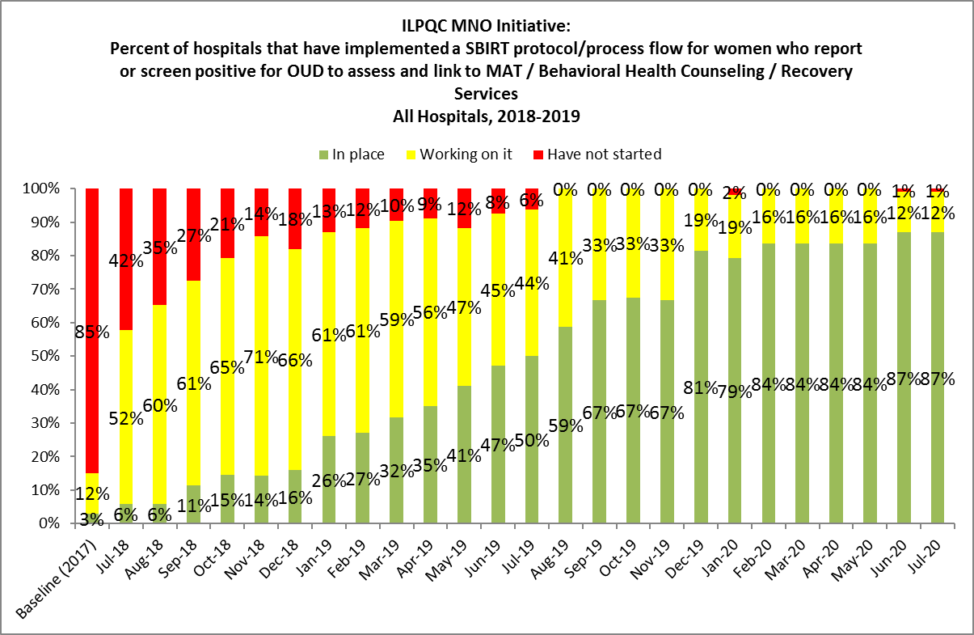
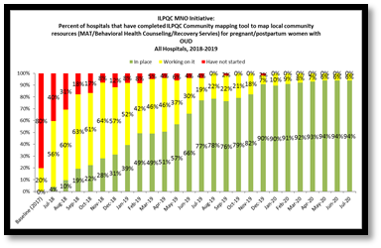
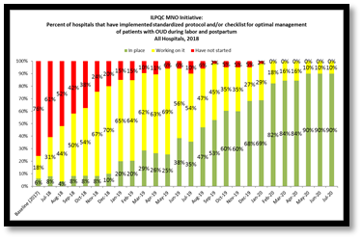
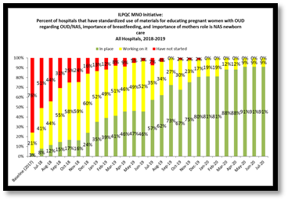
Making Systems Change Happen
100% of teams have a validated screening tool in place on L&D
90% of teams have a validated screening tool in place prenatally
90% of teams have a SBIRT protocol/algorithm in place on L&D
94% of teams have mapped community resources for women with OUD
90% of teams have implemented an OUD Clinical Care Checklist on L&D
91% of teams have implemented standardized patient education on L&D
Notes:
ONLY 40 TEAMS REPORTING…

Slide 17
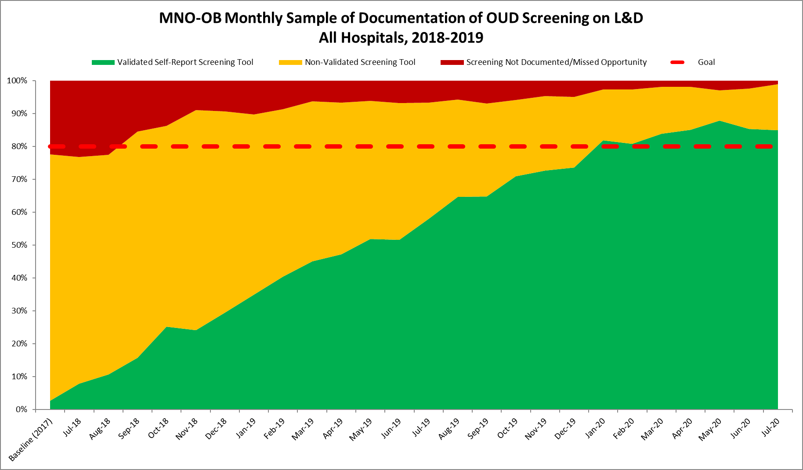
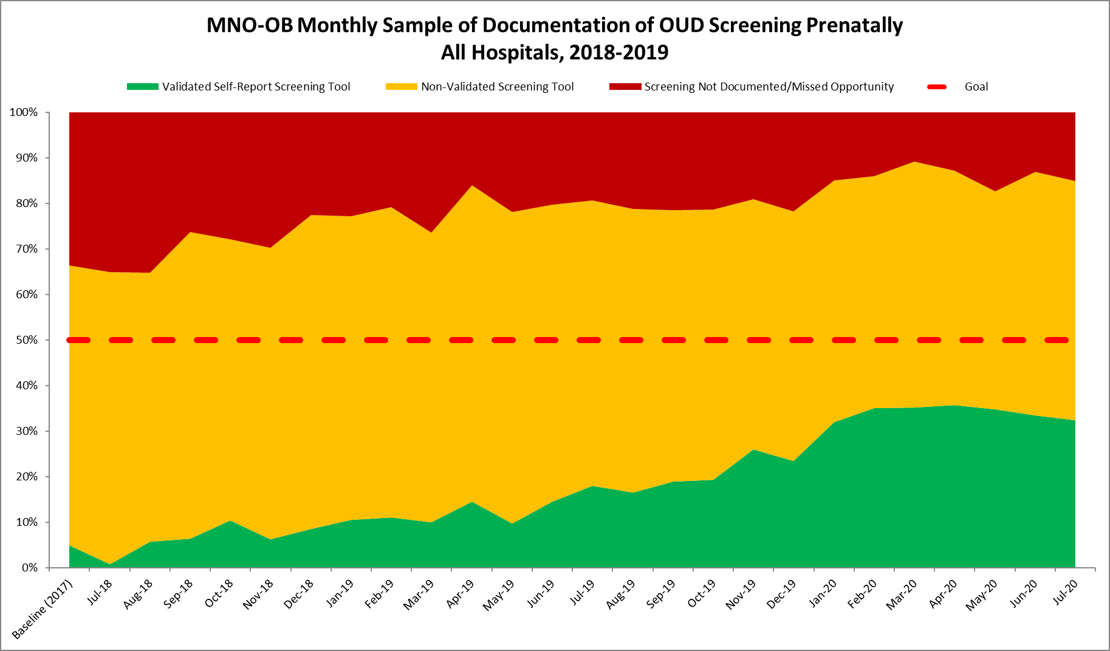
Documentation of Screening for SUD/OUD with Validated Tool
Random sample of 10 deliveries per month reviewed for documentation of SUD/OUD screening
N = 19,280 to date
85%
Prenatal
L&D
Red = No screening
Yellow = Screened single question
Green= Screened with validated SUD/OUD screening tool
32%
GOAL: ≥ 50%

Slide 18
Women with OUD on MAT by Delivery Discharge
Need all teams to push to assess readiness for MAT and achieve % on MAT before delivery discharge above 70%. We are almost there!!!
Goal = ≥ 70%

Slide 19
MAT Status for
Q2 (Apr-June) 2020
39 hospitals
124 patients with OUD
17 hospitals at or above the 70% MAT goal
70 patients with OUD
8 patients not connected to MAT
22 hospitals below the 70% MAT goal
54 patients with OUD
36 patients not connected to MAT
Notes:
Change goal line and update

Slide 20
Women with OUD Connected to Recovery Treatment Services by delivery
Way to go!!!
Goal ≥ 70%

Slide 21
Recovery Treatment Status
Q2 (Apr-Jun) 2020
39 hospitals
124 patients with OUD
18 hospitals at or above the 70% Recovery Tx Services goal
80 patients with OUD
6 patients not connected to Recovery Tx
21 hospitals below the 70% Recovery Tx Services goal
44 patients with OUD
20 patients not connected to Recovery TX
Notes:
Change goal line and update

Slide 22
Narcan Counseling & Documentation
Keep up the hard work!
Goal ≥ 60%

Slide 23
Narcan Status Q2 (Apr-Jun) 2020
39 hospitals
124 patients with OUD
9 hospitals at or above the 60% Recovery Tx Services goal
42 patients with OUD
10 patients not receiving Narcan counseling
30 hospitals below the 60% Recovery Tx Services goal
82 patients with OUD
38 patients not receiving Narcan counseling
Notes:
Change goal line and update

Slide 24
Hepatitis C Screen by delivery discharge
Way to go!!!
Goal = ≥ 70%

Slide 25
Patient education prenatally or by delivery discharge
Almost there, keep up the hard work!
Goal = ≥ 70%
Notes:
Change goal line and update

Slide 26
OB Provider & Nursing Education
Goal = ≥ 70%
Notes:
Change goal line and update

Slide 27
Optimal OUD Care
Screen all patients for OUD with validated screening tool prenatal and L&D
When patients screen + use MNO folder to activate OUD algorithm, complete OUD checklist and nursing workflow
Confirm optimal care provided
  L&D Huddle for all OUD patients on L&D to review MNO folder, and checklist, confirm optimal care elements provided
  Improve Narcan counseling: OUD order set, Narcan on formularly and Med to Bed program
  Prenatal care team conference for prenatal OUD patients identified to discuss optimal OUD care plan with OB/ neonatology/ nursing / SW.

Slide 28
National Guidance to Engage
OB Providers in Optimal OUD Care
Narcan/Naloxone: FDA Recommends that all healthcare professionals discuss Narcan/naloxone prescription with all patients with OUD and all patients on opioids (Link here).
Hepatitis C Screening: CDC & USPSTF recommend HCV screening for all adults, including pregnant and non-pregnant individuals (Link here).
Substance Use Screening: USPSTF recommends screening for adults 18 years or older, including pregnant and non-pregnant individuals for substance use Disorder with a validated verbal screening tool (Link here).
    Have you shared these national guidelines with your
    OB Providers?

Slide 29

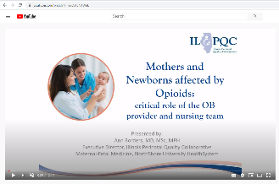

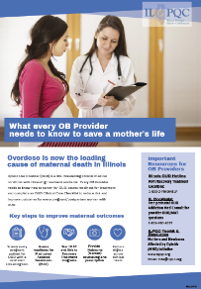



MNO Education for all OBs & RNs
Stigma & bias education
    Words Matter e-Module from ILPQC AC Conference
    CDC Opioid Use and Pregnancy e-Module
Implement stigma & bias education for all clinical staff
Provider & RN e-Modules
    MNO-OB Provider eModule
    MNO-OB Nursing eModule
Shares key strategies for caring for pregnant and postpartum women with OUD tailored to RNs & OB Providers
Post & distribute posters/flyers in clinical areas as well as share with outpatient prenatal sites
Provider & RN education campaign
    MNO-OB Education Flyers
SBIRT trainings to help equip providers in connecting patients to MAT & recovery treatment services when OUD patients are identified.
SBIRT Simulations Guide and e-training
    1hr SBIRT IRETA Training e-Module
    ACOG District II SBIRT Training 6 Min Video

Slide 30
Education Resources for
Teams
New hires should complete the MNO-OB eModules
Request Virtual Grand Rounds at info@ilpqc.org
Incorporate MNO-OB education into ongoing unit education
Post OUD/SBIRT Clinical Algorithm & OUD Clinical Care Checklist
Continue monthly Missed Opportunities Review or Real Time Huddles with feedback

Slide 31
MNO-OB Final Push
Submit and Review your MNO-OB data
Take action to improve prenatal validated OUD screening, and use systems to ensure optimal care for EVERY OUD patient prenatal / before delivery discharge every time
Determine what strategies your team needs to ensure your team can cross the MNO-OB finish line and achieve MNO aims.
Reach out to ILPQC for assistance to help you get there

Slide 32
Round Robin-
Abraham Lincoln Memorial Hospital
Advocate BroMenn Medical Center
Advocate Christ Medical Center
Advocate Condell Medical Center
Advocate Good Samaritan Hospital
Advocate Good Shepherd Hospital
Advocate Illinois Masonic Medical Center
Advocate Lutheran General Hospital
Advocate Sherman Hospital
Advocate South Suburban Hospital
Alton Memorial Hospital
AMITA Alexian Brothers Women’s and Children’s Hospital at St. Alexius
AMITA Health Adventist Glen Oaks Hospital
AMITA Health Adventist Medical Center - Bolingbrook
AMITA Health Adventist Medical Center Hinsdale
AMITA Health Alexian Brothers Medical Center
AMITA Health Saints Mary and Elizabeth Medical Center
AMITA Health St. Francis - Evanston
AMITA Health St. Joseph Hospital - Chicago
AMITA Health St. Mary's Hospital
AMITA Mercy Medical Center
AMITA Resurrection Medical Center
Anderson Hospital
Barnes-Jewish Hospital
Blessing Hospital
Carle Foundation Hospital
CGH Medical Center
Crawford Memorial Hospital
Decatur Memorial Hospital
Edward Hospital
Elmhurst Memorial Hospital
FHN Memorial Hospital
Galesburg Cottage Hospital
Gateway Regional Medical Center
Gibson Area Hospital
Graham Hospital

Slide 33
Round Robin- to share in Nov.
Highland Park Hospital
HSHS Holy Family Greenville
HSHS St. Elizabeth's Hospital
HSHS St. Francis Hospital - Litchfield
HSHS St. Mary's Hospital - Decatur
Illinois Valley Community Hospital
Ingalls Memorial Hospital
Iroquois Memorial Hospital
Javon Bea Hospital - Riverside
Katherine Shaw Bethea (KSB) Hospital
Little Company of Mary Hospital
Loyola University Medical Center
MacNeal Hospital
Memorial Belleville Hospital
Memorial Hospital Carthage Illinois
Memorial Hospital East
Memorial Hospital of Carbondale
Memorial Medical Center
Mercy Hospital & Medical Center - Chicago
Morris Hospital and Health Care Centers
Mount Sinai Hospital
NM Central DuPage Hospital
NM Delnor Hospital
NM Huntley Hospital
NM Kishwaukee Hospital
NM Lake Forest Hospital
NM McHenry Hospital
NorthShore University Health System - Evanston Hospital
Northwest Community Hospital
Northwestern Memorial Hospital
Norwegian American Hospital
OSF Healthcare Sacred Heart Medical Center
OSF Heart of Mary Medical Center
OSF St. Anthony Medical Center- Rockford
OSF St. Elizabeth Medical Center
OSF St. Francis Medical Center
OSF St. James - John W. Albrecht Medical Center

Slide 34

Upcoming Buprenorphine Waiver Training Opportunities
There are several available remote national trainings for ASAM Treatment of OUD Blended Courses for OB providers available via this link: https://www.asam.org/education/live-online-cme/waiver-qualifying-training/ob-gyn-focus
NEW: Moving Beyond the Barriers of Treating Opioid Use Disorder provides a deeper dive into implementing office-based treatment for opioid use disorder. This case-based, interactive, virtual-live course addresses moving beyond common barriers that prevent DEA-waivered clinicians from successfully treating patients with OUD. Common barriers related to implementing office-based treatment and patient care will be discussed, as well as how to address these barriers.

Slide 35
MNO-OB Regional Strategies for Success Meetings by Network
Team | Date | Team | Date
Northwestern Network | Completed (July 17, 2020) | St. Francis Network | September 2, 2020
UIC Network | September 18, 2020 | St. John’s Network | October 24, 2020
Loyola Network | September 8, 2020 | Stroger Network | Completed (August 19, 2020)
UChicago Network | Completed (August 18, 2020) | Rush Network | Being Scheduled
Cardinal Glennon Network | August 26, 2020 | Rockford Network | Being Scheduled
Notes:
Update

Slide 36
Upcoming MNO-OB Teams Calls
Date | Topic
September 28, 2020 | Sharing progress towards implementation of strategies to cross the finish line
October 2020 | No Teams Call… 2020 Annual Conference
Nov/Dec 2020 | Sustaining the Gains→ Preparing for Sustainability

Slide 37
Promoting vaginal birth
(PVB)

Slide 38
IDPH PVB Initiative Letter of Support for Hospital Leadership
Share this letter with your
OB Leadership today!
Download here

Slide 39


PVB Toolkit UPDATE
Roster forms available here
PVB Toolkits are currently being printed and will be shipped to teams on Oct. 1
Forgot to submit your roster? No worries, sign-up today to participate

Slide 40
PVB Timeline
June-Sept | Oct | Nov | Dec | Jan
MNO-OB | Annual Conference | ILPQC PVB Data Form Webinars | PVB team webinars start monthly and baseline data reporting (Oct-Dec 2019) begins | Monthly data reporting begins Baseline data reporting due
This means: October Annual Conference transition from MNO Active Phase to Sustainability and start of PVB data collection and monthly calls after Annual Conference in November 2020
Follow this link to submit your hospital’s PVB roster
https://redcap.healthlnk.org/surveys/?s=NF8MPDY9LF

Slide 41
Birth Equity

Slide 42
Birth Equity Initiative Update
Working with clinical leads to draft preliminary aims, drivers, and measures for Birth Equity Initiative to share at Annual Conference
Initial ideas in development for discussion include:
  Addressing social determinants of health during prenatal, delivery, and postpartum care to improve birth equity (e.g. Mapping resources, screening/referral tool)
  Utilize race/ethnicity medical record and quality data to improve birth equity (e.g. accurate race/ethnicity data collection, health measure dashboards, review of patient satisfaction data)
  Engage patients, birth partners, and communities to improve birth equity (e.g. patient advisor on QI team, engage doulas in care team, patient reported experience)
  Engage and educate providers and nurses to improve birth equity (implicit bias training, education on listening to patients, hiring strategies)
Wave 1 testing of data form in early 2021, launch in May 2021
Notes:
Ieshia updated 7/9/2020

Slide 43
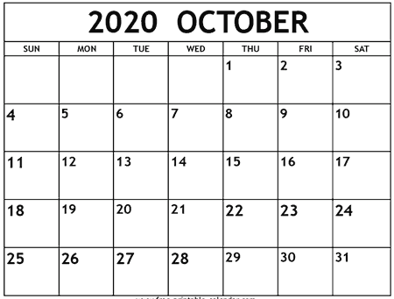

Abstract for awards due
AC Survey
Data submission
Hospital Slide
Late Breaking Abstracts due
Registration closes
ILPQC Annual Conference

Slide 44




THANKS TO OUR
FUNDERS
Email info@ilpqc.org or visit us at www.ilpqc.org

Slide 45
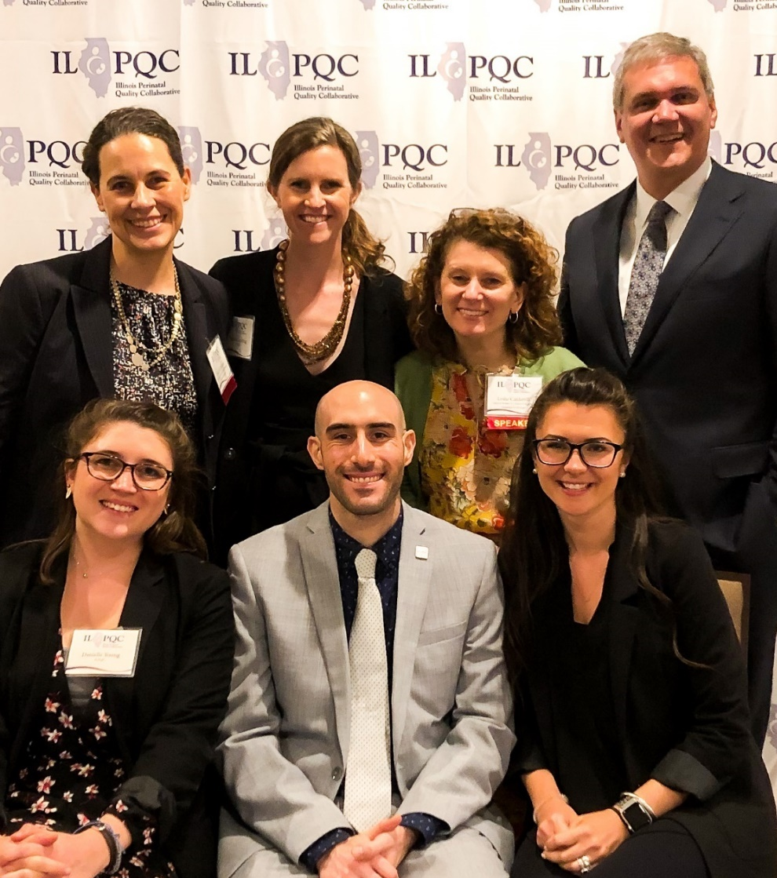



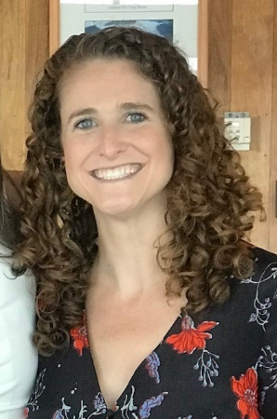


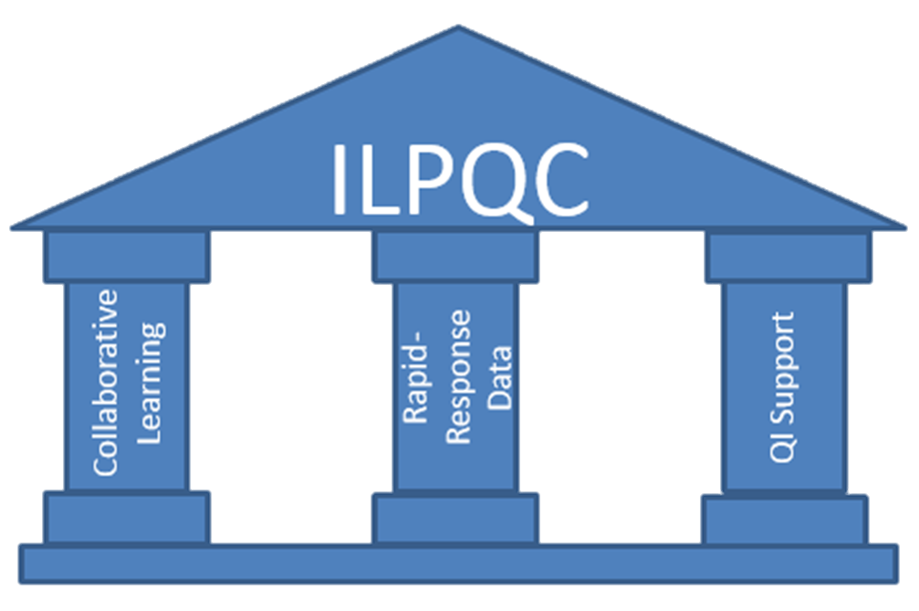
Nationally Recognized PQC!
Current Initiatives
  MNO-Neo
  MNO-OB
  IPLARC
  IPAC
Future
  PVB
  BE
  BASIC
We
QI
ILPQC was formed in late 2012
One of 13 CDC funded US State PQCs & invited to join AIM
Supports over 110 hospitals across IL in QI
Notes:
Patti, we can remove this, but I kept it here in case you wanted to edit.

