Slide 1

ILPQC Mothers and Newborns affected by Opioids (MNO) Initiative Sustainability
March 13, 2023
12-1:30pm

Slide 2
Call Overview
ILPQC Updates
IDPH: IL Maternal Overdose Data Overview
Cara Bergo, PhD, Maternal Mortality Epidemiologist, Illinois Department of Public health
IL DHS MAR NOW and DOPP Overview
  Nicole Gastala, MD, Medical Director Substance Use Prevention and Recovery, IL Department of Human Services
ILPQC Hospital Panel: Drug Overdose Prevention Program Strategies:
  Andrew Fisher, MD, University of Chicago Medical Center
  Katherine Austman, MD, Gibson Area Hospital
ILPQC Resources & Next Steps
Angel’s Story Video Screening

Slide 3
Illinois Perinatal Quality Collaborative
(ILPQC)
Multi-disciplinary, multi-stakeholder Perinatal Quality Collaborative with 101 Illinois hospitals participating in 1 or more initiative
Support participating hospitals’ implementation of evidenced-based practices using quality improvement science, collaborative learning and rapid response data

Slide 4
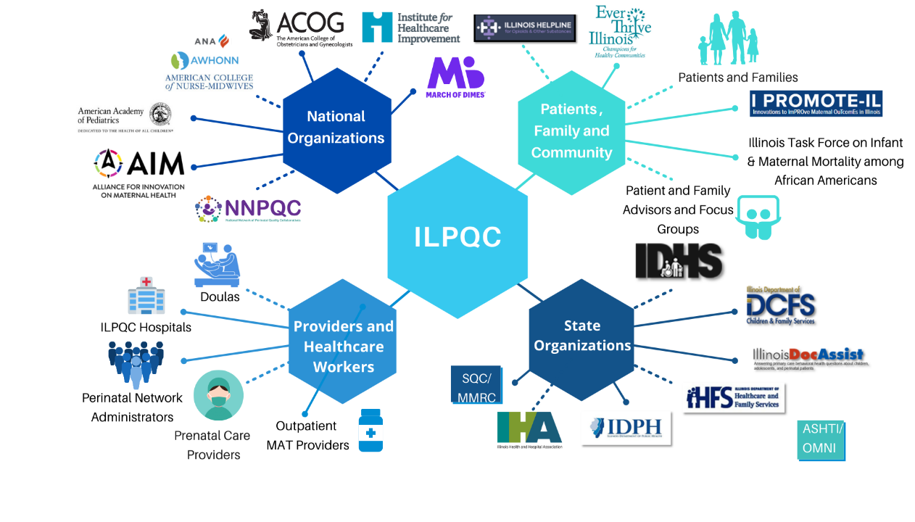
Welcome community outpatient providers, ED providers, and local health departments!
Together, WE ARE ILPQC!

Slide 5
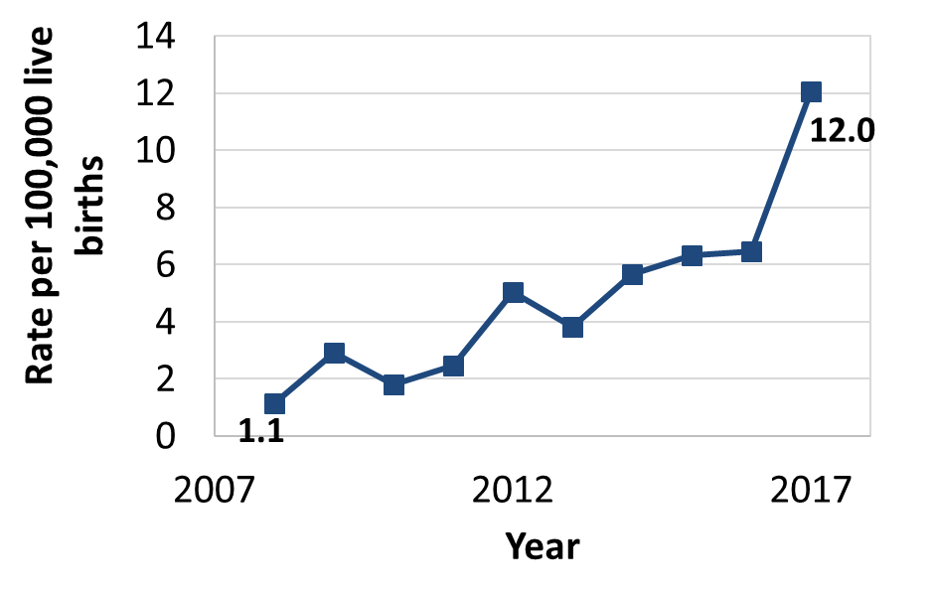
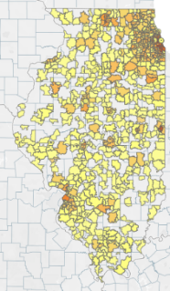
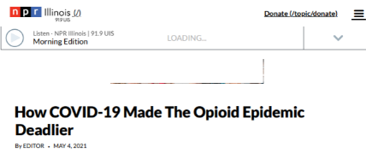
Opioid overdose is a leading cause of maternal death in IL
With the opioid crisis worsening, it is essential to identify pregnant patients with OUD and provide optimal OUD care for every patient, every time, to save lives
Rate of Pregnancy-Associated Deaths Due to Opioid Poisoning, Illinois Residents, 2008-2017
Overdose Counts by ZIP 2019 (IDPH)

Slide 6


Why we do this hard work…
women are losing their lives to OUD
Madelyn Linsenmeir
1988 to 2018
Anaya Rivers
1994 to 2019
The Burlington Free Press on Oct. 14, 2018
Photo Legacy.com
Daily News Philly.com on February 17, 2019
Photo Pendleton Candles Obituary Service on Facebook.com
OUD is a life threatening medical condition
Screening and linking pregnant patients with OUD to treatment/services
Reduces overdose deaths for moms
Improves pregnancy outcomes
Increases # parent/baby diads staying together
Notes:
Consider removing as it can “date” the module.
Madelyn Ellen Linsenmeir
https://www.legacy.com/obituaries/burlingtonfreepress/obituary.aspx?n=madelyn-ellen-linsenmeir&pid=190469930
Anaya Rivers
https://www.philly.com/news/columnists/opioid-overdose-addiction-anaya-rivers-obituary-jenice-armstrong-20190207.html

Slide 7
Treatment works:
Decreased overdose on MAT
(1) MAT saves lives across pregnancy/postpartum
(2) Postpartum is a risky time for all moms with OUD
Schiff DM, et al. Fatal and Nonfatal Overdose Among Pregnant and Postpartum Women in Massachusetts. Obstet Gynecol. 2018;132(2):466–474. doi:10.1097/AOG.0000000000002734
Notes:
There are TWO really interesting findings summarized on this graph. FIRST: The lowest time for OD was in the second and third trimester – likely when pts have the greatest interaction with medical care and resources. A corollary to this is that the number of overdoses is similar if not higher in the first year postpartum than in the year prior to becoming pregnant. Part of this is likely due to the absence of longitudinal support beyond antepartum and intrapartum care. SECOND: As you can see, the red bars indicate the number of OD events when pts are on MAT as compared to the gray bars which represent OD events not on MAT. In brief – MAT works and saves lives.

Slide 8

Mothers and Newborns affected by
Opioids, MNO - OB Initiative
Aim: ≥70% pregnant persons with OUD receive MAT and are connected to Recovery Treatment Services prenatally or by delivery discharge
Goals:
All pregnant persons screened with a universal validated screener prenatally and during their L&D admission
Pregnant Persons with OUD during pregnancy or by delivery discharge
  Assessed for readiness for MAT, linked to MAT and Recovery Treatment Services
  OUD clinical care checklist completed
  Receive Narcan counseling
  Pediatric / neonatal consult on OUD/ NAS and patient education
107 hospitals participating in the MNO OB & Neonatal Initiative kick off May 2018
  101 MNO-OB Hospital QI Teams
  88 MNO-Neo Hospital QI Teams

Slide 9




Clinical Team Key Messages to provide Optimal OUD Care
Opioid Use Disorder is an urgent obstetric issue
Opioid Use Disorder is a life-threatening chronic disease with lifesaving treatment available
There are key steps all providers must take prenatally, on L&D and postpartum (including EDs) to care for patients with Opioid Use Disorder
Screening & Linking moms to MAT / Recovery Services
Reduces overdose deaths for moms
Improves pregnancy outcomes
Increases # women who can parent their baby

Slide 10

Optimal care for all pregnant / postpartum persons with OUD
Screen every pregnant patient for OUD with a validated screening tool
Provide Naloxone (Narcan) Counseling / prescription and screen for Hepatitis C
Assess readiness for Medication Assisted Treatment (MAT)
Warm hand-offs for MAT/recovery services and close OB follow up
Provide patient education on OUD/NAS and reduce stigma, promote empathy across clinical team
Link to MAT and Recovery Treatment Services
Notes:
What key strategies are we focused on. Use the circle graphics as what we need to do to achieve best practice. These are what we use in one of our posters
Add… Reduce stigma, close follow up & warm handoff

Slide 11






Key Strategies to Provide Optimal
Opioid-Exposed Newborn care every time
Prenatal Consult
Non-Pharmacologic Care
Pharmacologic Treatment
Eat, Sleep, Console
MNO Folders
Coordinated Discharge
Notes:
Since the focus up to this point is how big of a problem exists, we shouldn’t brush over how to do the work. This needs a ”Call to Action” slide after this slide.
Keeping your systems changes in place, complicance monitoring and new hire and continuing education.

Slide 12
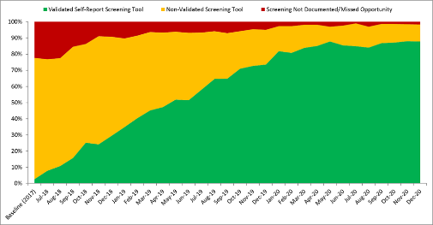
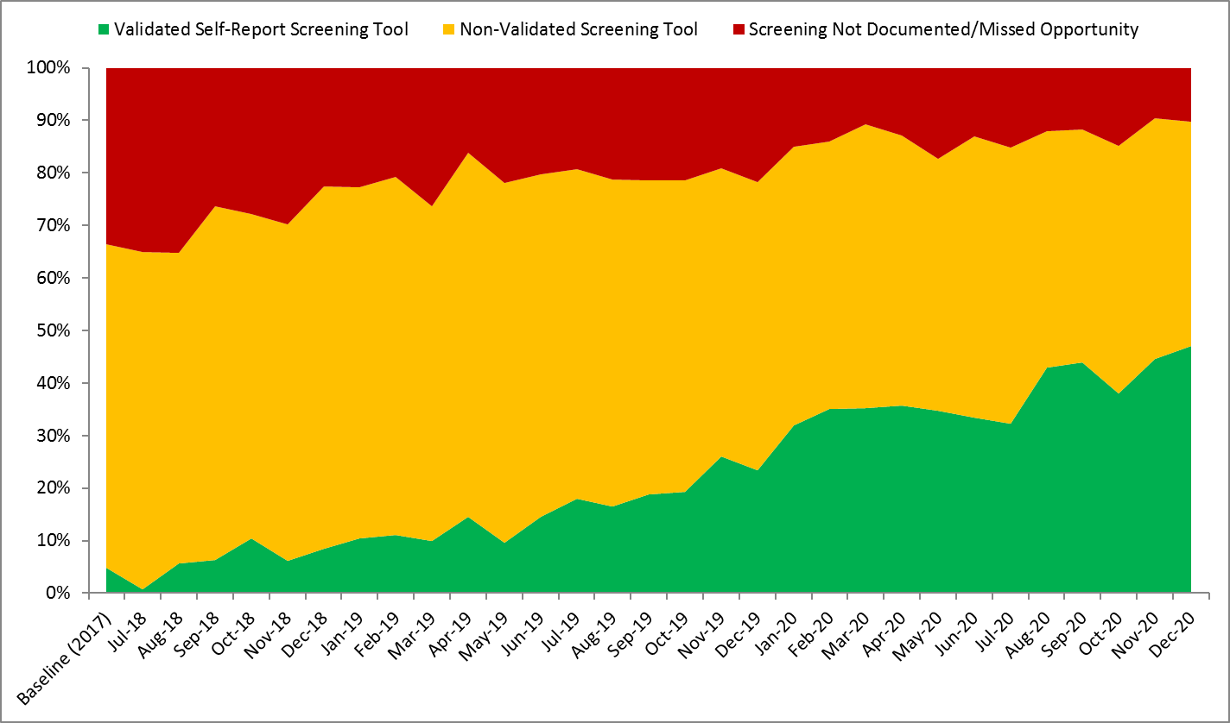
Universal Screening for SUD/OUD
88%
Random sample of 10 deliveries per month reviewed for documentation of SUD/OUD screening
N = 24,430 to date
Prenatal
L&D
GOAL: ≥ 80%
GOAL: ≥ 50%
Red = No screening
Yellow = Screened single question
Green= Screened with validated SUD/OUD screening tool
42%

Slide 13
MNO’s Impact Since 2018:
MAT and Recovery Treatment Services
Linkage to MAT and Recovery Treatment Services prenatally or before delivery discharge increased from 40% baseline to > 70% goal over 2 years of the initiative
88%
41%
Notes:
24,430 screening
2,666 patients with OUD
1288 connected to MAT
Impact of initiative, # of patients in data set, # received MAT/RTS/ # received Narcan (Show the % of patients and the # of patients this touches), screening

Slide 14
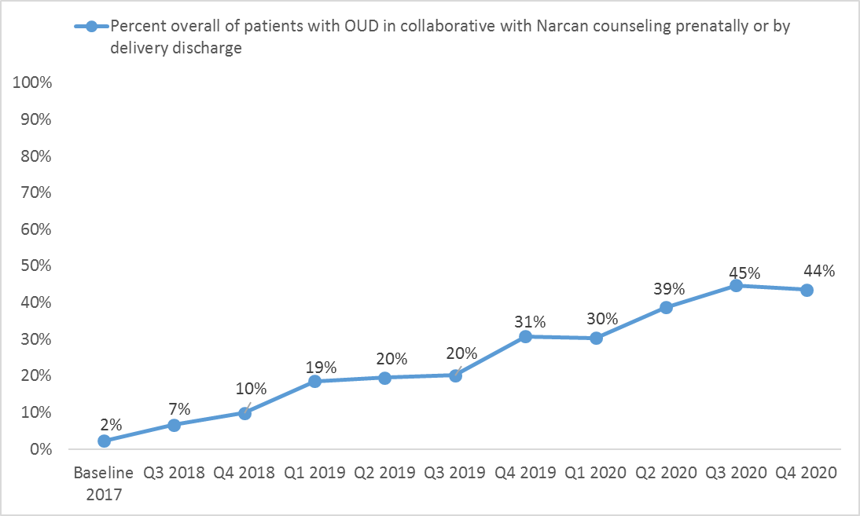
MNO’s Impact Since 2018: Narcan
Teams increased Narcan counseling rates prenatally or before delivery discharge from 2% to over 40% across the initiative
44%
2%

Slide 15
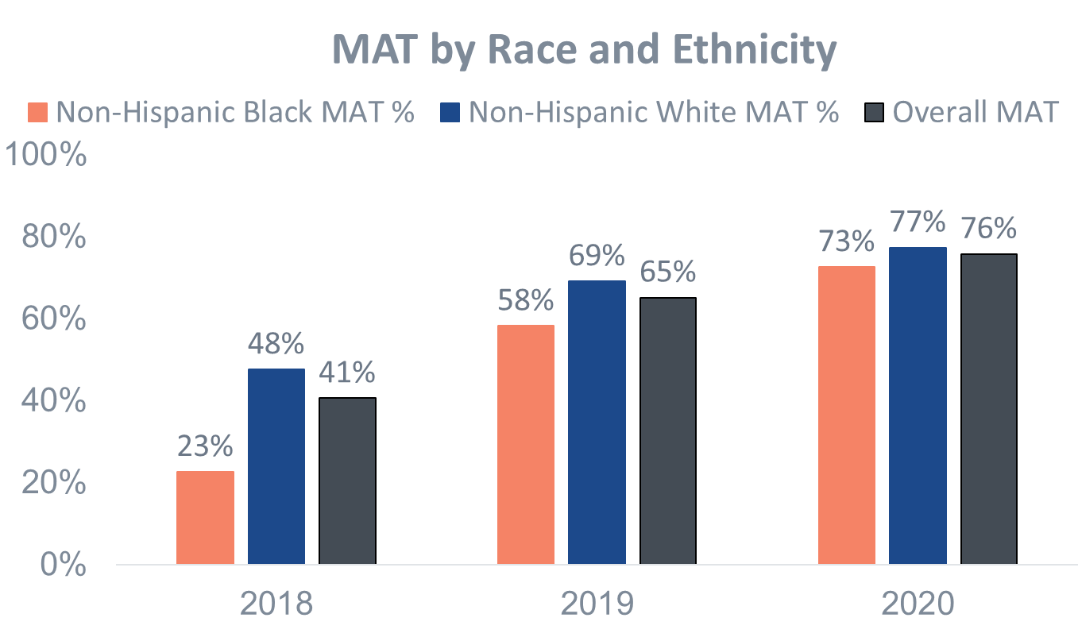
Improving equitable care and reducing disparities for patients receiving MAT
At baseline, Black patients with OUD were less likely to be on MAT, however across the initiative improvements in MAT rates were seen for all patients with the greatest improvement for Black patients.
Comparison of percent of patients with OUD receiving MAT by delivery discharge by race/ethnicity across the MNO Initiative
Notes:
Make the % blue and orange to match so you can see easily which has improved the most

Slide 16
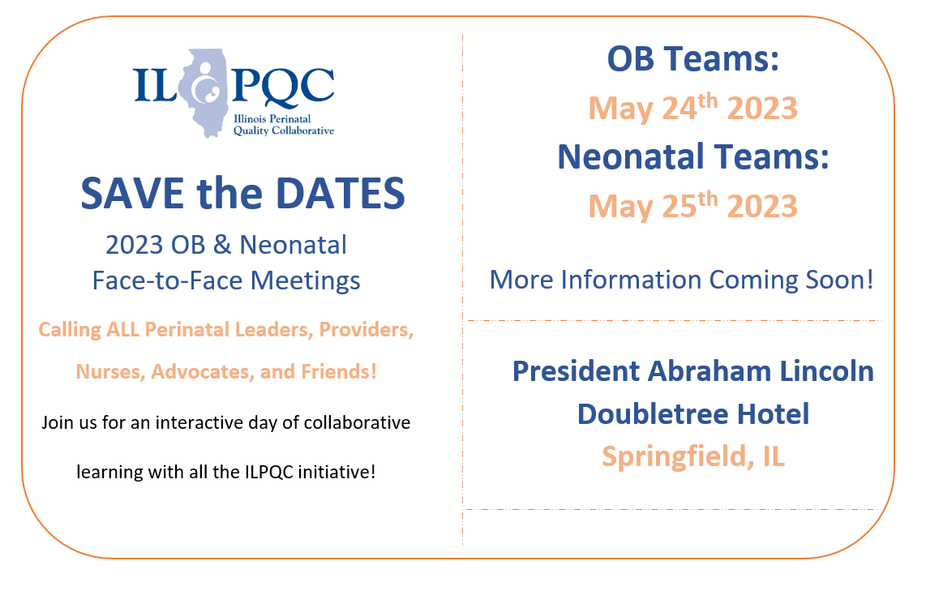

Slide 17
Focus for today
1) Is your clinical team aware of the rising rates of maternal overdose deaths and that providing optimal OUD care can reduce maternal deaths?
2) Are you providing Optimal OUD care for every patient, are you monitoring: screening for SUD, linkage to MAT / recovery treatment services, providing Narcan? Can you sustain optimal OUD care?
3) Are you aware of new resources every clinic, L&D, ER should be using?
  OUD Hotline 24/7 to link patients to MAR-Now: treatment start and care coordination
  DOPP program to provide free point of care Narcan kits to your patients
  Angel’s Story – new video link for provider / nurse / staff education on why Optimal OUD care matters!

Slide 18
IL MMRC Data Overview
Cara Bergo, PhD, Maternal Mortality Epidemiologist, Illinois Department of Public health

Slide 19
Illinois Maternal Mortality & Substance Use Disorder
IDPH Office of Women’s Health and Family Services
Cara Bergo, PhD MPH
March 13, 2023

Slide 20

Preliminary Data
All findings in this presentation are preliminary
Currently finalizing 2020 reviews
Working on Illinois Maternal Mortality Report 2023 for 2018-2020 Deaths
Report will be published in the Fall 2023

Slide 21
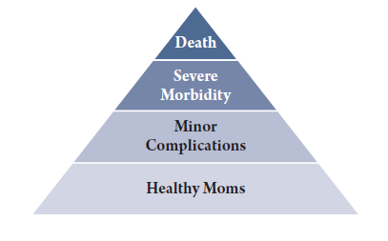
Maternal Mortality: The Tip of the Iceberg
During 2018-2020, 263 Illinois women died while
pregnant or within one year of pregnancy
In 2020 alone, 110 women died
But death is only the most severe outcome
along a continuum of morbidities and
pregnancy complications
Each maternal death is a sentinel event
that highlights critical issues in
women’s health and healthcare
Notes:
Much of what we measure as “maternal mortality” may actually be reflecting general problems in the health of women of reproductive age and we have chosen to shine a light on it for the period of conception to 1 year postpartum?

Slide 22
Pregnancy Associated Mortality Ratio,
Illinois 2-Year Averages

Slide 23
CDC Definition: Pregnancy-Related Death
The death of a woman during pregnancy or within one year of the end of pregnancy, from:
Complications of pregnancy
Chain of events initiated by pregnancy or its management
Aggravation of an unrelated condition by physiologic effects of pregnancy
Notes:
SHORTCUT: If she had not been pregnant, she would not have died
Comlications
Increased pain directly attributable to pregnancy or postpartum events leading to use of prescribed or illicit drugs
Traumatic event in pregnancy or postpartum with a temporal relationship to increased drug use and subsequent death
Chain of events initiated by pregnancy or its management
Cessation/ taper of treatment for pregnancy-related concerns led to drug use and subsequent death
Inability to access treatment due to pregnancy
Opioids prescribed at delivery initiated, worsened, or caused relapse
Recovery/stabilization achieved during pregnancy or postpartum and subsequent relapse and overdose due to decreased tolerance
Exacerbation, under-treatment or delayed treatment of pre-existing condition during pregnancy
Aggravation of an unrelated condition by effects of pregnancy
Worsening of underlying/pre-existing depression, anxiety or other psychiatric condition in pregnancy or postpartum period with documentation that mental illness led to drug use and subsequent death
Medical conditions secondary to drug use in setting of pregnancy or postpartum that may be attributable to pregnancy-related physiology and increased risk of complications

Slide 24
Maternal Mortality in Illinois
An average of 85 women die each year while pregnant or within one year of pregnancy
About 1 in 3 deaths were related to pregnancy
Substance use disorder is the leading cause of death, followed by cardiovascular disease

Slide 25
Top Underlying Cause of Death Categories for Pregnancy-Related Deaths, Illinois 2018-2019
Cause of Death Category | Number of Pregnancy-Related Deaths | Percent of Pregnancy-Related Deaths
Substance Use Disorder | 21 | 34%
Cardiovascular Disease | 12 | 20%
Pre-existing Chronic Medical Condition | 6 | 10%
Other Mental Health Conditions* | 5 | 8%
Infection/ Sepsis | 5 | 8%
All Other Causes Combined | 12 | 20%
*Includes deaths due to depression, schizophrenia, and psychosis
80% of deaths
Notes:
Why do we include substance use disorder within mental health conditions
The vast majority (~90% of substance use disorder deaths have another mental health condition contributing to the death)
They are intertwined factors that need to be addressed together. It is also sometimes hard to tell which began first.

Slide 26
Main substance found at toxicology to be cause of death
Notes:
71% of deaths due to substance use disorder had combined drug toxicity

Slide 27

Emergency Department Use
Among Pregnancy-Related Deaths
Almost 3 of 4 women who experienced a pregnancy-related death had at least one ED visit during pregnancy or postpartum (73%)
Over 2 in 4 women (54%) had two or more ED visits during pregnancy or postpartum
*Emergency department visits did not include visits for the death event
Notes:
Emergency department visits did not include visits for the death event
Of Illinois’ pregnancy-related deaths during 2015-2019
72.8% (n=107) had at least one ED visit during pregnancy or up to one year postpartum
53.7% (n=79) had two or more ED visits
There were no
Women who died from mental health conditions were more likely to visit the ED than women who died from medical conditionssignificant differences by maternal age, education or weight status.

Slide 28
Percent of Pregnancy- Related Deaths with Contributing Factors, Illinois 2018-2019
Notes:
Discrimination does not just mean racism
Obesity 12/61
Discrimination 30/61
Mental Health Conditions 29/61
Substance Use Disorder 26/61

Slide 29
Taylor’s Story
Notes:
Taylor was a White woman in her late teens with a history of a substance use disorder. She had a strong support network that included both her parents. She began prenatal care early in her pregnancy with an obstetrician. During her multiple prenatal care visits, there was no record of her prenatal care physician evaluating her for a substance use disorder or discussing possible treatment and recovery services. When she went to the hospital for her delivery, Taylor tested positive for multiple substances. She received social work and psychology services while in the hospital. Taylor was instructed to follow up with a therapist. She did not receive a connection to a specific provider, nor help arranging an appointment. The hospital scheduled Taylor for a general postpartum checkup with an obstetrician six weeks after delivery, but she did not attend this appointment. A couple of months after delivery, Taylor died of a drug overdose involving multiple substances, including opiates.
What can we learn from Taylor’s death?
Lack of proper screening and coordination into treatment programs for pregnant and postpartum women continues to be an issue for Illinois women. Some women attend many prenatal care visits but are not screened for substance use with a validated tool, nor referred to additional care. Despite drug use being identified at delivery, some women are not provided treatment or a direct path to substance use treatment and recovery services. Care coordination can help women navigate the health care system to obtain the care needed. Furthermore, naloxone awareness and education may be beneficial for women’s support system. All providers who care for pregnant or postpartum patients with OUD must provide naloxone counseling on overdose risk reduction and provide a naloxone prescription or point of care naloxone / Narcan kit. Health care providers and hospitals should educate patients with substance use disorder and their families about how and when to use naloxone.

Slide 30
Factors for Substance Use Disorder
Poor opioid use disorder care and poorly controlled pain
No navigation or warm handoffs for medication assisted treatment or recovery services
Little access to SUD support programs
Clinical team only called DCFS. No treatment for mom’s risk factors and no follow up.
Hospital unable to find inpatient care for her, rehab was unable to care for her due to chronic condition.
No one addressing SUD as life threatening illness, focused on baby.
SUD as an afterthought, came in with overdose and was released the next day from ER.
No intervention after overdose. Not started on treatment or connected.
Not optimal care due to stigma related to substance use disorder
Notes:
-

Slide 31
Recommendations for Substance Use Disorder
Providers should follow best practices for the identification and treatment of substance use disorders and ensure a “warm handoff ” to a behavioral health/ recovery treatment provider who can continue care during and after pregnancy.
Hospitals
Systems
Providers
Hospitals should train providers who see obstetric patients on how best to link patients to outpatient recovery and treatment services.
The State should expand home visiting and patient navigator programs for women with substance use disorder, regardless of income, to ensure care coordination, referrals for patient care navigators, and warm handoffs to necessary specialists.

Slide 32
Thank you!
Cara.Bergo@illinois.gov

Slide 33
IL DHS MAR NOW and DOPP Overview
Nicole Gastala, MD, Medical Director Substance Use Prevention and Recovery, IL Department of Human Services

Slide 34




Lowering Barriers to MOUD and Harm Reduction
Illinois Medication Assisted Recovery Telehealth Hotline
“MAR NOW” and DOPP program

Slide 35
MAR NOW Program Overview

Slide 36
MAR NOW launched May 2022 as a Chicago Pilot, expanded Sept. 1 statewide
Funded by Chicago Department of Public Health (CDPH) and Illinois Department of Human Services Division of Substance Use Prevention and Recovery (IDHS/SUPR)
Operates through the existing 24/7 IL Helpline for Opioids and Other Substances: 833-234-6343
Provides low-barrier, rapid access to buprenorphine, methadone, and naltrexone to all callers regardless of insurance status, income, ability to pay, or documentation status and ongoing care coordination and follow up.

Slide 37
Program provides access to medication within 48 hours of first call
Patient Options:
Buprenorphine home induction
Same or next-day MAR appointment at FGC (methadone, buprenorphine, naltrexone)
Connection to other SUD care in the community (withdrawal management, residential treatment)
Individual calls 24/7 IL Helpline for OUD treatment, withdrawal support
IL Helpline directly transfers caller to MAR NOW Care Manager
24/7 Access
Connected to Care Manager & Provider
Care Managers provide free transportation, insurance enrollment, assistance with pharmacy access, and follow up to ensure patient is connected to long-term care

Slide 38
Hub and Spoke Model
MAR NOW works closely with pharmacies to ensure that they have medications available and are able to assist patients
Mental health providers
Pharmacies
Mental health, primary care, and harm reduction services are key referral points to and from MAR NOW
Harm reduction providers
MAR NOW
Primary care providers
All patients connected to outpatient MAR for long-term treatment in the community
Cook County Jail
Program is working closely with jail and homeless shelter providers to offer linkage to MAR NOW
Community MAR providers
Homeless shelters and encampment outreach
Patients that leave treatment can come back to MAR NOW and be connected again to treatment in the community. MAR NOW can also serve as a bridge clinic for patients waiting for care.

Slide 39
Where to initiate MAR treatment via MAR NOW? Everywhere!
In the Emergency Department
  Ask patient if they are interested in starting medication, re-started on medication or being connected to services for opioid use disorder
    If yes, have a team member give the patient access to a phone and they can call 833-234-6343
    The MAR team will take it from there including case management
During Delivery Hospital Admission
  Ask patient if they are interested in starting medication, re-started on medication or being connected to services for opioid use disorder
    If yes, have a team member give the patient access to a phone and they can call 833-234-6343
    The MAR team will take it from there including case management
    Inpatient Team can start MAR if medically appropriate and MAR NOW case management team will coordinate follow-up and continuation
In the Urgent Care or Outpatient Setting
  Ask patient if they are interested in starting medication, re-started on medication or being connected to services for opioid use disorder
    If yes, have a team member give the patient access to a phone and they can call 833-234-6343
    The MAR team will take it from there including case management

Slide 40
Why initiate MAR treatment via MAR NOW?
Get help linking your patient to OUD treatment and recovery services from anywhere in the state with warm hand-off to care.
Ease of use can decrease work burden for staff
Improve connection to services for patients without increasing clinical staff
The Joint Commission has a requirement under the chronic pain management standards that hospitals have a mechanism for referral for patients with OUD – utilizing the MAR NOW hotline easily meets that TJC quality standard
Most important: Reduce maternal overdose death, improve pregnancy outcomes

Slide 41


1-833-234-6343 (2FINDHELP)
Or text "HELP" to 833234

Slide 42
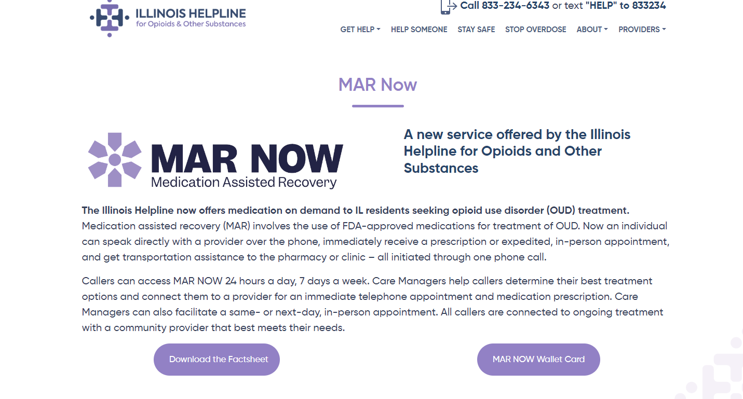

Slide 43
MAR restrictions have been waived under COVID to allow for low-barrier prescription
Buprenorphine may be prescribed via audio-only telemedicine
Initial in-person examination with provider before first buprenorphine prescription is waived
Buprenorphine providers may use non-HIPAA-compliant platforms to reach patients
In June 2022, the Office of National Drug Control Policy issued recommendations that the DEA and HHS make these changes permanent.

Slide 44
Initial Program Data & Learnings

Slide 45
Successful Connection to Care
May 9 – Feb 5, 2023: MAR NOW Call Data
 | Number | Percent of Total
Calls from patients seeking OUD care | 300
Patients seeking methadone | 106 | 35%
Patients seeking buprenorphine | 163 | 54%
Patients seeking withdrawal management w/ medical stabilization on MAR | 20 | 7%
Patients seeking residential treatment | 11 | 4%
May 9 – Feb 5, 2023: Patient Connection Data
 | Number | Percent of Total
Methadone patients attended first appointment | 74 | 70%
Buprenorphine patients connected to medication | 161 | 99%
Withdrawal management & medical stabilization patients who showed at appointment | 19 | 95%
Residential treatment patients who showed at appointment | 9 | 82%
*Note: connection to care pending for recent callers, data current as of Feb 5
Connection to care is high across all treatment options.
Patients connected to withdrawal management and medical stabilization are also connected to FGC's mobile van and MAR.

Slide 46
Home Induction Is Safe and Effective
May 9 – Feb 5, 2023: Buprenorphine Patient Data
 | Number | Percent of Total
Calls from patients seeking buprenorphine | 163
Buprenorphine patients connected to medication | 161 | 99%
Patients connected to medication that received home induction | 144 | 89%
Patients connected to medication that received in-person induction | 17 | 11%
Home induction patients connected to a community provider for ongoing care | 131 | 91%
Home induction patients that experienced adverse events during induction | 1 | 0.6%
Home induction patients terminated from care due to suspicions of misuse or diversion | 0 | 0%
*Note: connection to care pending for recent callers, data current as of Feb 5
FGC physicians provide a 7-day prescription for home induction, after which patients are connected to a community provider.

Slide 47
Home Induction Is Safe and Effective
May 9 – Feb 5, 2023: Buprenorphine Patient Data
 | Number | Percent of Total
Calls from patients seeking buprenorphine | 163
Buprenorphine patients connected to medication | 161 | 99%
Patients connected to medication that received home induction | 144 | 89%
Patients connected to medication that received in-person induction | 17 | 11%
Home induction patients connected to a community provider for ongoing care | 131 | 91%
Home induction patients that experienced adverse events during induction | 1 | 0.6%
Home induction patients terminated from care due to suspicions of misuse or diversion | 0 | 0%
*Note: connection to care pending for recent callers, data current as of Feb 5
FGC physicians provide a 7-day prescription for home induction, after which patients are connected to a community provider.

Slide 48
Early Learnings
Providing transportation to clinic appointments and pharmacies lowers barriers to care and increases first appointment attendance rate
Concerted outreach to pharmacies is required to ensure that buprenorphine is available and pharmacists will fill prescriptions
Patients often need intensive follow-up from Care Managers to ensure they can make it to their first appointment.
Operating through the existing IL Helpline for Opioids and Other Substances provides baseline patient demand, aligns City and State efforts, streamlines expansion of program statewide, and allows for patient data matching to capture more information on demographics
Calls for withdrawal management and residential treatment are common, and provide opportunity for education around buprenorphine treatment.

Slide 49
Next Steps
Spoke Provider Development: FGC is working to build out providers statewide.
  Contact Maria Bruni if interested in participating: mbruni@fgcinc.org
  Jennifer Cyran, Managing Director, Illinois Helpline, jcyran@hria.org
Provide Feedback: What’s working and what needs improved.
  Nicole Gastala, Medical Director SUPR/IDHS, Nicole.Gastala@illinois.gov
  Maria Bruni, mbruni@fgcinc.org

Slide 50
IDHS/SUPR Drug Overdose Prevention Program (DOPP)
Drug Overdose Prevention Program (DOPP)
Legislated program under the Substance Use Disorder Act 20 ILCS 301 Section 5-23
Allows IDHS to establish or authorize programs for prescribing, dispensing, or distributing Narcan / naloxone kits to prevent drug overdose
Enrollment by community-based organizations, hospitals, and clinics leads to automatic registration in Access Narcan project to receive free Narcan kits to provide to individuals with OUD or other risks for overdose

Slide 51
Receive free Narcan point-of-care kits to provide to patients
Enroll in Drug Overdose Prevention Program (DOPP) through links for community-based organizations or hospitals/clinics at https://www.dhs.state.il.us/page.aspx?item=58142
If a hospital or healthcare clinic, click the Hospitals & Clinics link
Follow the steps
Once approved and registered, order no-cost Narcan kits to distribute to patients

Slide 52
Access Narcan – Step 1 click link

Slide 53
Access Narcan – Step 2 enroll in DOPP

Slide 54
Access Narcan – Step 2b IDPH naloxone standing order, if needed

Slide 55
Access Narcan – That’s it!
Once requirements are met (complete DOPP enrollment), an ilsavesOD.org (portal) project will be created for the organization
A Project Administrator profile will be created for the DOPP contact person in the portal
A welcome to DOPP email will be sent out with instructions
A no-cost Narcan account set-up will be emailed to the contact person within a week of welcome email
Once all set-up, order Narcan!

Slide 56
Access Narcan – That’s it!
Once no-cost Narcan account is set-up, login with credentials
Submit order – we suggest max 10 cases per order to start
Will be approved by SUPR within a few days
Narcan shipped via 2-day FedEx
Organization can order as much as is necessary to met patient/community needs without hoarding

Slide 57
For DOPP Questions Contact
DHS.DOPP.Coordinator@Illinois.gov
For Access Narcan Questions Contact
Kathleen.Monahan@Illinois.gov

Slide 58
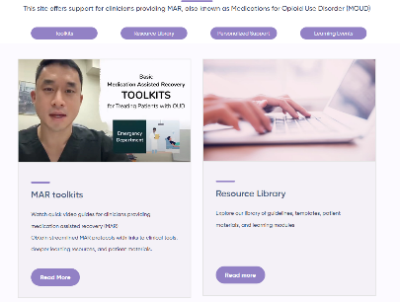


Tools and Resources
For Clinicians:
https://helplineil.org/app/mar
https://cabridge.org/tools/resources/
https://pcssnow.org/
For Patients:
https://helplineil.org/app/home
Patient Education Tools:
https://rethinkrecoveryil.com/

Slide 59
ILPQC Hospital Panel: Drug Overdose Prevention Program Strategies:
Andrew Fisher, MD, University of Chicago Medical Center
Katherine Austman, MD, Gibson Area Hospital

Slide 60
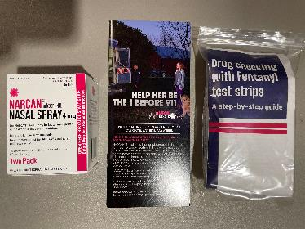
UCM OB DOPP Update
Andrew Fisher, MD MBE
Section of General Obstetrics & Gynecology
University of Chicago Medicine
Nov.–Dec. 2021
DOPP Registration Complete
Hyde Park, South Loop, River East, Orland Park Outpatient
Jan. 2022
Narcan Distribution Protocol
Nursing/Resident education (bi-annual)
Sep. 2022
Fentanyl Test Strips
Hospital-wide (ED, Outpatient Med/Psych, OB)
Protocol updated, ongoing education
Nov. 2022
Deploy in L&D triage
Apr. 2023
Quality Improvement Project
Ongoing Educational Improvements
July 2023
Sustainability

Slide 61
Outpatient
Reporting/Managing – OB Lead + Director of Ambulatory Operations
Access/Storage: Manager office (8-5 M-F)
Education/Awareness:
  Bi-annual resident/RN training
  Office signage
  Expand to patient rooms
Workflow/Quality
  MNO Sustainability/Screening
  Weekly EPIC Report (+5P)
  EPIC Dot/Smartphrases
      SBIRT w/ Narcan prompt
      Narcan patient instructions/dispensing documentation
Inpatient (L&D Triage)
Reporting/Managing – OB Lead + RN Mgr/Quality Leads
Access/Storage: 24/7 L&D triage – Charge RN
Education/Awareness:
  Bi-annual resident/RN training
  RN Desk signage
  Expand to triage rooms, work rooms
  UCM OUD Team – Hospital-wide
Workflow/Quality
  RN Quality Oversight
  MNO Sustainability/Screening
  Weekly EPIC Report (+5P)
  EPIC Dot/Smartphrases
    SBIRT w/ Narcan prompt
    Narcan patient instructions/dispensing documentation
  EMR Best Practice Advisory (BPA) – Narcan on discharge
UCM OB DOPP
Infrastructure

Slide 62


UCM OB DOPP
Successes
Institutional buy-in
Nursing-led
RN/physician/resident engagement
Challenges
The “Goldfish Effect”
Disrupting the stigma
  OB AND Gyn
Next Steps
More frequent education
Improve patient-facing signage in all areas
Open access in waiting areas/rooms?
  Limited by reporting requirements
Quality Improvement Initiatives
  Improve EMR Best Practice Advisories
  RN Post-op check workflow
  Virtual RN/Resident education

Slide 63
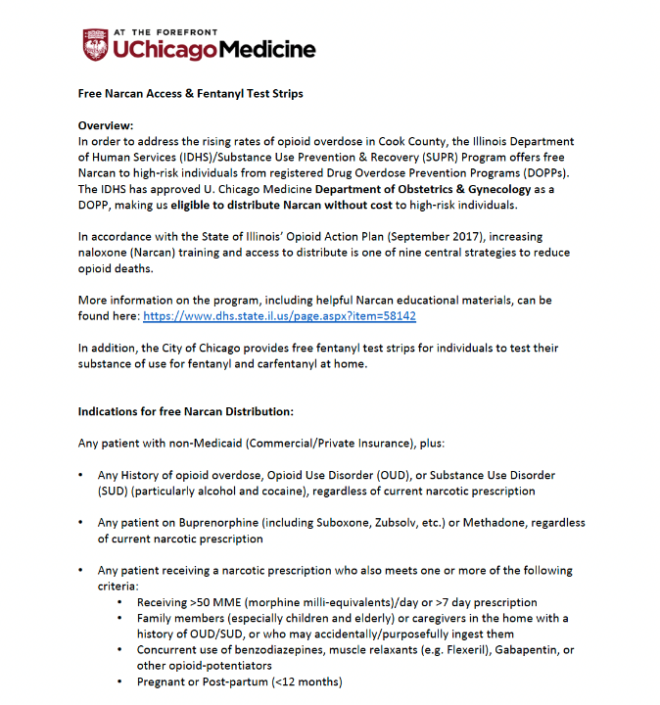

Slide 64
Dopp in the clinic setting
Kate Austman, MD, FASAM
Addiction Medicine
Family Medicine/Obstetrics
Gibson Area Hospital and Health Services

Slide 65


Slide 66
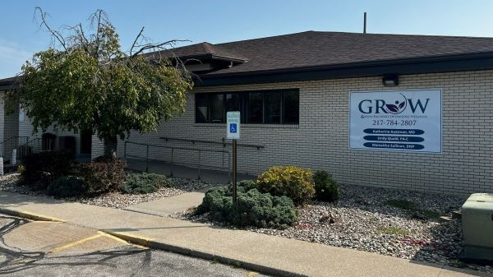

Slide 67

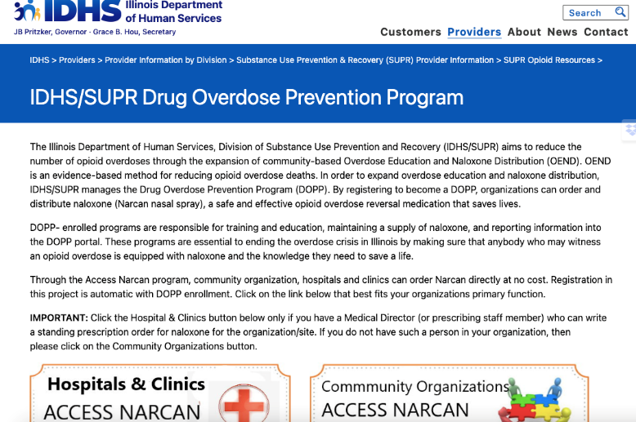

Slide 68
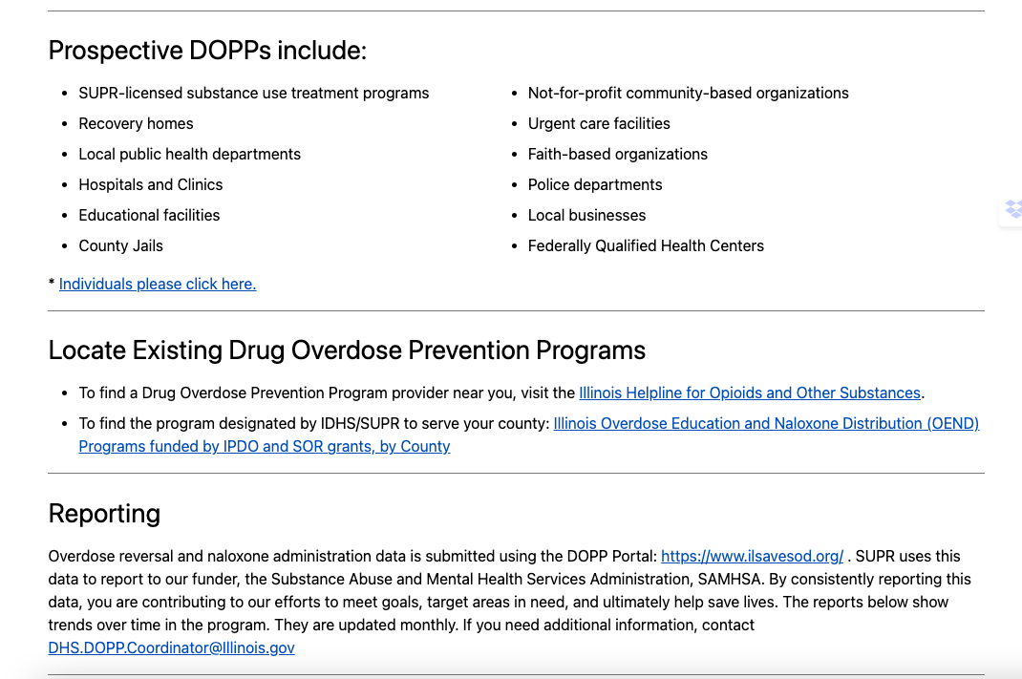

Slide 69
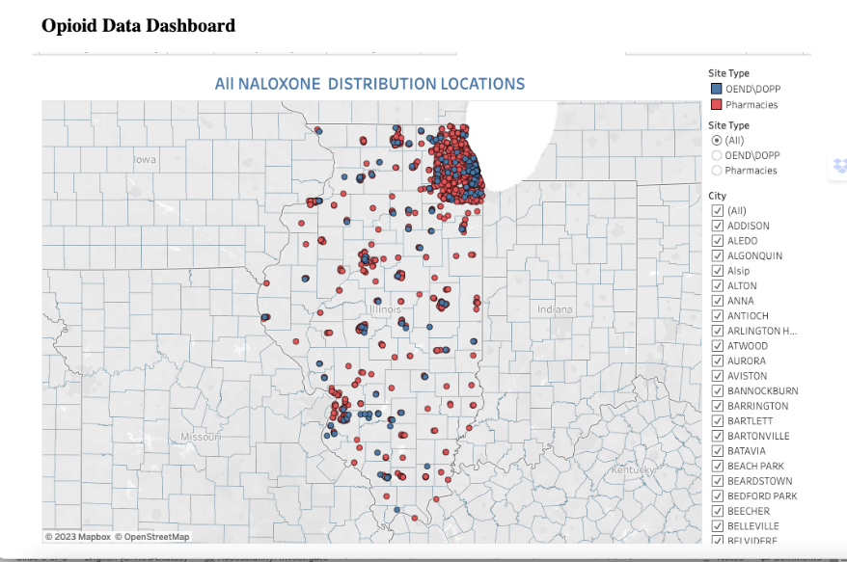

Slide 70


Slide 71


Slide 72
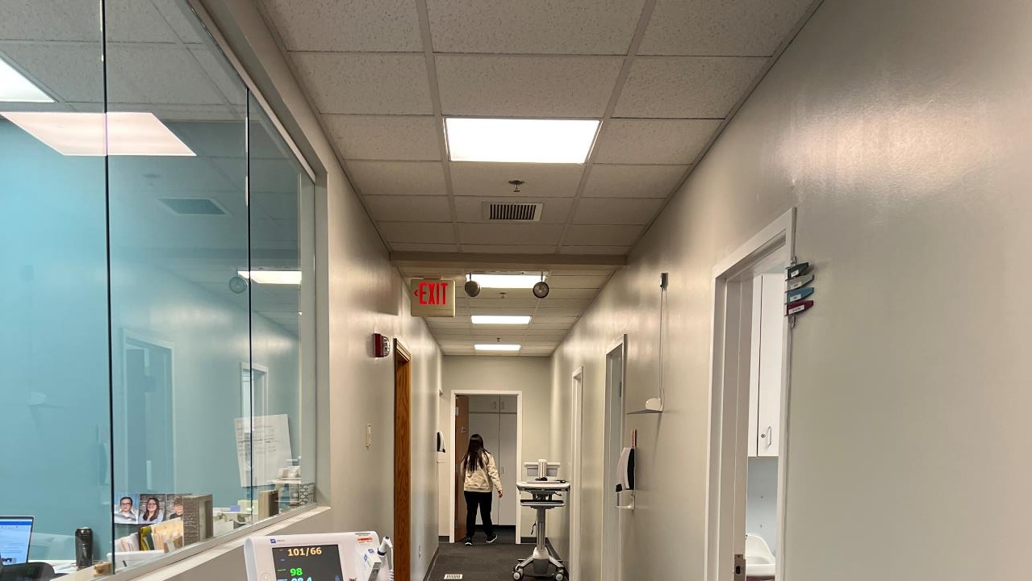

Slide 73
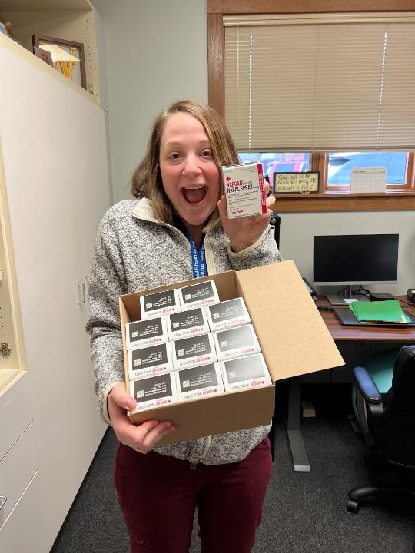

Slide 74
ILPQC Resources and Next Steps

Slide 75
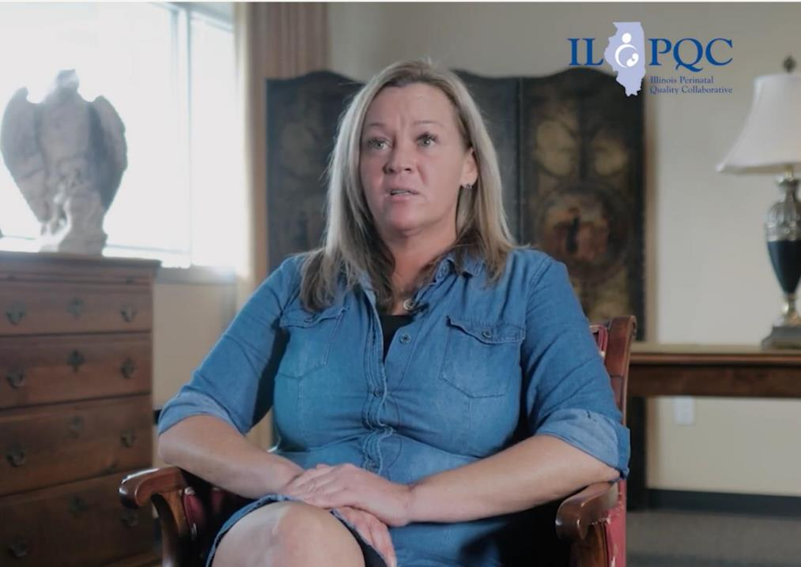
Angel's Story
NEW ILPQC provider education video
An inspiring patient story that touches on the importance of SBIRT, reducing stigma and providing Narcan to all at-risk patients
Find this video on our youtube channel or ilpqc.org

Slide 76
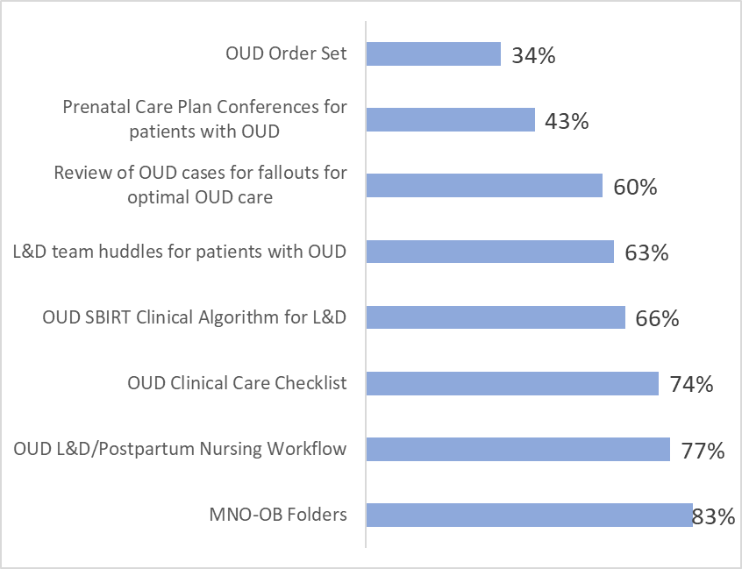
Sustainability strategies to facilitate optimal care for all pregnant & postpartum patients with OUD
2022 Teams Survey

Slide 77
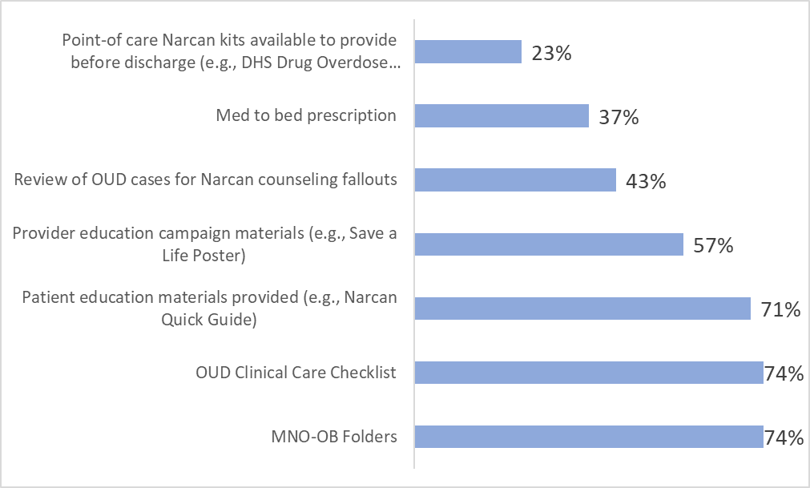

Strategies implemented to assist the
OB clinical team in providing Narcan counseling strategies and prescription offers
2022 Teams Survey
Don’t miss out:
17% of teams have already signed up to participate in DHS Drug Overdose Prevention Program!
Notes:
Has your hospital signed up to participate in the DHS Drug Overdose Prevention Program (DOPP) to access Narcan for free at your hospital?
17%

Slide 78


Key resources teams are using to connect patients with OUD to MAT and RTS prenatally or by delivery discharge
2022 Teams Survey
46%
Help navigate OUD patients to treatment and recovery services 24/7, can call for MAR-Now to get your patient started on OUD treatment and ongoing care coordination
49%
Warmline for free perinatal substance use technical/clinical support for providers caring for OUD patients
Notes:
Illinois Helpline for Opioids and Other Substances (to help navigate OUD patients to treatment and recovery services)
46%
IL DocAssist (warmline for free perinatal substance use technical/clinical support for providers caring for OUD patients)
49%

Slide 79

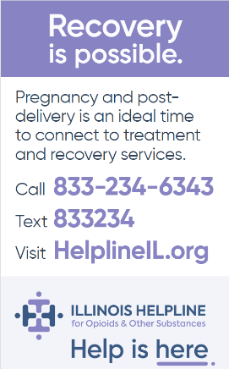
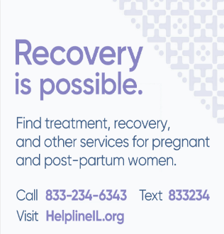
OUD Helpline Communication Campaign for OB & ED Units
Provider poster for OB & ED Units
Wallet Card for OB & ED Patients
Magnet for OB & ED Units
Notes:
Ann's full slide of poster
Just note the different tools

Slide 80


Slide 81









Thanks to our Funders
In kind support:

