Slide 1

Strategies to Cross the MNO-OB Finish Line
July 27, 2020
12:30 – 1:30pm

Slide 2
Overview
Welcome/introductions
MNO-OB Call to Action: Next steps to cross the finish line with initiative goals and moving into sustainability
Promoting Vaginal Birth Updates
Birth Equity Updates

Slide 3
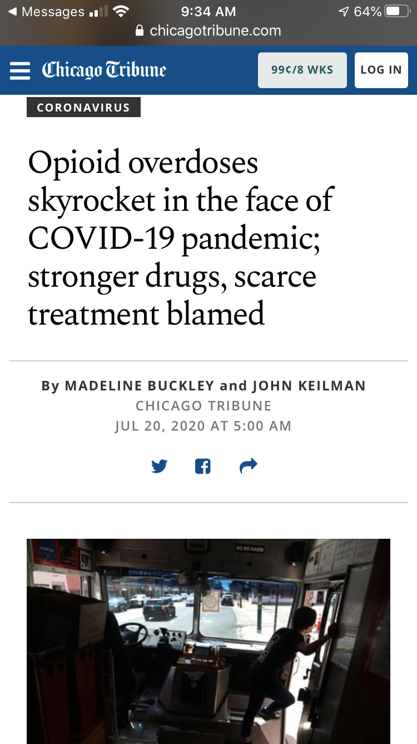
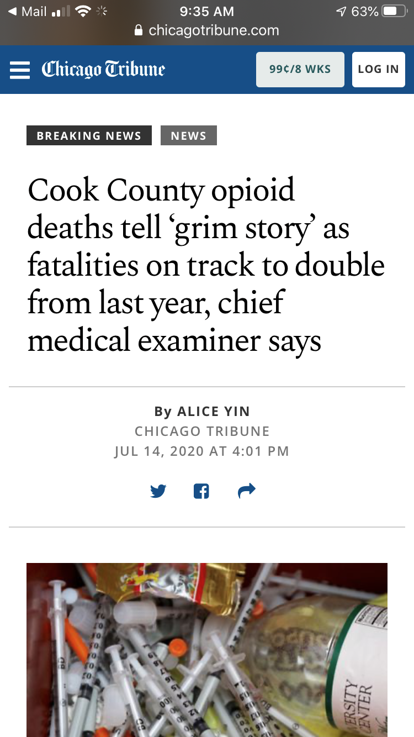
Engage OB Providers, Prescribe Narcan, Save Lives
https://www.chicagotribune.com/coronavirus/ct-opioid-deaths-spiking-covid-19-20200720-2ulyztrprzgrzffasff5c4l4hq-story.html
https://www.chicagotribune.com/news/breaking/ct-cook-county-opioid-deaths-medical-examiners-office-2020-20200714-l52fihc5sbhthlrnr73e22in2a-story.html

Slide 4
Crossing the finish line with MNO-OB
This summer into fall we will focus on helping all hospital teams achieve key aims to cross the finish line and move into sustainability
Not all teams are there yet, but these aims are achievable and we have clear strategies to achieve our goals to screen all pregnant woman for OUD and provide optimal OUD care in every hospital, every patient, every time
  MAT by delivery discharge ≥ 70%
  Linkage to Recovery Treatment Services ≥ 70%
  Narcan counseling by delivery discharge ≥ 60%
  Prenatal SUD/OUD validated tool screening ≥ 50%
Our goal is to reduce maternal mortality from overdose, improve pregnancy outcomes and increase the # woman who can parent by providing optimal OUD care every hospital, every patient, every time

Slide 5
Making Systems Change Happen
100%
83%
of teams have a validated screening tool in place on L&D
of teams have a validated screening tool in place prenatally
87%
93%
of teams have a SBIRT protocol/algorithm in place on L&D
of teams have mapped community resources for women with OUD
90%
90%
of teams have implemented an OUD Clinical Care Checklist on L&D
of teams have implemented standardized patient education on L&D
Notes:
ONLY 40 TEAMS REPORTING…

Slide 6
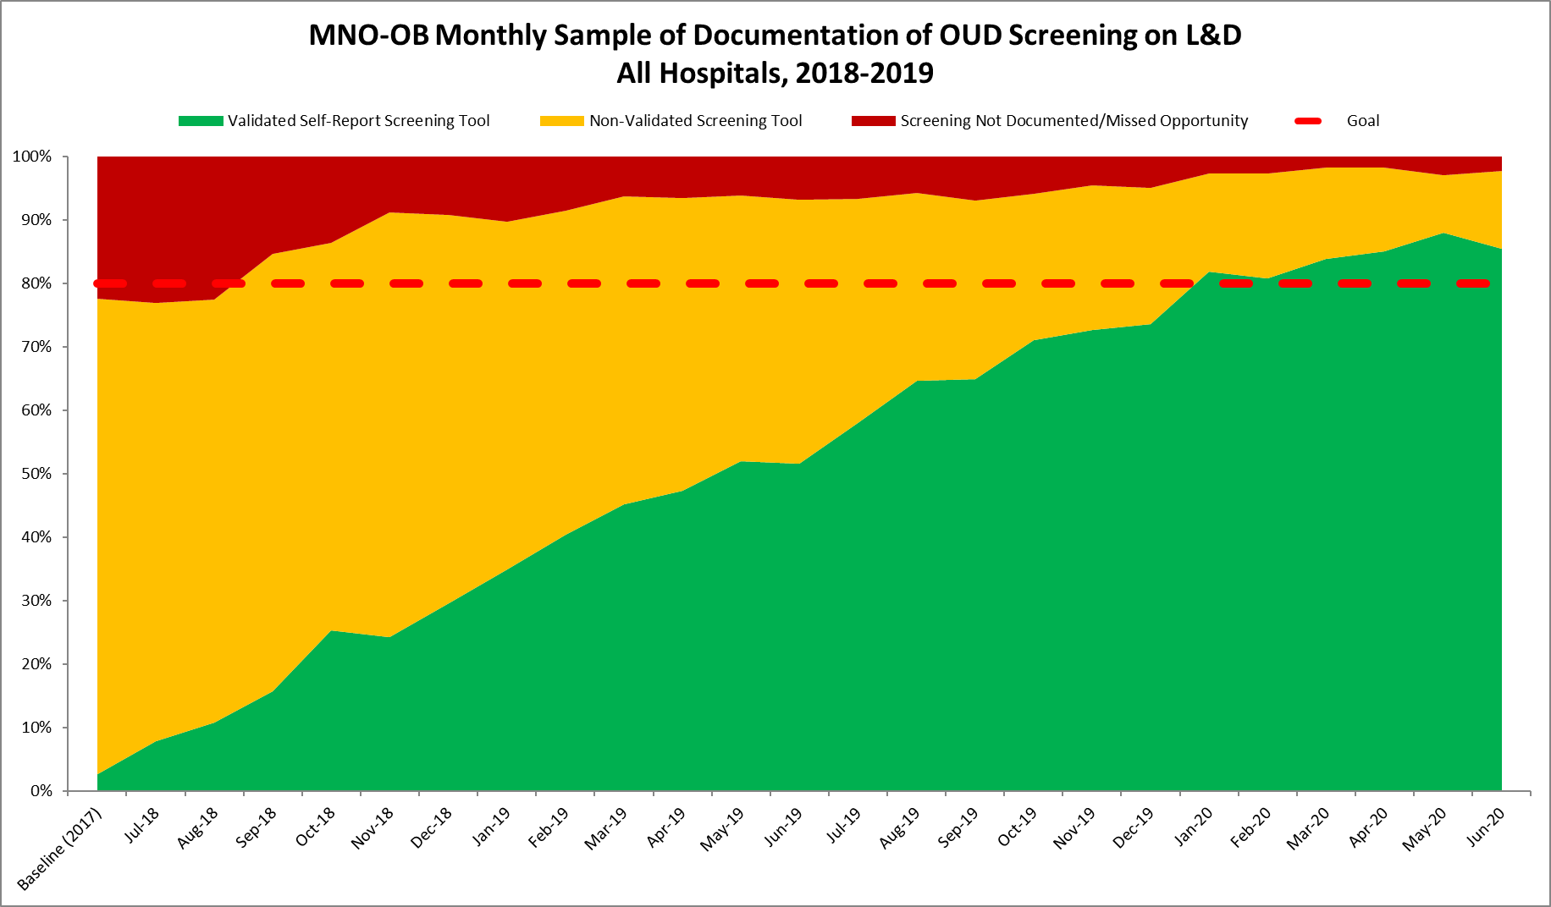
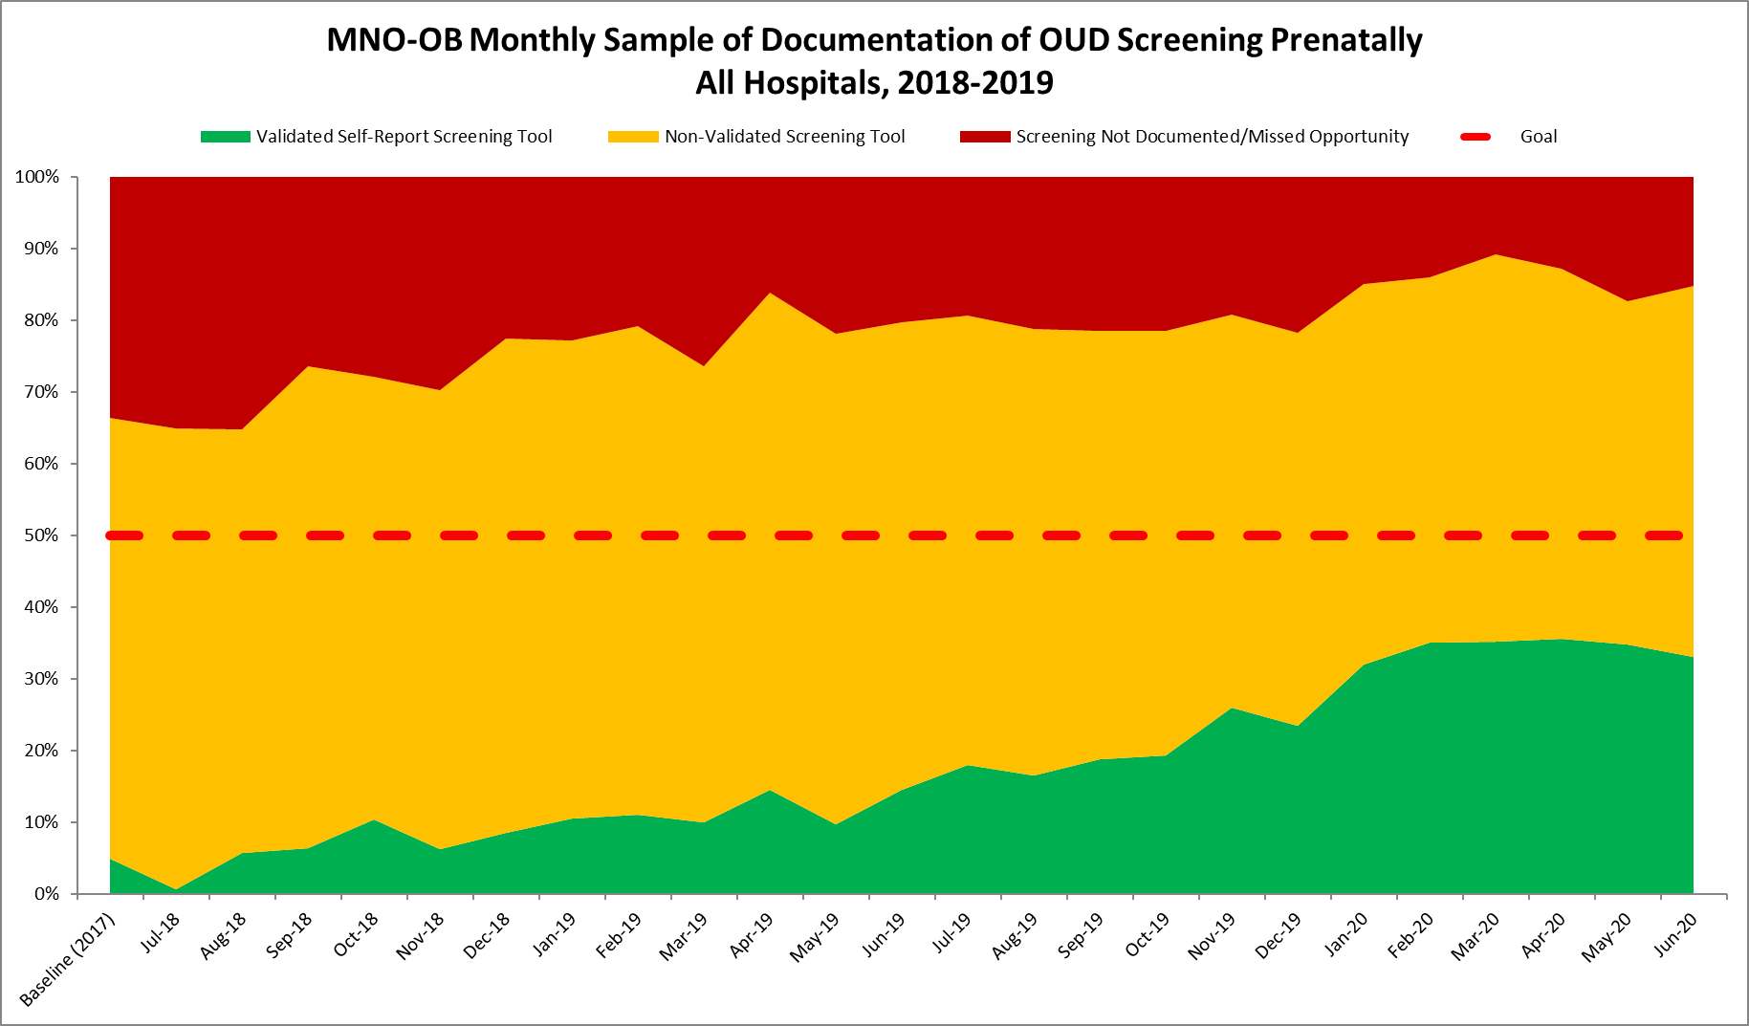
Documentation of Screening for SUD/OUD with Validated Tool
Random sample of 10 deliveries per month reviewed for documentation of SUD/OUD screening
N = 18,330 to date
85.4%
Prenatal
L&D
Red = No screening
Yellow = Screened single question
Green= Screened with validated SUD/OUD screening tool
33.0%
GOAL: ≥ 50%

Slide 7
Women with OUD on MAT by Delivery Discharge
Need all teams to push to assess readiness for MAT and achieve % on MAT before delivery discharge above 70%. We are almost there!!!
Goal = ≥ 70%

Slide 8
Women with OUD at Delivery Connected to Recovery Treatment
Almost there!
Goal ≥ 70%

Slide 9
Narcan Counseling & Documentation
Keep up the hard work!
Goal ≥ 60%

Slide 10
Call to action…
Prenatal OUD Screening
Systems for Optimal OUD Care
Narcan
We must improve prenatal screening with a validated self-reported screening tool (standard of care)
Goal is for you to have >50% of your affiliated prenatal sites standard of care screening for SUD/OUD
Consider audits and providing site specific data to assist with buy-in
L&D Care Team Huddles- initiated by the LD charge nurse to include all care team members review checklist & algorithm in MNO Folders (some teams use MNO Missed Opportunities Form as huddle guide)
OUD Order sets- to assist providers in key elements in checklist
Prenatal Care team conference
Use draft OB Chair letter to prenatal sites
Narcan prescription is a LIFE-SAVING strategy that every OUD patient needs
Use tools/systems of OUD care (MNO-OB Folder, OUD Order sets and Huddles) to ensure patient is counseled and co-prescribed before delivery discharge
Hang flyers/educate
Partner with pharmacy team
MNO Folders

Slide 11
Optimal OUD Obstetric Care
Does your hospital currently implement any of these strategies or plan to?
Given the high risk of maternal death from OUD, need systems to make sure optimal OUD OB care is provided for every patient, every time.
MNO Folders
  Stored in prenatal care sites and L&D, contains all provider, nurse and patient resources needed for optimal care. Obtain MNO folder for every OUD pt.
L&D Care Team Huddles
  Called by charge nurse, care team huddle for every OUD pt with OB/MFM, nursing, neonatalogy/peds, SW, anesthesia etc as appropriate, review MNO Folders, checklist/algorithm and care plan confirm optimal care provided.
Prenatal Care Team Conference for OUD pregnant pts
  Multidisciplinary prenatal care meeting /call with OB/MFM, neonatology/peds, nursing, SW to review algorithm & checklist to confirm key clinical elements completed (MAT/Narcan/linkage to care/neo consult).
OUD Order set
  Establish OUD order set with Narcan order, Hep C screen, consults, and key elements from checklist.

Slide 12
Optimal OUD Care
Does your hospital have a system to confirm optimal OUD care?
Screen all patients for OUD with validated screening tool prenatal and L&D
When patients screen + use MNO folder to activate OUD protocol and complete OUD checklist
Confirm optimal care provided
  L&D Huddle for all OUD patients to review MNO folder, and OUD checklist, confirm all key elements of care completed before delivery discharge
  Prenatal care conference for all OUD patients with OB/Neonatology/SW/ Nursing can help confirm OUD checklist, consults, key care elements including MAT, linkage to recovery treatment services and Narcan counseling are completed

Slide 13
Call to action for Narcan
Every OUD patient needs Narcan counseling during prenatal care or before deliver discharge
How can your QI team make sure this happens for every OUD patient?
  Engage pharmacy to determine if Narcan is on hospital formulary and can be included in Med to Bed Program
  OUD order set: include Narcan prescription
  L&D Huddle: called by charge nurse confirm key elements
  Education for providers & nurses: Narcan Save a Life flyers , e-module, virtual grand rounds or OB provider meeting.

Slide 14
L&D-OUD Order Set
OUD Order Set that includes Narcan prescription helps support OUD Checklist completion and improve OB comfort with Narcan prescribing
Example OUD Order Set:
Narcan Prescription
Hepatitis C Screening
MFM Consult
Neonatal/Pediatric Consult
Social Work Consult
Addiction Medicine/Psychiatry consult (if available)
Anesthesia Consult
Patient Education given on OUD, NAS, and maternal participation in non-pharmacologic care of newborn given
Schedule early postpartum visit within 2 weeks
Comprehensive contraception counseling completed
Confirm MAT/Recovery Treatment services follow up appointments) scheduled prior to discharge
Coordinated discharge planning for mom & infant with neonatology/peds and social work

Slide 15
Engage your Pharmacy to optimize Narcan prescribing
Set up a meeting with your pharmacy to determine if Narcan is on formulary at your hospital
Determine if your hospital has a med to bed program available
Discuss steps needed to implement these two strategies at your hospital and engage OB providers to provide Narcan to all patients with OUD/use opioids regularly before delivery discharge
Please share your experiences with engaging with Pharmacy to provide Narcan to patients before delivery discharge

Slide 16
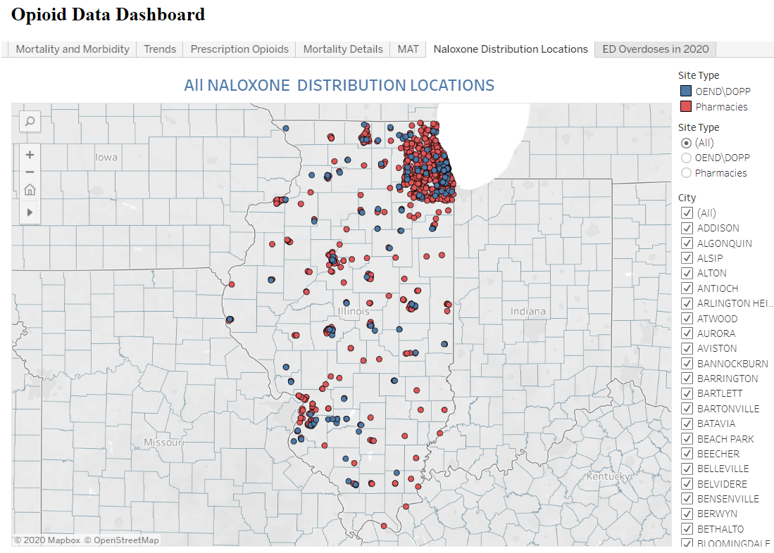
NARCAN Tools & Resources for Teams
Narcan- Save a Life Poster
IL DHS Helpline for Opioids & Other Substances: https://helplineil.org/app/home you can search for community-based Naloxone/Narcan distribution locations and view by insurance status
IDPH Opioid Data Dashboard- Naloxne Distribution Locations & contact information: https://idph.illinois.gov/OpioidDataDashboard/
IL DocAssist 866-986-ASST (2778)→ Free Addiction Medicine Consult for caring for pregnant & postpartum with OUD… Ask them about Narcan Counseling!!!
Has your team utilized ALL of these resources to optimize Narcan Counseling & Prescription offer?

Slide 17
MNO-OB Discussion
What strategies are your hospitals using to implement Narcan counseling & prescription offer prenatally or by delivery discharge?
What are barriers you are facing and what can we learn from other hospitals in the network, or from the key strategies?
What is the next step/action plan for your hospital? How can ILPQC support your efforts?

Slide 18
Together we can achieve
MNO Success
Review your MNO-OB data
Take action to improve prenatal validated OUD screening, and use systems to ensure optimal care for EVERY OUD patient prenatal / before delivery discharge every time
Determine what strategies your team needs to ensure your team can cross the MNO-OB finish line and achieve MNO aims by October.
Reach out to ILPQC for assistance to help you get there

Slide 19
Upcoming MNO-OB Teams Calls
Date | Topic
August 24, 2020 | Teams share progress strategies to cross the finish line *Upcoming August 2020 QI Topic calls on (1) Narcan and (2) Prenatal Screening! Stay tuned for dates/times
September 28, 2020 | Sharing progress towards implementation of strategies to cross the finish line
October 2020 | No Teams Call… 2020 Annual Conference
Nov/Dec 2020 | Sustaining the Gains→ Preparing for Sustainability

Slide 20
MNO-OB 2020 Timeline
Summer 2020:
All teams work to cross the finish line, and start sustainability plan
Fall & Winter 2020
Work to implement sustainability plan, ILPQC 1:1 QI Support for hospitals
2021:
Quarterly Sustainability check in Calls with Teams, implement sustainability plans

Slide 21
Promoting vaginal birth
(PVB)

Slide 22
Toolkit Binders being shipped soon!
Sign-up today to receive your printed toolkit

Slide 23
PVB Timeline
June-Sept | Oct | Nov | Dec | Jan
MNO-OB | Annual Conference | ILPQC PVB Data Form Webinars | PVB team webinars start monthly and baseline data reporting (Oct-Dec 2019) begins | Monthly data reporting begins Baseline data reporting due
This means: October Annual Conference transition from MNO Active Phase to Sustainability and start of PVB data collection and monthly calls after Annual Conference in November 2020
Follow this link to submit your hospital’s PVB roster
https://redcap.healthlnk.org/surveys/?s=NF8MPDY9LF

Slide 24
Birth Equity

Slide 25
Birth Equity Initiative Update
Plan to convene clinical leads to discuss preliminary aims, drivers, and measures for Birth Equity Initiative in September
Initial ideas in development for discussion include:
  Addressing social determinants of health during prenatal, delivery, and postpartum care to improve birth equity (e.g. Mapping resources, screening/referral tool)
  Utilize race/ethnicity medical record and quality data to improve birth equity (e.g. accurate race/ethnicity data collection, health measure dashboards, review of patient satisfaction data)
  Engage patients, birth partners, and communities to improve birth equity (e.g. patient advisor on QI team, engage doulas in care team, patient reported experience)
  Engage and educate providers and nurses to improve birth equity (implicit bias training, education on listening to patients, hiring strategies)
Wave 1 testing of data form in early 2021, launch in May 2021
Notes:
Ieshia updated 7/9/2020

Slide 26
Save the date!
ILPQC VIRTUAL Annual Conference 2020 – October 29, 2020

Slide 27



THANKS TO OUR
FUNDERS
Email info@ilpqc.org or visit us at www.ilpqc.org
Notes:
Updated 10/22/19

