Slide 1

MNO- Neo Teams Call:
Coordinated Discharge…it begins at admission
September 21, 2020
1:00 – 2:00pm

Slide 2
Call Overview
Annual Conference Updates
MNO-Neonatal: Next steps to support hospital teams to achieve the initiative goals
Data Review
Optimizing Discharge - ILPQC Resources
Patient perspective - Jessica Winchester
BASIC 2020 Next Steps

Slide 3
Annual Conference 2020

Slide 4
REGISTER TODAY!
Notes:
Ieshia updated 9/11/2020

Slide 5
8:00-8:10 | Welcome
8:10-9:00 | ILPQC Stronger Together: Celebrating Success with MNO-OB, MNO-Neo, IPLARC and IPAC; Launching PVB, BASIC, and Birth Equity– Ann Borders with Leslie Caldarelli and Justin Josephsen
9:00-9:45 | Supporting Vaginal Birth: Lessons Learned from CMQCC- Dr. David LaGrew
9:45-9:50 | Break
9:50-10:35 | Antibiotic Stewardship for the Newborn Population: Ample Opportunities for Improvement- Dr. Dmitry Dukhovny
10:35-11:30 | Leveraging QI Success in Other States: Leaders from State Perinatal Quality Collaboratives Discuss Key Initiatives- Dr. Susan Hwang (Colorado), Charlene Collier (Mississippi) & Brenda Barker (Tennessee)
11:30-11:45 | ILPQC Award Ceremony
11:45-12:45 | Lunch and Poster Session
12:45-1:30 | Integrating Equity into Quality Improvement: Lessons Learned form LAPQC- Dr. Veronica Gillispie-Bell
1:30-2:15 | Listening to Patients: The Importance of Integrating Patient Perspectives for Optimal Quality Improvement- Kristen Terlizzi, and LaToshia Rouse
2:15-2:30 | Break
2:30 – 4:00 | Hot Topics in Obstetric QI: Crossing the Finish Line and Successful Sustainability for MNO-OB; Promoting Vaginal Birth Deep Dive; and Looking ahead to Birth Equity in 2021- Ann Borders with expert panel Neonatal QI: Finding the Balance: Moving the MNO Initiative to Sustainability while Successfully Launching BASIC in QI Partnership with Patients and Families – Leslie Caldarelli and Justin Josephsen with expert panel Improving Outcomes Through Patient Engagement – LaToshia Rouse with Kristen Terlizzi
4:00 – 4:15 | Wrap-up & Evaluation

Slide 6

4 Steps to Get Ready for the
ILPQC 8th Annual Conference
Register online
Submit abstract
Complete Survey
Email QI Poster
Click here and Register today!
Held Virtually Thursday, October 29th, 2020
Conference will be from 8am-4:15pm
1.
Submit poster abstract here by October 9th to be considered for an award
Late-breaking abstracts due Oct 23rd
2.
Coordinate with your colleagues working across initiatives to have one person from your hospital submit the survey.
Survey coming soon!
3.
Please email your poster to info@ilpqc.org by Oct. 23rd to be displayed on the ILPQC Annual Conference webpage
4.
Notes:
Please add the links to abstract as well as the registration Ieshia updated 9/10/2020

Slide 7

COMING SOON!
Annual Neonatal Teams Survey
Ensure your voice is heard as we make plans to help teams finish strong and plan for sustainability and future initiatives.
Please coordinate with your colleagues at your hospital to submit one survey. If you need help identifying team leads for different ILPQC initiatives, please reach out to info@ilpqc.org for contacts.

Slide 8
Call for Abstracts for AC Poster Session
All hospital teams are asked to submit an abstract on complete or in progress quality improvement work
Abstracts submitted by Oct. 9th , will be reviewed for awards:
  Top abstract(s) in OB, Neonatal, Patient/Family Engagement, First time Level I/II Hospital receive Abstract of Excellence Awards
  Two OB & two Neonatal abstracts receive special recognition, one each for (1) Best Use of Data, (2) Best Project Implementation
Awarded abstracts will be announced at the conference and have a prize designation displayed on their poster
Late breaking abstracts (not eligible for awards) are due Oct 23rd
Submit: https://redcap.healthlnk.org/surveys/?s=RRXFCDL44H
A poster template will be provided and support is available from ILPQC.
Notes:
Ieshia, please add the link to the abstract submission AP (Ieshia updated 9/10/2020

Slide 9


Poster Session and Abstracts
Questions?
ILPQC offers a variety of support services to assist with abstract/poster submission
  Poster Template
  Mentorship Services
  FAQ Tool
  Information + Q&A Sessions after team webinars
Expert abstract reviewers & past awardees will be available immediate following team calls starting 9/21
Please share your thoughts!
Notes:
Do we want to include a box asking the OB advisory peeps their thoughts on these strategies? AP (Ieshia by updated 9/10/2020)

Slide 10


You are ILPQC!
ILPQC wants to celebrate all of you during our virtual conference!
Coordinate with your colleagues to create a slide to share the following:
  Team/Hospital Picture
  Picture of QI bulletin boards
  Location/Region
  Birth Volume/NICU Beds
  Perinatal Level
  Current & Future Initiatives
  Contact information for collaboration

Slide 11
2020 ILPQC annual conference AWARDS
MNO-Neo Award for Successful Completion of Key Initiative AIMs Awards
*All Data Submitted
+
4 Structure Measures In Place (Neonatal Prenatal Consult, Non-Pharmacologic Protocol, Pharmacologic Protocol, Discharge Plan)
+
All Process Measure goals met** >70% breastfeeding at infant discharge; <20% pharmacologic treatment for OENs with NAS symptoms; >95% coordinated discharge plans
**Determined by Cumulative data for Quarter 3 (July - September) of 2020
*All Data Submitted for Baseline (Oct – Dec 2017) and July 2018 through September 2020
*MNO-Neo Monthly Patient Data, Monthly Neo Structure Measures
    DATA DUE Friday, October 16th by MIDNIGHT

Slide 12
MNO-Neo Data Review

Slide 13
Making Systems Change Happen
87%
91%
of teams have a prenatal consult protocol in place
of teams have a non-pharm protocol in place
91%
91%
of teams have a pharm protocol in place
of teams have a discharge protocol in place

Slide 14
Achieving MNO-Neo AIMs Together: Received Maternal Breastmilk from Eligible Mothers at Infant Discharge
KEEP IT UP!!!
AIM = ≥ 70%

Slide 15
Achieving MNO-Neo AIMs Together: Received Pharmacologic Treatment
AIM = ≤ 20%

Slide 16
Achieving MNO-Neo AIMs Together: Discharged with a Coordinated Plan
AMAZING!!!
AIM = ≥ 95%

Slide 17
Coordinated Discharge…
IT begins at admission

Slide 18
Systems for
Optimal OEN Care
MNO Folders. Initiate the MNO folder to help create a standardized system to provide the highest level of care for every OEN. This included the coordinated discharge materials.
OEN Admission Huddle. Utilize an “OEN Admission Huddle” with the care team (Neo, Peds, Nursing, Social Work, etc.) at newborn admission to NICU/SCN/NBN to review the MNO folder and begin the coordinated discharge planning.
MNO-Neonatal Education Campaign. Implement standardized education for providers and nurses on key elements of the MNO-Neonatal initiative, including the importance of engaging families in non-pharmacologic care and coordinated discharge planning.
Non-Pharmacologic Care. Implement standardized protocols for care teams to engage families in optimizing non-pharmacologic care as the first line of treatment for OENs.
Coordinated Discharge. Include the MNO Coordinated Discharge Checklist and Collaborative Discharge Plan in every MNO-Neonatal folder activated by the care team when the mother delivers.

Slide 19

ILPQC MNO Coordinated Discharge in the National Spotlight!
ILPQC is working with the American Academy of Pediatrics to adapt the ILQPC MNO-Neonatal Coordinated Discharge Checklist and Collaborative Discharge Plan to be national resources.
Thank you for your hard work and great feedback to provide others across the country with a strategy to help families and newborns affected by opioids.

Slide 20

Coordinated Discharge:
What you need to know
We’re so close to the 95% goal!
Start early. Discharge planning should not wait until the newborn is ready for discharge.
Teams shared the biggest barrier to coordinated discharge is awareness of resources & understanding ILPQC data definitions…

Slide 21
Final Push
Ensure clinical readiness for OEN via the MNO Coordinated Discharge Checklist… start this checklist at OEN admission (NOTE: this is in the MNO folder)
Ensure families/caregivers receive education on NAS & engaging in non-pharmacologic care (NOTE: this is in the MNO folder)
Ensure a Collaborative Discharge Plan is completed with the family/caregivers to ensure :
  (1) Pediatric appointment scheduled
  (2) APORS report submitted
  (3) Early Intervention education provided
  (4) Any additional warm handoffs as needed (NOTE: this is in the MNO folder)
If your team is doing all these, then you are achieving the MNO Coordinated Discharge definition.

Slide 22
Implementation of an
OEN Admission Huddle
Has your team implemented OEN Admission Huddle?
Please press *6 to unmute and share your experiences
Which patients?
  For all for all OENs
Who?
  Initiated by the Charge Nurse and includes all care team members - RN, MD, Residents, Social Work and/or OB team
What?
  Review MNO-Neo folder, and confirm plan for all key elements of care completed before discharge. Some teams use the NAS Clinical Debrief to complete during the huddle
When?
  Following NICU/NBN admission

Slide 23
OEN Admission Huddles
Ok we have a opioid exposed newborn to discuss and we have the key clinical team together. I have an MNO-NEO Folder here. Let’s start the conversation and review the contents in the folder to make sure optimal care will be delivered.
Great, I have her chart opened right so we can review it against what you have
Let’s start with looking at the NAS Clinical Debrief form and review the prenatal consult and review the plan for non-pharmacologic care, breastfeeding eligibility and key elements for successfully completing a coordinated discharge?
Ok it looks like the family did receive a prenatal consult, and key educational materials. They are onboard with rooming-in and providing 1st line treatment for the newborn.
It’s also a good idea to confirm a Narcan prescription was provided.
Also, It looks like from the initial consult our patient’s mother was uncertain about breastfeeding- let’s explore barriers and put in and order for lactation counseling?
That’s great! Let’s update the family on the ILPQC Bedside Sheet and share our assessment process. Can we also determine who can make sure we get lactation consult and also who can verify that the family and mother received Narcan? Let’s also discuss how we can best engage the family in non-pharmacolgic care.
I can put in order in for lactation support and talk with the family about Narcan prescription. I can also begin reviewing the Coordinated Discharge checklist
Notes:
Prescriptions

Slide 24
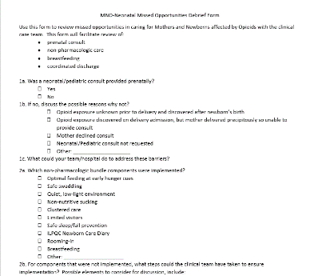
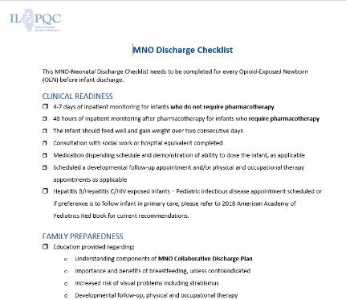
Key MNO-Neo Folder Items
NAS Clinical Debrief
MNO Coordinated Discharge Checklist
ILPQC Infant Bedside Sheet

Slide 25


SUSTAINABILITY PLAN PLACE HOLDER
Sustainability Plan
Compliance Monitoring
New Hire Education
Ongoing Staff/Provider Education
Sustained Systems
Help you identify system-level changes you need to put into place to sustain providing optimal care for every OEN regardless of the number of patients seen per month

Slide 26
SUSTAINABILITY PLAN

Slide 27
Completing your SUSTAINABILITY PLAN

Slide 28
Completing your SUSTAINABILITY PLAN

Slide 29
Completing your SUSTAINABILITY PLAN

Slide 30
Jessica Winchester’s Story

Slide 31

PNA Regional Strategies for Success Updates by Network for MNO-Neonatal
Team | Date | Team | Date
Northwestern Network | Completed (July 17, 2020) | St. Francis Network | Completed (September 2, 2020)
UIC Network | September 18, 2020 | St. John’s Network | October 24, 2020
Loyola Network | Completed (September 9, 2020) | Stroger Network | Completed (August 19, 2020
UChicago Network | Completed (August 18, 2020) | Rush Network | Being Scheduled
Cardinal Glennon Network | Completed (August 26, 2020) | Rockford Network | Being Scheduled
Notes:
Ieshia 9/10/2020

Slide 32
MNO-Neo 2020 Timeline
Summer & Fall 2020:
All teams work to cross the finish line and start sustainability plan
Fall & Winter 2020
Work to implement sustainability plan, ILPQC 1:1 QI Support for hospitals
2021:
Quarterly Sustainability check-in Calls with Teams, implement sustainability plans

Slide 33
Upcoming MNO-Neonatal Teams Calls
Date | Topic
September 2020 | Coordinated Discharge… it begins at admission
October 2020 | No Teams Call - 2020 Annual Conference
November/December 2020 | November 19th MNO-Neo Initiative Call Celebratory active initiative wrap up December 2020
2021 quarterly sustainability topics to include multi-substance exposure, cannabis, providing compassionate care, and more!
Notes:
Other Topic ideas:
-Multi Substance Exposure (Sustainability Topic??), compassionate care/nuanced medical challenges Steven Patrick?? -Cannabis Exposure (Sustainability Topic??)- Indiana PQC is doing multisubstance?? Someone from JHU
-Working with Patient/Family Challenges; Meeting Mothers and Families where they are at

Slide 34
Recap: Care Team Resources to
Optimize Non-Pharm Care
ILPQC Prenatal Consultation Checklist- include important information to share with mother/family about engaging in non-pharmacologic care of the newborn
ILPQC Infant Bedside Checklist- tool to be used by the care team during NAS assessments to track non-pharmacologic care by care team and family. Built in process to facilitate huddles with the family
Breastfeeding Traffic Light- tool to provide guidance on supporting breastfeeding for pregnant persons with OUD, lays out contraindications in easy to understand table
NAS Clinical Debrief Form- form to review missed opportunities in caring for Mothers and Newborns affected by Opioids. This form will facilitate review of prenatal consult, non-pharmacologic care, breastfeeding, and coordinated discharge planning
All included in the MNO-Neo Folder!

Slide 35
OB & Neonatal
MOC Part IV Opportunities
Per American Board of Pediatrics guidelines, you are eligible to receive 25 Part IV MOC credits from the ABP MNO-Neonatal Initiative if you can attest to all the following:
  Intellectually engaged in planning and executing the project
  Participated in the projects intervention
  Regularly reviewed data in keeping with the projects measurement plan (ILPQC RedCap data)
  Collaborated in activity by participating in team meetings (local meetings and ILPQC webinars).
Instructions to obtain credit are attached in the webinar. Please attest to the above requirements in the document, and have your LOCAL project leader sign the form, along with your signature. Scan and send the completed form to info@ilpqc.org. Please do this by Nov. 1, particularly if you are in an MOC renewal year, so that we can meet your deadlines. Please feel free to contact us at ILPQC if you have questions."

Slide 36
Babies antibiotic stewardship improvement collaborative (BASIC) Updates

Slide 37
THE FOLLOWING STATEWIDE QI INITIATIVE HAS BEEN APPROVED FOR
ALL ILPQC NEONATAL TEAMS
BY THE ILLINOIS PERINATAL QUALITY COLLABORATIVE & NEO ADVISORY GROUP
QI | QUALITY IMPROVEMENT
ALL MATERIAL IS SUITABLE FOR ILPQC HOSPITAL TEAMS
FOR IMPROVING CARE FOR NEWBORNS ACROSS ILLINOIS
WWW.ILPQC.ORG

Slide 38




Slide 39

BASIC Updates

Slide 40
BASIC Vision
ILPQC Hospitals, regardless of perinatal levels, will implement standardized system-wide guidelines, policies, and protocols
to provide appropriate antibiotics
to appropriate babies
for the appropriate length of time
Notes:
Added 10/22/19

Slide 41
BASIC 2020 Timeline
June-July 2020:
Workgroup finalize AIMs, Measures, Data Form
Aug-Oct 2020:
Wave 1 tests data collection process, Develop toolkit
October 29, 2020
Statewide Launch
November 2020: Monthly webinars begin
9/29 @ 2pm: Wave 1 Teams Call
10/6 @ 2pm: BASIC Planning Group
10/13 @ 2pm: Final Wave 1 Teams Call
10/29: ILPQC Annual Conference
11/16 @ 1pm: BASIC Teams Call
Notes:
Added 10/22/19

Slide 42
Key Drivers
Data Monitoring, Transparency, and Stewardship Infrastructure
Timely & Appropriate Initiation of Antibiotics
Appropriate Administration & De-Escalation
Equitable Care Delivery
Notes:
Added 10/22/19

Slide 43
BASIC SMART AIMs
Right Baby AIM: Decrease the number of newborns ≥35 0/7 weeks receiving antibiotics by 20%
Right Length of Time AIM: Decrease the number of newborns of any gestational age with a negative blood culture at 48 hours that receive additional antibiotics by 20%
Notes:
Added 10/22/19

Slide 44
Submit your BASIC QI
Roster for Statewide Launch!
We have opened the QI team roster link for all teams to sign up for the statewide initiative launch in October.
Completing a QI Team roster ensures your team receives timely communications about the BASIC initiative
Submission of a QI Team roster is a core component of active participation in an ILPQC initiative
Please submit the QI Team roster by Monday, October 26th!
LINK: https://redcap.healthlnk.org/surveys/?s=H8P8TAPF33

Slide 45
BASIC Team Roster
Project Team Leader (required)
Pediatric Provider Champion (required- can be team leader)
Pediatric Nurse Champion (required- can be team leader)
OB Provider Representative (recommended)
Clinical pharmacist (recommended)
Information System Specialist (recommended)
Clinical Microbiologist/Lab Professional (recommended)
Patient/Family Member representative (recommended)
Quality Improvement Professional (recommended)
Hospital epidemiologist (recommended)
Community pediatrician (recommended)

Slide 46



THANKS TO OUR
FUNDERS
Notes:
Updated 10/22/19

Slide 47
Annual Conference
Abstract & Poster Assistance

Slide 48
Breaking it down
WHO?
All hospital teams are encouraged to submit an abstract on complete or in-progress perinatal QI work. We especially encourage hospitals that have not previously submitted an abstract, including Level I and Level II hospitals, to submit an abstract this year!
WHAT?
Top abstract(s) in each submission category (OB, Neonatal, Patient/Family Engagement, and First Time Level I/II Hospital) will receive Abstract of Excellence Awards
  Top abstract(s) in each submission category:
      OB,
      Neonatal, and
      Patient/Family Engagement, and
      First time Level I/II Hospital
    Two OB abstracts and Two Neo abstracts will receive recognition:
      Best Use of Data
      Best Project Implementation

Slide 49
Breaking it down
HOW?
Abstract Submission Instructions:
  1. Please submit your written abstract using the submission form below.
  2. Abstracts should be no more than 300 words
  3. Please format your abstract using the following sections:
  · Problem
  · Project Implementation
  · Results
  · Conclusions
  · Please write using complete sentences and paragraph form

Slide 50
Breaking it down
Problem
Share why you are doing this work at your hospital. What is the context? What is unique about your patient population? What are your hospital characteristics? Who is your hospital QI team?

Slide 51
Problem
Share why you are doing this work at your hospital. What is the context? What is unique about your patient population? What are your hospital characteristics? Who is your hospital QI team?
Breaking it down
Project Implementation
What did your team do to work towards solving the problem stated above. What steps did you take? You can provide specifics and elaborate on what was submitted in the abstract submission form. Please feel free to share a single PDSA cycle, a work in progress, or a completed project
Include what you did, even if it did not work (you can explain that what you tried didn’t work in the results section)

Slide 52
Breaking it down
Results
Include a summary of your team’s results here
Describe what worked and what didn’t
Include data (in narrative form) to demonstrate your success
Table 1. Insert 1-2 data tables displaying your hospital’s QI progress
Table 2. Insert 1-2 data tables displaying your hospital’s QI progress

Slide 53
Breaking it down
Conclusions
Provide a concluding statement of what your team learned, a summary of your next steps moving forward, and/or what changes will you make, etc.

Slide 54
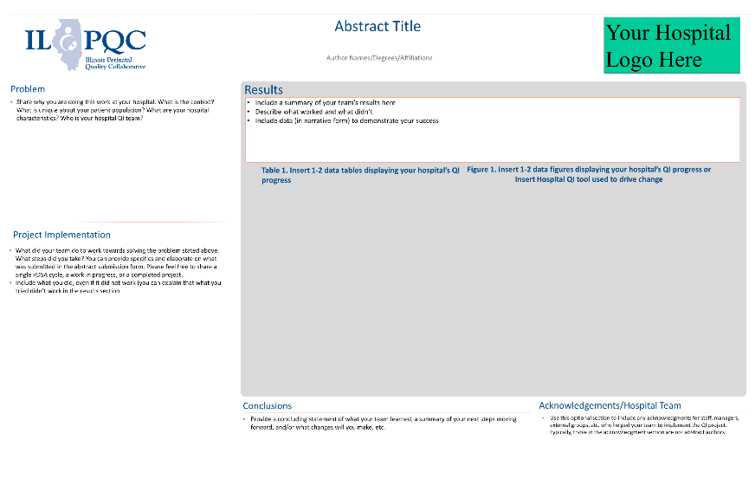
Poster Template Available

Slide 55
Poster Session and Abstracts
Questions?
ILPQC offers a variety of support services to assist with abstract/poster submission
  Poster Template
  Mentorship Services
  FAQ Tool
  Information + Q&A Sessions after team webinars
Expert abstract reviewers & past awardees will be available immediate following team calls starting 9/21
Please share your thoughts!
Notes:
Do we want to include a box asking the OB advisory peeps their thoughts on these strategies? AP (Ieshia by updated 9/10/2020)

