Slide 1

MNO- Neo Teams Call:
Optimizing non-pharmacologic care to support and reduce pharmacologic treatment of NAS symptoms
August 17th, 2020
1:00 – 2:00pm

Slide 2
Call Overview
MNO-Neonatal: Next steps to support hospital teams achieve the initiative goals and debrief
Data Review
Optimizing non-pharm to support and reduce pharm treatment of NAS symptoms- ILPQC Resources
Round Robin
BASIC 2020 planning updates and discussion
Annual Conference

Slide 3
Next steps to support hospital teams achieve the initiative goals and debrief

Slide 4
Crossing the Finish Line with MNO-Neo
This summer into fall we will focus on helping all hospital teams achieve key aims to cross the finish line and move into sustainability
Not all teams are there yet, but these aims are achievable and we have clear strategies to achieve our goals to decrease NAS pharmacologic care as appropriate, increase breastfeeding for eligible mothers, & coordinate discharge to ensure optimal care for OENS in every hospital, for every patient, every time.
  OENs receiving breastmilk from eligible mothers at discharge > 70%
  OENs with NAS symptoms receiving pharmacologic treatment <20%
  OENs discharged with a coordinated discharge plan> 95%
Notes:
Ieshia updated 8/7/2020

Slide 5

Strategies for
MNO-Neo Teams
NAS Assessment tool
Systems for NAS Care
Coordinated Discharge
We must provide non-pharm care as the first line treatment for OENs and NAS care.
OEN Admission Team Huddles- initiated by the charge nurse to include all care team members to obtain and launch tool in the MNO-Neo Folders
Partner with OB team to implement Prenatal Care team conferences
Key strategy for building partnerships for ongoing care for OENs
Use tools/systems of NAS care (MNO-Neo Folder, Prenatal Care team conference and Admission Huddles) to begin the process
Implement standardized protocols for care teams to engage families in optimizing non-pharmacologic
Provide education to mother/families prenatally during Prenatal Care team conferences
NAS Clinical debrief- implement of a NAS Clinical Debrief Review Form with the clinical team
Educate staff on MNO Coordinated Discharge Checklist and Collaborative Discharge Plan included in MNO-Neo folder for early activation

Slide 6
Systems for
Optimal OEN Care
MNO Folders. Initiate the MNO folder to help create a standardized system to provide the highest level of care for every OEN (including the coordinated discharge materials) to provide the highest level of care for every OEN
OEN Admission Huddle. Utilize an “OEN Admission Huddle” with the care team (Neo, Peds, Nursing, Social Work, etc.) at newborn admission to NICU/SCN/NBN to review the MNO folder and begin the coordinated discharge
MNO-Neonatal Education Campaign. Implement standardized education for providers and nurses on key elements of the MNO-Neonatal initiative, including the importance of engaging families in non-pharmacologic care and coordinated discharge planning.
Non-Pharmacologic Care. Implement standardized protocols for care teams to engage families in optimizing non-pharmacologic care as the first line of treatment for OENs
Coordinated Discharge. Include the MNO Coordinated Discharge Checklist and Collaborative Discharge Plan in every MNO-Neonatal folder activated by the care team when the mother delivers.

Slide 7
MNO-Neo Data Review

Slide 8
Making Systems Change Happen
83%
89%
of teams have a prenatal consult protocol in place
of teams have a non-pharm protocol in place
85%
89%
of teams have a pharm protocol in place
of teams have a discharge protocol in place

Slide 9
Achieving MNO-Neo AIMs Together: Received Maternal Breastmilk from Eligible Mothers at Infant Discharge
AIM = ≥ 70%

Slide 10
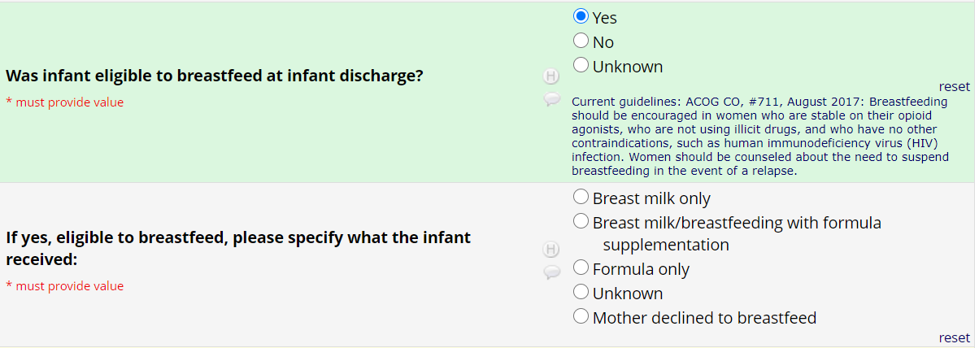
UPDATED REDCAP Question!

Slide 11
Achieving MNO-Neo AIMs Together: Received Pharmacologic Treatment
AIM = ≤ 20%
Notes:
Can we put the day slides here?

Slide 12
Achieving MNO-Neo AIMs Together: Discharged with a Coordinated Plan
AIM = ≥ 95%

Slide 13
Achieving MNO-Neo AIMs Together: Mothers engaged in Non-Pharmacologic Care

Slide 14
Achieving MNO-Neo AIMs Together: Use of ESC & Modified-Finnegan for NAS Assessments

Slide 15
Use of PRN & Standard Dosing for Pharmacologic Treatment

Slide 16
Optimizing non-pharm to support and reduce pharm treatment of NAS symptoms- ILPQC Resources

Slide 17

Finding the Right Balance
Non-pharm care as the first line treatment for OENs
Provide Pharm care as needed to treat OENs

Slide 18
Considerations for Pharm
Management of NAS
All OENs should receive these non-pharm interventions as the first-line treatment
  Skin-to-skin contact with parents as often as possible
  Decreased stimulation (lights/sound)
  Cluster care to avoid unnecessary wakings between feeds
  Swaddling
  Pacifier
  Breastfeeding (if eligible)
Pharmacological treatment is considered the last resort after all non-pharmacological measures have been unable to control NAS
Most OENs will exhibit signs & symptoms within 48-72 hours after birth
Notes:
This info came from our toolkit resources and from neoQIC- AP

Slide 19
Optimize Non-Pharmacologic Care
ILPQC Resources.
ILPQC Infant Bedside Sheet (tool for providers & nursing to track assessment, family engagement, and non-pharm bundle)
ILPQC Newborn Care Diary (tool for MOTHER and/or CAREGIVER to be engaged in tracking ESC & non-pharm care of newborn in conjunction with care team
Sample Rooming-In policy for mother-infant dyad impacted by in-utero opioid exposure (tool for team to model a rooming-in policy for unit)
NEW- FREE Trauma Informed Care eModules for providers, nurses, and staff https://www.aquifer.org/courses/trauma-informed-care/
Engaging Mom/Caregiver in Non-Pharmacologic Care & Team Huddle SIMULATION VIDEOS & DEBRIEFS (tools to train your providers, nurses, and staff)
  Eat, Sleep, Console Simulation & Debrief
  Engaging Mom in Non-pharm care & team huddle Simulation & Debrief
How is YOUR team utilizing these resources for every OEN every time?

Slide 20
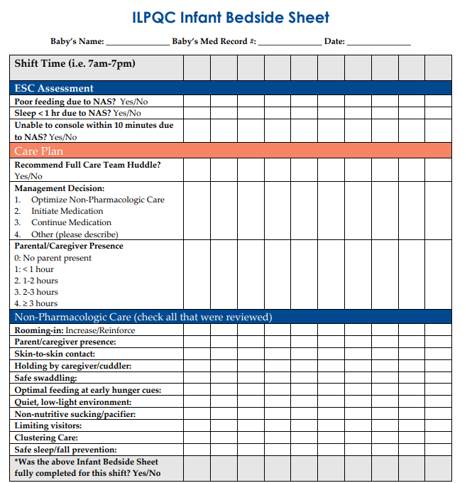
Infant Bedside Sheet
Tracking OEN’s ability to eat, sleep & console
Tool for GROUP decision to reinforce Non-Pharm or escalate to pharm (Includes PARENTS)
Is your team optimizing the non-pharm bundle & engaging the mother/caregiver EVERY TIME before going down a pharm route?

Slide 21
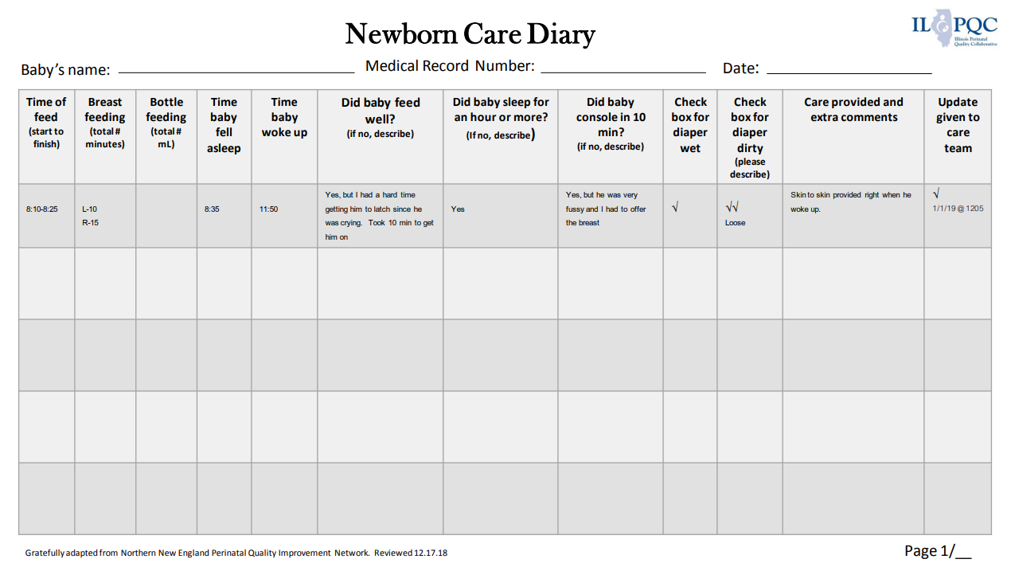
Newborn Care Diary
How is YOUR team actively engaging mothers/caregivers/staff in non-pharmacologic care
MOTHER/CAREGIVER Tracking OEN’s ability to eat, sleep & console
MOTHER/CAREGIVER Tracking reinforcing Non-pharmacologic bundle
ILPQC Newborn Care Diary- tool to be used by the family to NAS Assessments to track non-pharmacologic care being optimized and partner with the care team. Built in empower the family in engaging in the care of the newborn (included in the MNO Folder!)

Slide 22
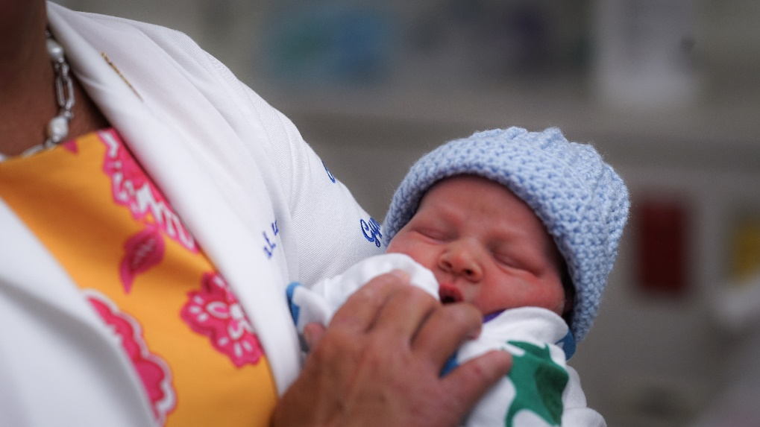
Cuddler Program launched by SSM Health St. Mary's Hospital and Cardinal Glennon. Example materials graciously shared with ILPQC by Mary Hope and her affiliated institutions:
CGCH Volunteer Service Description
Cuddler Presentation
Cuddler Training
Parent Letter
SMH Volunteer Service Description
Staff Update Letter CG
Volunteer Tracking Sheet Cuddlers
How is YOUR team actively engaging mothers/caregivers/staff in non-pharmacologic care

Slide 23



Available now
Join us at ILPQC and participate this August National Breastfeeding Awareness for MNO
Post **NEW** ILPQC Breastfeeding Awareness Resources in your staff lounges and on your unit
Share and distribute ILPQC Breastfeeding Packet that you receive in you MNO-Neo Newsletter
Complete at least 1 Breastfeeding Missed Opportunity Review form to improve non-pharm care and encourage breastfeeding for eligible infants

Slide 24
Care Team Education to
Optimize Non-Pharm Care
MNO-Neonatal Key Messages and Strategies Poster
Mothers are the Best Treatment Option Poster
Supporting Breastfeeding Poster
Eat-Sleep-Console Simulation & Debrief Video
Engaging Mom in Non-Pharmacologic Care Simulation & Debrief Video

Slide 25
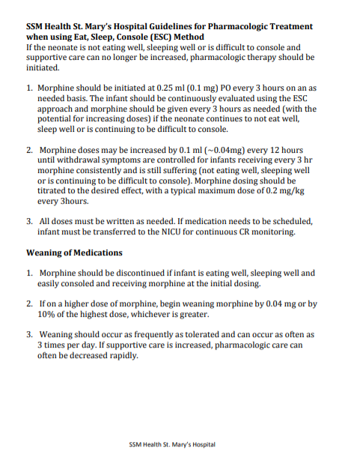
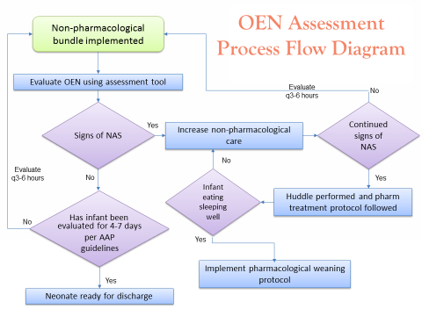
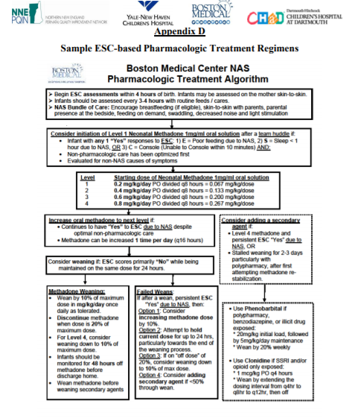
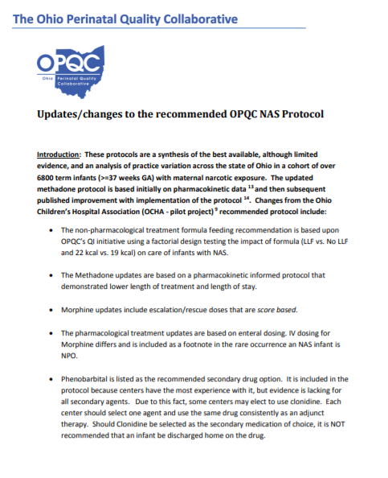
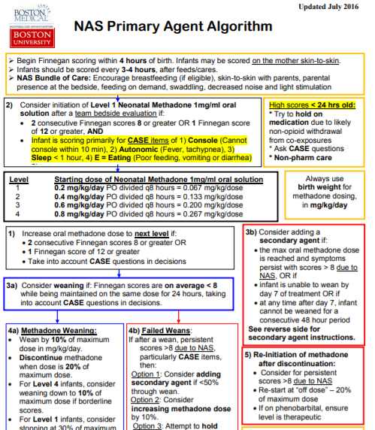
ILPQC Resources for pharmacologic care
PRN Morphine Resources
Weaning Resources
ILPQC team webinar and QI corner
SSM St Mary’s Protocol
NNEPQIN ESC Protocol
BMC Primary and Secondary Agent Algorithms
OPQC NAS Protocol

Slide 26
OEN Assessment Process Flow Diagram
Non-pharmacological bundle implemented
Evaluate using NAS assessment tool
Evaluate
q3-6 hours
No
Signs of NAS
Continued signs of NAS
Yes
Increase non-pharmacological care
No
Evaluate
q3-6 hours
No
Infant eating sleeping well
Yes
Has infant been
Huddle performed and pharm treatment protocol followed
No
evaluated for 4-7 days
per AAP
guidelines
Yes
Implement pharmacological weaning protocol
Yes
Neonate ready for discharge

Slide 27
Care team huddle performed and decision made to initiate pharmacological treatment protocol
Pharm Care
Process Flow
Initiate PRN morphine PO at (0.1mg)
All dose orders should be written as needed
Re-evaluate infant q 3 hours
Give 2nd PRN dose
If scheduled,
First increase dose by (~0.04mg)
- For subsequent doses, increase dose by 0.04 mg q 12 until symptoms are controlled.
- If infant is still suffering, dosing should be titrated to the desired effect, with a typical max dose of 0.2 mg/kg every 3hours
Infant consolable, sleeping well
No
Yes
Is on scheduled morphine and dose higher than 0.1mg
Yes
Begin weaning at 0.04mg or 10% of the highest dose (whichever is greater)
Wean as tolerated up to 3x/day and increase non-pharm care
No
Discontinue morphine and implement non-pharm bundle

Slide 28
MNO-Neo 2020 Timeline
Summer 2020:
All teams work to cross the finish line, and start sustainability plan
Fall & Winter 2020
Work to implement sustainability plan, ILPQC 1:1 QI Support for hospitals
2021:
Quarterly Sustainability check in Calls with Teams, implement sustainability plans

Slide 29
Upcoming MNO-Neonatal Teams Calls
Date | Topic
August 2020 | Optimizing non-pharmacologic care to support and reduce pharmacologic treatment of NAS symptoms
September 2020 | Coordinated Discharge… begins at newborn admission to mother-baby unit
October 2020 | No Teams Call - 2020 Annual Conference
Notes:
Other Topic ideas:
-Multi Substance Exposure
-Working with Patient/Family Challenges; Meeting Mothers and Families where they are at

Slide 30
MNO-Neonatal discussion/round robin

Slide 31

Please share …
What assessment tool are you using to increase non-pharm care?
What systems are you putting into place to every OEN patient seen at your hospital is receiving optimal non-pharm care ?
What key steps do you need to take to cross the finish line and achieve key MNO aims by October 2020
Feel free to share a case where your team successful provided appropriate prn pharm care while optimizing non-pharm care
*6
Unmute

Slide 32
Recap: Care Team Resources to
Optimize Non-Pharm Care
ILPQC Prenatal Consultation Checklist- include important information to share with mother/family about engaging in non-pharmacologic care of the newborn
ILPQC Infant Bedside Checklist- tool to be used by the care team during NAS Assessments to track non-pharmacologic care being optimized by care team and family. Built in process to facilitate huddles with the family
Breastfeeding Traffic Light- tool that provides guidance on supporting breastfeeding for pregnant persons with OUD, lays out contraindications in easy to understand table
NAS Clinical Debrief Form- Use this form to review missed opportunities in caring for Mothers and Newborns affected by Opioids with the clinical care team. This form will facilitate review of: prenatal consult, non-pharmacologic care, breastfeeding, and coordinated discharge
Should all be included in the MNO-Neo Folder!

Slide 33
Babies antibiotic stewardship improvement collaborative (BASIC) Updates

Slide 34
BASIC Vision
ILPQC Hospitals, regardless of perinatal levels, will implement standardized system-wide guidelines, policies, and protocols
to provide appropriate antibiotics
to appropriate babies
for the appropriate length of time
Notes:
Added 10/22/19

Slide 35
Accomplishments since
November 2020
What we have
What we’ve done
Proven effective strategies from other PQCs
Draft aims and key driver diagram
Review of work by North Carolina, Tennessee, VON
4 BASIC clinical leadership meetings
Kick-off Planning Committee meeting in March 2020
This month!
Measures, data form,
20 WAVE 1 teams test and provide feedback

Slide 36
BASIC 2020 Timeline
June-July 2020:
Workgroup finalize AIMs, Measures, Data Form
Aug-Oct 2020:
Wave 1 tests data collection process
October 29, 2020
Statewide Launch
November 2020: Monthly webinars begin
Wave 1 Launch→
Tuesday, August 25th
Notes:
Added 10/22/19

Slide 37
Annual Conference 2020

Slide 38
Save the date!
ILPQC VIRTUAL
Annual Conference 2020 October 29, 2020

Slide 39
ILPQC 2020 Line-up for AC
Dr David LaGrew (CA)-Promoting Vaginal Birth
Dr. Dmitry Dukhovny (OR)- Antibiotic Stewardship
PQC Leader Panel:
  Dr. Susan Hwang (CO), Charlene Collier (MS), Brenda Barker (TN)
Dr. Veronica Gillispie (LA)- Birth Equity
Patient stories
  Kristen Terlizzi – Accreta Foundatation
  LaTosia Rouse- NNPQC

Slide 40
To be awarded at the 2020 ILPQC annual conference
MNO-Neo Award for Successful Completion of Key Initiative AIMs Awards
*All Data Submitted
+
4 Structure Measures In Place (Neonatal Prenatal Consult, Non-Pharmacologic Protocol, Pharmacologic Protocol, Discharge Plan)
+
All Process Measure goals met** >70% MAT, >70% Recovery Treatment Services >60% Narcan, >70% Hep C >70% Patient Education, >50% Prenatal Screening
**Determined by Cumulative data for Quarter 3 (July - September) of 2020
*All Data Submitted for Baseline (Oct – Dec 2017) and July 2018 through September 2020
*MNO-Neo Monthly Patient Data, Monthly Neo Structure Measures
    DATA DUE Friday, October 16th by MIDNIGHT

Slide 41
Annual Poster Session
Call for Abstracts & Posters
Due October 9th for consideration for awards of excellence; October 23rdfor late breaking
Posters must be submitted by October 23rd to be displayed during Annual Conference
All hospital teams encouraged to submit on complete or in-progress QI work
  Especially encourage hospitals that have not previously submitted, including Level I/II and NBN
  Poster template and support available from ILPQC
  Special award category
Submit via survey form – Link will be distributed during next week

Slide 42



THANKS TO OUR
FUNDERS
Notes:
Updated 10/22/19

