Slide 1

COVID-19 Strategies for OB & Neonatal Units
September 4, 2020
12:00 – 1:15pm

Slide 2

Welcome
Please be certain you are on “mute” when not speaking to avoid background noise.
Whether you have joined by phone or computer audio, you can mute and unmute yourself by clicking on the microphone icon.
The following shortcuts can also be used
For PC: Alt + A : Mute or Unmute
For Mac: Shift + Command + A: Mute or Unmute
For telephone: *6 : Mute or Unmute

Slide 3
Housekeeping:
We Are Recording Now

Slide 4
ILPQC Covid 19 webinars
The strategies shared today are examples from individual institutions not IDPH or ILPQC recommendations.
This is our 12th COVID-19 strategies for OB/Neonatal Units webinars in coordination with IDPH, since April 3rd. Please see https://ilpqc.org/covid-19-information/ for future webinar registration, prior recorded webinars and written out Q/A’s from those webinars.
The next webinar will be Friday, October 2, noon to 1:15pm. We are continuing monthly webinars for now.
Please let us know if your hospital would like to share on an upcoming webinar, please put questions/comments into the chatbox or email directly to info@ilpqc.org

Slide 5
Overview
Introduction
IDPH Birthing Hospital Covid Sentinel Surveillance update
  Amanda Bennett, PhD, MPH, CDC Field Assignee in Maternal and Child Health Epidemiology, Illinois Department of Public Health
Discussion of OB Unit Strategies
  Rob Abrams, MD, Executive Director - SIU Center for Maternal - Fetal Medicine, HSHS St. John's Hospital, Springfield
  Emma Adams, MD – 2nd year OB/GYN resident SIU, Springfield
  Fidel Abrego, MD - Obstetrics & Gynecology, John H. Stroger, Jr. Hospital
  Julia Simon, MD – Obstetrics & Gynecology, University of Chicago
  Sarah Bradley MD - OB Hospitalist, Swedish American Hospital, Rockford
Discussion of Neonatal Unit Strategies
  Justin Josephsen, MD, Medical Director – St. Mary’s Hospital NICU, Neonatologist Cardinal Glennon Children’s Hospital, St. Louis
  Leslie Caldarelli, MD, NICU Director, Prentice Women's Hospital, Chicago

Slide 6
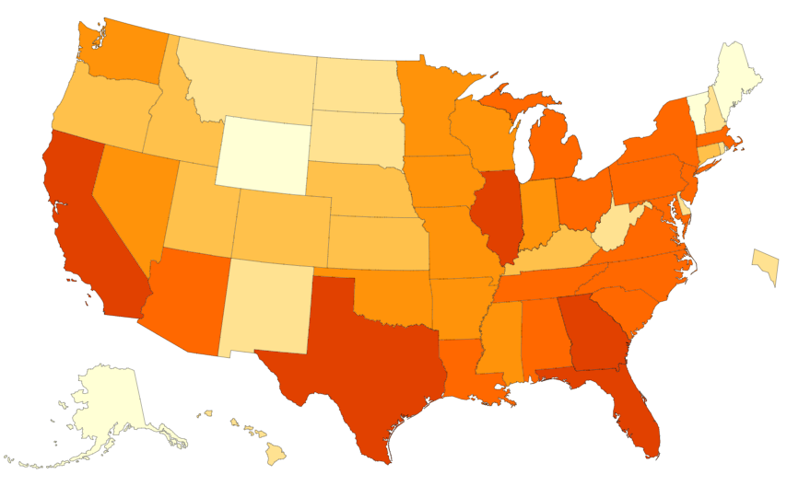
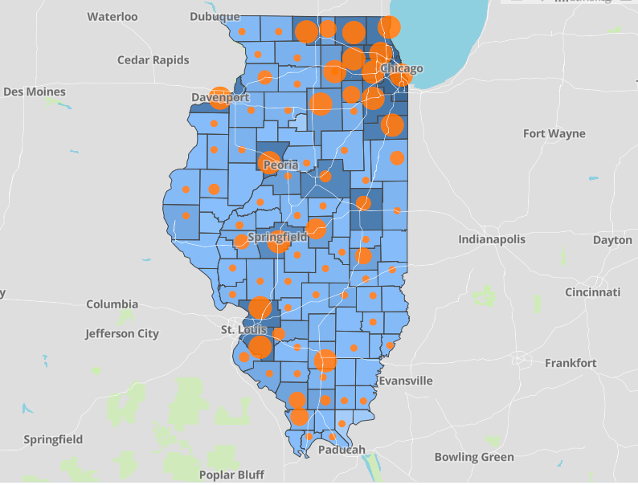
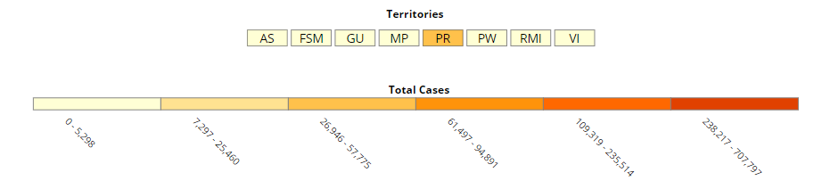
Data Update September 3, 2020
CDC/IDPH: COVID-19 Outbreak
CDC https://www.cdc.gov/coronavirus/2019-ncov/cases-updates/cases-in-us.html | IDPH https://www.dph.illinois.gov/covid19
Total cases: 6,047,692 confirmed Total deaths: 184,083 confirmed | 238,643 Confirmed Positive Cases 8,091 Deaths
Notes:
Ieshia updated 9/3/2020

Slide 7
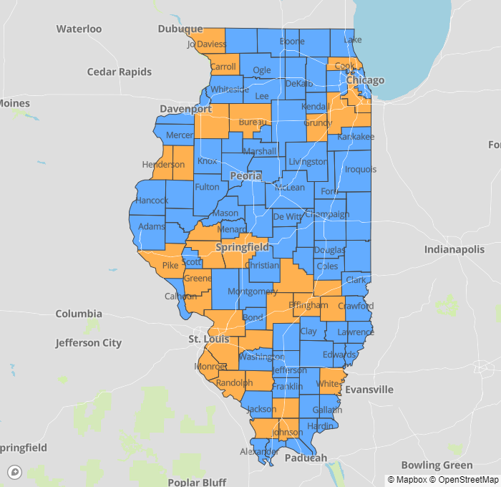
IDPH County Level COVID-19 Risk Metrics
Week 34:
8/16/2020 - 8/22/2020
Blue indicates that the county is experiencing overall stable COVID-19 metrics.
Orange indicates there are warning signs of increased COVID-19 risk in the county.

Slide 8
Hot off the presses…
Dr. Anthony Fauci (9/4/2020)
“ There are several states at risk of surging, namely North Dakota, South Dakota, Iowa, Arkansas, Missouri, Indiana, Illinois. Those states are starting to see an increase in the percent positive of their testing; that is generally predictive that there is going to be a problem.”

Slide 9
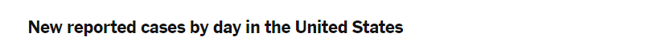
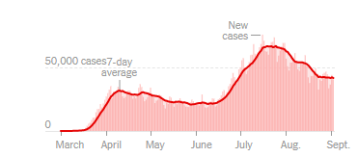
US COVID case trend
Notes:
Ieshia updated 9/3/2020
https://www.nytimes.com/interactive/2020/us/coronavirus-us-cases.html

Slide 10
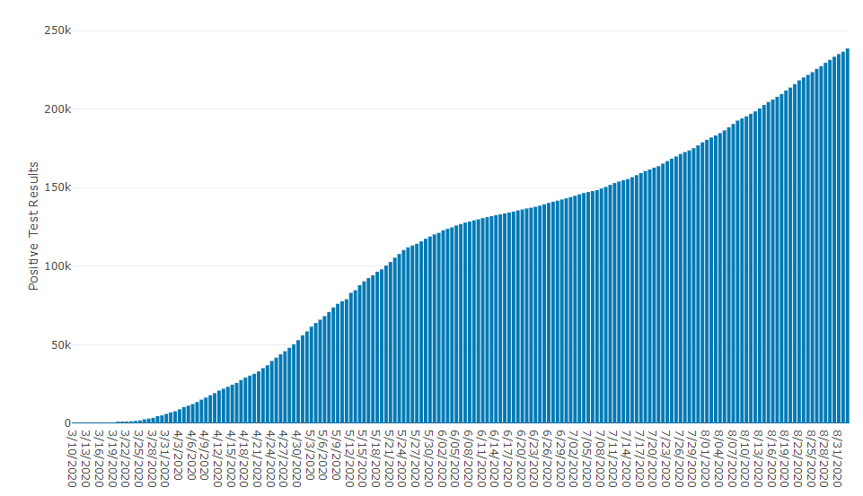
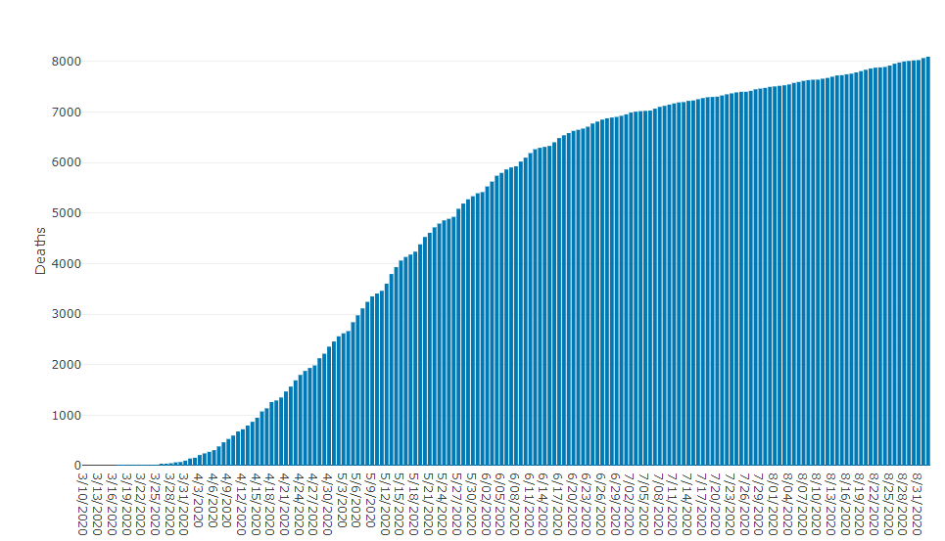
Data Update September 3, 2020
IDPH: COVID-19 Outbreak
https://www.dph.illinois.gov/covid19
IL Positive Cases Over Time
IL Deaths Over Time
Total: 238,643 Confirmed Positive Cases
Total: 8,091 Deaths
Notes:
http://www.dph.illinois.gov/covid19/covid19-statistics
Ieshia update 9/3/2020

Slide 11
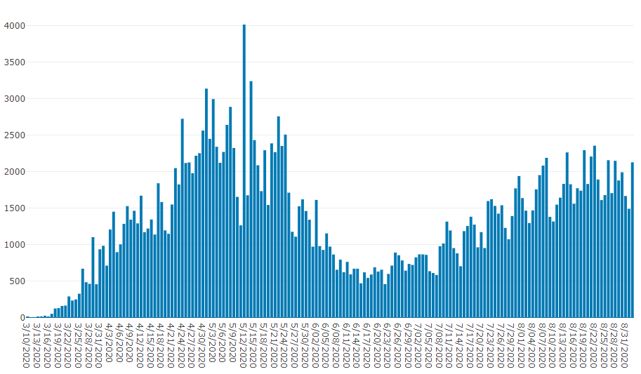
Illinois Daily Incidence
IDPH daily data summary
Notes:
Ieshia updated 9/3/2020
https://www.dph.illinois.gov/covid19/covid19-statistics

Slide 12
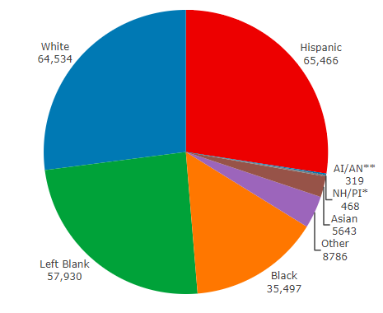
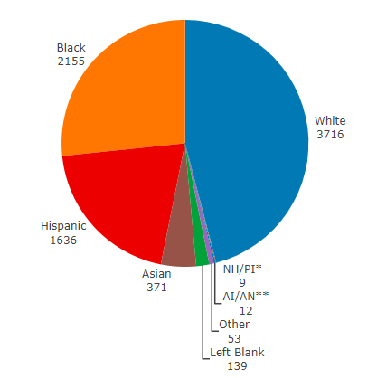
Data Update September 3, 2020
IDPH: COVID-19 Outbreak
Race Demographics
https://www.dph.illinois.gov/covid19
Confirmed Cases
Deaths
Notes:
http://www.dph.illinois.gov/covid19/covid19-statistics
Ieshia updated 9/3/2020

Slide 13
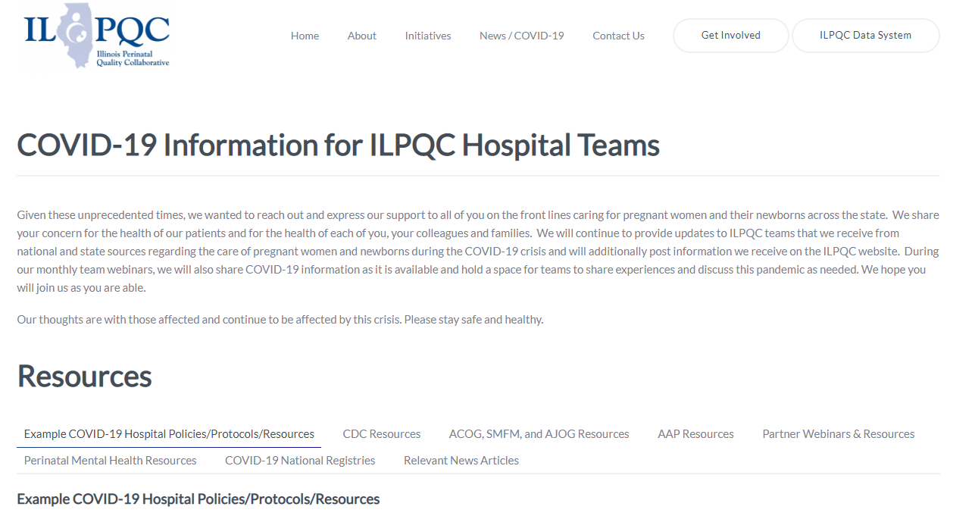
ILPQC COVID-19 Webpage www.ilpqc.org
ILPQC posts national guidelines and OB & Neonatal COVID-19 example hospital protocols & resources
please note dates as guidelines are changing rapidly
https://ilpqc.org/covid-19-information/

Slide 14
Updated OB (ACOG/SMFM) Resources
AJOG MFM: Coronovirus Guidance
ACOG: Statement on new CDC data COVID-19 and Pregnancy (6.24.2020)
Preeclampsia Foundation: How To Take Your Blood Pressure. (7.8.2020)
SMFM: Management Considerations for Pregnant Patients with COVID-19 (7.2.2020) updated
ACOG: COVID-19 FAQs for Obstetrician-Gynecologists, Ethics. (7.14.2020)
ACOG: Coronavirus (COVID-19), Pregnancy, and Breastfeeding: A Message for Patients (7.14.2020)
ACOG: Coronavirus (COVID-19) and Women’s Health Care: A Message for Patients. (7.23.20)
SMFM: Coronavirus (COVID-19) and Pregnancy: What Maternal-Fetal MedicineSubspecialists Need to Know (7.23.2020)
ACOG:COVID-19 FAQs for Obstetrician-Gynecologists, Obstetrics (Updated 8.4.2020)​
ACOG: Practice Advisory (Updated 8.12.2020)​

Slide 15
Updated Neonatal /AAP Resources
Multisystem Inflammatory Syndrome in Children (MIS-C) Interim Guidance: Clinical guidance for pediatricians including signs, symptoms, diagnosis and management of this rare but serious complication associated with COVID-19. (9/1/2020)
Frequently Asked Questions: Interfacility Transport of the Critically Ill Neonatal or Pediatric Patient with Suspected or Confirmed COVID-19: Guidance for both ground and air patient movements that balances infection control with transport safety to reduce risks for medical staff and patients. (8/26/2020)
Family Presence Policies for Pediatric Inpatient Settings During the COVID-19 Pandemic: Guidance on family presence policies developed to support family-centered care for all children and particularly for children with special health care needs, including those with disabilities, medical complexity, and serious illness. (8/7/2020)
Breastfeeding Guidance Post Hospital Discharge for Mothers or Infants with Suspected or Confirmed SARS-Co V-2 Infection: Guidance developed to support pediatricians providing direct care for breastfeeding families after discharge from the newborn hospital stay. (Updated 7/29/2020)
Newborn Care: Guidance for the care of infants whose mothers have suspected or confirmed COVID-19: Includes precautions for birth attendants, rooming-in, breastfeeding, testing, neonatal intensive care, visitation and hospital discharge. (Updated 7/22/2020)
Newborn Screening During the COVID-19 Pandemic: Guidance recommending that pediatricians continue to follow federal and state guidelines on newborn bloodspot screening, newborn hearing screening, and critical congenital heart disease screening. (7/16/2020)

Slide 16
Updated OB/Neo Covid Publications
NEJM: False Negative Tests for SARS-CoV-2 Infection — Challenges and Implications (6.5.2020)
OBGYN: Prone Positioning for Pregnant Women With Hypoxemia Due to Coronavirus Disease 2019 (COVID-19) (6.9.2020)
CDC MMWR: Characteristics of Women of Reproductive Age with Lab-Confirmed SARS-CoV-2 Infection by Pregnancy Status (6.26.2020)
JONN: Covid-19 In Babies: Knowledge for Neonatal Care. (6.29.2020)
AJOG: The role of a cytokine storm in severe COVID-19 disease in pregnancy. (7.8.2020)
JAMA: Change in the Incidence of Stillbirth and Preterm Delivery During the COVID-19 Pandemic (7.10.2020)​
AJOG: Implementation of Universal Testing for SARS-CoV-2 in pregnant women with intended admission for delivery (7.10.2020)​
BMJ: Clinical manifestations, risk factors, and maternal and perinatal outcomes of coronavirus disease 2019. (9.1.2020) ​
JAMA: Corticosteroids in COVID-19 ARDS Evidence and Hope During the Pandemic (9.2.2020)
JAMA: Association Between Administration of Systemic Corticosteroids and Mortality among Critically Ill Patients with COVID-19. (9.2.2020)
​

Slide 17
Birth Equity Links
Please see the following links and publications for information that may help your organization consider next steps to take action to address birth equity and reduction of perinatal racial and ethnic disparities.
AIM: Reduction of Peripartum Racial/Ethnic Disparities Patient Safety Bundle (2018)
ACOG: Reduction of Peripartum Racial and Ethnic Disparities: a conceptual framework and maternal safety consensus bundle (May 2018)
ACOG Committee Opinion No. 729: Importance of Social Determinants of Health and Cultural Awareness in the Delivery of Reproductive Health Care (January 2018)
SMFM: Strategies to overcome racism's impact on pregnancy outcomes (May 2020)
SMFM: Strategies to provide equitable care during COVID-19 (May 2020)
ACOG: Addressing Health Equity During the COVID-19 Pandemic (May 2020)
AAP Policy Statement: The impact of racism on child and adolescent health (Aug 2019)
Today: Black. Pregnant. And COVID-19 positive. (7.8.2020)
CDC: COVID-19 Response Promising Practices in Health Equity II (7.31.2020)
CDC: HEAR HER Campaign (8.4.2020)strategies promote birth equity and reduce preventable maternal mortality

Slide 18
IDPH / HFS / CDC Communications
HFS: Provider Notice Issued Blood Pressure Monitoring Kit (7.2.2020)​ - Medicaid now covers home BP cuffs for all pregnant / postpartum patients
CDC: Evaluation and Management Considerations for Neonates At Risk for COVID-19. (8.3.2020)​
CDC Data on Covid-19 and Pregnancy (9.3.2020) https://www.cdc.gov/coronavirus/2019-ncov/cases-updates/special-populations/pregnancy-data-on-covid-19.html

Slide 19
COVID Mental Health Support Resources for Physicians & Healthcare Workers
Project Parachute: offers pro-bono teletherapy (video or phone) to frontline workers
  https://project-parachute.org/
Physician Support Line
  staffed by volunteer psychiatrists
  offers free and confidential peer support to physicians in the U.S.
  available daily by calling 1 (888) 409-0141 from 8 a.m. to 3 a.m. EST.
For the Frontlines: 24/7 help line provides free crisis counseling for frontline workers. Text FRONTLINE to 741741

Slide 20
COVID Self-Help Support Resources for Physicians & Healthcare Workers
Meditation apps offering free subscriptions to frontline workers:
  Headspace https://www.headspace.com/health-covid-19
  Ten Percent Happier https://www.tenpercent.com/care offering free subscription to frontline workers
Delightful Gratitude https://delightfuljournal.com/ - free app to help practice daily gratitude, empirically shown to improve mood and outlook

Slide 21
COVID-19 Support for Patients
NorthShore MOMS Line 1-866-364-6667
  Staffed 24/7 by licensed mental health professionals
  Provides crisis intervention, support, psychoeducation, referrals & resources
Crisis Text Line: Text CONNECT to 741741
Postpartum Support International
  Offers phone-based and online support groups
  https://www.postpartum.net/get-help/help-for-moms/
Beyond the Baby Blues
  Free 6-session virtual support groups
  www.beyondthebabyblues.org

Slide 22
COVID-19 Support for Patients
The Wingspan Project
  https://www.thewingspanproject.org/community-response-program.html
  Pro bono psychotherapy for individuals from underserved and/or underrepresented communities, with emphasis on those impacted by recent protests and/or COVID-19
  Marcy Lichterman LCSW & Solveig Roverud LCSW are participating therapists with perinatal expertise

Slide 23

Masks for MOMS
Masks for MOMS Illinois launched on April 21, 2020 to help meet the need for cloth masks among pregnant and postpartum persons in the Chicagoland area in response to the COVID-19 Pandemic.
We will continue to accept donations through mid-Sept; for more information: https://coeinmch.uic.edu/masks-for-moms/
If your Chicagoland site needs masks for labor/delivery or postpartum patients, please email coemch@uic.edu
  To date:
    13,700 masks have been donated
    Over 140 donors and volunteers have contributed
    Masks have been donated to the following sites and hospitals:
Healthcare Sites | Hospitals
• Access Community Health Network • Chicago Family Health Center • Christian Community Health Center • Erie Family Health Centers • Esperanza Health Centers • Family Christian Health Center • Friend Family Health Center • Near North Health Service Corp • PCC Community Wellness Centers • PrimeCare Health Centers • UI Health Mile Square South Shore Health Center | • Advocate Trinity Hospital • Cook County Hospital • Lawndale Christian Hospital • Norwegian American Hospital • Roseland Hospital • Rush University Medical System • South Suburban Hospital • UChicago Medicine- Bernard Mitchell • UChicago Medicine- Ingalls Memorial Hospital • University of Illinois Hospital

Slide 24

NIH: Covid-19 Workshop
MEETING DATE AND TIME:
Tuesday, September 15, 2020
10:00 a.m.–4:15 p.m. Eastern Time
MEETING LOCATION:
This is a virtual meeting. Login details will be emailed to registrants closer to the meeting date.
REGISTRATION:
Attendance is free, but registration is required. REGISTER HERE
WORKSHOP PLANNING COMMITTEE
Zhaoxia Ren, M.D., Ph.D., NICHD, National Institutes of Health
Lynne P Yao, M.D., The U.S. Food and Drug Administration
Katherine L. Wisner, M.D., Northwestern University
Catherine Susan Stika, M.D., Northwestern University

Slide 25

ILPQC 8th Annual Conference

Slide 26
IDPH Update
IDPH Perinatal Sentinel Surveillance update
  Amanda Bennett, PhD, MPH, CDC Field Assignee in Maternal and Child Health Epidemiology, Illinois Department of Public Health

Slide 27
Perinatal Sentinel Surveillance - Pilot
Developed process for hospitals to submit aggregate (count) data on COVID-19 tests and results
  Intent is for system to be low burden
Piloted data submission process with 8 hospitals for over one month, testing:
  Ease of use
  Utility of data to IDPH
Chart credit: Civis Analytics

Slide 28
Perinatal Sentinel Surveillance Reminder
Sentinel surveillance captures timely changes in disease occurrence rates to signal need for early intervention and mitigation efforts
Delivering women are an ideal population for sentinel surveillance
  Relatively stable and healthy
  Continue to seek care in hospital, despite COVID-19
  Universal testing establishes true prevalence in population
IDPH has new sentinel surveillance system for hospitals conducting universal COVID-19 testing at labor & delivery
  Invitation email and materials sent from IDPH on 8/17 (to hospitals that indicated on state survey that they are doing universal testing)
  Hospitals report aggregate data to REDCap each week
    Daily counts for five data points
    Brief questions about testing and specimen types in use at hospital
  Voluntary hospital participation is needed – if interested, contact:
    Amanda.C.Bennett@Illinois.gov
    Sonal.Goyal@Illinois.gov

Slide 29
Discussion of OB Unit Strategies

Slide 30


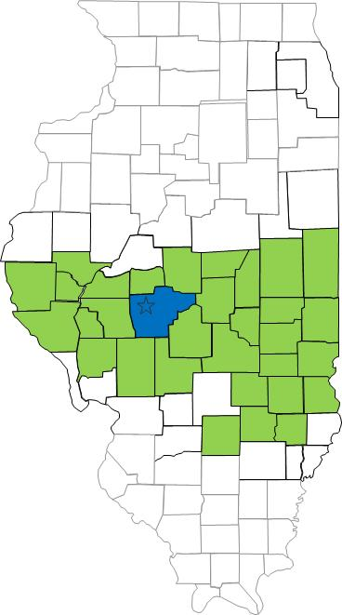

Springfield, IL
South Central Illinois Perinatal Center, Level III
2100 annual births
40 bed NICU

Slide 31
LB, 28 year old G4P2012 at 27w0d
Transferred for COVID associated pneumonia in a di-di twin pregnancy
ICU stay for 1 week, continuous FHT for 5 days
  Variables on FHT, growth scan and Dopplers normal
2 u convalescent plasma, 5 d. Remdesivir, 10 d. dexamethasone
Mild range BP, proteinuria, elevated LFTs, elevated Cr
Transfer to antepartum unit once 1 L O2 => transition to TID monitoring, labs normalizing
Discharged when on room air; LOS: 2 weeks

Slide 32
Lessons Learned
Every case is different
Communication and fetal monitoring in the ICU
Communicating the different needs of pregnant patients to hospital medicine/intensivist colleagues
  Increased O2 sat guidelines
  Home O2 trial recommendation
Differentiating preeclampsia from COVID-related lab abnormalities

Slide 33
SMFM updated Guidance Discussion
SMFM: Management Considerations for Pregnant Patients with COVID-19 (7.2.2020) updated

Slide 34
Question
What guidance has been provided to assist in decision making around when Covid pregnant patients should be admitted versus monitored as an outpatient?

Slide 35
Outpatient Monitoring for pregnant patients with mild or no symptoms
Outpatient monitoring with a 14-day self-quarantine can be considered for pregnant patients with COVID-19 who have mild symptoms or are asymptomatic. Recommendations for outpatient monitoring is outlined.
Check on outpatient Covid positive patients regularly and review signs/symptoms to call, recognize can worsen around day 7-10
For 3rd trimester patients who need outpatient fetal or maternal monitoring establish protocol: schedule at the end of the day with limited staff with appropriate PPE
After 14 days from positive test or symptom onset, if symptoms improved and no fever >72 hours then can be considered recovered.
SMFM: Management Considerations for Pregnant Patients with COVID-19 (7.2.2020) updated

Slide 36
The severity scale for COVID-19
Asymptomatic or presymptomatic disease or presumptive infection is defined as a positive COVID-19 test result with no symptoms.
Mild disease is defined as flu-like symptoms, such as fever, cough, myalgias, and anosmia without dyspnea, shortness of breath, or abnormal chest imaging.
Moderate disease is defined by evidence of lower respiratory tract disease with clinical assessment (dyspnea, pneumonia on imaging, abnormal blood gas results, refractory fever of 39.0 °C /102.2 °F or greater, while maintaining an oxygen saturation of greater than 93% on room air at sea level.
Severe disease is defined by a respiratory rate greater than 30 breaths per minute (bpm), hypoxia with oxygen saturation less than or equal to 93%, a ratio of arterial partial pressure of oxygen to fraction of inspired oxygen of less than 300, or greater than 50% lung involvement on imaging.
Critical disease is defined as multi-organ failure or dysfunction, shock, or respiratory failure requiring mechanical ventilation or high-flow nasal cannula.
SMFM: Management Considerations for Pregnant Patients with COVID-19 (7.2.2020) updated

Slide 37
Inpatient monitoring may be needed for the following categories of patients:
Pregnant COVID-19 patients with moderate to severe signs and symptoms or oxygen saturation less than 95%. (incudes dyspnea)
Pregnant COVID-19 patients with comorbid conditions, eg, uncontrolled hypertension, inadequately controlled gestational or pregestational diabetes, chronic renal disease, chronic cardiopulmonary disease, or immunosuppressive states (intrinsic or medication-related)
Pregnant COVID-19 patients with fevers greater than 39 °C despite acetaminophen, raising concern for secondary hemophagocytic lymphohistiocytosis (sHLH) or "cytokine storm syndrome." sHLH is a fulminant and often fatal hypercytokinemia associated with multi-organ failure. The disease is defined by unremitting fever, cytopenia, and high ferritin levels. If a patient has an Hscore (see Table 1) indicating a high probability for sHLH, inpatient observation is warranted.
SMFM: Management Considerations for Pregnant Patients with COVID-19 (7.2.2020) updated

Slide 38
Question
If someone presents for elective c/s at 39 weeks, has mild symptoms and their Covid test comes back positive what is the best course of action?

Slide 39
Timing of Delivery: mild symptoms
In an asymptomatic or mildly symptomatic woman positive for COVID-19 at 37 to 38 6/7 weeks of gestation without other indications for delivery, expectant management can be considered until 14 days after the polymerase chain reaction (PCR) result was noted to be positive OR until 7 days after onset of symptoms and 3 days after resolution of symptoms. This option allows for decreased exposure of health care workers and the neonate to SARS-CoV-2.
In an asymptomatic or mildly symptomatic woman positive for COVID-19 at 39 weeks of gestation or later, delivery can be considered to decrease the risk of worsening maternal status.
SMFM: Management Considerations for Pregnant Patients with COVID-19 (7.2.2020) updated

Slide 40
Timing of Delivery: critical illness
The timing of delivery requires carefully weighing the benefits and risks for the patient and fetus, and the decision to deliver requires close communication between the maternal-fetal medicine and critical care teams. Improvement in lung mechanics gained by early delivery is theoretical. In the third trimester, the pressure of the uterus can decrease expiratory reserve volume, inspiratory reserve volume, and functional residual capacity, which can increase the risk of severe hypoxemia in pregnant patients, especially those who are critically ill.
Although data regarding delivery timing and acute respiratory distress syndrome are limited, it is reasonable to consider delivery in the setting of worsening critical illness.
SMFM: Management Considerations for Pregnant Patients with COVID-19 (7.2.2020) updated

Slide 41
OB Discussion Panel
  Rob Abrams, MD, Executive Director - SIU Center for Maternal - Fetal Medicine, HSHS St. John's Hospital, Springfield
  Emma Adams, MD – 2nd year OB/GYN resident SIU, Springfield
  Fidel Abrego, MD - Obstetrics & Gynecology, John H. Stroger, Jr. Hospital
  Julia Simon, MD – Obstetrics & Gynecology, University of Chicago
  Sarah Bradley MD - OB Hospitalist, Swedish American Hospital, Rockford

Slide 42
IDPH County Level COVID-19 Risk Metrics
Week 34:
8/16/2020 - 8/22/2020
Blue indicates that the county is experiencing overall stable COVID-19 metrics.
Orange indicates there are warning signs of increased COVID-19 risk in the county.

Slide 43
OB Questions/Discussion
Questions from chat box and registration
OB Q&A from 5.15.20 webinar
Q/A from 5.8.2020 webinar (OB answers)
Q/A from 5.01.2020 – questions answered webcast
Q/A from 4.24.2020 webinar (OB answers)
Q/A from 4.17.2020 webinar
Q/A from 4.10.2020 webinar
Q/A from 4.3.2020 webinar
Notes:
Massachusetts General Hospital: Prone Positioning for Non-Intubated Patients Guideline. (4.02.2020)

Slide 44
Discussion of Neonatal Unit Strategies

Slide 45
Neonatal Discussion Panel
Justin Josephsen, MD, ILPQC Neonatal Lead, Medical Director – St. Mary’s Hospital NICU, Neonatologist Cardinal Glennon Children’s Hospital, St. Louis
Leslie Caldarelli, MD, ILPQC Neonatal Lead, NICU Director, Prentice Women's Hospital, Chicago
Notes:
UPDATE

Slide 46
Neonatal Questions/Discussion
Questions from chat box and meeting registration
Slides from 6.12.20 webinar
Slides from 5.29.20 webinar
Neonatal Q&A from 5.15.20 webinar
Q/A from 5.8.2020
Q/A from 5.01.2020 – questions answered webcast
Q/A from 4.24.2020 webinar (Neonatal Answers)
Q/A from 4.17.2020 webinar
Q/A from 4.10.2020 webinar
Q/A from 4.3.2020 webinar

Slide 47
Thank You
We continue to give thanks to the nurses, doctors, health care workers, public health teams and others across our state at work confronting the COVID-19 pandemic.
Please send questions, comments and recommendations, cases / willingness to share for future COVID-19 OB/Neo discussion webinars to info@ilpqc.org
Recording of this webinar, Q/A and registration for the next webinar on Friday, 10/2/20 will be available at www.ilpqc.org

Slide 48



THANKS TO OUR
FUNDERS
Email info@ilpqc.org or visit us at www.ilpqc.org
Notes:
Updated 10/22/19

