Slide 1

COVID-19 Strategies for OB & Neonatal Units
May 7, 2021
12:00 – 1:15pm

Slide 2

Welcome
Please be certain you are on “mute” when not speaking to avoid background noise.
Whether you have joined by phone or computer audio, you can mute and unmute yourself by clicking on the microphone icon.
The following shortcuts can also be used
For PC: Alt + A : Mute or Unmute
For Mac: Shift + Command + A: Mute or Unmute
For telephone: *6 : Mute or Unmute

Slide 3
Housekeeping:
We Are Recording Now

Slide 4
ILPQC Covid 19 webinars
The strategies shared today are examples from individual institutions not IDPH or ILPQC recommendations.
This is our 21st COVID-19 strategies for OB/Neonatal Units webinar in coordination with IDPH, since April 2020. Please see https://ilpqc.org/covid-19-information/ for future webinar registration, prior recorded webinars and written out Q/A’s from those webinars.
The next webinar will be Friday, June 4, noon to 1:15pm. We are continuing monthly webinars for now.
Please let us know if your hospital would like to share on an upcoming webinar, please put questions/comments into the chatbox or email directly to info@ilpqc.org

Slide 5
Overview
Introduction
Discussion of OB Unit Strategies
  Thaddeus Waters, MD - Director Maternal-Fetal Medicine, Rush University Medical Center, Chicago
  Denise E Banton MS, CNL, CEFM RNC OB - Director for nursing on LD/antepartum/postpartum, Rush University Medical Center, Chicago
  Rob Abrams, MD, Executive Director - SIU Center for Maternal - Fetal Medicine, HSHS St. John's Hospital, Springfield
  Erin Tran – Maternal Fetal Medicine, NorthShore University HealthSystem, Evanston Hospital
  Steven Ambrose, MD - Maternal-Fetal Medicine, Unity Point Health Methodist Hospital, Peoria
  Marta Perez, MD – Laborist, Assistant Professor of Obstetrics & Gynecology, Washington University School of Medicine
Discussion of NEO Unit Strategies
  Ramzi Kilani, MD, MSc, FAAP - Director of Neonatology Unity Point Methodist Hospital, Peoria
  Justin Josephsen, MD – Medical Director, St. Mary’s Hospital NICU, Neonatologist Cardinal Glennon Children’s Hospital, St. Louis
  Leslie Caldarelli, MD – NICU Director, Prentice Women's Hospital, Chicago

Slide 6
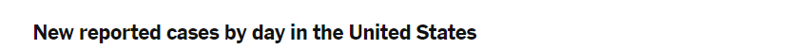
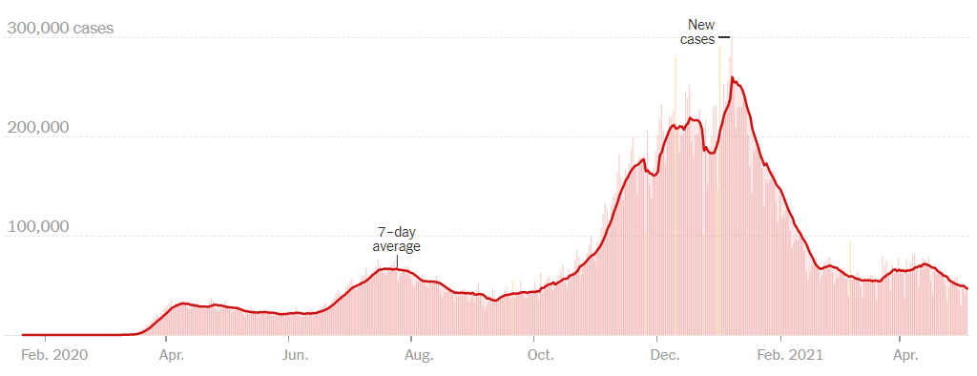
US COVID case trend
Notes:
Updated 5/6/2021
https://www.nytimes.com/interactive/2020/us/coronavirus-us-cases.html

Slide 7
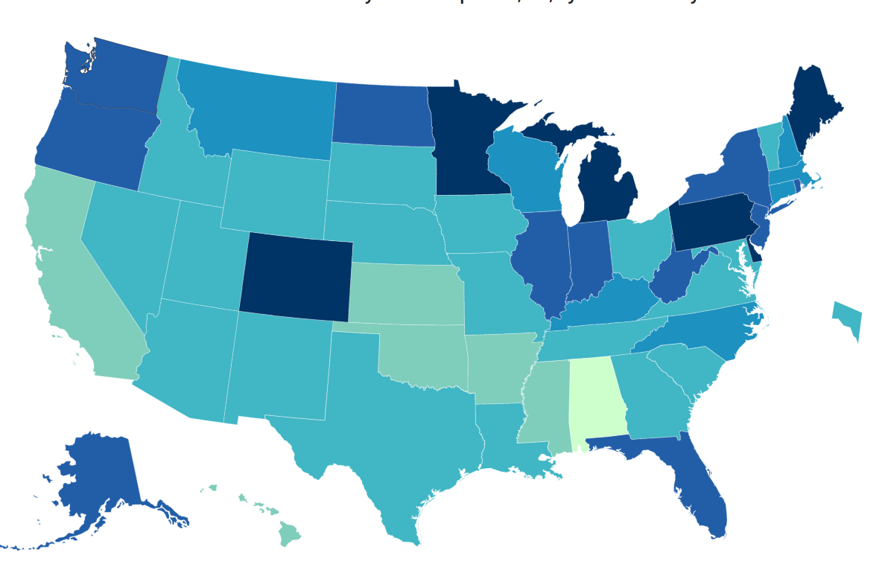
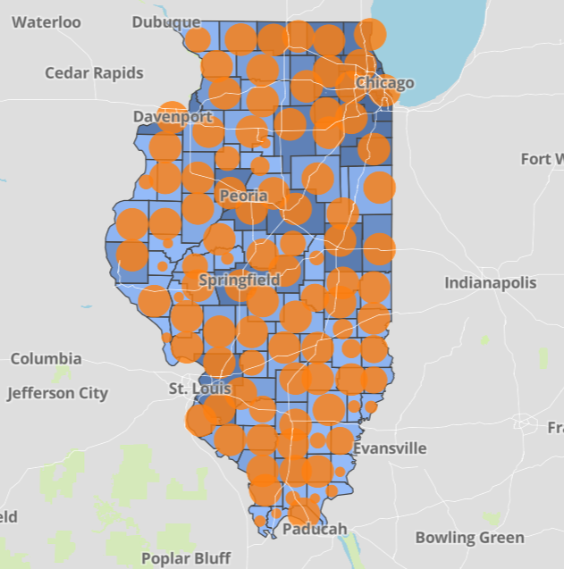
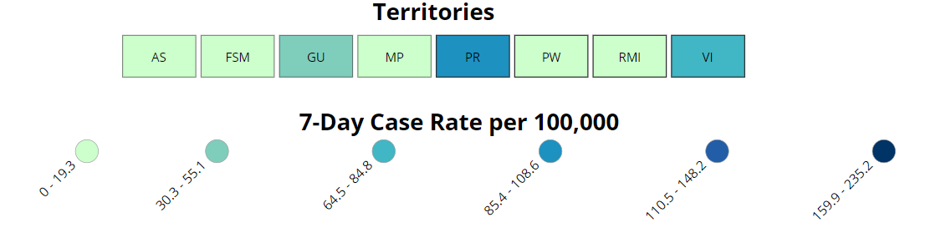
Data Update: May 6, 2021
CDC/IDPH: COVID-19 Outbreak
CDC https://www.cdc.gov/coronavirus/2019-ncov/cases-updates/cases-in-us.html | IDPH https://www.dph.illinois.gov/covid19
Total cases: 32,356,034 confirmed Total deaths: 576,238 confirmed | 1,348,176 Confirmed Positive Cases 22,136 Deaths
Notes:
Updated 5/6/2021

Slide 8
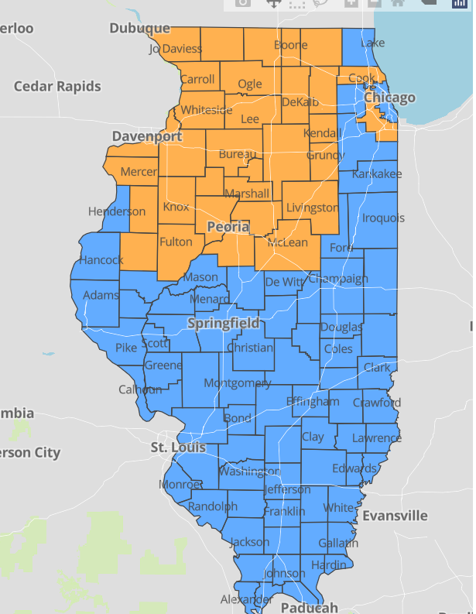
IDPH County Level COVID-19 Risk Metrics
Week 16: 4/18/2021 Through 4/24/2021
Blue indicates that the county is experiencing overall stable COVID-19 metrics.
Orange indicates there are warning signs of increased COVID-19 risk in the county.
Notes:
Updated 5/6/2021
https://www.dph.illinois.gov/countymetrics?county=Cook

Slide 9
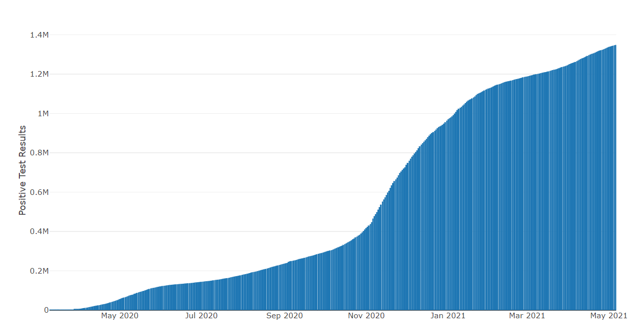
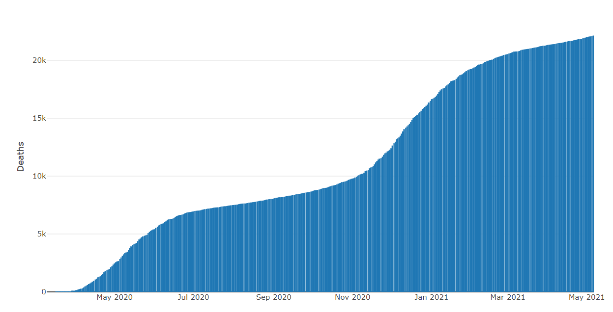
Data Update May 6, 2021
IDPH: COVID-19 Outbreak
https://www.dph.illinois.gov/covid19
IL Positive Cases Over Time
IL Deaths Over Time
Total: 1,348,176 Confirmed Positive Cases
Total: 22,136 Deaths
Notes:
Update 5/6/2021
http://www.dph.illinois.gov/covid19/covid19-statistics

Slide 10
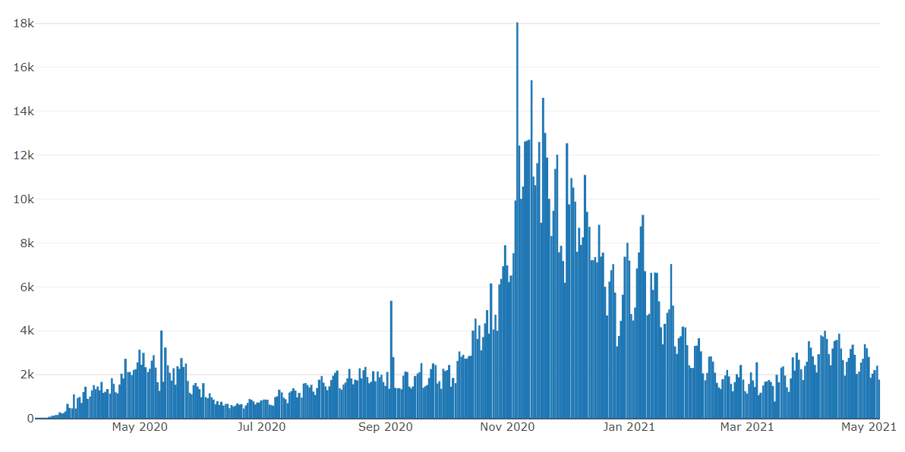
Illinois Daily Incidence
IDPH daily data summary
Notes:
Updated 5/6/2021
https://www.dph.illinois.gov/covid19/covid19-statistics

Slide 11
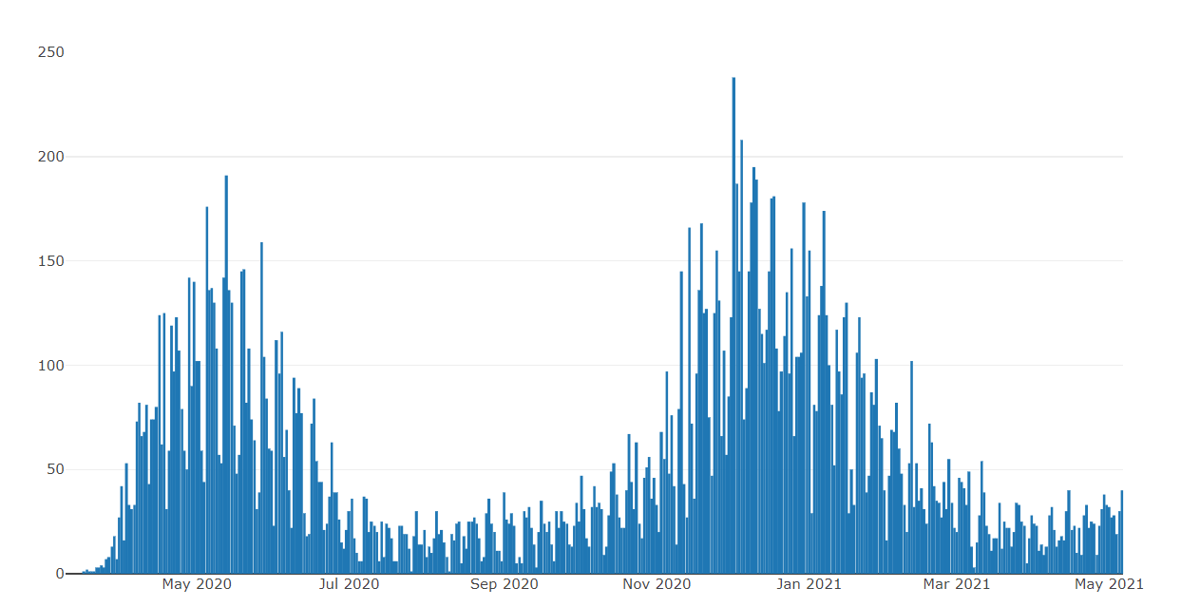
Illinois Covid Deaths
IDPH daily data summary
Notes:
Updated 5/6/2021
https://www.dph.illinois.gov/covid19/covid19-statistics

Slide 12
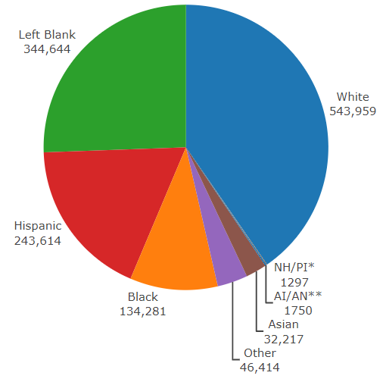
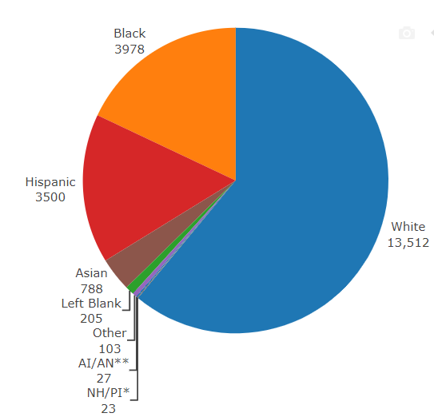
Data Update May 6, 2021
IDPH: COVID-19 Outbreak
Race Demographics
https://www.dph.illinois.gov/covid19
Confirmed Cases
Deaths
Notes:
Updated 5/6/2021
http://www.dph.illinois.gov/covid19/covid19-statistics

Slide 13
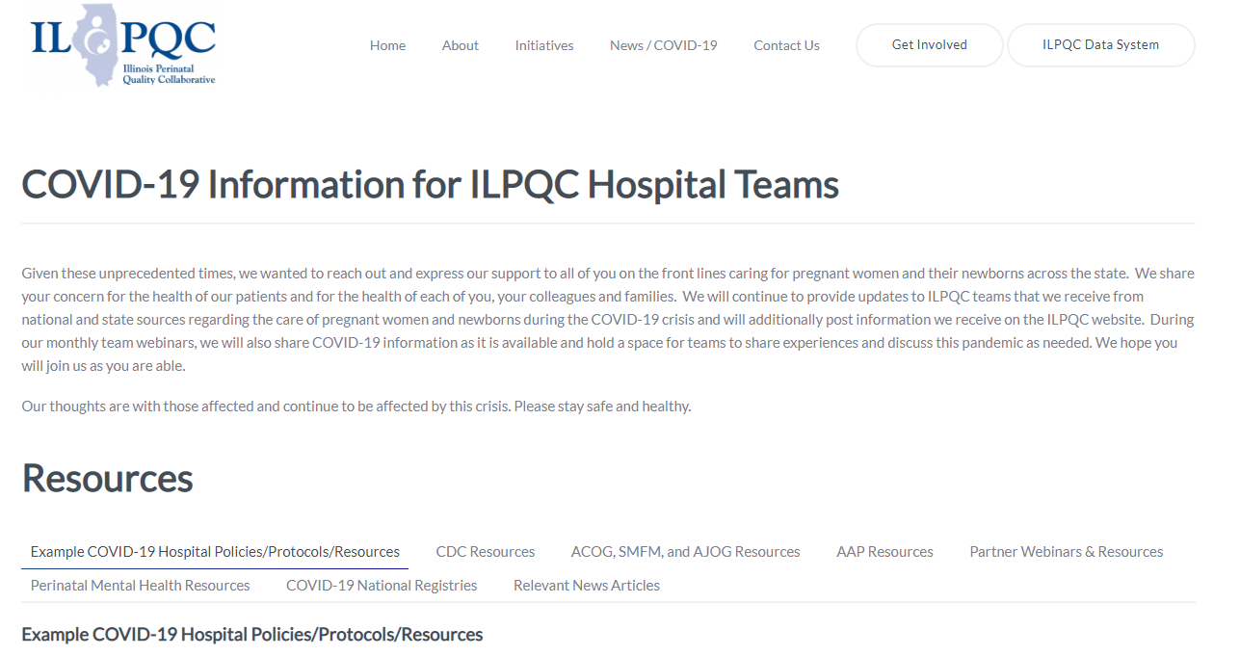
ILPQC COVID-19 Webpage www.ilpqc.org
ILPQC posts national guidelines and OB & Neonatal COVID-19 example hospital protocols & resources
please note dates as guidelines are changing rapidly
https://ilpqc.org/covid-19-information/

Slide 14
Updated OB (ACOG/SMFM) Resources
ACOG: Vaccinating Pregnant Individuals: Eight Key Recommendations for COVID-19 Vaccination Sites. (2.3.21)
SMFM: Management Considerations for Pregnant Patients With COVID-19 (2.2.21)
ACOG: COVID-19 Vaccines Pregnancy - Conversation Guide for Clinicians. (3.5.21)
SMFM Pt Education (English/Spanish): COVID-19 Vaccines and Pregnancy. (3.4.21)
AGOG: My Vaccine Choice: A Pregnant Ob-Gyn Shares Why She Got a COVID-19 Vaccine (March 2021)
ACOG:COVID-19 FAQs for Obstetrician-Gynecologists, Obstetrics (Updated 3.30.2021)
ACOG: Statement on the Johnson & Johnson COVID-19 Vaccine. (4.13.21)
SMFM: Responds to the FDA and CDC Recommendation to Pause Administration of the Johnson & Johnson (Janssen) Vaccine. (4.19.21)
ACOG: Practice Advisory: Vaccinating Pregnant and Lactating Patients Against COVID-19. (Updated 4.28.21)
NEW Provider Considerations for Engaging in COVID-19 Vaccine Counseling With Pregnant and Lactating Patients (April 30, 2021)

Slide 15
Updated Neonatal /AAP Resources
Family Presence Policies for Pediatric Inpatient Settings During the COVID-19 Pandemic: (1/25/21)
Multisystem Inflammatory Syndrome in Children (MIS-C) Interim Guidance: Clinical guidance for pediatricians including signs, symptoms, diagnosis and management of this rare but serious complication associated with COVID-19. (Updated 2/10/2021)
AAP: Interim Guidance for COVID-19 Vaccination in Children and Adolescents. (2.2.21)
FAQs: Management of Infants Born to Mothers with Suspected or Confirmed COVID-19: Includes precautions for birth attendants, rooming-in, breastfeeding, testing, neonatal intensive care, visitation and hospital discharge. (2/11/2021)
Breastfeeding Guidance Post Hospital Discharge for Mothers or Infants with Suspected or Confirmed SARS-Co V-2 Infection: Guidance developed to support pediatricians providing direct care for breastfeeding families after discharge from the newborn hospital stay. (2/11/2021)
AAP: COVID-19 Testing Guidance - Guidance developed to help pediatric practices determine when to test for severe acute respiratory syndrome-coronavirus 2 (SARS-CoV-2) infection in their patient population. (Updated 3.5.21)

Slide 16
Updated OB/Neo Covid Publications
JAHA: Extracorporeal Life Support in Pregnancy: A Systematic Review. (9.2020)
JAMA: Pregnancy Outcomes Among Women With and Without Severe Acute Respiratory Syndrome Coronavirus 2 Infection. (11.19.2020)​
JAMA: Assessment of Maternal and Neonatal SARS-CoV-2 Viral Load, Transplacental Antibody Transfer, and Placental Pathology in Pregnancies During the COVID-19 Pandemic. (12.22.20)
AJOG: Disease Severity, Pregnancy Outcomes and Maternal Deaths among Pregnant Patients with SARS-CoV-2 Infection (12.30.20)
Neo Reviews: Perinatal SARS-CoV-2 Infection and Neonatal COVID-19: A 2021 Update (2.4.21)
ACOG: Disease Severity and Perinatal Outcomes of Pregnant Patients With Coronavirus Disease 2019 (COVID-19) (2.21.21)
MedRxiv: SARS-CoV-2 antibodies detected in human breast milk post-vaccination. (3.02.21)
AJOG: COVID-19 vaccine response in pregnant and lactating women: a cohort study. (3.21.21)
BMC Pediatrics: Newborn antibodies to SARS-CoV-2 detected in cord blood after maternal vaccination – a case report. (3.22.21)
U.S. News: Promising News for Pregnant People Who Want a COVID-19 Vaccine. (4.6.21)
NEJM: Preliminary Findings of mRNA Covid-19Vaccine Safety in Pregnant Persons. (4.21.21)
​

Slide 17
IDPH / HFS / CDC
HFS: Provider Notice Issued Blood Pressure Monitoring Kit (7.2.2020)​ - Medicaid now covers home BP cuffs for all pregnant / postpartum patients
CDC: Birth and Infant Outcomes Following Laboratory-Confirmed SARS-CoV-2 Infection in Pregnancy. (MMWR 11.6.2020)
CDC: Interim Clinical Considerations for Use of mRNA COVID-19 Vaccines Currently Authorized in the United States. (MMWR 1.6.21)
Racial and Ethnic Disparities in the Prevalence of Stress and Worry, Mental Health Conditions, and Increased Substance Use Among Adults During the COVID-19 Pandemic (MMWR Feb 5, 2021)
CDC: The Advisory Committee on Immunization Practices’ Interim Recommendation for Use of Janssen COVID-19 Vaccine (MMWR 3.5.21)
CDC: Toolkit for Pregnant People and New Parents. (2.26.21)
CDC: Information about COVID-19 Vaccines for People who Are Pregnant or Breastfeeding. (4.28.21)
CDC: Joint CDC and FDA Statement on Johnson & Johnson COVID-19 Vaccine. (4.13.21)

Slide 18


Slide 19
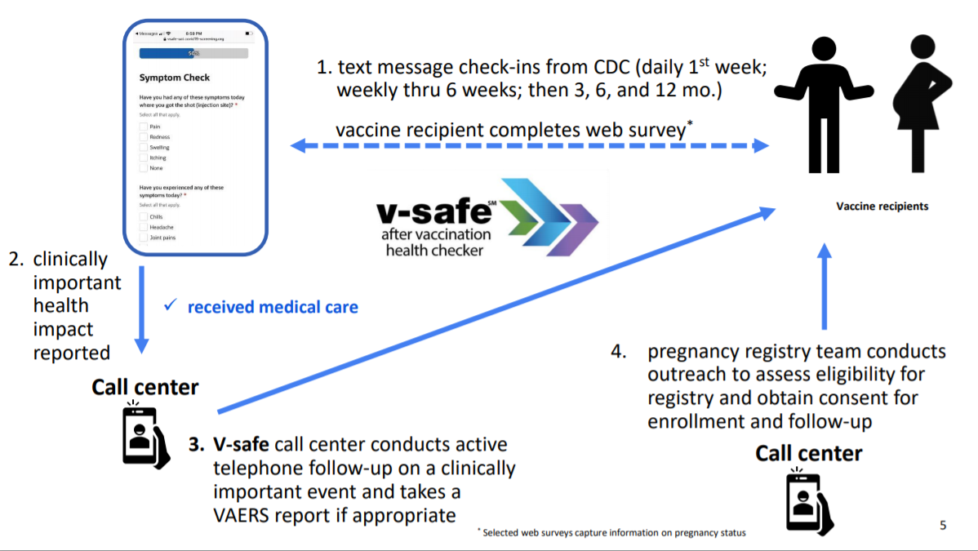

Slide 20
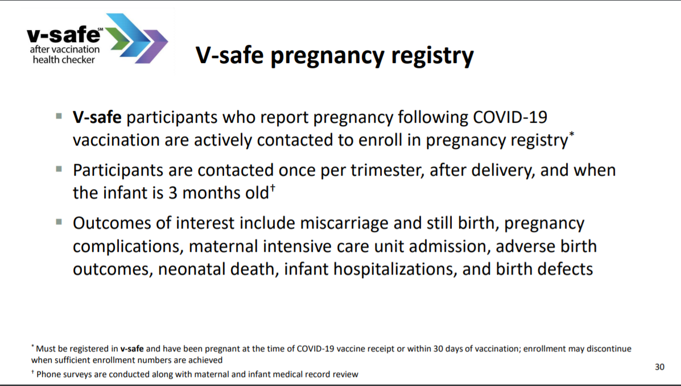

Slide 21
V-SAFE vaccine monitoring
– what data is being gathered pregnant patients
As of May 3, 2021, there have been over 106,241 pregnancies reported in CDC’s V-SAFE post-vaccination health checker
CDC is currently enrolling pregnant individuals in a pregnancy registry with 4,077 enrolled.
Evidence gathered through these system provide clinicians with critically needed data to inform future recommendations related to COVID-19 vaccination during pregnancy
https://www.cdc.gov/coronavirus/2019-ncov/vaccines/safety/vsafe.html
Notes:
v-safe COVID-19 Vaccine Pregnancy Registry
Pregnant people enrolled, United States, as of April 5, 2021
4,218*

Slide 22
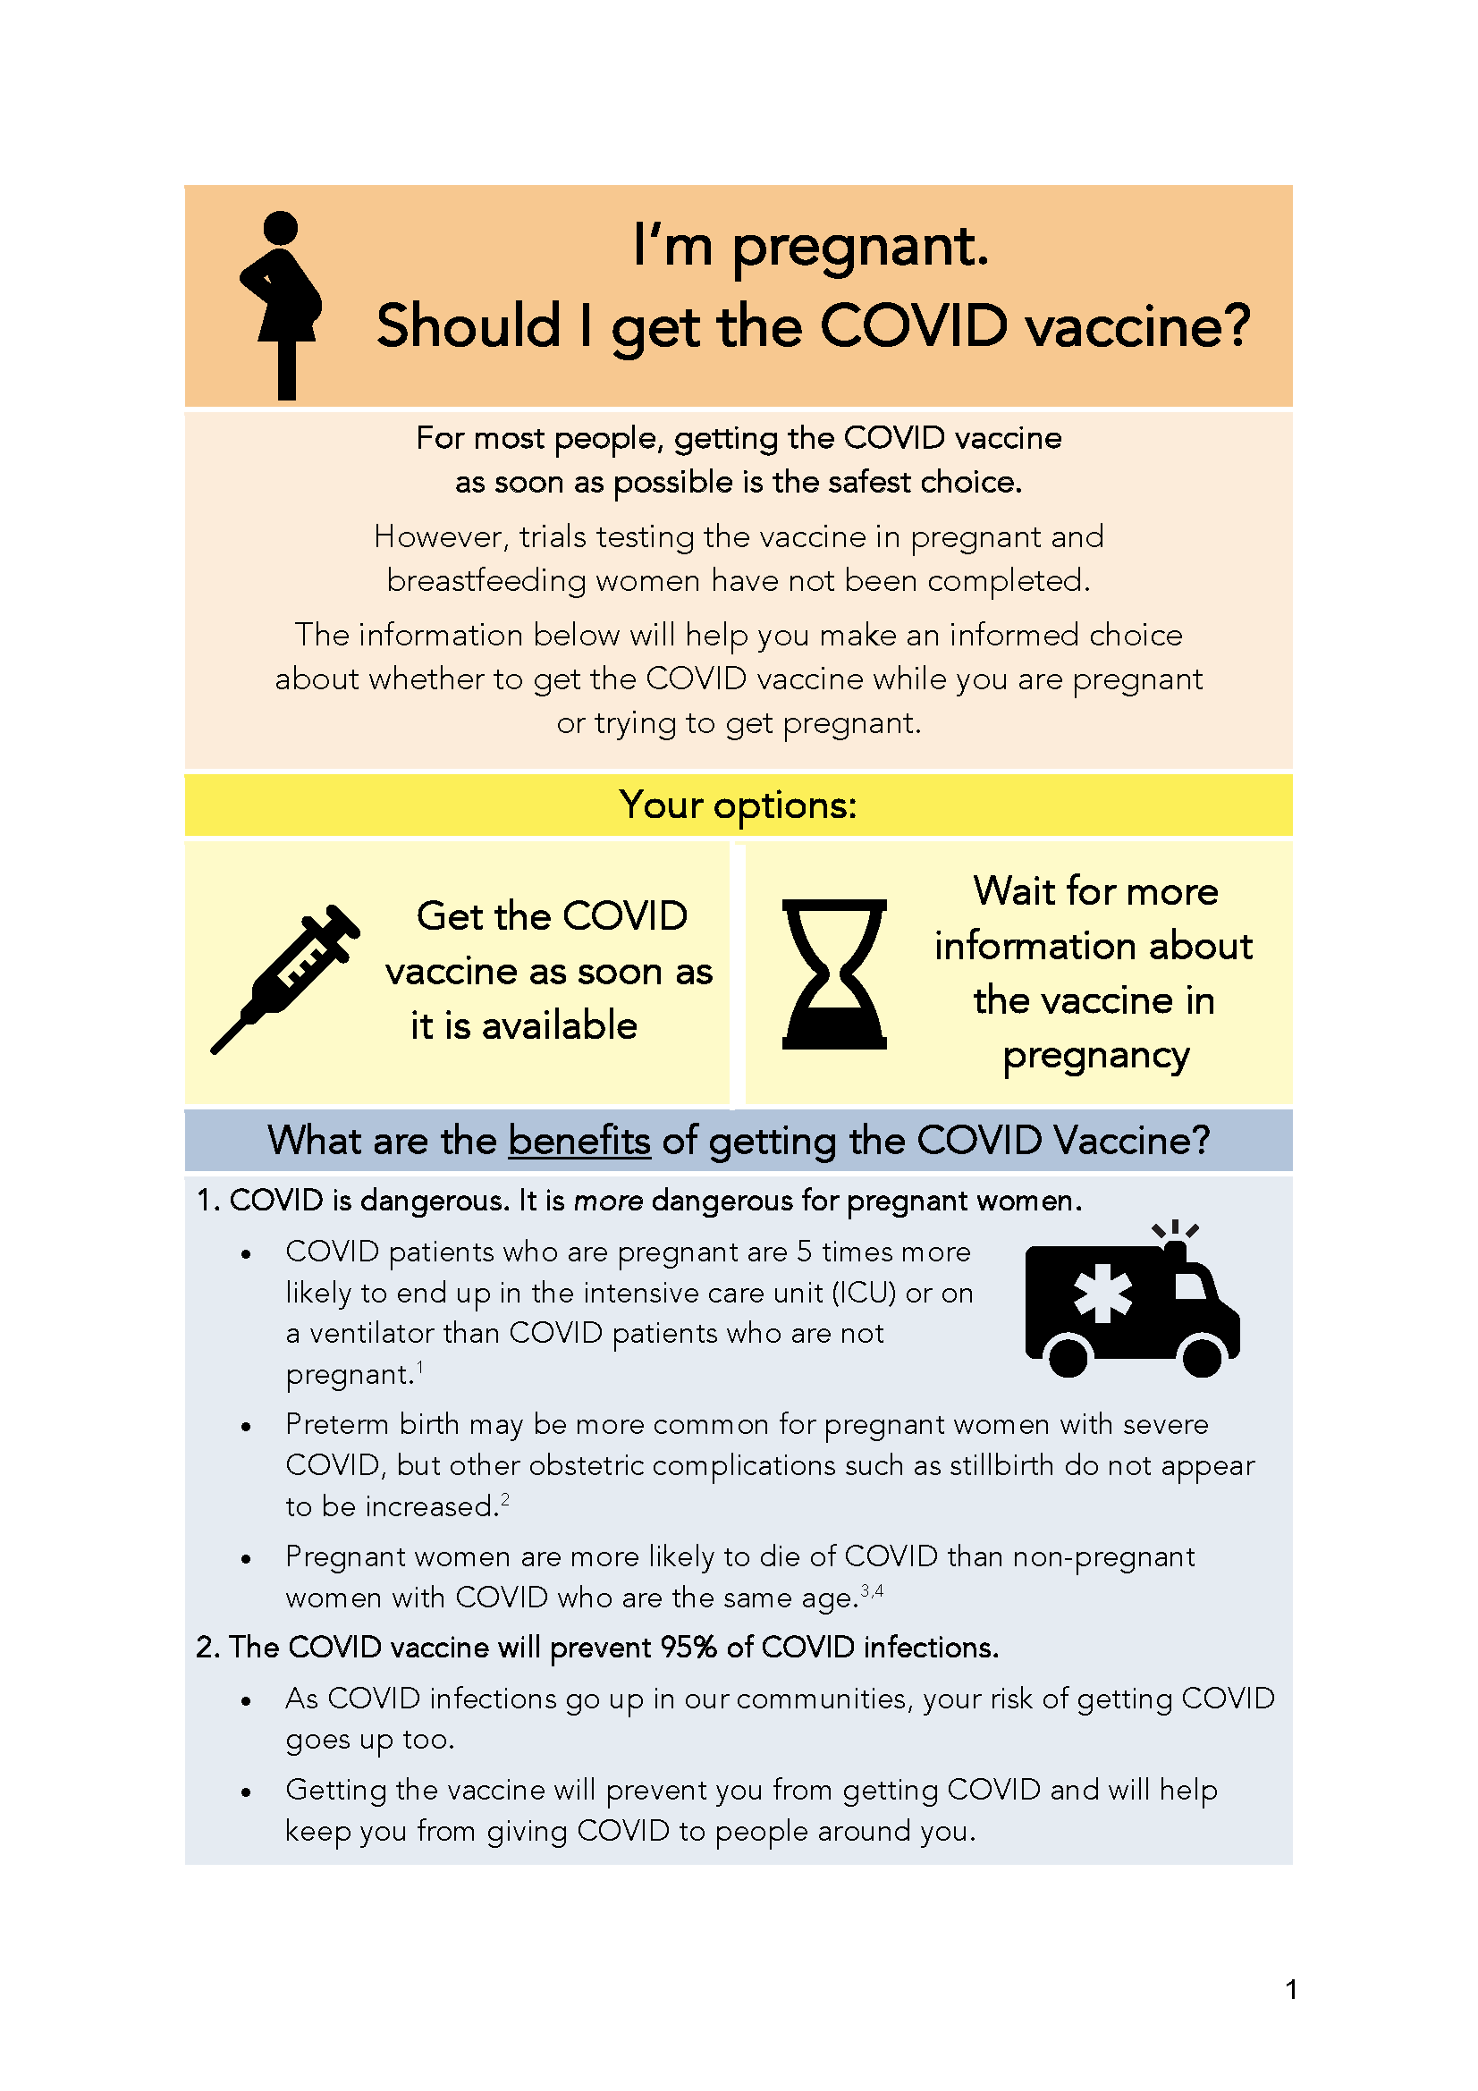
COVID Vaccine
Patient Education Examples
University of Massachusetts Medical School – Baystate: Covid Vaccine Info for Pregnant/Breastfeeding Patients English.
Available in:
Spanish, Nepali, Portuguese, Arabic,
Turkish, Somali, Chinese, Vietnamese,
Russian (3.17.21)
SMFM Patient Education (English/Spanish): COVID-19 Vaccines and Pregnancy. (3.4.21)
CDC: Information about COVID-19 Vaccines for People who Are Pregnant or Breastfeeding. (3.18.21)

Slide 23
Help Finding Vaccines
State of Illinois Coronavirus Response: Find IL Vaccine Distribution Locations by Zipcode or City

Slide 24
COVID Vaccination in Pregnancy
Updates: NEJM Article
Marta Perez, MD
Assistant Professor, WasU School of Medicine
Laborist
Obstetrics and Gynecology

Slide 25
Financial Disclosures
None

Slide 26
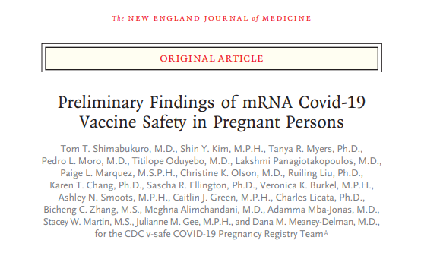

Slide 27
Background
Pregnant people are at increased risk of severe COVID-19
Pregnant people were not included in clinical trials for the Pfizer or Moderna mRNA vaccine
Post-authorization monitoring to characterize safety of the vaccines in this population
  V-SAFE health checker
  V-SAFE pregnancy registry
  VAERS

Slide 28
Methods
V-SAFE pregnancy registry – contacted and offered enrollment by phone
  Includes those vaccinated during pregnancy or periconception period
  Collects information including medical, obstetric, and pediatric
VAERS – passive surveillance
Comparison: descriptive statistics
  Local & systemic reactogenicity: Pregnant 16-54yrs to nonpregnant females 16-54yrs
  Pregnancy otucomes: pregnancy and neonatal outcomes reported for completed pregnancies
35,691 persons reported pregnancy through V-SAFE through Feb 28, 2021
Pregnancy registry: 3,958
VAERS: 221 reports

Slide 29
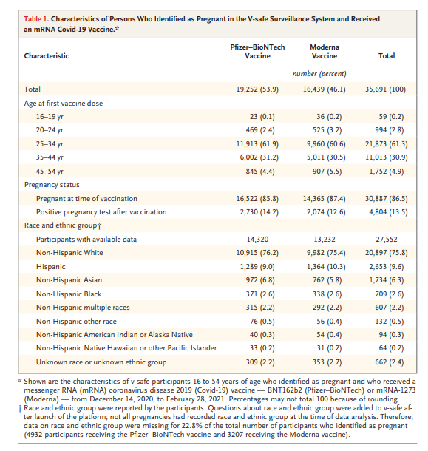

Slide 30
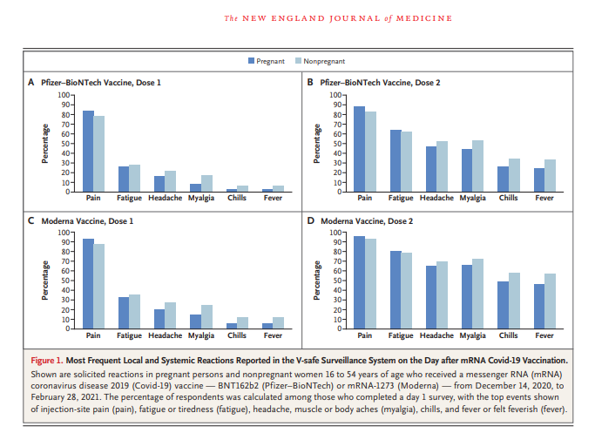

Slide 31
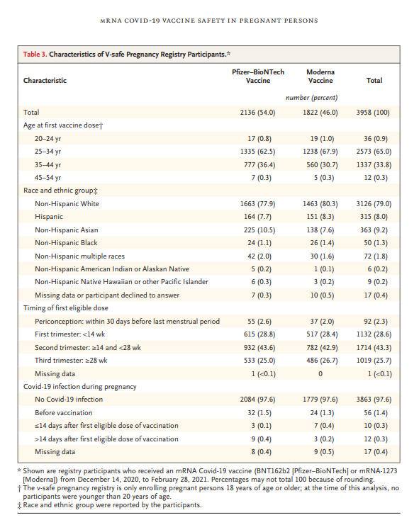

Slide 32
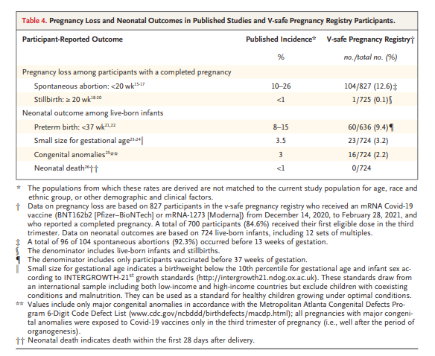
827 of 3,958 included in VSAFE Pregnancy Registry had completed pregnancy
  712 (86.1%) live birth
  104 (12.6%) spon abortion
  1 (0.1%) stillbirth
  10 (1.2%) other (induced abortion/ectopic)
None of the patients with reported congenital anomalies had received vaccine in first trimester or periconception

Slide 33
Discussion
Pregnant people are choosing to be vaccinated in all trimesters
Local and systemic reactions were similar between pregnant and nonpregnant individuals
Proportions of adverse pregnancy and neonatal outcomes among those with completed pregnancies are similar to published indices in pregnancy before COVID-19 pandemic
Only 14.7% of those who identified as pregnant had been contacted, limitations of data for those with ongoing pregnancies
Emerging evidence of transplacental transfer of antibodies following maternal vaccination

Slide 34
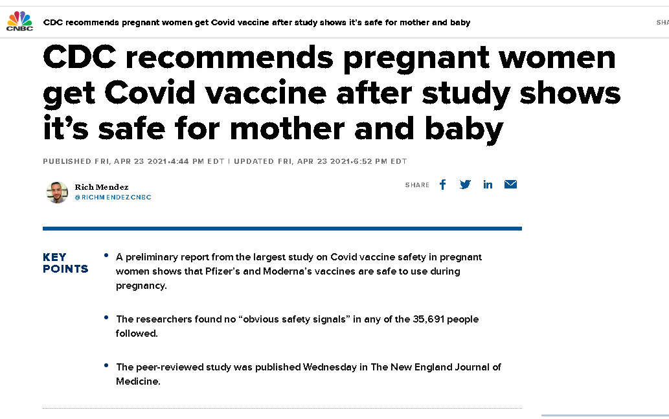
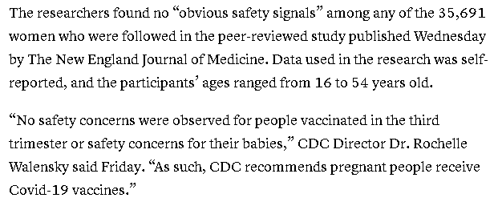

Slide 35
Questions?

Slide 36
OB Discussion Panel
Thaddeus Waters, MD - Director Maternal-Fetal Medicine, Rush University Medical Center, Chicago
Denise E Banton MS, CNL, CEFM RNC OB - Director for Nursing on LD/Antepartum/Postpartum, Rush University Medical Center, Chicago
Rob Abrams, MD, Executive Director - SIU Center for Maternal - Fetal Medicine, HSHS St. John's Hospital, Springfield
Erin Tran, MD – Maternal-Fetal Medicine, NorthShore University HealthSystem, Evanston Hospital
Steven Ambrose, MD - Maternal-Fetal Medicine, Unity Point Health Methodist Hospital, Peoria
Marta Perez, MD – Laborist, Assistant Professor of Obstetrics & Gynecology, Washington University School of Medicine

Slide 37
Evanston Hospital
Evanston, IL
Northeast Illinois Perinatal Center, Level III
3400 annual births
44 bed NICU

Slide 38
NB, 37 year old G3P0111 at 34w5d
PMHx:
  maternal spina bifida occulta with neurogenic bladder, self-catheterization
  stage II chronic kidney disease
  Chronic hypertension
  A1 gestational diabetes
Diagnosed with COVID-19 at 34w3d
Admitted to Hospital Medicine service at 34w5d with worsening shortness of breath, COVID-19 pneumonia
  Supplemental O2 (5L non-rebreather)
  MFM team consulted
  Mild transaminitis
  Dexamethasone, prophylactic enoxaparin
Rapid decompensation several hours after admission
Transferred to ICU
Notes:
cHTN on labetalol, amlodipine
Past OB history included prior C section at 29 weeks for preE with SF, Cr 1.6 on admission (baseline 1.4)
Diagnosed with COVID in setting of dry cough, fatigue, SOB
Rapid decompensation ~6 hours after admission → RR high 30s, desat to 88 on HF → back to non-rebreather
- Rapid response called
Mild transamninitis likely secondary to COVID infxn (rather than preE)
With MFM consultation, recommended fetal lung maturity dosing of dexamethasone, consent for C section, Neonatology notified

Slide 39
Case NB
Admitted to ICU
  55L HFNC, FiO2 70%
  Remdesivir
  Severe range hypertension, AKI on CKD, transaminitis
    superimposed preeclampsia with severe features
  Continuous fetal monitoring
Worsening respiratory status
  C section under GETA on HD#2 at 34w6d for worsening respiratory status, minimal variability, superimposed preeclampsia with severe features, prior C section
    Male infant, 2410g, APGARS 7,8
Notes:
C section with mild PPH (QBL 1.2L) managed with Cytotec and Pitocin
Worsening respiratory status
- continued increased work of breathing, tachypnea to high 40s, desats despite highest O2 support

Slide 40
Case NB
Remained intubated until POD#9
POD#12 developed urosepsis
  Urine and blood cultures with ESBL E. coli
  Vancomycin/cefepime/flagyl → meropenem → ciprofloxacin
Discharged home on POD# 16
  Blood pressures well controlled with labetalol 400mg TID and amlodipine 2.5mg daily
  Cr down-trended to 1.1, LFTs normalized
  Ciprofloxacin x7 days
  Physical therapy, declined rehab stay
Notes:
Difficulty weaning sedation
POD#12 → increased tachycardia, vaginal bleeding, fever to 103F

Slide 41
Lessons Learned
COVID patients can decompensate suddenly and quickly
Communication can be challenging
  MFM/OB
  Medicine
  ICU
  OR team
  Neonatology
Differentiating preeclampsia from COVID-related lab abnormalities
Antepartum patients are always potential surgical patients
  Adequate IV access
  Active T&S
  IV fluid management
  Consent
  Healthcare proxy
  Ongoing communication between teams

Slide 42
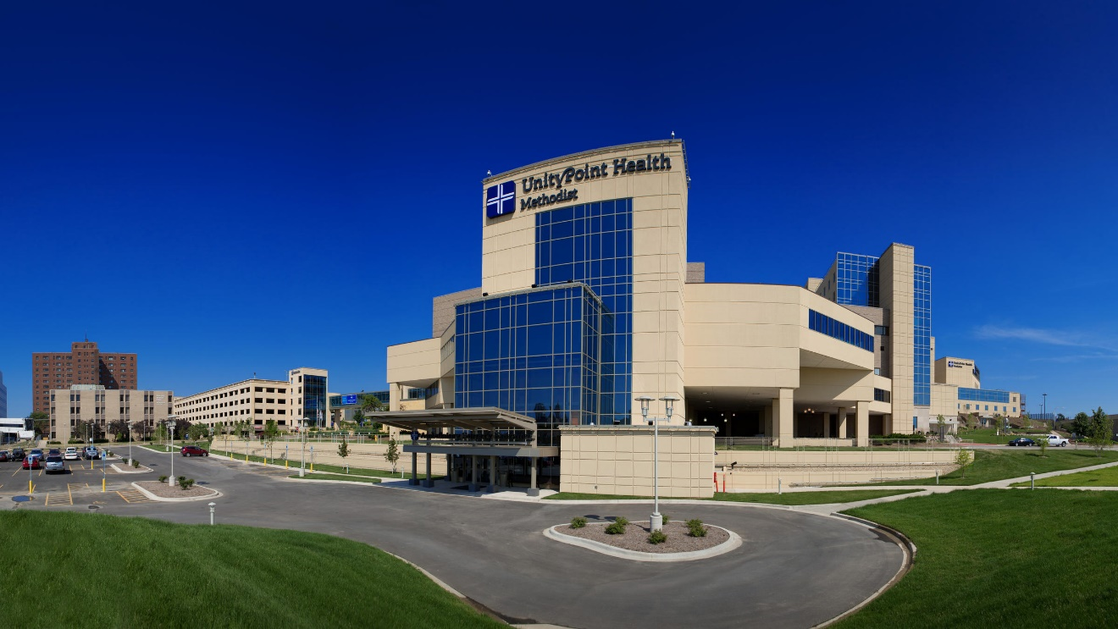

Unity Point Health Methodist
Dr. Steven Ambrose, MFM
Level IIE
1700 Deliveries per year
OSF Perinatal Network

Slide 43

My Covid Week
Steven E Ambrose, MD

Slide 44

Covid Cases
Covid PNA Day 11
Fluid overload/Myocarditis Postpartum
Minor symptoms, Weight 427 lbs, uncontrolled diabetes, 33 weeks
Labor & Delivery – rule out labor and mild covid symptoms
Suspected vertical transmission

Slide 45

Vertical Transmission Details
23 year old G2P0101 at 33 wks GA
Presented with cough, congestion and loss of smell
Presented with possible contractions
Possible exposure at concert on 04/17/2021
Symptoms began 04/20/2021
Baby positive at 30 hours of life

Slide 46

Possible reinfection Risk factors
Immigrant/Multigenerational family
Ramadan/Religious gatherings?
Primary infection in January
Multiple family members infected last month
Asymptomatic positive test today pre-op
Posterior placenta previa, 36w6d

Slide 47

Covid Recovered
System is using Day 10 as covid recovered
Both pregnancy and covid are described as hypercoagulable
Antenatal testing?
Serial ultrasounds?
Timing of delivery?

Slide 48
Severe Covid Pneumonia
Improvement with prone positioning
Marked improvement in tidal volume with C/S

Slide 49

SO MANY QUESTIONS

Slide 50
OB Discussion Panel
Thaddeus Waters, MD - Director Maternal-Fetal Medicine, Rush University Medical Center, Chicago
Denise E Banton MS, CNL, CEFM RNC OB - Director for Nursing on LD/Antepartum/Postpartum, Rush University Medical Center, Chicago
Rob Abrams, MD, Executive Director - SIU Center for Maternal - Fetal Medicine, HSHS St. John's Hospital, Springfield
Erin Tran, MD – Maternal-Fetal Medicine, NorthShore University HealthSystem, Evanston Hospital
Steven Ambrose, MD - Maternal-Fetal Medicine, Unity Point Health Methodist Hospital, Peoria

Slide 51
Neonatal Discussion Panel
Ramzi Kilani, MD, MSc, FAAP - Director of Neonatology Unity Point Methodist Hospital, Peoria
Justin Josephsen, MD – Medical Director, St. Mary’s Hospital NICU, Neonatologist Cardinal Glennon Children’s Hospital, St. Louis
Leslie Caldarelli, MD – NICU Director, Prentice Women's Hospital, Chicago

Slide 52
Thank You
We continue to give thanks to the nurses, doctors, health care workers, public health teams and others across our state at work confronting the COVID-19 pandemic.
Please send questions, comments and recommendations, cases / willingness to share for future COVID-19 OB/Neo discussion webinars to info@ilpqc.org
Recording of this webinar, Q/A and registration for the next webinar on Friday, 6/4/21 will be available at www.ilpqc.org

Slide 53










THANKS TO OUR
FUNDERS
In Kind Support

