Slide 1

COVID-19 Strategies for OB & Neonatal Units
January 8, 2021
12:00 – 1:15pm

Slide 2

Welcome
Please be certain you are on “mute” when not speaking to avoid background noise.
Whether you have joined by phone or computer audio, you can mute and unmute yourself by clicking on the microphone icon.
The following shortcuts can also be used
For PC: Alt + A : Mute or Unmute
For Mac: Shift + Command + A: Mute or Unmute
For telephone: *6 : Mute or Unmute

Slide 3
Housekeeping:
We Are Recording Now

Slide 4
ILPQC Covid 19 webinars
The strategies shared today are examples from individual institutions not IDPH or ILPQC recommendations.
This is our 17th COVID-19 strategies for OB/Neonatal Units webinar in coordination with IDPH, since April 3rd. Please see https://ilpqc.org/covid-19-information/ for future webinar registration, prior recorded webinars and written out Q/A’s from those webinars.
The next webinar will be Friday, February 5, noon to 1:15pm. We are continuing monthly webinars for now.
Please let us know if your hospital would like to share on an upcoming webinar, please put questions/comments into the chatbox or email directly to info@ilpqc.org

Slide 5
Overview
Introduction
IDPH Birthing Hospital Covid Sentinel Surveillance update
  Amanda Bennett, PhD, MPH – CDC Field Assignee in Maternal and Child Health Epidemiology, Illinois Department of Public Health
  Lynn Pistorio ,RN, MPH – Public Health Nurse III, Chicago Department of Public Health
Discussion of Neonatal Unit Strategies
  Beau Batton, MD – Chief Neonatology, SIU School of Medicine, Director of Newborn Services HSHS St. John’s Hospital, Springfield
  Justin Josephsen, MD – Medical Director, St. Mary’s Hospital NICU, Neonatologist Cardinal Glennon Children’s Hospital, St. Louis
  Leslie Caldarelli, MD – NICU Director, Prentice Women's Hospital, Chicago
Discussion of OB Unit Strategies
  Michele A. Bucciero MD, MBA-HCM – Medical Director of Perinatal Services, Saint Anthony Hospital
  Jonathan (Jake) Hirshberg, MD – Clinical Fellow in Maternal-Fetal Medicine and Surgical Critical Care, Washington University in St. Louis
  Sarah L Bradley, MD – OB Hospitalist, Swedish American Hospital, Rockford
  Jeannie Kelly, MD – Director Maternal Fetal Transport, Maternal Fetal Medicine, Barnes Jewish Hospital, Washington University, St. Louis
Notes:
Chief of the Neonatology division of Pediatrics at SIU School of Medicine, and the Director of Newborn Services at HSHS St. John's Children's Hospital.

Slide 6
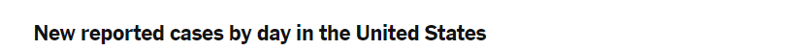
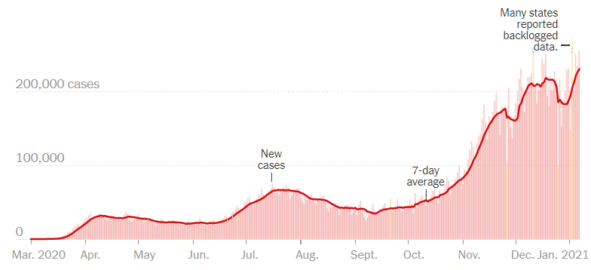
US COVID case trend
Notes:
Ieshia updated 1/7/2021
https://www.nytimes.com/interactive/2020/us/coronavirus-us-cases.html

Slide 7
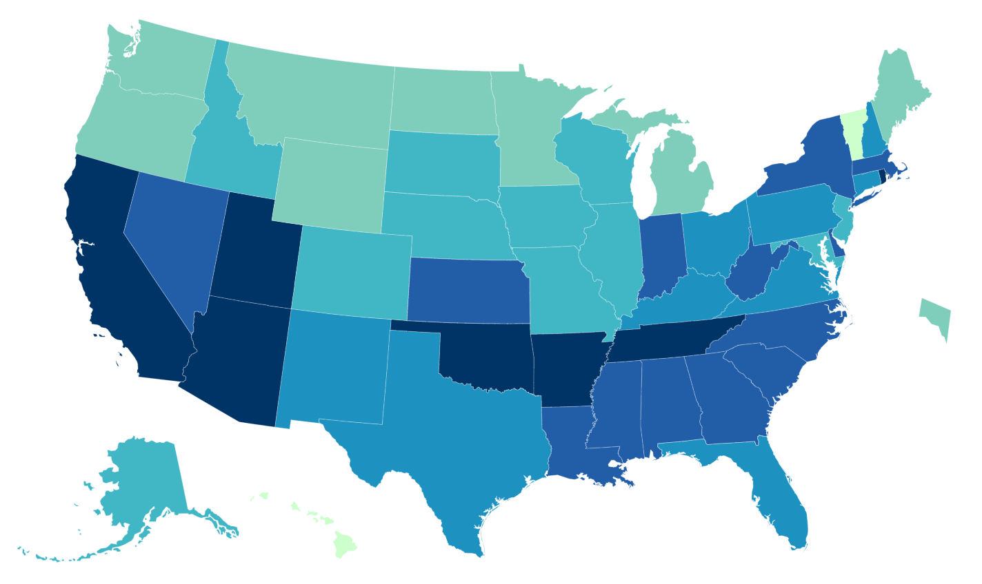
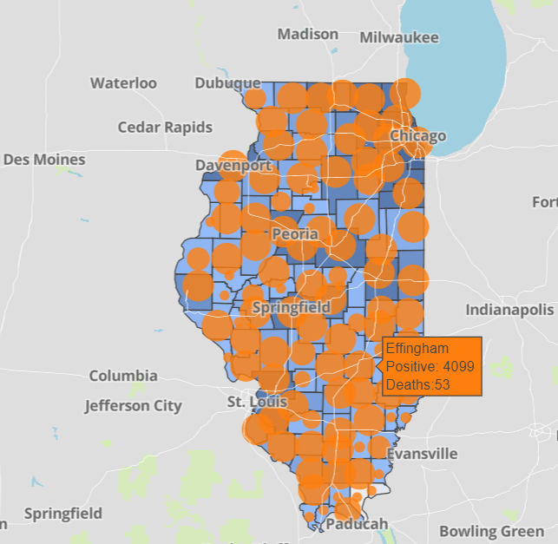

Data Update January 7, 2021
CDC/IDPH: COVID-19 Outbreak
CDC https://www.cdc.gov/coronavirus/2019-ncov/cases-updates/cases-in-us.html | IDPH https://www.dph.illinois.gov/covid19
Total cases: 20,960,096 confirmed Total deaths: 356,005 confirmed | 1,008,045 Confirmed Positive Cases 17,272 Deaths
Notes:
Ieshia updated 1/7/2021

Slide 8
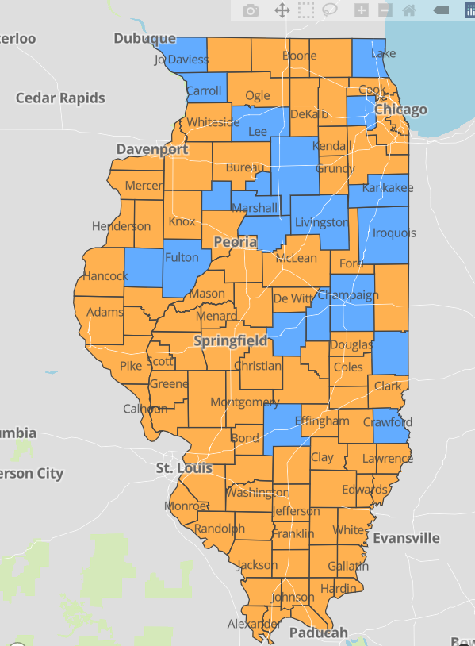
IDPH County Level COVID-19 Risk Metrics
Week 52: 12/20/2020 Through 12/26/2020
Blue indicates that the county is experiencing overall stable COVID-19 metrics.
Orange indicates there are warning signs of increased COVID-19 risk in the county.
Notes:
Ieshia updated 1/7/2021
https://www.dph.illinois.gov/countymetrics?county=Cook

Slide 9
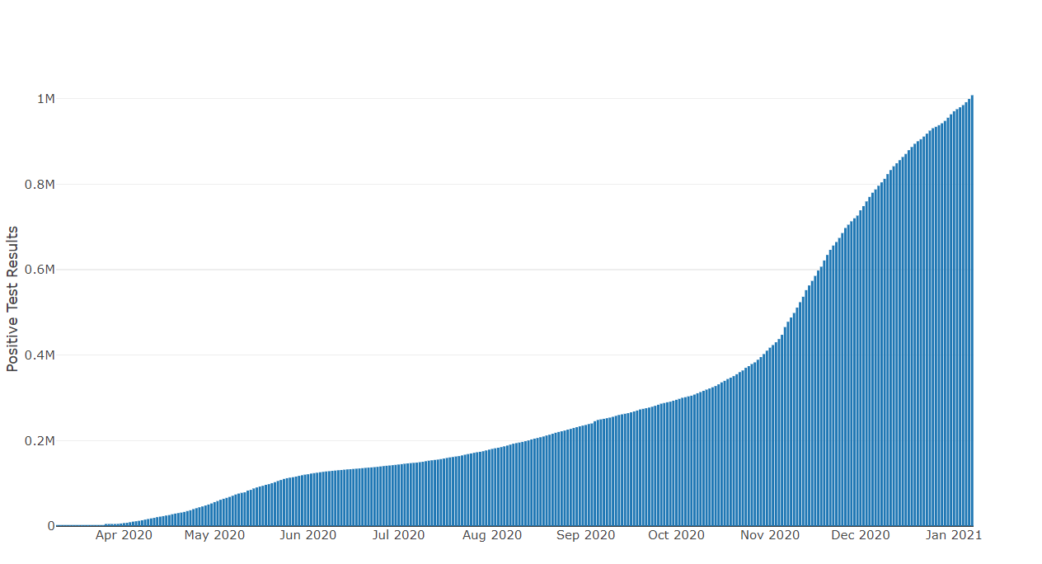
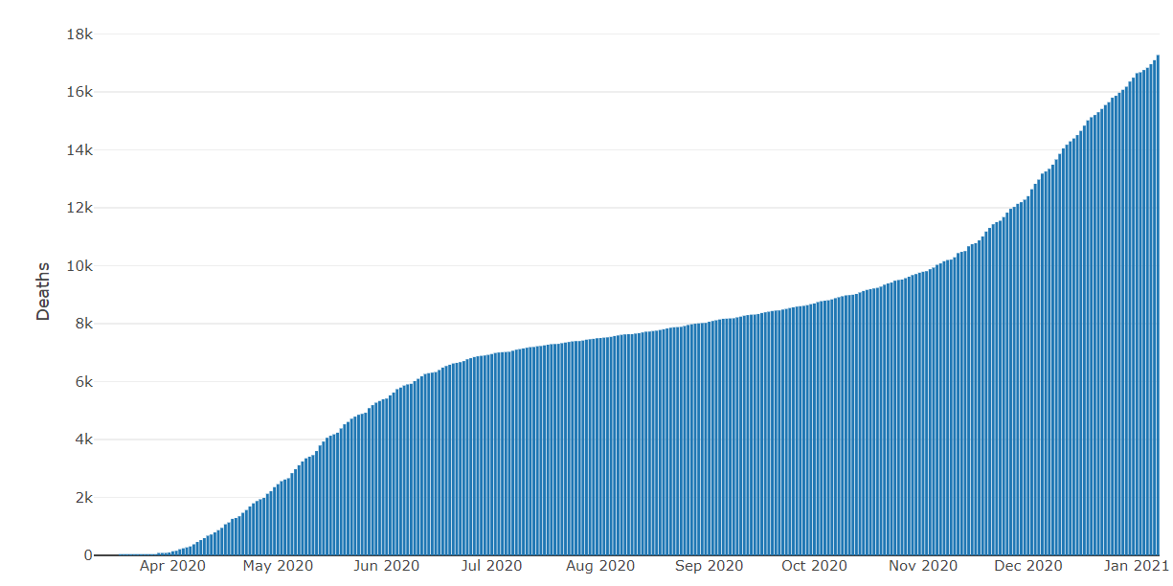
Data Update January 7, 2021
IDPH: COVID-19 Outbreak
https://www.dph.illinois.gov/covid19
IL Positive Cases Over Time
IL Deaths Over Time
Total: 1,008,045 Confirmed Positive Cases
Total: 17,272 Deaths
Notes:
Ieshia update 1/7/2021
http://www.dph.illinois.gov/covid19/covid19-statistics

Slide 10
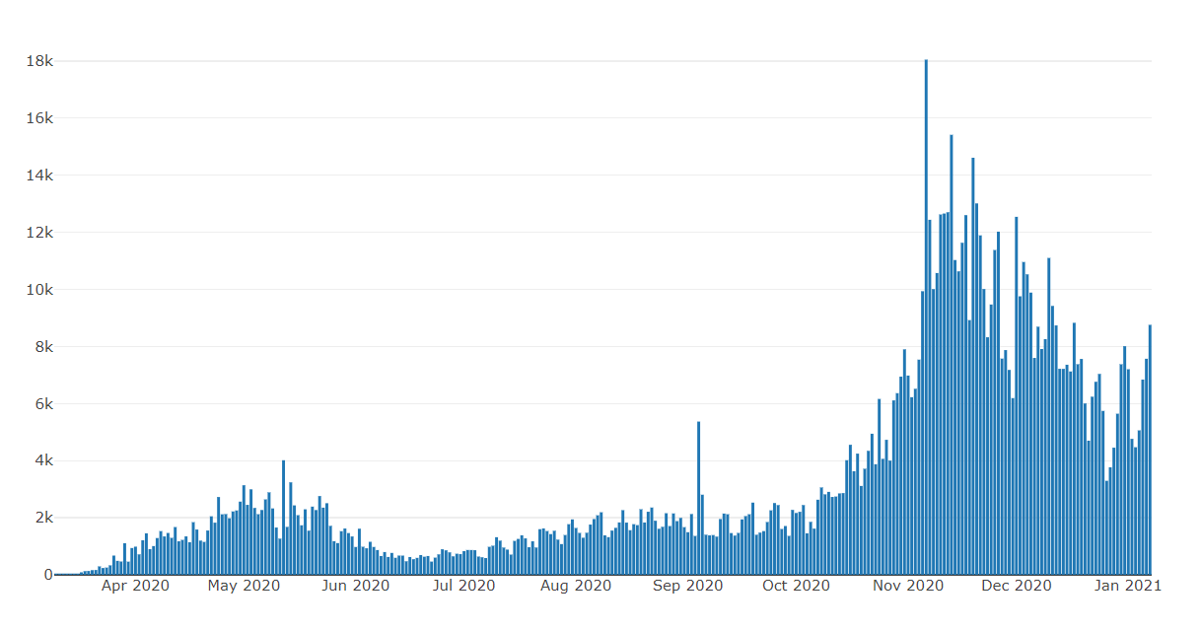
Illinois Daily Incidence
IDPH daily data summary
Notes:
Ieshia updated 1/7/2021
https://www.dph.illinois.gov/covid19/covid19-statistics

Slide 11
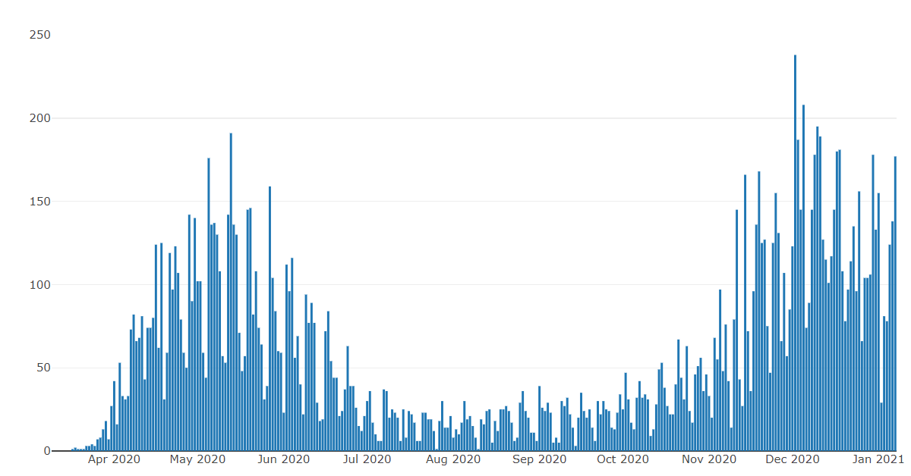
Illinois Covid Deaths
IDPH daily data summary
Notes:
Ieshia updated 1/7/2021
https://www.dph.illinois.gov/covid19/covid19-statistics

Slide 12
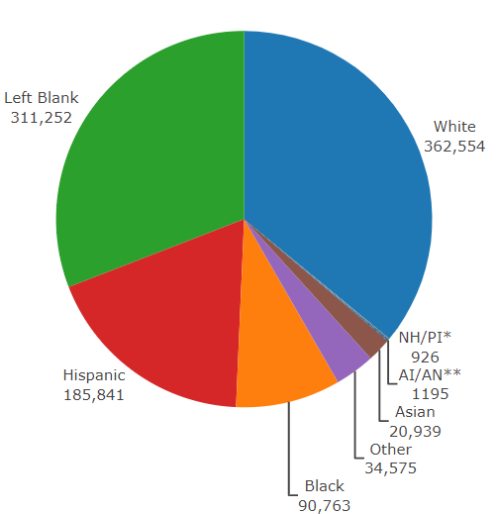
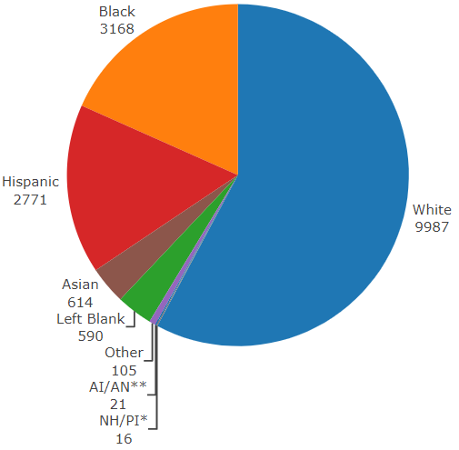
Data Update January 7, 2021
IDPH: COVID-19 Outbreak
Race Demographics
https://www.dph.illinois.gov/covid19
Confirmed Cases
Deaths
Notes:
Ieshia updated 1/7/2021
http://www.dph.illinois.gov/covid19/covid19-statistics

Slide 13
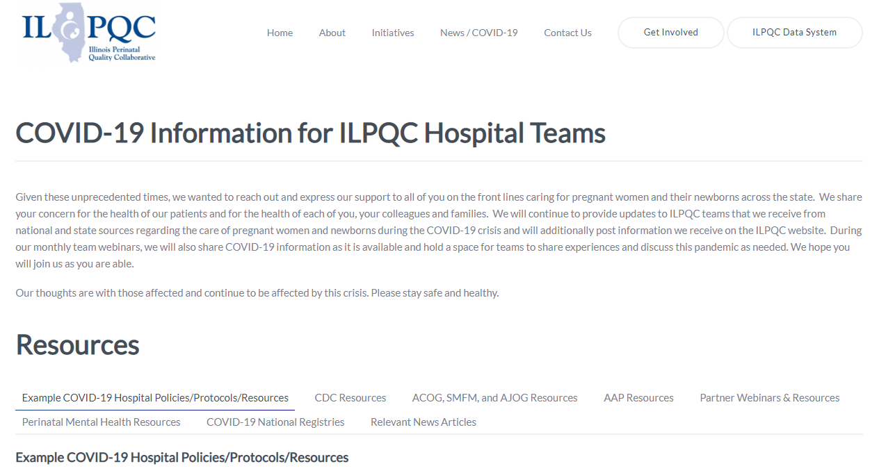
ILPQC COVID-19 Webpage www.ilpqc.org
ILPQC posts national guidelines and OB & Neonatal COVID-19 example hospital protocols & resources
please note dates as guidelines are changing rapidly
https://ilpqc.org/covid-19-information/

Slide 14
Updated OB (ACOG/SMFM) Resources
ACOG & SMFM: Outpatient Assessment and Management for Pregnant Women With(COVID-19) (7.14.2020)​
SMFM: The Society for Maternal-Fetal Medicine COVID-19 Ultrasound Clinical Practice Suggestions. (10.20.2020)
SMFM & SOAP: Labor and Delivery COVID-19 Considerations. (10.09.2020)
ACOG Practice Advisory: Novel Coronavirus 2019 (COVID-19) (11.9.20)
ACOG: COVID-19 FAQs for Obstetrician-Gynecologists, Obstetrics (11.9.20)
ACOG Pt Educ: COVID-19 and Pregnancy: 3 Steps to Stay Safe. (Nov 2020)
ACOG Practice Advisory: Vaccinating Pregnant and Lactating Patients Against COVID-19 (12.21.20)
ACOG: COVID-19 Vaccines and Pregnancy: Conversation Guide for Clinicians (12.20.20)
SMFM: revises Coronavirus (COVID-19) and Pregnancy: What Maternal-Fetal Medicine Subspecialists Need to Know (11.23.20)
SMFM: Provider Considerations for Engaging in COVID-19 Vaccine Counseling With Pregnant and Lactating Patients (Updated 12.21.20)
SMFM: Management Considerations for Pregnant Patients with COVID-19 (Updated 1.7.21)
Notes:
ACOG: Vaccinating Pregnant and Lactating Patients Against COVID-19, Practice Advisory. (12.21.20)
ACOG: COVID-19 Vaccines and Pregnancy: Conversation Guide for Clinicians. (12.20.20)
SMFM: Management Considerations for Pregnant Patients with COVID-19 (Updated 1.7.21)
SMFM: Provider Considerations for Engaging in COVID-19 Vaccine Counseling With Pregnant and Lactating Patients. (Updated 12.21.20)

Slide 15
Updated Neonatal /AAP Resources
COVID-19 Testing Guidance: Guidance developed to help pediatric practices determine when to test for severe acute respiratory syndrome-coronavirus 2 (SARS-CoV-2) infection in their patient population. (Updated 12/30/2020)
Breastfeeding Guidance Post Hospital Discharge for Mothers or Infants with Suspected or Confirmed SARS-Co V-2 Infection: Guidance developed to support pediatricians providing direct care for breastfeeding families after discharge from the newborn hospital stay. (12/2/2020)
FAQs: Management of Infants Born to Mothers with Suspected or Confirmed COVID-19: Includes precautions for birth attendants, rooming-in, breastfeeding, testing, neonatal intensive care, visitation and hospital discharge. (11/19/2020)
Multisystem Inflammatory Syndrome in Children (MIS-C) Interim Guidance: Clinical guidance for pediatricians including signs, symptoms, diagnosis and management of this rare but serious complication associated with COVID-19. (Updated 11/17/2020)
Family Presence Policies for Pediatric Inpatient Settings During the COVID-19 Pandemic: Guidance on family presence policies developed to support family-centered care for all children and particularly for children with special health care needs, including those with disabilities, medical complexity, and serious illness. (10/12/2020)
Frequently Asked Questions: Interfacility Transport of the Critically Ill Neonatal or Pediatric Patient with Suspected or Confirmed COVID-19: Guidance for both ground and air patient movements that balances infection control with transport safety to reduce risks for medical staff and patients. (10/06/2020)
Notes:
AAP: Multisystem Inflammatory Syndrome in Children (MIS-C) Interim Guidance (Updated 11.17.2020)
AAP: FAQs: Management of Infants Born to Mothers with Suspected or Confirmed COVID-19 (11.19.2020)
AAP: Breastfeeding Guidance Post Hospital Discharge for Mothers or Infants (12.2.2020)

Slide 16
Updated OB/Neo Covid Publications
NEOBGYN: Prone Positioning for Pregnant Women With Hypoxemia Due to Coronavirus Disease 2019 (COVID-19) (6.9.2020)
JAHA: Extracorporeal Life Support in Pregnancy: A Systematic Review. (9.2020)
AJOG: Epidemiology of COVID-19 in Pregnancy: Risk Factors and Associations with Adverse Maternal and Neonatal Outcomes. (9.24.2020)​
AJOG: Risk factors for severe acute respiratory syndrome coronavirus 2 infection in pregnant women. (9.2020)​
ACOG: Clinical Implications of Universal Severe Acute Respiratory Syndrome Coronavirus. (8.2020)​
JAMA: Association of SARS-CoV-2 Test Status and Pregnancy Outcomes. (9.23.2020)
JAMA: Outcomes of Neonates Born to Mothers With Severe Acute Respiratory. (10.16.2020)
Archives of Women's Mental Health: Risk for probable post-partum depression among women during the COVID-19 pandemic. (10.12.2020)
PRIORITY Study Published: Pregnancy Coronavirus Outcomes Registry. (10.9.2020)
JAMA: COVID-19 Poses Pregnancy Risks (11.10.2020)
JAMA: Pregnancy Outcomes Among Women With and Without Severe Acute Respiratory Syndrome Coronavirus 2 Infection. (11.19.2020)​
NEJM: Safety and Efficacy of the BNT162b2 mRNA Covid-19 Vaccine. (12.31.20)
JAMA: Protecting Pregnant Women and Their Infants From COVID-19: Clues From Maternal Viral Loads, Antibody Responses, and Placentas. (12.22.20)
JAMA: Assessment of Maternal and Neonatal SARS-CoV-2 Viral Load, Transplacental Antibody Transfer, and Placental Pathology in Pregnancies During the COVID-19 Pandemic. (12.22.20)
​

Slide 17
Birth Equity Links
Please see the following links and publications for information that may help your organization consider next steps to take action to address birth equity and reduction of perinatal racial and ethnic disparities.
AIM: Reduction of Peripartum Racial/Ethnic Disparities Patient Safety Bundle (2018)
ACOG: Reduction of Peripartum Racial and Ethnic Disparities: a conceptual framework and maternal safety consensus bundle (May 2018)
ACOG Committee Opinion No. 729: Importance of Social Determinants of Health and Cultural Awareness in the Delivery of Reproductive Health Care (January 2018)
SMFM: Strategies to overcome racism's impact on pregnancy outcomes (May 2020)
SMFM: Strategies to provide equitable care during COVID-19 (May 2020)
ACOG: Addressing Health Equity During the COVID-19 Pandemic (May 2020)
AAP Policy Statement: The impact of racism on child and adolescent health (Aug 2019)
Today: Black. Pregnant. And COVID-19 positive. (7.8.2020)
CDC: COVID-19 Response Promising Practices in Health Equity II (7.31.2020)
CDC: HEAR HER Campaign (8.4.2020)strategies promote birth equity and reduce preventable maternal mortality
The NY Times: Protecting your Birth: a Guide for Black Mothers. (10.22.2020) How racism can impact your pre- and postnatal care — and advice for speaking to your OB.
NeoReviews: Advancing Health Equity by Translating Lessons Learned from NICU Family Visitations during the COVID-19 Pandemic (8.31.2020)

Slide 18
IDPH / HFS / CDC
HFS: Provider Notice Issued Blood Pressure Monitoring Kit (7.2.2020)​ - Medicaid now covers home BP cuffs for all pregnant / postpartum patients
CDC: Characteristics of Symptomatic Women of Reproductive Age with Laboratory-Confirmed SARS-CoV-2 Infection. (11.2.2020)
CDC: Birth and Infant Outcomes Following Laboratory-Confirmed SARS-CoV-2 Infection in Pregnancy. (11.6.2020)
​CDC: Considerations for Inpatient Obstetric Healthcare Settings (12.1.20)
CDC: Guidance on Care for Breastfeeding Women. (12.3.20)
CDC patient education: Pregnancy, Breastfeeding, and Caring for Newborns. (12.28.20)
CDC: Allergic Reactions After Receipt of the First Dose of Pfizer-BioNTech COVID-19 Vaccine. (1.6.21)
CDC: Interim Clinical Considerations for Use of mRNA COVID-19 Vaccines Currently Authorized in the United States. (1.6.21)

Slide 19
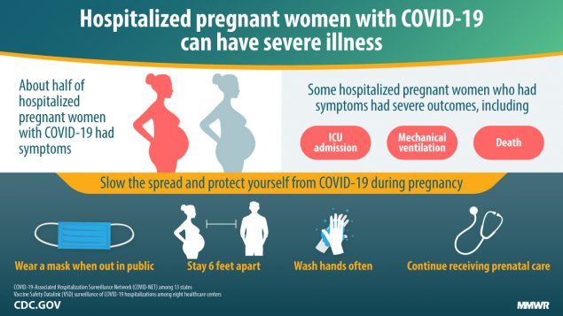
CDC patient education

Slide 20
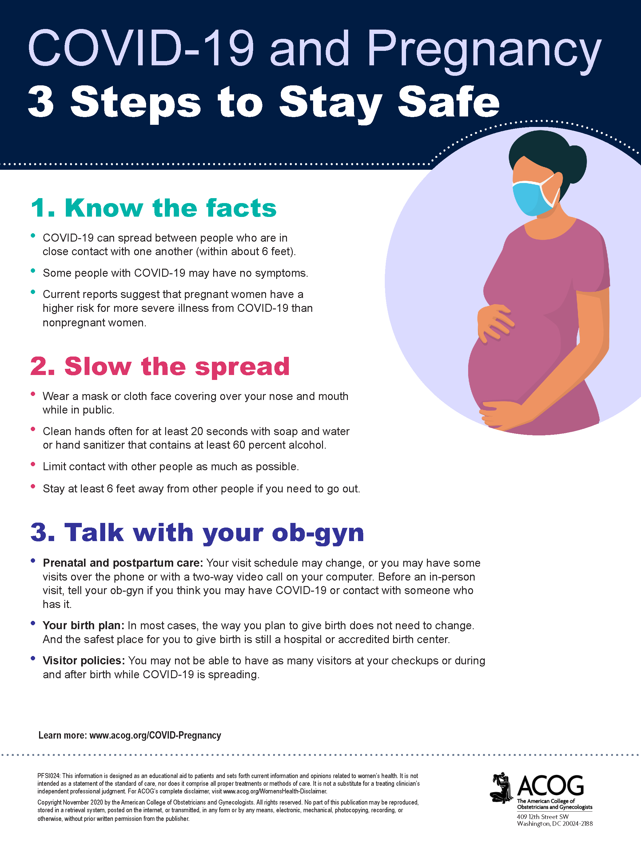
ACOG patient education
ACOG Patient Education: COVID-19 and Pregnancy: 3 Steps to Stay Safe. (Nov 2020)

Slide 21
COVID Vaccines Updates
National Pfizer Vaccine summary of Allergic reactions
  During December 14-23, 1,893,360 first doses of the vaccine administers
  Vaccine Adverse Event Reporting System (VAERS) detected 21 cases of anaphylaxis after administration
  71% of these events occurred within 15 minutes of vaccine administration
  81% had a history of allergies or allergic reactions
  90% occurred in women (but more women than men received the vaccine
  11.1 cases per million doses administered
MMWR, Jan 6, 2021

Slide 22
ACIP recommendations for prioritization of COVID-19 vaccine:
Phase 1a: Health care workers and long-term care facility residents (CDC 2020)
Phase 1b: Persons aged ≥75 years and frontline essential workers (ACIP Slides 2020)
Phase 1c: Persons aged 65-75 years, persons aged 16-64 years with high-risk* medical conditions (including pregnancy), and other essential workers (ACIP Slides 2020)
*High-risk medical conditions outlined by the CDC include:
Pregnancy
Cancer
Chronic kidney disease
COPD (chronic obstructive pulmonary disease)
Heart conditions, such as heart failure, coronary artery disease, or cardiomyopathies
Immunocompromised state (weakened immune system) from solid organ transplant
Obesity (body mass index [BMI] of 30 kg/m2 or higher but < 40 kg/m2)
Severe Obesity (BMI ≥ 40 kg/m2)
Sickle cell disease
Smoking (current or history)
Type 2 diabetes mellitus

Slide 23
ACOG Practice Advisory:
Vaccinating Pregnant and Lactating Patients against Covid-19 (12/21/21)
ACOG recommends that COVID-19 vaccines should not be withheld from pregnant individuals who meet criteria for vaccination based on ACIP-recommended priority groups.
COVID-19 vaccines should be offered to lactating individuals similar to non-lactating individuals when they meet criteria for receipt of the vaccine based on prioritization groups outlined by the ACIP.
Individuals considering a COVID-19 vaccine should have access to available information about the safety and efficacy of the vaccine, including information about data that are not available. A conversation between the patient and their clinical team may assist with decisions regarding the use of vaccines approved under EUA for the prevention of COVID-19 by pregnant patients. Important considerations include:
  the level of activity of the virus in the community
  the potential efficacy of the vaccine
  the risk and potential severity of maternal disease, including the effects of disease on the fetus and newborn
  the safety of the vaccine for the pregnant patient and the fetus.
While a conversation with a clinician may be helpful, it should not be required prior to vaccination, as this may cause unnecessary barriers to access.
Vaccines currently available under EUA have not been tested in pregnant women. Therefore, there are no safety data specific to use in pregnancy. See details about the Food and Drug Administration’s (FDA) EUA process below.
Pregnancy testing should not be a requirement prior to receiving any EUA-approved COVID-19 vaccine.
Pregnant patients who decline vaccination should be supported in their decision. Regardless of their decision to receive or not receive the vaccine, these conversations provide an opportunity to remind patients about the importance of other prevention measures such as hand washing, physical distancing, and wearing a mask.
Expected side effects should be explained as part of counseling patients, including that they are a normal part of the body’s reaction to the vaccine and developing antibodies to protect against COVID-19 illness.
The mRNA vaccines are not live virus vaccines, nor do they use an adjuvant to enhance vaccine efficacy. These vaccines do not enter the nucleus and do not alter human DNA in vaccine recipients. As a result, mRNA vaccines cannot cause any genetic changes.

Slide 24
ACOG Practice Advisory:
Vaccinating Pregnant and Lactating Patients against Covid-19 (12/21/21)
While a conversation with a clinician may be helpful, it should not be required prior to vaccination, as this may cause unnecessary barriers to access.
Vaccines currently available under EUA have not been tested in pregnant women. Therefore, there are no safety data specific to use in pregnancy. See details about the Food and Drug Administration’s (FDA) EUA process below.
Pregnancy testing should not be a requirement prior to receiving any EUA-approved COVID-19 vaccine.
Pregnant patients who decline vaccination should be supported in their decision. Regardless of their decision to receive or not receive the vaccine, these conversations provide an opportunity to remind patients about the importance of other prevention measures such as hand washing, physical distancing, and wearing a mask.
Expected side effects should be explained as part of counseling patients, including that they are a normal part of the body’s reaction to the vaccine and developing antibodies to protect against COVID-19 illness.
The mRNA vaccines are not live virus vaccines, nor do they use an adjuvant to enhance vaccine efficacy. These vaccines do not enter the nucleus and do not alter human DNA in vaccine recipients. As a result, mRNA vaccines cannot cause any genetic changes.

Slide 25
SMFM: SARS CoV-2
Vaccination in Pregnancy (12.21.20)
Despite the categorization of pregnancy as a high-risk condition pregnancy currently remains an exclusion for participation in vaccine trials.
SMFM / ACOG have consistently advocated for the inclusion of pregnant and lactating women in vaccination trials.
In general, SMFM strongly recommends that pregnant women have access to COVID-19 vaccines in all phases of future vaccine campaigns, and that she and her healthcare professional engage in shared decision-making regarding her receipt of the vaccine.
Counseling should balance available data on vaccine safety, risks to pregnant women from SARS-CoV-2 infection, and a woman’s individual risk for infection and severe disease.
SMFM: Provider Considerations for Engaging in COVID-19 Vaccine Counseling With Pregnant and Lactating Patients (Updated 12.21.20)

Slide 26
SMFM: SARS CoV-2
Vaccination in Pregnancy (12.21.20)
Three vaccines demonstrating early efficacy have been highlighted in the media (AstraZeneca's AZD1222, Moderna's mRNA-1273, Pfizer's BNT162b2). These vaccines employ novel next-generation platforms
AstraZeneca’s viral-vector is similar to the mechanism used in the regulated Ebola vaccine. The Ebola vaccine has been safely administered during pregnancy.
Other vaccines that use conventional technologies for which there are known data for use in pregnancy (eg, the COVID-19 PiCoVacc and the NVX-CoV2373, similar to the seasonal flu vaccines) remain in phase I and II trials.
As data emerge, counseling will likely shift, as some vaccines may be more suitable for pregnant women. mRNA vaccines, which are likely to be the first vaccines available, do not contain a live virus but rather induce humoral and cellular immune response through the use of viral mRNA.
Healthcare professionals should also counsel their patients that the theoretical risk of fetal harm from mRNA vaccines is very low.
SMFM: Provider Considerations for Engaging in COVID-19 Vaccine Counseling With Pregnant and Lactating Patients (Updated 12.21.20)

Slide 27
SMFM: SARS CoV-2
Vaccination in Pregnancy (12.21.20)
SMFM recommends that healthcare workers, who are considered prioritized for vaccination, be offered the vaccine if pregnant.
A report by the National Academies of Sciences recommends that high-risk workers in health facilities or first responders should be among the first to receive the vaccine.
Although pregnant women are not explicitly targeted in this framework, pregnant and lactating women who are otherwise eligible should be offered the vaccine.
SMFM will continue to monitor data as it becomes available on COVID-19 vaccine efficacy and safety to evaluate appropriateness in pregnancy, and we will update recommendations on the SMFM COVID-19 website (https://www.smfm.org/covidclinical).
SMFM: Provider Considerations for Engaging in COVID-19 Vaccine Counseling With Pregnant and Lactating Patients (Updated 12.21.20)

Slide 28
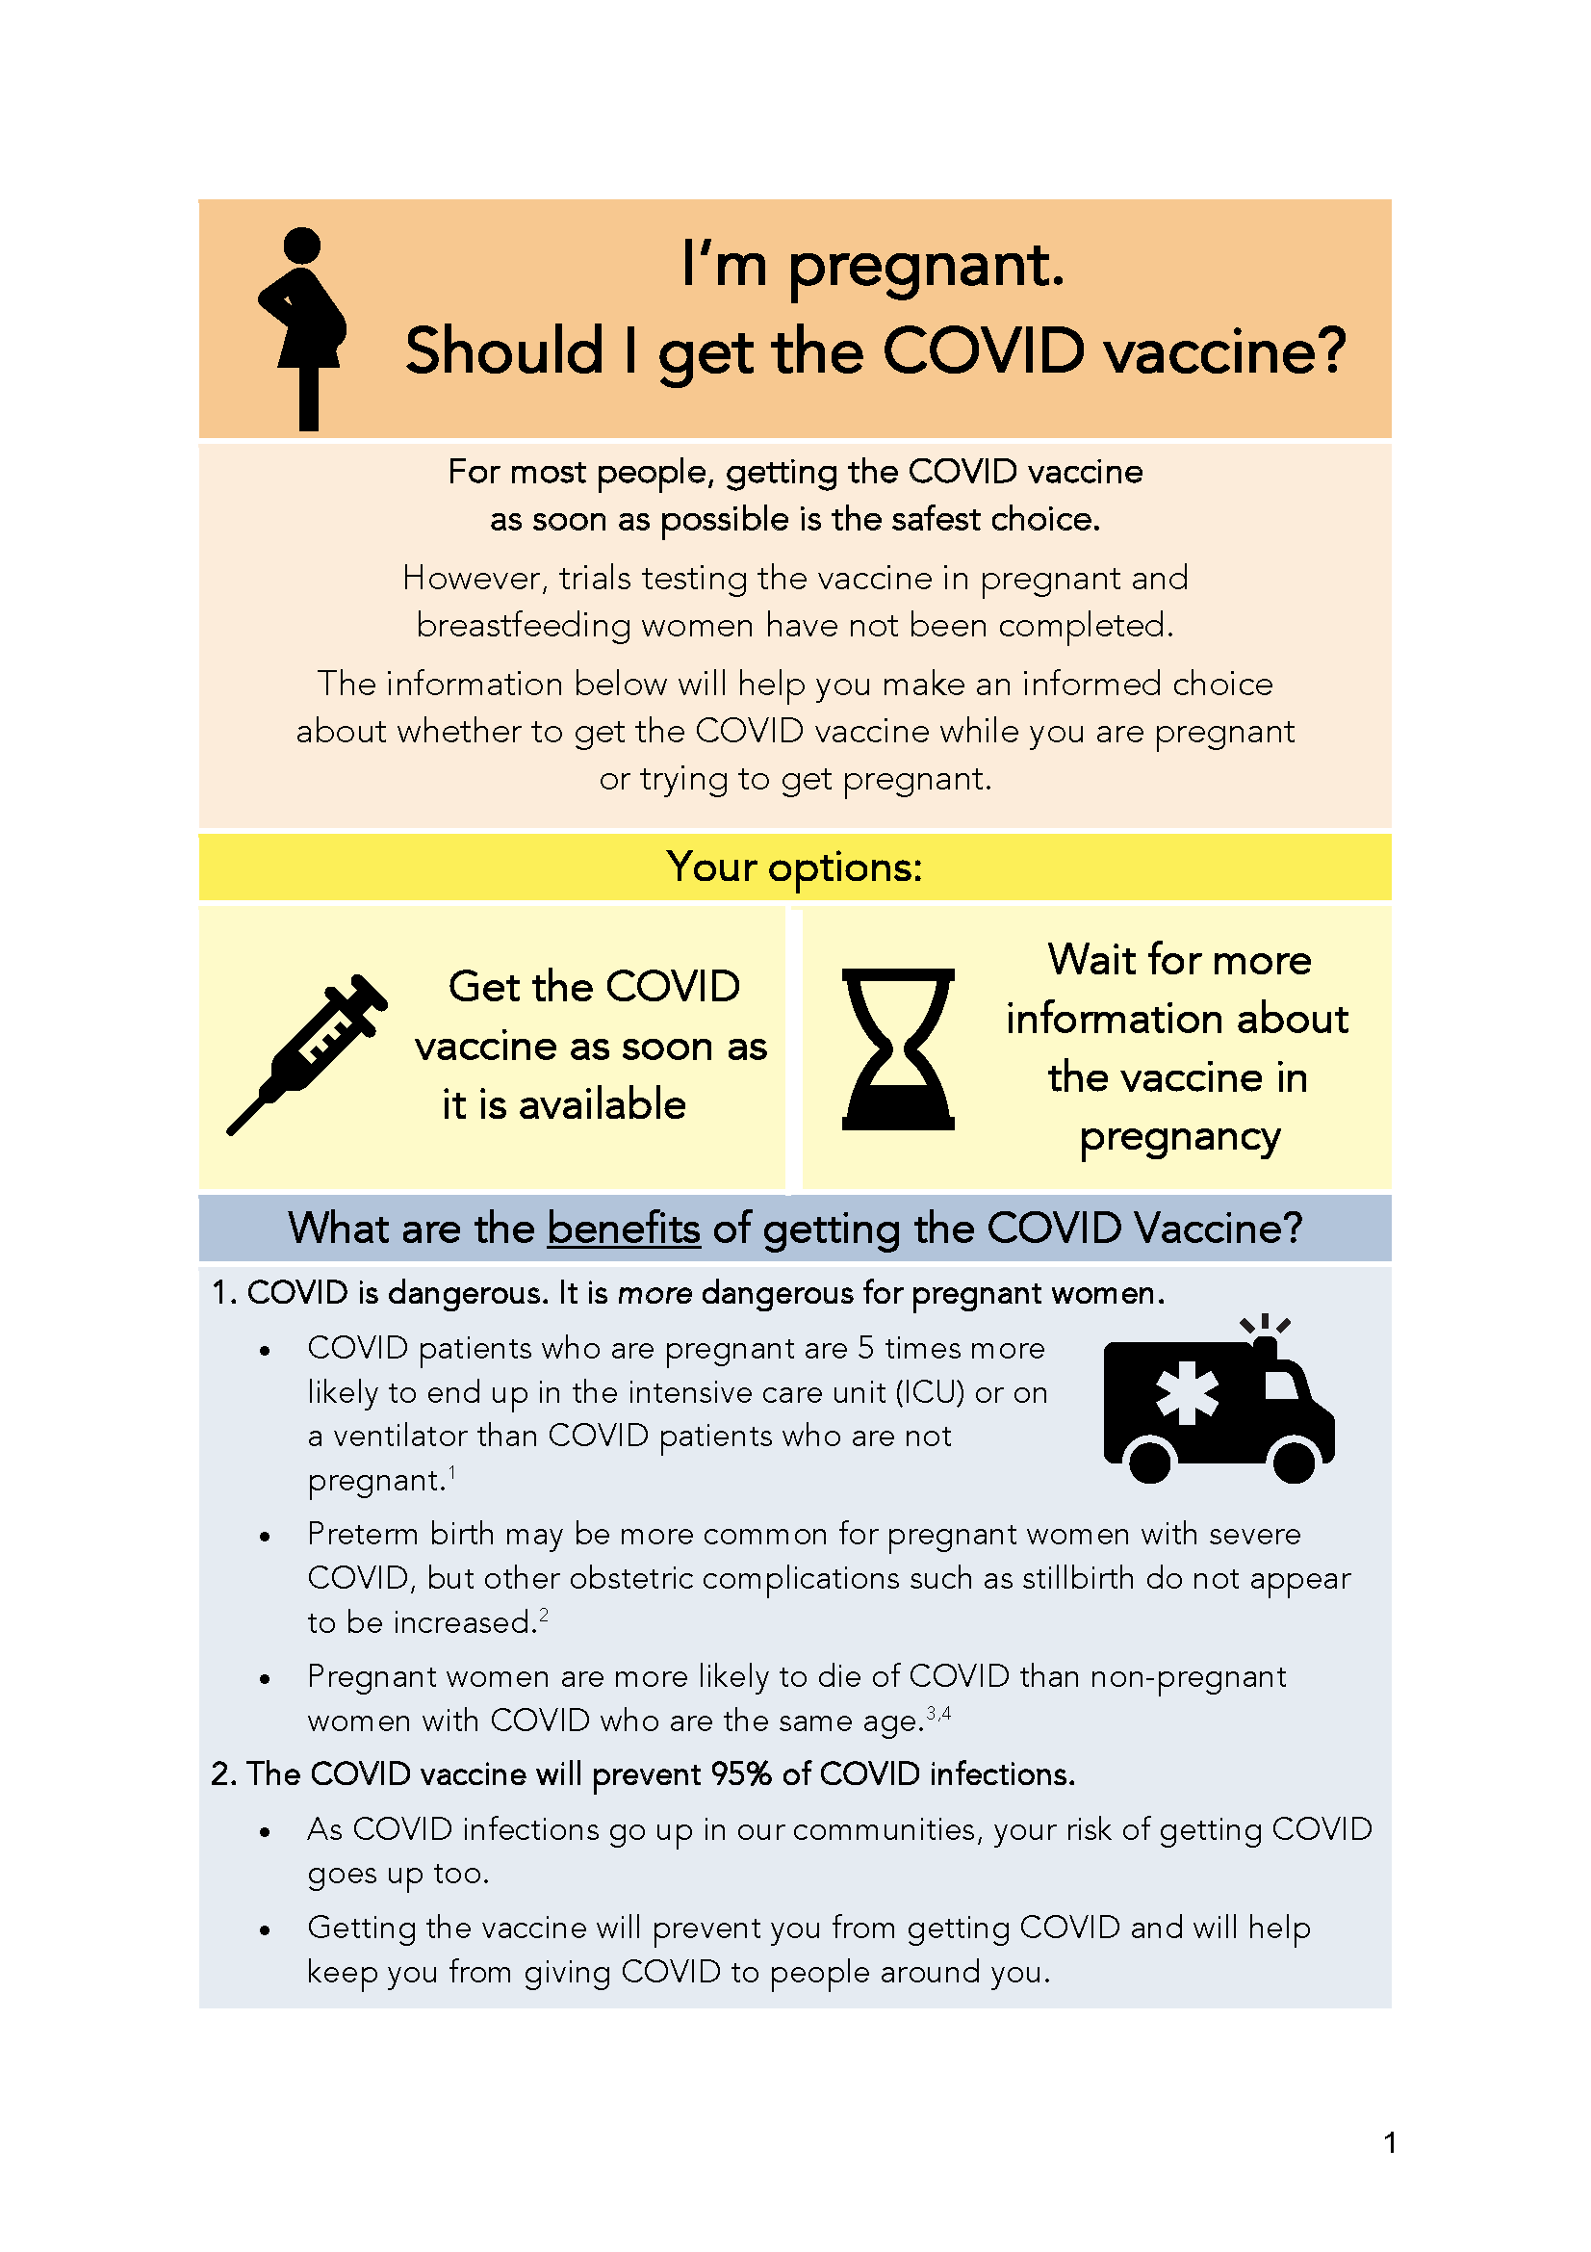
COVID Vaccine
Patient Education Examples
Baystate Health, MA: Covid Vaccine Info for Pregnant/ Breastfeeding Patients. (12.14.20)
Washington University: Pregnancy, Breastfeeding, and the Covid-19 Vaccine. (12.20.20)

Slide 29
COVID Mental Health Support Resources for Physicians & Healthcare Workers
Project Parachute: offers pro-bono teletherapy (video or phone) to frontline workers
  https://project-parachute.org/
Physician Support Line
  staffed by volunteer psychiatrists
  offers free and confidential peer support to physicians in the U.S.
  available daily by calling 1 (888) 409-0141 from 8 a.m. to 3 a.m. EST.
For the Frontlines: 24/7 help line provides free crisis counseling for frontline workers. Text FRONTLINE to 741741

Slide 30
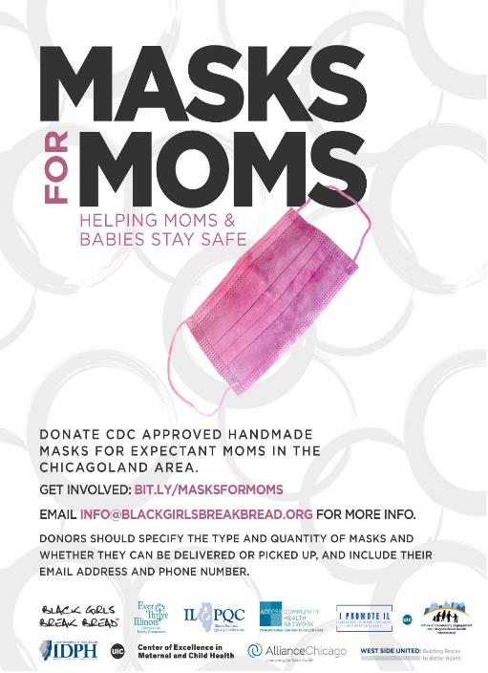
Masks for MOMS
Masks for MOMS Illinois launched on April 21, 2020 to help meet the need for cloth masks among pregnant and postpartum persons in the Chicagoland area in response to the COVID-19 Pandemic.
If your Chicagoland site needs masks for labor/delivery or postpartum patients, please email coemch@uic.edu
  To date:
    14,2 00 masks have been donated
    Over 140 donors and volunteers have contributed
    Masks have been donated to the following sites and hospitals:
Healthcare Sites | Hospitals
• Access Community Health Network • Chicago Family Health Center • Christian Community Health Center • Erie Family Health Centers • Esperanza Health Centers • Family Christian Health Center • Friend Family Health Center • Near North Health Service Corp • PCC Community Wellness Centers • PrimeCare Health Centers • UI Health Mile Square South Shore Health Center | • Advocate Trinity Hospital • Cook County Hospital • Lawndale Christian Hospital • Norwegian American Hospital • Roseland Hospital • Rush University Medical System • South Suburban Hospital • UChicago Medicine- Bernard Mitchell • UChicago Medicine- Ingalls Memorial Hospital • University of Illinois Hospital Evanston Hospital

Slide 31
Perinatal Sentinel Surveillance Reminder
IDPH has a sentinel surveillance system for hospitals conducting universal COVID-19 testing at labor & delivery
  Hospitals report aggregate data to REDCap each week
    Daily counts for five data points
    Brief questions about testing and specimen types in use at hospital
  Voluntary hospital participation is needed – if interested, contact:
    Amanda.C.Bennett@Illinois.gov
    Sonal.Goyal@Illinois.gov

Slide 32
Enhanced Surveillance of COVID-19 During Pregnancy

Slide 33
Collecting Detailed Data on COVID-19 Cases During Pregnancy
CDC developed a “pregnancy module” to augment the more general data collected on COVID-19 case reporting forms
IDPH & CDPH received grants from CDC to conduct enhanced data collection for pregnant women with confirmed COVID-19
  Includes delivering women with positive specimens during 2020
  Involves abstracting medical charts for woman and her infant(s)
IDPH & CDPH are coordinating to develop project plans and will submit data jointly to CDC
  Cases will be divided by location of delivery hospitalization

Slide 34
IDPH Pregnancy Module Data Collection
IDPH will manage chart abstraction for women who deliver in birthing hospitals outside the city of Chicago
APORS program will begin chart abstraction in January 2021
  Process will be very similar to what is already done for birth defects
  No additional requirements from hospitals other than responding to record requests and continuing to enable record sharing with APORS

Slide 35

Chicago Department of Public Health
Partnering with hospitals to be able to collect data from medical records of ALL women who were infected with COVID-19 in 2020 while pregnant and delivered in a Chicago hospital.
CDPH will train and support hospital staff (i.e. Quality team, medical residents or other clinical staff) to abstract data from medical records and input into an online REDCap survey.
Hospitals that do not have the capacity to abstract the data from the EMR may grant CDPH access to these records
(CDPH does not have the same authorization to medical records as IDPH through the APORS program).
Data collection has started at Stroger and Rush and we have initiated planning with several other teaching hospitals.

Slide 36
CDPH Contact information
Jennifer Seo, MD
Medical Director, MICAH
Jennifer.seo@cityofchicago.org
Lynn Pistorio, RN, MPH
Public Health Nurse III
Lynn.pistorio@cityofchicago.org
Beatriz Cabello, MPH
Epidemiologist
Beatriz.cabello@cityofchicago.org

Slide 37
Discussion of Neonatal Unit Strategies

Slide 38
Neonatal Discussion Panel
Beau Batton, MD – Chief Neonatology, SIU School of Medicine, Director of Newborn Services HSHS St. John’s Hospital, Springfield
Justin Josephsen, MD – Medical Director, St. Mary’s Hospital NICU, Neonatologist Cardinal Glennon Children’s Hospital, St. Louis

Slide 39
Cardinal Glennon Children’s Hospital
Significant number of patients from Southern Illinois and the “Metro East” Illinois
Partnership with SSM Health and Saint Louis University Physicians

Slide 40
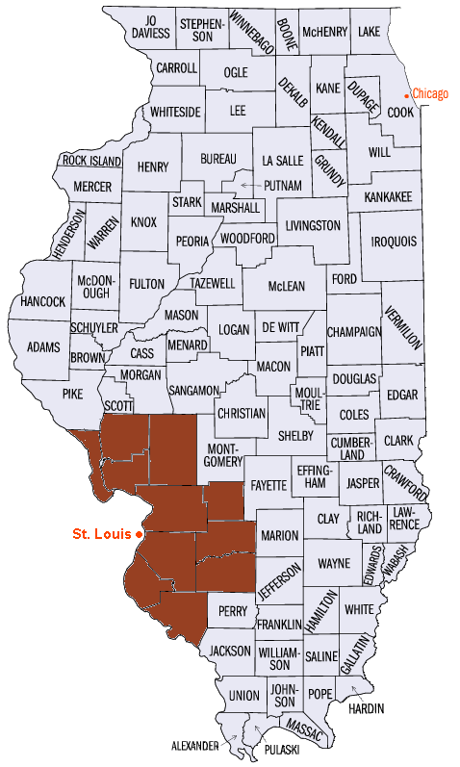

Case Study

Slide 41
Level IV NICU
Within 195-bed, freestanding childrens hospital
65 bed, private NICU room model (twin rooms)
2 visitors, legal guardians (family centered care)
>700 admissions / year
Serve 150 mile+ radius of patients from rural and urban combination
Quaternary referral center for subspeciality patients in including cardiothoracic surgery and ECMO

Slide 42
Case
35 5/7 week infant, 2180g
22 y/o G2, now P2
Minimal prenatal care
UDS positive
Congenital anomalies seen prenatally
  CHD, omphalocele
Planned delivery at tertiary center, but delivered at very rural hospital
  Hospital is 150 miles from Cardinal Glennon
  Family had to drive 35 miles on 2 lane road to reach community hospital
  Approx. total of 4-hour drive to Cardinal Glennon from home
Intubated in the delivery room

Slide 43
After birth
Ultimately diagnosed with
  Double outlet right ventricle
  Giant omphalocele with fistular tract leaking meconium
  Associated pulmonary hypoplasia
Intubated for entirety of life on high ventilator settings
  PIP >30 cmH20, RR 50, pressure support 27 cmH20
  Ultimately >60-70% FiO2
Multiple subspecialists
After 5-6 weeks, slow, but continued steady deterioration
Parents were difficult to reach by telephone. Missed multiple “care conference” appointments.
  DFS involvement, but remained in parental custody at the time
Ultimately visited for first time at 6 weeks

Slide 44
COVID
Parents arrive in AM (on a Saturday), their ride left shortly afterward
COVID screen at hospital entrance (temp check, verbal screen of COVID sx denied)
Daytime medical team reviewed critical nature and offered withdrawal of care, given fact baby highly unlikely to survive
Parents not ready and want to spend time with infant
  Medical team completely understanding of this
In afternoon, mother noted to have non-productive cough

Slide 45
In evening cough persisted, requested to leave (Sat. night)
  Parents with no transportation, no where to go at all
After discussion with on-call senior hospital leadership, decision as follows:
  Mother needs immediate COVID testing in ED
  After, mother and dad to stay in room with N95 mask, closed door
  Patient’s room treated as PUI room for staff PPE purposes (not neg pressure)
  Parents only to leave for restroom, food to be brought to room
  If they leave NICU, not able to return
Parents appeared under influence throughout, falling asleep during normal conversations
Next AM, dad left after discussion that he could not return if he left
Mom COVID positive in afternoon
Mom decided to redirect care
Baby extubated, died quickly
Mother left, unsure how she able to get home

Slide 46
COVID + Visitor Event
Situation
  Multifactorial, end of life event involving a COVID+ parent
Background
  Family under the influence
  First (only) Visit
  Withdraw Life Support
Assessment
  Opportunities for better communication for situation outside of normal process
  Current IP/ COVID guidelines (required PPE left minimal to no risk of exposure to staff and families)
  Identifying/ assessing the need for support of staff’s emotional state
Recommendations
  Share a process to escalate issues/ concerns in the NICU
  Increase staff awareness of current IP guideline.
  Keep guide updated with changes.
  Frequent rounding or follow up by charge nurse and managers.

Slide 47
Influencers
Mom and Dad first (only) visit after 6 weeks
All events occurred on weekend (Saturday and Sunday)
Parents misconception of Easton’s condition
Both parents under the influence. Fluctuating between lucid and impaired/ coherent and incoherent.
Dad did not truly leave the premises, kept low profile in building. He did not return to the NICU.

Slide 48
Event Follow Up
Interviewed Staff
Recreated Timeline of Events
Created Action Plan
Debriefed
No staff member infected from this family

Slide 49
Lessons Learned
Uncoordinated decision making
Keep Patient at the center of decision making
Unusual situation
Nursing is empowered to call security
Efficient communication during escalation
Ensuring complete communication with all relevant parties
Ways respectfully gather reliable information about concerns, especially for staff not directly involved
  Managing rumors and/or misunderstandings from non-involved staff

Slide 50
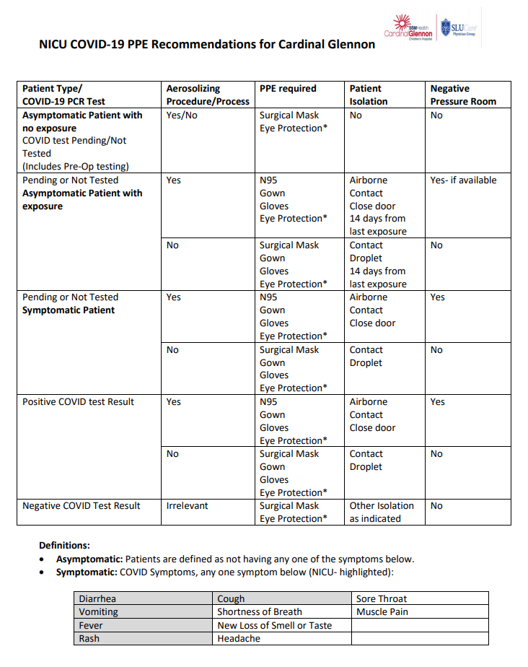
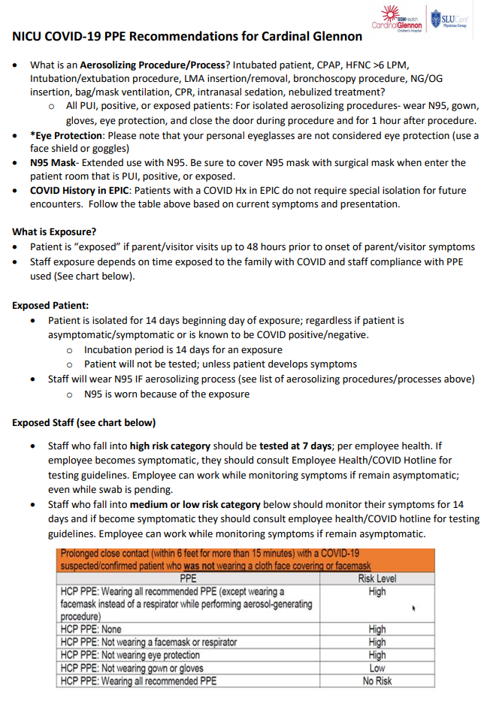
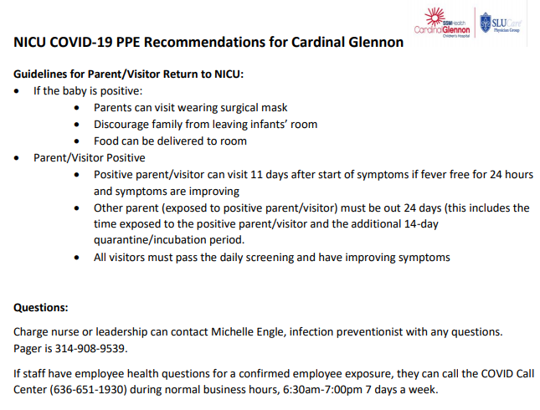
Action Items

Slide 51
2nd Case, 2 weeks later
Infant with severe HIE
Refractory seizures with exceptionally abnormal MRI
As this was evaluated, dad with COVID sx and COVID+
Need for serious discussion about potential end of life care

Slide 52
Results of Action Items
Followed Patient Isolation Guidelines
Discussion with family about changes in visitation
Need for Care Conference
  Adjusted Visitation Parameters
Extended Patient Isolation due to Care Conference
Successes:
  Better Communication
  Clear pathway of a plan that can be adjusted with communication
  Increased Comfort Level of Staff

Slide 53
Discussion of OB Unit Strategies

Slide 54
OB Discussion Panel
  Michele A. Bucciero MD, MBA-HCM – Medical Director of Perinatal Services, Saint Anthony Hospital, Chicago
  Jonathan (Jake) Hirshberg, MD – Clinical Fellow in Maternal-Fetal Medicine and Surgical Critical Care, Washington University, St. Louis
  Sarah L Bradley, MD – OB Hospitalist, Swedish American Hospital, Rockford
  Jeannie Kelly, MD – Director Maternal Fetal Transport, Maternal Fetal Medicine, Barnes Jewish Hospital, Washington University, St. Louis

Slide 55
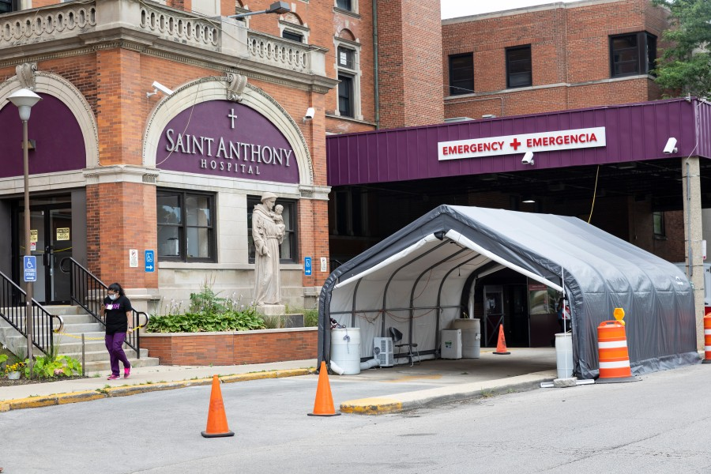
Maternity Care During COVID-19 Pandemic
Saint Anthony Hospital
Chicago, Illinois
Michele A Bucciero, MD MBA-HCM
Medical Director of Perinatal Services

Slide 56
Case Presentation
26 y/o G1P0 @ 32 weeks with dichorionic/diamniotic twin gestation presented with leakage of fluid
PPROM confirmed, SVE cl/L/H with transverse/breech presentation
Betamethasone and latency antibiotics started, Neonatology and MFM consults obtained
Rapid COVID screen positive, patient asymptomatic
Patient began to feel mild menstrual cramping, SVE 9/100/0
Patient was taken to COVID OR for emergent Cesarean section
Female 3 lbs. 8 oz Apgars 6, 9; Male 4 lbs. 0 oz Apgars 8, 9
Patient did well post-operatively and was discharged on POD #2

Slide 57
Pandemic Lessons Learned
Delays from test results continue to be problematic
Slow vaccine roll-out has been frustrating for healthcare workers and patients
Shortages of patient rooms and staff continue to pose challenges
Patients presenting for care are more critically ill
COVID Operating Room in Main OR – supplies from our cart were being used by main OR staff
Mental health challenges of staff largely underestimated and untreated
Financial challenges to hospitals are significant, especially small and independent institutions in under-served areas

Slide 58

Barnes-Jewish Hospital affiliated with Washington University Physicians
St. Louis, Missouri
10,125 employees
1,266 beds
Parkview Tower
Opened Feb. 2018
  Women and Infants
    18 Labor rooms
    12 Triage bed unit
    18 Antepartum bed unit
    34 Postpartum bed unit
    3 OR’s
      1 for Fetal Surgery
3,665 Deliveries
545 Inbound Maternal Transfers
150 Bed NICU St. Louis Children’s Hospital (August 2020)

Slide 59
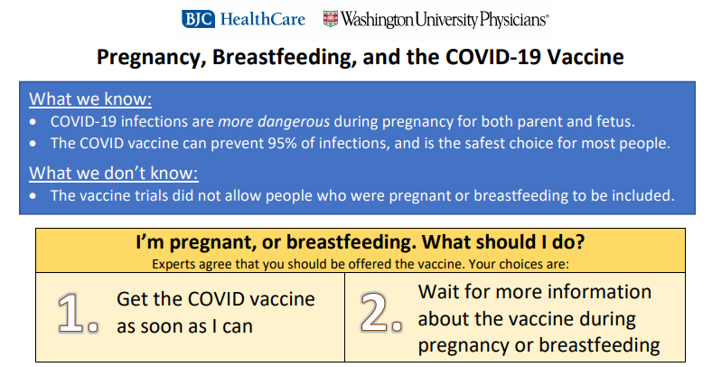
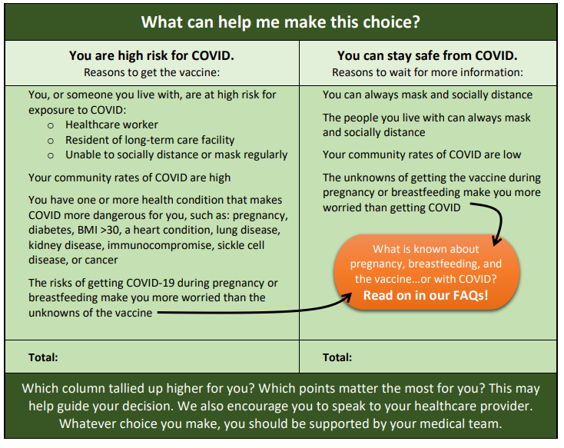

Link to full doc with FAQ

Slide 60
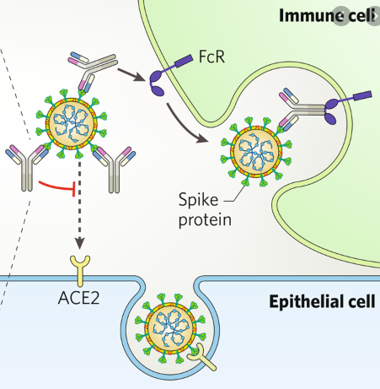
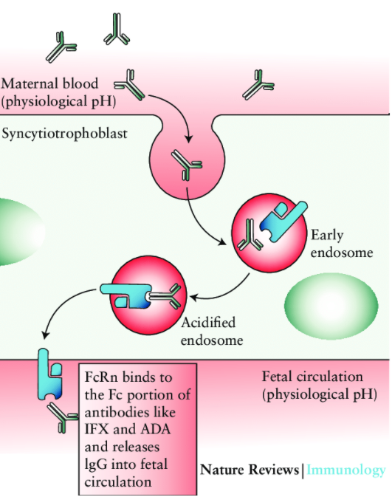
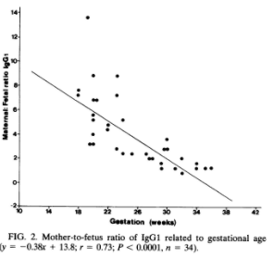
Monoclonal Antibody Therapy
Notes:
FC portion is unadulterated
Bamlanivimab is a recombinant neutralizing human IgG1κ monoclonal antibody (mAb) to the spike protein of SARS-CoV-2, and is unmodified in the Fc region
. Following a single 700 mg IV dose, bamlanivimab was quantifiable for at least 29 days. The mean concentration was 22 µg/mL (90% CI: 10.7 to 41.6 µg/mL) on Day 29.

Slide 61
Bamlanivimab (Eli Lilly) and Casirivimab and imdevimab (Regeneron)
ACITV-3 Trial (Bamlanivimab)
  NIH sponsored trial of hospitalized patients with COVID
  Pregnancy and lactation excluded
  Halted due to futility, published 12/22 w/ no benefit
BLAZE-1 Trial (Bamlanivimab)
  452 patients at high risk of progression to sev disease
  Pregnancy and lactation excluded
  There was a sig reduction in hospitalization rates (1.6 v 6.3%, p=0.02
  Adaptive trial now in its second phase
R10933-10987-COV-2067 Trial (Casirivimab and imdevimab)
  4 cohorts separated by disease severity
  IDMC halted recruitment in patients requiring high levels of oxygen
  Results from 777 non-hospitalized patients published 12/17
    Reduced viral load
    Reduced “medically attended visits”
FDA/NIH/ISDA guidelines
  Routine use not recommended for ambulatory patients
  EUA for patients at high risk of disease progression
  Use in pregnancy/lactation based on risk benefit discussion with providers
Notes:
High risk is defined as patients who meet at least one of the following criteria:
Body mass index (BMI) ≥35
CKD
Diabetes
Immunosuppressive disease
Are currently receiving immunosuppressive treatment.

Slide 62
OB Discussion Panel
  Michele A. Bucciero MD, MBA-HCM – Medical Director of Perinatal Services, Saint Anthony Hospital, Chicago
  Jonathan (Jake) Hirshberg, MD – Clinical Fellow in Maternal-Fetal Medicine and Surgical Critical Care, Washington University, St. Louis
  Sarah L Bradley, MD – OB Hospitalist, Swedish American Hospital, Rockford
  Jeannie Kelly, MD – Director Maternal Fetal Transport, Maternal Fetal Medicine, Barnes Jewish Hospital, Washington University, St. Louis

Slide 63
Thank You
We continue to give thanks to the nurses, doctors, health care workers, public health teams and others across our state at work confronting the COVID-19 pandemic.
Please send questions, comments and recommendations, cases / willingness to share for future COVID-19 OB/Neo discussion webinars to info@ilpqc.org
Recording of this webinar, Q/A and registration for the next webinar on Friday, 2/5/21 will be available at www.ilpqc.org

Slide 64










THANKS TO OUR
FUNDERS
In Kind Support

Slide 65
Outpatient Monitoring for pregnant patients with mild or no symptoms
Outpatient monitoring with a 14-day self-quarantine can be considered for pregnant patients with COVID-19 who have mild symptoms or are asymptomatic. Recommendations for outpatient monitoring is outlined.
Check on outpatient Covid positive patients regularly and review signs/symptoms to call, recognize can worsen around day 7-10
For 3rd trimester patients who need outpatient fetal or maternal monitoring establish protocol: schedule at the end of the day with limited staff with appropriate PPE
After 14 days from positive test or symptom onset, if symptoms improved and no fever >72 hours then can be considered recovered.
SMFM: Management Considerations for Pregnant Patients with COVID-19 (7.2.2020) updated

Slide 66
The severity scale for COVID-19
Asymptomatic or presymptomatic disease or presumptive infection is defined as a positive COVID-19 test result with no symptoms.
Mild disease is defined as flu-like symptoms, such as fever, cough, myalgias, and anosmia without dyspnea, shortness of breath, or abnormal chest imaging.
Moderate disease is defined by evidence of lower respiratory tract disease with clinical assessment (dyspnea, pneumonia on imaging, abnormal blood gas results, refractory fever of 39.0 °C /102.2 °F or greater, while maintaining an oxygen saturation of greater than 93% on room air at sea level.
Severe disease is defined by a respiratory rate greater than 30 breaths per minute (bpm), hypoxia with oxygen saturation less than or equal to 93%, a ratio of arterial partial pressure of oxygen to fraction of inspired oxygen of less than 300, or greater than 50% lung involvement on imaging.
Critical disease is defined as multi-organ failure or dysfunction, shock, or respiratory failure requiring mechanical ventilation or high-flow nasal cannula.
SMFM: Management Considerations for Pregnant Patients with COVID-19 (7.2.2020) updated

Slide 67
Inpatient monitoring may be needed for the following categories of patients:
Pregnant COVID-19 patients with moderate to severe signs and symptoms or oxygen saturation less than 95%. (incudes dyspnea)
Pregnant COVID-19 patients with comorbid conditions, eg, uncontrolled hypertension, inadequately controlled gestational or pregestational diabetes, chronic renal disease, chronic cardiopulmonary disease, or immunosuppressive states (intrinsic or medication-related)
Pregnant COVID-19 patients with fevers greater than 39 °C despite acetaminophen, raising concern for secondary hemophagocytic lymphohistiocytosis (sHLH) or "cytokine storm syndrome." sHLH is a fulminant and often fatal hypercytokinemia associated with multi-organ failure. The disease is defined by unremitting fever, cytopenia, and high ferritin levels. If a patient has an Hscore (see Table 1) indicating a high probability for sHLH, inpatient observation is warranted.
SMFM: Management Considerations for Pregnant Patients with COVID-19 (7.2.2020) updated

Slide 68
Timing of Delivery: mild symptoms
In an asymptomatic or mildly symptomatic woman positive for COVID-19 at 37 to 38 6/7 weeks of gestation without other indications for delivery, expectant management can be considered until 14 days after the polymerase chain reaction (PCR) result was noted to be positive OR until 7 days after onset of symptoms and 3 days after resolution of symptoms. This option allows for decreased exposure of health care workers and the neonate to SARS-CoV-2.
In an asymptomatic or mildly symptomatic woman positive for COVID-19 at 39 weeks of gestation or later, delivery can be considered to decrease the risk of worsening maternal status.
SMFM: Management Considerations for Pregnant Patients with COVID-19 (7.2.2020) updated

Slide 69
Timing of Delivery: critical illness
The timing of delivery requires carefully weighing the benefits and risks for the patient and fetus, and the decision to deliver requires close communication between the maternal-fetal medicine and critical care teams. Improvement in lung mechanics gained by early delivery is theoretical. In the third trimester, the pressure of the uterus can decrease expiratory reserve volume, inspiratory reserve volume, and functional residual capacity, which can increase the risk of severe hypoxemia in pregnant patients, especially those who are critically ill.
Although data regarding delivery timing and acute respiratory distress syndrome are limited, it is reasonable to consider delivery in the setting of worsening critical illness.
SMFM: Management Considerations for Pregnant Patients with COVID-19 (7.2.2020) updated

