Slide 1

COVID-19 Strategies for OB & Neonatal Units
August 14, 2020
12:00 – 1:15pm

Slide 2

Welcome
Please be certain you are on “mute” when not speaking to avoid background noise.
Whether you have joined by phone or computer audio, you can mute and unmute yourself by clicking on the microphone icon.
The following shortcuts can also be used
For PC: Alt + A : Mute or Unmute
For Mac: Shift + Command + A: Mute or Unmute
For telephone: *6 : Mute or Unmute

Slide 3
Housekeeping:
We Are Recording Now

Slide 4
ILPQC Covid 19 webinars
The strategies shared today are examples from individual institutions not IDPH or ILPQC recommendations.
This is our 11th COVID-19 strategies for OB/Neonatal Units webinars in coordination with IDPH, since April 3rd. Please see https://ilpqc.org/covid-19-information/ for future webinar registration, prior recorded webinars and written out Q/A’s from those webinars.
The next webinar will be Friday, September 11, noon to 1:15pm. We are continuing monthly webinars for now.
Please let us know if your hospital would like to share on an upcoming webinar, please put questions/comments into the chatbox or email directly to info@ilpqc.org

Slide 5
Overview
Introduction
IDPH Hospital Survey Covid-19 update
  Amanda Bennett, PhD, MPH, CDC Field Assignee in Maternal and Child Health Epidemiology, Illinois Department of Public Health
Discussion of Neonatal Unit Strategies
  Justin Josephsen, MD, Medical Director – St. Mary’s Hospital NICU, Neonatologist Cardinal Glennon Children’s Hospital, St. Louis
  Leslie Caldarelli, MD, NICU Director, Prentice Women's Hospital, Chicago
Discussion of OB Unit Strategies
  Emily Miller, MD – Maternal-Fetal Medicine, Northwestern University
  Rob Abrams, MD, Executive Director - SIU Center for Maternal - Fetal Medicine, HSHS St. John's Hospital, Springfield
  Thaddeus Waters, MD – Director, Maternal Fetal Medicine, Rush University
  Xavier Pombar, DO – Maternal Fetal Medicine, Rush University Medical Center
  Jo Kim PhD – Director NorthShore University HeathSystem Perinatal Depression Program

Slide 6
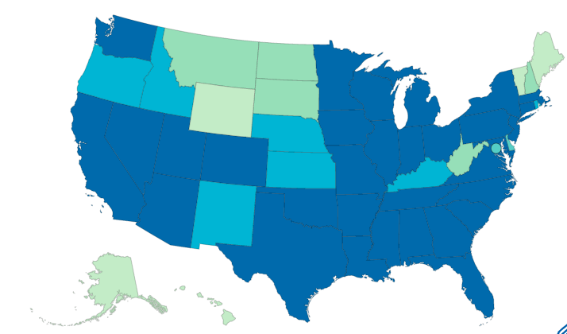
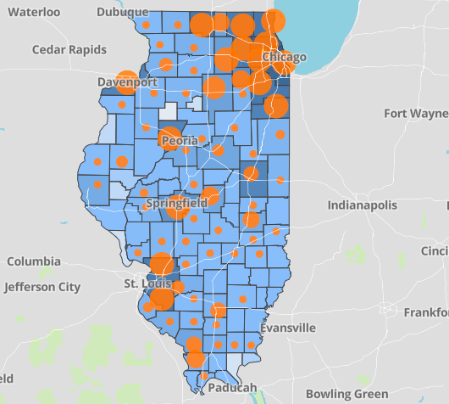
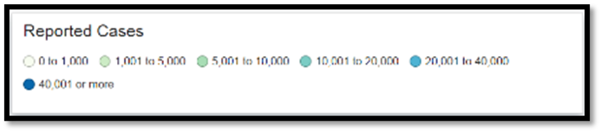
Data Update August 13, 2020
CDC/IDPH: COVID-19 Outbreak
CDC https://www.cdc.gov/coronavirus/2019-ncov/cases-updates/cases-in-us.html | IDPH https://www.dph.illinois.gov/covid19
Total cases: 5,176,018 confirmed Total deaths: 165,148 confirmed | 200,427 Confirmed Positive Cases 7,696 Deaths
Notes:
Ieshia updated 8/13/2020

Slide 7
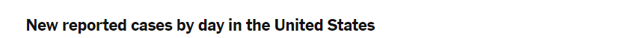
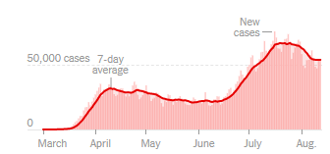
US COVID case trend
Notes:
Ieshia updated 8/13/2020
https://www.nytimes.com/interactive/2020/us/coronavirus-us-cases.html

Slide 8
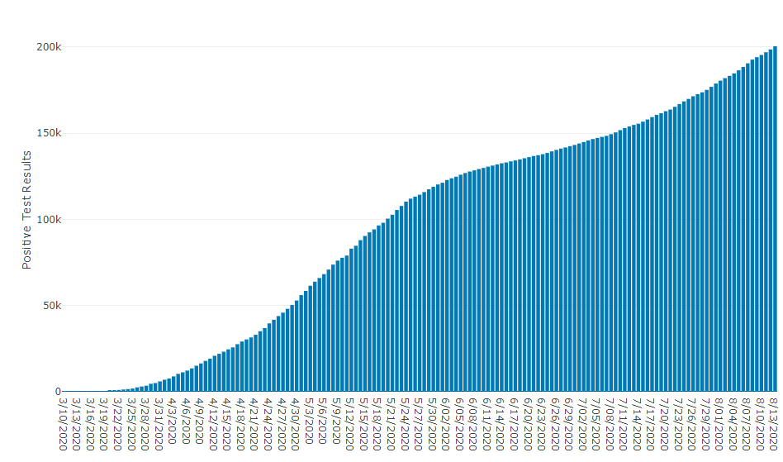
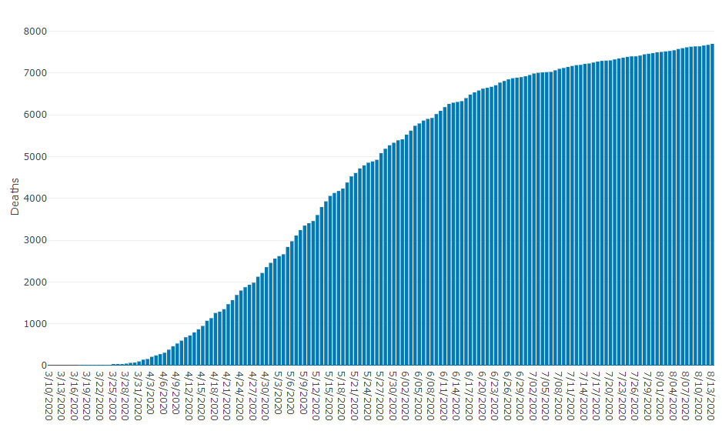
Data Update August 13, 2020
IDPH: COVID-19 Outbreak
https://www.dph.illinois.gov/covid19
IL Positive Cases Over Time
IL Deaths Over Time
Total: 200,427 Confirmed Positive Cases
Total: 7,696 Deaths
Notes:
http://www.dph.illinois.gov/covid19/covid19-statistics
Ieshia update 8/13/2020

Slide 9
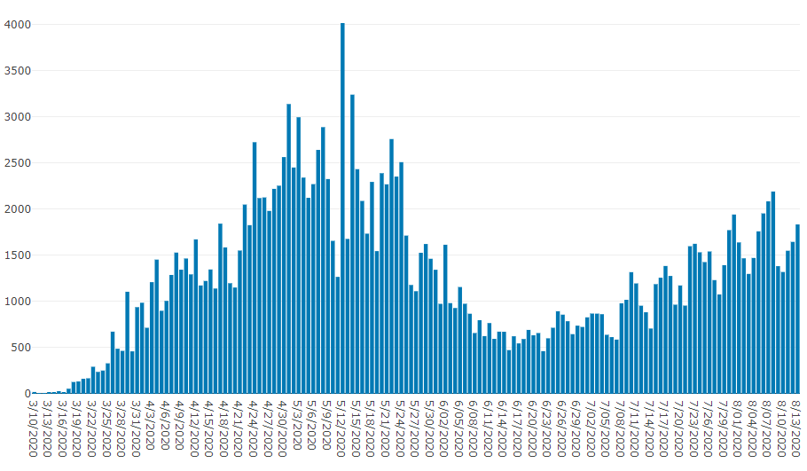
Illinois Daily Incidence
IDPH daily data summary
Notes:
Ieshia updated 8/13/2020
https://www.dph.illinois.gov/covid19/covid19-statistics

Slide 10
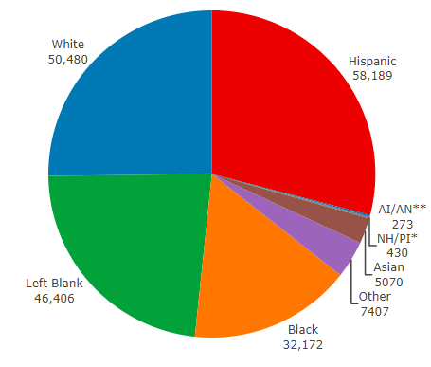
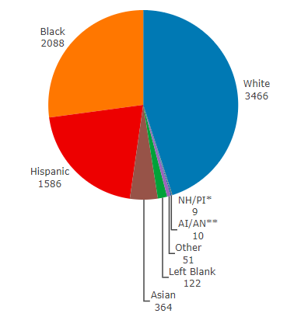
Data Update August 13, 2020
IDPH: COVID-19 Outbreak
Race Demographics
https://www.dph.illinois.gov/covid19
Confirmed Cases
Deaths
Notes:
http://www.dph.illinois.gov/covid19/covid19-statistics
Ieshia updated 8/13/2020

Slide 11
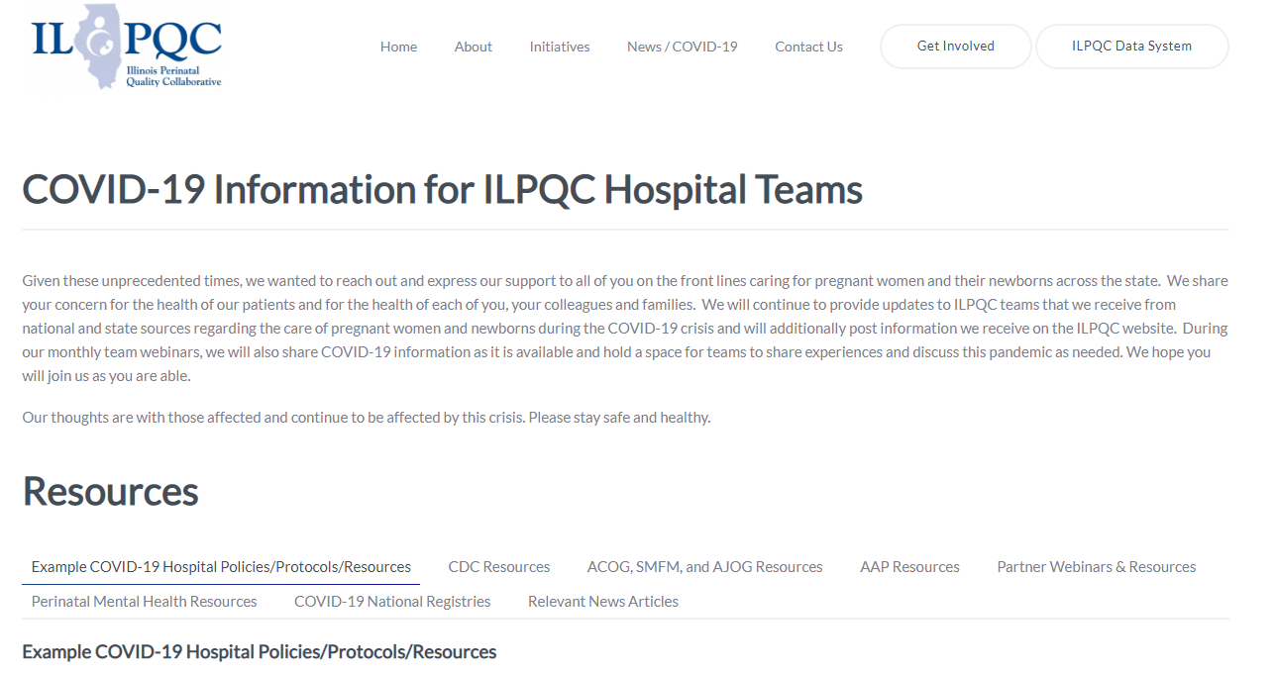
ILPQC COVID-19 Webpage www.ilpqc.org
ILPQC posts national guidelines and OB & Neonatal COVID-19 example hospital protocols & resources
please note dates as guidelines are changing rapidly
https://ilpqc.org/covid-19-information/

Slide 12
Updated OB (ACOG/SMFM) Resources
AJOG MFM: Coronovirus Guidance
ACOG: Statement on new CDC data COVID-19 and Pregnancy (6.24.2020)
Preeclampsia Foundation: How To Take Your Blood Pressure. (7.8.2020)
SMFM: Management Considerations for Pregnant Patients with COVID-19 (7.2.2020) updated
ACOG: COVID-19 FAQs for Obstetrician-Gynecologists, Ethics. (7.14.2020)
ACOG: Coronavirus (COVID-19), Pregnancy, and Breastfeeding: A Message for Patients (7.14.2020)
ACOG: Coronavirus (COVID-19) and Women’s Health Care: A Message for Patients. (7.23.20)
SMFM: Coronavirus (COVID-19) and Pregnancy: What Maternal-Fetal MedicineSubspecialists Need to Know (7.23.2020)
ACOG:COVID-19 FAQs for Obstetrician-Gynecologists, Obstetrics (Updated 8.4.2020)​
ACOG: Practice Advisory (Updated 8.12.2020)​

Slide 13
Updated Neonatal /AAP Resources
Cloth Face Coverings: .Guidance for pediatricians when counseling families about the universal use of cloth face coverings by children 2 years of age and older and the adults with whom they interact. (8/12/2020)
COVID-19 Testing Guidance: Guidance developed to help pediatric practices determine when to test for severe acute respiratory syndrome-coronavirus 2 (SARS-CoV-2) infection in their patient population. (8/12/2020)
Family Presence Policies for Pediatric Inpatient Settings During the COVID-19 Pandemic: Guidance on family presence policies developed to support family-centered care for all children and particularly for children with special health care needs, including those with disabilities, medical complexity, and serious illness. (8/7/2020)
Breastfeeding Guidance Post Hospital Discharge for Mothers or Infants with Suspected or Confirmed SARS-Co V-2 Infection: Guidance developed to support pediatricians providing direct care for breastfeeding families after discharge from the newborn hospital stay. (Updated 7/29/2020)
Newborn Care: Guidance for the care of infants whose mothers have suspected or confirmed COVID-19: Includes precautions for birth attendants, rooming-in, breastfeeding, testing, neonatal intensive care, visitation and hospital discharge. (Updated 7/22/2020)
Newborn Screening During the COVID-19 Pandemic: Guidance recommending that pediatricians continue to follow federal and state guidelines on newborn bloodspot screening, newborn hearing screening, and critical congenital heart disease screening. (7/16/2020)
Multisystem Inflammatory Syndrome in Children (MIS-C) Interim Guidance: Clinical guidance for pediatricians including signs, symptoms, diagnosis and management of this rare but serious complication associated with COVID-19. (7/13/2020)

Slide 14
Updated OB/Neo Covid Publications
AJOG MFM: Extracorporeal membrane oxygenation in pregnant and postpartum women. (5.2020)
OBGYN: Prevention of thrombosis in pregnant women with suspected SARS‐CoV ‐2 infection: clinical management algorithm (5.25.2020)
Lancet: Physical distancing, face masks, and eye protection to prevent person-to-person transmission of SARS-CoV-2 and COVID-19: a systematic review and meta-analysis (6.1.2020)
NEJM: False Negative Tests for SARS-CoV-2 Infection — Challenges and Implications (6.5.2020)
OBGYN: Prone Positioning for Pregnant Women With Hypoxemia Due to Coronavirus Disease 2019 (COVID-19) (6.9.2020)
JOP: The clinical course of SARS-CoV-2 positive neonates. (6.24.2020)
CDC MMWR: Characteristics of Women of Reproductive Age with Lab-Confirmed SARS-CoV-2 Infection by Pregnancy Status (6.26.2020)
JONN: Covid-19 In Babies: Knowledge for Neonatal Care. (6.29.2020)
Front. Immunol: Pregnancy, Viral Infection, and COVID-19. (7.7.2020)
AJOG: The role of a cytokine storm in severe COVID-19 disease in pregnancy. (7.8.2020)
JAMA: Change in the Incidence of Stillbirth and Preterm Delivery During the COVID-19 Pandemic (7.10.2020)​
AJOG: Implementation of Universal Testing for SARS-CoV-2 in pregnant women with intended admission for delivery (7.10.2020)​

Slide 15
Birth Equity Links
Please see the following links and publications for information that may help your organization consider next steps to take action to address birth equity and reduction of perinatal racial and ethnic disparities.
AIM: Reduction of Peripartum Racial/Ethnic Disparities Patient Safety Bundle (2018)
ACOG: Reduction of Peripartum Racial and Ethnic Disparities: a conceptual framework and maternal safety consensus bundle (May 2018)
ACOG Committee Opinion No. 729: Importance of Social Determinants of Health and Cultural Awareness in the Delivery of Reproductive Health Care (January 2018)
SMFM: Strategies to overcome racism's impact on pregnancy outcomes (May 2020)
SMFM: Strategies to provide equitable care during COVID-19 (May 2020)
ACOG: Addressing Health Equity During the COVID-19 Pandemic (May 2020)
AAP Policy Statement: The impact of racism on child and adolescent health (Aug 2019)
Today: Black. Pregnant. And COVID-19 positive. (7.8.2020)
CDC: COVID-19 Response Promising Practices in Health Equity II (7.31.2020)
CDC: HEAR HER Campaign (8.4.2020)strategies promote birth equity and reduce preventable maternal mortality

Slide 16
IDPH / HFS / CDC Communications
CDC: Characteristics of Women of Reproductive Age with Lab-Confirmed SARS-CoV-2 Infection by Pregnancy Status (6.26.2020)
CDC: Pregnancy Data on COVID-19 (7.9.2020)
HFS: Provider Notice Issued Blood Pressure Monitoring Kit (7.2.2020)​ - Medicaid now covers home BP cuffs for all pregnant / postpartum patients
CDC: Evaluation and Management Considerations for Neonates At Risk for COVID-19. (8.3.2020)​

Slide 17
IDPH Update
IDPH Hospital Survey Covid-19 update
  Amanda Bennett, PhD, MPH, CDC Field Assignee in Maternal and Child Health Epidemiology, Illinois Department of Public Health

Slide 18
IDPH Hospital Survey Update
Original survey in May 2020 to assess COVID-19-related practices and policies in Illinois birthing hospitals
  95% response rate
Follow-up survey sent in July 2020 to update testing practice information
  Administered via SurveyMonkey
  Available 7/20/20 – 7/28/20
  Response rate = 74%
    74 / 100 hospitals currently open for obstetric services
    Includes two hospitals in St. Louis

Slide 19
Universal COVID-19 Testing at L&D
62% of Illinois hospitals with current obstetric services are doing universal COVID-19 testing at L&D
  Covers 78% of deliveries in Illinois hospitals
  Increase from 49% of hospitals in May 2020

Slide 20
Perinatal Sentinel Surveillance - Introduction
Sentinel Surveillance captures timely changes in disease occurrence rates for a population in a timely manner
It can help inform preventative actions and signal potential need for early intervention in a region
Pregnant women delivering at birthing hospitals conducting universal Covid-19 testing are ideal for sentinel surveillance
  relatively stable and healthy population
  continue to seek care and present to L&D even with Covid-19

Slide 21
Perinatal Sentinel Surveillance - Pilot
Developed process for hospitals to submit aggregate (count) data on COVID-19 tests and results
  Intent is for system to be low burden
Piloted data submission process with 8 hospitals for over one month, testing:
  Ease of use
  Utility of data to IDPH
Chart credit: Civis Analytics

Slide 22
Perinatal Sentinel Surveillance - Recruitment
We will now open up the surveillance system for all interested hospitals
Participating birthing hospitals must be conducting universal Covid-19 testing in L&D
Expectations:
  Hospitals will voluntarily report aggregated daily counts of
    # women delivering, # tested for Covid-19, # positive for Covid-19, # asymptomatic; and some supplementary questions
  Data will be uploaded to REDCap survey every Monday for the prior week
  Hospitals should plan to participate through at least the end of 2020
Invitation email will go to APCs and Hospitals next week!
Contact Amanda.C.Bennett@illinois.gov for details

Slide 23
Discussion of Neonatal Unit Strategies

Slide 24
Neonatal Discussion Panel
Justin Josephsen, MD, Medical Director – St. Mary’s Hospital NICU, Neonatologist Cardinal Glennon Children’s Hospital, St. Louis
Leslie Caldarelli, MD, NICU Director, Prentice Women's Hospital, Chicago
Notes:
UPDATE

Slide 25
Newborn COVID Updates
Justin Josephsen, MD
Leslie Caldarelli, MD
Neonatal Co-leads, ILPQC

Slide 26
Outline
COVID in children
AAP COVID Registry Updates
AAP updated recommendations

Slide 27

COVID in Children

Slide 28
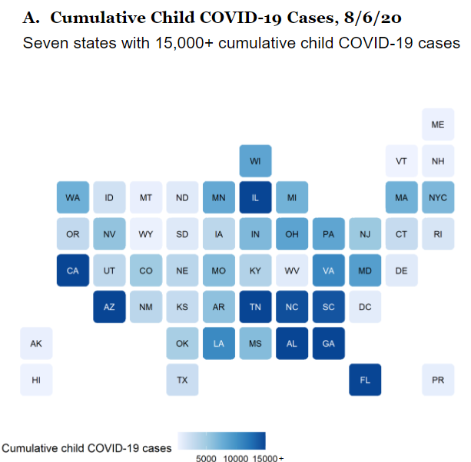

Slide 29
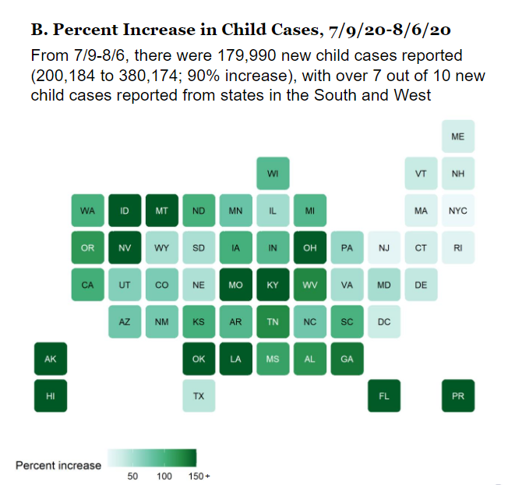

Slide 30
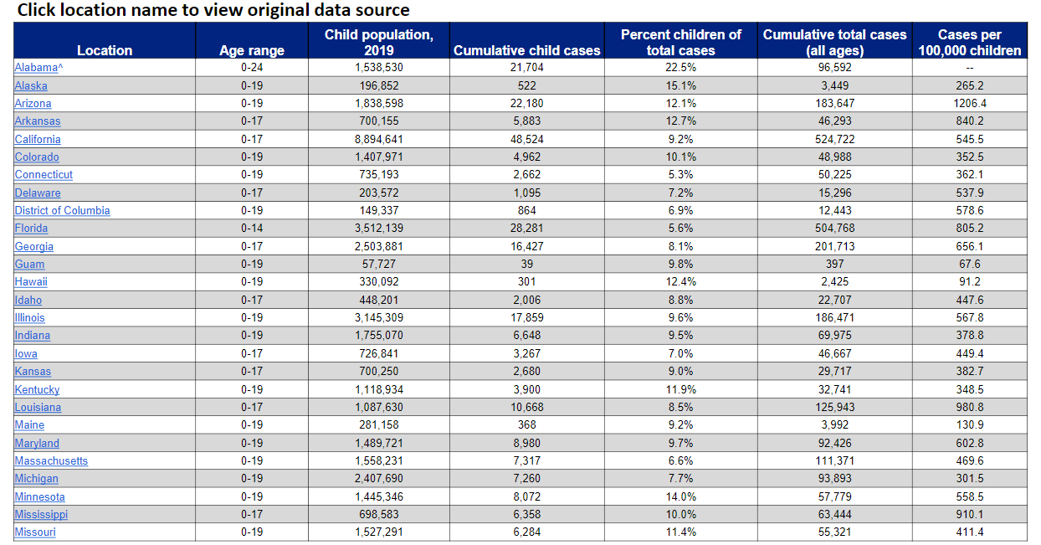

Slide 31
AAP National Registry of Perinatal COVID Infection
Updated 8/8/2020
246 Centers

Slide 32
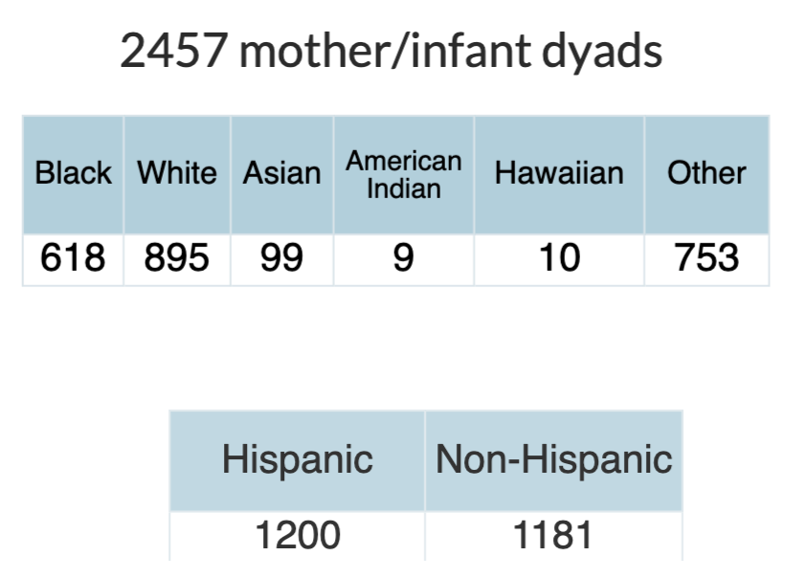

Slide 33
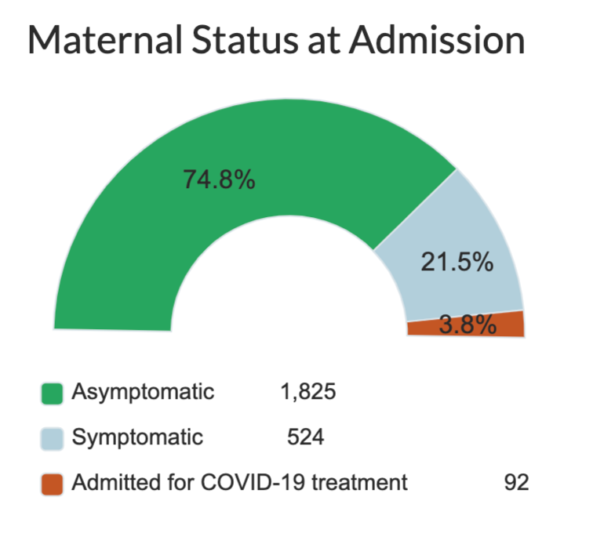

Slide 34
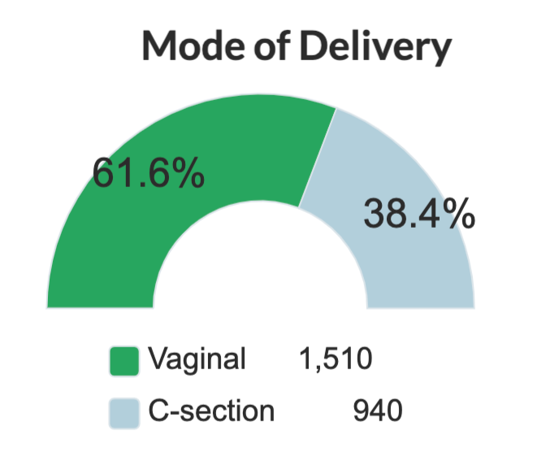

Slide 35
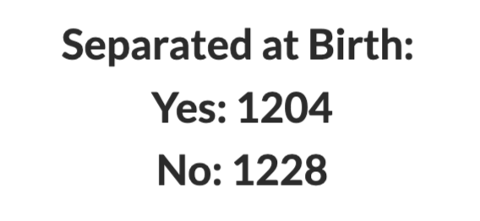

Slide 36
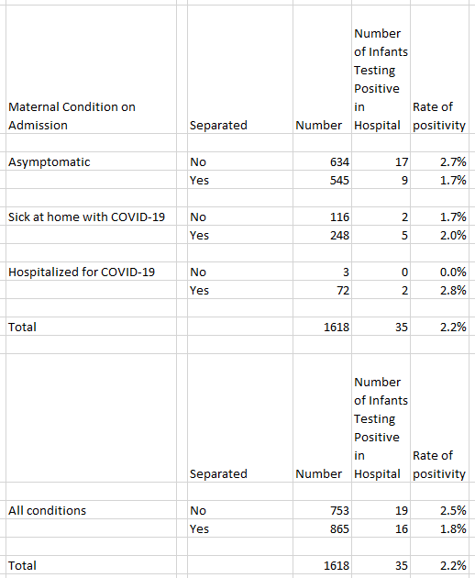

Slide 37
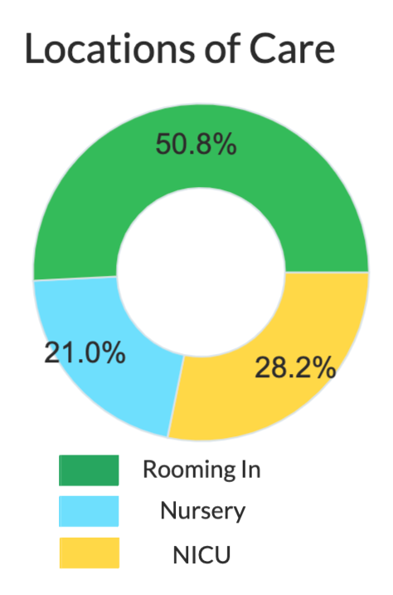

Slide 38
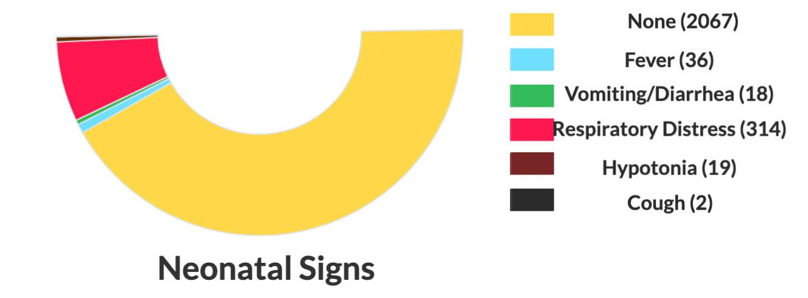

Slide 39
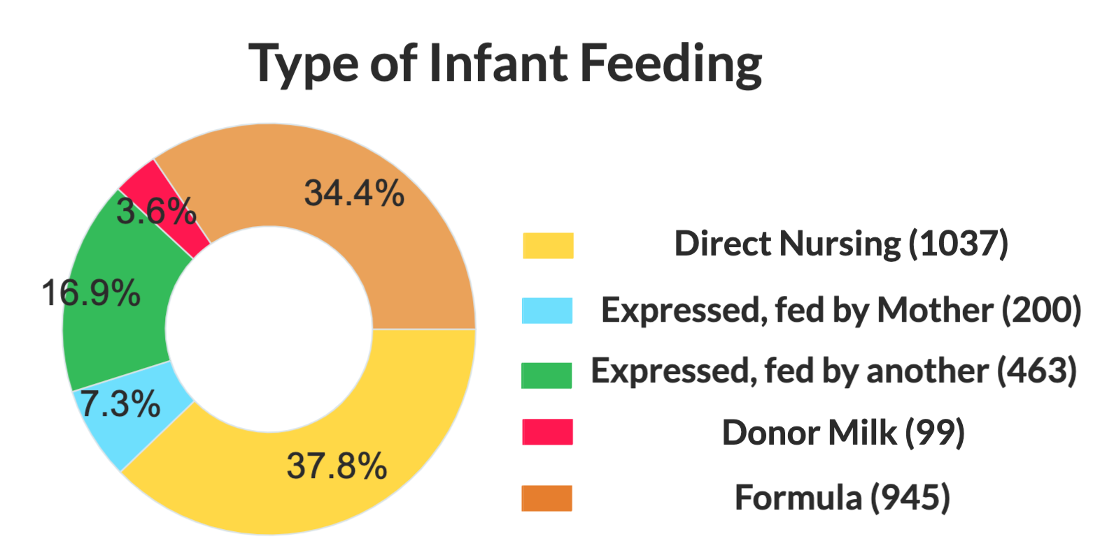

Slide 40
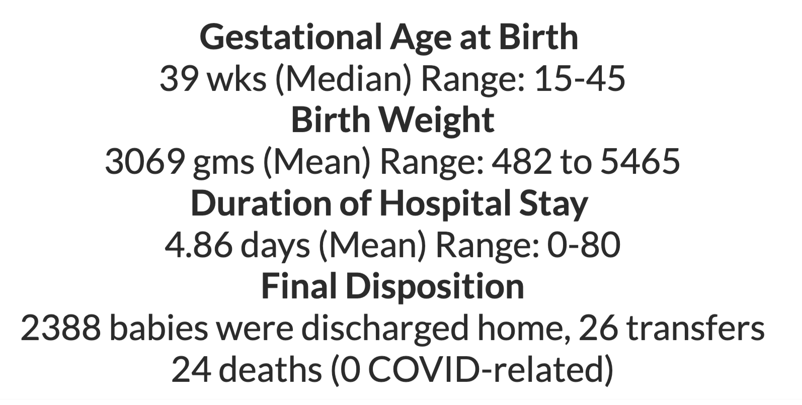
5 maternal deaths attributed to COVID

Slide 41
AAP Newborn Recommendations
Updated July 22, 2020

Slide 42
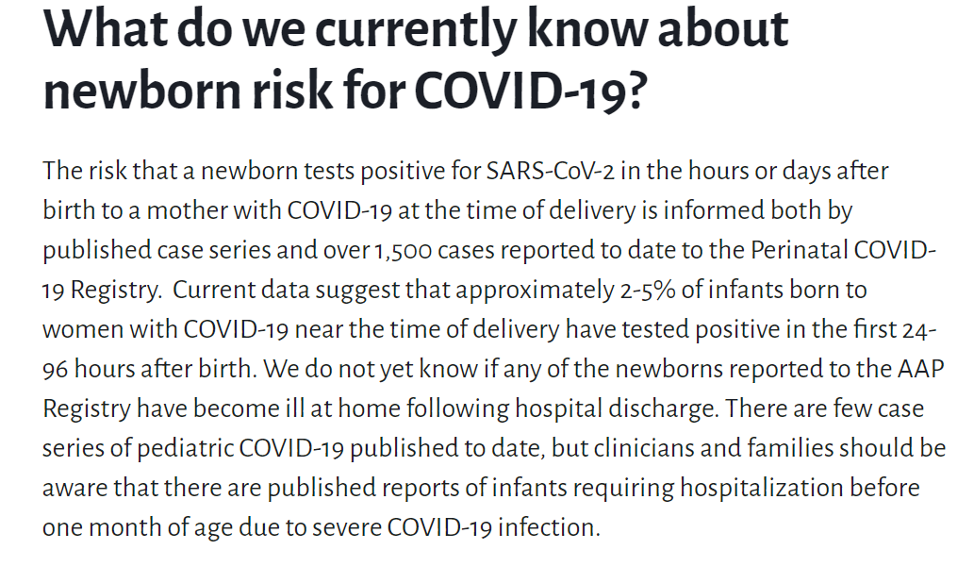

Slide 43
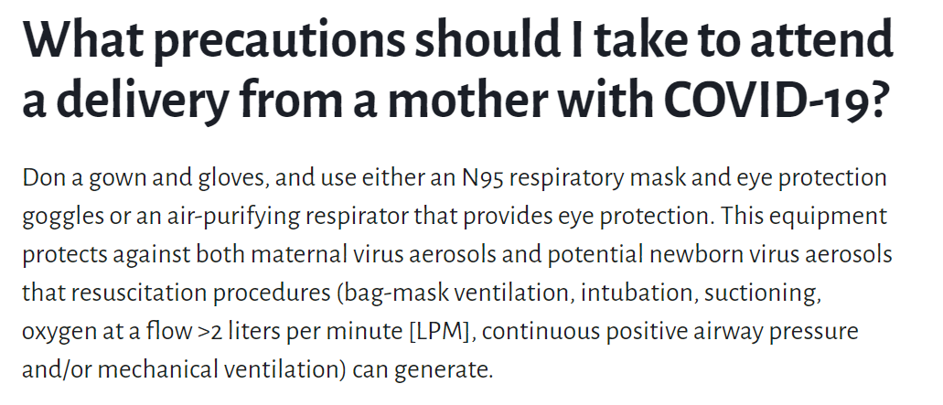

Slide 44
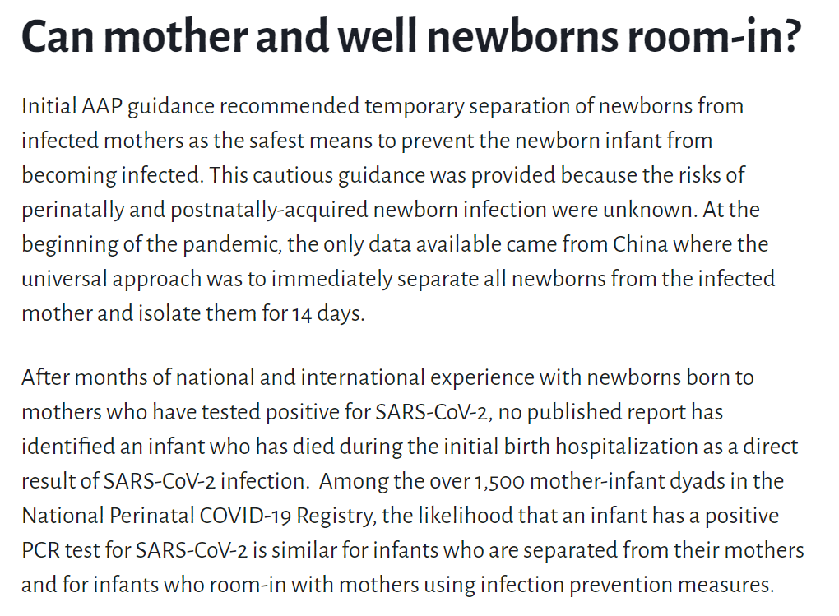

Slide 45
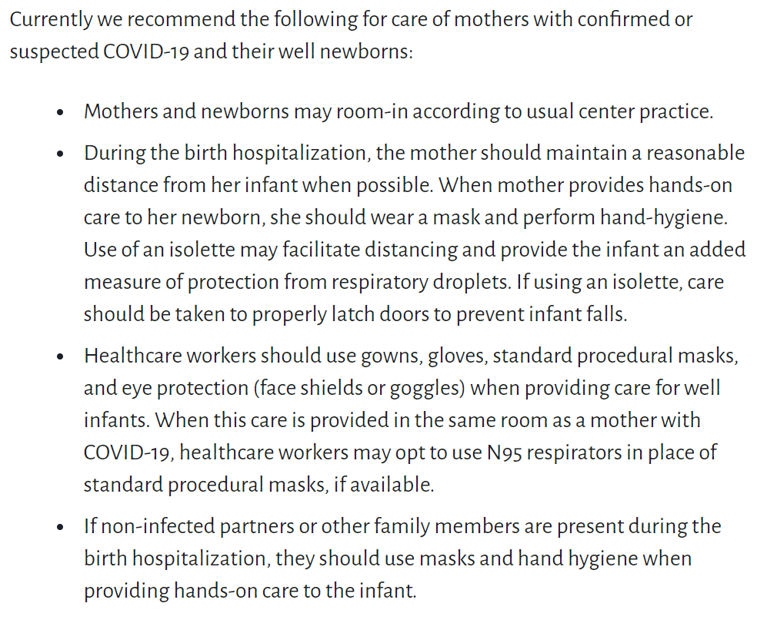

Slide 46
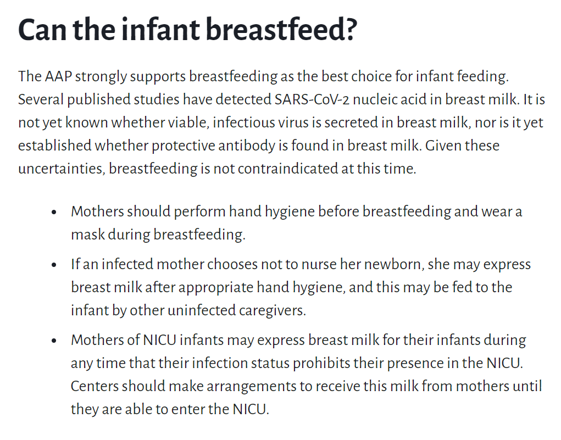

Slide 47
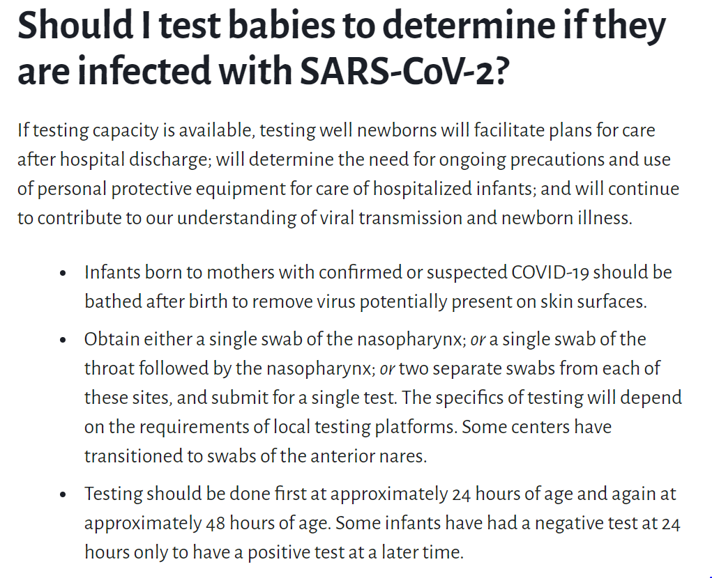

Slide 48
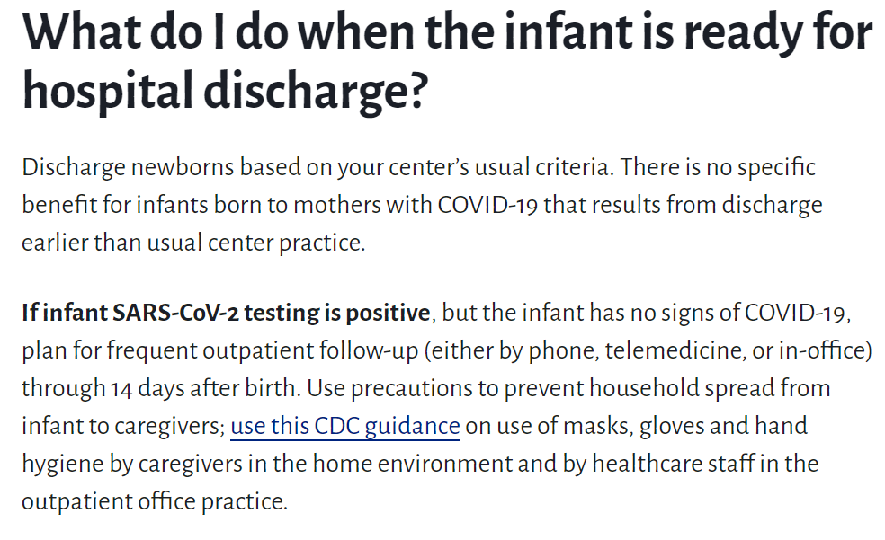

Slide 49
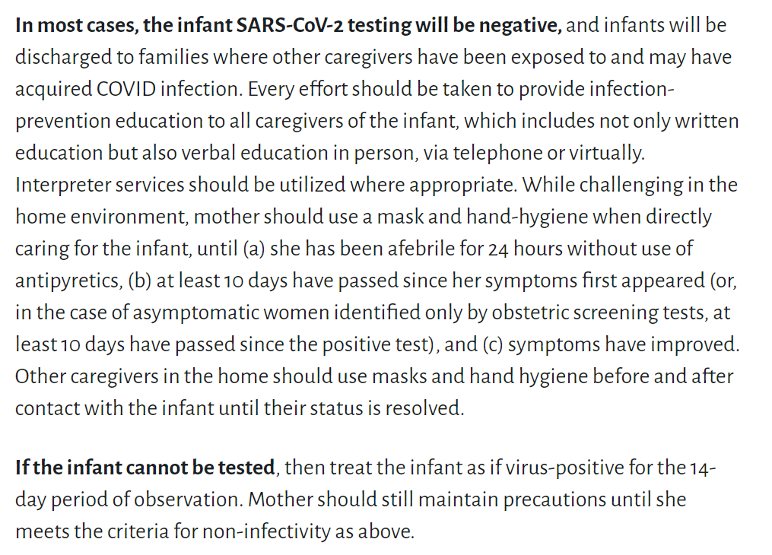

Slide 50
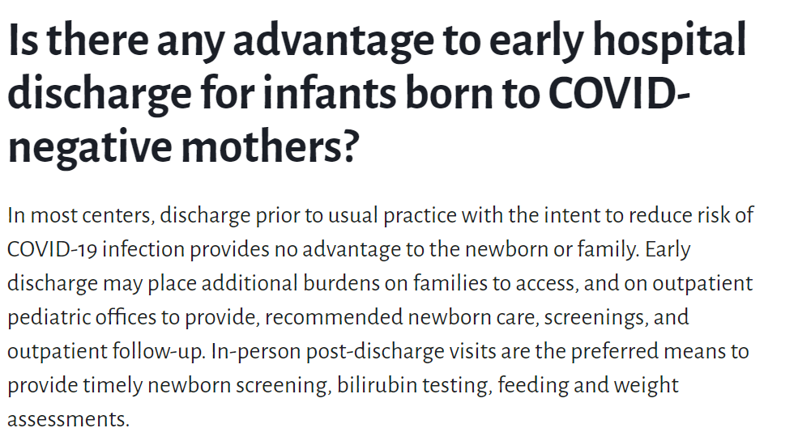
Avoid early discharges

Slide 51
Neonatal Questions/Discussion
Questions from chat box and meeting registration
Slides from 6.12.20 webinar
Slides from 5.29.20 webinar
Neonatal Q&A from 5.15.20 webinar
Q/A from 5.8.2020
Q/A from 5.01.2020 – questions answered webcast
Q/A from 4.24.2020 webinar (Neonatal Answers)
Q/A from 4.17.2020 webinar
Q/A from 4.10.2020 webinar
Q/A from 4.3.2020 webinar

Slide 52
Discussion of OB Unit Strategies

Slide 53
Rush University OB
Academic Medical Center located on western side of Chicago
  Opened in 2012
  Tower built to handle pandemic with 130% surge capacity and ability to “flip” entire floors to negative pressure
2,300 annual deliveries (2019), 24 residents
10 labor and delivery rooms
  Negative pressure rooms on L&D and antepartum
5 triage rooms
5 prep/hold/recovery rooms
3 OR
72 bed NICU
Thaddeus Waters, MD - Director, Maternal-Fetal Medicine
Xavier Pombar, DO – Maternal Fetal Medicine

Slide 54
PLACING PREGNANT PATIENT IN THE PRONE POSITION DUE TO HYPOXIA RELATED TO COVID-19 INFECTION

Slide 55
Management Considerations for Pregnant Patients With COVID-19 – 7/2/2020
Prone positioning - feasible in pregnant and postpartum patients
Padding and/or support devices (eg, pillows, padding from the operating room, etc) may need to be utilized to position the patient properly.
The most important aspect of this maneuver is to ensure that the endotracheal tube remains in place throughout rotation and positioning and that it is secured afterward.

Slide 56
Management Considerations for Pregnant Patients With COVID-19 – 7/2/2020
"Passive prone positioning,"
Patients are not intubated and positions herself in either the lateral decubitus (typically for ~2 hours in each position) or fully prone position, may aid in patient comfort and theoretically help avoid intubation.

Slide 57
ADMISSION
25 y/o G1P0 at 28 6/7 wks gestation
Transferred from OSH to our ICU for worsening hypoxic respiratory failure secondary to known COVID-19 pneumonia
Medical Hx - Grave’s disease.

Slide 58
HD #1
On admission patient reports:
Worsening nonproductive cough
Exertional dyspnea,
Nausea and emesis x 1 week.
Vitals and findings on admission
Temp. - 105.2 °F; HR - 114 BPM; BP - 111/77 mmHg
RR - 28/min; spO2 95% on 10 L high flow nasal canula (HFNC)
CXR - BIlateral patchy opacities worse in the right lower lobe
OB US – IUP with EFW of 1271g.

Slide 59
HD #1
FHR monitoring - intermittent
CT - negative for pulmonary embolism
Transthoracic echo - normal limits
Significant labs findings:
Elevated CRP 114;6 mg/L
LDH – 291 U/L
d-dimer – 0.84 mg/L

Slide 60
HD #1
ABG - Significant for hypoxemia
pH 7.47
PaCO₂ 24 mm Hg
PaO₂ 67 mm Hg
HCO₃ 17.7 mmol/L
Patient started on a 5-day course of compassionate use remdesivir and therapeutic heparin for anticoagulation.
Also course of betamethasone administered in the event of premature delivery

Slide 61
HD#2
Patient made minimal improvement
Weaned to 8 L/min HFNC
RR 30 – 38/min on spO2 of 95%
Continued with persistent exertional dyspnea

Slide 62
HD# 3
Due to lack of improvement, decision made to place the patient in the prone position
After placed in the prone position, patient experienced clinical improvement
Rise of spO2 from 95% to 100%
Weaned from 8L/min to 3L/min HFNC within 4 hours

Slide 63
HD#4
Again placed in the prone position due to continued dyspnea and intermittent desaturation to low 90s
Proned for approximately 6 hours
Maintained spO2 >95% on 3L nasal canula
RR remained below 30/minute
Transferred from the ICU to labor and delivery mid-day
In L&D, patient placed in prone position for additional 6 hours
Weaned to 2L nasal canula
HD#6 Patient transitioned to room air
Discharged on hospital day 7

Slide 64

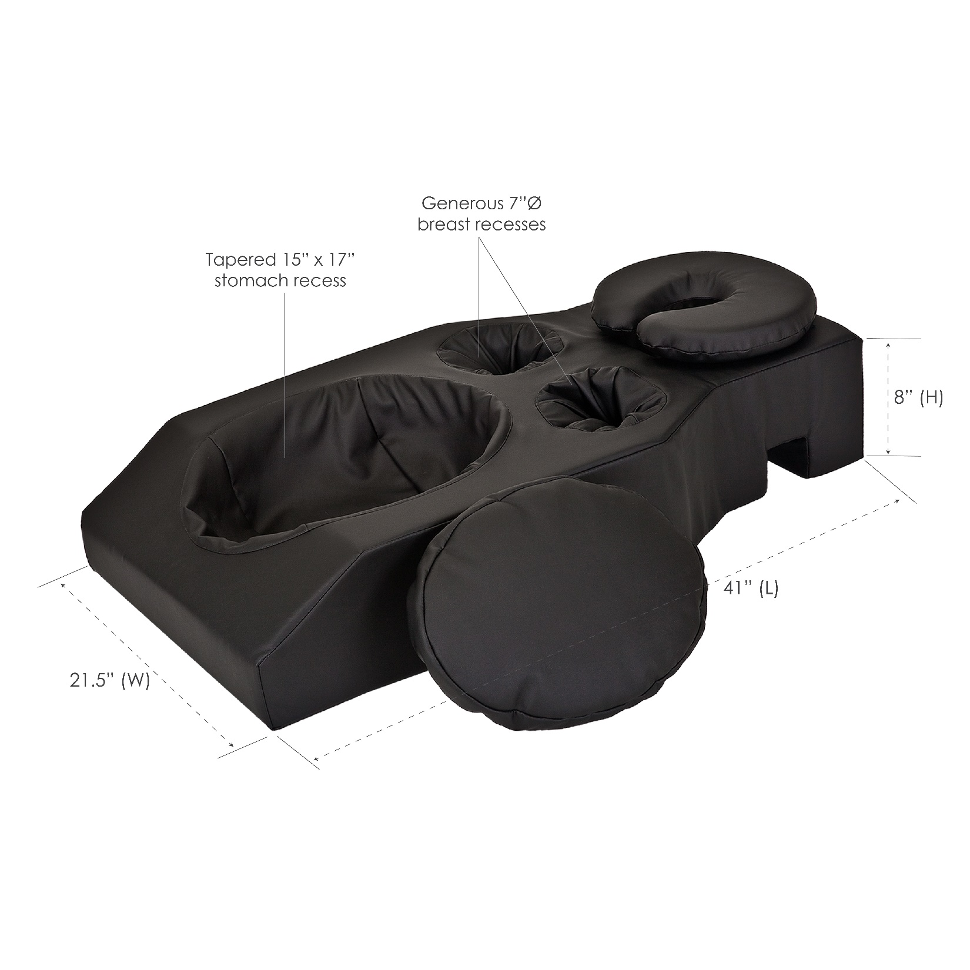

Slide 65
LESSONS LEARNED
Working with “Prone” team in ICU to learn the nuances of the process is helpful
Need department “Champions” to promote it’s implementation
Increasing oxygen delivery to patients prior to move helps reduce activity associated desaturation
Do not limit time that patient is in prone position

Slide 66
QUESTIONS?

Slide 67
 | Reference Range | HD1 | HD2 | HD3 | HD4 | HD5 | HD6 | HD7
D-dimer (mg/L) | 0 – 0.6 | 0.84 | NA | NA | 0.45 | 0.72 | 1.94 | 1.51
CRP (mg/L) | 0 – 8.0 | 114.6 | 160.4 | 93.6 | 37.7 | 14.8 | 13.8 | 11.5
LDH (U/L) | 110 – 240 | 291 | 349 | 287 | 291 | 384 | 309 | 267
Ferritin (ng/mL) | 12 – 260 | 94 | 119 | 151 | 132 | NA | NA | NA
CPK (U/L) | 10 – 205 | 113 | 95 | 52 | 40 | 44 | 37 | 33
Troponin (ng/mL) | 0 – 0.4 | 0.003 | NA | NA | NA | NA | NA | NA
WBC (x 10⁹/L) | 3.4 – 10.0 | 12.5 | 12.8 | 9.2 | 7.7 | 5.1 | 6.0 | 6.4
Hgb (g/dL) | 12.0 – 15.5 | 10.0 | 11.1 | 11.9 | 10.4 | 10.3 | 10.7 | 9.9
Lymphocyte count (x 10⁹/L) | 0.7 – 5.2 | 0.97 | 0.81 | 1.05 | 0.87 | 1.36 | 1.53 | 1.99
PLT (x 10⁹/L) | 140 – 450 | 244 | 268 | 272 | 355 | 375 | 374 | 321
ALT (U/L) | 10 – 40 | 25 | 26 | 20 | 19 | 34 | 66 | 77
AST (U/L) | 10 – 40 | 37 | 39 | 29 | 31 | 57 | 81 | 82

Slide 68
OB Discussion Panel
Emily Miller, MD – Maternal-Fetal Medicine, Northwestern University
Rob Abrams, MD, Executive Director - SIU Center for Maternal - Fetal Medicine, HSHS St. John's Hospital, Springfield
Thaddeus Waters, MD – Director, Maternal Fetal Medicine, Rush University Medical Center
Xavier Pombar, DO – Maternal Fetal Medicine, Rush University Medical Cente
Jo Kim PhD – Director NorthShore University HeathSystem Perinatal Depression Program

Slide 69
OB Questions/Discussion
Questions from chat box and registration
OB Q&A from 5.15.20 webinar
Q/A from 5.8.2020 webinar (OB answers)
Q/A from 5.01.2020 – questions answered webcast
Q/A from 4.24.2020 webinar (OB answers)
Q/A from 4.17.2020 webinar
Q/A from 4.10.2020 webinar
Q/A from 4.3.2020 webinar
Notes:
Massachusetts General Hospital: Prone Positioning for Non-Intubated Patients Guideline. (4.02.2020)

Slide 70
covid-19 mental health resources for healthcare providers & perinatal women

Slide 71
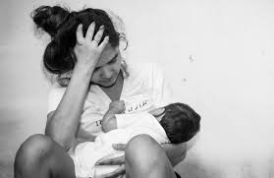
Impact of COVID-19 on Perinatal Women
Anxiety
Depression
Social isolation
Economic insecurity
Food insecurity
Increased domestic violence risk

Slide 72

Impact of COVID-19 on Healthcare Providers
Stress
Overwhelm
Anxiety
Burnout
Depression
Suicide

Slide 73
COVID Mental Health Support Resources for Physicians & Healthcare Workers
Project Parachute: offers pro-bono teletherapy (video or phone) to frontline workers
  https://project-parachute.org/
Physician Support Line
  staffed by volunteer psychiatrists
  offers free and confidential peer support to physicians in the U.S.
  available daily by calling 1 (888) 409-0141 from 8 a.m. to 3 a.m. EST.
For the Frontlines: 24/7 help line provides free crisis counseling for frontline workers. Text FRONTLINE to 741741

Slide 74
COVID Self-Help Support Resources for Physicians & Healthcare Workers
Meditation apps offering free subscriptions to frontline workers:
  Headspace https://www.headspace.com/health-covid-19
  Ten Percent Happier https://www.tenpercent.com/care offering free subscription to frontline workers
Delightful Gratitude https://delightfuljournal.com/ - free app to help practice daily gratitude, empirically shown to improve mood and outlook

Slide 75
COVID-19 Support for Patients
NorthShore MOMS Line 1-866-364-6667
  Staffed 24/7 by licensed mental health professionals
  Provides crisis intervention, support, psychoeducation, referrals & resources
Crisis Text Line: Text CONNECT to 741741
Postpartum Support International
  Offers phone-based and online support groups
  https://www.postpartum.net/get-help/help-for-moms/
Beyond the Baby Blues
  Free 6-session virtual support groups
  www.beyondthebabyblues.org

Slide 76
COVID-19 Support for Patients
The Wingspan Project
  https://www.thewingspanproject.org/community-response-program.html
  Pro bono psychotherapy for individuals from underserved and/or underrepresented communities, with emphasis on those impacted by recent protests and/or COVID-19
  Marcy Lichterman LCSW & Solveig Roverud LCSW are participating therapists with perinatal expertise

Slide 77
OB Questions/Discussion
Questions from chat box and registration
OB Q&A from 5.15.20 webinar
Q/A from 5.8.2020 webinar (OB answers)
Q/A from 5.01.2020 – questions answered webcast
Q/A from 4.24.2020 webinar (OB answers)
Q/A from 4.17.2020 webinar
Q/A from 4.10.2020 webinar
Q/A from 4.3.2020 webinar
Notes:
Massachusetts General Hospital: Prone Positioning for Non-Intubated Patients Guideline. (4.02.2020)

Slide 78
Thank You
We continue to give thanks to the nurses, doctors, health care workers, public health teams and others across our state at work confronting the COVID-19 pandemic.
Please send questions, comments and recommendations, cases / willingness to share for future COVID-19 OB/Neo discussion webinars to info@ilpqc.org
Recording of this webinar, Q/A and registration for the next webinar on Friday, 09/4/20 will be available at www.ilpqc.org

Slide 79



THANKS TO OUR
FUNDERS
Email info@ilpqc.org or visit us at www.ilpqc.org
Notes:
Updated 10/22/19

Slide 80
The severity scale for COVID-19
● Asymptomatic or presymptomatic disease or presumptive infection is defined as a positive COVID-19 test result with no symptoms.
● Mild disease is defined as flu-like symptoms, such as fever, cough, myalgias, and anosmia without dyspnea, shortness of breath, or abnormal chest imaging.
● Moderate disease is defined by evidence of lower respiratory tract disease with clinical assessment (dyspnea, pneumonia on imaging, abnormal blood gas results, refractory fever of 39.0 °C /102.2 °F or greater, while maintaining an oxygen saturation of greater than 93% on room air at sea level.
● Severe disease is defined by a respiratory rate greater than 30 breaths per minute (bpm), hypoxia with oxygen saturation less than or equal to 93%, a ratio of arterial partial pressure of oxygen to fraction of inspired oxygen of less than 300, or greater than 50% lung involvement on imaging.
● Critical disease is defined as multi-organ failure or dysfunction, shock, or respiratory failure requiring mechanical ventilation or high-flow nasal cannula.
SMFM: Management Considerations for Pregnant Patients with COVID-19 (7.2.2020) updated

Slide 81
Many COVID-19 patients, including pregnant patients, have mild or no symptoms.
● Outpatient monitoring with a 14-day self-quarantine can be considered for pregnant patients with COVID-19 who have mild symptoms or are asymptomatic. Recommendations for outpatient monitoring is outlined.
Check on outpatient Covid positive patients regularly and review signs/symptoms to call, recognize can worsen around day 7-10
After 14 days from positive test or symptom onset, if symptoms improved and no fever >72 hours then can be considered recovered.
SMFM: Management Considerations for Pregnant Patients with COVID-19 (7.2.2020) updated

Slide 82
Inpatient monitoring may be needed for the following categories of patients:
○ Pregnant COVID-19 patients with moderate to severe signs and symptoms or oxygen saturation less than 95%. (incudes dyspnea)
○ Pregnant COVID-19 patients with comorbid conditions, eg, uncontrolled hypertension, inadequately controlled gestational or pregestational diabetes, chronic renal disease, chronic cardiopulmonary disease, or immunosuppressive states (intrinsic or medication-related)
○ Pregnant COVID-19 patients with fevers greater than 39 °C despite acetaminophen, raising concern for secondary hemophagocytic lymphohistiocytosis (sHLH) or "cytokine storm syndrome." sHLH is a fulminant and often fatal hypercytokinemia associated with multi-organ failure. The disease is defined by unremitting fever, cytopenia, and high ferritin levels. If a patient has an Hscore (see Table 1) indicating a high probability for sHLH, inpatient observation is warranted.
SMFM: Management Considerations for Pregnant Patients with COVID-19 (7.2.2020) updated

Slide 83
Timing of Delivery: mild symptoms
In an asymptomatic or mildly symptomatic woman positive for COVID-19 at 37 to 38 6/7 weeks of gestation without other indications for delivery, expectant management can be considered until 14 days after the polymerase chain reaction (PCR) result was noted to be positive OR until 7 days after onset of symptoms and 3 days after resolution of symptoms. This option allows for decreased exposure of health care workers and the neonate to SARS-CoV-2.
In an asymptomatic or mildly symptomatic woman positive for COVID-19 at 39 weeks of gestation or later, delivery can be considered to decrease the risk of worsening maternal status.
SMFM: Management Considerations for Pregnant Patients with COVID-19 (7.2.2020) updated

Slide 84
Timing of Delivery: critical illness
The timing of delivery requires carefully weighing the benefits and risks for the patient and fetus, and the decision to deliver requires close communication between the maternal-fetal medicine and critical care teams. Improvement in lung mechanics gained by early delivery is theoretical. In the third trimester, the pressure of the uterus can decrease expiratory reserve volume, inspiratory reserve volume, and functional residual capacity, which can increase the risk of severe hypoxemia in pregnant patients, especially those who are critically ill.
Although data regarding delivery timing and acute respiratory distress syndrome are limited, it is reasonable to consider delivery in the setting of worsening critical illness.
SMFM: Management Considerations for Pregnant Patients with COVID-19 (7.2.2020) updated

