Slide 1



Birth Equity (BE) Monthly Webinar
November 15th, 2021

Slide 2


Overview
ILPQC Updates
Birth Equity data review
Universal Social Determinants of Health screening and mapping resources
Allison Bryant, MD, MPH, Senior Medical Director for Health Equity, Mass General Brigham, Maternal-Fetal Medicine, Mass General Hospital
Team Talk – West Suburban Medical Center
Notes:
Need Allison Bryant

Slide 3

ILPQC Updates
14

Slide 4
Annual Conference
658 registered, over 500 total attendees
  41 OB MDs
  63 Neo MDs
7 National Speakers
Breakout Sessions
  About 200 in the OB
  About 100 in the Patient and Family
  About 110 in the Neonatal
54 Quality Improvement Posters, with 12 Awards of Excellence
Over 100 QI Awards for hospital teams for MNO-OB, MNO-Neo, BASIC, PVB, and Birth Equity
10 Collaborator Booths
ILPQC will upload slide presentations & recordings in the upcoming weeks
Notes:
Ellie to fill in #s when we get attendance from 25/8
Hi Ellie, would you please help us find the number of OB and patient family engagement breakout participants. We’ll want to know that for Monday.
Have we integrated the plus one sheets to see what our actual attendance is? I see notes here but not sure the numbers in the slide are updated?
It was 37 total plus one surveys which I think puts us over 500 attendees!
10 Neo breakout
1 Patent and Family breakout
26 OB breakout

Slide 5
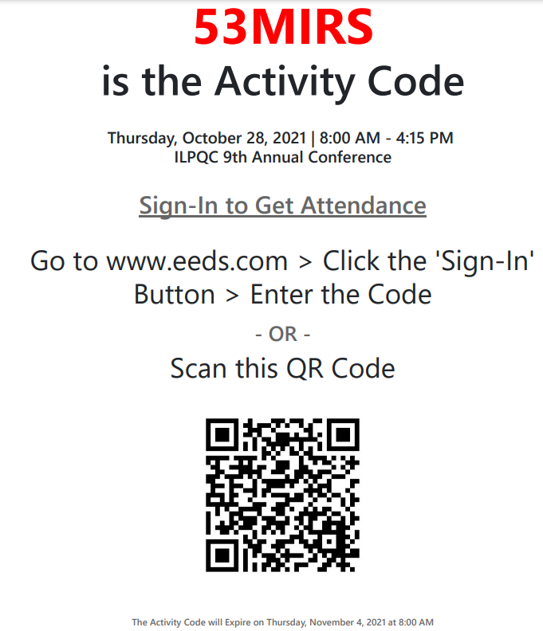

Post Conference Next Steps
To obtain your continuing education hours
If you have yet to receive your credits please email Fiza.Scaletty@ssmhealth.com directly
Education credits available for providers, nurse, and social workers
Education credits sponsored by:
Notes:
Credits must be claimed by 11/4, but I will connect with Fiza on Friday to see how many people collected the credits and if it is possible to provide more time for people. (AP) Left message with Fiza on Friday
If you have yet to receive your credits please email Fiza.Scaletty@ssmhealth.com directly

Slide 6

Birth Equity Outstanding Launch Award
AMITA Alexian Brothers Women’s and Children’s Hospital at St. Alexius
Advocate Aurora Sherman Hospital
Advocate Christ Medical Center
Advocate Condell Medical Center
Advocate Good Samaritan Hospital
Advocate Illinois Masonic Medical Center
Advocate Lutheran General Hospital
AMITA Health Adventist Glen Oaks Hospital
AMITA Health Adventist Medical Center - Bolingbrook
AMITA Health Alexian Brothers Medical Center
AMITA Health Saints Mary and Elizabeth Medical Center
Barnes-Jewish Hospital
Carle Foundation Hospital
Edward Hospital
Elmhurst Memorial Hospital
Gibson Area Hospital
HSHS St. Elizabeth's Hospital
HSHS St. Francis Hospital - Litchfield
HSHS St. John's Hospital
HSHS St. Mary's Hospital - Decatur
Ingalls Memorial Hospital
Loyola University Medical Center
MacNeal Hospital
Memorial Hospital East
Notes:
We are excited to award our Obstetric hospital teams the Birth Equity Initiative Outstanding Launch Award to acknowledge their hard work getting started on the initiative. Award recipients submitted a Team Roster, filled out a readiness survey, submitted hospital level data for Baseline, as wells as August of 2021. Please join us in congratulating all the award winners!

Slide 7

Birth Equity Outstanding Launch Award
OSF St. Francis Medical Center
Palos Community Hospital
Riverside Medical Center
Rush University Medical Center
Rush-Copley Medical Center
Silver Cross Hospital
SSM Health Good Samaritan
SSM St. Mary's Hospital - St. Louis
St. Anthony Hospital
Stroger Hospital of Cook County
Swedish American Hospital
University of Chicago Medical Center
West Suburban Medical Center
NM Huntley Hospital
NM Kishwaukee Hospital
NM Lake Forest Hospital
Northwest Community Hospital
Northwestern Memorial Hospital
NSUHS- Evanston Hospital
FHN Memorial Hospital
OSF Heart of Mary Medical Center
OSF Little Company of Mary Hospital
OSF St. Francis Medical Center
Palos Community Hospital
AMITA Health Adventist Glen Oaks Hospital

Slide 8

2022 OB & Neonatal Face-to-Face Meetings
Obstetric May 25, 2022
Neonatal May 26, 2022
More information coming soon!
2022 10th Annual Conference
October 27, 2022

Slide 9
Birth Equity Initiative
Helping hospital teams move this important work forward together

Slide 10


What is the focus of Birth Equity (BE)?
BE AIM: By December 2023, more than 75% of Illinois birthing hospitals will be participating in the Birth Equity Initiative and more than 75% of participating hospitals will have the key strategies in place.
Promote patient- centered approach to engage patients and communities
Implement respectful care and bias education for providers, nurses, and staff
Addressing Social Determinants of Health
Optimize and review race/ethnicity medical record and quality data

Slide 11

BE Key Drivers Diagram
Strategies
Drivers
1. Utilize ILPQC social determinants of health (SDoH) community resources mapping
tool to assist linking patients to resources based on the social determinants of health
screening and share with affiliated prenatal care sites and hospital OB units
1. Address social determinants of health during prenatal, delivery,
and postpartum care to improve birth equity
2. Screen patients for social determinants of health during prenatal care and delivery admission and appropriately link to resources
AIM
3. Implement strategy for incorporating discussion of social determinants of health and discrimination as factors in potential hospital maternal morbidity reviews
By December 2023, more than 75% of Illinois birthing hospitals will be participating in the Birth Equity Initiative and more than 75% of participating hospitals will have all key strategies in place
4. Implement processes and protocols for improving the collection and accuracy of patient- reported race/ethnicity data
2. Utilize race/ethnicity medical record &
quality data to improve
birth equity
5. Develop and implement a process to review and share maternal health quality data stratified by race/ethnicity and Medicaid status
6. Identify a patient advisor for hospital perinatal quality improvement team or other opportunities to engage patient / community members
3. Engage patients, support partners
including doulas, and
communities to improve birth equity
7. Implement a strategy for sharing expected respectful care practices with delivery staff & patient (i.e. posting in LD) including appropriately engaging support partners and/or doulas
8. Implement a Patient Reported Experience Measure (PREM) patient survey to obtain feedback from postpartum patients and a process to review & share results with providers,
nurses, and staff
9. Provide patients the recommended postpartum safety patient education materials prior to hospital discharge including education on urgent maternal warning signs, postpartum
safety, communication with healthcare providers and importance of early follow up
4. Engage and educate providers, nurses, & staff to improve birth
equity
10. Educating providers, nurses, and staff on the importance of listening to patients, providing respectful care and addressing implicit bias

Slide 12
Key QI Strategies
Optimize race/ethnicity data collection & review key maternal quality data by race, ethnicity & Medicaid status
Engage patients and community members for input on quality improvement efforts
Universal social determinants of health screening tool (prenatal/L&D) with system for linkage to appropriate resources
Share respectful care practices on L&D and survey patients before discharge on their care experience (using the PREM) for feedback
Standardize postpartum safety education and schedule early postpartum follow up prior to hospital discharge
Implicit Bias / Respectful Care training for providers, nurses and other staff
Notes:
Optimize race/ethnicity data collection and review key maternal quality data by race, ethnicity and Medicaid status
Universal social determinants of health screening tool (prenatal/L&D) with system for linkage to appropriate resources
Share respectful care practices on L&D and survey patients before discharge on their care experience (using the PREM tool) for feedback
Engage patients and community members for input on quality improvement efforts
Standardize postpartum safety education and schedule early postpartum follow up prior to hospital discharge
Implicit Bias / Respectful Care training for providers, nurses and other staff

Slide 13
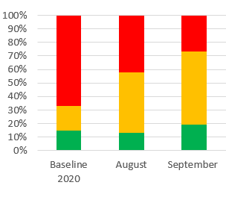
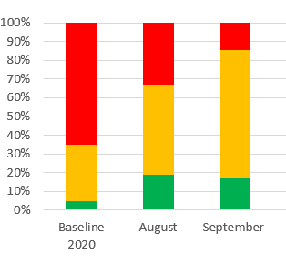
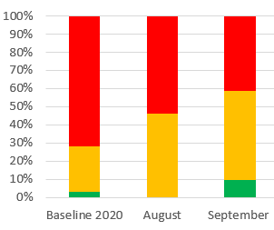

Structure Measures:
Implementing Systems Changes
Implemented standardized social determinants of health screening tools for delivery admission
Completed and shared social determinants of health community resources mapping tool
Protocol for improving the collection and accuracy of patient-reported race/ethnicity data

Slide 14
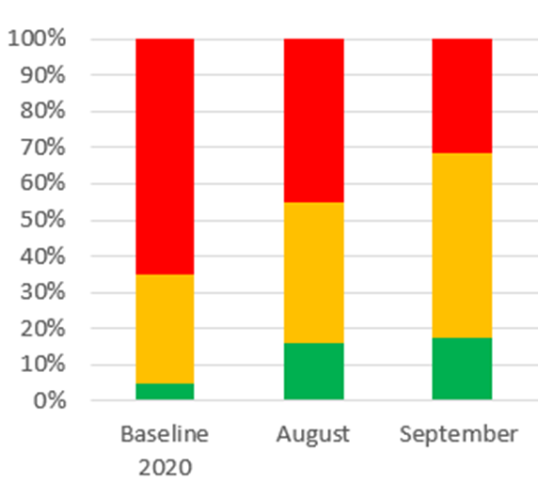
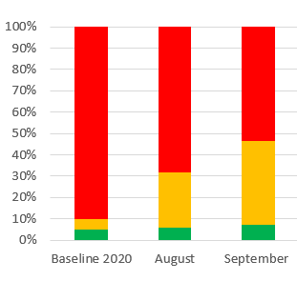
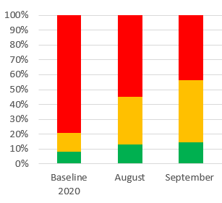
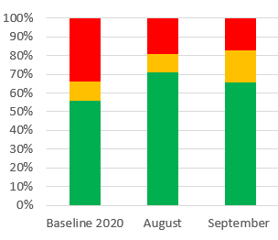
Structure Measures:
Implementing Systems Changes
Process to review maternal health quality data stratified by race/ethnicity and Medicaid status
Engaged patients and/or community members to provide input on QI efforts
Sharing expected respectful care practices with delivery staff and patients
System to provide patients postpartum safety education, where to call, and early follow-up

Slide 15
Outcome Measures:
Social Determinants of Health Screening

Slide 16
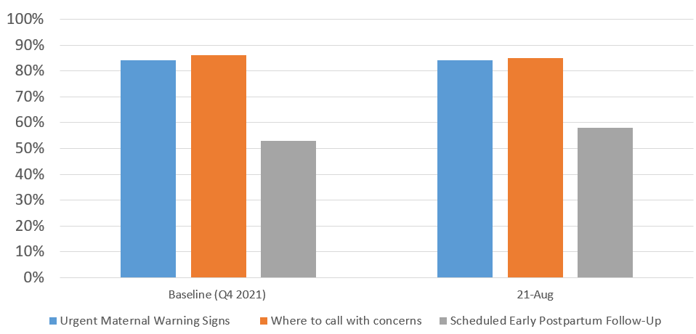
Process Measures:
Postpartum Safety
Patients receiving postpartum safety education prior to hospital discharge including urgent maternal warning signs, where to call with concerns, and scheduling early postpartum follow-up

Slide 17
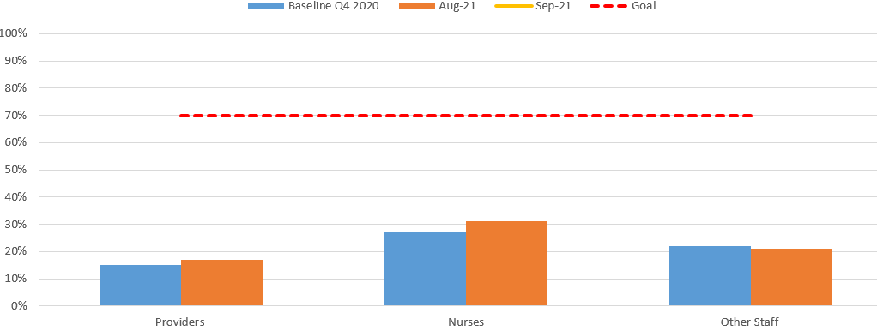
Process Measures:
Staff Training
Providers, nurses, and other staff completing education addressing implicit bias and respectful care

Slide 18
ILPQC Hospital Team
Data Submission (86 Teams Total)
Month | Teams Reporting Hospital Data
Baseline (Q4 2020) | 47
August 2021 | 48
September 2021 | 40
Use your hospital data form as a QI team meeting roadmap to guide your efforts. Please contact us if you need help getting started with reviewing and entering your data!
Please submit monthly data into REDCap by the 15th of each month!

Slide 19
Universal Social Determinants of Health Screening and Mapping Resources

Slide 20


What are Social Determinants of Health?
Factors in a persons environment that play an important role in shaping health outcomes (ACOG, CO#, 729).
Have historically prevented many people from racial and ethnic minority groups from having fair opportunities for economic, physical and mental health (CDC, 2021).
Social Determinants of Health
Food
Housing
Transportation
Utilities
Exposure to Violence
Financial Resources
Community/ Social Support
Education/Health Literacy
Child Care
Legal Status
Stress
Illinois Perinatal Quality Collaborative
20
Notes:
Dr. James’ 1. incorporation of structural determinants as causes of 2. social determinants or living conditions and then the 3. consequences of the living conditions

Slide 21
Why Social Determinants Health (SDoH) so important?
The World Health Organization defines social determinants of health as circumstances (living conditions) in which people are born, grow up, live, work and age, and the systems put into place to deal with illness.
These circumstances have tremendous affect on one’s health. And, they can affect anyone, regardless of age, race, ethnicity.
For example, in the U.S. each year,
  1.5 million individuals experience homelessness
  3.6 million people cannot access medical care due to lack of transportation
  40 million people face hunger, and
  11.8 percent of households are food insecure
Reference: American Hospital Association 2018 SDOH presentation

Slide 22
ACOG CO #729: Importance of Social Determinants of Health and Cultural Awareness in the Delivery of Reproductive Health Care
The American College of Obstetricians and Gynecologists makes the following recommendations for obstetrician–gynecologists and other health care providers to improve patient-centered care and decrease inequities in reproductive health care:
  Inquire about and document social and structural determinants of health that may influence a patient’s health and use of health care such as access to stable housing, access to food and safe drinking water, utility needs, safety in the home and community, immigration status, and employment conditions.
  Maximize referrals to resources and social services to help improve patients’ abilities to fulfill these needs.
  Provide access to interpreter services for all patient interactions when patient language is not the clinician’s language.
  Acknowledge that race, institutionalized racism, and other forms of discrimination serve as social determinants of health.

Slide 23
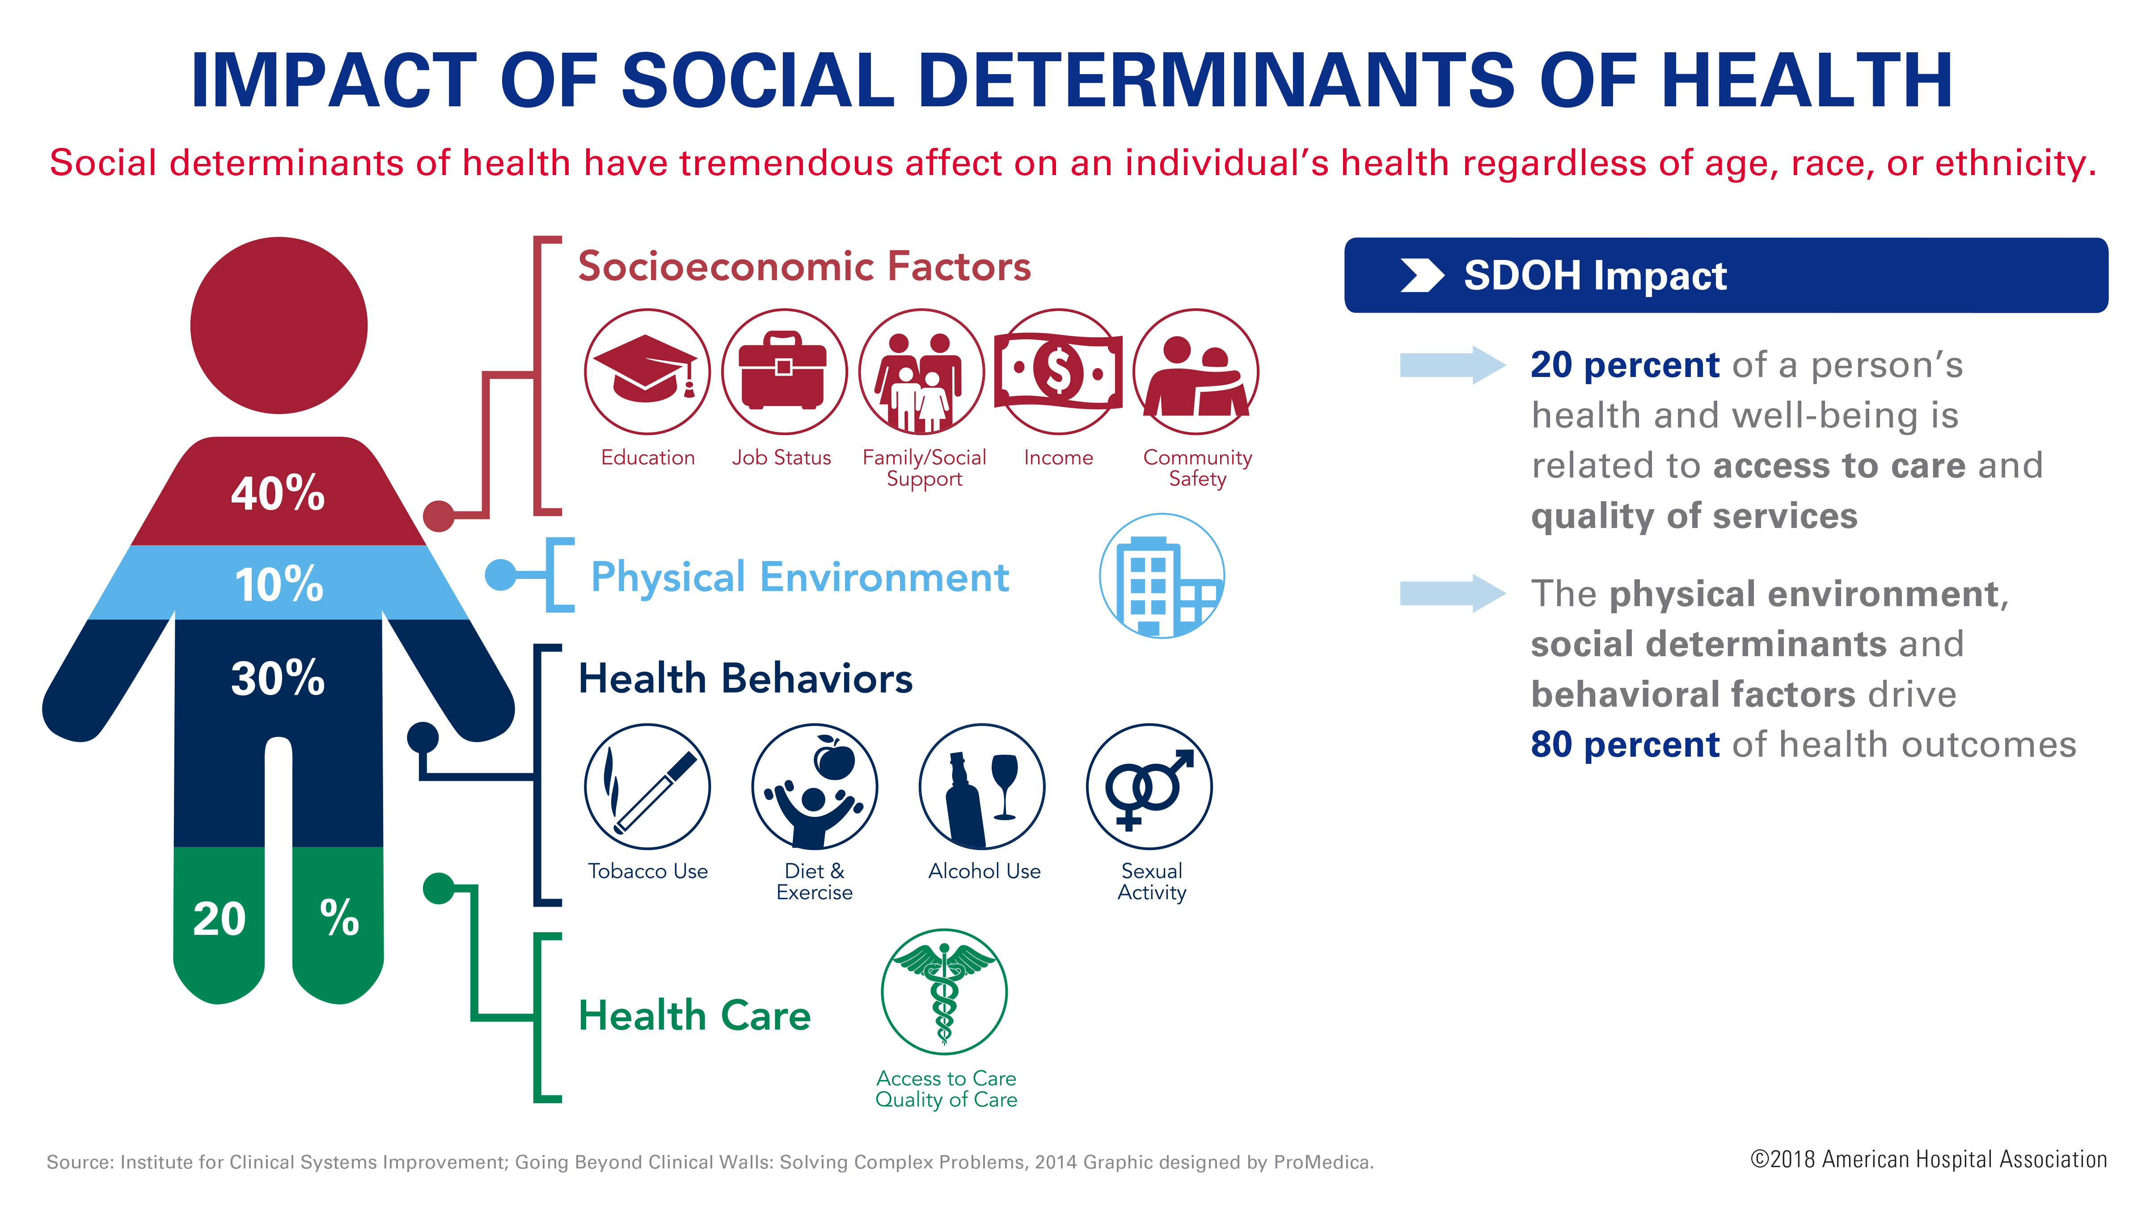
Notes:
Only 20 percent of an individual’s health is tied to clinical care, which includes access to and quality of health care services. 80 percent of an individual’s health is tied to their physical environment, social determinants – where you live, work and play – and behavioral factors – including exercise or smoking.
More specifically, that 80 percent can be broken down as follows:
Roughly 40 percent is attributed to socio-economic factors
10 percent to physical environment
30 percent to health behaviors
Source: http://www.countyhealthrankings.org/county-health-rankings-model
and https://www.icsi.org/_asset/w6zn9x/solvcomplexproblems.pdf
Image source: https://www.promedica.org/socialdeterminants/pages/default.aspx

Slide 24

1. Addressing social determinants of health
1. Mapping social determinants of health community resources and services
2. Screening all patients for social determinants of health needs during prenatal care and at the delivery admission and linking to resources/ services
3. Incorporating social determinants of health and discrimination factors in hospital maternal morbidity reviews

Slide 25
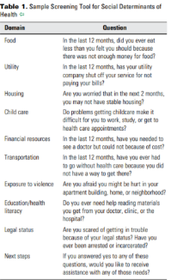
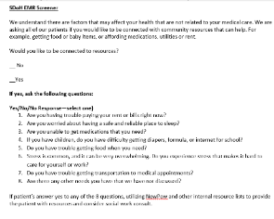
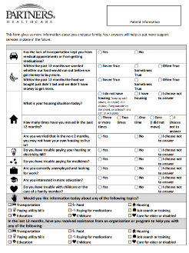
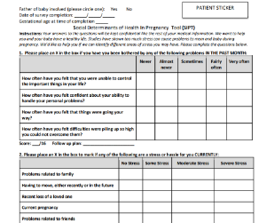
Social Determinants of Health
Screening Tools
SDoH EMR Screener (Developed by Erie Health Center)
ACOG Committee Opinion #729: Sample Screening Tool for Social Determinants of Health
Social Determinants of Health In Pregnancy Tool (SIPT) with 5Ps (Used by Chicago PCC Communities Wellness Centers) and Actionable Map and Scoring Sheet
Partner Healthcare SDoH Screening Tool Used by Massachusetts General Hospital Obstetrics & Gynecology, and Mass General Brigham)

Slide 26
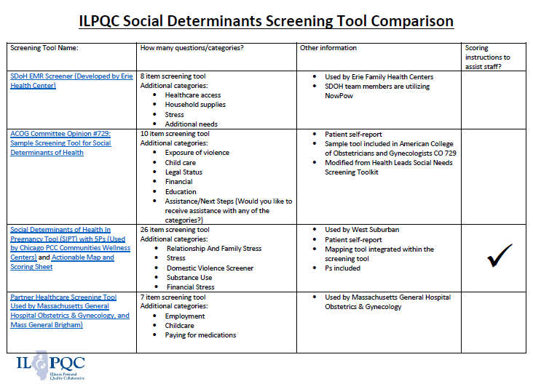
**Each tool below includes screening for the following common social determinants of health (food, housing, transportation, utilities) in addition to other categories listed below
49

Slide 27


Addressing Social Determinants of Health
Community resources and mapping tool
Sample screening tools
Folders with patient and provider resources for SDoH screen positive patients
SDoH Folder
SDoH Screening Tools
SDoH Resource Mapping Tool
NowPow Access Guide
Universal SDoH Resources
SDoH Tip Sheets by Topic
Local SDoH Resources
Patient handouts on SDoH resources
Guide for incorporating discussion of SDoH and discrimination in hospital M&Ms
Create a Process Flow for patients who screen positive
Review our online toolkit to find these resources linked on our BE website: https://ilpqc.org/birthequity/ !
Illinois Perinatal Quality Collaborative

Slide 28
Need to consider QI Strategies
PDSA cycle to test SDOH screening tools implementation on L&D
  Start with one nurse, one patient or one day on L&D to trial a screen
  Get feedback on process and determine best tool
  Share information with outpatient sites
Develop a Process Flow Diagram
  assist implementation of screening and how to incorporate referral to services for all screen + patients and follow up
Consider steps needed in 30/60/90 day planning process

Slide 29

Linking Patients to
Social Determinants of Health
ILPQC is sponsoring access for hospitals to an online tool
NowPow supports hospitals for addressing social determinants of health for birthing patients across the state
Tools to screen and identify maternal and familial needs for referrals and local resources
Now available free on ILPQC website
NowPow Information Sheet
ILPQC NowPow Access Guide
Three ways teams can access NowPow:
1. Already have NowPow at your hospital? Expand NowPow access and usage to OB department, if not already in place
2. Interested in NowPow at your hospital? Designated NowPow contact and special rate
3. Looking to access NowPow resources? Free access to ILPQC sponsored self-serve version of the NowPow platform

Slide 30

NowPow Demonstration to link patients to SDoH resources
https://ilpqc.org/
Notes:
https://findrx.ilpqc.org/findrx/ilpqc

Slide 31
Allison Bryant, MD, MPH
Senior Medical Director for Health Equity,
Mass General Brigham,
Maternal-Fetal Medicine, Mass General Hospital
Universal Social Determinants of Health Screening in Pregnancy

Slide 32
Social Determinants of Health Screening in OB (and in the health system)
Allison Bryant, MD MPH
Senior Medical Director for Health Equity, Mass General Brigham
Frederic D. Frigoletto Endowed Chair of OB/GYN, Mass General Hospital
Associate Professor of Obstetrics, Gynecology & Reproductive Biology, HMS

Slide 33
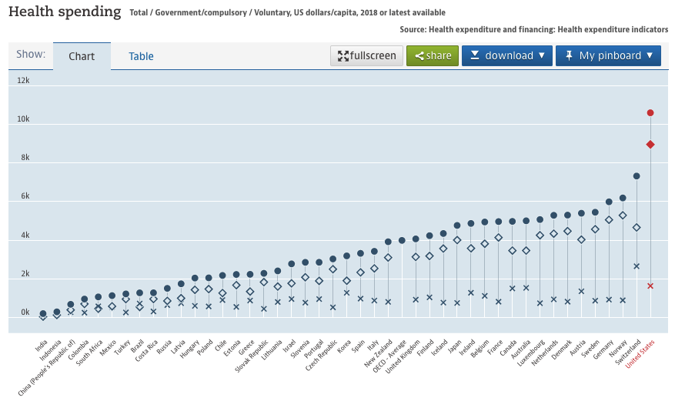
oecd.org

Slide 34
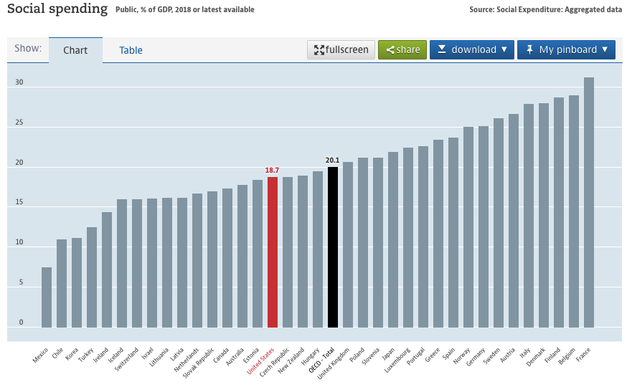
oecd.org

Slide 35
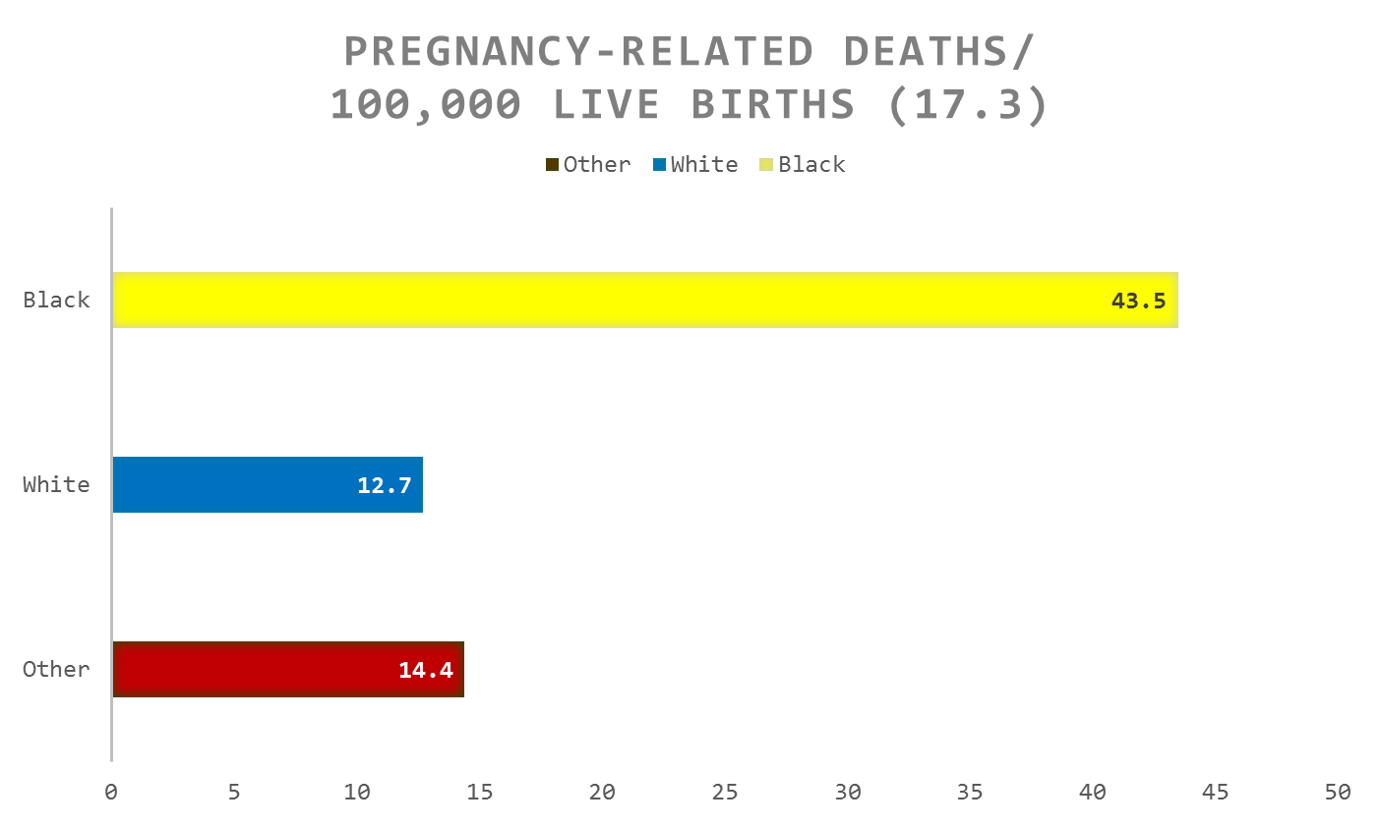
Maternal mortality: Inequities
CDC, PMSS 2013

Slide 36
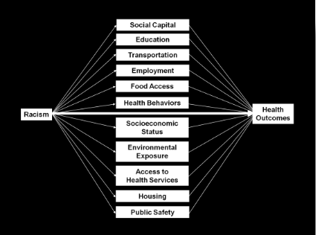
Reminder: Why Racism Matters
Boston Public Health Commission

Slide 37
Social determinants of health screening: mgh ob experience

Slide 38
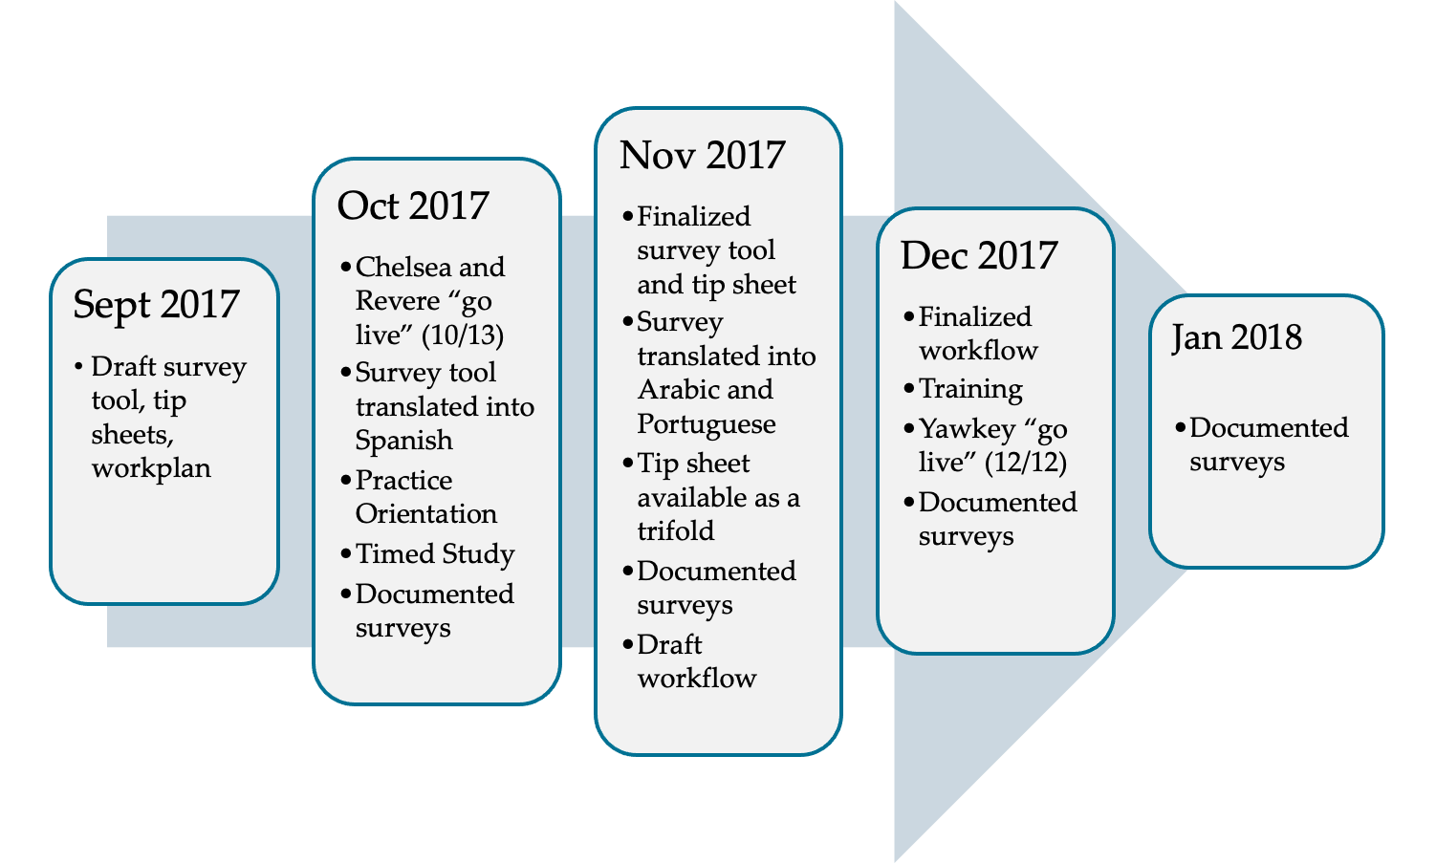
Timeline

Slide 39
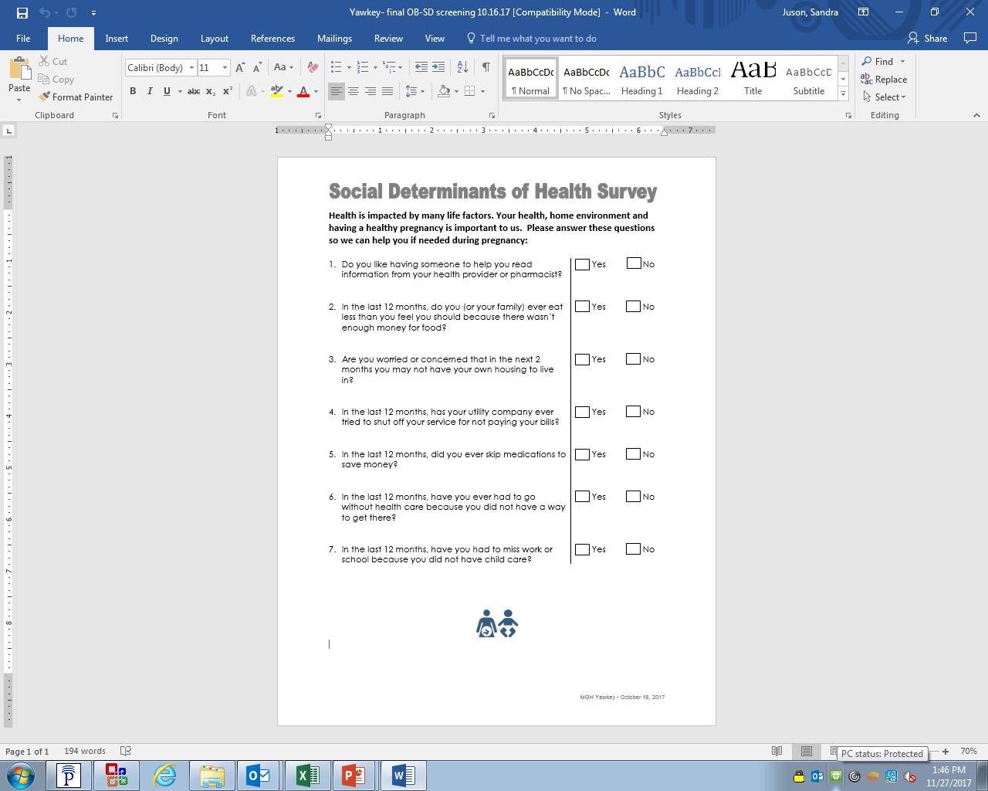
Social Determinants Survey tool
Notes:
Central to all the work that followed; i.e., workflow, tip sheets, tri-fold
Note this is the same survey tool used at all 4 locations – Yawkey, Chelsea, Charlestown, Revere

Slide 40




Workflow
A patient arrives for her NEW OB appointment.
Front desk gives patient the survey.
MA takes survey from the patient and gives it to the RN
Notes:
To understand the patient’s experience with the survey; i.e. literacy, amount of time to complete
To determine if the survey would have an impact on the practice schedule; would it slow down through put

Slide 41
Time Study
# of Patients Screened* and Time N=6
6-Nov | # | Seconds
9:30 AM | 1 | 44.79
1:30 PM | 1 | 51.89
2:30 PM | 1 | 37.34
2:30 PM | 1 | 37.34
13-Nov | # | Seconds
9:30 AM | 1 | 46.25
2:30 PM | 1 | 37.00
*partially or fully completed
Goal:
To understand the length of time to complete the survey and impact on patient through put.
After removing the outliers (2 seconds on 1:30 PM,
13-Nov),
Average time to complete survey was 42.43 seconds.

Slide 42
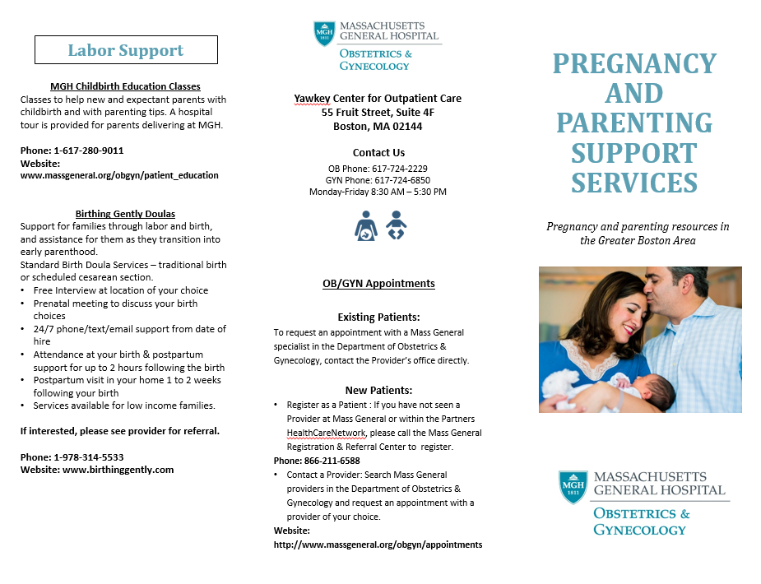

Referral Resources

Slide 43
Dashboard: Positive Screens
N=186

Slide 44
2018 - 2019
Continued screening on paper
With enhancements to our PROMs platform and electronic capture, moved screening to Patient Gateway (MyChart) and iPad questionnaires
  Required buy-in across the health system to build these features and “turn on” in certain OB practices
Continued provision of tip sheets for 1 positive domain, referral to SW for 2 or more with external referrals as needed
Attempted expansion to Gynecology for pre-operative screening

Slide 45
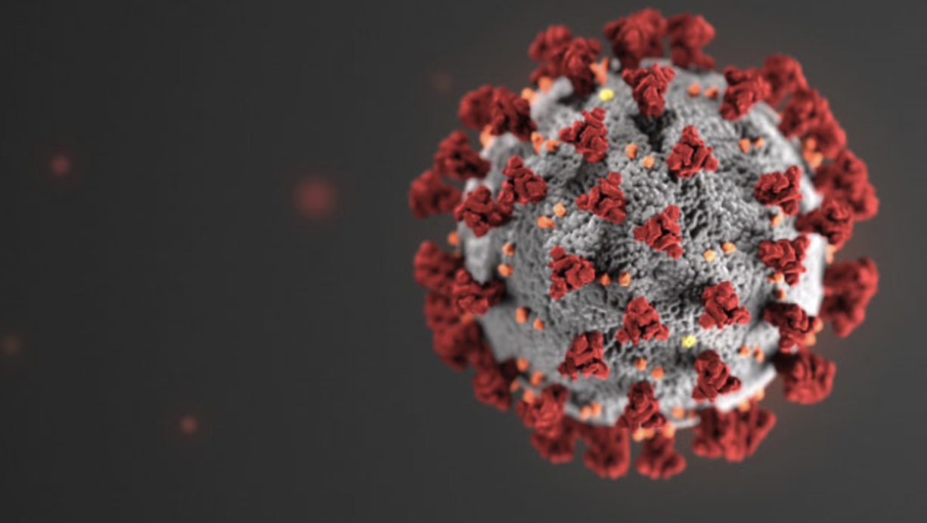
2020

Slide 46
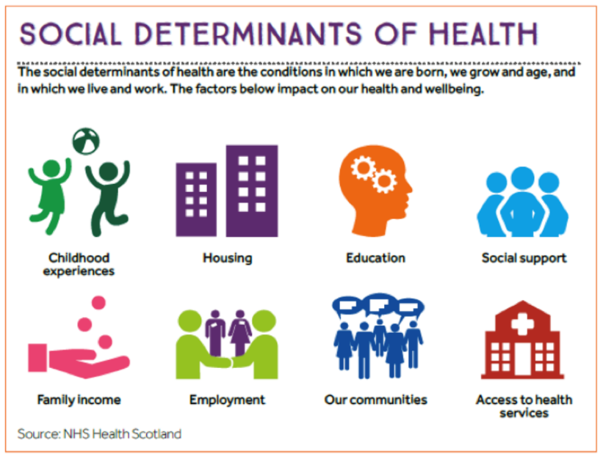
The interplay of community health + medical care
Understand social determinants of health to be a dynamic and sometimes-situational construct
  Screen frequently, know community resources
    Food insecurity; housing “instability” vis-à-vis social distancing
Health care team expansion
  Medical students
  Community health navigators

Slide 47

Project HUGS:
Social & Behavioral Support for Pregnant Women and Young Families during COVID
Collaborative effort by MGH Departments of Pediatrics, Obstetrics & Gynecology, Population Health, Community Health,
Behavioral Health, and Medicaid ACO

Slide 48
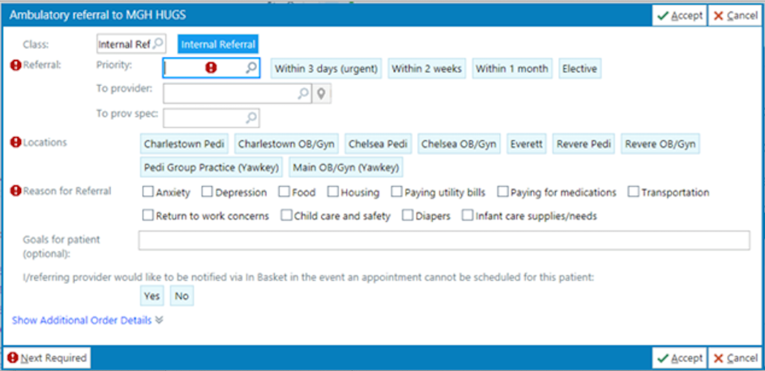
Project HUGS (Abrazos)
Purpose: To support vulnerable pregnant women and families with children <6 facing emotional, physical, and economic distress due to the COVID-19 pandemic.
Plan: Once referred to the program, the HUGS social worker and/or community health worker will provide mental health screening, short-term social and behavioral health support, and tailored community resource navigation.
Design:
  Two generation approach
  Connect parent with social worker & community health worker
  Multimodal outreach: phone, text, virtual visits, in-person (future)
Notes:
Two generation approach: screening at OB, IM, and pediatrics, support for parent and child

Slide 49

Program Eligibility
Inclusion criteria:
  Pregnant mother or parent of child < 6 (from CHC, RHC, Charlestown or Yawkey sites)
  1 family member must be MGH patient (either parent or child)
  Pregnant mother or parent-child dyad must have 1 of the following:
    History of depression or anxiety
    Unmet social determinant of health need (e.g. food insecurity, infant supplies, child care, housing, utilities)
Pediatrics
HUGS
Obstetrics & Gynecology
Internal
Medicine

Slide 50
How does a referral to HUGS differ from a referral to SDH or Behavioral Health?
  The HUGS social worker and community health worker work close together
  HUGS not dependent on location—program accepts referrals from all health centers and Yawkey
  HUGS provides short-term crisis stabilization support. If needed, HUGS will provide warm hand-off to longer term care.
What’s New?
  Multimodal patient outreach: phone, text, virtual visits
  Use of social determinants platforms (IRIS and Aunt Bertha) to more efficiently navigate resources, place direct referrals to community-based organizations, and track referrals to ensure loop is closed
  Cross-department initiative involving Pediatrics, Obstetrics, Behavioral Health, Community Health, Medicaid ACO, Population Health

Slide 51
Back to MGH OB

Slide 52
Mass General Brigham
United Against Racism

Slide 53

United Against Racism, UAR, empowers Mass General Brigham to bring our system to a new and higher level of leadership and accountability in addressing and eliminating racism.

Slide 54
Health Equity & United Against Racism Objectives
Measure Health Equity & Determinants of Health
Advocate for antiracist public policy positions
Expand access to our care through payer contracting, translation services and digital health
Ensure equity and antiracism across our workforce, clinical care, and partnerships with our communities
Develop new care models to better serve communities
Eliminate racism in clinical protocols
Develop culture of Equity improvement across clinical departments

Slide 55
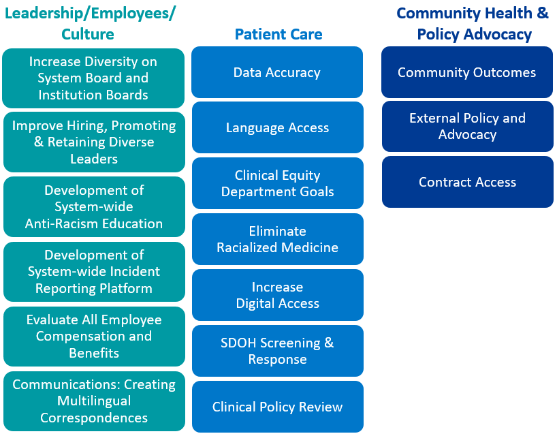
United Against Racism (UAR)

Slide 56
Social Determinants of Health Screening & Response

Slide 57
Social Determinants
80% of the influence on health is by factors outside of the healthcare system, known as the social determinants of health such as food, housing, transportation, education. Further, racist policy and institutions have created inequitable distribution of resources to support good health for all.
What we must do to accomplish this:
Expand screening of social determinants of health to all primary care patients.
Expand our community health worker workforce, who serve as primary supports for connecting patients to resources.
Invest in interventions to address the most common unmet needs among our patients, namely food insecurity through establishing clinical food pantries.
Measures of success:
Increase screening rates through achieving collection of social determinants at all primary care visits, beginning first in targeted communities.
Increase rate of follow up on positive screenings
Demonstrate reduction in food insecurity among primary care patients.

Slide 58
Questionnaire completion options
Patient Gateway 7 days prior to visit
iPad Devices upon patient arrival in clinic
Verbally with the Care Team up to 2 days prior to visit without an encounter
Paper if methods above are unavailable
Addressing domains with positive screens
Clinical staff (provider, MA) reviews questionnaire responses with patient and determines if the following interventions are necessary:
Local resource tip sheet in the positively screened domain(s) and/or
  Patient is provided a tip sheet through the AVS containing local/state resources for self-enrollment
Referral to SDOH at their respective institutions
  Patient is contacted by a community resource specialist or similar for additional assistance

Slide 59









Medicaid ACO – Flexible Services Program Eligibility
Must have one of the following Health Needs Based Criteria:
One Risk Factor (SDOH Need)
AND
Housing
  Behavioral Health Need
Be homeless, at risk for homelessness, or have unhealthy housing conditions
OR
  Complex Physical Health Need
OR
Need assistance with one or more ADL or IADL*
OR
OR
Nutrition
  Repeated ED use - 4 or more ED visits in 1 year or 2 or more ED visits in 6 months
At risk for nutritional deficiency or imbalance
OR
  High risk pregnancy - with a diagnosis of preeclampsia, gestational diabetes, a referral to Maternal Fetal Medicine
Notes:
A patient must have a need for the services, along with the diagnosis
For example: A patient must have uncontrolled diabetes
Patients should be connected to existing state resources, for example SNAP
If a patient is being referred into a nutrition supports program, they must first be enrolled or referred to SNAP to ensure they are utilizing all state resources
The patient must be in the Partners HealthCare Choice ACO to be provided these services
Patient’s eligibility must be checked every 90 days to ensure they are still in the ACO
The risk factor and health needs based criteria should be from the last year and documented in the chart

Slide 60
5 Core Flexible Services Programs
Intervention | Program Type
Food | Medically Tailored Food
 | Nutrition Education (not yet live due to COVID restrictions for in person meetings)
Housing | Housing Search and Stabilization
 | Home Modifications
 | Legal Advocacy
Example: Community Servings provides medically tailored meals to patients with hypertension, high BMI, diabetes, and other conditions statewide
Example: Just Roots provides farm share for families of pediatric patients with developmental conditions, pediatric uncontrolled diabetes, hypertension, and other conditions who are served at APP.
Example: Metro Housing Boston and SMOC help patients who are experiencing risk factor of being at risk for homelessness, are currently homeless, or have an unsafe living condition with housing search, application assistance, budgeting, etc.

Slide 61
Thank you! abryant@partners.org

Slide 62
Birth Equity Additional Resources & Tools
14

Slide 63

Birth Equity Toolkit Outline
Introduction
National Guidance ACOG/SMFM
ACOG Committee Opinions/Statements
SMFM Guidance
Birth Equity Toolkit now available online: https://ilpqc.org/birthequity/
National Guidance Alliance for Innovation on Maternal Health (AIM):
Initiative Resources *10 Steps to Getting Started with BE*
Address Social Determinants of Health (SDoH)
Utilize Race and Ethnicity Medical Record and Quality Data
Engage patients, support partners, and communities in patient- centered, respectful care
Engage and educate providers, nurses, and staff to improve birth
equity
41

Slide 64
Resources and Education for Buy-in
Resources to review for social determinants of health (SDoH) providers and nurses buy-in:
Empower Journey Map
Principles for Patient-Centered Approaches to Social Needs Screening
Patient-Centered Social Needs Screening Conversation Guide for Staff
Social Determinants of Health Curriculum for Clinicians (E-modules)
PQI Socio-Ecological Model – Perinatal Disparities
AWHONN SBAR for Inclusive and Equitable Patient Care
References: PQI; AHA; AWHONN

Slide 65
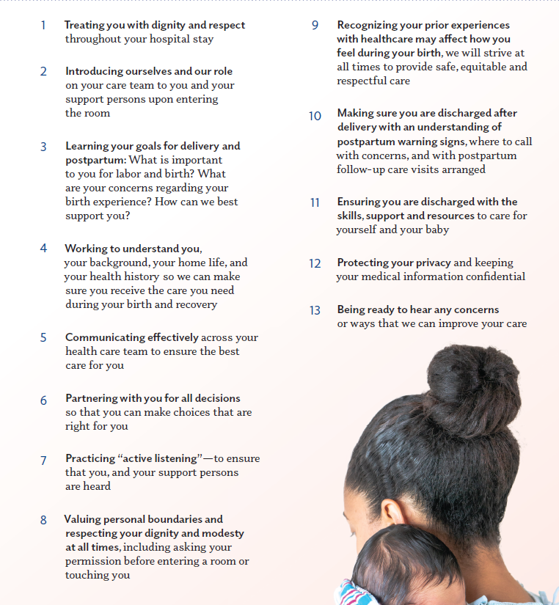
Available in:
  Tear pads
  Posters
  Bi-Fold
Respectful Care Practices Resources
Order your materials today: https://redcap.healthlnk.org/surveys/?s=RLM4M4DPJ4

Slide 66



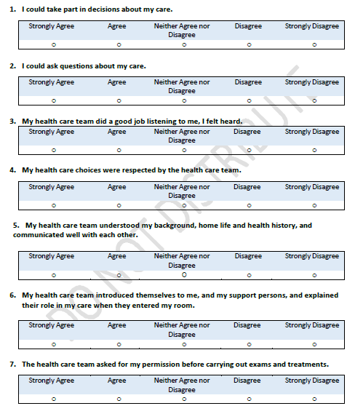

Labor & Delivery
PREM
Respectful Care Practices
Notes:
PREM survey:
Teams will receive patient handout with QR code reports on patient feedback will be available in the ILPQC Data System
Available in English and Spanish
Additional 7 languages coming soon

Slide 67

We are shipping out Respectful Care Practices Materials for teams
ILPQC will be shipping each BE QI teams a sample package of Respectful Care Resources:
  10 Posters (English)
  5 Posters (Spanish)
  1 Tear pad of 50 sheets (English and Spanish)
  10 Bi-folds Brochure
We will be shipping the materials to the hospital addresses we have on file for your BE team
If you would like additional resources for your hospital please complete the Respectful Care Practices Order Form

Slide 68

Tiered Approach for Birth Equity Implicit
Bias Training
Confirm someone from your hospital attended the November PQI Speak Up training, if not plan on signing up for Jan 2022
Diversity Science: Dignity in Pregnancy and Childbirth Course training
  FREE e-module trainings available for all staff
  Can integrate into the hospitals e-learning systems to track completion
Perinatal Quality Improvement SPEAKUp Training
  1 team member per hospital to attend over 2 days (total 8 hours) anti-racism training
  Train the trainer model to amplify local trainings
Laboring with Hope video and discussion guide
  Working with developer (Dr. Nakeitra Burse) to make the 30 min video and discussion guide available for free for all BE teams for group viewing and discussion
Illinois Perinatal Quality Collaborative
Notes:
Webpage link to Diversity Science
https://www.diversityscience.org/ilpqc-2/!
SPEAK-UP Registration link:
https://www.perinatalqi.org/event/SPEAKUPCONFILNOV2021

Slide 69



Develop respectful care and bias education for providers, nurses, and staff
ILPQC has partnered with Diversity Science to provide simplified online access to the Dignity in Pregnancy and Childbirth online e-module training
3-module free program for perinatal providers, nurses and staff
  With resources to promote health equity in clinical practice and organizations also available
Free access to the resources and support to add e-modules to online hospital learning systems will be provided
Webpage link: NEW*
https://www.diversityscience.org/ilpqc-2/!
Illinois Perinatal Quality Collaborative
49

Slide 70
Team Talk

Slide 71

Birth Equity
Located in Oak Park, Illinois
Serving the Austin, Belmont-Cragin, and other west side and western suburb communities
Part of the Northwestern Perinatal Network
Level II with 12 LDR, 20 PP, 8 ICN rooms
Partnered with PCC Wellness
  Offering in-house Addiction Medicine & out-patient Chemical Dependency care
Wave-one team

Slide 72
Baseline data collection was a team approach!
Our PCC team was already using a SDoH screening tool
Self-identified race & ethnicity collected from the birth certificate worksheets filled out by the parents
Our BE Team:
Family Medicine Providers (obstetric and neonatal care)
Certified Nurse Midwives
Nursing
Addiction Medicine
Social Work

Slide 73
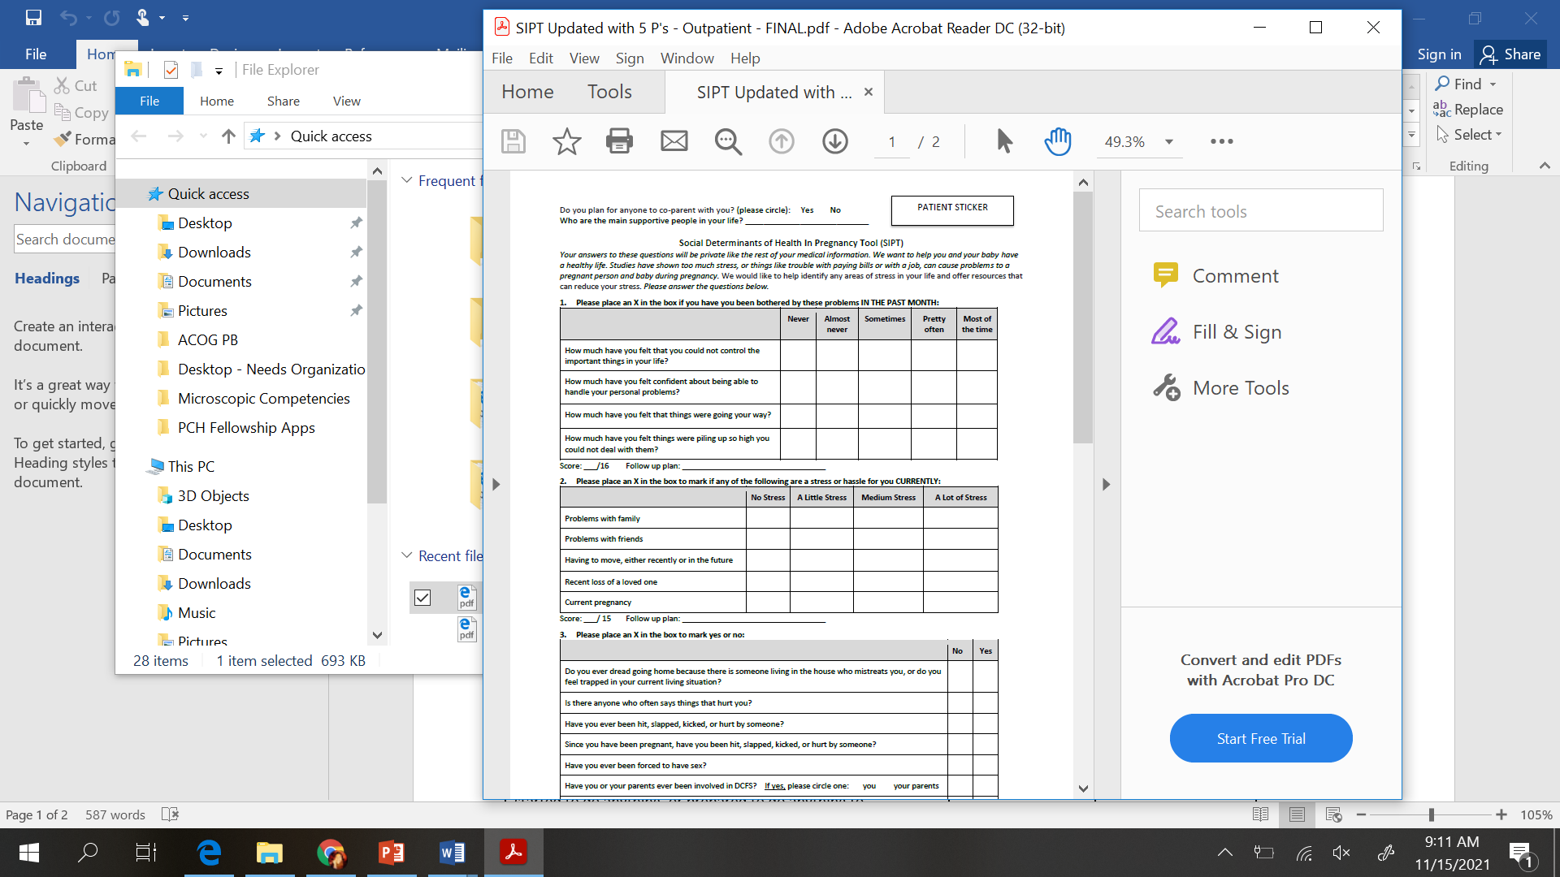
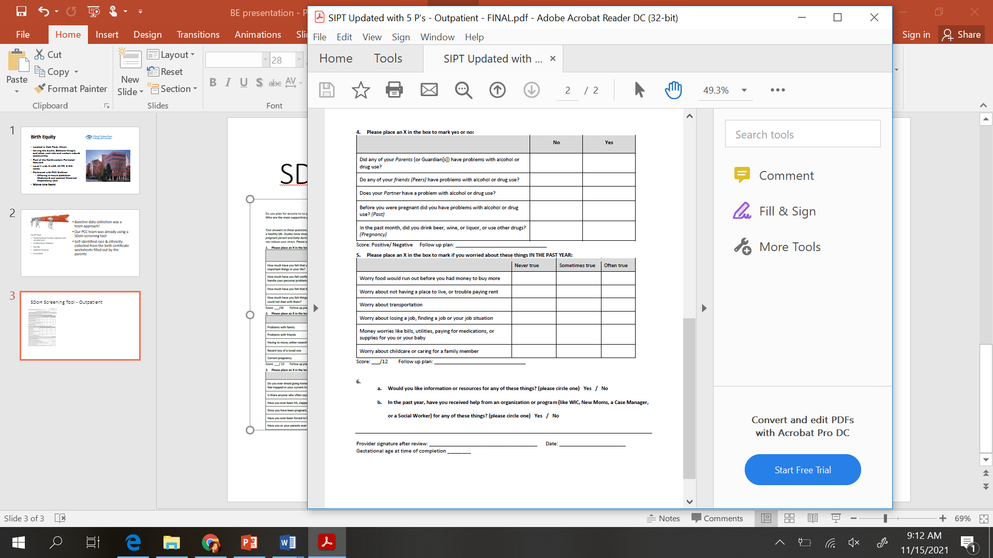
SDoH Screening Tool - Outpatient

Slide 74
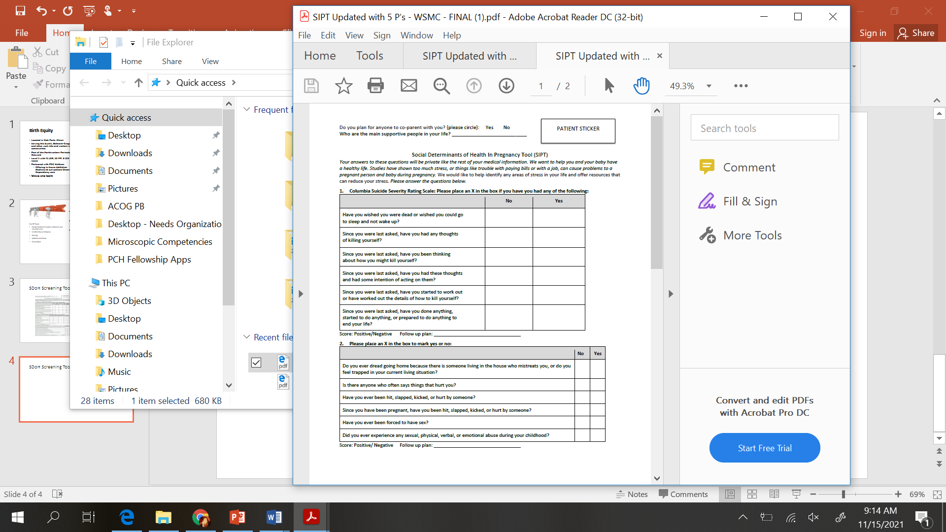

SDoH Screening Tool - Inpatient

Slide 75
Process
Monthly team meetings
Empower each team member to sign up for tasks
  Reviewing resources on ILPQC website to use as standardized training
  Attending Speak Up
  Working with Social Work to have both local resource handouts and utilizing NowPow

Slide 76
Birth Equity next steps

Slide 77

Schedule a BE Key Players Meeting for your hospital
Need help getting started with the BE initiative at your hospital?
KMP meetings is the opportunity for each BE team to receive consultation with a BE champion to strategize and map out your hospital’s next steps for making progress with BE.
ILPQC will help arrange a meeting with key players at your hospital: your QI team and OB department /hospital leadership or any other participants that you feel would be helpful to move the work forward
  Request your KPM meeting with this link: https://redcap.healthlnk.org/surveys/?s=C9TKXKJNMD
Illinois Perinatal Quality Collaborative
Notes:
Additional support for your birth equity initiative! We want to help you succeed by:
Partnering with you to arrange your Key Players meeting.
Assist you with who to invite at each hospital for most effective meeting with representative from ILPQC
Provide you with a Birth Equity champion from the BE speakers bureau to partner with you to problem solve, overcome barriers and move implementation forward
Who should be at the KPM: who do have currently on the leadership at your hospital, and bring the ILPQC side, OB chair,, nurses leadership, QI leadership, Diversity, Equity and Inclusion committee leadership, anyone other hospital senior leadership, additional OB staff including providers and nurse, and QI roster as well below:
Team lead
OB lead
Nurse Lead
Prenatal/Outpatient Representative
Patient/Family Advisor or Community Liaison
Midwife/Doula Representative, Quality Improvement (QI) Professional
Health Information Technology (HIT) Representative
Equity Officer

Slide 78
Upcoming Monthly Webinars:
Date | Topic
Monday, December 20th 12:00-1:00 | PREM & Respectful Care
Monday, January 17th 12:00-1:00 | Implementing a comprehensive implicit bias training for provider / nurse education
Monday, February 21th 12:00-1:00 | Engaging patients and community in QI / Birth Equity work
Register and Join here:
https://northwestern.zoom.us/meeting/register/tJMod-uoqDotGtzzJICE1O5TphPWT2-pZfmY

Slide 79

Next Steps for Birth Equity
Submit baseline data collection (Oct – Dec 2020), August and Sept into REDCap,
Monthly data for October due into REDCap by November 15th
Complete the Respectful Care Practices order form to receive any additional BE resources
Check out NowPow Community Resource & Service Directory!
Next Stop!
Illinois Perinatal Quality Collaborative

Slide 80


QI Champions
Obtain a Certificate in
Quality Improvement Science Sponsored by ILPQC
ILPQC is offering hospital teams access to IHI Open School, a free opportunity to asynchronously complete over 13 continuing education hours
Access starting June 2021 but can complete the certificate over two years.
Please complete the IHI Open School inquiry form to designate a specific number of members across OB & Neonatal QI initiatives at your hospital.
40 hospitals have team members receiving this FREE QI training
Fill out this link with your team TODAY!
https://redcap.healthlnk.org/surveys/?s=RN9D4H9AMD
Pump up your Quality Improvement skills!

Slide 81
Hemorrhage and HTN continuing Education

Slide 82
Maternal Hypertension & OB
Hemorrhage Continuing Education
Public Act 101 0390 passed by the State of Illinois in 2019 requires all birthing facilities to conduct annual continuing education on maternal hypertension and obstetric hemorrhage.
All obstetric, emergency department, and other staff that care for pregnant and postpartum women must complete the training requirement each year by December 31. Please report by February 28th, 2022. Please visit https://ilpqc.org/continuinged/ for more inofrmation.
There are several ways for birthing facilities to fulfill this annual training requirement, including e-modules, simulations, or drills from AIM, ACOG and other leading national groups available on the ilpqc.org website.

Slide 83










Thanks to our Funders
In kind support:

Slide 84
BE Questions
What are your early successes with BE at your hospital? Can be small wins!
How is it going getting a BE team together and meeting regularly?
What are your thoughts regarding getting started with implementation of Respectful Care Practices and the PREM Survey? How can you best implement the materials at your hospital?
How can we help teams get started engaging patients and community members in QI work?
How can we best support BE teams to get stared with QI strategies to get these system changes in place?
Notes:
Patti, can you please read the questions and add or edit them?

