Slide 1

BE Teams Call:
Achievable Patient / Community Engagement Strategies
Monday, February 20th, 2023

Slide 2
Call Overview
ILPQC Updates
BE Data Review
Achievable Patient/Community Engagement Strategies
  Regional Community Engagement Meetings Recap
  Respectful Care Breakfast Strategy
Team Talk
  Rush University Medical Center – Denise Banton

Slide 3
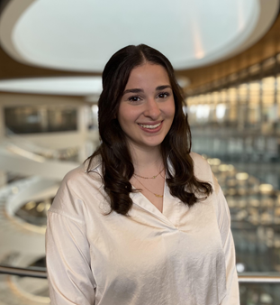
Welcome Aleena!
Please welcome our newest ILPQC team member:
Aleena Surenian, MPH
ILPQC Project Coordinator

Slide 4


Happening every day of February –
not too late to get started
https://www.perinatalqi.org/page/Anti-RacismChallengev2
The Reflect - Learn - Act for each day during weeks 1 and 3 focus on the letters in SPEAK UP.
The Reflect - Learn - Act for each day during weeks 2 and 4 focus on the letters in RESPECT.

Slide 5


ILPQC-Sponsored – FREE AWHONN Resource for your Respectful Care work:
Respectful Maternity Care Guideline (RMC-EBG) &
Implementation Toolkit (RMC-IT)
ILPQC is providing access to
(1) AWHONN Respectful Maternity Care Framework and Evidence-Based Guideline & Toolkit for each BE Team.
A $74.95 value.
Team leads look out for an email with more information!
Notes:
The Respectful Maternity Care Framework and Evidence-Based Clinical Practice Guideline provides evidence-based approaches to accomplish the following:
Identify the essential aspects of respectful care
Enhance awareness regarding the need for RMC
Encourage reflection to identify opportunities for personal and organizational improvement to provide RMC
Participate in improving the birth experience for people obtaining health care in maternity settings
Support the implementation of RMC processes
Description
Respectful Maternity Care (RMC) is an approach to care that emphasizes the fundamental rights of women, newborn, and families, promoting equitable access to evidence-based care while recognizing unique needs and preferencerods (Shakibazadeh et al., 2018). Attitudes and behaviors of healthcare providers are entrenched in cultural norms and implicit and explicit bias may cause unintended harm during patient interactions (Howell et al., 2018). These factors may lead to harmful consequences and place patients at greater risk for not receiving appropriate attention to address individual concerns or quality care, specifically in the intrapartum and postpartum periods (Levine & Lowe, 2015; Miller et al., 2016; Saluja & Bryant, 2021).
The Respectful Maternity Care Framework and Evidence-Based Clinical Practice Guideline provides evidence-based approaches to accomplish the following:
Identify the essential aspects of respectful care
Enhance awareness regarding the need for RMC
Encourage reflection to identify opportunities for personal and organizational improvement to provide RMC
Participate in improving the birth experience for people obtaining health care in maternity settings
Support the implementation of RMC processes
Respectful Maternity Care Implementation Toolkit provides you the tools and resources you need to implement the 10 Step “C.A.R.E. P.A.A.T.T.H.” in your organization to provide Respectful Maternity Care to every patient, every interaction, every time.

Slide 6
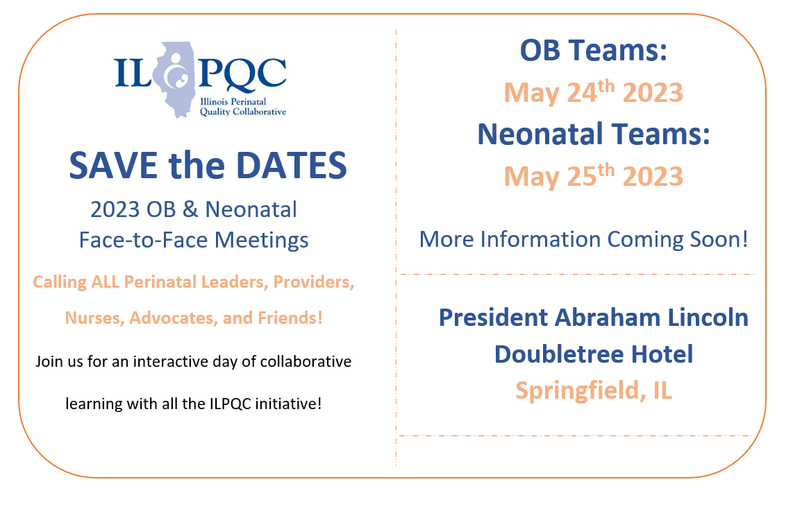

Slide 7

2023 F2F Volunteers Needed...
Come one! Come ALL!
Join us as we collaborate in-person
at the ILPQC Face-to-Face event in Springfield, IL.
The first ILPQC Face-to-Face event since 2019!
We are looking for volunteers to be a part of the:
2023 F2F PLANNING COMMITTEE
2023 F2F BREAKOUT FACILIATORS
Interested? Drop your name in the chat or email info@ilpqc.org

Slide 8
2023 Face to Face: Let's Get Ready!
Save the Dates!
Submit your Data!
Submit all your 2022 data plus January, February, March 2023
OB- May 24th, Wednesday
Neonatal- May 25th, Thursday
Storyboard Submissions!
Share your successes, opportunities, and specific strategies implemented!
Share your DATA, graphs, PDSA cycles, process flow or 30/60/90 plans
Review the award criteria for PVB, BE, and BASIC to achieve QI Excellence!
Start brainstorming your storyboard ideas!
ILPQC Room Block TBA
President Abraham Lincoln Hotel, Springfield, IL
Share your teams past year QI story
All Data due
April 21st!
Registration opens soon!
Templates coming soon!

Slide 9
BE Award Criteria for F2F
QI Leader Award
  All data submitted through March by April 21, 2023
  5 of 7 structure measures In Place / Green
  Achieving goal for 3 of 6 of the following outcome & process measures:
    Provider, Nurse, & Other Staff Bias education – 75%
    Scheduled early postpartum follow up – 75%
    Postpartum Safety Patient education - 75%
    SDoH delivery admission screening – 75%
    SDoH screen positive linked to resources – 75%
    PREM completion rate – 40%

Slide 10
Goal for every team to achieve BE QI Excellence by end of 2023
Submit all of your BE data through March by April 21
Move your structure measures to green / in place
Move your process/outcome measures to goal
    Provider, Nurse, & Other Staff Bias education – 75%
    Scheduled early postpartum follow up before discharge – 75%
    Postpartum Safety Patient education - 75%
    SDoH delivery admission screening – 75%
    SDoH screen positive linked to resources – 75%
    PREM completion rate – 40%
Call ILPQC info@ilpqc.org for help achieving your QI excellence award!

Slide 11
Birth Equity Data Review

Slide 12







BE Aim: By December 2023, ≥75% will have all key strategies in place
Screen all patients for social determinants of health and link to needed services
Optimize race and ethnicity data collection and review stratified data
Standardize postpartum safety education and schedule early postpartum visit
Share respectful care practices and survey patients on their care experience
Engage patients and community members for input
Implicit bias, respectful care training for providers, nurses, other staff
Notes:
Shortened in this breakout version. Original in YIR
Guide slide/

Slide 13
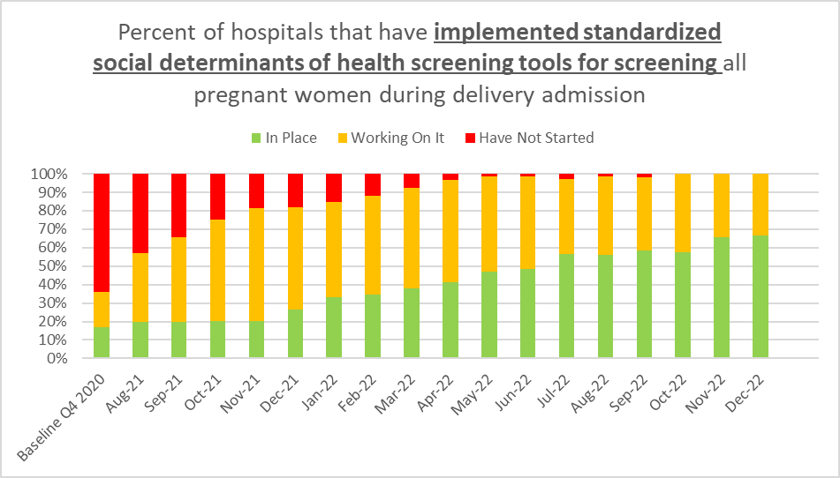
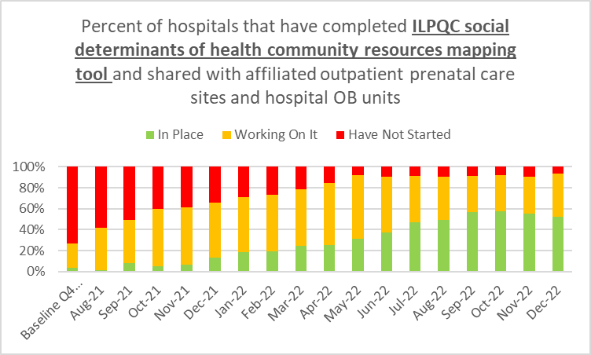
Structure Measures:
Implementing Systems Changes
SDOH Screening
Linkage to Community Resources
67%
52%

Slide 14
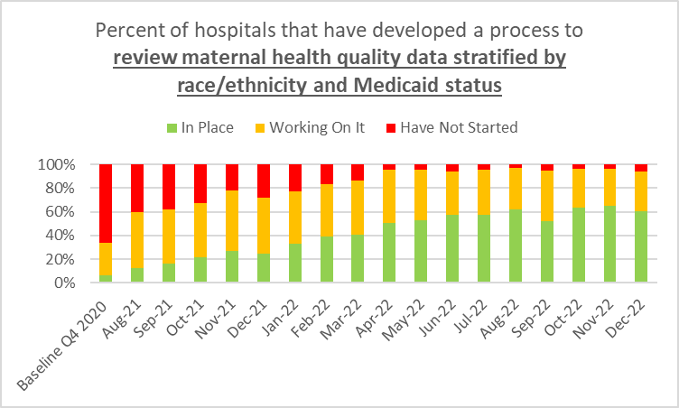
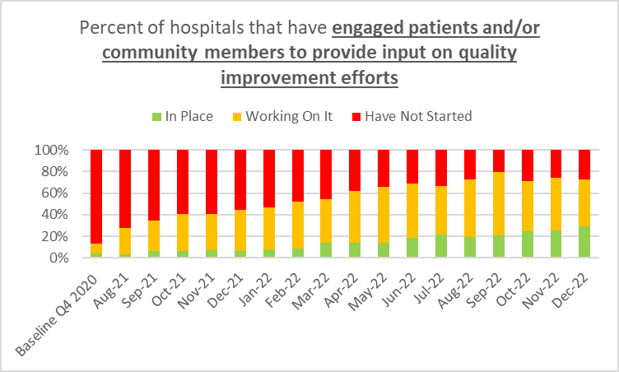
Structure Measures:
Implementing Systems Changes
Stratify Maternal Health QI Data
Patient / Community Engagement
60%
29%

Slide 15
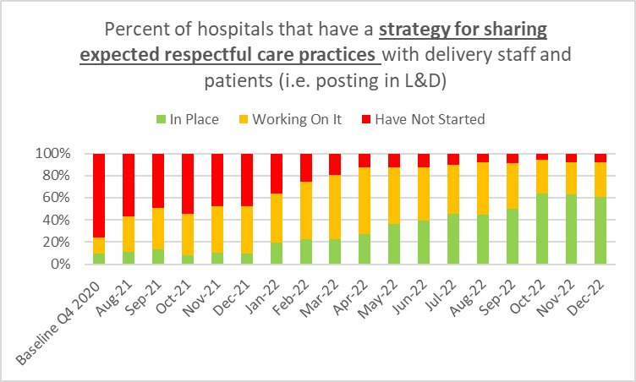
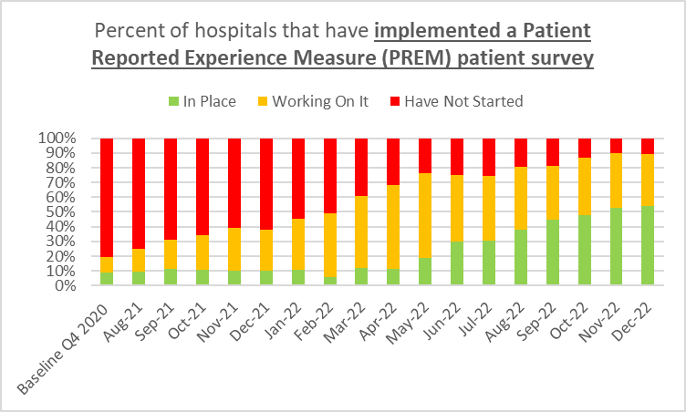
Structure Measures:
Implementing Systems Changes
Promote Respectful Care Practices
Implement PREM Survey
60%
54%

Slide 16
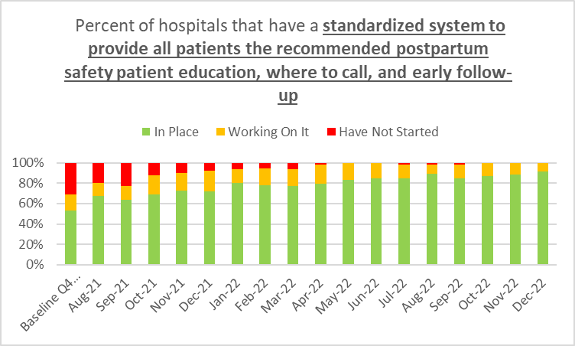
Structure Measures:
Implementing Systems Changes
Postpartum Safety Education
92%

Slide 17
ILPQC Hospital Team Data Submission
(86 Teams Total)
Structure Measures​ | Baseline (% In Place)​ | December 2022​ (% In Place)​
SDOH Screening (L&D)​ | 16%​ | 67%​
Identifying local SDOH Resources​ | 3%​ | 57%​
Optimize Self-Reported ​ Race and Ethnicity Collection​ | 6%​ | 75%​
Engage Patients and Community ​ in QI Work​ | 3%​ | 29%​
Sharing Respectful Care Strategies with Healthcare Team and Patients​ | 10%​ | 65%​
PREM Implementation​ | 8%​ | 55%​
Postpartum Safety Patient Education​ | 54%​ | 92%​

Slide 18
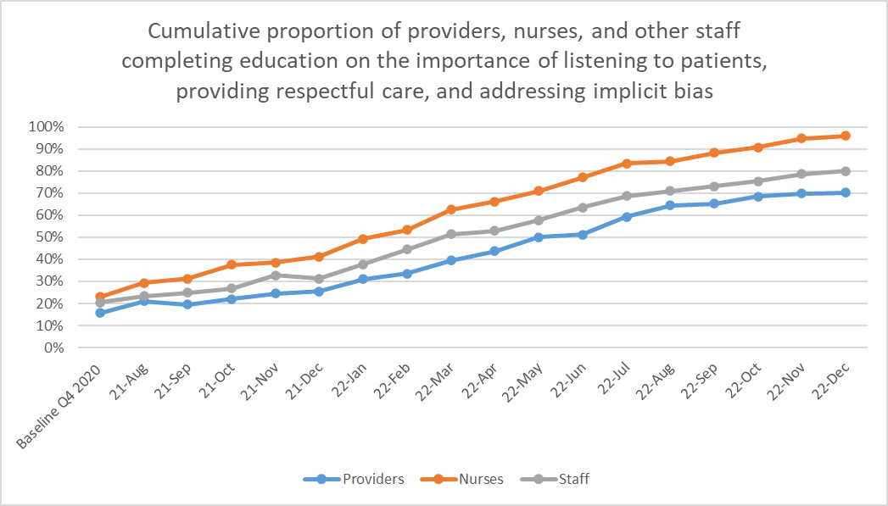
Process Measures
95%
80%
70%
23%
21%
16%

Slide 19
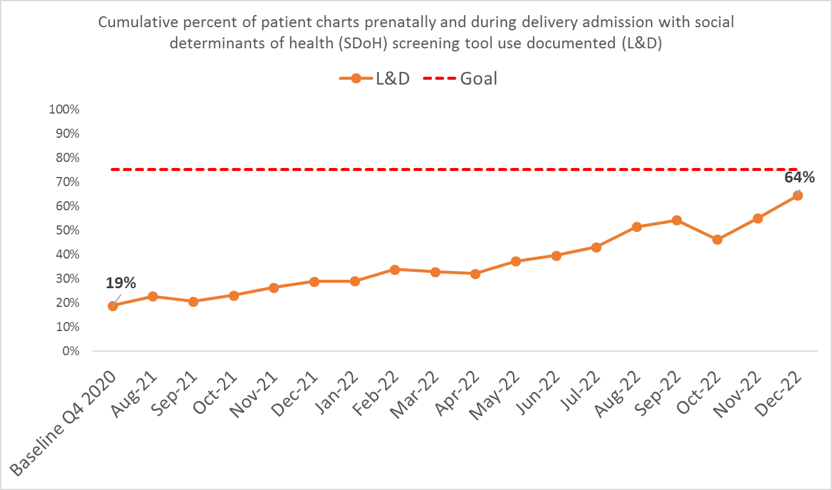
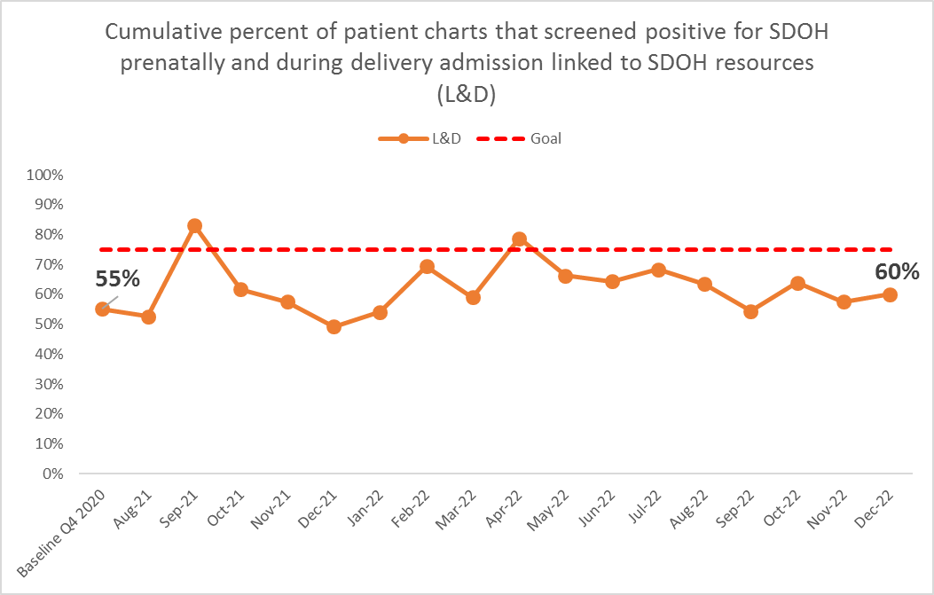
Outcome Measures

Slide 20
Birth Equity 2023 Focus: Bring BE to the bedside
Engaging our clinical teams to actively participate in the BE work

Slide 21
2023 BE Focus: bring BE to the bedside
Engaging L&D/postpartum OB providers and nurses to actively participate:
  Engage clinical teams to work on actionable Respectful Care Practices and increasing % of patients completing PREM
  Implement achievable patient/community engagement strategies such as hosting a Respectful Care Breakfast - inviting postpartum patients to discuss Respectful Care Practices and perspectives on how to best incorporate Respectful Care Practices into care with clinical staff
  Work on SDOH screening and process flow to link patients with positive screens to resources / services and engage clinical team to document SDOH, consider how SDOH needs impact clinical care and provide follow-up.

Slide 22

Why Respectful Care Practices and
Patient Reported Experience matters?
Patients of color, particularly Black and Latinx patients, as well as those enrolled in Medicaid at the time of delivery more often report that members of their care team:
  Did not engage them in care
  Did not respond to their concerns and requests
  Did not treat them with respect compared to White and privately insured patients
Patient experience matters:
  Individuals with poorer experience of healthcare are more likely to have poorer health outcomes
  Demonstrate lower adherence to recommended treatments
  Forego preventative care; and have poorer technical care delivery and higher likelihood of adverse event
Hoyert DL, Miniño AM. Maternal Mortality in the United States: Changes in Coding, Publication, and Data Release, 2018. Natl Vital Stat Rep. 2020 Jan;69(2):1–18. PMID: 32510319
2. Vedam S, Stoll K, Taiwo TK, Rubashkin N, Cheyney M, Strauss N, McLemore M, Cadena M, Nethery E, Rushton E, Schummers L, Declercq E, GVtM-US Steering Council. The Giving Voice to Mothers study: inequity and mistreatment during pregnancy and childbirth in the United States. Reprod Health. 2019 Jun 11;16(1):77. PMCID: PMC6558766
3. Doyle C, Lennox L, Bell D. A systematic review of evidence on the links between patient experience and clinical safety and effectiveness. BMJ Open. 2013 Jan 3;3(1):e001570. PMCID: PMC3549241
Notes:
Add references from grant for these articles at the bottom in italics

Slide 23
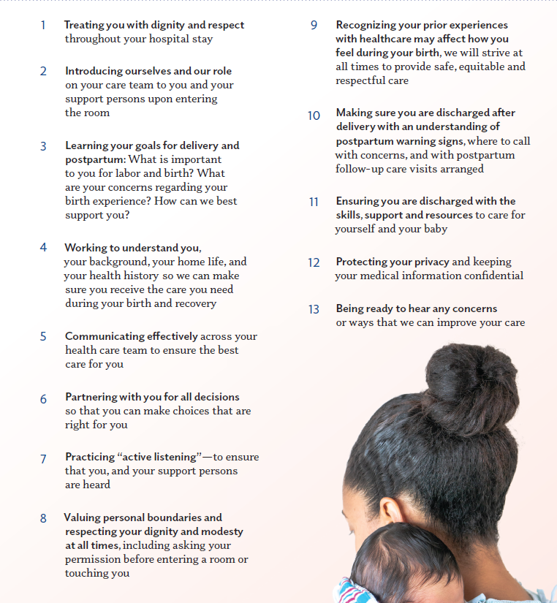
Respectful Care Practices Resources
We commit
to....

Slide 24
How to actively implement Respectful Care and PREM with your clinical teams....
Provide all providers and nurses a copy of the Respectful Care Practices to read and sign off to acknowledge they commit to these practices.
Discuss activation of Respectful Care Practices with clinical care teams: how do we improve “Commit to Sit”, active listening, shared decision making...
Post Respectful Care Practices posters in patient facing areas where patients can read them: such as admission area, triage, labor and delivery rooms and postpartum!
Create a process flow to:
  Provide and Review with all patients the expected Respectful Care Practices on arrival to L&D and inform patients they will be asked for feedback on their respectful care experience
  Opportunity to review expected Respectful Care Practices after delivery on postpartum
  During postpartum, ensure all patients receive PREM Survey QR code and are asked to anonymously complete the PREM Survey on their phone/or IPAD before discharge to give their feedback

Slide 25




Reminder: Share pic of your Respectful Care/PREM Survey Promotion
Grab your cameras and encourage everyone on the unit to get involved with promoting Respectful Care! How are you engaging your clinical teams?
Ex- Take pictures of clinical team members:
  With dedicated Respectful Care/PREM bulletin board(s)
  During Respectful Care/PREM discussion staff huddles
  Team discussion around a Respectful Care Poster or PREM flyer
  Wearing Respectful Care Buttons with pride
Submit your Respectful Care/PREM promotion photos to info@ilpqc.org to enter the QI coffee & doughnuts gift card raffle by March 15th, 2023.

Slide 26
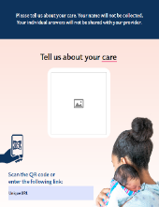


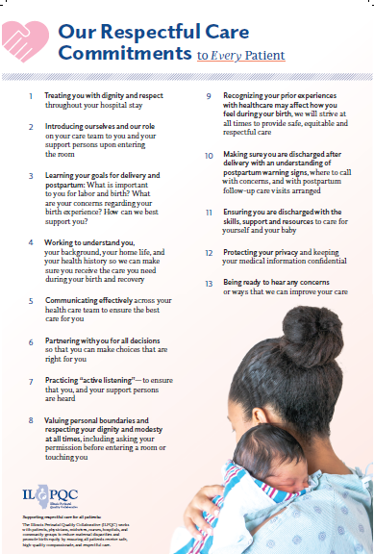
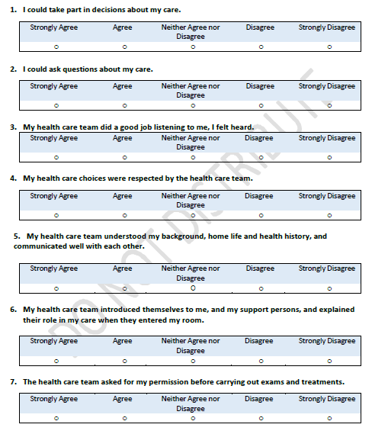
Labor & Delivery
PREM
Respectful Care Practices

Slide 27
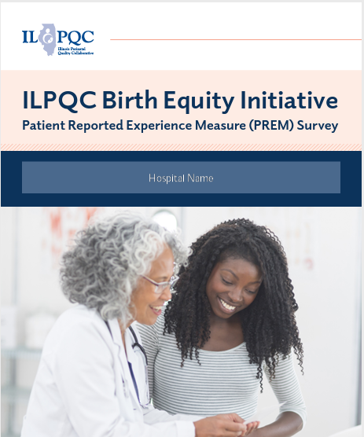
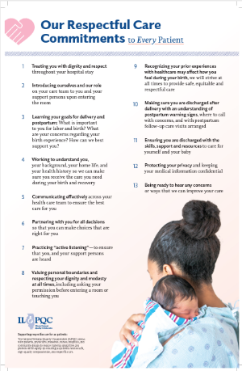
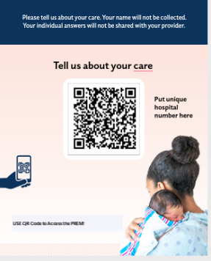
Addressing Respectful Care
To date,
1,620 PREM surveys submitted across 47 hospitals
Among the 47 hospitals, the statewide average PREM completion rate is only 8%
A few hospitals have completion rates ranging from 30-90%. Great work!!

Slide 28
Summary of PREM Survey Completion: Demographic Breakdown
Race
  18% of survey respondents reported their race as Hispanic
  75% of survey respondents reported their race as Non-Hispanic
Ethnicity
  21% of survey respondents reported their ethnicity as Black
  62% of survey respondents reported their ethnicity as White
Insurance
  52% of survey respondents have private insurance
  41% of survey respondents have public insurance

Slide 29
PREM Data Breakdown

Slide 30
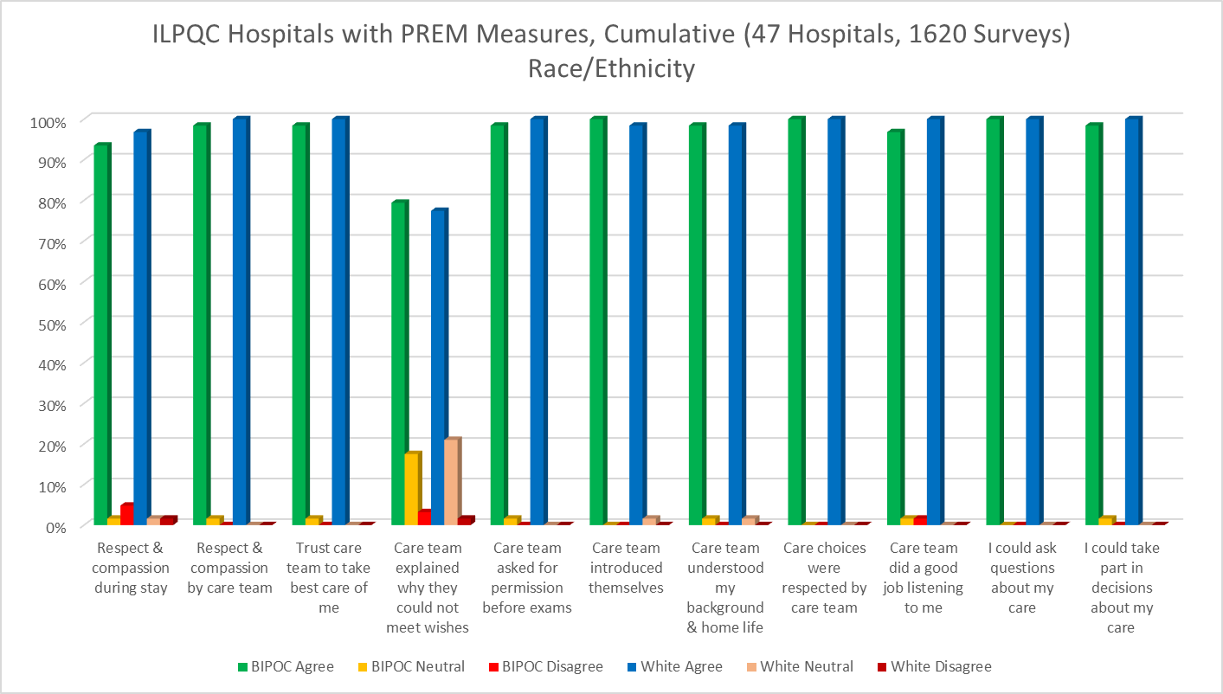
PREM Measures by Race/Ethnicity, pt. 1

Slide 31
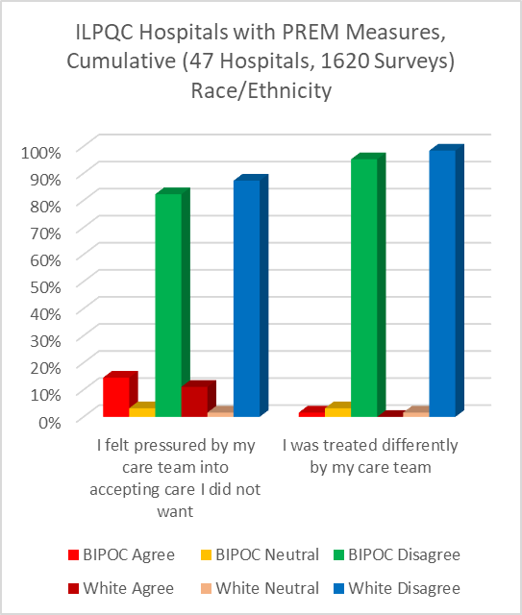
PREM Measures by Race/Ethnicity, pt. 2

Slide 32
 | Black, Indigenous, People of Color (BIPOC) |  |  | Non-Hispanic White
 | Agree | Neutral | Disagree | Agree | Neutral | Disagree
I was treated with respect and compassion by the care team | 98% | 2% | 0% | 100% | 0% | 0%
I was treated with respect and compassion during my delivery stay | 93% | 2% | 5% | 97% | 2% | 2%
When they couldn't meet my wishes, they explained why | 79% | 18% | 3% | 77% | 21% | 2%
I felt pressured into accepting care I did not want | 15% | 3% | 82% | 11% | 2% | 87%
Notes:
Get input on PREM Results and how to help teams focus on actively responding to PREM results
How to we help teams focus Respectful Care Strategies

Slide 33
 | Black, Indigenous, People of Color (BIPOC) |  |  | Non-Hispanic White
 | Agree | Neutral | Disagree | Agree | Neutral | Disagree
The care team asked for my permission before carrying out exams | 98% | 2% | 0% | 100% | 0% | 0%
My health care team did a good job listening to me | 97% | 2% | 2% | 100% | 0% | 0%
Notes:
Get input on PREM Results and how to help teams focus on actively responding to PREM results
How to we help teams focus Respectful Care Strategies

Slide 34
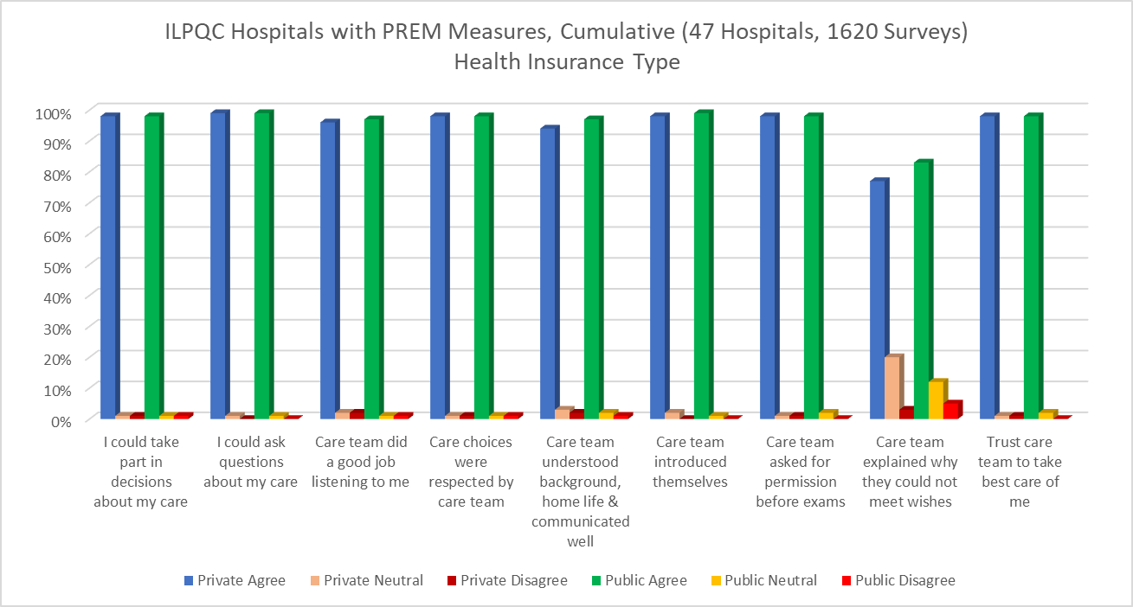
PREM Measures by Insurance Type, pt. 1

Slide 35
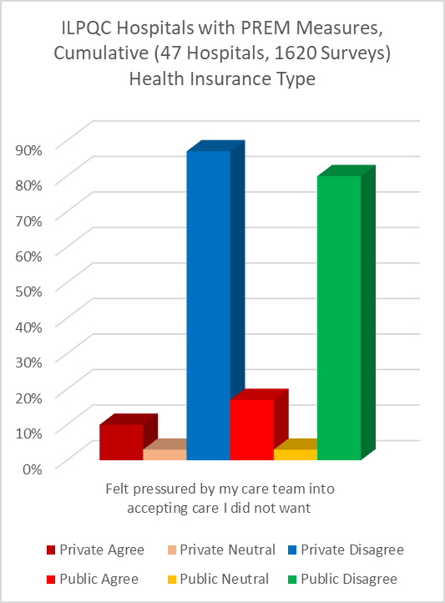
PREM Measures by Insurance Type, pt. 2

Slide 36
 | Private Insurance |  |  | Public Insurance
 | Agree | Neutral | Disagree | Agree | Neutral | Disagree
My health care team understood my background, home life, and communicated well | 94% | 3% | 2% | 97% | 2% | 1%
When they couldn't meet my wishes, they explained why | 77% | 20% | 3% | 83% | 12% | 5%
I felt pressured into accepting care I did not want | 10% | 3% | 87% | 17% | 3% | 80%
Notes:
Get input on PREM Results and how to help teams focus on actively responding to PREM results
How to we help teams focus Respectful Care Strategies

Slide 37
Summary of PREM data: by Race/Ethnicity
93% of patients of color felt they were treated with respect during L&D stay vs 97% of white patients (5% of BIPOC patients felt not treated with respect).
Only 79% of BIPOC patients and 77% of white patients felt that when clinical team couldn’t meet patients wishes they explained why (over 20% of pts across all racial groups did not feel that decision making was explained to them)
15% of BIPOC patients and 11% of white patients felt they were pressured into care they didn’t want
97% of Black patients, compared to 100% of white patients felt their health care team did a good job of listening to me

Slide 38
Summary of PREM data: insurance status
Only 77% of private patients and 83% of public insurance patients felt that When my clinical team couldn’t meet my wishes they explained why
10% of private insurance patients and 17% of public insurance patients felt pressured into accepting care they didn’t want
GOAL is to improve RESPECTFUL CARE and focus on improved communication with patients!
Shared decision making and active listening
How do we make progress?

Slide 39
Birth Equity 2023 Focus: Bringing BE to the bedside
Engaging our patients and community members for QI input

Slide 40

Patients and community engagement helps us do better
Patient / community engagement creates an opportunity to get input on QI efforts from those with the best information to help us do better!
  Make Sure Each Patient Is Heard (CDC, Hear Her Campaign)
  “Holding space” for women, “listening” to women and “trusting women” when they say, “something’s not right . . .” (AWHONN, Birth Equity)
“Embedded at every level of the organization and in all stages of clinical initiatives, patients and family members have been strong catalysts for change.” – NC PQC

Slide 41


Regional Community Engagement
Meetings across Illinois
10 Regional Community Engagement Meeting February – July 2022
29 community member/patient panelists
66 (77%) of BE teams participated with 180 clinical team members
Patient / community panels provided teams input on Birth Equity QI work
Modeled benefits of patient / community engagement with hospital teams
74% of teams reported RCEMs "Extremely Helpful / Very Helpful"
On AC 2022 Survey
Notes:
In collaboration with Tamela Milan-Alexander,
Director of Community Engagement at Everthrive

Slide 42
What was learned across 10 meetings:
5 Key Discussion Themes
Respectful care matters and involves connection with people as individuals without judgment and includes listening, discussing, and providing explanations
Patient feedback is critical and necessary to improve care
Hospitals must work with community stakeholders to identify existing community resources to address unmet needs
“Sit and listen, a few minutes can change a lot.” - Doula
Our community has so much to offer. I now have a better understanding how to help our patients access it - OB

Slide 43
What was learned across 10 meetings:
5 Key Discussion Themes
Care coordination is necessary and currently insufficient for pregnant and postpartum families
Creating meaningful change toward Birth Equity requires input from patients and community
Pregnant patients must be better informed of community resources and get help connecting with what they need
– Patient
We must reach out to people within our community who had perinatal care experiences and create the space for feedback. -Nurse

Slide 44
Strategies to continue engaging​ patient advisors and community members for input in QI work​
Invite patents / community members to share at hospital grand rounds
Start postpartum listening rounds
Host a community meeting or Respectful Care Breakfast!
Engage patient partner as member of your BE QI team
Develop a patient community advisory board

Slide 45
Working through an Achievable Patient/Community
Engagement strategy
Engaging clinical teams and patients/communities with Respectful Care

Slide 46
Creating patient/community engagement opportunities at your hospital
Asking every Birth Equity team to plan a Respectful Care Breakfast
Celebration of Respectful Care and Patient Voices
Building connections over breakfast
Invite a panel of postpartum patients and a community stakeholder (ie. doula, community health worker, community health clinic rep) for discussion and feedback on respectful care
Invite your OB providers and nurses to connect, listen and learn

Slide 47
Respectful Care Breakfast Workgroup
Collaboration
with OB Advisory and OB CAB members!
Vision:
  Celebration of Respectful Care and Patient Voices
  Sharing, connecting, and building relationships with clinical team and patients/community members to get QI input on BE strategies
Discussed achievable goals for planning a Respectful Care Breakfast
  What could this look like at your hospital?
    Celebration of Respectful Care and patient voices during Black Maternal Health Week (April 11-17) and/or Mother’s Day (week of May 14) over coffee/breakfast
  How would you get started?
    Engaging unit leadership for buy-in / Involve other clinical team members (providers, nurses, doulas)
    Invite OB providers, midwives, nurses, residents, social workers, staff; consider in place of Grand Rounds
  How can patients / community stakeholders be invited to attend?
    Patients – during PP rounding, an opportunity to invite patients, or patients with babies with NICU stays
    Providers – encourage affiliated providers to invite 1-2 patients/site delivered in last year to attend
    Community Stakeholders – reach out to local health department members, home visiting nurses, local doulas, community health workers --------WOULD LIKE a discussion panel of 3-5 patients/community members!

Slide 48
2023 Respectful Care Breakfast:
Celebration of Respectful Care -Sample Agenda
20 min: Coffee / Breakfast and Mingling (Name tags help!)
10 min: Welcome / Introduction to ILPQC Birth Equity / Share Respectful Care Practices
30 min: Patient/Community Panel Discussion (3-5 patients/community stakeholder)
  Moderator/Facilitator (could be DEI officer at facility, BE Champion, OB leader etc.)
  Guided Discussions around how clinical teams can best provide Respectful Care:
  Sample Discussion Questions:
    What does respectful care mean? What does it look like/feel like for each patient on panel? Any examples where they have experienced Respectful Care in a clinical setting.
    How can clinical team members best take action on the Respectful Care Practices? How do we make sure patients feel listened to? How do we best practice shared decision making?
    Any PREM Survey elements you are seeing a disparity. Ask for input on how to do better.

Slide 49

Next Steps for Planning your Respectful Care Breakfast
Gather your planning group
Connect/ Invite Patients
Providers engaging patients during prenatal/PP visits, invite NICU moms.
Set the Date
Unit leadership
Educator
Provider and RN Champion
Black Maternal Health Week (April 11-17) and/or
Mother’s Day Week (week of May 14)
PP Leader Rounds
Community Outreach (invite doulas, community health worker, home visit program, community health clinic etc)
Celebration of Respectful Care and Patient Voices Breakfast with clinical team members and patients!
Consider using a Grand Rounds time slot?
Social work
Excited to move forward? Reach out to ILPQC aleena.surenian@northwestern.edu for support!
Notify ILPQC when you have your Respectful Care Breakfast Scheduled!
We will send you a short survey tool to get participant feedback!

Slide 50

Thinking Creatively on Engagement!
Achievable Patient/Community Engagement Strategies
Regional Community Engagement Meetings
Local-level:
Hospital Patient/Community Engagement strategy
Respectful Care Breakfast
Patient Partner on QI team

Slide 51

Reminder:
ILPQC Patient & Family Engagement Toolkit
Improved Outcomes
  Engaging patient and families in quality improvement work results in improved outcomes
Improved Patient Experiences
  Engaging patients and families in QI work has been shown to improve patient experiences of care
Reach out to ILPQC for help! Info@ilpqc.org

Slide 52
Team Talk:
Rush University Medical Center, Chicago IL
Denise Banton, MS CPPS CNL CEFM RNC OB
Unit Director of Inpatient OB Services

Slide 53
ILPQC Birth Equity Progress report
Denise E Banton MS CPPS CNL CEFM RNC OB
Unit Director of inpatient OB services
February 20, 2023
This document is privileged and confidential under the Illinois Medical Studies Act and should not be shared or distributed other than through the Rush University Medical Center quality improvement committee structure.

Slide 54

664 Bed hospital located in the IL Medical District.
Serves a diverse population of patients on the near downtown and south west sides of Chicago.
Averages 2500 deliveries annually.

Slide 55

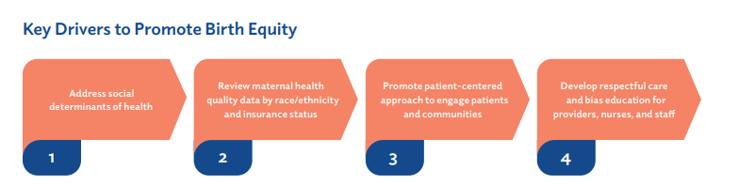

Slide 56
Review Maternal Health Quality Data by race, ethnicity, insurance, and zip code:
Complete monthly review of SMM data including infusion of 4 or more units of PRBCs and unanticipated ICU admissions
Reviewed all NTSV case outcomes from 2020 stratified by race/ethnicity and insurance status including SMM, hypertensive disorders of pregnancy, NICU admissions, and surgical site infections among others
  Review of all patient outcomes from 2020 stratified by race/ethnicity and insurance status nearing completion
  Incorporating race/ethnicity and insurance status in all current and future data collections
  admission
  Review
  te

Slide 57
Develop respectful care and implicit bias training for all staff:
Utilized the Diversity Science in Pregnancy modules and assigned all Physicians, Nurses, PCTs, OBST, and Clerks in the department.
One session was assigned each quarter starting in April 2022.
Providers had in person retreats to provide interactive discussions about the impact of our biases on the patient experience and outcome.
Nursing Staff meetings and UACs viewed patient experience video generating conversation about care and outcome.
Exploring multidisciplinary in class interactive sessions led by our HR partners.
  te

Slide 58
Develop respectful care and implicit bias training for all staff continues:
PREM surveys distributed prior to discharge. Initially 86 responses in the 3rd quarter of 2022 with significant decrease (9) in 4th quarter 2022. Currently a re-messaging campaign in process for 2023.
We have printed Respectful Care Practice wall clings to be dispersed throughout the OB areas.
Initial introduction provided to staff.
Intend to print life size posters, encourage staff to sign their commitment to these practices and place on entrance to the unit.
Intend to explore concept of signed document by RN, Provider, and patient to be placed in the chart pending discussion with our leadership team, risk, and legal.
  te

Slide 59
Address SDoH:
Currently process implemented in the out-patient setting.
OB triage team in process of addressing inpatient screening and process for connection to resources for positive screens.
  te
Take steps to engage patients and/or community members to provide input in QI efforts:
Community partners include Family connects. Rush is part of the initial pilot.
More opportunities TBD
  te

Slide 60
Standardized system for provide education prior to discharge:
EPDS screening offered to all patients prior to discharge.
Patients provided the AWHONN post partum booklet.
Prior to discharge, the last 2 pages are reviewed with the patient. This includes when to call a Pediatric provider for the baby and POST BIRTH concerns to notify a provider.
Patients partner encouraged to play an active role in removing this sheet and placing on the fridge of their home.

Slide 61
Thank you.

Slide 62
Educational Opportunities and Resources

Slide 63
*FREE* ACOG Respectful Care eModules:
The learning objectives of this course series are to:
  Describe the concepts of race and birth equity
  Describe the history concepts of medicalization of obstetrics, and unethical experimentation on marginalized populations
  Discuss how the history of the field affects obstetric and gynecologic care today
  Describe the goals of respectful maternity care and identify steps to put it into practice
Race and Equity // Historical Foundations // Respectful Care
https://www.acog.org/education-and-events/emodules/respectful-care
Notes:
https://www.acog.org/education-and-events/emodules/respectful-care

Slide 64

All those who completed the ILPQC hosted Speak Up Trainings in November 2021, January or June 2022 are eligible for the Ambassador Course

Slide 65
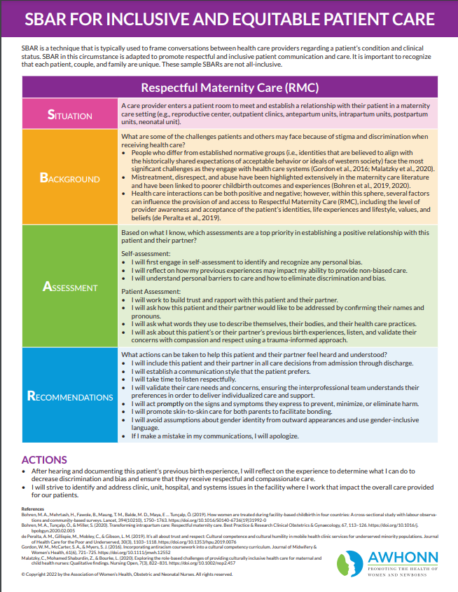
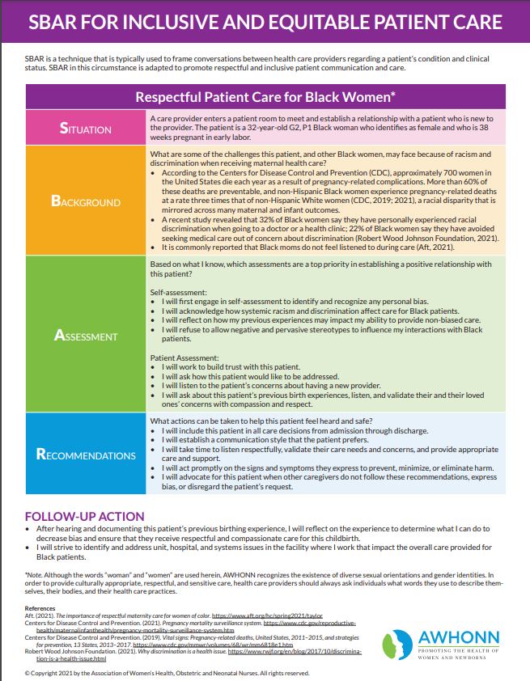
AWHONN SBAR for Equitable Patient Care Resource
SBAR to improve equitable communication with patients
SBAR is a technique that is typically used to frame conversations between health care providers regarding a patient’s condition and clinical status. This SBAR is adapted to promote respectful and inclusive patient communication and care.
https://www.awhonn.org/awhonn-sbars/

Slide 66
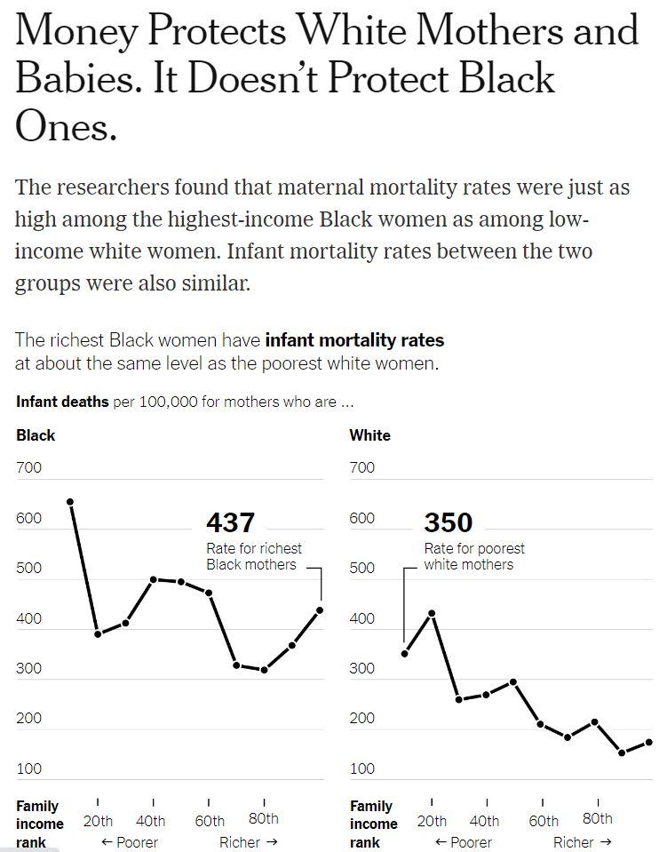

Read the article here

Slide 67
Upcoming ILPQC BE calls

Slide 68

Upcoming BE Calls
Event | Day/Time
BE Teams Call (3rd Monday of the Month) | March 15th, Your photos promoting Respectful Care/PREM with your OB clinical team members due for chance to win QI Coffee and Doughnuts gift card raffle. March 20th, at 12:00pm BE Webinar TOPIC: Strategies for increasing PREM survey completion April 17th, at 12:00pm BE Webinar TOPIC: Using PREM survey data feedback to improve Respectful Care May 24-25, See you at Face-to-Face in Springfield

Slide 70



