Slide 1
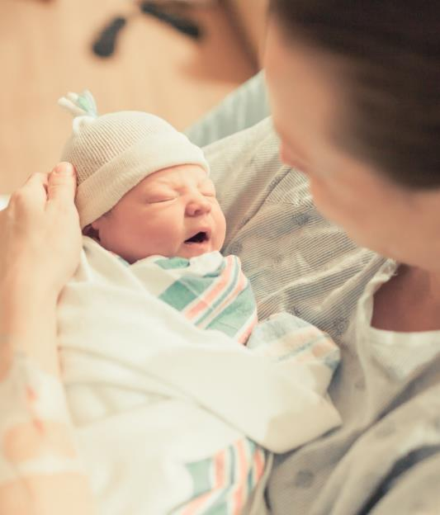
BASIC Monthly Teams Call: Preparing for the 2022
Annual Conference
Monday September 19th, 2022 2:00 PM

Slide 2
Call Overview
BASIC QI Excellence Award Criteria
ILPQC BASIC Data Review
Creating your abstract and poster for the 2022 Annual Conference
BASIC Team Talks:
  OSF St. Francis Medical Center and Advocate Children's Hospital- Oak Lawn
BASIC Next Steps

Slide 3


Registration Open!

Slide 4


Slide 5


ILPQC 10th Annual Conference Webpage
Register here // Reserve Hotel Room // AC Teams Survey // Poster Abstract

Slide 6

Call for Data for Award Recognitions
All Data Welcome!
  MNO-OB
  MNO-Neo
  PVB
  BASIC
  BE
Review and Submit QI initiative data by Monday, September 19th to be considered for Quality Improvement Recognition.

Slide 7


All structure & patient-level data entered for Baseline-August 2022
Key Structure Measures "In Place":
  Standardized Family Education Process
  EOS Risk Assessment Protocols for ≥35 and <35 Newborns
  Standardized Dosing Guidelines
  Antibiotic Discussions/Time Outs Protocol
  Standardized Automatic Stop Order Process

Slide 8
Achievement of process and outcome level measures
  ≥80% of neonatal/pediatric providers and nurses educated
  20% reduction (or absolute rate of ≤4%) in newborns ≥35 who receive antibiotics
  20% reduction in newborns with a negative blood culture who receive antibiotics for >36 (up to 48) hours
  ≥80% of newborns with anticipated duration of antibiotic course discussed by clinical team (antibiotic time out)
  ≥80% of newborns with an automatic stop order entered into the medical chart

Slide 9
Hospital Team Annual Conference Prep
Register
Data & Awards
Submit your AC Poster Abstract by October 3rd to be considered for an award.
2022 AC Survey
Abstracts
Make sure all data Baseline-August 2022 is entered in REDCap by Sept 19th 2022
Registration open on ILPQC webpage!
Attend Event
Meet together in-person for Annual Conference 8:00am-4:30pm
Book your hotel at the Westin in Lombard, IL
Opportunity to share thoughts & insights reflecting on 2022 & 2023 planning
Submit the survey by October 3rd
Print and bring your poster to display!

Slide 10
BASIC Data Review: Crossing the finish line
Notes:
Dan please update the data section. I think as much data as we can share on collaborative progress towards

Slide 11
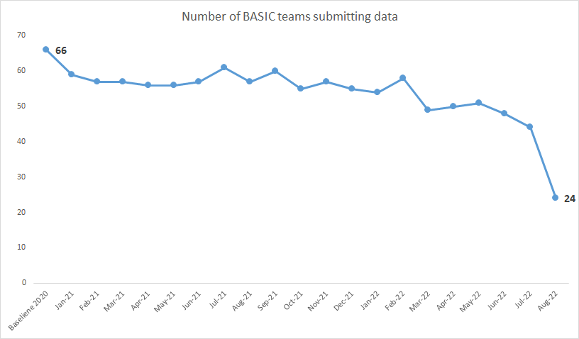
Data Submission Status:
Not too late!
74 teams have submitted any BASIC data
  29/74 (39%) have submitted Baseline 2020 and Jan 2021 – August 2022
  17/74 (23%) have 1-3 months missing from Baseline 2020 and Jan 2021 – August 2022

Slide 12
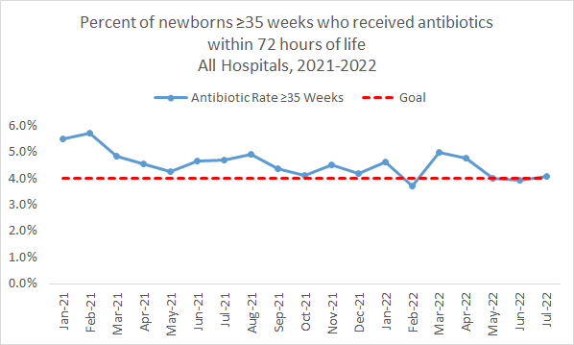
ABX Prescribing ≥35 Weeks
Notes:
What are avergae # of teams entering data? If May is incomplete we should exclude May Data

Slide 13
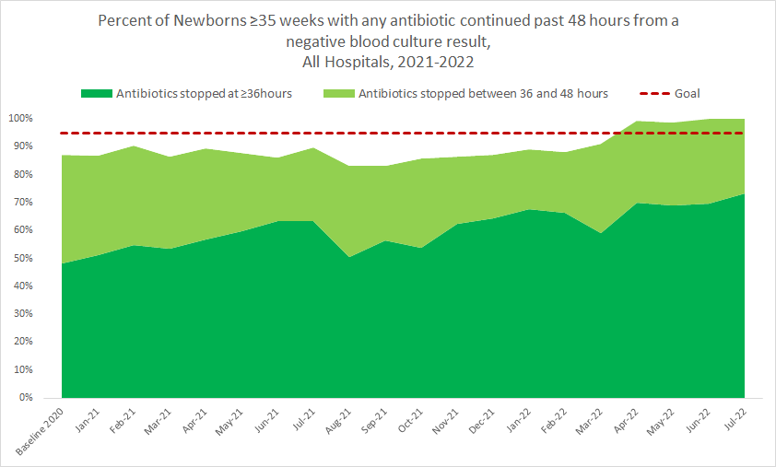
Stopping Antibiotics with Negative
Blood Culture ≥35 Weeks
Notes:
What are avergae # of teams entering data? If May is incomplete we should exclude May Data

Slide 14
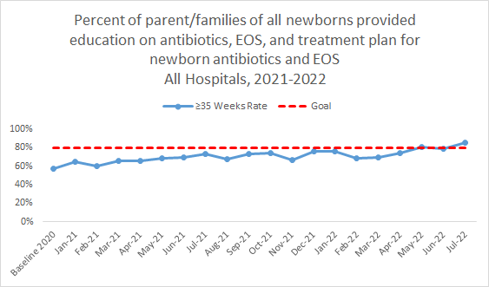
Family Education
83% of teams have the Structure Measure In Place!
17% of teams still are Working on or Not Started
Notes:
What are avergae # of teams entering data? If May is incomplete we should exclude May Data

Slide 15
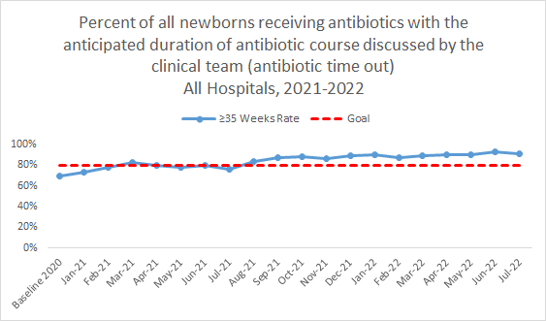
Antibiotic Time Out
81% of teams have the Structure Measure In Place!
19% of teams still are Working on or Not Started

Slide 16
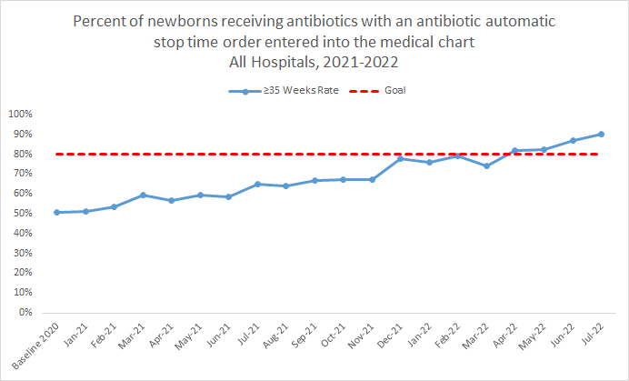
Automatic Stop Orders
85% of teams have the Structure Measure In Place!
15% of teams still are Working on or Not Started

Slide 17
Creating your Abstract and Poster for 2022 Annual Conference

Slide 18

Call for Abstracts for AC Poster Session
All hospital teams are encouraged to submit an abstract on complete or in-progress perinatal quality improvement (QI) work.
Abstract briefly describes your QI work and is foundation for your poster you create to display and share at the ILPQC 10th Annual Conference Poster Session.

Slide 19

WHO?
All hospital teams are encouraged to submit an abstract on complete or in-progress perinatal quality improvement (QI) work.
We especially encourage hospitals that have not previously submitted an abstract, including Level I and Level II/II+ hospitals, to submit an abstract this year!

Slide 20


WHAT?
Your abstract briefly describes your QI work and will be the foundation for a poster that your team creates to display and share at the ILPQC 10th Annual Conference Poster Session.
This year we are especially interested in posters looking at hospital implementation of key initiative strategies and outcome measures stratified by race, ethnicity, and insurance status across all initiatives.

Slide 21

WHAT?
Top abstract(s) in each submission category (OB, Neonatal, and Patient/Family/Community Engagement) will receive Abstract of Excellence Awards.
Two OB abstracts will receive special recognition, one each for (1) Best Use of Data, (2) Best Project Implementation
Two Neonatal QI will receive special recognition, one each for (1) Best Use of Data, (2) Best Project Implementation.

Slide 22

WHEN?
Abstracts submitted in each category by midnight on Monday, October 3rd will be considered for an award and blindly reviewed on predetermined criteria by a panel of reviewers.
Abstracts submitted after Monday, October 3rd, but before Monday, October 10th will be considered Late Breaking Abstracts and will be displayed at the conference but not considered for an award.

Slide 23
HOW to Submit Abstract
Submit your written abstract using the submission form via RedCap.
  Write using complete sentences and paragraph form.
Please format your abstract using the following sections no more than 300 words:
  Title (clear, concise, eye-catching)
  Background (only key background to provide context for subsequent work)
  Project Implementation (key information including what you did)
  Results (key results presented to fit well with general story)
  Conclusions (wrap up story, convey important results, state opportunities)
All abstracts are accepted!
After abstract submitted, develop a poster to bring to 10th Annual Conference!

Slide 24
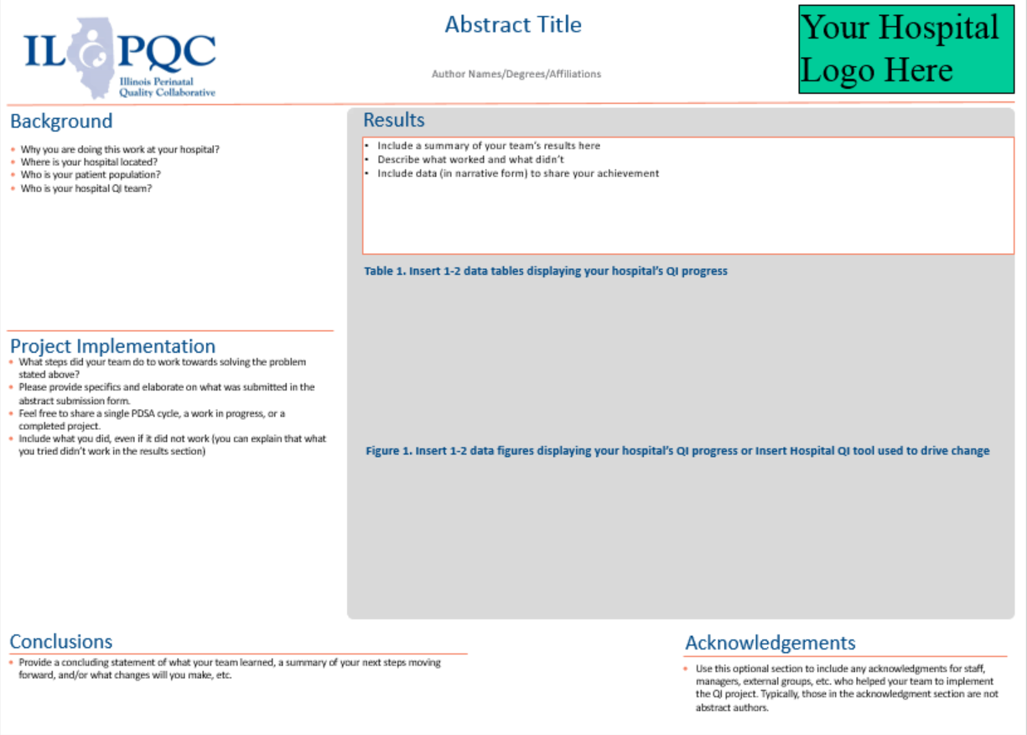
How to make your ILPQC Annual Conference poster
This is the FUN PART!
An abstract poster template is available to use.

Slide 25
HOW TO CREATE YOUR POSTER
BACKGROUND
(Why did you start?)
PROJECT IMPLEMENTATION
(What did you do?)
Problem description
Summary of current literature of the problem
Specific aims
Why is this work important for your unit/hospital?
Who is your patient population?
Context
Interventions and outcomes
Measures chosen for studying processes and outcomes of the intervention
  Share a PDSA cycle, a work in progress, or a completed project
Analysis
  Share QI methods used

Slide 26
HOW TO CREATE YOUR POSTER
RESULTS
(What did you find?)
CONCLUSIONS
(What does it mean?)
Steps of the intervention(s)
Details of the process measures and outcome
Describe what worked and what didn’t
Include data to share your achievement
  Include GRAPHS, CHARTS, TABLES to show your team's QI progress
Summary of your work
Sustainability
Interpretations
Opportunities
Suggested next steps

Slide 27

5 Quick Steps to Building your Poster Plan
What is your presentation's perspective?
Who's your audience?
What's your story?
What's the data?
What does the story and data tell us?

Slide 28
Tips and Tricks for Printing your Poster
Graphs and tables created in PowerPoint, Excel, Visio and Word should be copied and pasted directly into the template and ‘embedded’.
To determine if images are fuzzy, zoom in 100% to 200%. If it appears fuzzy on the monitor, it will be fuzzy on the printed poster.
Make sure the font size can be read from 5ft.
Posters should be printed 36" high X 48" wide - the poster template is formatted to accommodate this size.

Slide 29
BASIC Team Talk:
OSF St. Francis Medical Center
Peoria, IL
Dr. Ashley Fischer
Notes:
-waiting for slides 07.14.22

Slide 30
BASIC at OSF SFMC and Children’s Hospital of Illinois
September 19, 2022

Slide 31
Objectives
History of EOS at CHOI
Driver Diagram
PDSA cycles
Outcomes

Slide 32
History of EOS at OSF SFMC/CHOI
2011 – September 2016: following 2010 CDC guidelines (including 48 hour r/o period)
October 2016 – introduced 36-hour r/o period to NICU + newborn nursery, introduced local EOS guidelines
January 2018 – VON initiative, NBN also involved, more EOS education monthly for residents on newborn nursery service
August 2019 – modified EOS guidelines to no longer obtain serial CBCs or blood cultures for patients at risk due to inadequately GBS with ROM > 18 hours or < 37 weeks. Decreased GA for premature infant guidelines to 34 weeks.
Fall 2020 – joined BASIC

Slide 33
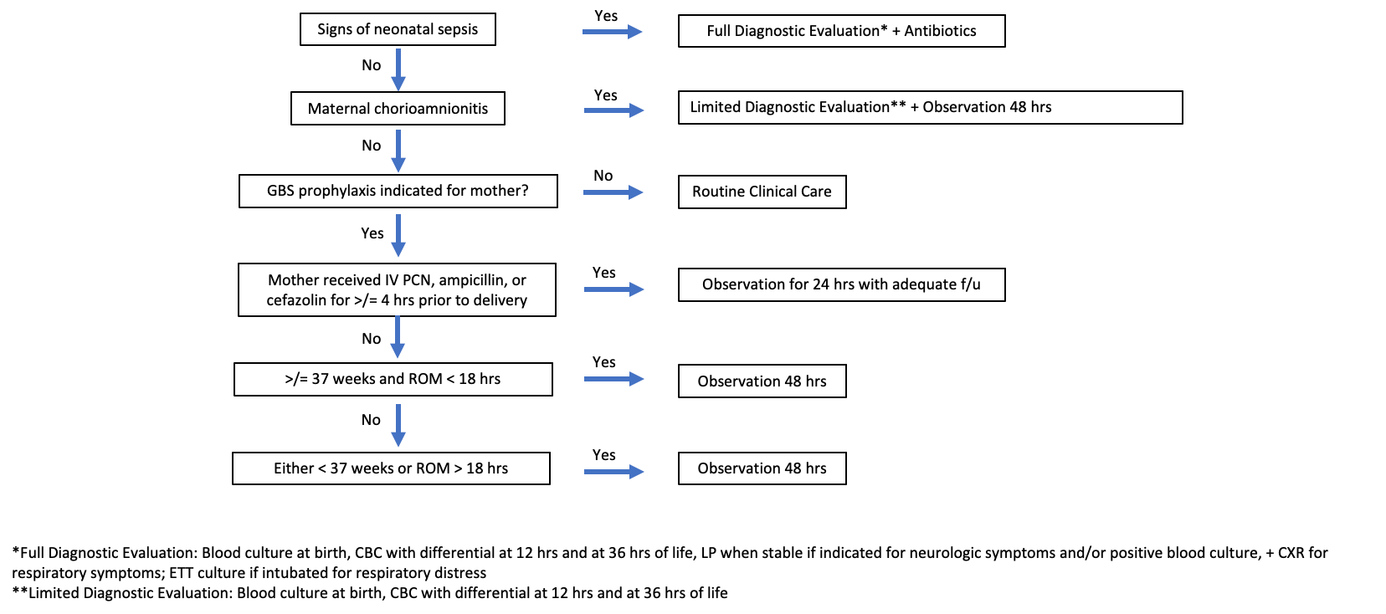
Local EOS Guidelines > 34 weeks

Slide 34
Local EOS Guidelines < 34 weeks
No empiric antibiotics for LOW risk infants. Obtain a blood culture at birth + serial CBCs at 12 and 36 hours of life for trending purposes:
  Scheduled C-section or induced vaginal delivery due to maternal indications
  No rupture of membranes prior to delivery or ROM < 18 hours for induced vaginal deliveries
  If delivered via vaginal delivery: GBS negative or adequately treated
**Antibiotics started in this population MUST be discussed with attending physician
All other higher risk infants with empiric amp/gent, blood culture at birth + serial CBCs at 12 and 36 hours of life for trending purposes. Also to include ETT culture if intubated for respiratory distress.

Slide 35
BASIC Driver Diagram

Slide 36
PDSA Cycles
PDSA Cycle 1 – Ensure consistency among providers for use of tool
  Plan:
    Reviewed Lippincott’s, current algorithm, and ministry EOS education
    Dot phrase created in Epic for EOS (premature infants and term infants)
    Ensured updated algorithms in workroom and education completed for all residents and providers
  Do:
    Use of dotphrase by providers – shared with others within OSF ministry as well
    Created EOS guidance document and added to OSF portal
    Education completed others within OSF ministry
    Pediatric and ministry grand rounds completed
  Study:
    Monitored parental education and use of tool within monthly audits
  Act:
    Multiple rounds of education, assistance with adding dotphrases for providers, NBN resident orientation additions

Slide 37
PDSA Cycles Cont.
PDSA Cycle 2 – Educating RN staff about EOS and antibiotic use
  Plan:
    Reviewed information available from ILPQC
    Recruited MD/APN to create education material
    Engaged RN leadership
  Do:
    Education material completed – multiple rounds of edits
    Education uploaded into healthstream
    RN leadership assigned education as appropriate
  Study:
    Monitored completion rates of education
  Act:
    Email reminders sent when needed

Slide 38
PDSA Cycles Cont.
PDSA Cycle 3 – Automating 36 hour stop times
  Plan:
    Extra doses given unintentionally with current process (reliance on provider to place manual stop times)
    Edit admission order sets for EOS to include automated stop times
  Do:
    Submitted proposal and request to update order sets in Epic
    Approved by hospital P&T committee
  Study:
    Real time monitoring – found instead of 36 hour r/o had been changed to 36 doses of amp
    Monitored impact on 36 hour r/o courses
  Act:
    Resubmitted for 36 hour change
    Reviewed audits for indications for antibiotics > 36 hours, provided individualized feedback if needed

Slide 39
PDSA Cycles Cont
PDSA Cycle 4 – Ensuring parental education
  Plan:
    Gathered resources from ILPQC website
    Group discussed best way to disseminate – educational papers approved by OSF
    Planning for pharmacist on weekdays in NICU, RN/provider in NBN and NICU on weekends
    Epic dot phrase to include educational component for documentation purposes
  Do:
    Enacted plan above
    Forms placed into online portal for ease of printing throughout the OSF ministry
  Study:
    Analyzed for gaps in above process through redcap audits
  Act:
    Re-education regarding utilization of dot phrase and documentation for providers and RNs

Slide 40
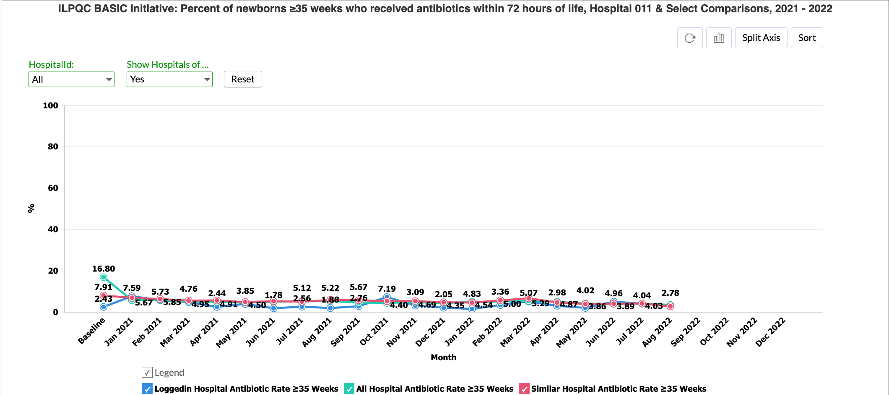
Outcomes

Slide 41
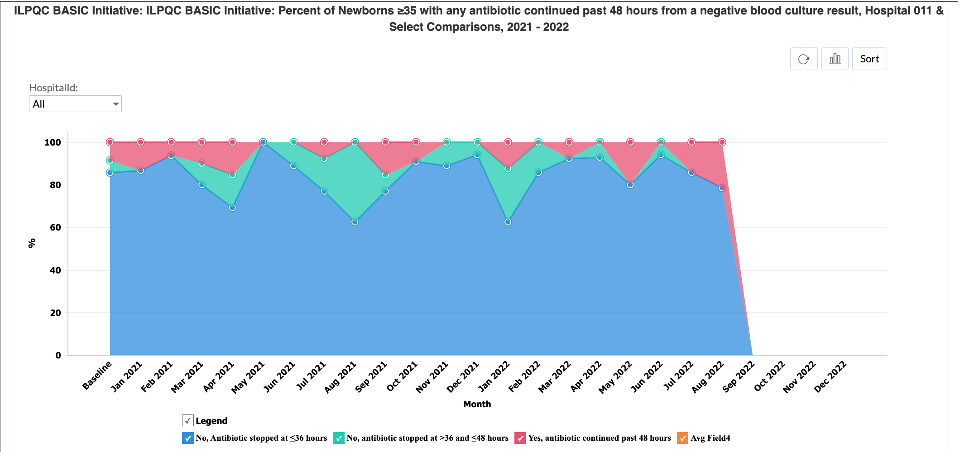
Outcomes cont.

Slide 42
Antibiotic Usage – Patients > 35 weeks antibiotics started in first 72 hours of life

Slide 43
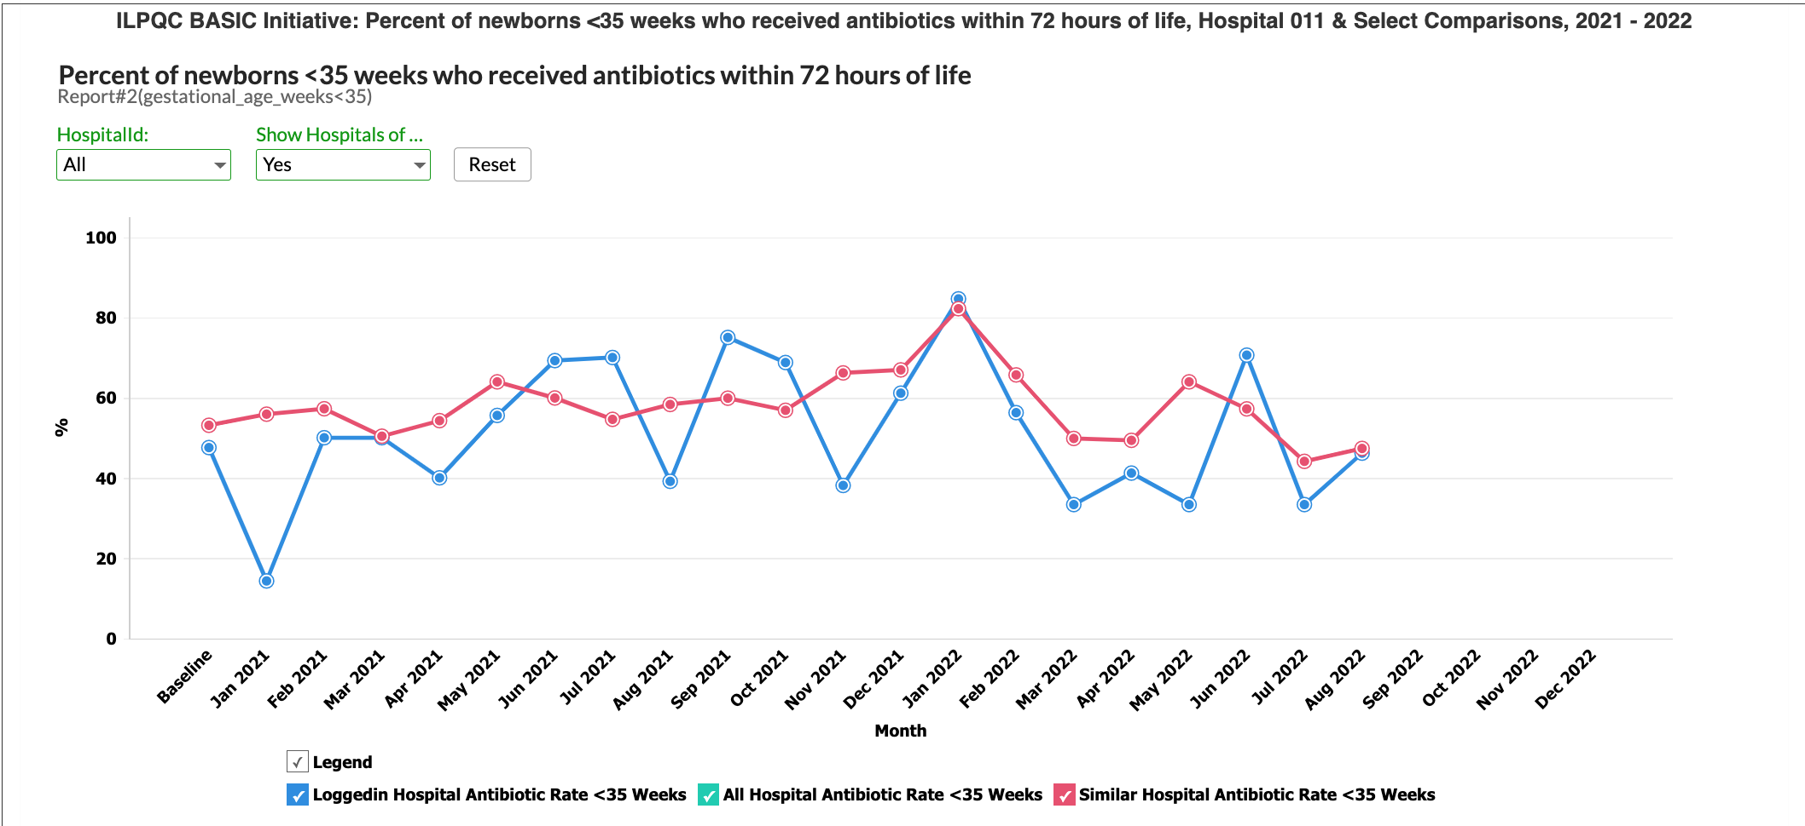
Outcomes cont.

Slide 44
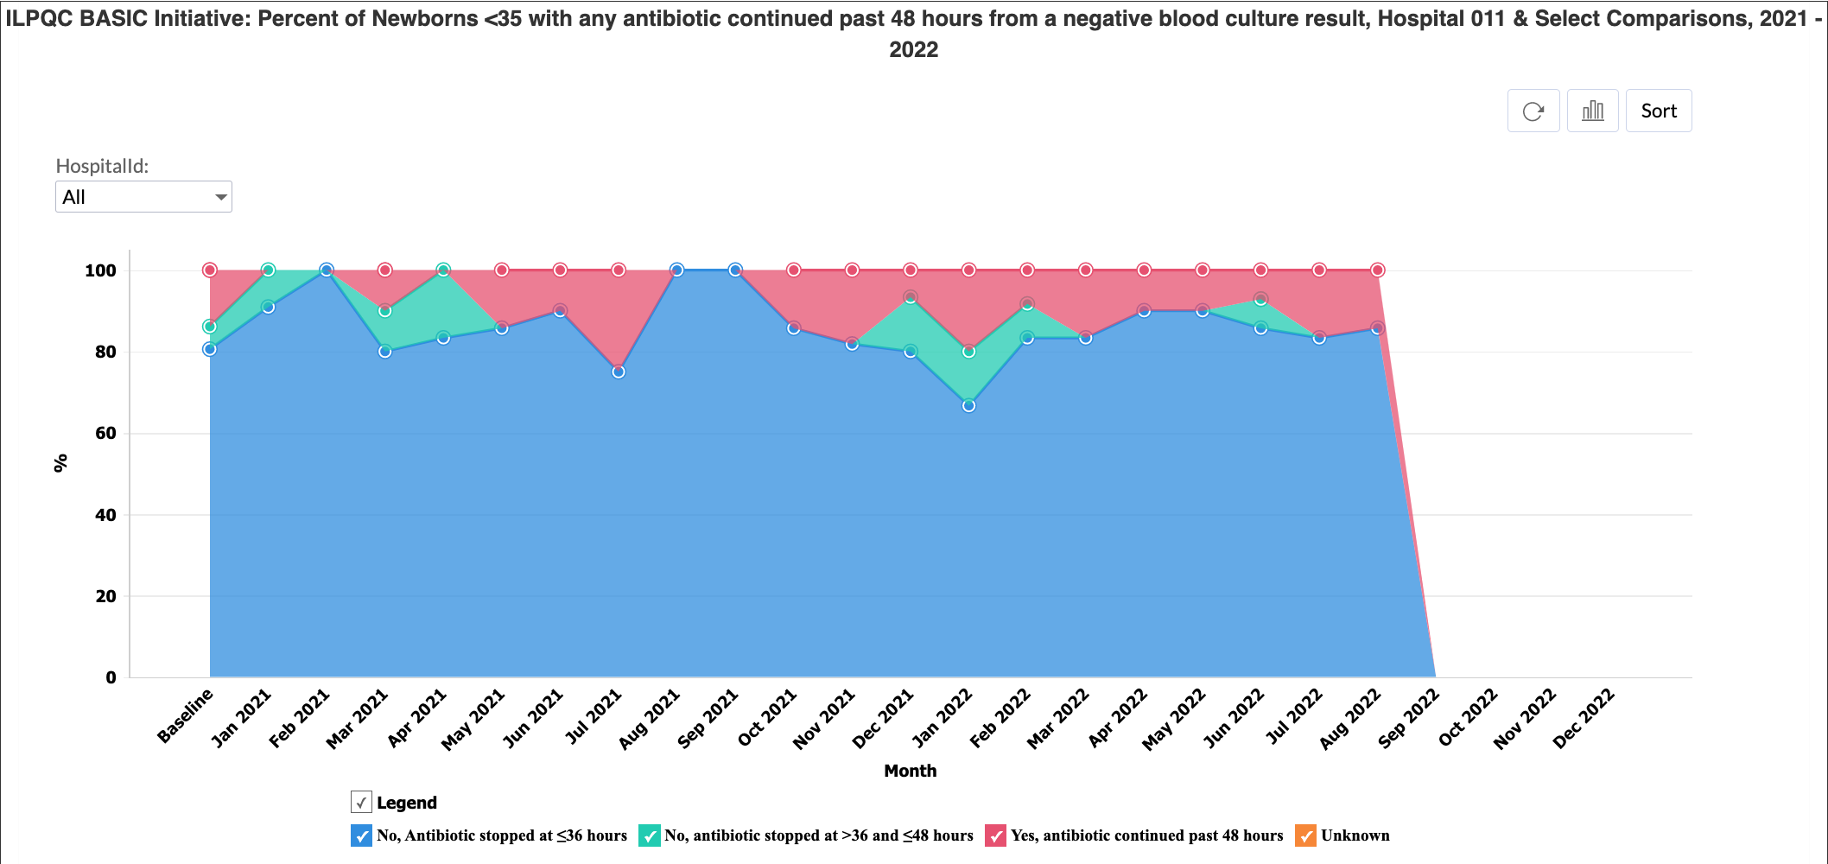
Outcomes cont.

Slide 45
Antibiotic Usage – Patients < 35 weeks antibiotics started in first 72 hours of life

Slide 46
Next steps
Working on late onset sepsis order set into Epic
Working on standardizing a LOS dot phrase into Epic
Reducing CLABSI
HUGE Thank you to team at OSF
Dr Shallat
NBN, NICC, and NICU Nursing educators
NICU pharmacists
APNs, Neos, Residents
Parents and babies!

Slide 47
BASIC Team Talk:
Advocate Children's Hospital
Oak Lawn, IL
Laura Jester MSN, APN, ACNS-BC, RN-BC, Clinical Practice Specialist
Paul Kasprzak, Clinical pharmacy specialist
Melissa Sheeran, MCO Postpartum
Notes:
-waiting for slides 07.14.22

Slide 48

Antibiotic
Stewardship
Advocate Aurora Health System
Christ Hospital
Advocate Children's Hospital
Oak Lawn Campus

Slide 49
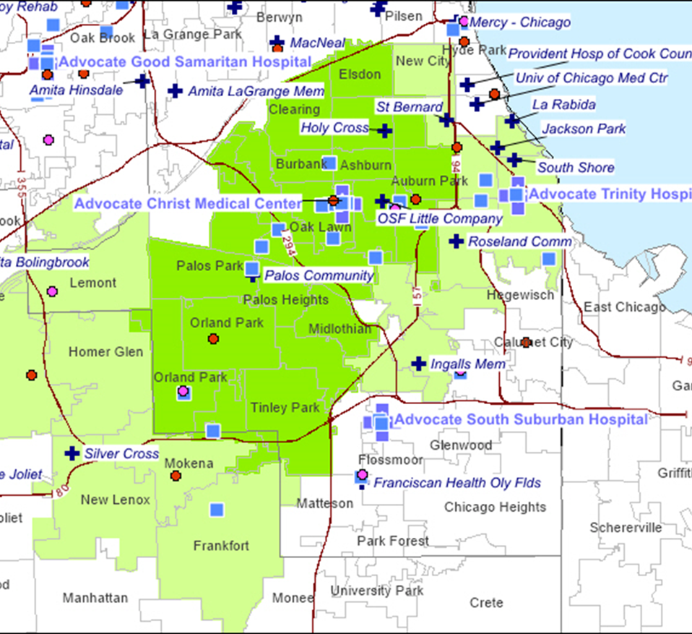

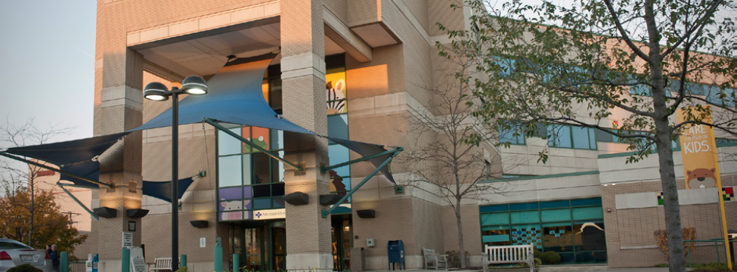

Slide 50
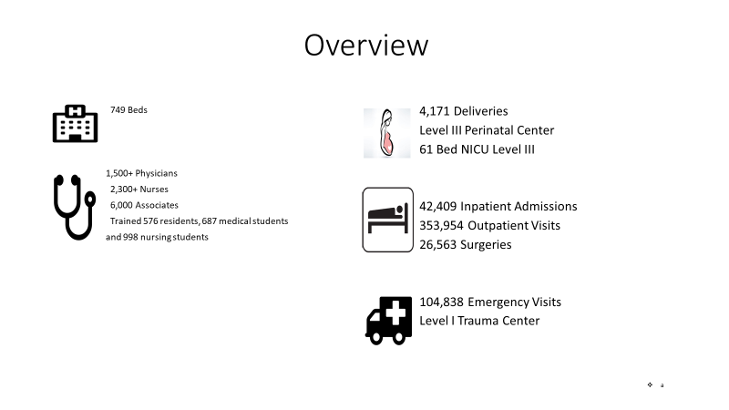

Slide 51
Neonatal Sepsis Screening Mother/Baby Unit
All RNs were educated on the process in November/December 2020
Sepsis screening went live Jan 4, 2021
At first, L&D RN calculate one-time sepsis risk score on newborns >35 weeks.
As of 8/31/2021 the Neonatal Sepsis Risk Calculator runs automatically
If the baby is at high risk for sepsis, a pop-up BPA will fire when the calculator is complete, and the physician must be notified
Depending on BPA recommendations, the physician may watch and wait during the 4-hour transition period or may order CBC, blood cultures and antibiotics
At 4 hours of life-RN will perform and document a set of VS and perform a neonatal sepsis classification assessment
If the baby is classified as Well Appearing, RN will document vital signs and a Sepsis Classification every shift thereafter
If at any time the baby is classified as Equivocal, the physician is notified for further orders
If a high-risk BPA fires, the system also automatically adds a Newborn Sepsis Care Plan and teaching points to the Education record of the newborn’s chart.

Slide 52
AAH Children’s Hospital Antibiotic Stewardship Initiatives
Goals
  Reduce antibiotic usage rate
    AAH reduced antibiotic usage rate by 33% with initiatives implemented from 2016 to 2019
    Developed pathways with specific duration of therapy
  Reduce antibiotic resistance
    Utilize agent with appropriately narrow coverage
    Reduce overuse of broad-spectrum agents (Vancomycin, 3rd generation cephalosporins)

Slide 53
AAH Children’s Hospital Antibiotic Stewardship Initiatives
Early Onset Sepsis (EOS)
  36 hour auto-stop on antibiotics (Ampicillin/Gentamicin) ordered through NICU admission order set.
  Antibiotic time out on daily rounds.
  Reduce empiric use of 3rd generation cephalosporins for EOS
Late Onset Sepsis (LOS)
  Developed algorithm using oxacillin/gentamicin for the empiric treatment of LOS.
  Goal of reducing empiric vancomycin use.
Necrotizing Enterocolitis (NEC) and Ventilator Associated Events (VAE)
  Developed pathways to streamline empiric and definitive treatment of NEC and VAE.
Surgical prophylaxis guidelines
  Developed guideline recommending antibiotic choice and duration for Surgical prophylaxis.

Slide 54
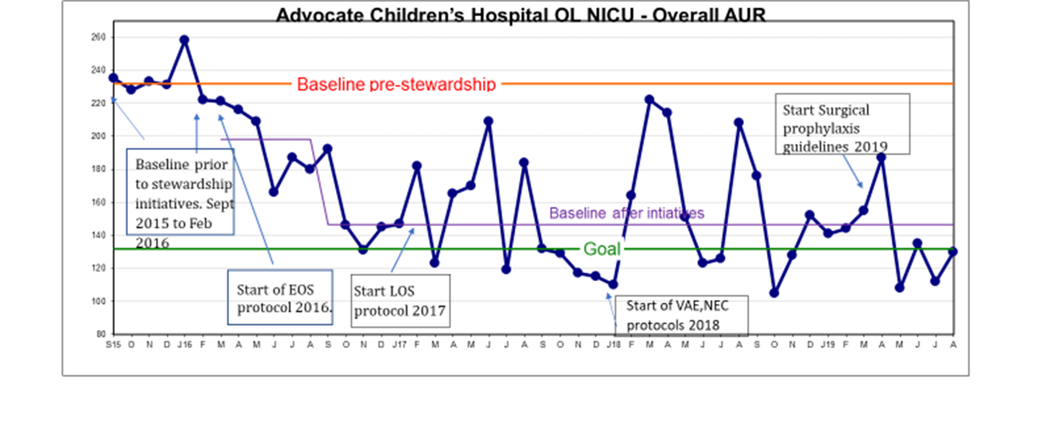
AAH Children’s Hospital Antibiotic Stewardship History

Slide 55
Early Onset Sepsis Pathway
Utilize AAP criteria to determine if appropriate to start antibiotics
Less than 35weeks gestation
Pre-term labor, respiratory instability
35 weeks and greater
Use of sepsis risk calculator
Antibiotic agents and duration
Less than 35 weeks
Ampicillin 50mg/kg/dose q12 hours x 3 doses. Gentamicin 5mg/kg/dose q36 hours x1
Provides 36 hours of coverage
35 weeks and greater
Ampicillin 50mg/kg/dose q8 hours x 4 doses. Gentamicin 5mg/kg/dose q36 hr x1
Provides 36 hours of coverage
Antibiotic time out
Discussion on daily rounds to evaluate clinical status and blood culture results at 36 hours

Slide 56
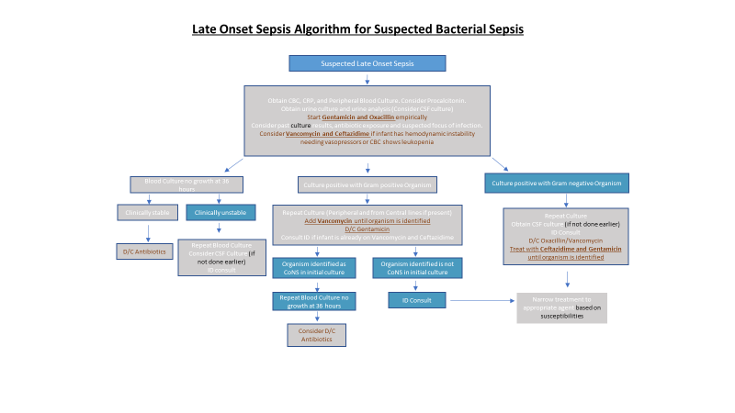

Slide 57
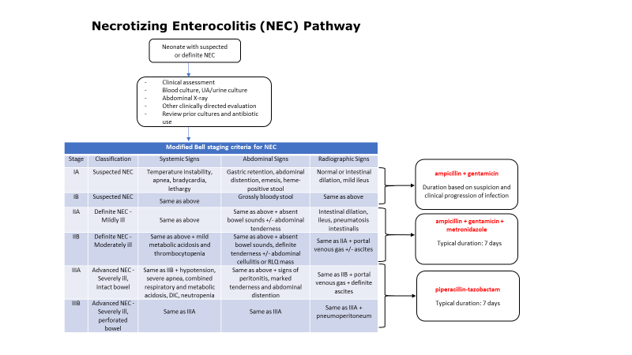

Slide 58
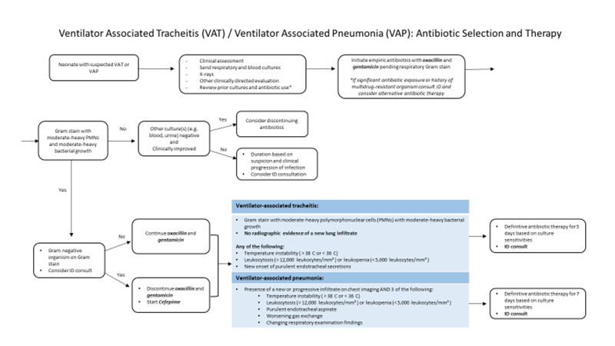

Slide 59
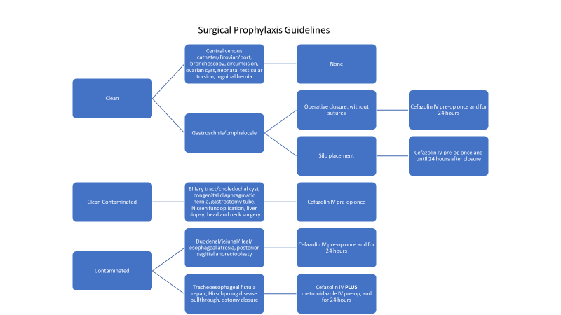

Slide 60
How do we turn these Team Talks into a Poster?
OSF St. Francis Medical Center
Share the story of the OSF SFMC Driver Diagram
Take one of the PDSA cycles and share the story
Utilize the data shared through graphs
Advocate Children's Hospital-Oak Lawn
Share project of implementing neonatal sepsis screening in MBU
Take one of the antibioitic stewardship initiatives and share the project details
Share the visuals, share the pathways, and share the data

Slide 61
Wrap-up

Slide 62
Upcoming Call Schedule
Month | Topic
September 19th, 2022 2-3 PM | BASIC
October 27th, 2022 | 10th Annual Conference at the Westin Lombard
November 21st, 2022 2-3 PM | BASIC Monthly Webinar
December 19th, 2022 2-3 PM | BASIC Monthly Webinar
What topics would be helpful to get your BASIC Team across the fnish line?

Slide 63
Office Hours
Q & A

Slide 64










Thanks to our Funders
In kind support:

