Slide 1
Thanks to our Funders
CME Provider:
Supporters:
Notes:
Team, let's us this slide for sponsors

Slide 2
Illinois Perinatal Quality Collaborative
OB Face-to-Face Meeting
Wednesday, May 24th, 2023

Slide 3
Disclosures & Joint Accreditation Statement & eeds™ Information
In support of improving patient care, this activity has been planned and implemented by the Illinois Perinatal Quality Collaborative (ILPQC) and SSM Health. SSM Health is jointly accredited by the Accreditation Council for Continuing Medical Education (ACCME), the Accreditation Council for Pharmacy Education (ACPE), and the American Nurses Credentialing Center (ANCC), to provide continuing education for the healthcare team.
As a Jointly Accredited Organization, SSM Health is approved to offer social work continuing education by the Association of Social Work Boards (ASWB) Approved Continuing Education (ACE) program. Organizations, not individual courses, are approved under this program. Regulatory boards are the final authority on courses accepted for continuing education credit.
The speakers and planning team members report no relevant financial relationships.
Dr. Joseph Hageman’s disclosed financial relationship has been mitigated and will have no impact on the content being delivered during this conference.
Joseph Hageman, MD has disclosed a financial relationship with one or more ineligible companies whose primary business is producing, marketing, selling,
re-selling, or distributing healthcare products used by or on patients:
Owlet, Inc - Advisory Committee Member - Relationship Has Not Ended
5.25 education credits available for nurses, physicians, providers,
and social workers. Continuing education credits available for physician, nurse and social work attendees. *NOTE* CE credits must be claimed by no later than Monday, June 26th by 9AM CDT.

Slide 4
Obtain your Continuing Education Hours:
Must stay to the end of the event.
QR codes to be distributed during wrap-up session at 3:45-4:00pm.
Must complete evaluation online to receive your credits.
*NOTE* Credits must be claimed by
June 26, 2023 at 9am
5.25 education credits available for nurses, physicians, providers,
and social workers.
Education credits sponsored by:

Slide 5
Resources also available at ilpqc.org

Slide 6
ILPQC 2023 OB Face-to-Face Agenda
9:00-9:10am | Welcome and Overview of Day Ann Borders, MD, MSc, MPH Executive Director and Obstetric Lead, ILPQC VIP Welcome: Lisa Masinter, MD, MPH MS Deputy Director Office of Women’s Health and Family Services
9:10-9:40am | Working Together in 2023 Ann Borders, MD, MSc, MPH
9:40-10:25am | Louisiana Perinatal Quality Collaborative (LaPQC): Achieving Safe, Equitable, and Dignified Births Veronica Gillispie-Bell, MD, MAS, FACOG Medical Director, Louisiana Perinatal Quality Collaborative and Pregnancy Associated Mortality Review
10:25-10:35am | Break
10:35-11:25am | Hospital Teams Panel: Sharing Approaches that make a Difference Laura Smith, BSN, RNC-OB, C-EFM BE: Mercyhealth Javon Bea-Riverside, Rockford, IL Elena Jenkins, RN, BSN BE: SSM Health St. Mary's Hospital, St. Louis, MO Anna Marzano, RN, BSN, CBC, C-EFM and Abbe Kordik, MD, FACOG PVB: University of Chicago Medicine, Chicago IL Danielle Wittig, BSN, RN and Keri Schubert, BSN, RNC-MNN PVB: FHN Memorial Hospital, Freeport, IL
11:25-11:35am | QI Awards Ceremony
11:35-12:15pm | Team Storyboard Session
12:15-12:45pm | Networking Lunch
12:45-1:45pm | Engaging Patient / Community Partners to Optimize Birth Equity Ebony Carter, MD, MPH Washington University School of Medicine St. Louis Integrated Health Network-EleVATE Cheron Phillips and Richelle Smith St. Louis Integrated Health Network- EleVATE
1:45-2:00pm | Transition to Breakout Sessions/Break
2:00- 2:45pm | Breakout Session 1: Small Group Key Topic Discussions on Implementation Strategies Co-facilitated by IL perinatal network administrators, educators, providers and nurses
2:45-3:00pm | Transition/Break
3:00-3:45pm | Breakout Session 2: Small Group Key Topic Discussions on Implementation Strategies Co-facilitated by IL perinatal network administrators, educators, providers, and nurses
3:45-4:00pm | Wrap-up and Next Steps in 2023 Ann Borders, MD, MSc, MPH Executive Director and Obstetric Lead, ILPQC

Slide 7
Breakout Session Topics
Breakout 1: 2:00- 2:45pm
Breakout 2: 3:00-3:45pm
BE:
BE:
BE:
BE/PVB:
Social Determinants of Health Screening and Linkage to Resources
Active implementation of Respectful Care Practices and PREM survey
Moving Patient and Community Engagement forward at your hospital
Stratify your NTSV C/S Data and Actively Address Disparities
PVB:
PVB:
PVB:
MNO-OB:
Checklist and Huddles Strategies that Promote Shared Decision Making
Sharing Provider Data and Using Data to Drive QI
Implementing Fallout Reviews and Sharing Results with Clinical Team Members
New Resources to Address Maternal Overdose Deaths and Sustain Optimal OUD Care

Slide 8
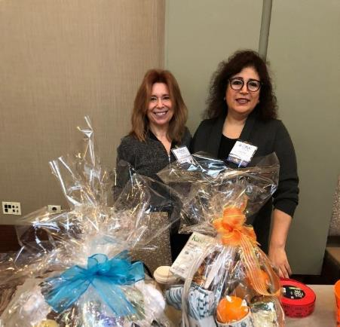
ILPQC 2023 Face-to-Face Raffle
Every attendee received one raffle ticket during registration today.
Raffle will be held at the end of the day during wrap-up session today at 3:45-4:00pm.
3 raffle baskets/chances to win.
Must be present to win.
This Photo by Unknown author is licensed under CC BY-SA.

Slide 9
But wait there's more....
Extra Raffle Ticket Fun!
Visit Teams Storyboards and Complete your Bingo card for another chance to win one of the amazing raffle baskets!
Located in your ILPQC F2F Folder
Opportunity to Get up and Storyboard BinGO ​
Notes:
Opportunity to share raffle baskets here, raffle to be at end of day and must be present to win.
Attendees get (1) raffle ticket when they grab their name badges at beginning of day.
Attendees can get another raffle ticket by participating in Storyboard BinGO.

Slide 10
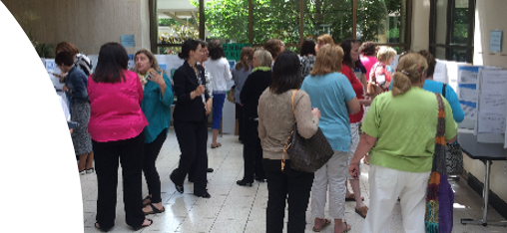
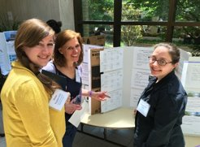
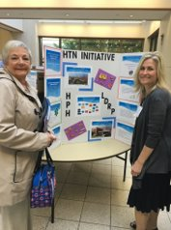
Located in your ILPQC F2F Folder
Notes:
Mention Storyboard Bingo and Steal Shamelessly sheet

Slide 11
Make Sure
To Come & Visit ILPQC's Partner Tables
Open during Storyboard & Lunch Sessions
Located in the Outside of Ballroom

Slide 12
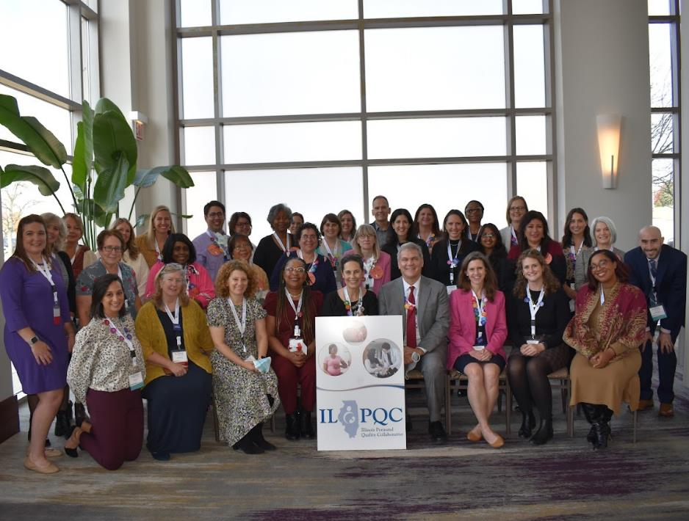
ILPQC
Statewide network of hospital teams, perinatal clinicians, patients, community partners, and public health leaders.
Committed to equitably improving outcomes and reducing disparities for birthing people and newborns in Illinois.
Notes:
Cap off celebrating 10 years of ILPQC and together we have made change happen, together we made a difference
Wrapping up 10 years and transitioning to current year

Slide 13
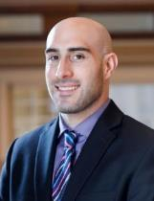
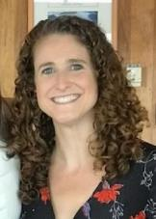
ILPQC Central Team
Ann Borders, MD, MSc, MPH: Executive Director, OB Lead
Leslie Caldarelli, MD : Neonatal Co-Lead
Justin Josephsen, MD: Neonatal Co-Lead
Patricia Lee King, PhD, MSW: State Project Director, Quality Lead
Daniel Weiss, MPH:
Director of Data & Operations
Alana Rivera, MSN,
RNC-OB, C-EFM, CLC:
Nurse Quality Manager
Su Lee, PhD:
Postdoctoral Scholar
Emma Hegemiller, MS:
ILPQC Data System Team
Ellie Suse, MPH, MSN, RN: Project Coordinator
Aleena Surenan, MPH: Project Coordinator

Slide 14
Welcome Address
Lisa Masinter, MD, MPH, MS
Deputy Director Office of Women’s Health and Family Services Illinois Department of Public Health (IDPH)

Slide 15
Working Together in 2023
Ann Borders, MD, MSc, MPH

Slide 16
Welcome Back to Springfield, IL
We are so excited to welcome you back to Springfield, IL for our 1st in-person Face-to-Face Meeting since 2019!
Notes:
Can we make the graphic over Springfield a little bigger?

Slide 17
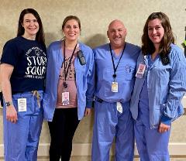
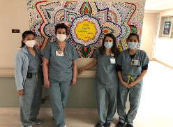
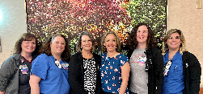
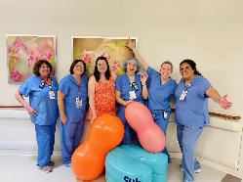
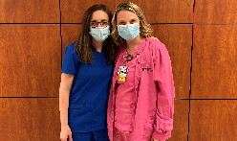
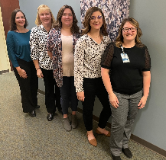
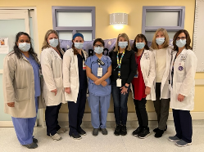
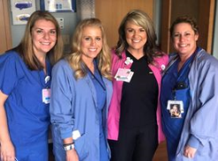
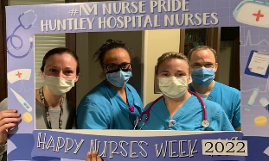
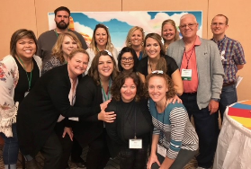
Thank YOU!
ILPQC is a network of hospital teams, perinatal clinicians, patients, community partners, public health leaders and .....YOU!
We are so grateful for your hard work, commitment, dedication and expertise
You have all done such incredible work over the last 3 years
We are so excited to be here together to share this work and learn from one another
Notes:
ILPQC Obstetric Advisory Workgroups
ILPQC Leadership Team
ILPQC Planning Committee & Meeting Volunteers
Perinatal Network Administrators and Educators
ILPQC Speakers, Experts, and Clinical Leads
ILPQC Community Advisory Boards & additional Patient/Family Advisors
ILPQC OB Hospital Teams

Slide 18
Together, WE ARE ILPQC!

Slide 19
Promoting Vaginal Birth
Moving from systems change to culture change to achieve success

Slide 20
2023 PVB Focus
Helping all PVB teams to bring their NTSV C-Section Rates below 23.6%
NTSV C-Section Rate <23.6%
Increasing the % of NTSV C-Sections Meeting ACOG/SMFM Criteria with a focus on Failed Inductions and Second Stage Arrest to >70%
>70% Meeting ACOG/SMFM Criteria
Addressing Disparities
Identifying and addressing disparities in NTSV C-Section rates

Slide 21
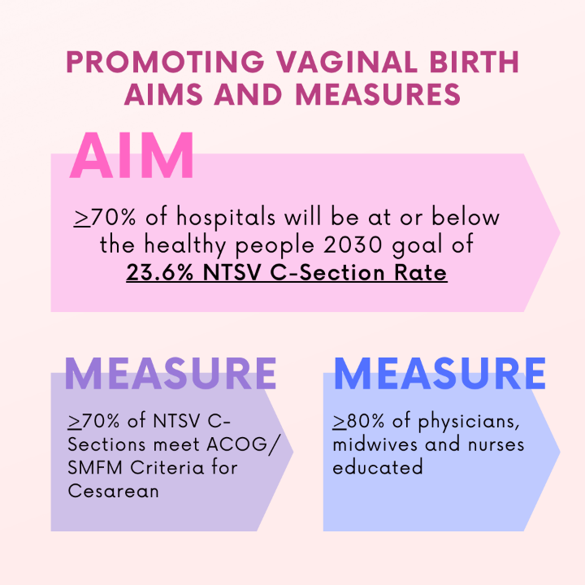
PVB Aims and Measures
Notes:
On ACOG/SMFM critera

Slide 22
PVB Key Strategies for Culture Change
Clinical Team Education and Buy-in
Delivery Decision Huddles and Checklist
Sharing Unblinded Provider-level NTSV C-Section Rates
Educating patients and shared decision making
Fallout Reviews of cases not meeting ACOG/SMFM Criteria
Labor Management Support

Slide 23
PVB Structure Measures 2022 2023
27% 60%
of PVB Teams have all 6 key SM in place
59% 84%
of PVB Teams have at least 4 key SM in place
80% 96%
of PVB Teams have all 6 key SM in place or working on it

Slide 24
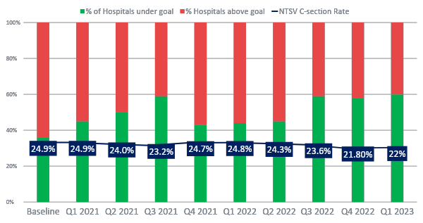
NTSV C-Section Rate PVB Hospitals baseline to Q1 2023
59% of ILPQC Hospitals achieving NTSV C-Section Rate goal of < 23.6%
Goal: 70% of hospitals achieving NTSV C-Section Rate Goal
Baseline: 35%
Notes:
Can we fix the 59% on the next slide or 60% on this slide and make them consistent?

Slide 25
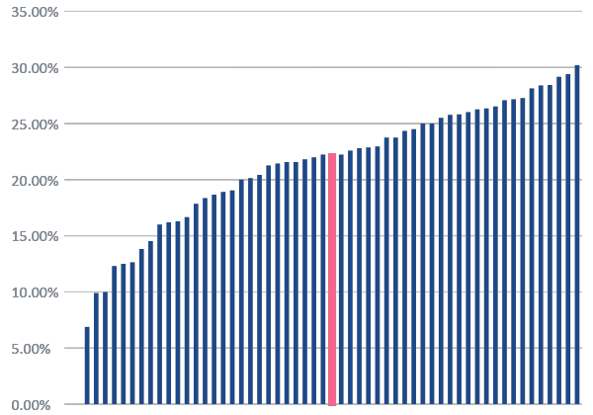
NTSV C-Section Rate by Hospital: Aim >70% hospitals at goal
Q1 2023
35%
Baseline
Goal: < 23.6%
59%
Hospitals are now achieving their NTSV CS goal
All ILPQC Rate: 22.2%
70%
If 7 more hospitals achieve goal
Notes:
If 7 more hospitals achieve <23.6%, we will achieve 70% of Illinois hospitals at goal FIX THE 35% ARROW

Slide 26
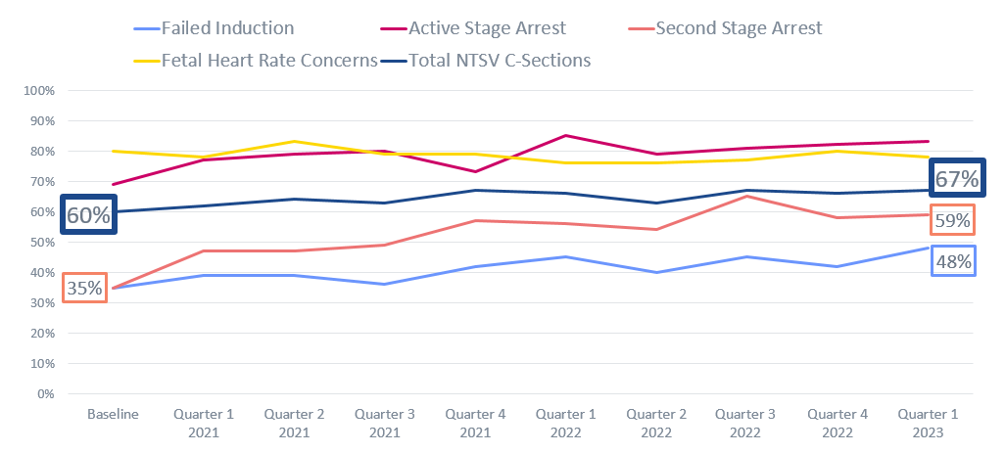
NTSV C-Sections Meeting ACOG/SMFM Criteria
Goal: > 70%
2023 Focus Improving % Second Stage Arrest
&
Failed Induction
meeting criteria

Slide 27
Improving % NTSV C-Sections Meeting ACOG/SMFM criteria Requires Culture Change
Empower shared decision-making and practice patience to achieve goals
ACOG/SMFM Criteria for Failed Induction (<6cm):
ACOG/SMFM Criteria for Second Stage Arrest (10cm):
Allow at least 12-18 hours after membrane rupture with oxytocin provided
Allow at least 24 hours of latent phase (from start of induction)
At least 3 hours* of pushing in nulliparous patients
*Longer durations (e.g. 4 hours with epidural) may be appropriate on an individualized basis

Slide 28
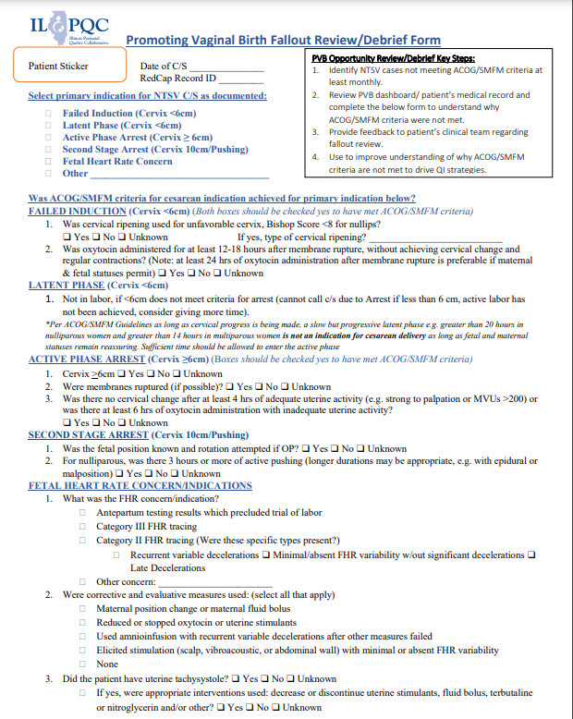
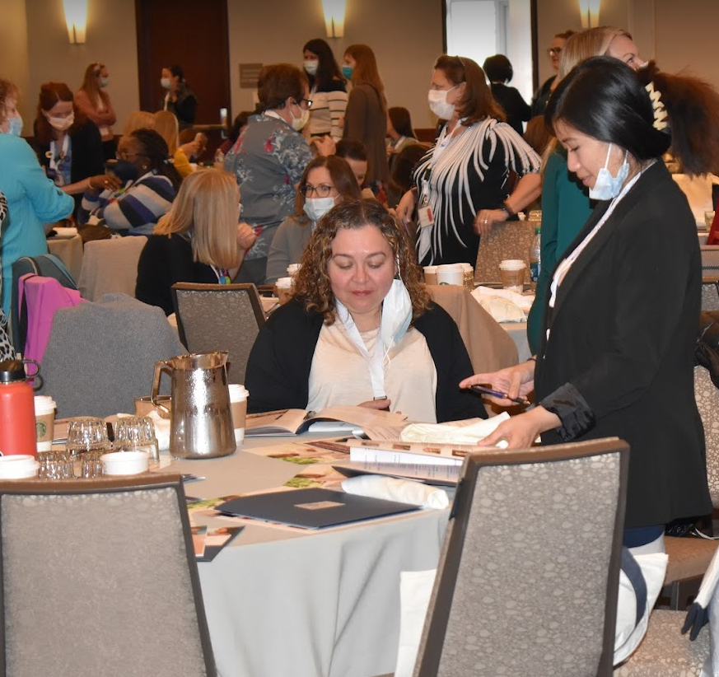
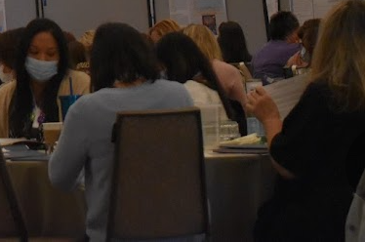
Key ILPQC Resource for Fallout Review NTSV C-Section Cases Not Meeting ACOG/SMFM Criteria
Understand which ACOG/SMFM guidelines not met
Provide feedback to clinical team
Identify patterns and areas to work on

Slide 29
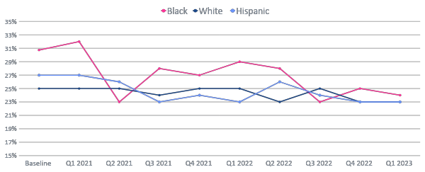
Addressing disparities: NTSV C-Section Rate by Race and Ethnicity
24%
Goal: <23.6%
23%

Slide 30
Addressing disparities: NTSV C-Section Rate by Race and Ethnicity
Goal: <23.6%

Slide 31
Steps to Address NTSV C-Section Disparities
Available in folder

Slide 32
PVB AWARD CRITERIA
QI Excellence Award:
All data submitted
6 key structure measures in place
Achieved all 3 process and outcome measures
≥ 80% of Providers and Nurses educated on ACOG/SMFM guidelines
≥ 70% of all NTSV C-Sections meeting ACOG/SMFM guidelines
NTSV C-Section Rate ≤ 23.6%
Your Hospital's Name Here!
Your H
Notes:
QI Excellence Awards signify that you have achieved the initiative aims. Did we change NTSV CS meeting criteria to 70%?

Slide 33
Birth Equity Initiative
Helping teams continue to move this important work forward together

Slide 34
Birth Equity Initiative Aim
Birth Equity Key Strategies
Screen all patients for social determinants of health and link to needed services​
Standardize postpartum safety education and schedule early postpartum visit​
Optimize race and ethnicity data collection and review stratified data ​
By December 2023, ≥ 70% of participating hospitals will have implemented all key strategies
Engage patients and community members for quality improvement input ​
Implicit bias & respectful care training for providers, nurses, other staff​
Share respectful care practices and survey patients on their care experience​

Slide 35
2023 Focus: Bringing Birth Equity to the Bedside
Engage
Clinical teams to work on actionable Respectful Care Practices and increasing % of patients completing PREM survey
Implement
Achievable patient & community engagement strategies for input on QI efforts
Improve
SDOH screening and process flow to link patients with positive screens to community resources & services

Slide 36
4%→29%
17%→79%
7%→76%
Accurate Self-Reported Race & Ethnicity Data Collection
Engage Patients & Community in QI Work
SDoH Screening (L&D)
9%→65%
6%→66%
PREM Survey Implementation
Review Maternal Health Quality Data Stratified by Race, Ethnicity & Insurance
9%→71%
54%→92%
Share Respectful Care Strategies with Healthcare Team & Patients
Postpartum Safety Patient Education

Slide 37
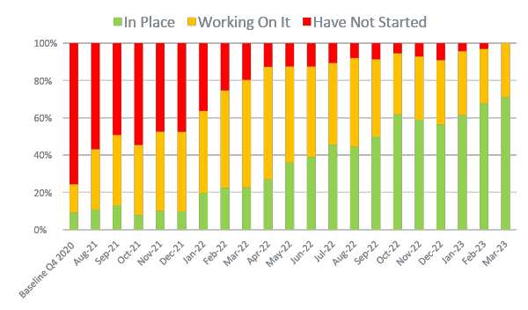
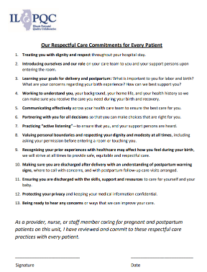
Sharing Respectful Care Strategies with Healthcare Team and Patients
FREE AWHONN Resource for each BE team!
9% --> 71%
Located in your ILPQC F2F Folder!
QI Strategy: Healthcare team sign Respectful Care Commitment & post respectful care posters in patient rooms to share with patients at admission

Slide 38
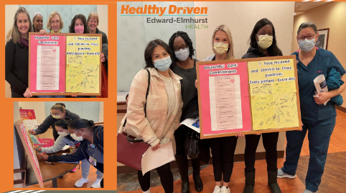
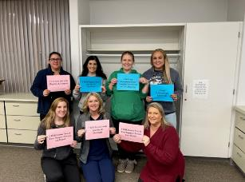
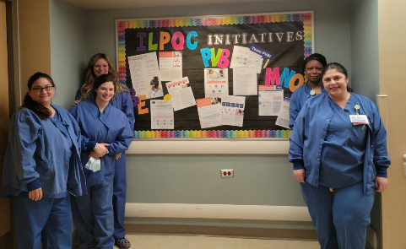
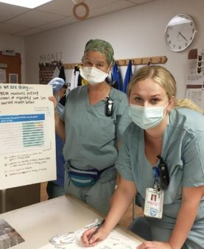
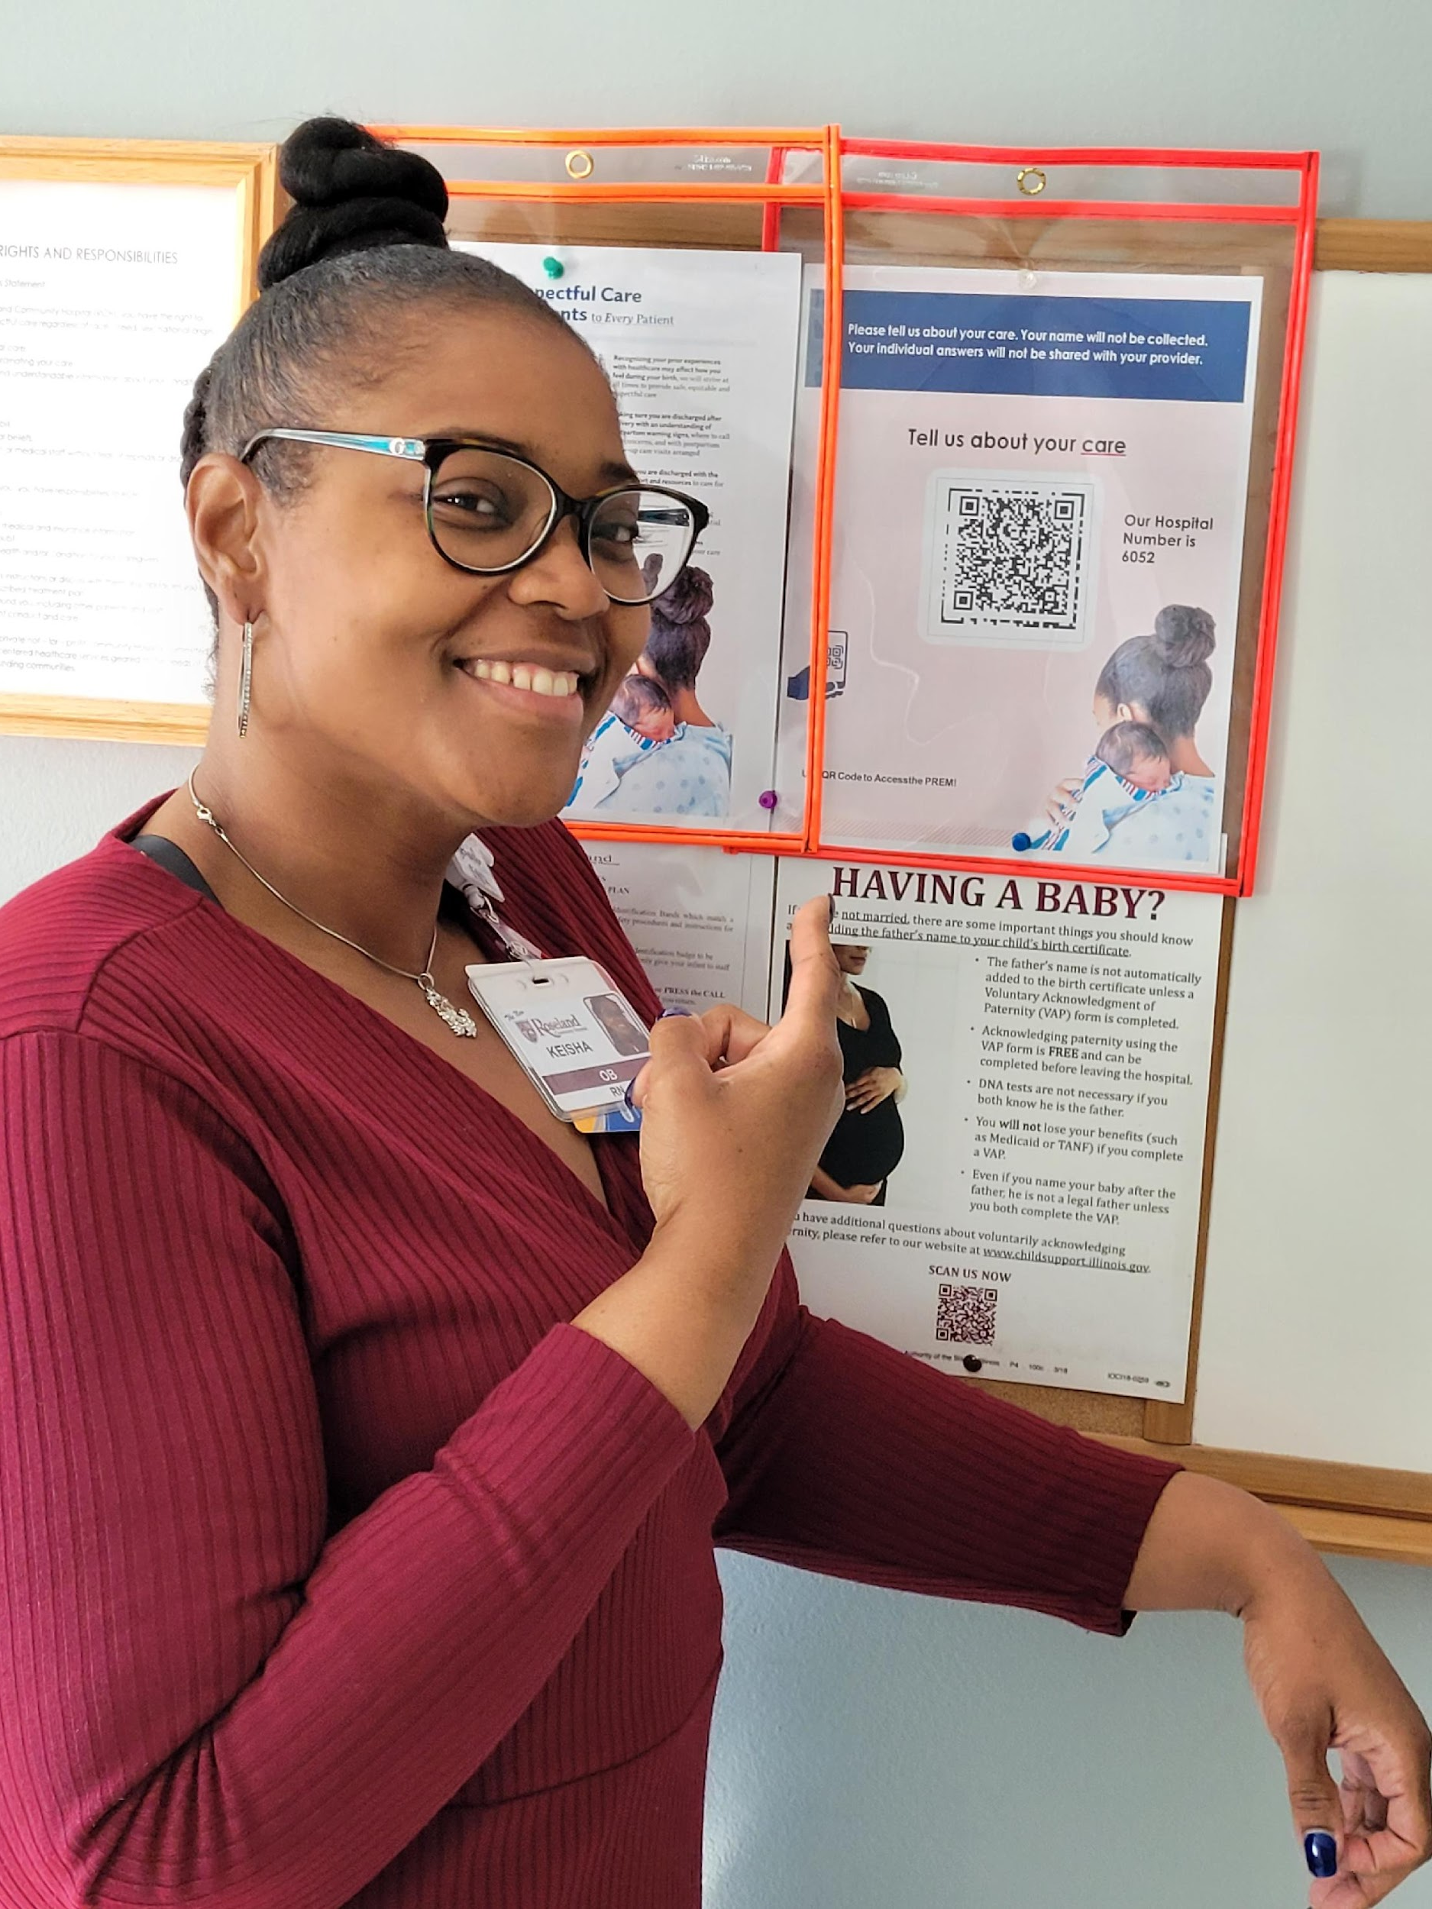
Active Implementation of Respectful Care

Slide 39
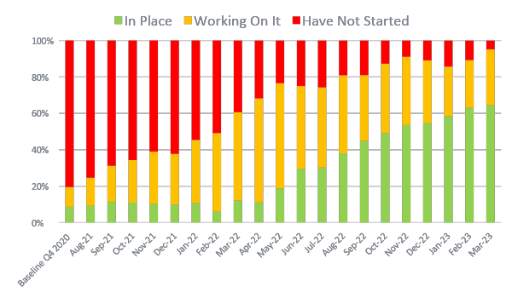
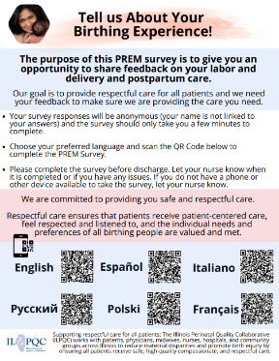
PREM Survey Implementation
9% --> 65%
Located in your ILPQC F2F Folder!
QI Strategy: Working to increase % PREM survey completion

Slide 40
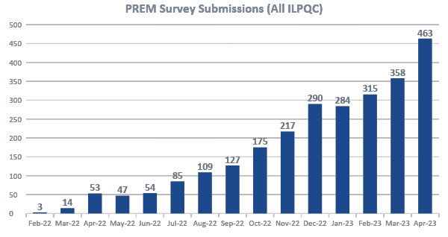
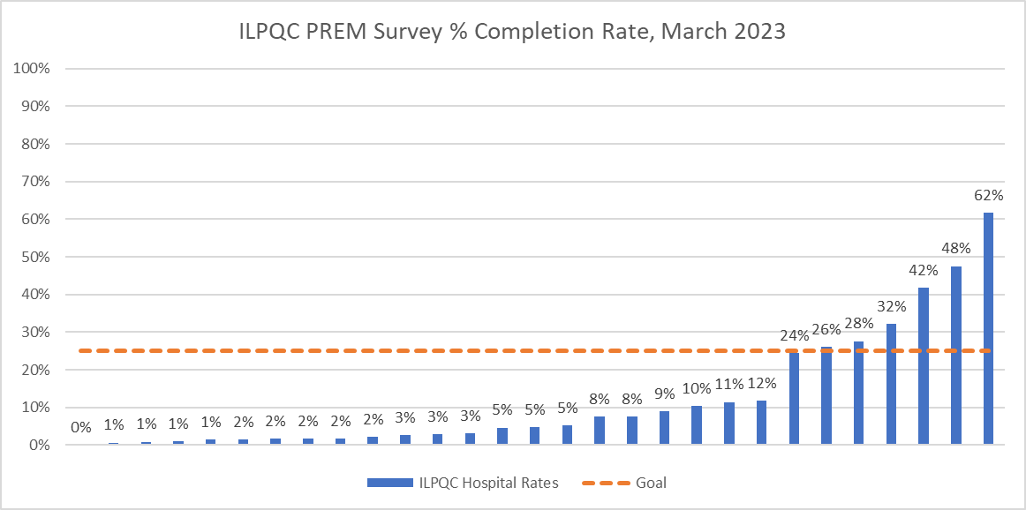
PREM Survey Completion
Total PREM Surveys:
n = 2,594
58 Hospitals have submitted PREM surveys
Notes:
Reformat slide

Slide 41
Improving Respectful Care Requires Shared Decision-Making
15% of BIPOC patients (10% white patients) report feeling pressured into accepting care they did not want
Over 20% of all patients report that when the health care team did not meet their wishes, they did not explain why
Recognizing
Empowering
Patients as the experts of their own experience
Patients to make choices through accessible, nonjudgmental communication

Slide 42
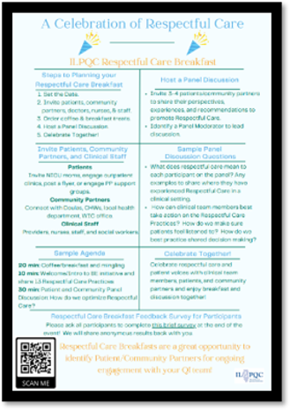
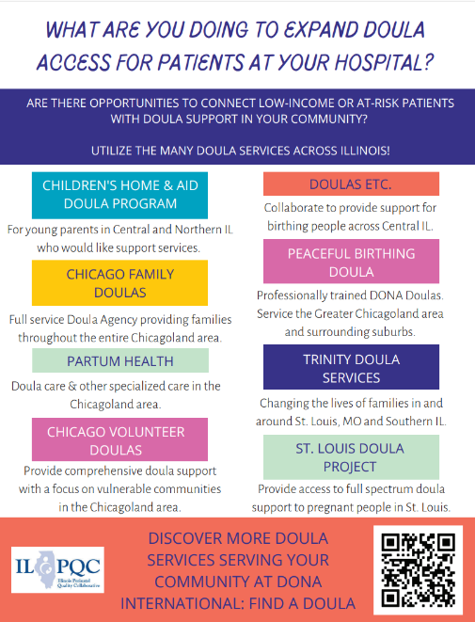
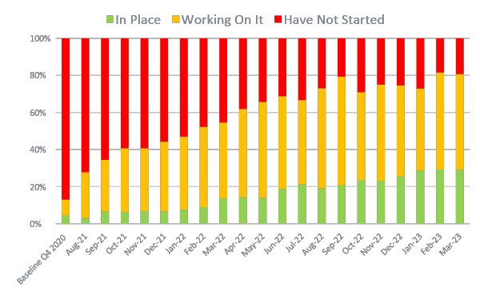
Engage Patients and Community in QI Work
4% --> 29%
QI Strategy: By the end of 2023, every hospital team should host a Respectful Care Breakfast and include a patient partner on your QI team
Located in your ILPQC F2F Folder!

Slide 43
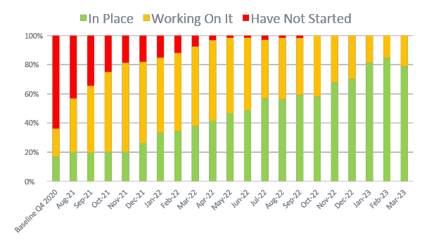
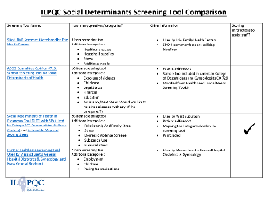
Social Determinants of Health Screening (L&D)
17% --> 79%
Located in your ILPQC F2F Folder & Online Toolkit!
QI Strategy: Improve your process to link SDoH screen-positive patients to community resources

Slide 44
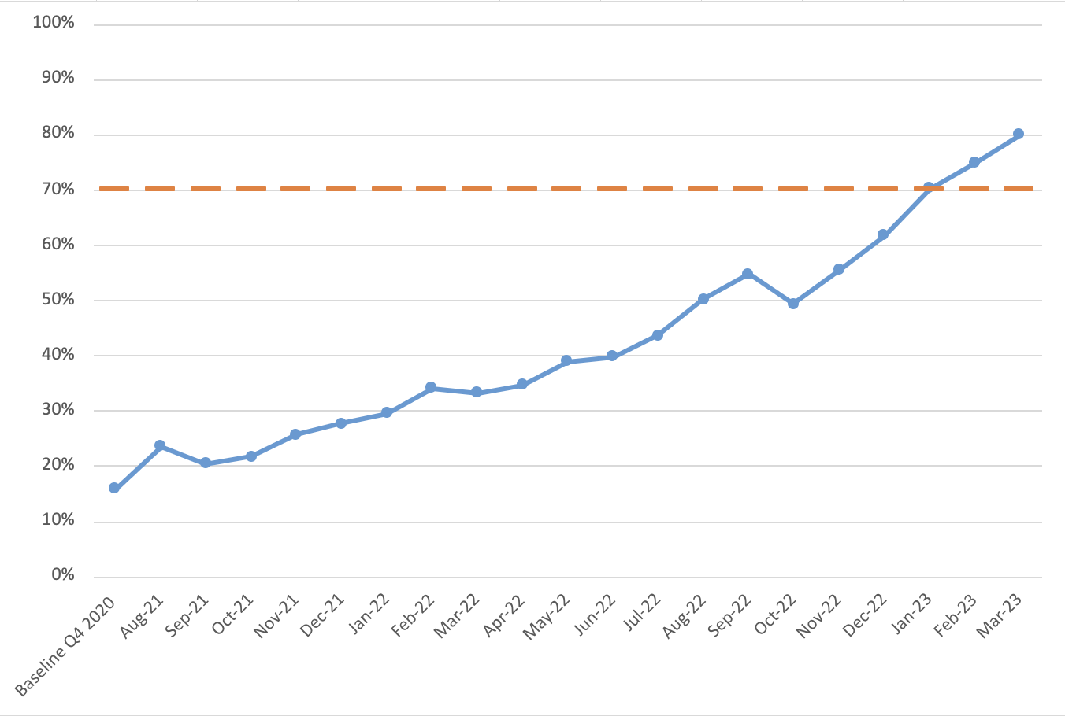
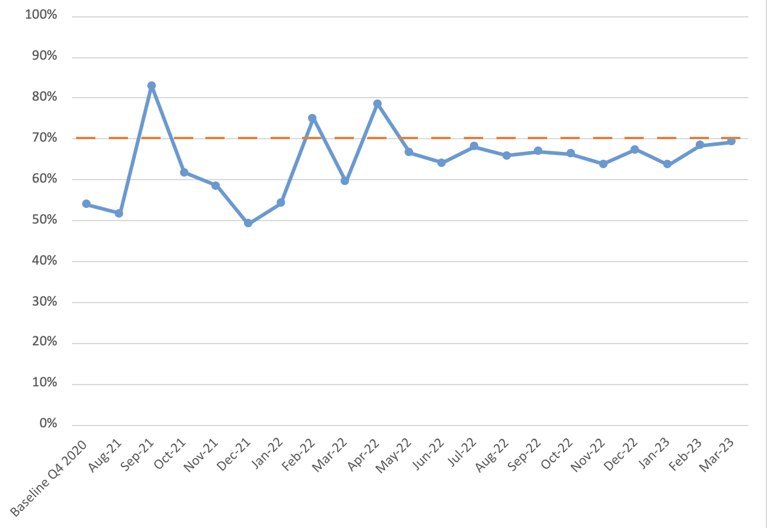
SDOH Screening and Linkage to Resources
Documentation of Linkage to Resources (L&D)
SDoH Screening (L&D)
80%
69%
54%
16%
Notes:
Thin the goal line should be at 70%

Slide 45
Achieving Birth Equity QI Excellence Award Will start awarding for ILPQC Annual Meeting 11/2/2023
QI Excellence Award:
All data submitted
7 of 7 key strategies In Place (Green)
Achieving ALL goals for the following outcome & process measures:
Provider, Nurse, & Other Staff Bias Education ≥70%
SDoH Delivery Admission Screening Documented ≥70%
SDoH Screen Positive Linkage to Resources Documented ≥70%
PREM Completion Rate at least 25% (goal ≥40%)
Your Hospital's Name Here!
Your H

Slide 46
Mothers and Newborns affected by Opioids (MNO) Sustainability
New resources and strategies to continue our MNO-OB work amidst increasing maternal OUD rates in Illinois

Slide 47
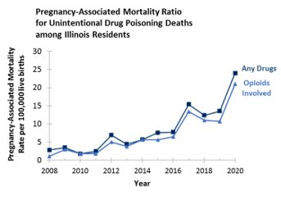
Maternal Deaths Due to Opioids in IL Need our Urgent Attention!
34%
Pregnancy-Associated Mortality Ratio for Unintentional Drug Poisoning Deaths among Illinois Residents
Overdose is the leading cause of pregnancy-related deaths in Illinois*
​
*preliminary data from IDPH, 2018-2019, final data to be released Fall 2023
IDPH Maternal Morbidity and Mortality report on 2016-2017 deaths, 2021; IDPH Death Certificates, 2021
Notes:
All findings in this presentation are preliminary
Currently finalizing 2020 reviews
Working on Illinois Maternal Mortality Report 2023 for 2018-2020 Deaths
Report will be published in the Fall 2023
I think we use a slide about the increase in Overdose deaths showing rapid rise across last few years and include the preliminary 2018-2019 data 34%pregnancy related deaths from overdose because the rest of the info here not important

Slide 48
Saving lives requires providing optimal OUD care for every patient, every time
Screen every pregnant patient with OUD with a validated screening tool
Assess readiness for Medication Assisted Recovery (MAR)
Start MAR and link to recovery treatment services (RTS) (MAR-NOW)
Provide patient education on OUD, NAS, and reduce stigma, promote respectful care across clinical team
Provide naloxone (Narcan) counseling and medication (DOPP)
Warm hand-offs for community-based MAT, RTS, OB follow up

Slide 49
Resources to Share Everywhere...
Located in your ILPQC F2F Folder

Slide 50
MAR NOW is now statewide: a phone call can navigate your patients to OUD treatment​
Individual calls existing 24/7 IL Helpline
833-234-6343
MAR-NOW provides low-barrier, rapid access to buprenorphine, methadone, and naltrexone to all callers regardless of insurance status, income, ability to pay, or documentation status within 48 hours of first call.
Scan here to access flyer
Illinois Perinatal Quality Collaborative
Notes:
It is critical that the IL Opioid Helpline is clearly available to all ED clinical team members as it directly links your patients to MAR NOW.
MAR NOW is now statewide and a phone call can navigate your patients to OUD treatment.
MAR Now provides low-barrier rapid access to Buprenorphine, methadone and naltrexone to all callers regardless of insurance or ability to pay or documentation status within 48 hrs of the first call. Case Managers provide free transportation, insurance enrollment, assistance with pharmacy access and follow up to ensure patient connected to long-term care.
Patients are connected to both a care manager and a provider: they are given the option: Buprenorphine home induction. Same or next day MAR appointment. And Connection to other SUD care in the community, withdrawal management or residential treatment.

Slide 51
Where to initiate MAR treatment via MAR NOW? Everywhere!
Ask patient if they are interested in starting medication, re-starting medication or being connected to services for opioid use disorder
If yes, have a team member give the patient access to a phone and help them call MAR NOW: (833) 234-6343
The MAR (Medication-Assisted Recovery) team will take it from there including starting medication, case management, help with insurance, transportation and follow up
* MAR = Medication Assisted Recovery

Slide 52
Receive free Narcan point-of-care kits to provide to patients
Enroll in the Illinois Drug Overdose Prevention Program (DOPP) (flyer in folder)
Once approved and registered, order no-cost Narcan kits to distribute to patients
Give out a Narcan Kit and SAVE A LIFE TODAY!

Slide 53
OUD Helpline Communication Campaign for OB & ED Units
Magnet for OB & ED Units
Wallet Card for OB & ED Patients
Provider poster for OB & ED Units
Order FREE materials here -->

Slide 55
Thanks to our Funders
CME Provider:
Supporters:
Notes:
Team, let's us this slide for sponsors

