Slide 1
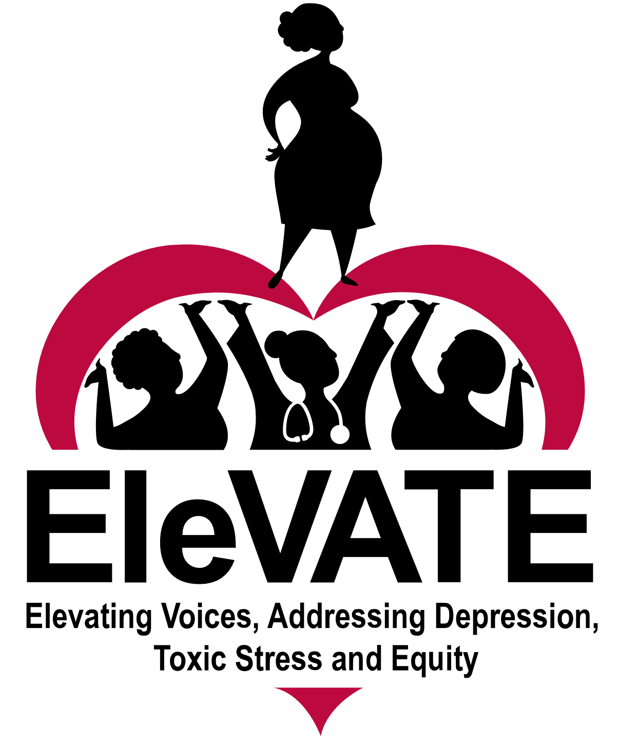
Engaging Patient/Community Partners to Optimize Birth Equity
Cheron Phillips, St. Louis Integrated Health Network
Richelle Smith, St. Louis Integrated Health Network
Ebony Carter, Washington University School of Medicine
On behalf of the
EleVATE Collaborative
Notes:
Presenter: Cheron
My name is Cheron Phillips and I’m a patient turned Partner and Community Collaborator with the EleVATE Collaborative, which stands for Elevating Voices, Addressing Depression, Toxic Stress and Equity. I’m thrilled to tell you about our journey to EleVATE pregnancy and mental health outcomes for Black and Brown birthing people in our community, along with my fellow Community Collaborator, Richelle Smith, and Dr. Ebony Carter who is a high-risk obstetrician with the Collaborative.

Slide 2
Objectives
Discuss patient-centered and community engaged approaches to increase racial equity in reproductive health
Implement evidence-informed practices that enhance the health care team’s clinical skills in providing quality perinatal health and meet emerging health care needs of patients and families
Notes:
Presenter: Cheron
1) Discuss patient-centered and community engaged approaches to increase racial equity in reproductive health
2) Implement evidence-informed practices that enhance the health care team’s clinical skills in providing quality women’s health and meet emerging health care needs of patients and families.

Slide 3












Shared Work Disclosure
Community Collaborators:
Jessica Belton
Joie Cruesoe
Jenella Norman
Cheron Phillips
Teneisha Parks
Richelle Smith
Co-Principal Investigators:
Ebony Carter, MD, MPH
Shannon Lenze, PhD
Washington University Medical Campus
Program Director:
Kelly McKay-Gist, MSW, LCSW
St. Louis Integrated Health Network
Notes:
Presenter: Cheron
I also want to disclose that this is shared work from a dedicated collaborative of organizations and people and we have been entrusted to represent them today in discussing both our successes and challenges.

Slide 4
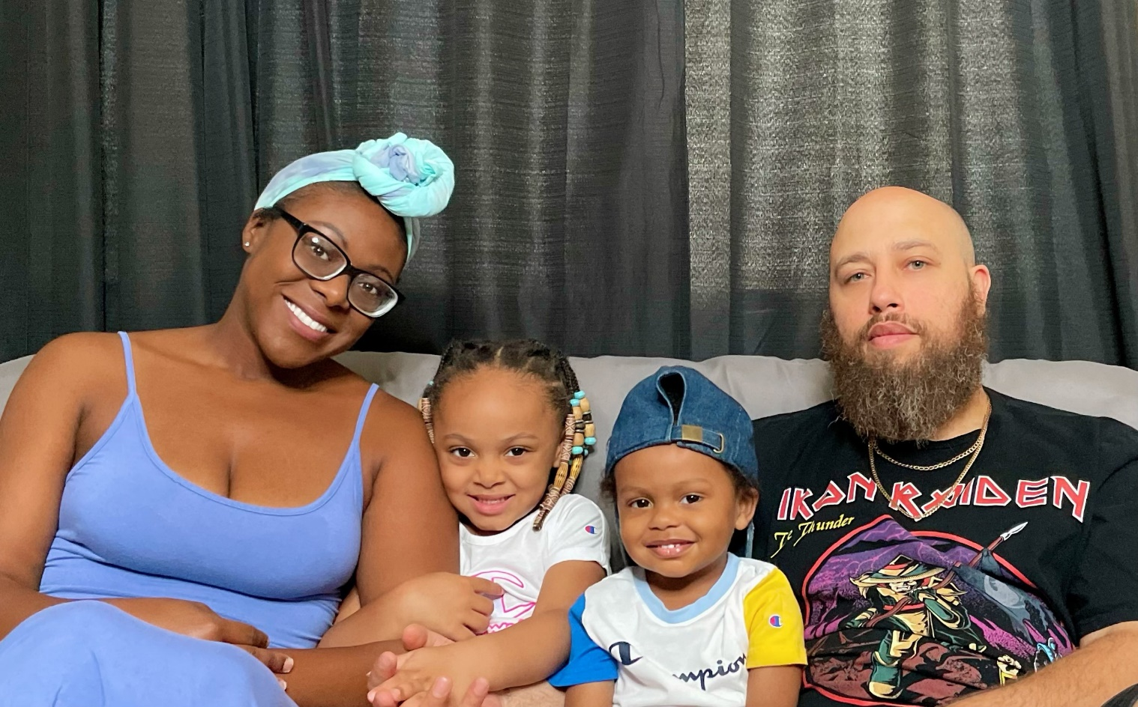

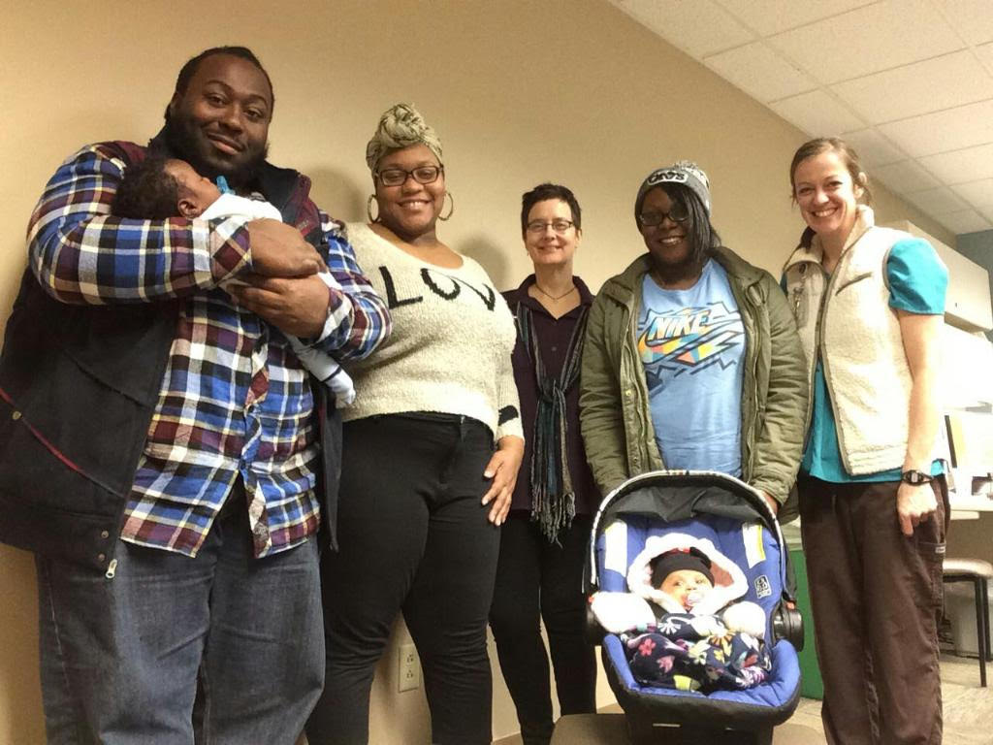
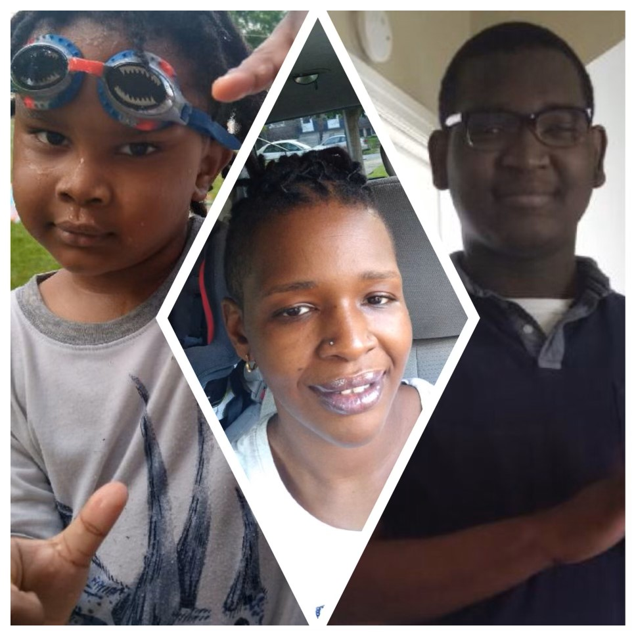
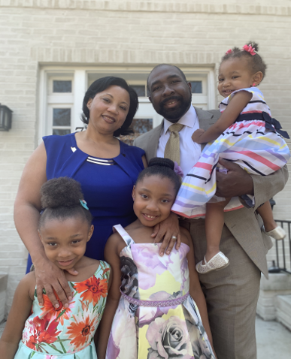
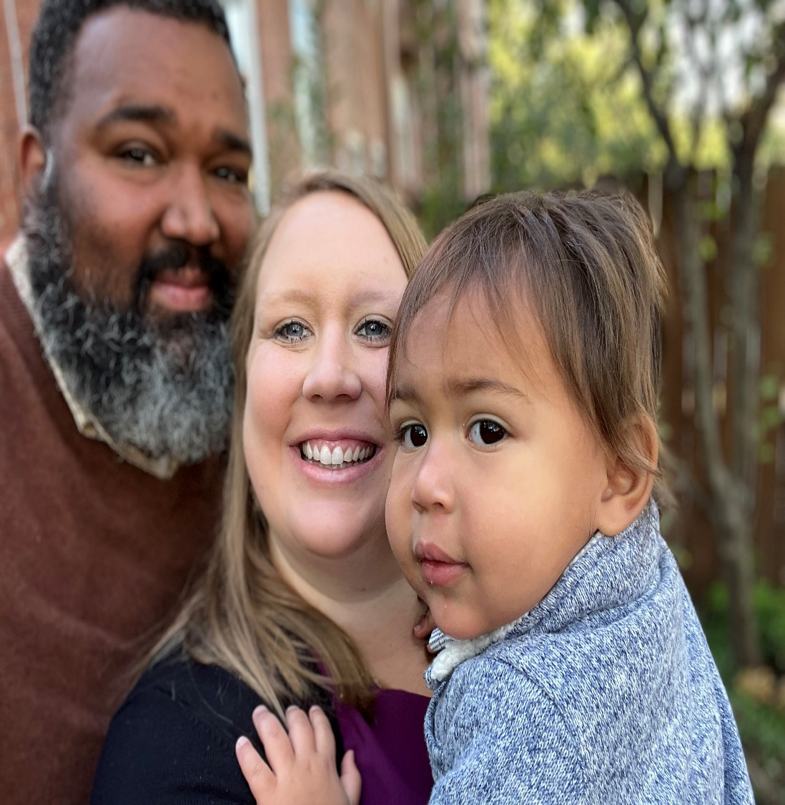
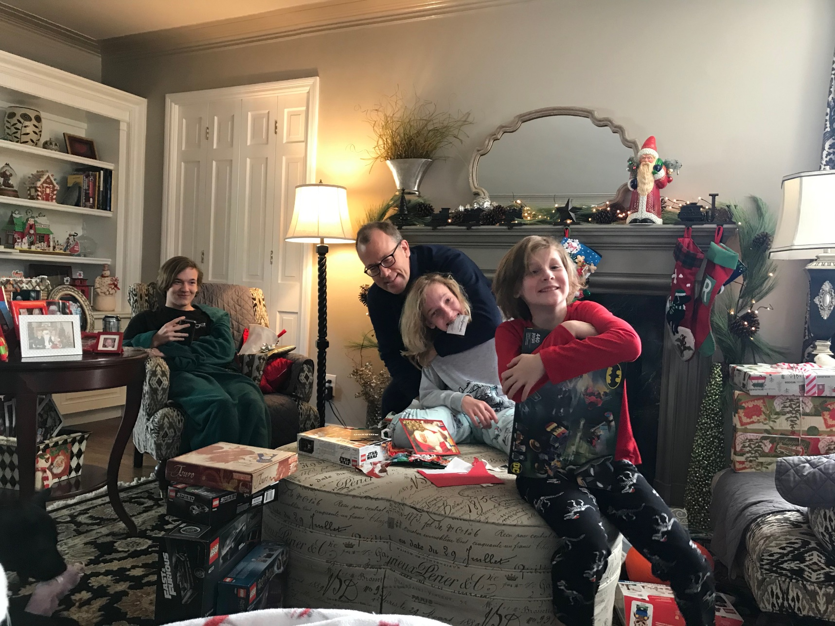
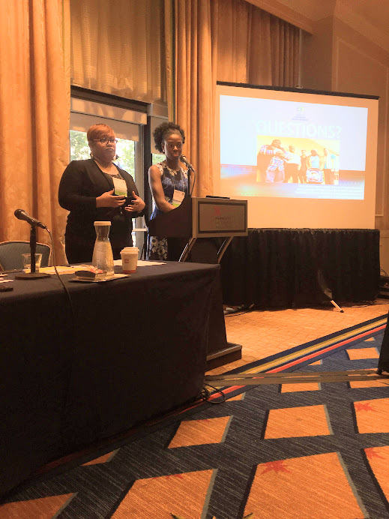
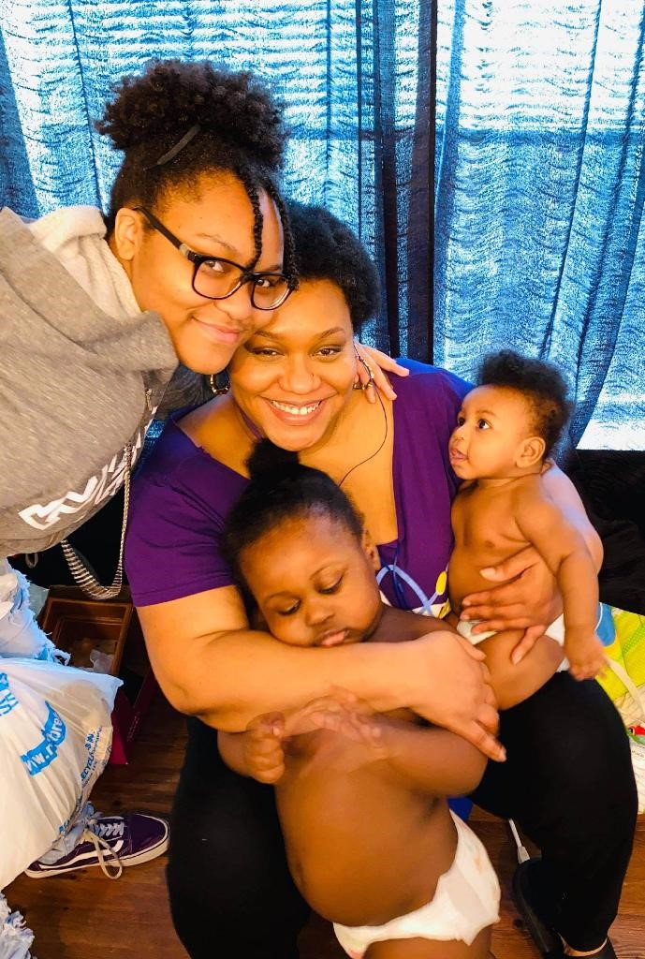
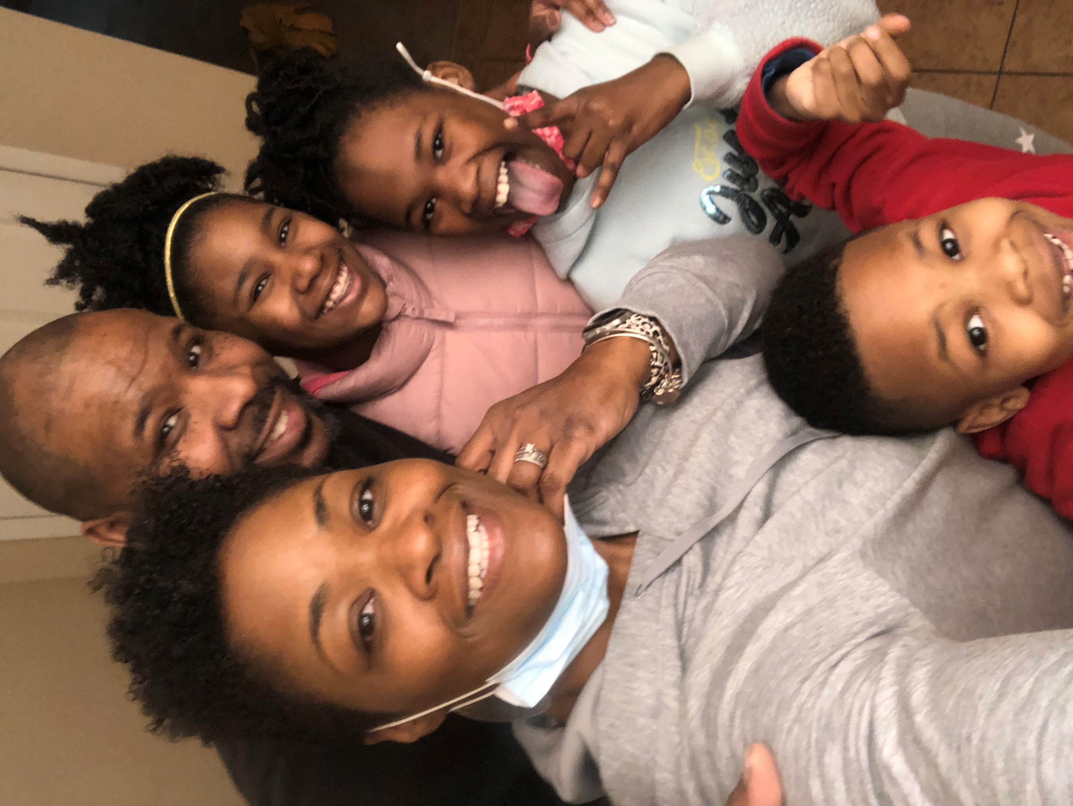
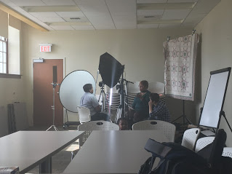
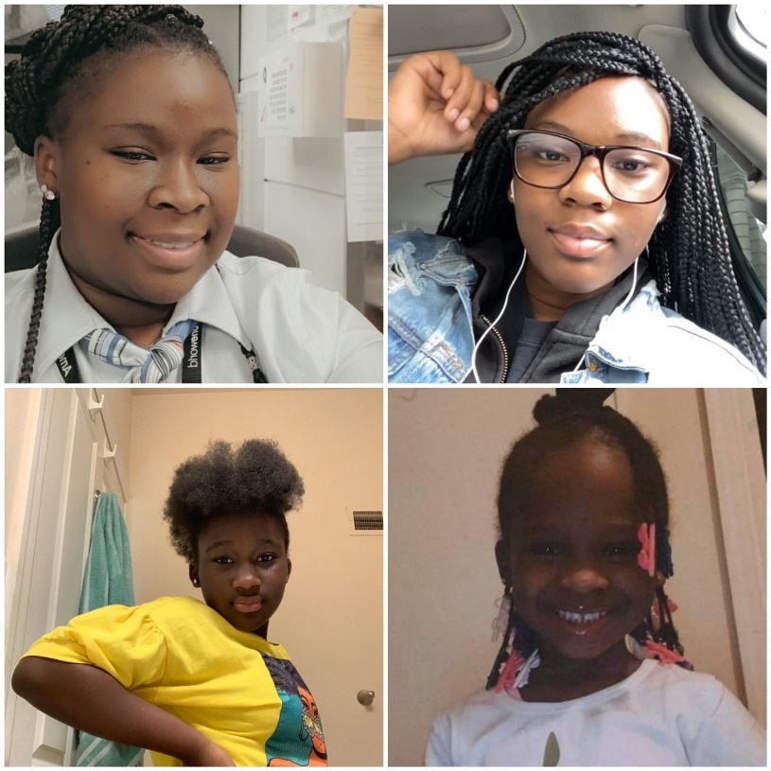
Notes:
Presenter: Cheron
But beyond the organizations we represent, EleVATE is a trans-disciplinary team of former patients--like me and Richelle whom you see here [point to your families/pictures], Obstetricians like Ebony Carter with her family here [point], Midwives, Nurses, Mental Health, and Public Health Professionals. We share with you here some of our faces and families to reflect that EleVATE is comprised of whole humans who each have our own personal journey and can’t only bring our professional-selves to this work.
In our six years of working together, we’ve learned that EleVATE requires real vulnerability from: 1) admitting to how racism and white supremacy impacts our lives, 2) acknowledging that change must come from the health care team/system level and not only the patient to advance positive outcomes, and 3.) working collaboratively with community members. Richelle and I are two of the six community collaborators and I can honestly say that we have the most important voice at the table…
Describe community collaborator role and why it’s essential to any initiative and why you got involved
Why is this work so personal to you?
I am going to pass it to Dr. Carter to speak more group prenatal care and maternal health

Slide 5
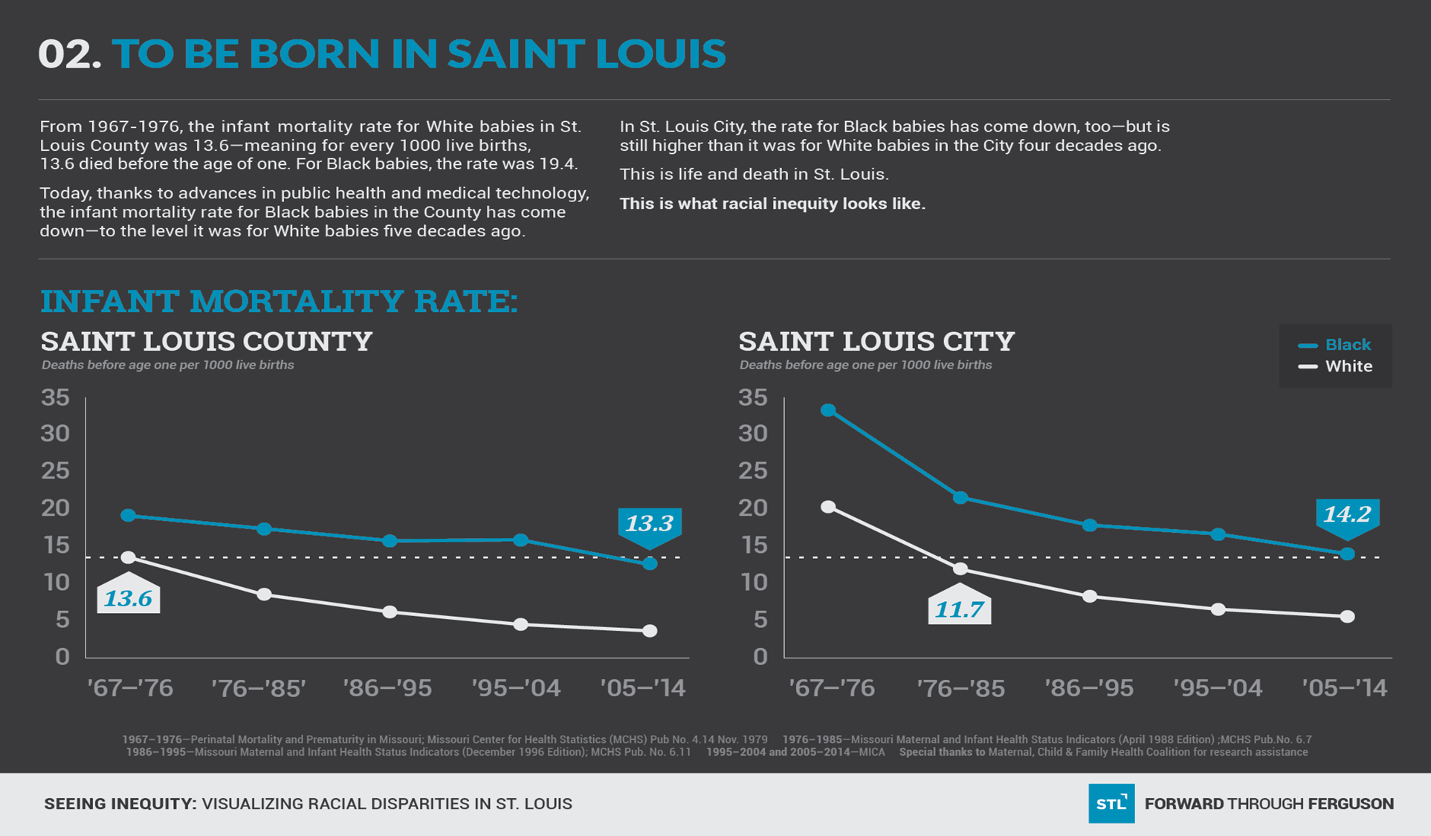
Notes:
Presenter: Ebony
Our collaborative initially came together in 2016 in response to the unacceptably high

Slide 6
Telling the Story of the Work...
Maternal health inequities
  Black women experience pregnancy-associated deaths at a rate 4 times greater
Mental health inequities
  Mental health challenges contributed 27% of pregnancy-associated maternal deaths and 16% of pregnancy-related deaths
  79% of deaths had a mental health condition and history of substance abuse
Infant health inequities
  Black babies are three times more likely to die before their first birthday
Missouri recently expanded Medicaid and Pregnancy-Medicaid for 1 year postpartum
Link to Missouri Pregnancy Associated Mortality Review
Notes:
Presenter: Ebony
We are from Missouri and for those who do not know much about Missouri, we’re struggling–we struggle to provide equitable care for birthing people and babies and we see huge disparities with regard to mortality, morbidity and mental health. We have a sense of immediacy to close the gap and foster opportunities for birthing people and babies to thrive. The 2014 death of Michael Brown in Ferguson forced an examination of racial inequities in our region, including the wide gap in access to health care and health outcomes. These disparities across the country are well-known to this audience so I won’t belabor them other than to say they’re all generally worse in Missouri than national averages. Missouri was not a Medicaid expansion state, and despite the voters voting for expansion last August, the state legislature excluded from the 2022 budget, so caring for patients who largely have no access to preventive care or healthcare between pregnancies is a struggle. But drilling down to the patient population served by the EleVATE sites, we found two things that were very striking. 80% of the patients we serve have a mental health diagnosis, and 70% have a history of trauma…and I mention that here because we’re going to come back to it.

Slide 7
Telling the Story of the Work…
Number of preterm deliveries
per 1,000 live births
  St. Louis Group Prenatal Providers convened in Summer 2016:
  Consensus:
    1. Trans-disciplinary and cross institutional collaborative work
    2. Address reproductive health inequities
    3. Patients need to be part of the work
  Consensus building needed:
    1. Role of research
    2. How do we address the root causes and policies impacting reproductive health inequities?
    3. What does accountability to community voice look like?
114
0
76
152+
EleVATE Locations (Blue Circles)
1. BJC Healthcare Barnes-Jewish Hospital/Washington University School of Medicine
2. Affinia Healthcare - North Florissant
3. Affinia Healthcare - Biddle
4. Affinia Healthcare - Lemp
5. Affinia Healthcare - South Broadway
6. University Health Lakewood Medical Center
7. University Health Truman Medical Center
1
2
3
4
6
7
5
Preterm birth (less than 37 weeks) rate by zip code (2001)
Notes:
Presenter: Ebony
Tell the story of how this began and how the group was horrified by the maternal and infant mortality rates for Black birthing people in St. Louis…why group prenatal care? why patients needed to be at the table? How did we end up embracing the evolution and why did equity need to be so integral?
All of EleVATE’s group prenatal care sites are list on the right and the preterm birth rates per 1,000 live births for each zip code. The red zip codes are the zip codes most impacted by preterm births. The dark red is the higher rates of preterm birth and we are currently sitting in a zip code with the highest rate of preterm birth. I also want to state that these are real women who have real stories about their challenges with mental health or preterm births from actually saying out loud that they might be feeling “off” or talking with family/health care teams about how they are feeling or difficulties taking care of themselves or their new babies. These statistics represent real women and honestly their stories are just as important as these statistics. Though there are many risks for maternal mental health and preterm birth –we also have to acknowledge the resilience of these women and how it is important to speak about their resilience as much as it is about the risks.
In a nutshell, EleVATE is one stop shopping for prenatal care. We essentially bundle two evidence based techniques that improve health outcomes—group prenatal care and behavioral health techniques like cognitive behavioral therapy and mindfulness—into a group care intervention that is imbued with trauma informed care and anti-racism principles.
But it was born in the summer of 2016 without a name in the basement of a community health center. We were just a handful of clinicians who provided group prenatal care across the city of St. Louis and we were united by our disgust with the absolutely abhorrent birth outcomes being experienced by the birthing people and babies we cared for. You can see here a map of zip codes in the St. Louis metropolitan area—the blue circles represent the locations of our partner sites mapped to the preterm birth rates that disproportionately impact north St. Louis city and county here, which is also where most Black St. Louisans live.
In those early meetings and conversations, we faced some critical decisions that were pivotal to our work: There was pretty quick consensus that whatever we did needed to promote health equity for the patients we served, but there were a few issues where we needed to build consensus:
An early issue we grappled with was whether this work should include a research component. The debate was heated because of past and present abuses and injustices based on research in our communities, and a history of researchers coming in, taking what they needed, and never returning to give what was learned back to the community or doing anything with it that benefited the community. We ultimately made the decision that we had no choice but to make research an integral part of this work because we were not looking for a “one and done” experience. As academics, we are also accountable to acknowledge the history of coercive practices, mistrust, and harm that research systems have caused, but also how do we try to help heal and document how research could be done in an equitable way. So we were very intentional in : 1) using a lens of trauma informed care community based participatory research that applies the principles of choice, trust, collaboration and empowerment, 2) we actively worked with community members through equitable decision making, shared goals and values, and 3) we tried to leave our egos at the door and humble ourselves to radically listen to the people around us.
So in those heated early arguments about research, we came to the realization that, if we were going to create an intervention that truly changed outcomes for birthing people in our community, we wanted to make sure that we kept track of what worked, what didn’t work, and how we did it. We wanted to make sure that we were in the position to tell the story so that people coming after us would be able to replicate the model. In addition, we especially wanted to tell the story of how research could impact communities, Black birthing women, advance racial equity and be implemented in an equitable way.
The 2nd issue that we wanted to figure out was where there was synergy between what was needed in our communities and where we had the ability and skill-set to affect change. So, I already told you that we were all group prenatal care providers—and group care has been shown to significantly reduce the preterm birth rate among high risk groups like Black women and, like I said earlier, we realized that we all felt the impact of unmet mental health needs on the patients and families we served in a profound way. Mental health care is hard to come by for everyone, but nearly impossible to find if you’re poor, which in and of itself is enough to adversely impact one’s mental health. So, that’s where we started to focus our efforts.
Third, we knew that if patients were going to be central to this work, the balance of power needed a huge shift. Some serious work was needed to figure out how to yield power, listen, and follow patients—or community collaborators as they became known– to co-design this initiative to best meet their needs and the needs of the community. Finally, we needed to understand what accountability looks like. Just listening simply isn’t enough. . .community collaborators having a seat at the table isn’t enough either. The question is how do we follow their lead in implementing the change they want to see at every step in the process. The voice of the community collaborators is the most important voice at the table.
I am going to turn it over to Richelle to discuss more about EleVATE

Slide 8
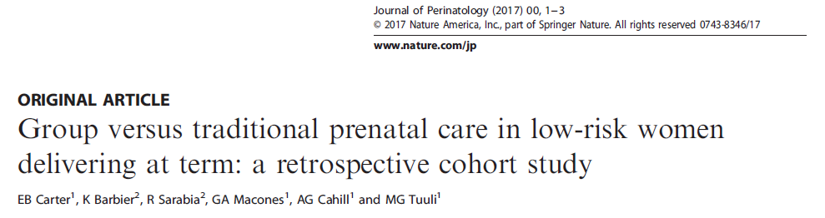
Group Care associated with
  Lower risk of
    Low birthweight < 2500 g
    Cesarean delivery
    Low 5 minute APGAR score (<7)
    Special care nursery
    NICU admission
  No Difference
    Early term birth 37.0-38 6/7 weeks
    Neonatal demise
Notes:
Presenter: Ebony
We didn’t settle on group care by accident and there was compelling evidence that it improved outcomes
BJH program is now 20 years old
Looked at 10 years of data and found…

Slide 9
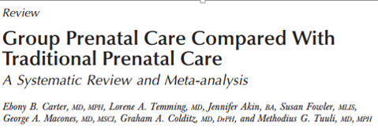
Why Group Prenatal Care?
Conclusion: Available data suggest that women who participate in group care have similar rates of preterm birth, neonatal intensive care unit admission, and breastfeeding.
Notes:
Presenter: Ebony
Our group published the meta-analysis, looking at the sum total of all of the Centering studies.
Conclusion: Available data suggest that women who participate in group care have similar rates of preterm birth, neonatal intensive care unit admission, and breastfeeding.

Slide 10
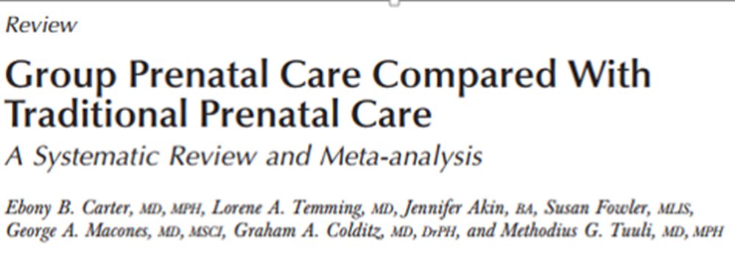
Preterm Birth
Overall:
  8% GC vs. 9% TC
  RR 0.87 (95% CI 0.70-1.09)
Black women
  8% GC vs. 11% TC
  RR 0.55; 95% CI 0.34-0.88
  Black women in Group Care are 45% less likely to have a preterm birth
Notes:
Presenter: Ebony
Our group published this meta-analysis, looking at all of the group prenatal care studies and available data suggest that women who participate in group care have similar rates of preterm birth, neonatal intensive care unit admission, and breastfeeding. But when we disaggregated the data by race, we found that Black women, in particular, participating in group prenatal care were 45% less likely to have a preterm birth than those in traditional care.

Slide 11
EleVATE Overview
Patients: Reduce inequitable adverse perinatal outcomes through group prenatal care (EleVATE Patients)
Health Care Teams: Provide intensive trainings for health care teams and communities to support patients who are experiencing trauma, depression and psychosocial stress as result of racism (EleVATE Clinicians)
Health Care System: Increase shared accountability between communities and health care teams through the development of innovative solutions, policies and new approaches to care delivery (EleVATE Patients and Clinicians)
Notes:
Presenter: Richelle
We focus on three areas to change pregnancy outcomes for patients, health care teams and health care systems. We understand that prenatal care will not erase a lifetime of inequities that show up as toxic stress, trauma and other mental health concerns, but prenatal care can be a strong place of intervention to develop reproductive life plans, gain mental health coping skills to use during pregnancy and postpartum period, provide appropriate postpartum materials to meet patient, health care team and health care system needs.
From a patient perspective, 80% of the patients served by the EleVATE sites have a past of present mental health diagnosis complicating the pregnancy—most commonly depression and/or anxiety, but mental health services are hard to come by, especially when resources are limited. We know that mental health and pregnancy outcomes are inextricably linked, so our patient focus is on reducing inequitable adverse perinatal outcomes by addressing both pregnancy and behavioral health needs.
For healthcare teams, we provide intensive trainings for health care teams to support patients who are experiencing trauma, depression and psychosocial stress as result of racism. We also explicitly address power dynamics between health care team members.
And finally at the health care systems, we work to increase shared accountability between communities and health care teams through the development of innovative solutions, policies and new approaches to care delivery
Community collaborators participated in each of the teams and committees. Our curriculum team focused writing a group prenatal care curriculum after attending trauma informed care and racial equity trainings. The goal of the curriculum was to create a curriculum that was true of the experience of our Black birthing patients with our community collaborators and trans-disciplinary team members. Our evaluation team focused on telling our story and how we wanted share our impact. Finally, we formed a steering committee to direct the work, design the vision and hold all members of EleVATE accountable to community voice.
Richelle answer: As a community collaborator to EleVATE –I said yes to joining EleVATE and why did you continue to be involved?

Slide 12
https://www.youtube.com/watch?v=IA47DLsdDoM
Notes:
Presenter: Richelle

Slide 13
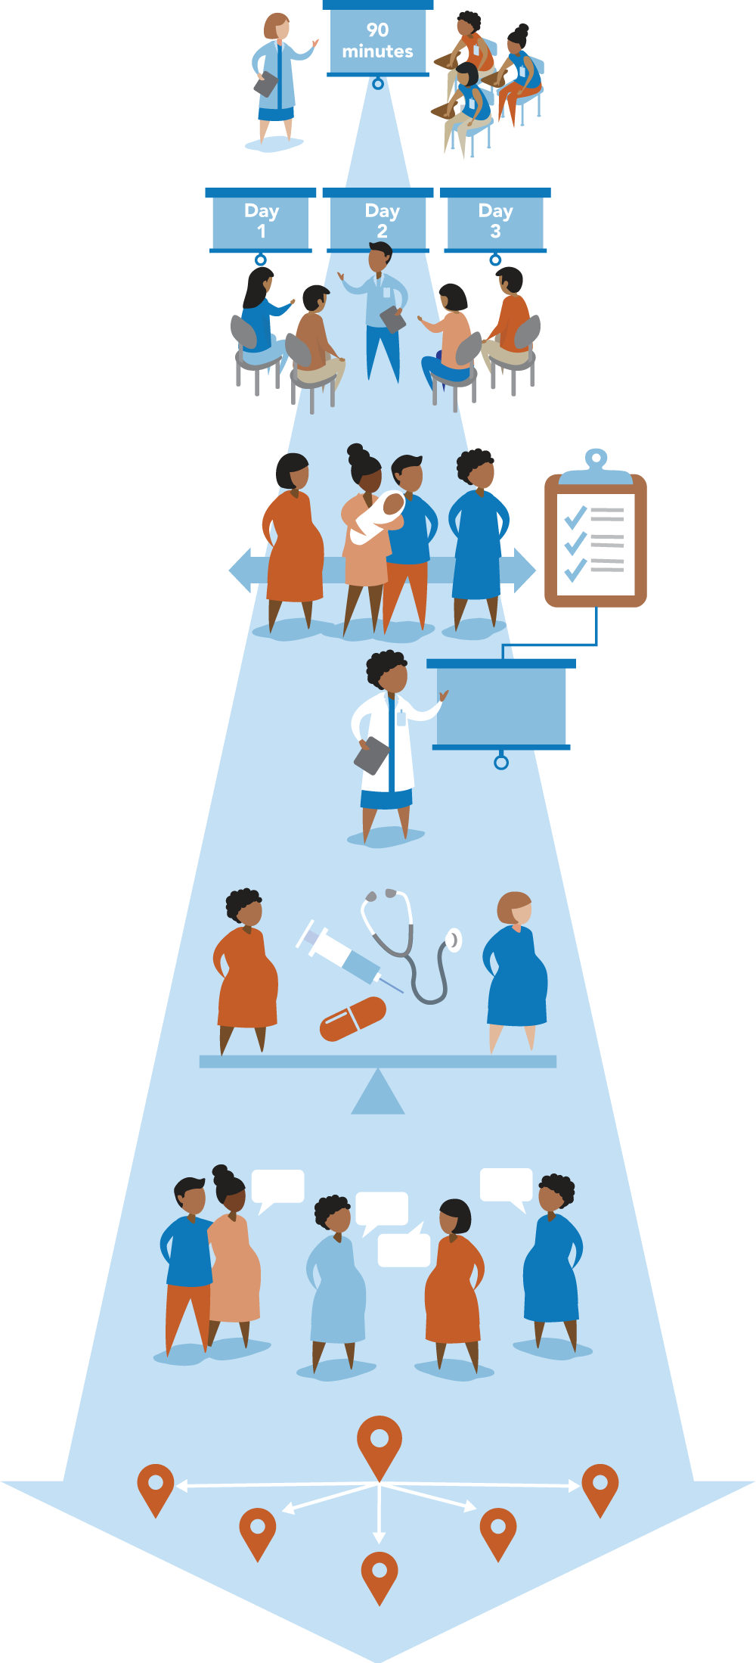
EleVATE Overview
Curriculum Team: Formed an interdisciplinary curriculum team to write the group prenatal care curriculum
Evaluation Team: Formed an interdisciplinary evaluation team to establish evaluation methods and assessment
Steering Committee: A steering committee designed trainings for health care teams, focuses on the overall initiative strategy and initiative oversight
Notes:
Presenter: Richelle
So early on in the EleVATE journey, we divided into 3 teams:
Our curriculum team focused writing a group prenatal care curriculum with trauma informed care and racial equity as core values. The goal was to create “one-stop shopping” where patients could have both their prenatal care and mental health needs addressed in a safe, group space through a curriculum that reflected the lived experience of Black birthing people. I was on the curriculum committee and … Describe what was it like to write a curriculum with clinicians, community members, mental health professionals?
Our evaluation team focused on telling our story and how we wanted share our impact. We reviewed surveys, qualitative questions patients were going to be ask, discussed the history/harm of research and its impact on patients and health care teams. I was also on the Evaluation team and. . .Describe what it was it like to be part of the evaluation team?
Finally, we formed a steering committee to direct the work, design the vision and hold all members of EleVATE accountable to community voice.
I am going to talk more about EleVATE’s impact on patients

Slide 14
EleVATE Implementation
Trained health care providers and community collaborators on integrating trauma informed care & racial equity and integrating behavioral & medical health
Using community-based participatory research, piloted an enhanced model of group prenatal care
Community collaborators led curriculum re-write, establishing of evaluation methods and assessment, designing trainings for health care teams and overall initiative strategy
Notes:
Presenter: Richelle
Answer question: What was it like to be part of leading the initiative, designing the new curriculum and evaluation plan?
Answer question: What was it like to be in trainings on trauma informed care, anti-racism and behavioral health with health care team members?

Slide 15


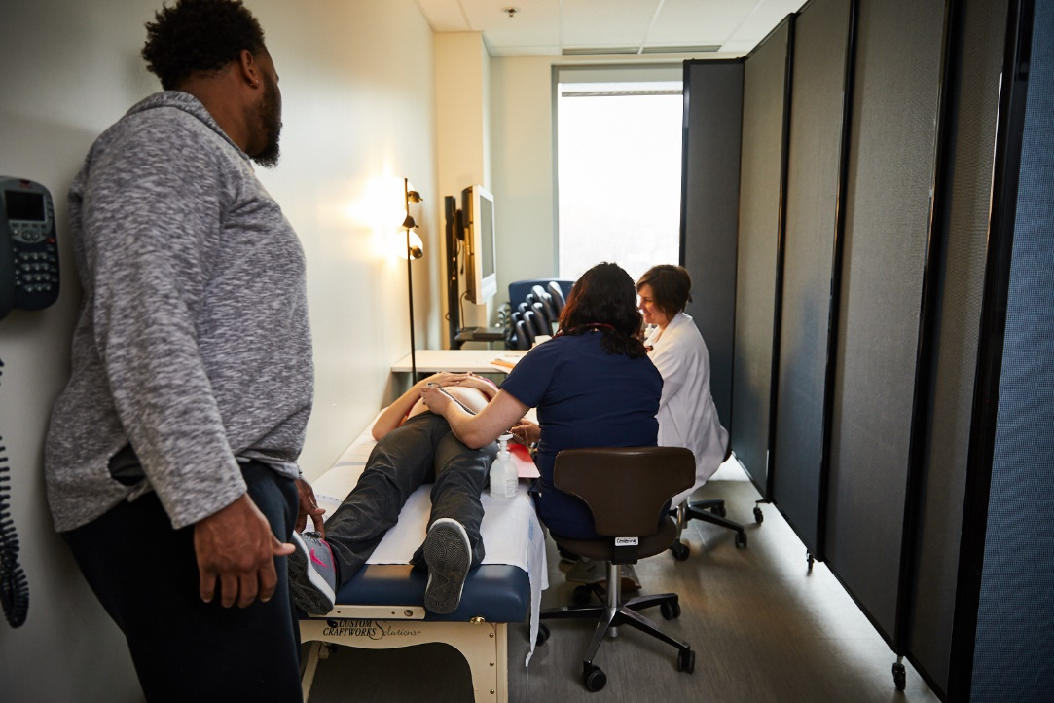
EleVATE Impact on Patients
Notes:
Presenter: Richelle
In our early meetings 6 years ago, one of the things that all of the teams had in common was a group prenatal care program, with some evidence that group prenatal care reduces preterm birth rates. I received group prenatal care for program and, for those of you who might not be familiar, let me describe it for you, here are some pictures of our groups at Barnes and, essentially, 6-12 women receive all of their prenatal care in the group space in a circle, like the one you see here. Let me paint a picture of a typical prenatal group for you if you were a pregnant patient or her support person. There is no wait time. You check-in for the appointment, go directly to the group space, weigh yourself, and check your own blood pressure, and have a brief meeting with the midwife or obstetrician to discuss issues specific to your pregnancy. While the individual assessments are happening [which you see here], other members of the group enjoy healthy snacks and engage in activities, like making relaxation rice socks you can heat in the microwave or drawing a social support map for about 30 minutes. The remaining 90 minutes are devoted to fun, interactive activities using adult learning principles with time devoted to pregnancy topics, including many that we don’t have enough time to cover in traditional prenatal care, like intimate partner violence, comfort measures in labor, or how do you take care of a baby.
I decided to join group prenatal care because. . .
So we developed a 10 session, 2 hour, every other week program called EleVATE that is one stop-shopping prenatal and behavioral health care rolled into one. Like Cheron said earlier, we were all already proving group prenatal care and we were already utilizing a lot of behavioral health techniques like yoga and mindfulness for labor management. So it wasn’t a stretch to embed evidence-based behavioral health techniques, like mindfulness and cognitive behavioral therapy, into our group prenatal care program. Here’s a picture of us trying to do yoga. But there weren’t enough mental health providers to address this need so we essentially made Obstetric clinicians—like OB’s, family practice docs, and midwives, mental health extenders. We trained them in how to do group activities grounded in cognitive behavioral therapy and mindfulness, and then created a robust referral network so that patients who required more care than could be provided in the group setting could still get their needs met. All of our EleVATE Clinicians facilitating these groups received Anti-Racism, Behavioral Health, Group Care, and Trauma Informed Care training. But could we actually pull this off?

Slide 16
EleVATE Pilot: 2016-2019
St. Louis Group Prenatal Care Community
Traditional Care
Consent
EleVATE Group Prenatal Care and Standard Group Prenatal Care
Neonatal outcomes
Maternal outcomes
Future follow-up
Affinia Healthcare
Barnes-Jewish Hospital
St. Mary’s Hospital
Notes:
Presenter: Richelle
This diagram shows the flow of the pilot study. The pilot took place at Affinia, which is the largest community health center in the region, and Barnes Jewish Hospital and St. Mary’s Hospital, which are large academic centers in St. Louis
Patients could choose to participate in:
EleVATE group prenatal care
Standard group prenatal care
Standard individual prenatal care
49 patients participated and were screened for depression at their initial prenatal visit, before delivery and 4-12 weeks postpartum. Each institution had a response protocol to help clinicians support patients who screened positive, and we provided trainings on ways to respond and educate patients on depression/anxiety.

Slide 17
While 18% of individual care patients gave birth preterm (< 37 weeks)
No EleVATE patients experienced preterm birth.
Notes:
Presenter: Richelle

Slide 18
13% fewer inductions of labor
10% fewer C-sections
51%
64%
17%
27%
26% more patients breastfeeding at discharge
81%
55%
29% more patients attending their postpartum visit
84%
55%
Notes:
Presenter: Richelle
I am going to turn it over to Ebony to discuss more about our health care team and system level engagement

Slide 19
Programs are short-term intervention that create temporary improvements in the wake of challenges. Policies, on the other hand, are covenants we collectively choose to live by, as articulated in legislation and regulation. They inform our socially accepted mores and ethnics.
-Reverend Starsky Wilson
Former Co-Chair Ferguson Commission
President & CEO Children’s Defense Fund
Notes:
Presenter: Ebony
While we’re excited and believe that EleVATE is a promising intervention, we also recognize that health care and other systems focus on solving inequities through programmatic approaches.
And although these programs can be powerful tools to meet immediate community needs and impact individual lives, Programs alone are ill-equipped to change the underlying, root causes that both create and sustain inequities.

Slide 20
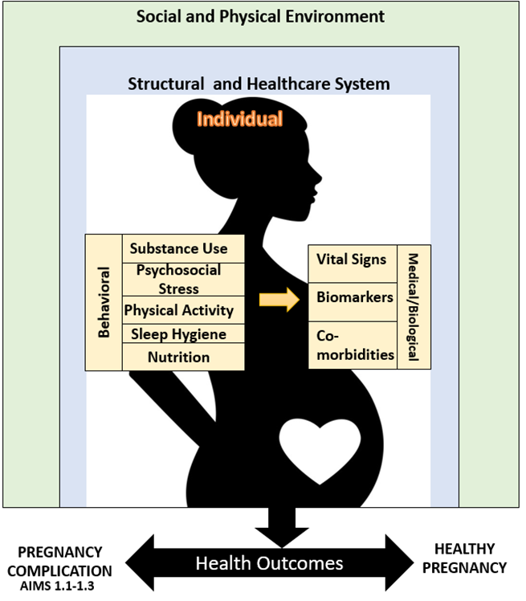
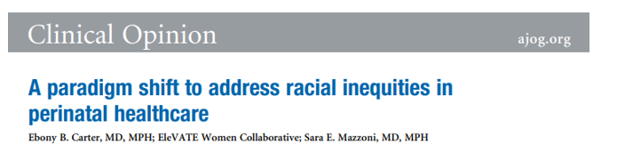
EleVATE Impact on Health Care Teams
Notes:
Presenter: Ebony
As mentioned, before we focus on Health Care Teams: Provide intensive trainings for health care teams and communities to support patients who are experiencing trauma, depression and psychosocial stress as result of racism and address power dynamics between health care team members
There is solid evidence that group prenatal care likely improves outcomes for high risk groups, but why? Many people have focused on the patient and suggest that participation in group care improves patient’s knowledge acquisition, behavior change, social support, and reduces stress and depression. But we think that we need to keep in mind that health equity implementation frameworks uniformly stress the importance of multiple levels of influence including, not just the individual, but the clinician, community, organization, healthcare system, and society levels. So, we would argue that our patient-level approach is probably misguided. What if group care is actually exerting its effect on US-- the clinicians--and the systems in which we work? And what if group care stands out as one of the few evidence-based interventions to improve pregnancy outcomes for Black women because it inadvertently exerts its impact on the clinicians and systems that are supposed to be providing health-promoting prenatal care for the mother and the baby. The EleVATE Collaborative argues this point in this clinical opinion piece published last year in American Journal of Obstetrics and Gynecology.
Let us be clear--Group prenatal care alone will not fundamentally affect systemic change without intentionally developing anti-racist systems, policies, and implementing trauma-informed principles to shift the culture of healthcare and improve patient outcomes.
Our health care team members attended trainings on Introduction to Trauma Informed Care, Introduction to Systemic Racism and Behavioral Health Integration. We know by now that training alone will not change the way care is delivered, but what EleVATE does is teach these skills and then intentionally provide opportunities to apply them in the group prenatal care setting over 7 plus months while facilitating over 9 sessions. They are able to put their new knowledge and skills to practice while doing their job of caring for patients.
Since we are a multi-site and multi-disciplinary team, we recognized very quickly the hierarchy of medicine and the power dynamics that exist between health care team members and also health care teams and our community collaborators. We decided to provide opportunities for health care team members to deeply examine how white supremacy, systemic and institutional racism and the medical model impact care delivery and how health care teams can be complicit. We received many questions especially asking: What does white supremacy and racial equity have to do with working with other health care team members or what does it have to do with providing care to patients?
I can’t sugar coat it –it was hard. Many people were very on board because they had not found a space to learn and reflect about these issues, but also some people decided to take a step back from EleVATE as they found their path. We had to have difficult conversations about listening to community voice, decentering whiteness and understanding how embedded racism was in our health care system. We all took our own journeys to acknowledge the historical and present traumas our patients, co-workers and leadership experience and how racial equity is connected to work we do.

Slide 21


Strategies to shift power
Community Collaboration/Address Power Dynamics
Establish Common Language
Create Opportunities and Space
Notes:
Presenter: Ebony
The 3 visual represent the biggest learnings as our collaborative developed:
We needed to address the bias we held that “We are teaching community members skills” to “Community voice are leaders in this program” and listen intensely to their feedback and act upon it.
Community Collaboration/Address Power Dynamics
We focused on formalizing structures to ensure community participation and ensure information is driven by them and returned to them
Recognize institutional capacity and readiness to share power with community collaborators and how to learn from/awaken health care teams (specifically white individuals) without exploiting the pain of Black and Brown women and birthing people. Assess capacity and readiness of staff, partners, resources and knowledge.
Recognition that expertise comes from experience, and value lived expertise equally to academic or professional experience: Attention needs to be focused on the vulnerability differential between community voice and health care teams when personal experiences are shared. We needed to be aware that it is not only the community sharing personal experiences, but a relationship is built on a dialogue of personal experiences.
Common Language:
Establishing a common language can create a shared connection and the connection can increase as we become on the same page with one another. Level setting supports us in acknowledging the history we do not learn or talk about, creating a common language helped us to put a stake in the ground on what this initiative values.
Create Opportunities and Space:
Further acknowledgment that racial and ethnic groups can feel unsafe in healthcare settings and racial and ethnic groups experience increased trauma from navigating systems that have a history of untrustworthiness and harm.
Our health care teams voiced time and time again that they are not provided the space to process or explore their discomforts in their professions or how they could be perpetuating harm, but they needed to figure out how to do it and appreciated EleVATE catalyzing these opportunities.
Reinforce that our team is going to grow as we need additional expertise and partners want to learn from us and this includes reevaluating who needs to be a part of our team in order to leverage expertise and grow as a collective.

Slide 22
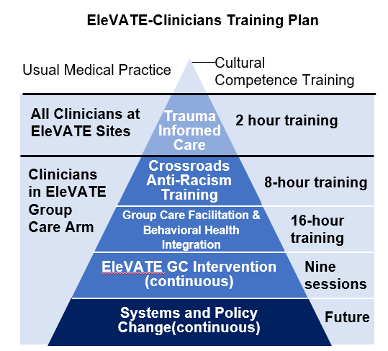
EleVATE Implementation
Introduction Trauma Informed Care Training for all health care team staff
EleVATE 2-day training for EleVATE facilitators and support staff
Annual Training Boosters: Group facilitation, group dynamics and many more topics.
Individual/Group Facilitator Coaching Sessions for EleVATE facilitators with Becky Hassler, CNM
Notes:
Presenter: Ebony

Slide 23
Strategies to shift power
Power sharing and building on community strengths
Healing harm, trust and building capacity across all partners
Center community voice as partners and leaders
Address past and present trauma
Notes:
Presenter: Ebony
We made a commitment to trauma informed participatory research and have really tried to embrace these principals. I don’t proclaim to be an expert or say that we’ve done this perfectly; but we’ve tried. I can honestly say that the EleVATE moms/patient consultants have been my greatest teachers on this journey. I remember a heated debate regarding whether we should ask patients about traumatic experiences. We feared re-traumatizing them in the process and were leaning towards not asking the questions. . .until the Moms checked us. They made the point that not asking about it didn’t mean that it didn’t happen and they wanted to be asked about it to start the process of healing. We also realized that, if you bring trauma to the surface, it is unethical not to have the support mechanisms in place, so we had our work cut out for us, and we needed a framework to help us understand the impact of systems on Black Birthing People.

Slide 24
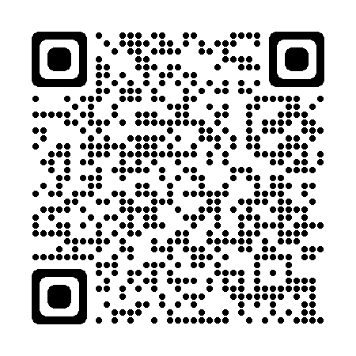
Strategies to shift power
Notes:
Presenter: Ebony
Tell the story of the Ferguson Commission
Tell the story of Forward Through Ferguson
We get asked this question often -how do you implement equitable decision making and ensure every voice is heard. We try our best every time and use these questions to support our collaborative to make decisions. These three essential questions have helped us to understand the impact and consequences of our decisions and how it could or could not benefit Black birthing people.
Who does this recommendation benefit?
How are different racial and ethnic groups affected?
What is missing from this discussion so that racial disparities can be eliminated?
We focused on these questions throughout our intensive trainings and are at the forefront of our agenda’s during meetings and collaborative efforts
Trusting means trusting community members to be the best solvers of the challenges in their communities
This requires being uncomfortable, being vulnerable to share personal stories, not trying to solve all the problems, giving up power so community members have a voice and resources to act. The power of telling personal stories and setting the collective message to believe patients truth (“Just because you didn’t live it, doesn’t mean it doesn’t happen”)
Address the bias and believe community members already have the capacity to make decisions about their community
Focus on positive aspects of community and broaden/highlight the work
Asking means authentically asking for individuals' ideas and listening without judging, criticizing and filtering reality based on your conditioning of what's right and what's wrong.
We hear all the time -we can’t do this because of this policy or we can’t do this because this isn’t our department that is filtering based on our judgements and what rules we follow at our institutions. We need to build capacity for community collaboration at all of our institutions. We would argue that this is the most difficult part of the work is convincing institutions that they need to work on their policies and practices that allow for community collaborations and partnerships.
Acting means being accountable to what you hear.
Acting with community members to implement their own ideas and solutions that they have created, designed, implemented and evaluated.

Slide 25
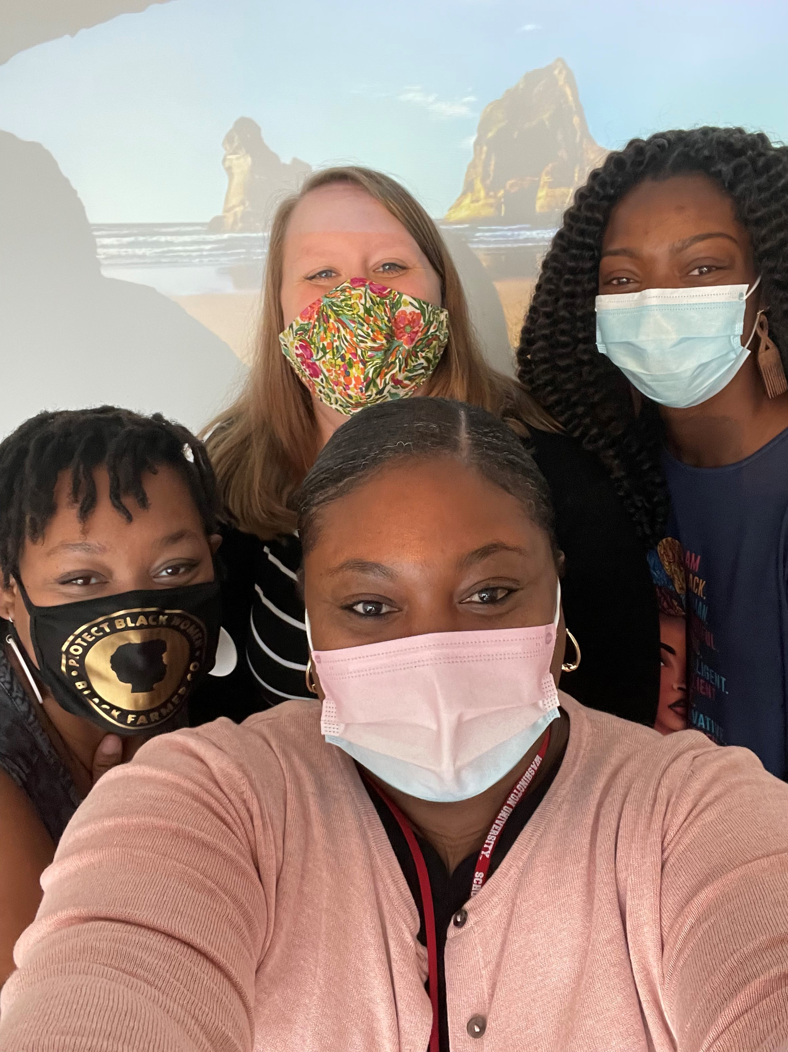
Strategies to shift power
Trusting
Asking
Acting
Link to Ferguson Commission Report
Notes:
Presenter: Ebony
As mentioned before: Equity is a PROCESS and an OUTCOME.
Trusting means trusting community members to be the best solvers of the challenges in their communities
This requires being uncomfortable, being vulnerable to share personal stories, not trying to solve all the problems, giving up power so community members have a voice and resources to act. The power of telling personal stories and setting the collective message to believe patients truth (“Just because you didn’t live it, doesn’t mean it doesn’t happen”)
Address the bias and believe community members already have the capacity to make decisions about their community
Focus on positive aspects of community and broaden/highlight the work
Asking means authentically asking for individuals' ideas and listening without judging, criticizing and filtering reality based on your conditioning of what's right and what's wrong.
We hear all the time -we can’t do this because of this policy or we can’t do this because this isn’t our department that is filtering based on our judgements and what rules we follow at our institutions. We need to build capacity for community collaboration at all of our institutions. We would argue that this is the most difficult part of the work is convincing institutions that they need to work on their policies and practices that allow for community collaborations and partnerships.
Acting means being accountable to what you hear.
Acting with community members to implement their own ideas and solutions that they have created, designed, implemented and evaluated.

Slide 26
EleVATE Patients Full-Implementation: 2020-Present
Aim 1: Determine the effectiveness of EleVATE GC to reduce perinatal depression and adverse pregnancy outcomes among low-income, predominantly African-American women.
Aim 2: Identify strategies and contextual implementation factors to enhance implementation of EleVATE GC.
Notes:
Presenter: Ebony
These objectives will be achieved by conducting a pragmatic effectiveness-implementation randomized controlled trial comparing EleVATE GC (n=220) to individual prenatal care (n=110) for pregnant women at high risk for depression. This trial will be conducted at diverse prenatal clinics in the St. Louis and Kansas City areas in Missouri that serve a population with a high preterm birth rate (~16% vs. 11% nationally).
To rigorously assess the effectiveness of EleVATE GC and to determine the feasibility, sustainability, and barriers to implementing EleVATE GC in real-world care settings.

Slide 27
EleVATE Patients
Traditional Care
Consent
EleVATE
Randomization
IMPLEMENTATION
Clinician and Clinic
EFFECTIVENESS
Perinatal Depression
Preterm Birth
Low birthweight
Clinician bias & empathy
Notes:
. Presenter: Ebony
And for those that consent they will then be randomized to traditional, one-on-one care OR EleVATE group care.
Explain implementation –we’re using a hybrid effectiveness-implementation study design. This means we are studying the factors that make delivering the intervention more or less successful at the same time as we are studying the effectiveness of the intervention. The goal of using a model like this is to be able to move the EleVATE model into routine care more quickly if it is found to be effective.
Explain effectiveness –hypothesis is that EleVATE GC will have lower risk of antenatal and postpartum depression (primary outcome), preterm birth, and low birthweight infants (secondary outcomes) than those receiving individual care.

Slide 28
EleVATE Clinicians Full-Implementation: 2022-Present
Aim 1: Measure the extent to which patients' perinatal depression and pregnancy outcomes associate with clinicians' empathy
Aim 2: Measure the impact of EleVATE GC training and group facilitation on clinicians' empathy
Notes:
Presenter: Ebony
Improved outcomes in group care have historically been attributed to altering patient behaviors.⁹ However, we hypothesize that an important—and unstudied—feature of group care is that it directly mitigates clinicians' implicit bias (unconscious attitudes that influence behavior¹⁰⁻¹⁷) by increasing their empathy for patients. Lack of empathy is one of the most powerful predictors of prejudice;^{18, 19} yet, empathy can be cultivated by forging meaningful relationships.²⁰⁻²² The 20+ hours that clinicians spend in group care allow them to develop close relationships, share experiences, focus on patients' individual identities, and strengthen their ability to provide high-quality care for socially dissimilar patients.^{23, 24} We are in an opportune moment to test our hypothesis because we have an ongoing, R01-funded, randomized controlled trial enrolling 330 pregnant participants into EleVATE GC vs. individual care (2:1) at eight sites across Missouri. The trial (referred to herein as EleVATE–Patients) is powered to determine whether EleVATE GC prevents postpartum depression, preterm birth, and low birthweight. Here, in a sub-trial called EleVATE–Clinicians, we will pursue the following specific aims:

Slide 29
EleVATE Clinicians
Traditional Care
Consent
EleVATE
Randomization
Implementation
Clinician and Clinic
Effectiveness
Perinatal Depression
Preterm Birth
Low Birthweight
Clinician Bias Clinician Empathy
Notes:
Presenter: Ebony

Slide 30

EleVATE Impact on Health Care Systems
Notes:
Presenter: Ebony
Health care systems require uplifting the voices of community members and patients who attend their institutions everyday.
As mentioned, before we focus on Health Care Systems: Increase shared accountability between communities and health care teams through the development of innovative solutions, policies and new approaches to care delivery
Equity is a PROCESS and an OUTCOME; it influences how you think and how you shape conversation and facilitation. We needed to set guiding principles and visions for our team. We also needed to develop structures that helped to ensure the community was centered.
At the very beginning of this initiative our trans-disciplinary team from community health centers, hospitals, schools of medicine, community organizations and community collaborators needed to 1)Formalize structures to ensure community participation and ensure information is driven by them and returned to them and 2) Promote reciprocal knowledge, sourcing data points that were important to community members, incorporating community leadership into research and promote evidence-based and community informed culturally appropriate interventions effective for reducing Black maternal and infant mortality
Forward Through Ferguson is a nonprofit organization here in Missouri who released the Advancing Social Change toolkit and was formed as a result of the Ferguson Commission report. We used A Path to Racial Equity and the calls to
I am going to turn it over to Cheron to close our presentation

Slide 31
EleVATE Lessons Continuous Learning
Increasing contribution and collaboration instead of individual acknowledgement
Breaking out of: “We have always done it this way” and acting on what we are learning
Systems change is not possible without “flexing new muscles” and individual and collectives open to building internal adaptive capacity
Continuous commitment to eliminating inequities and addressing power and organizational barriers to equity
Notes:
Presenter: Cheron
Like we said earlier, we don’t have all of the answers. We’re continuously learning and striving. Some of the lessons we’ve learned so far include:
Increasing contribution and collaboration instead of individual acknowledgement: The collective strength of our work is stronger than individual contribution and acknowledgement.
Breaking out of: “We have always done it this way” and acting on what we are learning. We expected “push back” and resistance, but we didn’t expect how much we received from our institutions to maintain how things always are
System change is not possible without “flexing new muscles” and changing organizational structures, processes and systems to be able to “flexing new muscles” and need to lean into discomfort and have courage to build new structures, processes and systems.
Equity in action means that we have accounted for how we balance voices across moms, staff, academic leaders, and clinicians with the main goal of having this initiative work as well, if not better, for community members as it does for academic leaders.
Why are you still committed to the work now? How have you grown/why have you stayed?
How are health care teams accountable to your feedback, input and vision for EleVATE? What were the indicators that you knew Dr. Carter or Kelly were actually listening?
What are the best tips you can give to someone starting a community advisory board? What tips to you have to community members attend the first session and keep coming back?

Slide 32
More Information on EleVATE
Articles:
Health Affairs: Patients Lift Their Voices to Advance Maternal Health
American Journal of Obstetrics and Gynecology: A Paradigm Shift to Address Racial Inequities in Perinatal Healthcare
Missouri Hospital Association: Missouri Maternal-Infant Health: State and Regional Actions Care Delivery and Health Outcomes
Videos:
EleVATE Intro 5 Minute Video
EleVATE Intro 30 Second Video
Visual Media:
Improving Prenatal Care and Better Health Outcomes for Black Women
Groups Work to Fix Racial Disparity in Maternity Care
NAACP Health and Well-being Check-ups
National Presentations:
Eunice Kennedy Shriver National Institute of Child Health and Human Development (NICHD): Partnering with Communities in Research to Improve Maternal Health Outcomes and Reduce Disparities
Awards:
Awarded the Dr. Terry Leet Researcher Award at Generate Health’s 2021 Standing Up for Black Mothers and Babies Awards Ceremony
Awarded the Improving Equity and Inclusion Award at Focus St. Louis’s 2022 What’s Right with the Region Award
Notes:
Presenter: Cheron
Here are some current places EleVATE has been highlighted

Slide 33
Thank you!
Cheron Phillips
cheronphillips@gmail.com
Richelle Smith
richellesmith93@gmail.com
Ebony Carter
ebcarter@wustl.edu
Notes:
Presenter: Cheron

