Slide 1
Data Driven Approaches to SUID Prevention: from Surveillance to Safe Sleep
Gina Lowell, MD, MPH
Associate Professor, Department of Pediatrics, RUSH Medical College
Co-Investigator for the CDC SUID Case Registry for Cook County
Kyran Quinlan, MD, MPH
Professor, Department of Pediatrics, RUSH Medical College
Principal Investigator for the CDC SUID Case Registry for Cook County

Slide 2
Sudden Unexpected Infant Death (SUID)
SUID and Infant Mortality
Risk Perception and Disparities
The SUID Case Registry for Cook County and
Turning Data to Action
Gina Lowell MD, MPH
Kyran Quinlan MD, MPH
Rush University Children’s Hospital
Notes:
Chicago is a highly segregated city with a large LE gap between Black, Latinx and white Chicagoans.
Chronic disease and gun related homicide are the 1st and 2nd drivers of this gap.
Less well known is that infant mortality is the 3rd leading driver of the LE gap in our city.

Slide 3
Sudden Unexpected Infant Death
Accidental Suffocation
SUID
+
Unknown/SIDS

Slide 4
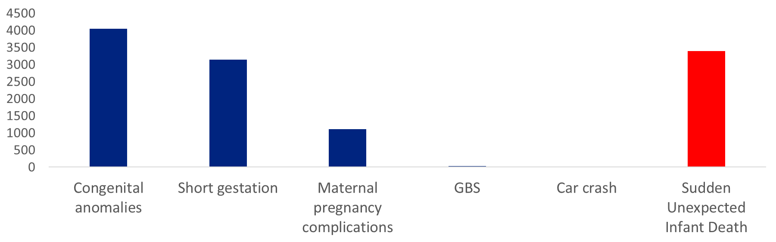
SUID is a major contributor to Infant Mortality
Infant Mortality
Neonatal mortality = Death in the 1st month of life
Post-neonatal mortality = Death from 1-month to 1-year of life
SUID is the leading threat to the lives of babies discharged from the hospital after birth –
babies who were otherwise expected to live.
Infant Mortality, US, 2020
Notes:
Chicago is a highly segregated city with a large LE gap between Black, Latinx and white Chicagoans.
Chronic disease and gun related homicide are the 1st and 2nd drivers of this gap.
Less well known is that infant mortality is the 3rd leading driver of the LE gap in our city.

Slide 5
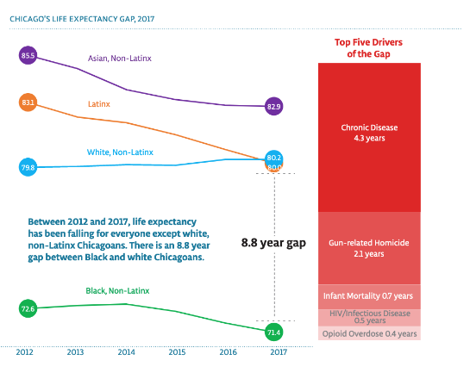
Infant mortality is the 3rd leading driver of the life expectancy gap in Chicago
Data source and figure from Healthy Chicago 2025
Closing Our Life Expectancy Gap, 2022
Notes:
Chicago is a highly segregated city with a large LE gap between Black, Latinx and white Chicagoans.
Chronic disease and gun related homicide are the 1st and 2nd drivers of this gap.
Less well known is that infant mortality is the 3rd leading driver of the LE gap in our city.

Slide 6
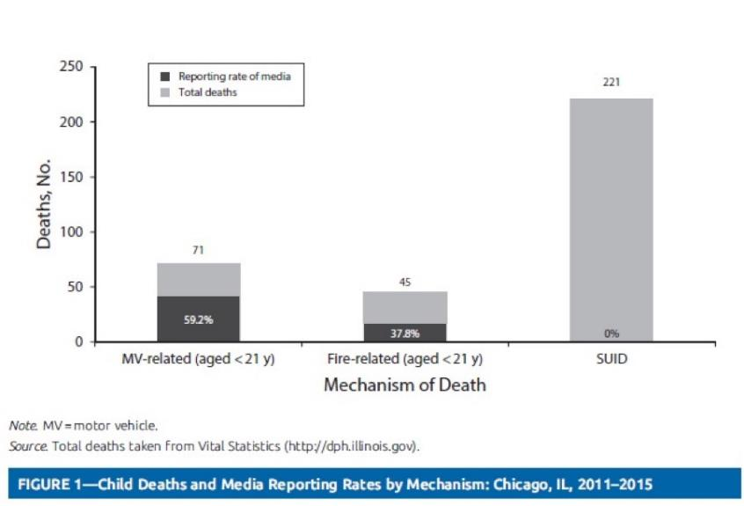
Media Reporting of SUID
Roehler DR, Lowell GS, Silvestri JM, Eason EA, Quinlan KP. Differential Media Reporting of Unintentional Child Deaths in Chicago, 2011-2015. Am J Public Health. 2018 Oct;108(10):1318-1319.

Slide 7
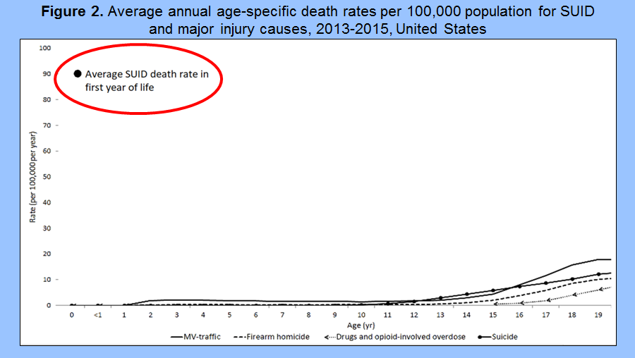
Roehler DR, Batra EK, Quinlan KP. Comparing the Risk of Sudden Unexpected Infant Death to Common Causes of Childhood Injury Death. J Pediatr. 2019 Sep;212:224-227.e5.

Slide 8
Roehler DR, Batra EK, Quinlan KP. Comparing the Risk of Sudden Unexpected Infant Death to Common Causes of Childhood Injury Death. J Pediatr. 2019 Sep;212:224-227.e5.

Slide 9
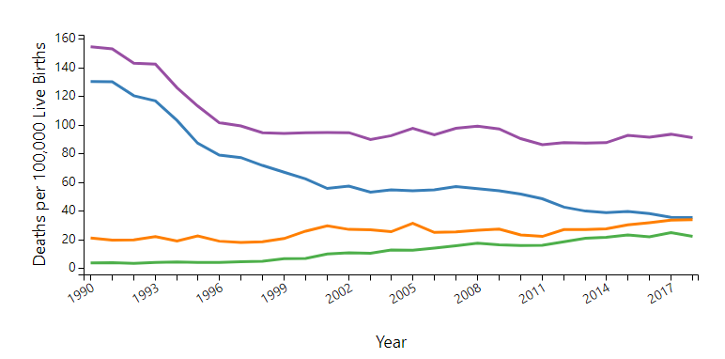
Trends in Sudden Unexpected Infant Death by Cause, 1990-2018
Back to Sleep
Combined SUID
SIDS
Unknown
ASSB
https://www.cdc.gov/sids/data.htm

Slide 10
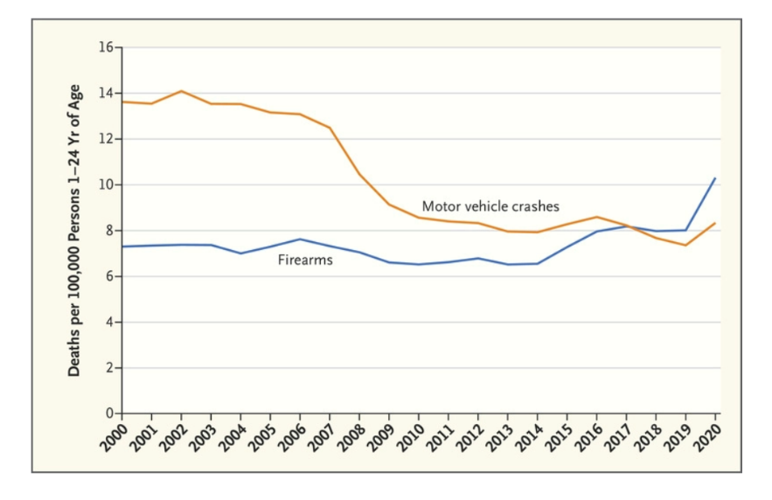
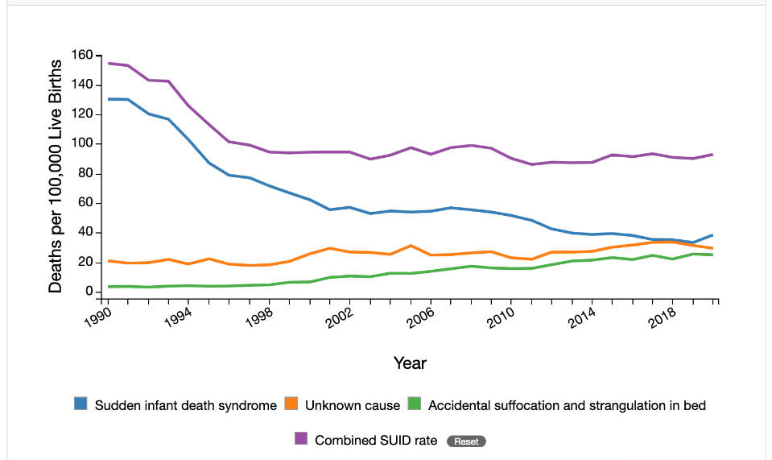
Childhood Injury Mortality Rates and Perceived Risk
Back to Sleep
Deaths per 100,000 infants ages 0-12-months from SUID
Deaths per 100,000 persons ages 1-24-years from MVC and Firearms
Our society is justifiably aware of the risk of death to children from motor vehicle crashes and firearms,
however remains far less aware of the risk of death to infants from SUID – despite a 10 times risk to infants.
Notes:
The problem of risk perception plagues our efforts in SUID prevention.
As a society, we are justifiably aware of the risk of death to children over 1 from MVC and firearm-related injuries, but we remain much less aware of the risk of death from SUID, despite a 10x risk.

Slide 11
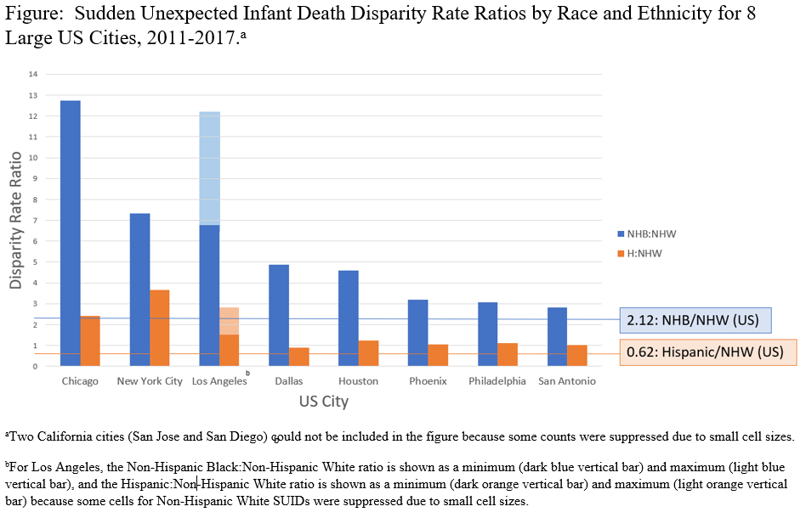
Race and Ethnic SUID Disparities are Magnified in Large Cities
In Chicago, Black infants die of SUID at over 12 times the rate of white infants; Hispanic infants die of SUID at over 2 times the rate of white infants
Boyer BT, Lowell GS, Roehler DR, Quinlan KP. Racial and ethnic disparities of sudden unexpected infant death in large US cities: a descriptive epidemiological study. Inj Epidemiol. 2022 Mar 25;9(1):12.
Notes:
The problem of risk perception plagues our efforts in SUID prevention.
As a society, we are justifiably aware of the risk of death to children over 1 from MVC and firearm-related injuries, but we remain much less aware of the risk of death from SUID, despite a 10x risk.

Slide 12
Risk Factors for SUID due to ASSB and Unknown/SIDS Strongly Overlap
Sleep Related Risk Factors | ASSB (Adjusted OR) | Unknown/SIDS (Adjusted OR)
Sleep position = Not on back | 1.9 (0.9–4.1) | 1.6 (1.1–2.4)
Soft bedding use = Yes | 16.3 (5.0–53.3) | 5.0 (3.2–8.0)
Surface sharing = Yes | 2.5 (1.1–6.0) | 2.1 (1.4–3.2)
Non-approved sleep surface = Yes | 3.9 (1.4–10.4) | 1.0 (0.7–1.6)
Counseling to prevent suffocation will likely also protect infants from unknown/SIDS
Parent-Infant Factors | ASSB (Exposure OR) | Unknown/SIDS (Exposure OR)
Breastfeeding = Ever breastfed | 0.2 (0.1–0.4) | 0.2 (0.2–0.3)
Smoked during pregnancy = Yes | 12.0 (6.8–20.9) | 4.3 (3.2–5.9)
Prenatal Care = No* | 8.3 (1.5–45.6) | 4.2 (1.7–10.7)
Insurance = Medicaid* | 4.7 (2.8–7.9) | 6.0 (4.3–8.5)
Prioritizing equitable health promotion and policies may also address SUID
*can be considered as a proxy for issues related to access to care and unmet SDOH needs
Parks SE, DeSisto CL, Kortsmit K, et al. Risk Factors for Suffocation and Unexplained Causes of Infant Deaths. Pediatrics. 2023;151(1):e2022057771
Notes:
The hallmark of education and SUID prevention has been encouraging families to adhere to the ABC’s of safe sleep. However, in this study representative of parents from all 77 CAs of Chicago, we understand that the majority of families regularly engage in one or more unsafe sleep practices.

Slide 13
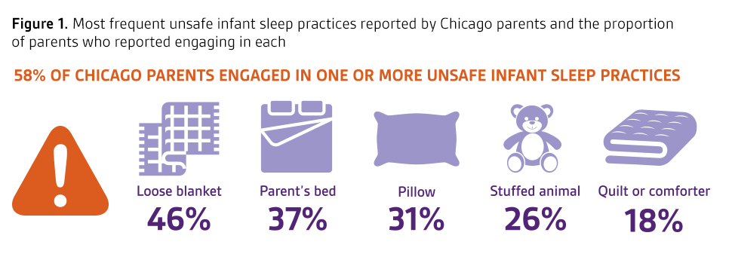
Voices of Child Health in Chicago - 2022
Attridge M, Heffernan ME, Smith TL, Bendelow A, Menker C, Macy ML, Davis MM. Infant Sleep Practices in Chicago Families, Voices of Child Health in Chicago Report. Vol 4, Number 1. January 2022. Available at luriechildrens.org/voices.
Notes:
The hallmark of education and SUID prevention has been encouraging families to adhere to the ABC’s of safe sleep. However, in this study representative of parents from all 77 CAs of Chicago, we understand that the majority of families regularly engage in one or more unsafe sleep practices.

Slide 14
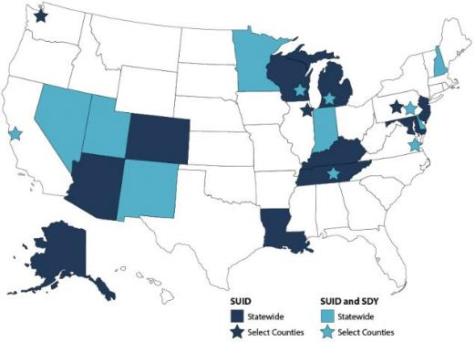
What is the SUID Case Registry?
As part of the Sudden Unexpected Infant Death (SUID) and Sudden Death in the Young (SDY) Case Registry, CDC’s Division of Reproductive Health supports SUID monitoring programs in 22 states and jurisdictions, covering about 1 in 3 SUID cases in the United States.
The SUID and SDY Case Registry builds on child death review programs and uses the National Center for Fatality Review and Prevention’s Case Reporting System, bringing together information about the circumstances associated with SUID and SDY cases, as well as information about investigations into these deaths.
Participating states and jurisdictions use data about SUID and SDY trends and circumstances to develop strategies to reduce future deaths.
Cook County’s SUID Case Registry began in 2019
Description and map from: https://www.cdc.gov/sids/case-registry.htm

Slide 15



Slide 16
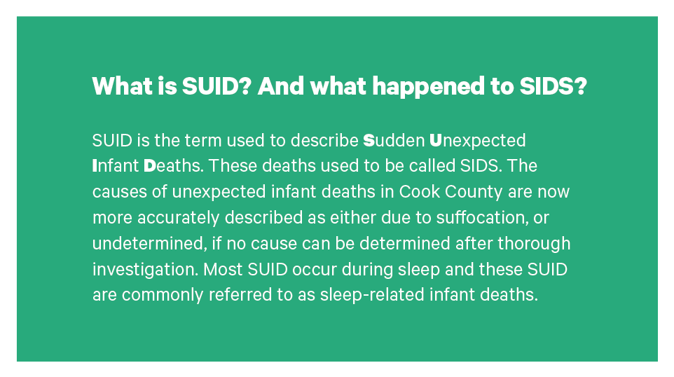
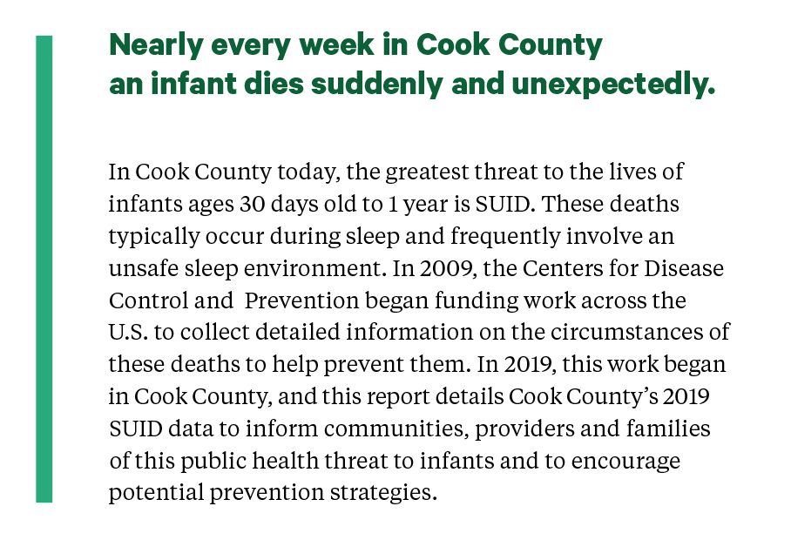

Slide 17
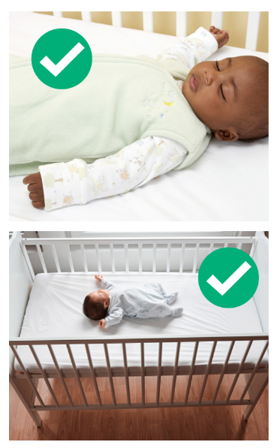
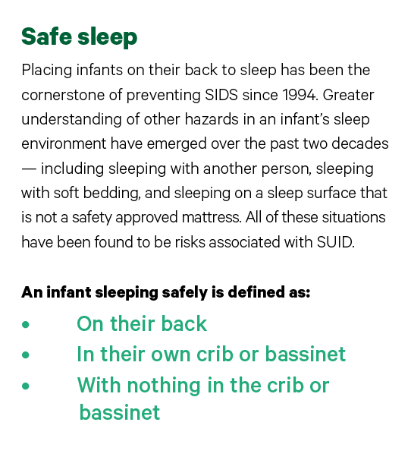
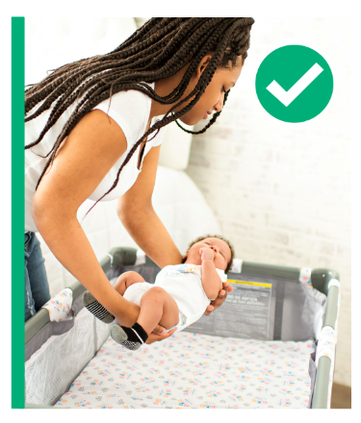
The Sleep Environment

Slide 18
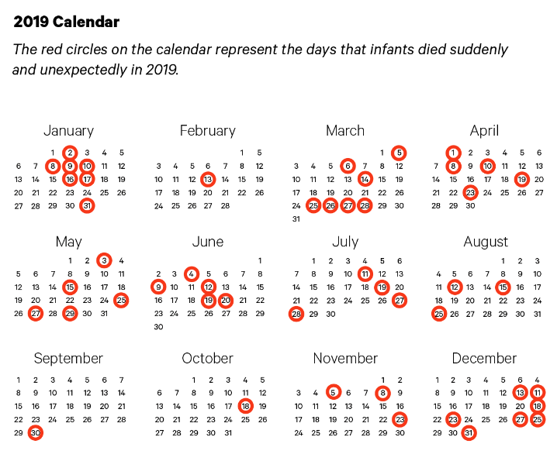
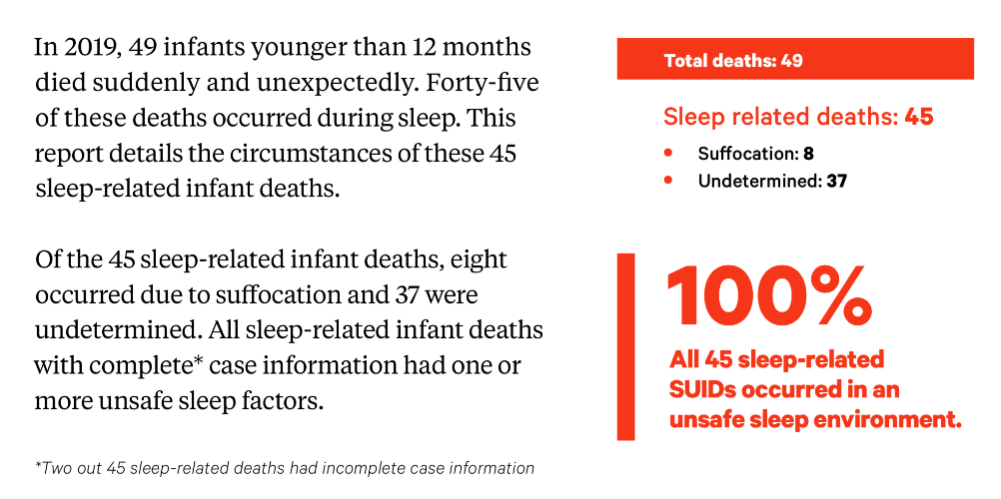
2019 Cook County SUID

Slide 19
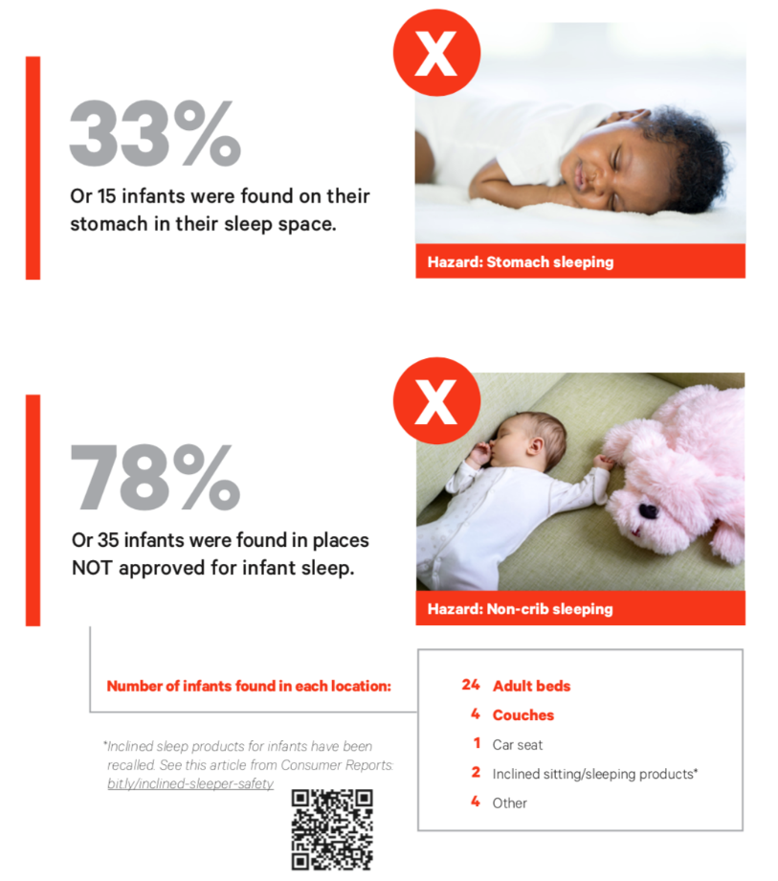
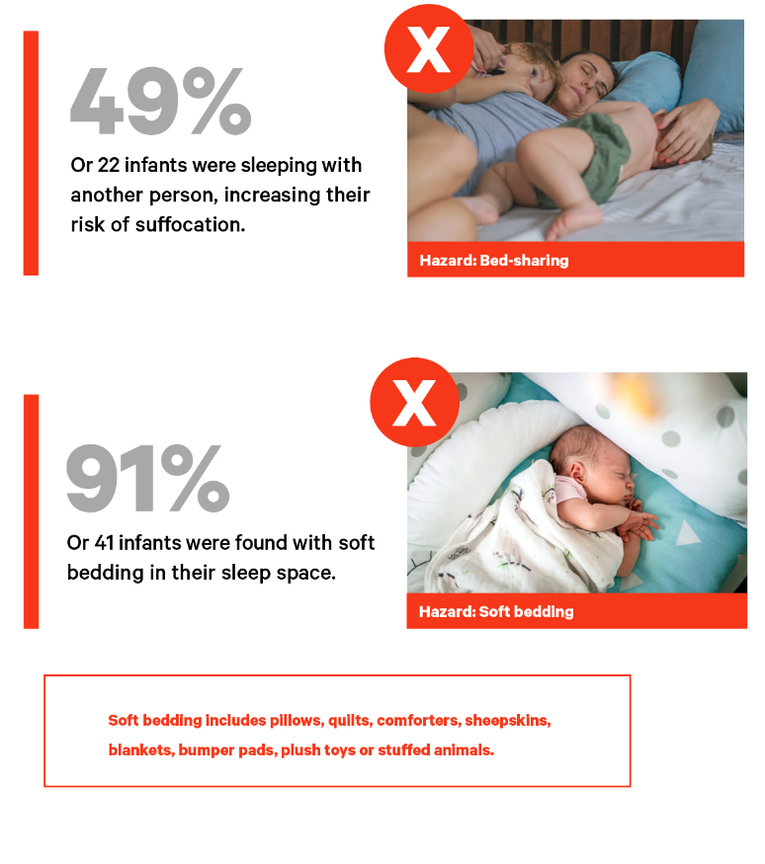
Sleep-Related Infant Deaths (45)
Unsafe Sleep Factors

Slide 20
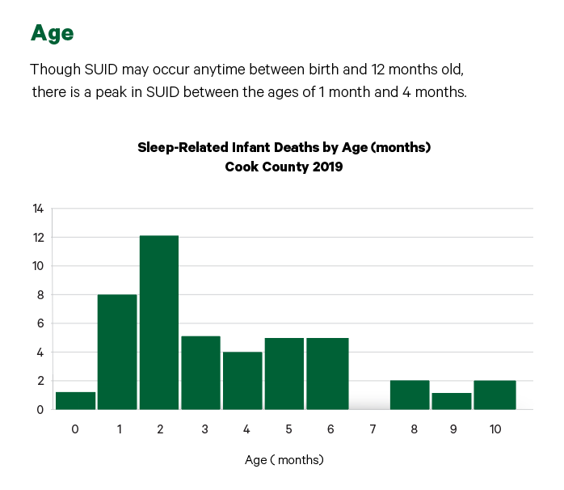
Sleep-Related Infant Deaths (45)
Demographics

Slide 21

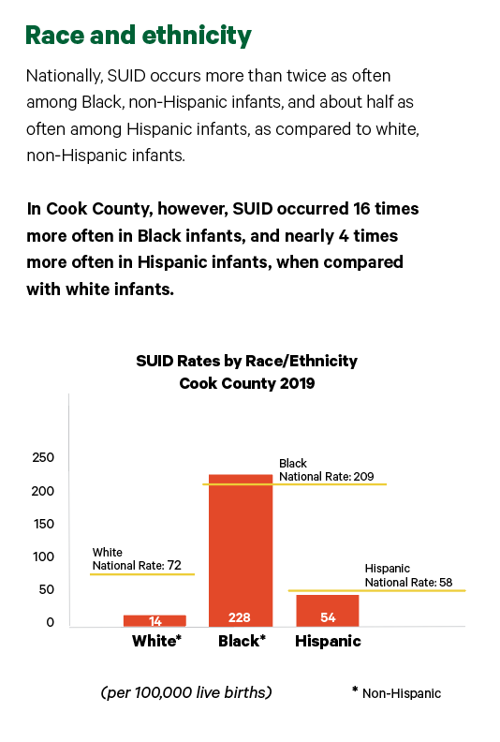
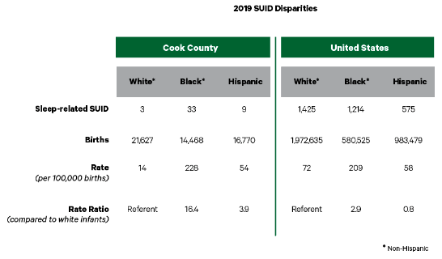
Sleep-Related Infant Deaths (45)
Demographics

Slide 22
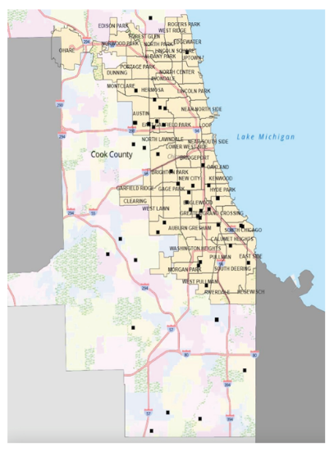
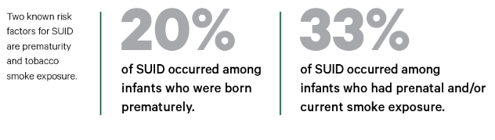
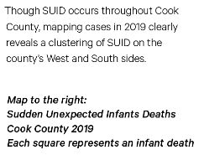
Sleep-Related Infant Deaths (45)
Risk Factors
Geographic distribution

Slide 23
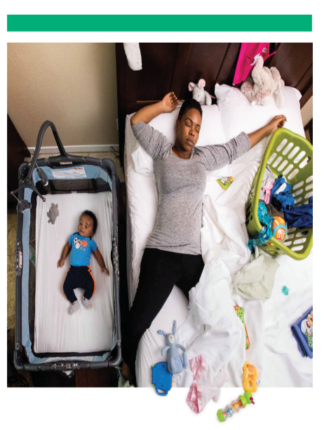
Moving Forward
Community health is the collective well-being of its people.
Disparities in health indicators across communities are typically driven by inequitable access to necessary resources.
The health of a community that is home to an infant is part of the environment that may place an infant at risk for – or protect them from – SUID.
SUID prevention means addressing the root causes of health inequities – alongside promoting safe sleep approaches that work – to protect our infants, families and communities.

Slide 24
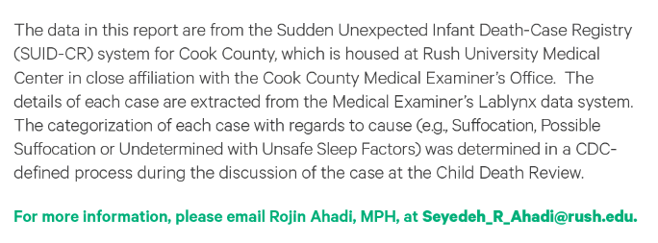
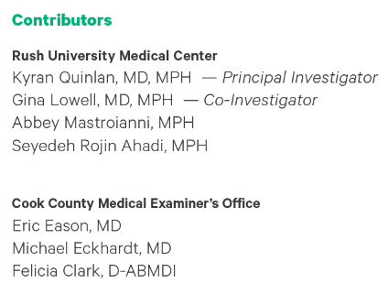

Slide 25




Preventing SUID: Turning Data to Action with CPASS Chicago
CPASS CHICAGO SLEEPS SAFE!
COMMUNITY PARTNERSHIP APPROACHES FOR SAFE SLEEP
Gina Lowell MD, MPH
Kyran Quinlan MD, MPH
Felicia Clark D-ABMDI
Christie Lawrence DNP, RNC-NIC
Darren Harris, Center Director, Family Focus
Notes:
Chicago is a highly segregated city with a large LE gap between Black, Latinx and white Chicagoans.
Chronic disease and gun related homicide are the 1st and 2nd drivers of this gap.
Less well known is that infant mortality is the 3rd leading driver of the LE gap in our city.

Slide 26
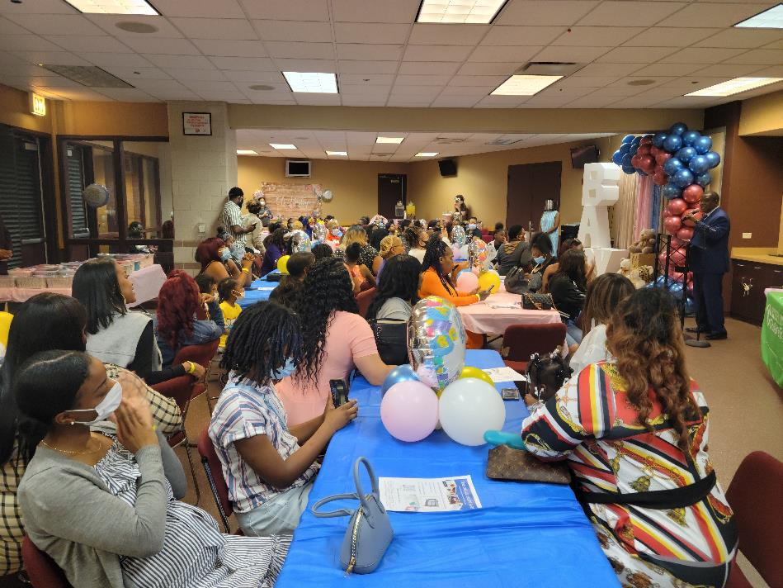
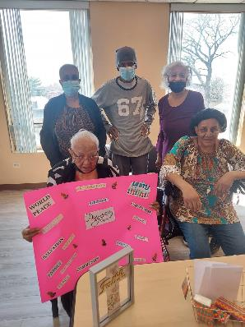
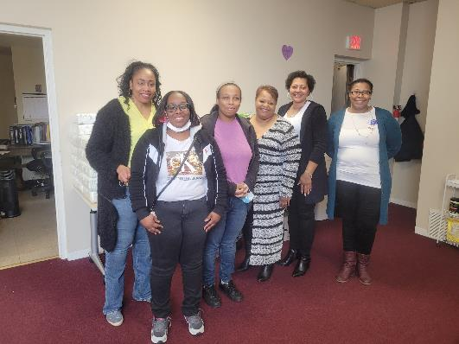


CPASS CHICAGO SLEEPS SAFE!
COMMUNITY PARTNERSHIP APPROACHES FOR SAFE SLEEP
Salem Baptist Church, Citywide Baby Shower, Roseland community, Chicago
Bethel New Life, Senior Living,
Austin community, Chicago
Life Changing Community Outreach Center,
Austin community, Chicago
In 2022, Community Partnership Approaches for Safe Sleep (CPASS), funded by the American Academy of Pediatrics, the Injury Free Coalition for Kids, and Amazon, provided funding and a learning community for children’s hospitals to partner with CBOs serving pregnant and parenting families.
CPASS Chicago is a Family Focus-Rush partnership led by Felicia Clark, Darren Harris, Christie Lawrence, Gina Lowell and Kyran Quinlan.

Slide 27

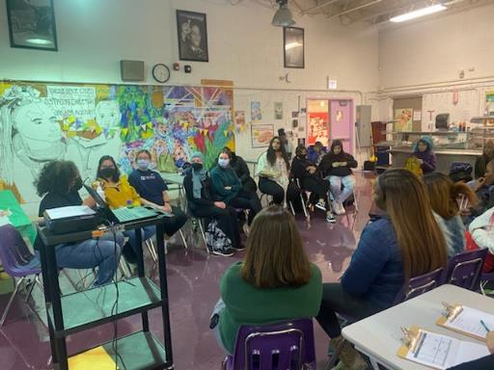
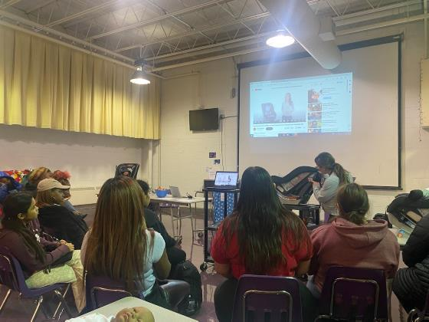
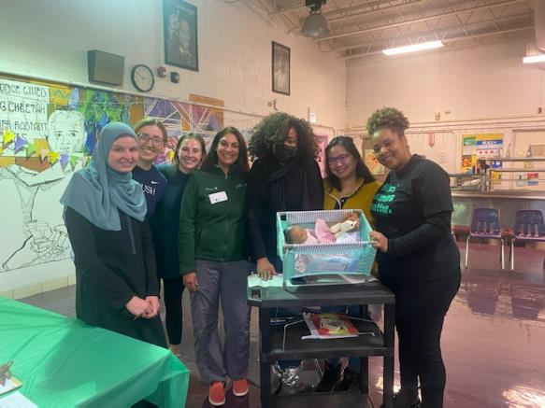
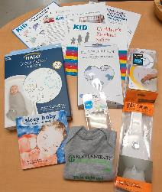
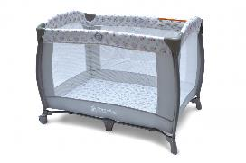
Baby Safety Shower at
Simpson Academy for Young Women
November 30 ✦ December 7, 2022
Our team conducted 2 hands-on sessions on child passenger safety and infant safe sleep reaching 16 students and distributing 16 car seats and 15 cribettes + prenatal safe sleep kits
Student surveys showed:
13 students said they had a better understanding of safe sleep.
9 students noted they would use a crib or bassinet for infant sleep.
4 students noted they would share their bed for infant sleep.
3 students worried about how they were going to keep their babies safe during sleep; 2 of these students were those who noted they would share a bed for infant sleep.

Slide 28
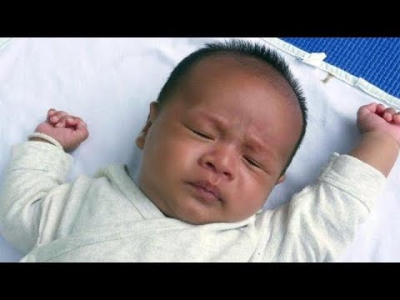

Safe Sleep Video
Notes:
Alongside our CPASS efforts we have been disseminating our 2019 Case Registry report to…
Along with presenting the data in the report, we typically share our CPASS outreach efforts, and this combination of hearing the data alongside the CPASS approaches to engaging families through conversation at resource-filled, often joyous events, allows stakeholders to hear how education and prevention is about both the ABC’s and much more – empowering families to take steps – big or small – towards safe sleep on their terms and in the context of their circumstances.

Slide 29

I thought it was very informative. I didn't know this was common within our community amongst my demographic
Being a first time mom when the lady said “you would never think it’ll happen to you until it does” it stuck out to me. Preparation is key! Having a crib for my baby is the safest option
Scan to watch our safe sleep video
I feel that’s good to know I am a new mother and that’s something I needed to understand that baby sleeps in own crib I have lost a nephew due to SIDS
I feel as though the safe sleep video is extremely helpful because I’m able to hear the point of view from a parent who has lost her child due to unsafe sleeping. This video has now alerted me on what not to do with my baby and how I can avoid unsafe sleeping.
The video was very helpful im a first time mom and actually planned on sleeping with my baby in my bed but now that I see the video I see that its not safe helped me a lot to understand the danger of sleeping with my baby thank you
As a first time mom, I am very concerned with keeping my child safe. To realize that black infants have a higher rate of dying by sleeping with adults is eye opening. This has opened my eyes to how important it is to have my child sleep in her own bed when she arrives.
It kinda made me sad and cry a little bit , mainly because I never knew some of the things they were saying! And unfortunately my daughter sleeps with me! Now it has me a little scared and worried
This video is very informative, growing up babies slept with family members, I wanna break that cycle, I want my baby to have a baby bed for safety most of all
Scan to watch our safe sleep video
Parent reflections*
*selected from 170 responses

Slide 30
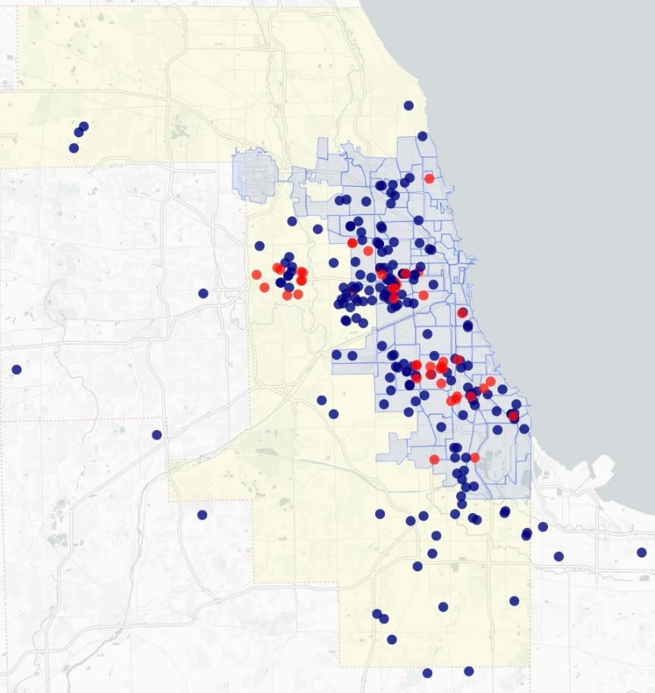
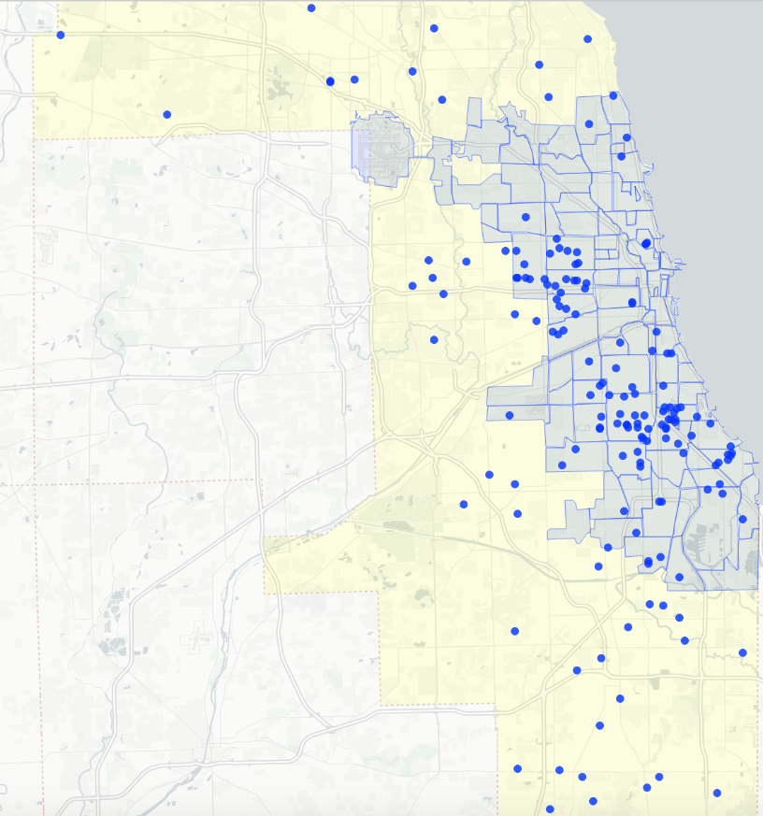
Community baby showers
Home Visiting and Doula
Senior Living Centers
Community resource fairs
Barbershops and Nail Salons
Churches
Community festivals
Back to school events
Community health fairs
CPASS 2022
Cribette Distribution
Outreach Events
SUIDs of Cook County, 2019-2021
(144)
CPASS CHICAGO 2022
Reaching Cook County’s Most Impacted Communities
Notes:
Here you see the geographic distribution of our CPASS outreach and cribette distribution. The map on the left is that which you saw before, of the SUID deaths in Cook County in 2019, and the map on the right indicates with red dots representing each of the community outreach events Felicia described, and each of the blue dots representing the addresses of the 200 families who received safe sleep kits through CPASS. This visual representation allowed us to see what we hoped for – that CPASS Chicago could reach our communities most impacted by SUID.

Slide 31
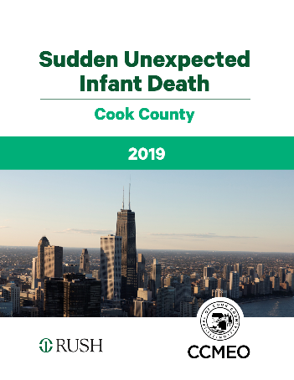
Building Awareness: 2019 Cook County SUID Report Dissemination
Public Health
Health and Human Services
Maternal Child Health Stakeholders
SUID Prevention Advocates
Notes:
Alongside our CPASS efforts we have been disseminating our 2019 Case Registry report to…
Along with presenting the data in the report, we typically share our CPASS outreach efforts, and this combination of hearing the data alongside the CPASS approaches to engaging families through conversation at resource-filled, often joyous events, allows stakeholders to hear how education and prevention is about both the ABC’s and much more – empowering families to take steps – big or small – towards safe sleep on their terms and in the context of their circumstances.

Slide 32
Building Awareness: Birth Hospital Data
?
X
X
X
X
Notes:
Alongside our CPASS efforts we have been disseminating our 2019 Case Registry report to…
Along with presenting the data in the report, we typically share our CPASS outreach efforts, and this combination of hearing the data alongside the CPASS approaches to engaging families through conversation at resource-filled, often joyous events, allows stakeholders to hear how education and prevention is about both the ABC’s and much more – empowering families to take steps – big or small – towards safe sleep on their terms and in the context of their circumstances.

Slide 33
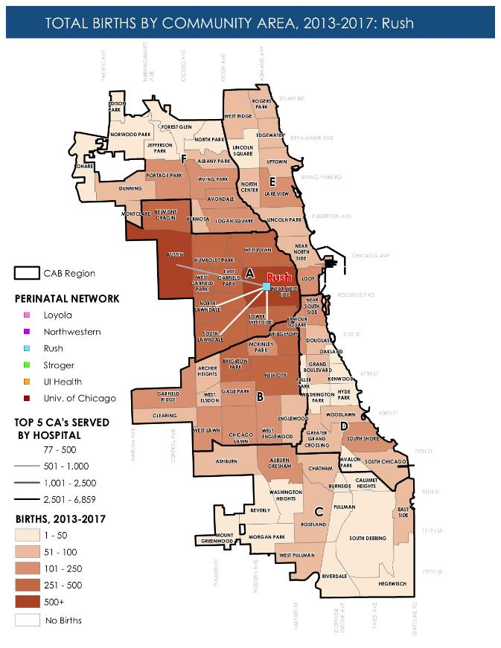
SUIDs of Cook County, 2019-2021
(144)
Notes:
Here you see the geographic distribution of our CPASS outreach and cribette distribution. The map on the left is that which you saw before, of the SUID deaths in Cook County in 2019, and the map on the right indicates with red dots representing each of the community outreach events Felicia described, and each of the blue dots representing the addresses of the 200 families who received safe sleep kits through CPASS. This visual representation allowed us to see what we hoped for – that CPASS Chicago could reach our communities most impacted by SUID.

Slide 34
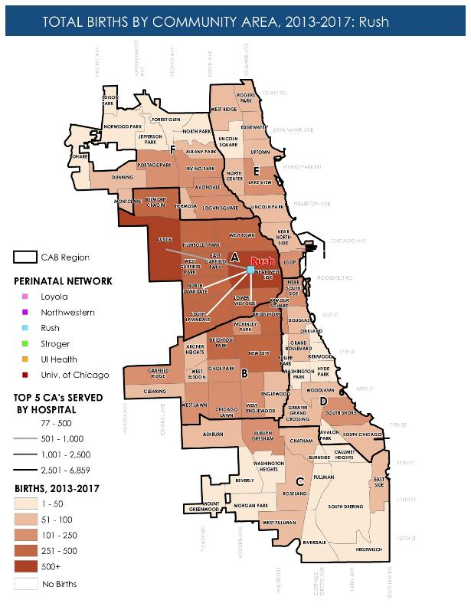
Closing the Loop: Getting the Data Back to Birth Hospitals
Notes:
Alongside our CPASS efforts we have been disseminating our 2019 Case Registry report to…
Along with presenting the data in the report, we typically share our CPASS outreach efforts, and this combination of hearing the data alongside the CPASS approaches to engaging families through conversation at resource-filled, often joyous events, allows stakeholders to hear how education and prevention is about both the ABC’s and much more – empowering families to take steps – big or small – towards safe sleep on their terms and in the context of their circumstances.

Slide 35
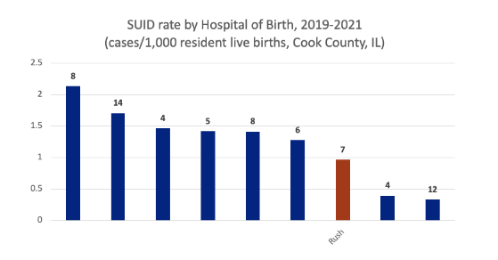
Removing Barriers:
Building a Birth Hospital Safe Sleep Learning Community
X
X
X
X
Notes:
Alongside our CPASS efforts we have been disseminating our 2019 Case Registry report to…
Along with presenting the data in the report, we typically share our CPASS outreach efforts, and this combination of hearing the data alongside the CPASS approaches to engaging families through conversation at resource-filled, often joyous events, allows stakeholders to hear how education and prevention is about both the ABC’s and much more – empowering families to take steps – big or small – towards safe sleep on their terms and in the context of their circumstances.

Slide 36
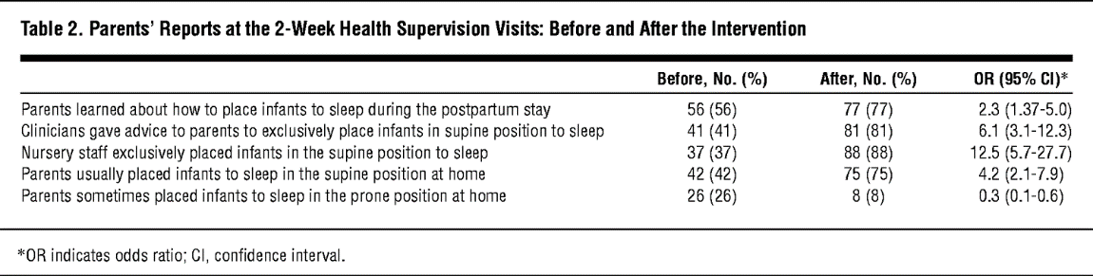
Modeling Safe Sleep in Birth Hospitals
Colson ER, Joslin SC. Changing Nursery Practice Gets Inner-city Infants in the Supine Position for Sleep. Arch Pediatr Adolesc Med. 2002;156(7):717–720.
Notes:
The hallmark of education and SUID prevention has been encouraging families to adhere to the ABC’s of safe sleep. However, in this study representative of parents from all 77 CAs of Chicago, we understand that the majority of families regularly engage in one or more unsafe sleep practices.

Slide 37
Our Hospital Safe Sleep Working Group
Safe Sleep Modeling QI
Monthly Safe Sleep Audits
Monthly HSS meetings
Review audits
Welcoming atmosphere strengthens relationships
Policy and Staff Trainings
Regular policy review
Staff Safe Sleep Training module development
Unit Champions
Unit-Driven QA/QI
Raise unit-specific challenges/issues
Standardized Education with a Family Centered Approach
Multidisciplinary approach
Go-to group for SUID/Safe Sleep related hospital needs
Takeaways:
Start with baseline data – and be kind to yourselves
Set a goal – like Cribs for Kids Certification
Find 2 leaders who can commit to the long game
Find your champions – no matter their day job
Listen like you have all day
Every setback is a chance to learn
Celebrate wins – big or small
Getting our own house in order opened opportunities for student projects and community engagement
Rush’s Hospital Safe Sleep Working Group are:
Christie Lawrence and Gina Lowell (co-chairs);
Ramona Hunter, Denise Banton, Antoinette Williams, Regina Piper, Carrie Drazba; Adelaide Caprio, Rebecca Weber, Jean Silvestri, Briana Stanley, Cassandra Pedersen; Kathy Kosmala, Michael Russell, Rachel Winter; Rojin Ahadi, Felicia Clark; Megan Hartnett, Elaina Bartoli, Amanda Mawrence, Jen Gideon; special thanks to our inpatient SW team and to Markierra White and Kyran Quinlan in Peds Primary Care for support!
Notes:
The hallmark of education and SUID prevention has been encouraging families to adhere to the ABC’s of safe sleep. However, in this study representative of parents from all 77 CAs of Chicago, we understand that the majority of families regularly engage in one or more unsafe sleep practices.

Slide 38
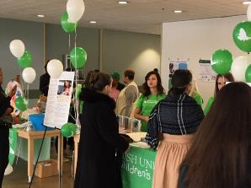
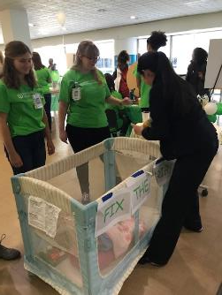
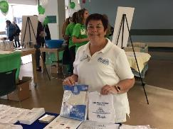
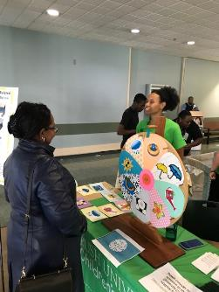
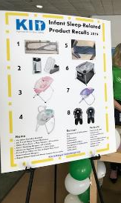
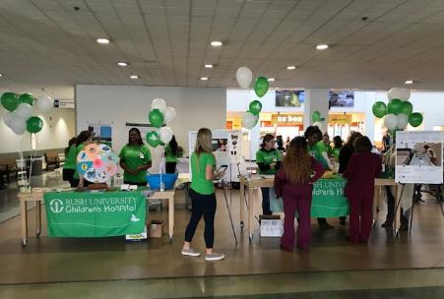
“This is More than Just a Job”
2019 Safe Sleep Carnival
What does being on our Hospital Safe Sleep group mean to you?
“We can make real change and save lives.”
“It means we are collectively working together to save our babies.”
“We are working hard to streamline our message and unify our language so that what we are saying to families is consistently understood within our system. Breaking siloes "Saves Babies!””
Nursing students
SIDS of Illinois
Kids In Danger
Teamwork!
“This work group has been a consistent force in continually promoting safe sleep in our hospital, clinics and community. It has not wavered and has built into our foundation the message of safe sleep.”
“A little bit of worry knowing what happens in the community and pride that we are fiercely working to help the community do what is best for their families.”
Over 300 participants
111 survey respondents
80% learned something new!
“Wanting to save lives - and providing our patients with education and resources to promote autonomy and equity (especially amongst underserved communities).”
Notes:
The hallmark of education and SUID prevention has been encouraging families to adhere to the ABC’s of safe sleep. However, in this study representative of parents from all 77 CAs of Chicago, we understand that the majority of families regularly engage in one or more unsafe sleep practices.

Slide 39





Safe Sleep Allies
Safe Sleep Education and Trainings for Professionals
Bereavement Services
Cribettes (some eligibility limitations)
Safe Sleep Education for Families
Provider and Family Resources
Data Sources
Child Product Safety advocates
Safe Sleep and Child Product Safety education and trainings
Curated materials on request/KID Recall Digests
Safe Sleep Ambassador Trainings
Partner Locator for Cribettes
Hospital Safe Sleep Certification
Notes:
Alongside our CPASS efforts we have been disseminating our 2019 Case Registry report to…
Along with presenting the data in the report, we typically share our CPASS outreach efforts, and this combination of hearing the data alongside the CPASS approaches to engaging families through conversation at resource-filled, often joyous events, allows stakeholders to hear how education and prevention is about both the ABC’s and much more – empowering families to take steps – big or small – towards safe sleep on their terms and in the context of their circumstances.

Slide 40










National Campaigns and Toolkits
Safe Sleep Toolkits
Infographics, posters and videos
Parent-informed messaging
Parent Information Handouts
Social Media Graphics
Multi-language Safe Sleep Materials
SIDS Awareness Month Toolkit (October)
Notes:
Alongside our CPASS efforts we have been disseminating our 2019 Case Registry report to…
Along with presenting the data in the report, we typically share our CPASS outreach efforts, and this combination of hearing the data alongside the CPASS approaches to engaging families through conversation at resource-filled, often joyous events, allows stakeholders to hear how education and prevention is about both the ABC’s and much more – empowering families to take steps – big or small – towards safe sleep on their terms and in the context of their circumstances.

Slide 41

Contact Us!
CPASS CHICAGO SLEEPS SAFE!
COMMUNITY PARTNERSHIP APPROACHES FOR SAFE SLEEP
Felicia Clark: feliciaclark798@yahoo.com
Christie Lawrence: christie_lawrence@rush.edu
Gina Lowell: gina_lowell@rush.edu
Kyran Quinlan: kyran_quinlan@rush.edu
THANK YOU!
Notes:
Chicago is a highly segregated city with a large LE gap between Black, Latinx and white Chicagoans.
Chronic disease and gun related homicide are the 1st and 2nd drivers of this gap.
Less well known is that infant mortality is the 3rd leading driver of the LE gap in our city.

